Slide 1
Report on the theme
"Investigations of Neutron Nuclear Interactions and Properties of the Neutron“
Proposals for extension of the theme
E. Lychagin

Slide 2
Theme 03-4-1128-2017/2019 JINR TP
Investigations of Neutron Nuclear Interactions and Properties of the Neutron
Leader: | V.N. Shvetsov
Deputies: | Yu.N. Kopatch E.V. Lychagin P.V. Sedyshev
Issues addressed and the main goals of research:
Experimental and theoretical investigation of symmetry breaking effects in reactions with neutrons and fundamental properties of the neutron to test the parameters of the Standard Model and search for "new physics". Investigation of the properties of excited nuclei, reactions with emission of charged particles, fission physics. Obtaining of relevant data for astrophysics, nuclear power engineering and nuclear waste transmutation problem using neutron- and gamma-induced reactions. Application of neutron physics methods in other fields of science and technology. Development and construction of detectors of neutrons and other ionizing radiation, as well as applied methods in nuclear physics with neutrons. Development of the Intense REsonance Neutron Source (IREN) and the experimental base at the IREN and IBR-2 facilities.

Slide 3
Main scopes of research:
Investigations of violations of fundamental symmetries in neutron-nuclear interactions and related data
Investigation of fundamental properties of the neutron, UCN physics
Applied and methodological research
Main directions of research:
Investigation of P- T-symmetry breaking in reactions with neutrons;
Nuclear data measurements for neutron energy up to 1GeV;
Research with very cold and ultracold neutrons;
Nuclear analytical methods and research for different fields of science;
Methodical research;
Development of the Intense REsonance Neutron Source (IREN)
Project TANGRA (TAgged Neutrons & Gamma RAys)

Slide 4
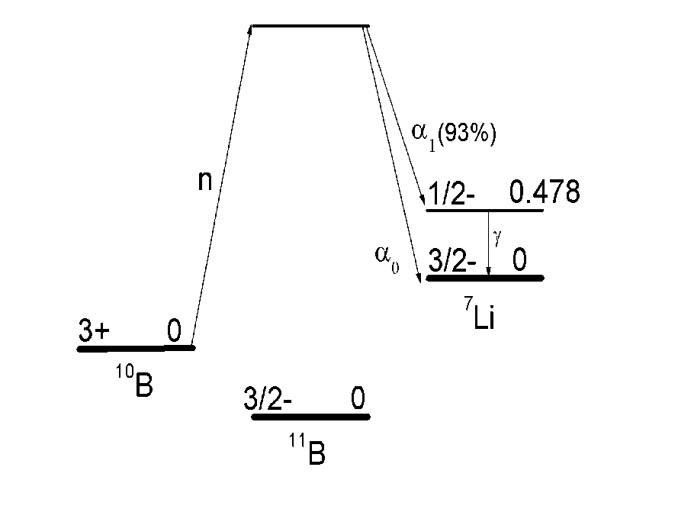
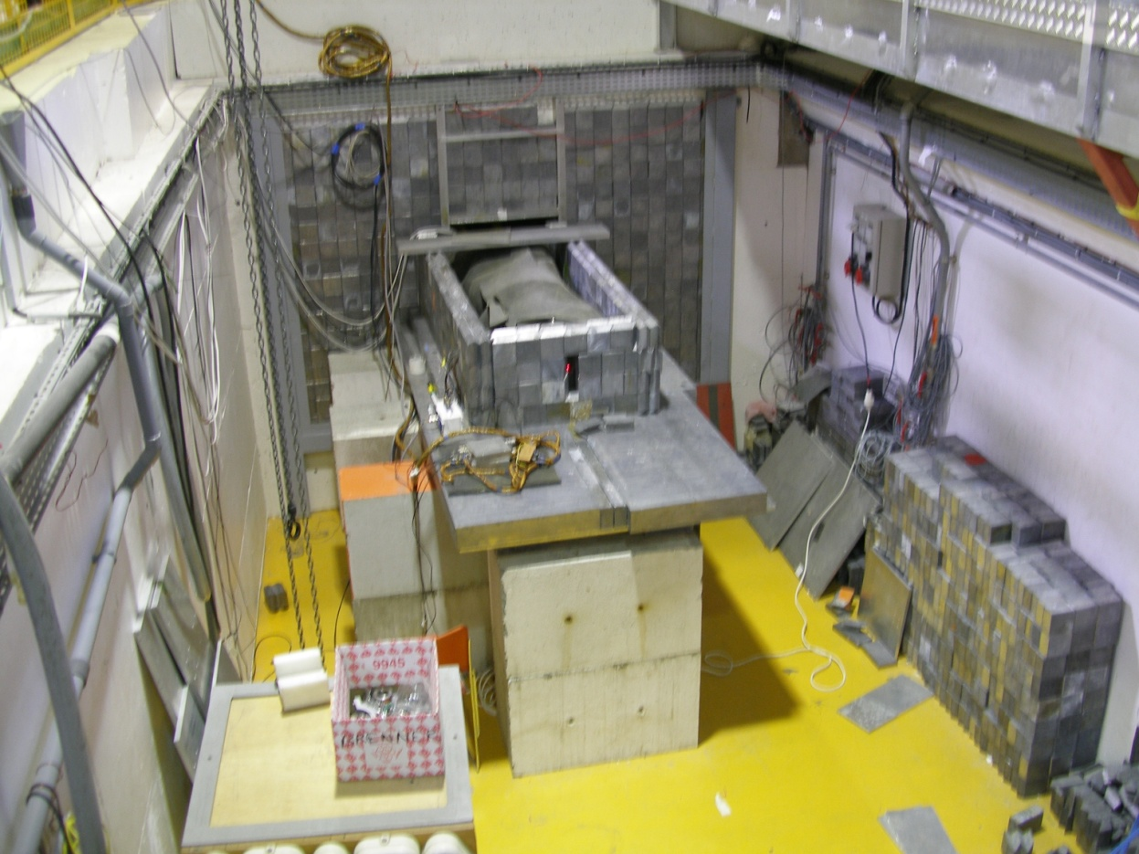
The first observation of P-odd asymmetry of α-particle emission in the ¹⁰B(n,α)⁷Li nuclear reaction
Yu. M. Gledenov, V. V. Nesvizhevsky ,P. V. Sedyshev, E. V. Shul’gina P. Szalanski,V. V. Vesna.
Q = 2.79 MeV
E_{α0} = 1.78 MeV
E_{Li0} = 1.01 MeV
E_{α1} = 1.47 MeV
E_{Li1} = 0.84 MeV
E_{γ} = 0.478 MeV
PNPI, Gatchina, Russia
WWR-M reactor
ILL, Grenoble, France
2015, 2016
PF1B instrument:
λ_{n} = 4.7 Å,
F_{n}~ (4 – 5)∙10¹⁰ s⁻¹
P = 92 ± 2 %

Slide 5
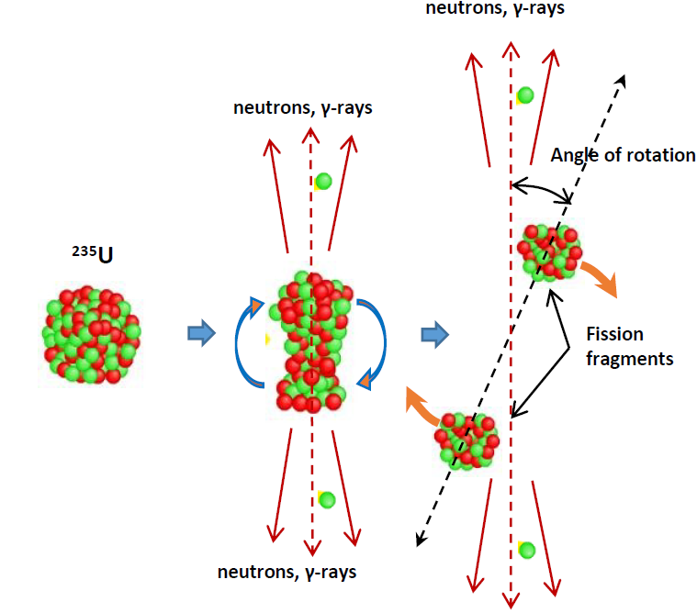
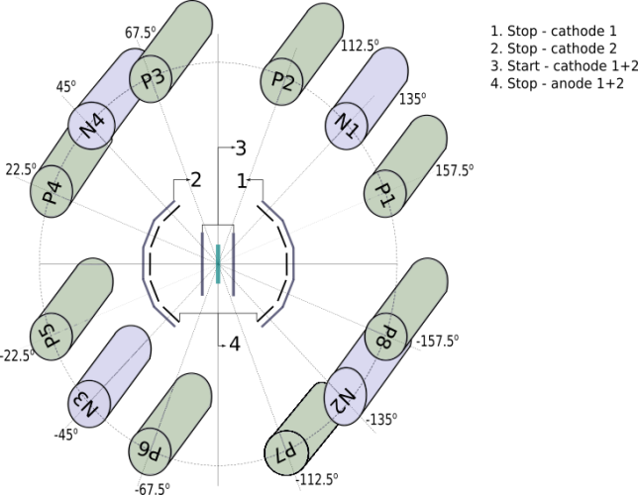
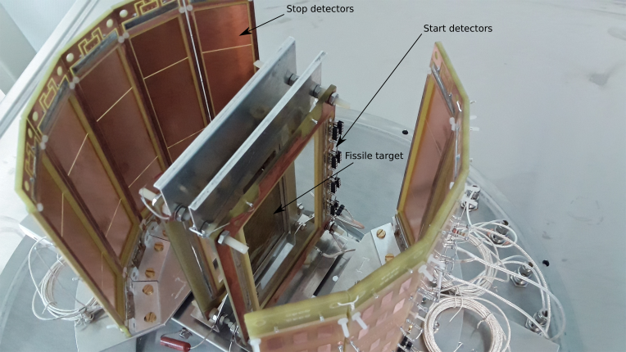

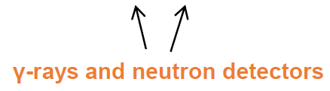
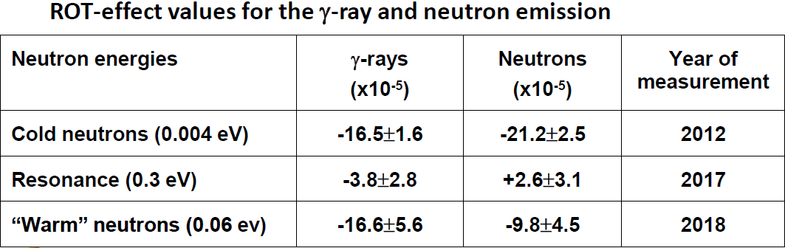
The series of experiments are performed at the FRM-II reactor
In Garching (Germany)

Slide 6
Reactions with fast neutrons and charged particles at exit channels (Yu. Gledenov and his team )
Measurements at EG-5 of FLNP and EG-4.5 HII PU
¹⁴⁴Sm(n,α)¹⁴¹Nd and ⁶⁶Zn(n,α)⁶³Ni at E_{n}= 4.0, 5.0 и 6.0 MeV
^{56,54}Fe(n,α)^{53,51}Cr at 5.0-11.0 MeV
²⁵Mg(n,α)²²Ne at 4.0 - 6.0 MeV
¹⁰B(n,t2α) and ¹⁰B(n,α)⁷Li
at E_{n}=4.0, 4.5 и 5.0 MeV

Slide 7
Cross section for ²⁵Mg(n,α)²²Ne reaction in comparison with the existing experimental data, libraries and calculations by TALYS-1.8.
Cross section for ²⁵Mg(n,α₀)²²Ne reaction in comparison with the existing experimental data, libraries and calculations by TALYS-1.8.
According to the principle of detailed balance, the data provide information about the reaction ²²Ne(α,n)²⁵Mg that is one of the main sources of neutrons in the nucleosynthesis process

Slide 8
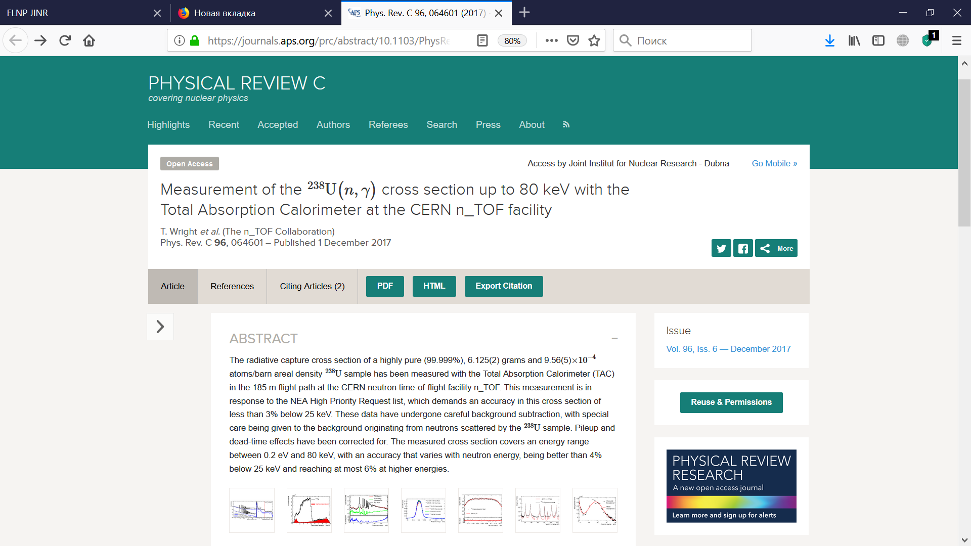

Slide 9
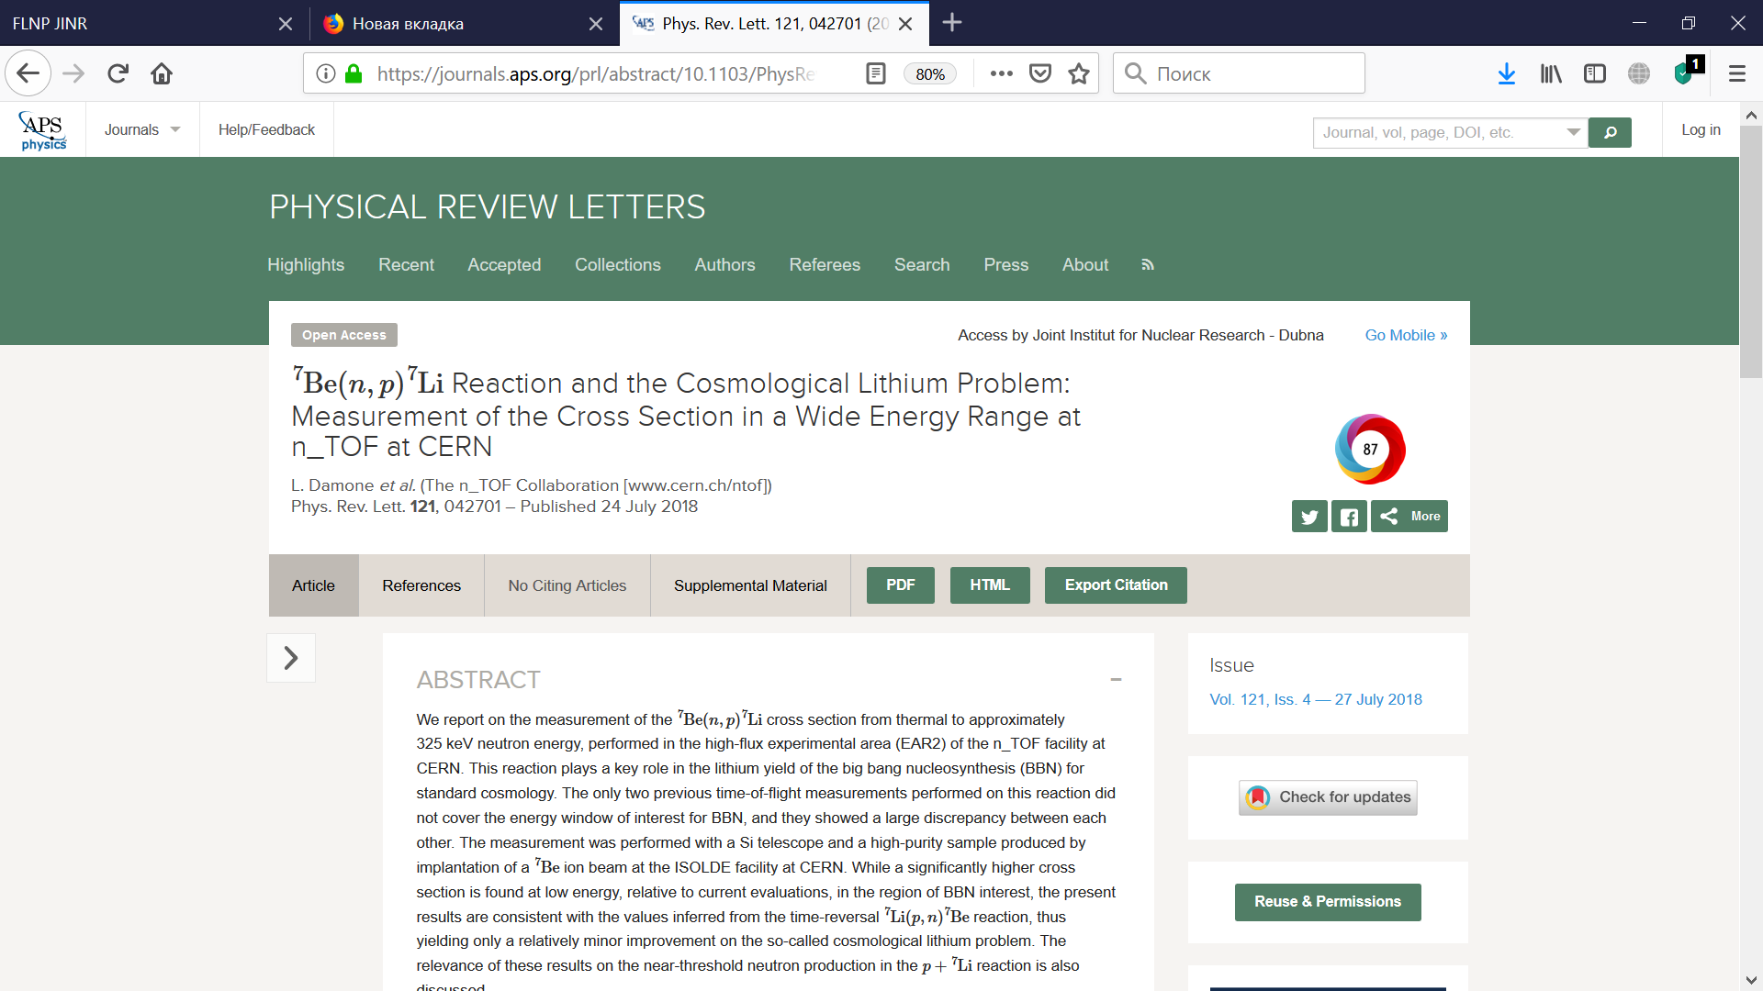

Slide 10
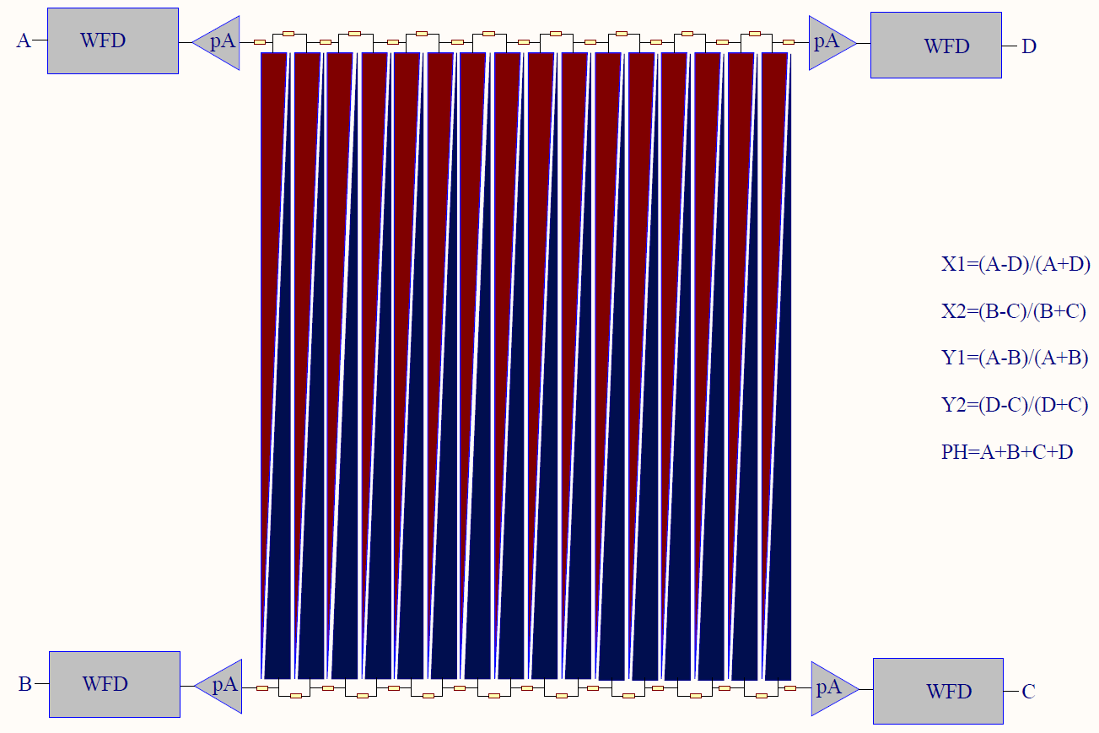
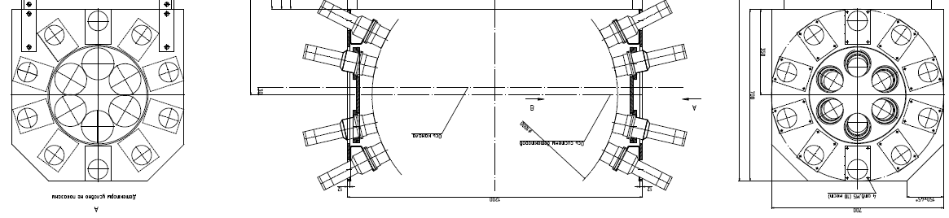
Set-up for the study of PFN in fission induced by resonance neutrons
A double ionization chamber was designed to measure the kinetic energies, masses, and orientation of fission axe in the 3D space for the correlated fission fragments. The accuracy of direction cosines definition is better than 0.05.
32 PFN detectors were placed close to the axis of the ionization chamber to guarantee the maximum PFN detection efficiency ~0.8π.
The slides on the left demonstrate measurements of PFN distributions measured at FLNP for ²³⁵U(n,f) reaction in comparison with the old data from KI measured in 1964. With improved data on PFN distribution we managed to achieve better mass resolution of FF in ²³⁵U(n,f) reaction. This fact, along with the new PFN investigation facility, raises interest in the investigation of mass&TKE variations in resonance neutron induced fission of ²³⁵U and ²³⁹Pu at IREN source.
[1] Sh. Zeynalov, P. Sedyshev, O. Sidorova, V. Shvetsov. International Journal of Modern Physics: Conference Series, Vol. 48 (2018) 1860123.
Segmented Anode Position Sensitive Detector. UCANS-VII, March 11-15,2017, Bariloche, Argentina
[2] Sh. Zeynalov, P. Sedyshev, O. Sidorova, V. Shvetsov. Prompt fission neutron investigation in 235U(nth,f) reaction. EPJ Web of Conferences 146, 04022 (2017), ND2016
[3] Sh. Zeynalov, P. Sedyshev, O. Sidorova, V. Shvetsov. WONDER 2018 (to be published in EPJ Web of Conferences)
[4] Zeynalov Sh.C., Sedyshev P. P., Sidorova O.V., Shvetsov V.N. ISINN-26, International Seminar on Interaction of Neutrons with Nuclei, Xi‘an, China, 28 May-2 June, 2018

Slide 11
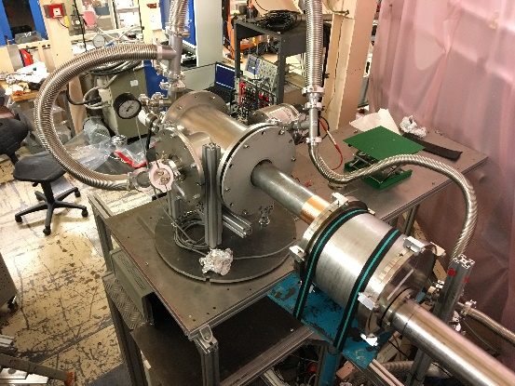
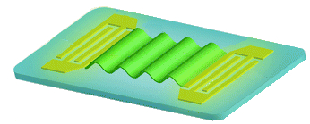
Search of the UCN heating on surface acoustic waves (SAW)
The measurement is performed at the HF reactor
In Grenoble (France)
1
2
Sample with US wave
IDT
Detector
Cupper foil
UCN out
Λ
UCN in
surface acoustic wave
Monitor
Vacuum chamber
Chamber for UCN spectra cleaning
@PF2EDM
Amplitude of SAW ~2 nm
The heating effect was determined as -0.035 ± 0.047 c/s at the first measurement while a theoretical estimate is 0.1 c/s. The effect is not visible. Analysis of the results is under the way. The experiment will be repeated with the better statistics.

Slide 12
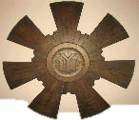
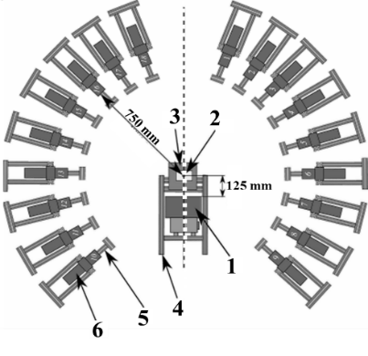
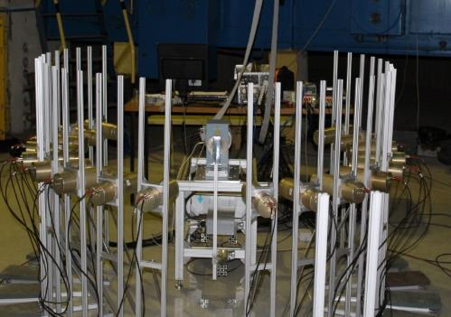
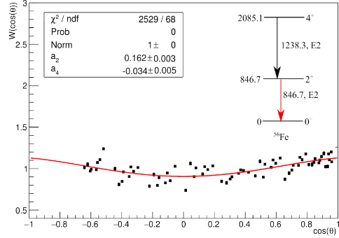
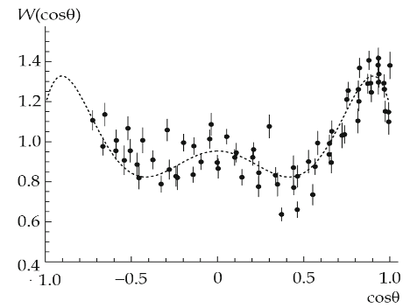
TANGRA Project
A new configuration of the set-up consisting of 18 BGO detectors has been created.
Gamma-spectra and angular distributions of gamma ray have been measured in inelastic neutron scattering reactions for 20 nuclei.
Examples of measured angular distributions for 847 keV gamma transition in iron and 6.13 MeV transitions in oxygen.

Slide 13
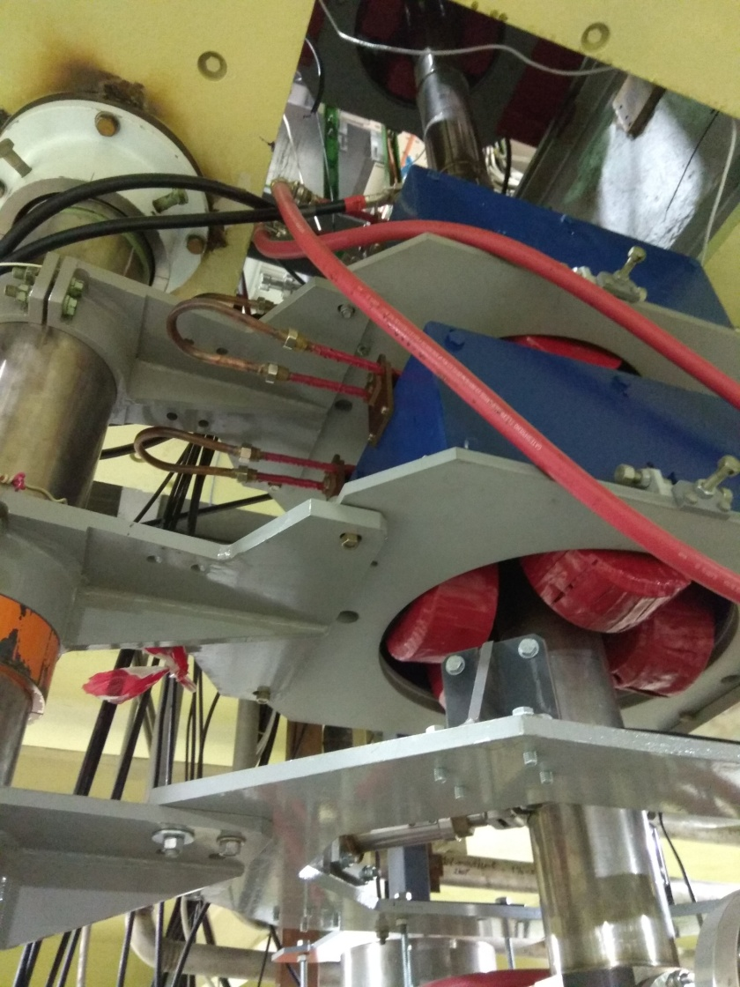
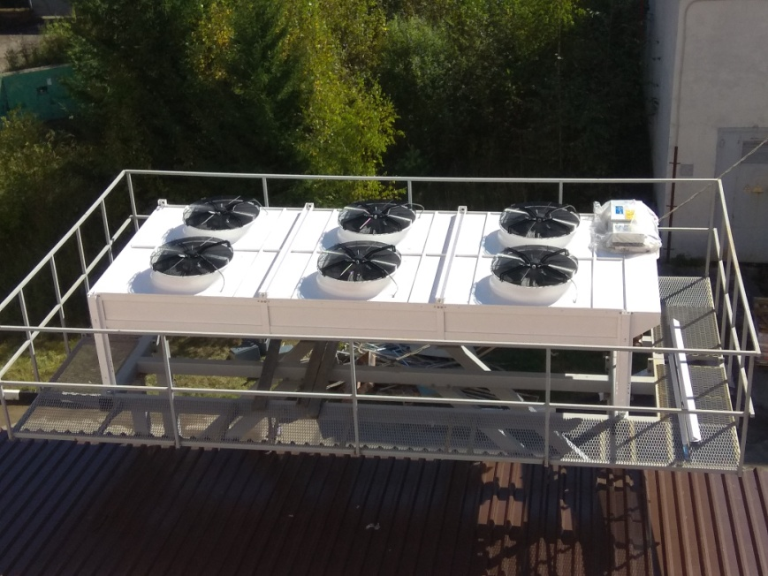
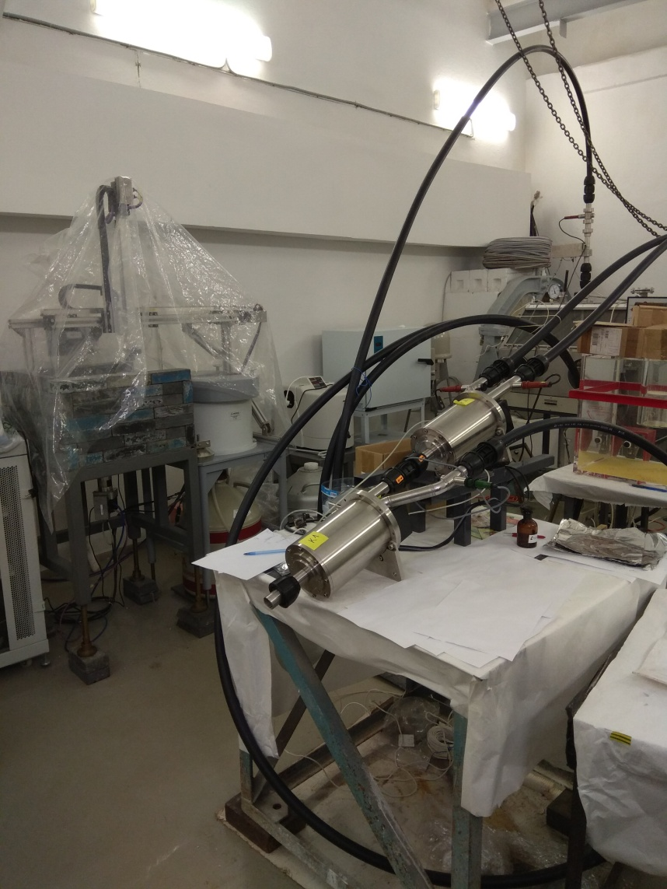
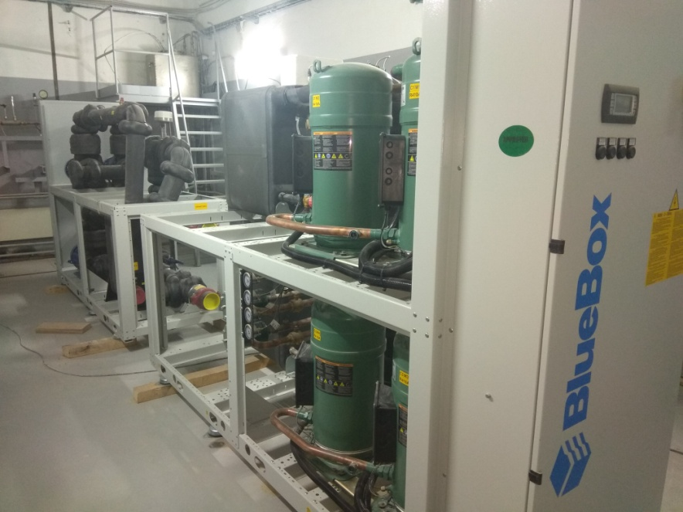
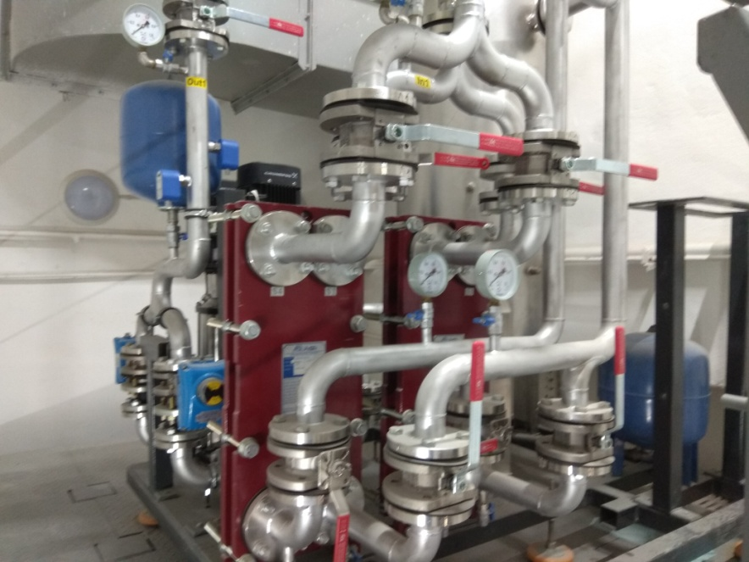
Development of the Intense REsonance Neutron Source (IREN)
During 2017 the IREN worked on the experiment at a frequency of cycles of 20–25 Hz for 1049 hours with two accelerating sections of linac.
In 2018 it was stopped for deep modernization of the cooling system.
REGATA-2 tube transportation system at stand
During 2018
Deep modernization of the cooling system to operate independently of IBR-2 (was started and finished in 2019)
New ventilation for target hall was mounted
The REGATA-2 equipment was assembled and tested at the stand
To work with ANA at IREN the renovation of rooms (a sanitary inspection room, a chemical laboratory, etc.) was started (it was finished in 2019)
Preparatory works were carried out for designing the overhauls of experimental halls
Manufacturing of a new waveguide
Manufacturing of new klystrons (120 Hz) will be finished in the first month of 2019
Dry cooling tower
One of two Chillers
Four heat exchange
modules
During 2019:
Designing overhauls of experimental halls is started
Start to operate with a new cooling system routinely
REGATA-2 mounting at its place

Slide 14
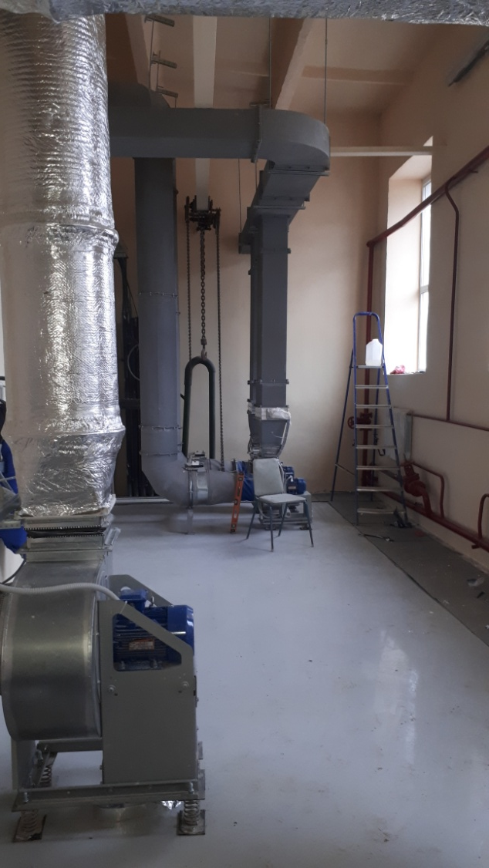
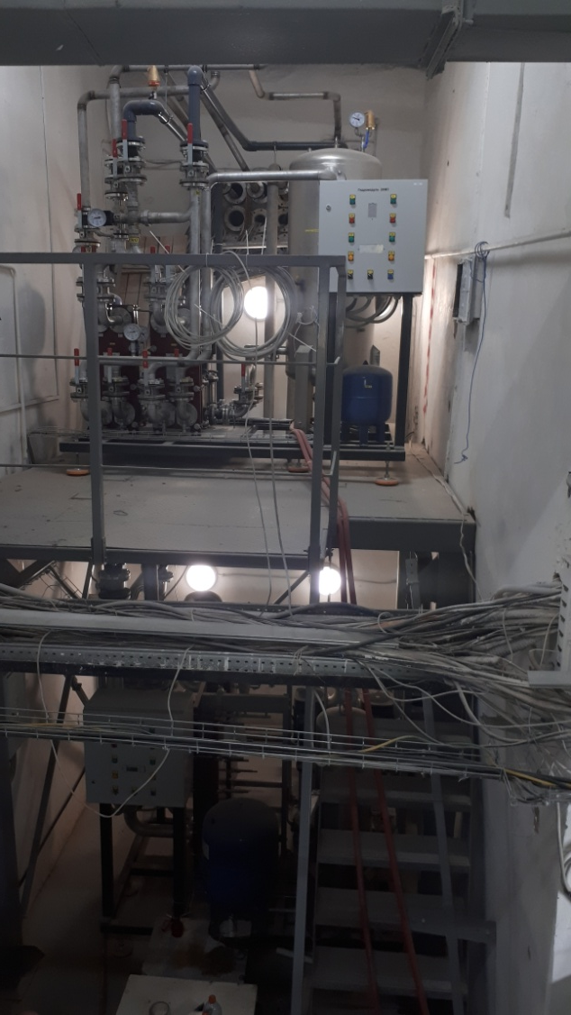
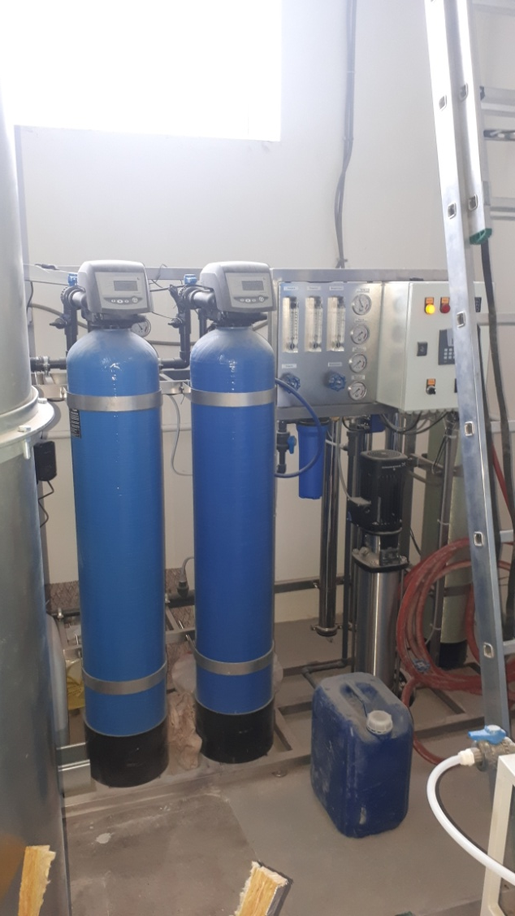
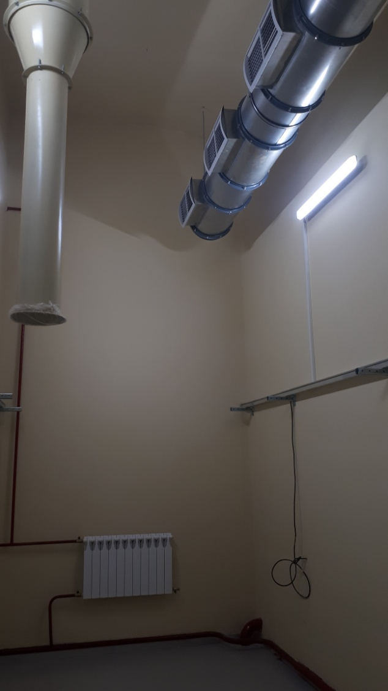

Slide 15
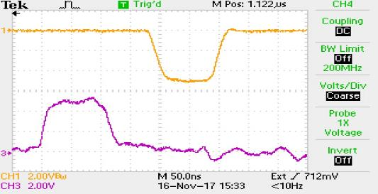
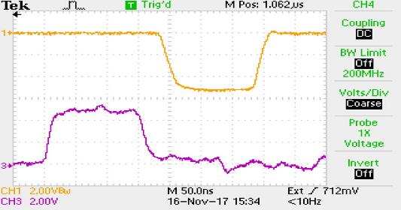
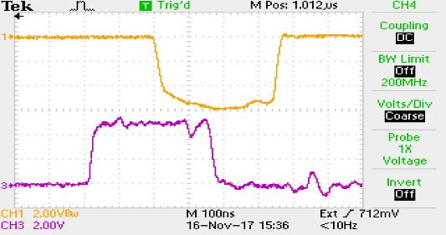
A three-electrode high-voltage electron gun for the accelerator LUE-200 of the IREN installation has been constructed and tasted.
A feature of this injector is the ability to control the pulse duration of the electron beam in the range from 40 up to 400 ns
Oscillograms of the electron gun start-up pulses and the pulses of beam current: СН3 is the trigger pulse of the electron gun grid; CH1 is the pulse of the current beam.

Slide 16
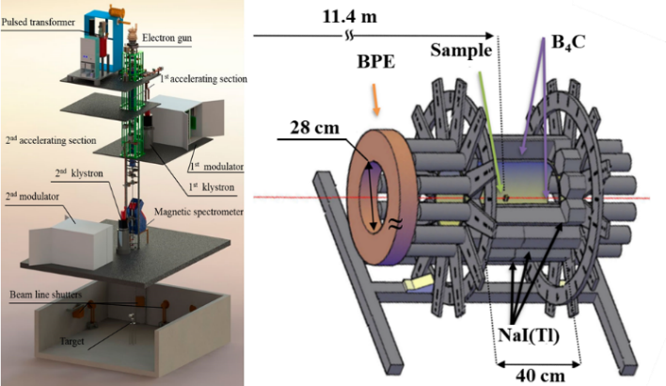
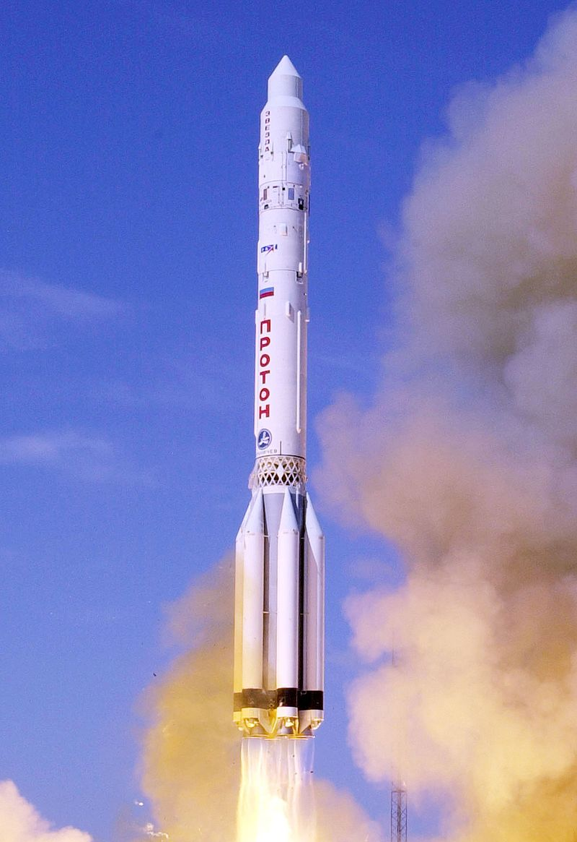
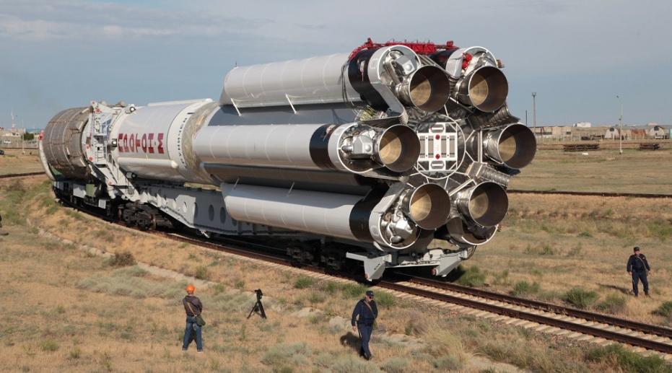
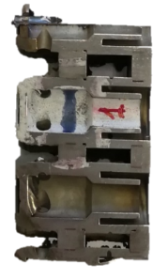
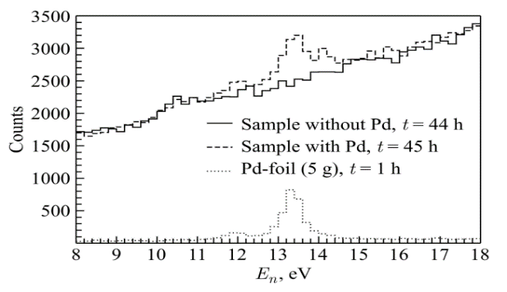
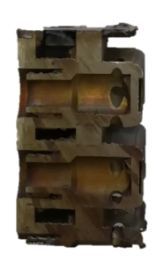
Measurement of the palladium content in the engine elements (nozzles) of the “Proton” launch vehicle using neutron resonance analysis at the IREN facility
Spectrum from parts containing palladium
Spectrum from a sample of pure palladium
Spectrum from palladium-free parts
The mass of detected palladium is 99 ± 7 mg in a sample with a mass of 60 g. The sensitivity of the method is about 2 mg / g.

Slide 17

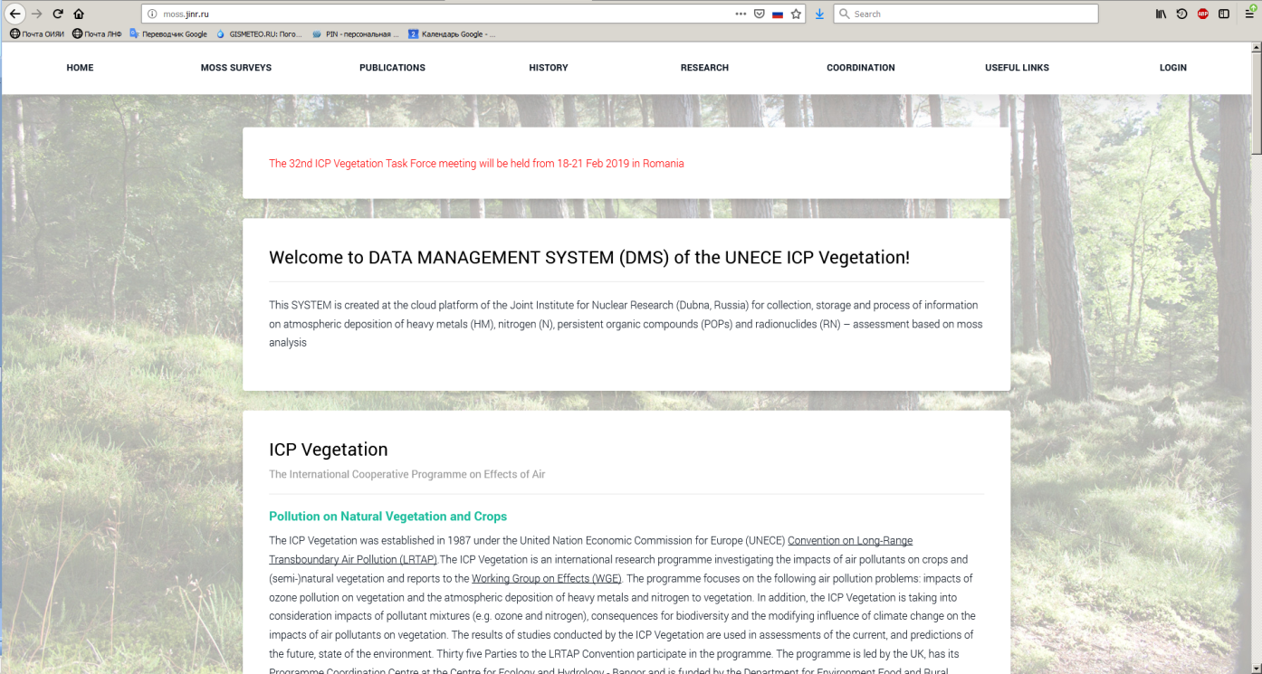

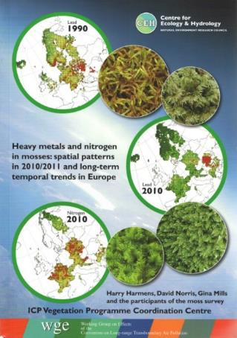
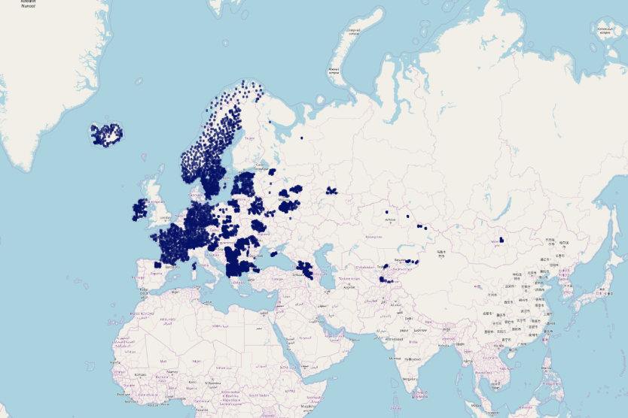
UNECE
Collaboration with Laboratory of Information Technologies of JINR
United Nations Economic Commission for Europe
DATA MANAGEMENT SYSTEM OF THE UNECE ICP VEGETATION MONITORING NETWORK
created at the cloud platform of JINR
Prof. Gednnadiy Ososkov and Dr. Aleksandr Uzinskiy
International Cooperative Programme on Effects of Air Pollution on Natural Vegetation and Crops
http://moss.jinr.ru
About 2000 samples were measured by NAA technique and about 1000 samples - by AAS only during 2018.
~ 6000 sampling sites

Slide 18
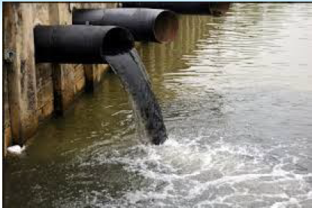
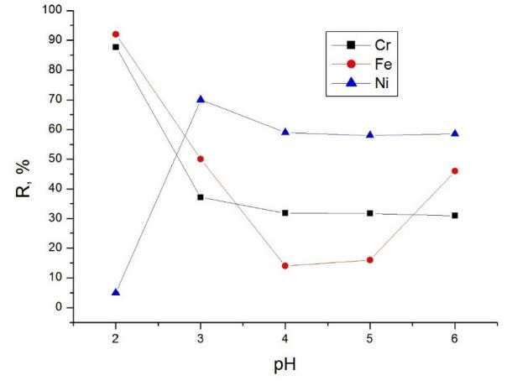
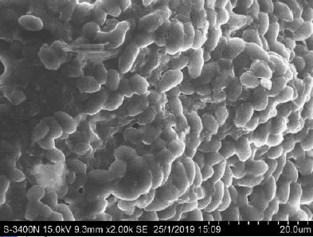
Study of metal biosorption and bioaccumulation from complex solutions using different types of biological sorbents
Reduction of metal content to the maximum admissible level
Effect of pH on Cr, Fe and Ni removal
SEM Image of biosorbent

Slide 19


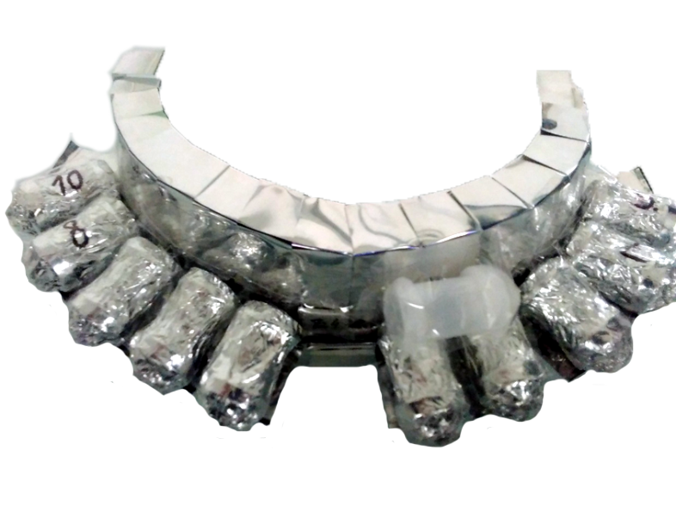
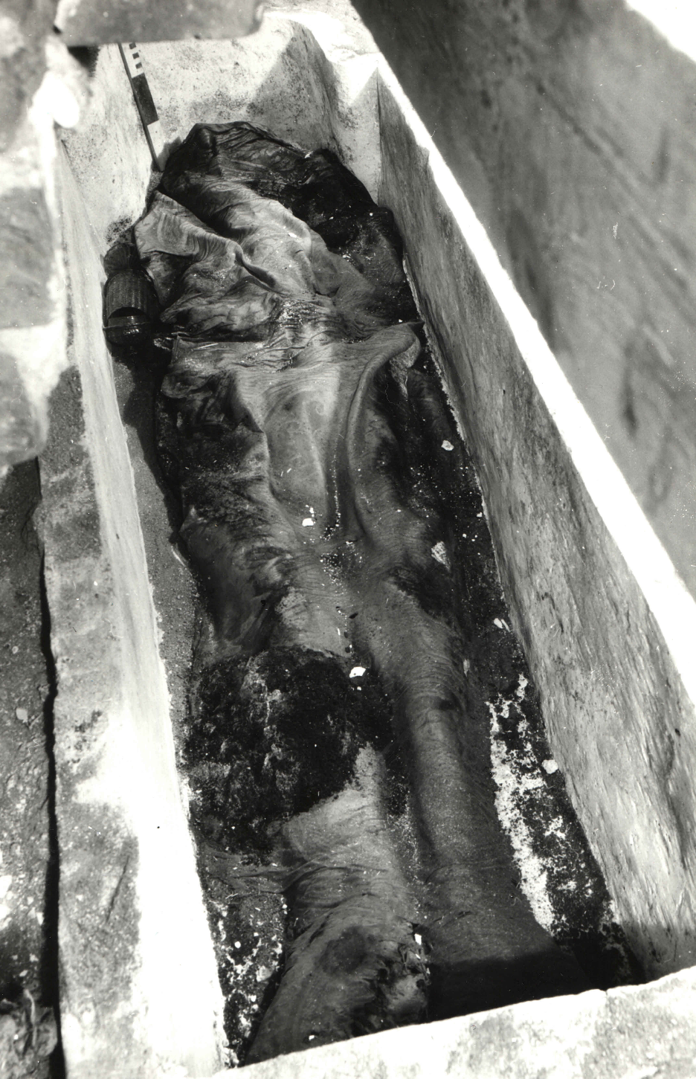
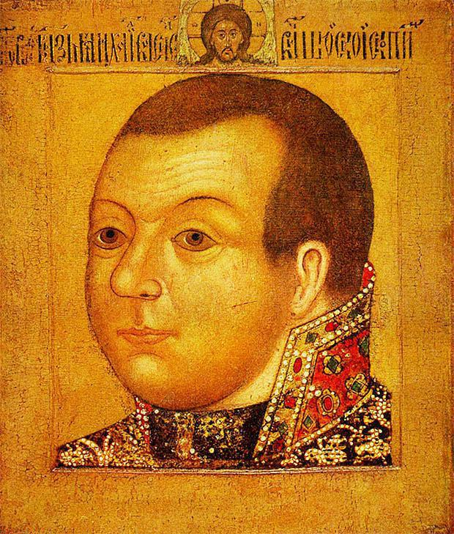
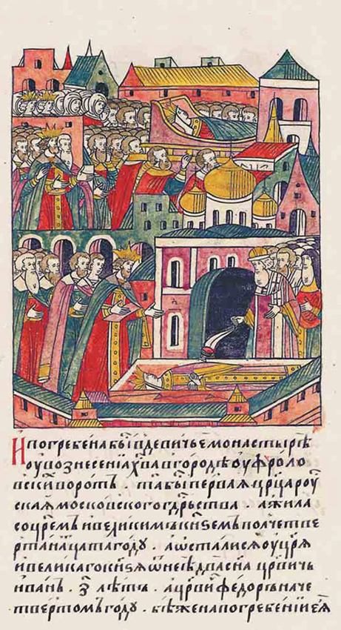
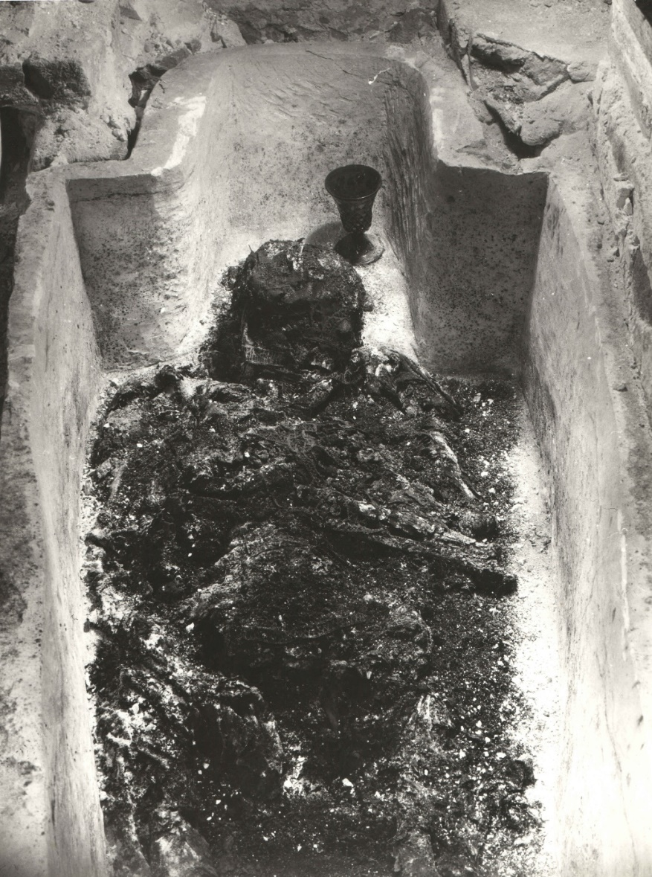
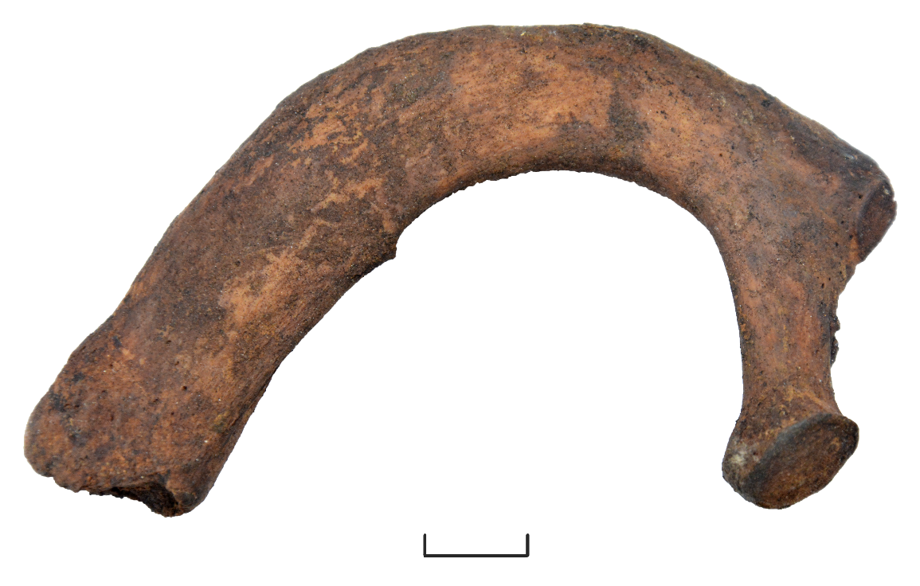
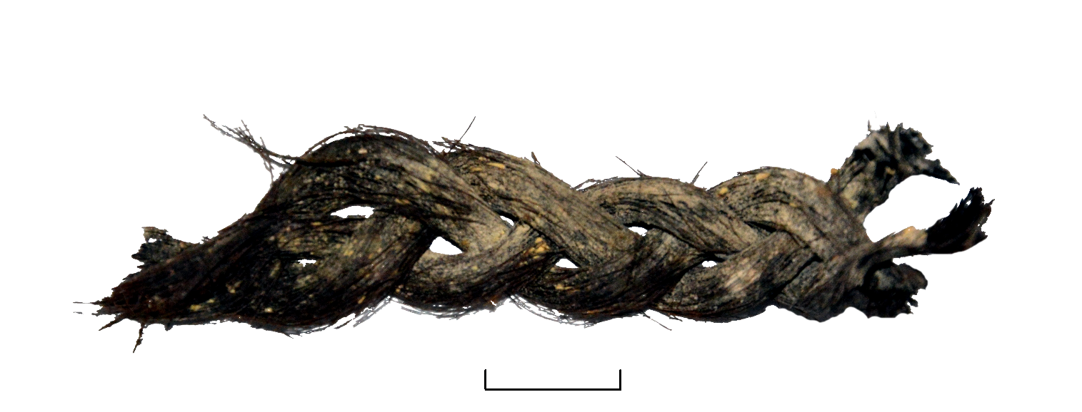
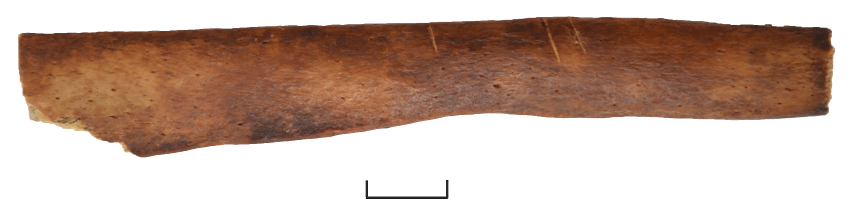
QUALITATIVE AND QUANTITATIVE ANALYSIS OF ARSENIC AND MERCURY IN HUMAN REMAINS OF THE XVI-XVII CENTURIES FROM THE MOSCOW KREMLIN NECROPOLISES BY NEUTRON ACTIVATION ANALYSIS AT THE IREN FACILITY AND THE IBR-2 REACTOR OF FLNP JINR.
T.D. Panova, A.Yu. Dmitriev, S.B. Borzakov, C. Hramco
Measurements at
IREN and IBR-2
Unknown author.
Prince M. V. Skopin-Shuisky.
The remains of Ivan the Terrible in the grave.
The remains of Tsarevich Ivan. The opening in 1963.
Mass fraction of arsenic and mercury in the samples
Sample number | Arsenic (As) |  | Mercury (Hg)
 | Mass fraction, mg/kg | Relative uncertainty, % | Mass fraction, mg/kg | Relative uncertainty, %
1 | 0.19 | 30 | 0.36 | 19.1
2 | 0.23 | 30 | 0.2 | 29.5
3 | 1.18 | 18.3 | 46.6 | 2.5
For modern people
Sample type | Mass fraction, mg/kg
 | Arsenic (As) | Mercury (Hg)
Hair | <= 0.05 | 0.145 ± 0.009
Rib bones | < 0.1 | <= 0.008

Slide 20
A series of methodological and applied research on the interaction of slow neutrons with nanoparticles continues (development of reflectors of slow neutrons)
2009-2015 search of the technology for purification of nano-diamond from hydrogen. Fluoridation gave the first positive results.
2016
Using for very cold neutron extraction
Simulation of the reflection probability
2018
Increasing of quasi-mirror reflection probability for cold neutrons after fluoridation
V.V.Nesvizhevsky, M.Dubois, Ph.Gutfreund, E.V.Lychagin, A.Yu.Nezvanov, and K. N. Zhernenkov
“Effect of nanodiamond fluorination on the efficiency of quasispecular reflection of cold neutrons” // PHYSICAL REVIEW A 97, 023629 (2018)

Slide 21
 | 2017 | 2018
Grants and programs of plenipotentiaries | 60 | 73
Formal results :
 | 2017 | 2018
Publications | 64 | 82
Reports at conferences | 72 | 59
JINR prizes | 1 | 2
RFBR and RSF grants (during 2017-2019) --- 8 .

Slide 22
The theme budget (without grants of PP) k$:
 | 2017 | 2018 | 2019
Equipment and materials | 810 | 1089,1 | 1954
International cooperation | 100 | 110 | 110
Capital construction | 652 | 771,9 | 1155
IREN exploitation k$ :
 | 2017 | 2018 | 2019
Equipment and materials | 1025,7 | 1178,1 | 876,5
Total: | 2587,7 | 3149,1 | 4095,5
7-year plans | 2754 | 2995 | 3205

Slide 23
Theme title: «Investigations of neutron nuclear interactions and properties of the neutron».
Theme leader: Lychagin Е.V.
Deputies: Kopatch Yu.N.
Sedyshev P.V.
Expected scientific results:
1. Measurements and search for P-odd and T-odd effects in reactions with polarized neutrons.
2. Measurements of new nuclear data (total and partial neutron cross sections) in the energy range from thermal to 1 GeV.
3. Measurements of angular and energy correlations in the emission of fragments, neutrons, gamma rays and light charged particles in fission.
4. Measurements of angular correlations in the emission of gamma-rays and neutrons in the interaction of 14-MeV tagged neutrons with nuclei (TANGRA project).
5. Theoretical and experimental investigations of nonstationary quantum effects with slow neutrons.
6. Theoretical and experimental investigations of models of interaction of slow neutrons with diamond nanostructures.
7. Elemental analysis of layered solid-state structures with a depth resolution of about 10 nm. Measurement of the concentration of hydrogen atoms at a level above 1 at.% and concentration of heavy elements above 0.01 at.%.
8. Determination of elemental composition of various samples using nuclear physics methods for environmental and life-sciences studies.

Slide 24
Expected methodological results:
1. Stable operation of IREN for physics experiments. Increase of IREN intensity by raising the frequency.
2. Development of methods of polarization of neutrons and nuclei for experiments to search for effects of parity violation and time invariance in neutron-nuclear interactions. Construction of a prototype of polarized nuclear target.
3. Modernization of the electrostatic generator EG-5.
4. Modernization of the setup for measuring angular and energy correlations in neutron-nuclear interactions using tagged neutrons (project TANGRA).
5. Development of techniques and construction of a prototype of an experimental setup for measuring the neutron lifetime on beamline 1 of the IBR-2 reactor.
6. Commissioning of REGATA-2.
7. Construction of a prototype of a very cold neutron source and its testing on an extracted neutron beam of the IBR-2 or HFR reactors (Grenoble, France).
8. Development and construction of detector and data-acquisition equipment for measuring P-odd effect in ³He(n,p)³H reaction with cold polarized neutrons in the framework of the weak NN-potential study at ILL, Grenoble.
9. Development and construction of neutron detectors for space vehicles.
10. Creation of neutron activation analysis database for the Institute of Nuclear Physics in Almaty, Kazakhstan.

Slide 25
Budget (items 5, 6, 9, 10, 18, 19, kUSD.)
Theme:
 | 2020 | 2021 | 2022 | Total
Studies of neutron-nuclear reactions | 870 | 810 | 760 | 2440
Investigations of the fundamental properties of a neutron, UCN physics. | 440 | 530 | 350 | 1320
Applied and methodical works | 210 | 210 | 210 | 630
Development of experimental and engineering infrastructure | 2010 | 2235 | 1700 | 5945
Total | 3530 | 3785 | 3020 | 10335
IREN exploitation and development
 | 2020 | 2021 | 2022 | Total
Maintenance and operation | 300 | 300 | 300 | 900
Improving of the IREN systems | 200 | 200 | 300 | 700
Total | 350 | 500 | 600 | 1600
The total estimated cost of the topic 11935 kUSD

Slide 26
Thank you for attention

