Slide 1
Creation of a prototype of a polarized nuclear target.
V.V.Novitsky

Slide 2
Introduction
When a polarized s-neutrons are captured by a spin-J target nucleus, two states are formed in accordance with their partial cross sections: J + 1/2 and J-1/2. The degree of polarization of the first state is parallel to the back of the neutron, the second - antiparallel. Thus, there is always a mutual annihilation of the degree of polarization of the compound nuclei, down to a practical zero, and, consequently, angular correlations in certain intervals of the neutron energy. Therefore, an obvious advantage is the experimental method that would allow one of the spin states to be removed. This can be done using the method of dynamic polarization of nuclei (DNP).

Slide 3
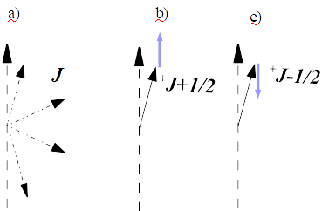
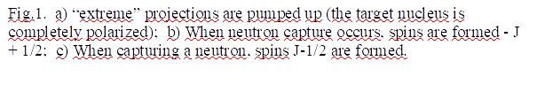
Introduction

Slide 4
Introduction
The DPN will allow:
to carry out qualitatively new measurements of P-odd effects, while simultaneously reversing the spins of the nucleus and the neutron ..
qualitatively new measurements of TRi and ROT effects.
to measure separated cross sections, especially important for fissile nuclei.
finally, to bring the possibility of measuring the T-odd, P-odd correlation at a resonance of 0.74 eV La
there is no doubt that as the experimental base develops, new tasks will arise.

Slide 5
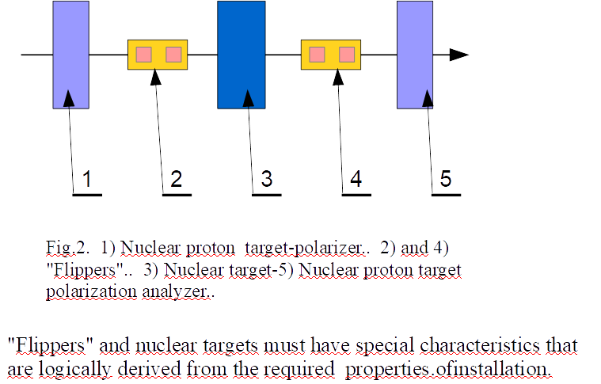
The composition of the experimental setup.

Slide 6
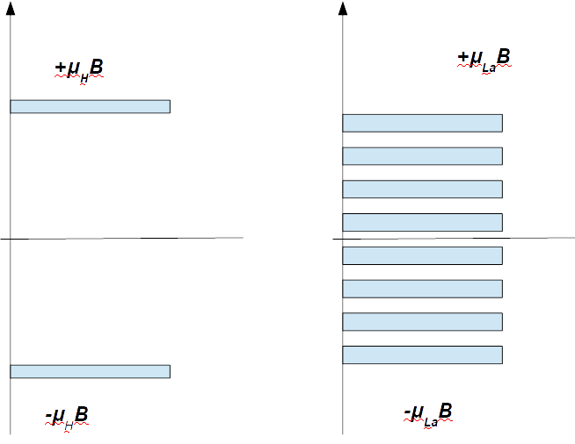


The need to have a field uniformity of 10⁻⁵.

Slide 7
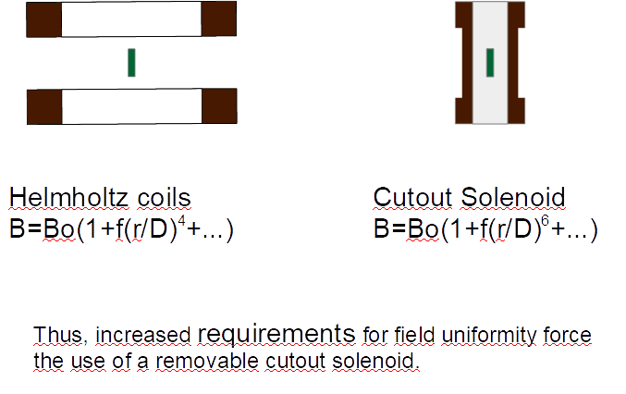
Superconducting magnet.

Slide 8
Conclusion
Target is dynamically polarized in a high homogeneity superconducting cutout solenoid, surrounding the target dilution refrigerator.. In a second step the target polarization is frozen in by lowering the temperature to 30 - 50 mK and subsequently the magnetic field B to 0.8 – 0.6T. Then the magnetic field is taken over by a holding coil system, integrated in the target refrigerator cryostat, and the polarization solenoid is removed from its polarizing i.e. beam obstructing position.

Slide 9
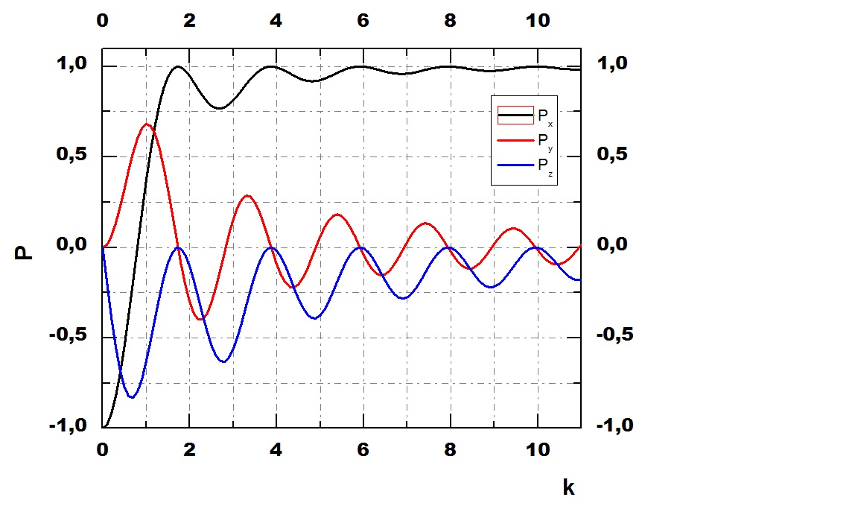
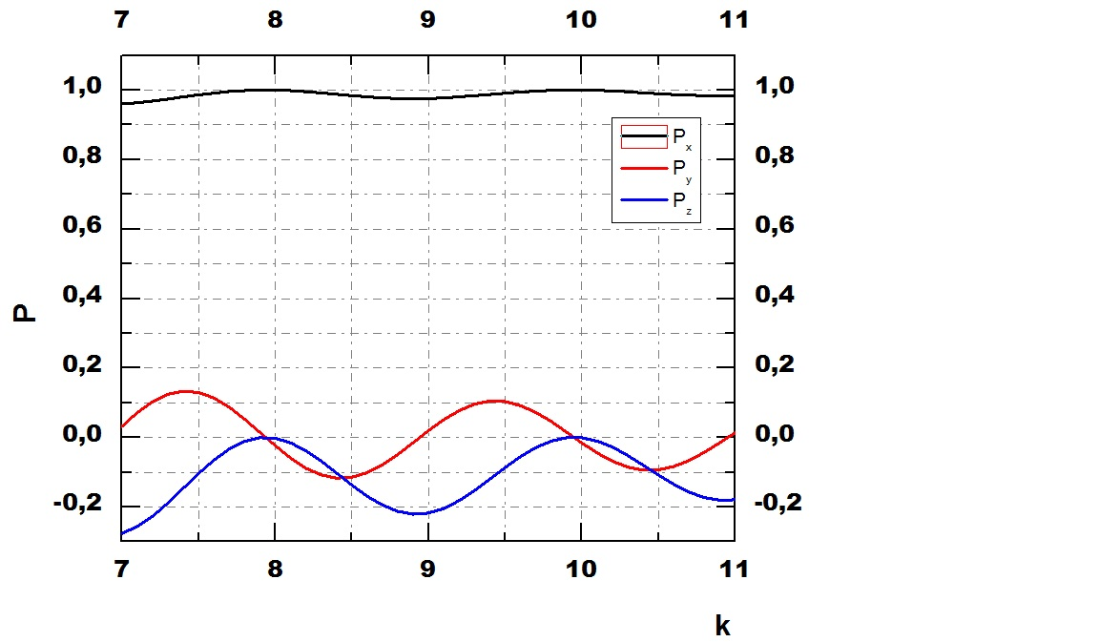
"Adiabatic" rotation of the neutron spin
Rapid precession with respect to the slow rotation of the field in the neutron reference system.
B_{x}=-B₀cos(ω_{B}t); B_{y}=-B₀sin(ω_{B}t); B_{z}=0
k=f_{L}/ f_{B} =( ν_{n} / ν_{n})BL;

Slide 10
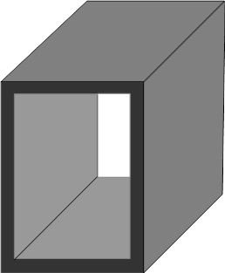
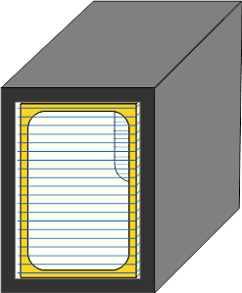
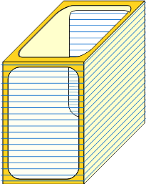
“Flippers”
The actuator is a short rectangular solenoid in a magnetic screen.

Slide 11

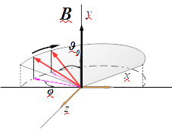
Neutron polarization vector control
Control of neutron spin precession in a magnetic field
f_{L}= ν_{n} ·B; ν_{n}=29,16МГц/Тл;
Use a sequence of rectangular solenoids with uniform fields directed along the coordinate axes perpendicular to the beam. Since the angles of precession of the spin of the neutron depend on the time of its stay in the field, change the currents of the solenoids in accordance with TOF as 1 / t

Slide 12
The concept of this setup was developed for conducting experiments aimed at the search for T-invariance violation when measuring three-vector correlation in forward polarized neutron scattering at polarized ¹³⁹La in the resonance 0.74 eV and five-vector correlations on aligned nuclei…
…In the project ISTC #0608-97
“Development of a Research Technique for Investigation of Fundamental Problems of parity Violation and Time Reversal Invariance”.

Slide 13
What is supposed to be carried out within the framework of the project?
We have a 5T superconducting magnet made in 1988, with a 2x10-4 d70x20 mm homogeneity area, which will enable us to master and implement the above method of producing DNP on a hydrogen-containing target. Thus, at a minimum, an all-wave neutron polarizer will be created at the first stage (2019-2022) .
In addition, on the basis of the experience gained, a design will be made of an installation for obtaining a nuclear polarized target at the second stage (2022-2023) .
The ultimate goal of the project is to create in the future a full-scale portable installation described above.

Slide 14
Thank you for attention

Slide 15
WWW.LEIDENCRYOGENICS.COM

