Slide 1
Study of deep subcritical electronuclear systems and possibilities of their application for energy production, transmutation of radioactive waste and research in the field of radiation material science
A.A.Baldin
Report and proposal for extension of the project to 2019-2020.
Scientific-methodical Department LHEP
24.06.2019

Slide 2
Study of deep subcritical electronuclear systems and possibilities of their application for energy production, transmutation of radioactive waste and research in the field of radiation material science
QUASI INFINITE TARGET
TOPIC NUMBER 02-1-1107/2017–2019
AUTHORS
J.Adam, A.Baldin, E.Baldina, A.Berlev, A.Cheryemukhin, E.Levterova, E.Kostyukhov, Yu.Kovalev, E.Kozulin, I.Kriachko, I.Kudashkin, A. Makan'kin, I.Mar'in, M.Paraipan, V.Pronskikh, A.Rogachev, A.Shafranovskaya, V.Shaliapin, V.Slepnev, A.Solnyshkin, V.Stegailov, E.Strekalovskaya, V. Tsupko-Sitnikov, S.Tyutyunnikov, S.Vasil’ev, A. Vishnevsky, V.Wagner, I.Yudin, B.Yuldashev, N.Zamyatin, (Joint Institute for Nuclear Research, Dubna),
Project Leader: S.TYUTYUNNIKOV
Deputy Project Leader: A.A.SOLNYSHKIN

Slide 3
Specific goals of E+T experiment
Determination of the energy spectrum of the neutrons generated in a heavy (uranium, thorium) bulk target with a beam of relativistic particles, comparison of the experimental data with calculations based on different methods.
Determination of the spatial distribution of neutron leakage, its dependence on the energy of incident particles.
Measuring the energy yield from deeply subcritical assembly, its dependence on the energy of incident particles.
Study of transmutation of minor actinides by neutrons generated in a deeply subcritical assembly.
Optimization of beam parameters for ADS.

Slide 4
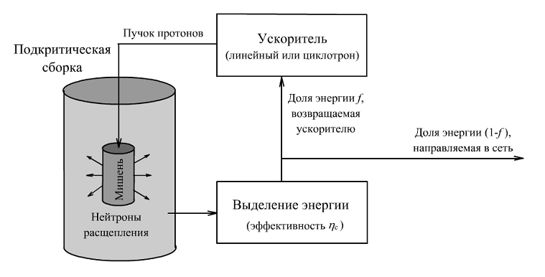
Accelerator Driven Systems
Proton beam
Accelerator
(linac or cyclotron)
Subcritical
assembly
Fraction of energy f
required for running the accelerator
Fraction of energy (1-f ) supplied to the
network
Target
Released energy
(efficiency ηc)
Spallation
neutrons

Slide 5
On June 30, 1947, the director of the Institute of Chemical Physics (USSR AS) academician N.N. Semenov sent a letter to I.V.Stalin concerning the idea of protection from atomic bombs using an accelerator. The concept discussed with Zeldovich and Leipunskii involved a proton accelerator to produce an 1-3 GeV proton beam that should hit an active substance of a bomb carried by an aircraft and generate a sufficient number of neutrons to stop the possible nuclear explosion.
It was also kept in mind that such an accelerator, being created, would be useful as a part of a nuclear power plant.
Source: G.V.Kiselev, head of reactor department (1982-1997 ) ITEP,
Presentation at «Semenov Readings, April 2014.)

Slide 6
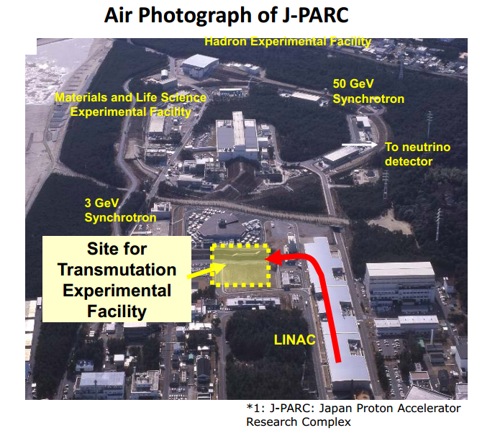

Slide 7
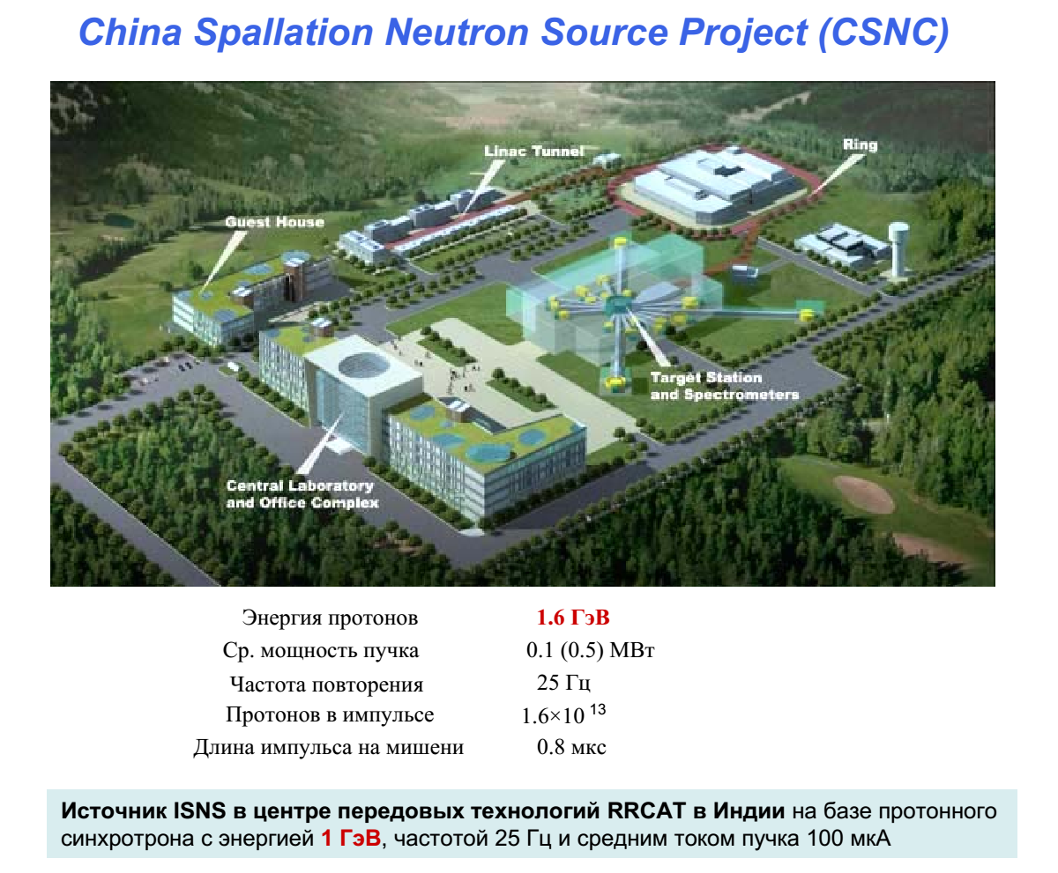

Slide 8
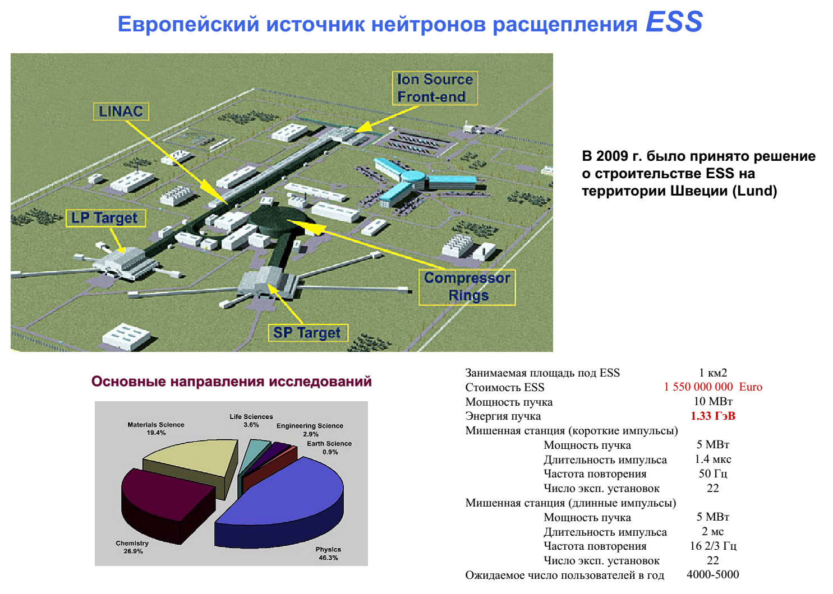

Slide 9
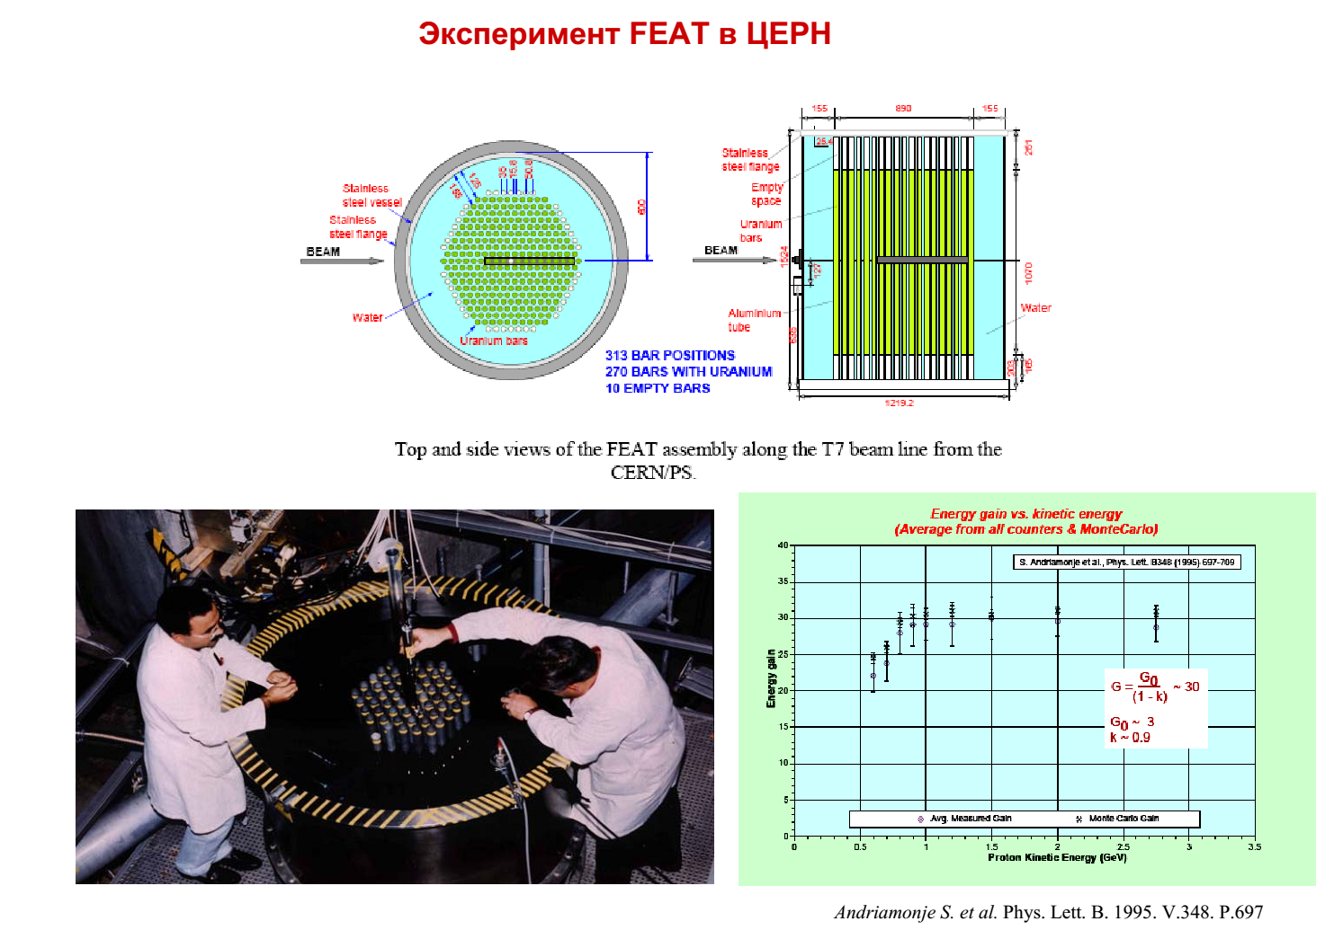

Slide 10
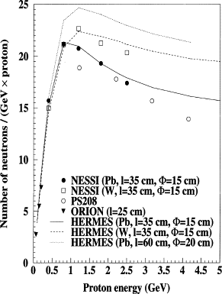

Slide 11
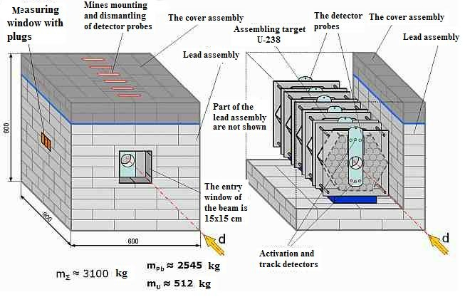
The “Quinta” target with the lead reflector

Slide 12
Power gain as a function of energy (in units of fission numbers per1 deuteron and per 1 GeV). Runs 2012-2015.

Slide 13
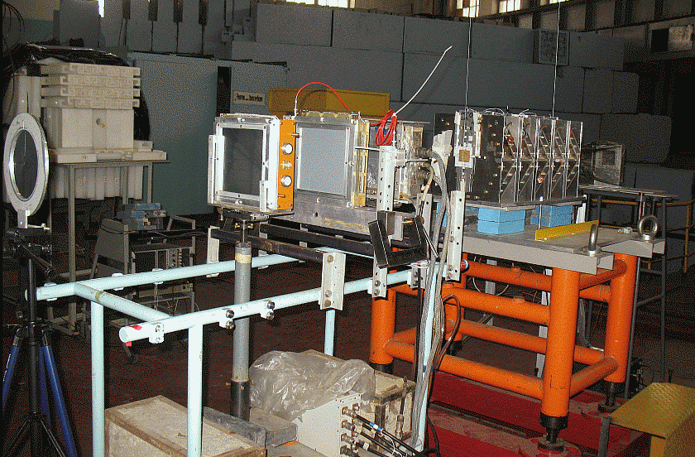
Quinta target at extracted Nuclotron beam (LHEP JINR)

Slide 14
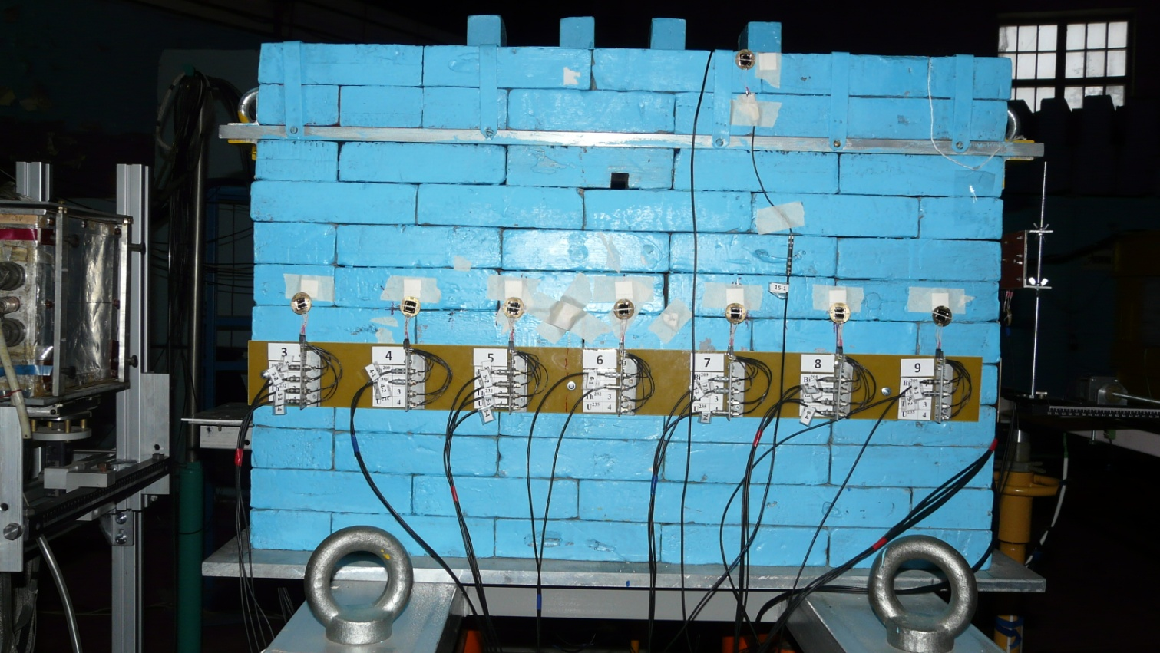
Setup "Quinta" with a set of semiconductor detectors

Slide 15
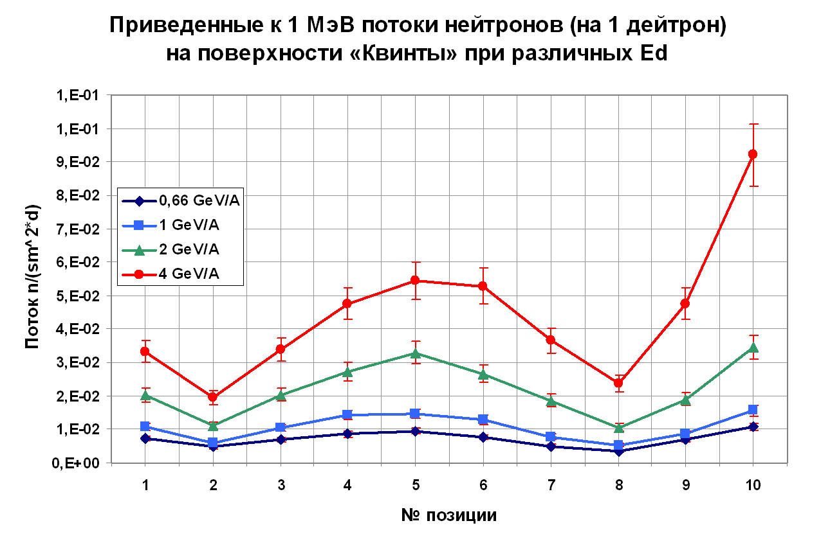
Normalized to 1 Mev neutron flux (1 "deuteron") on the surface of "Quinta" in various Ed
The front surface of the “Quinta"
Lateral surface of the “Quinta"
Back surface of the “Quinta"
Density of neutron flux
Position

Slide 16
Neutron energy spectra in a common nuclear reactor and Quinta irradiated by 0.66 GeV proton beam

Slide 17
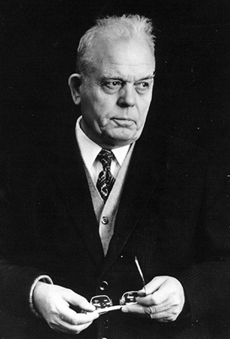
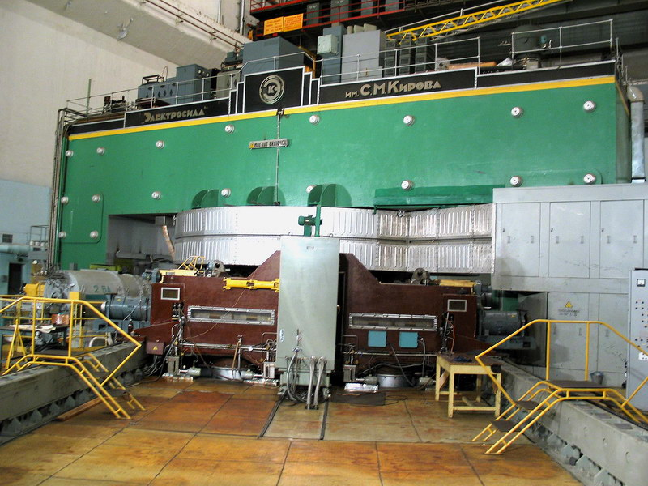
Phasotron and medical applications
Synchrocyclotron “Phasotron”
The First Accelerator in Dubna
Constructed in frames of the Soviet Atomic Project,
commissioned in December 1949,
still in operation after a series of modernizations
I.V.Kurchatov and
V.P. Dzhelepov
M. G.Meshcheryakov
Research program:
Muon-catalysis
Pion & muon
physics
Nuclear
physics
Machine
parameters:
Protons
680 MeV
2.2 mA – slow extraction,
3 mA – fast extraction
Main application:
Cancer therapy
Dzhelepov Laboratory For Nuclear Problems

Slide 18
Isotope | E_{th} [MeV]
⁵⁹Fe | 3
⁵⁸Co | 10
⁵⁷Co | 25
⁵⁶Co | 40
⁴⁸V | 90
⁴⁷Sc | 100
⁵⁹Fe
⁵⁸Co
⁵⁷Co
⁵⁶Co
⁴⁸V
⁴⁷Sc

Slide 19
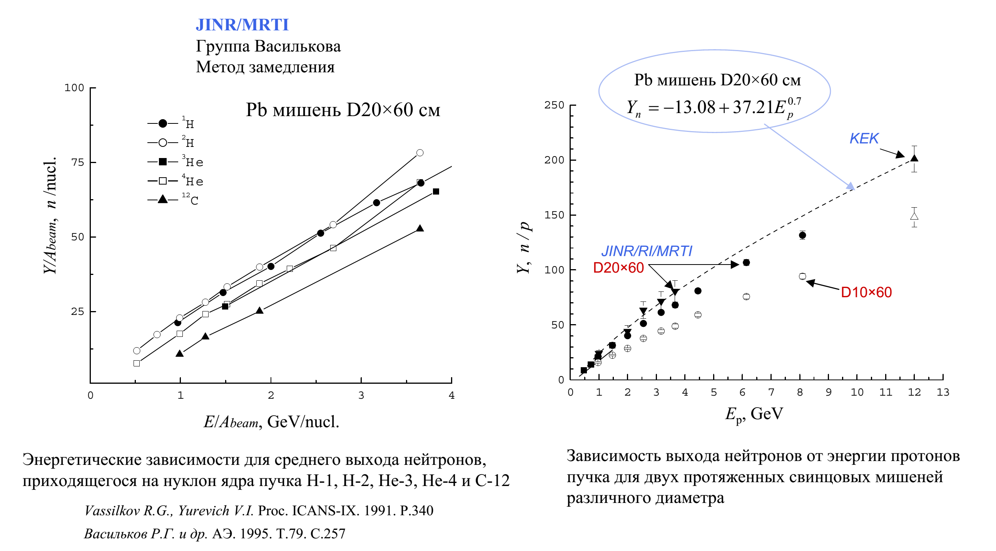

Slide 20
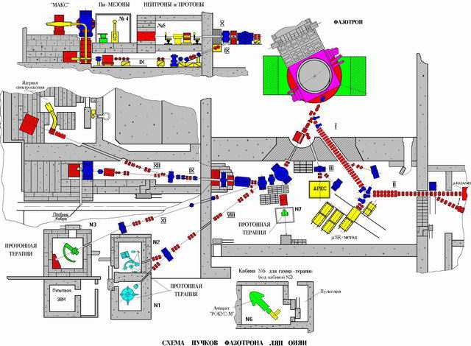
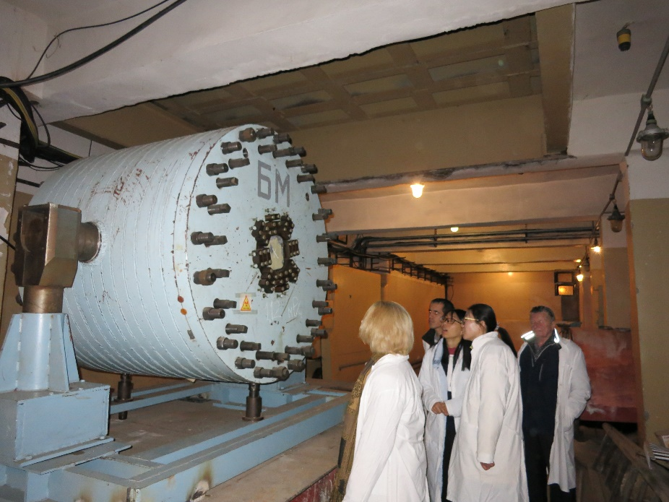
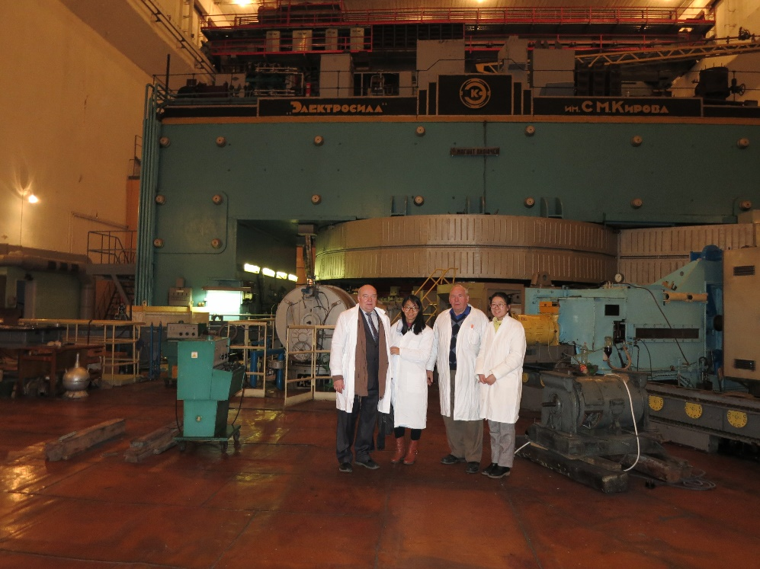
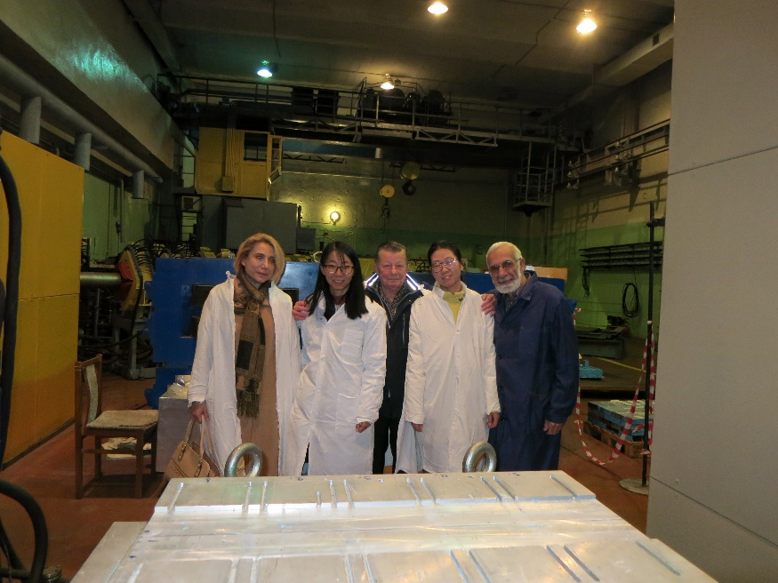

Slide 21
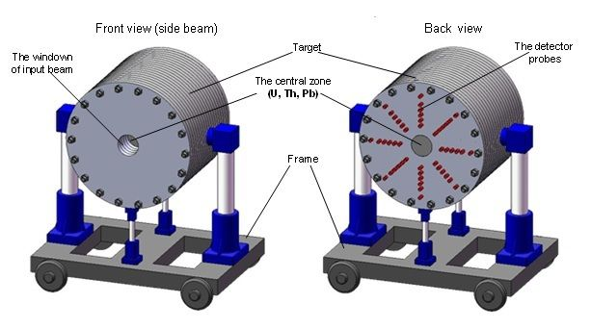
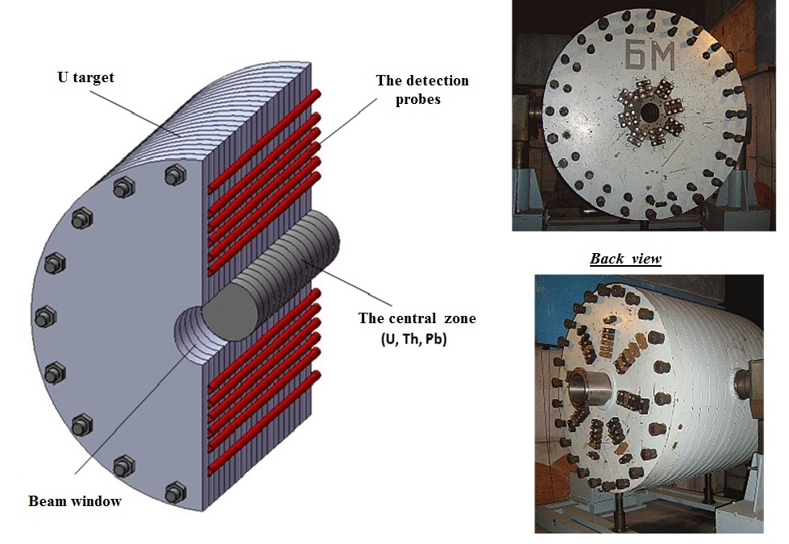
Mass of uranium – 19.5 т. Materials of central zone – U, Th, Pb.
Diameter – 1,2 м. Diameter of central zone – 0,2 м.
Length – 1 м.
General view of the target setup BURAN at the transport-fixing platform.
The scheme of longitudinal section of the TS BURAN with the mounted central zone (top-left) and general view photo (right).
Big uranium target

Slide 22
Proton and ion (deuterons, tritium nuclei, ⁷Li, ⁹Be, ¹¹B, ¹²C,¹⁴N²⁰Ne, ²⁴Mg, ³²S, and ⁴⁰Ca) interaction with the quasi-infinite target was simulated using GEANT4.
In all calculations the cylindrical target from natural uranium with a length of 160 cm and a radius of 60 cm was considered.
The simulation was performed for beam energies from 0.3 to 10 GeV/nucleon. The parameterizations based on experimental data ENDF (Evaluated Nuclear Data File) were used for simulation of the well known neutron spectrum region below 20 MeV. Special attention was paid to simulation of inelastic hadron interactions. For particles with an energy above 50 MeV three cascade models were used: Bertini cascade, Liege cascade и binary cascade (BC). The BC model was used for comparative analysis of ion beams with mass numbers up to 40.

Slide 23
Results of simulation of (a) the total number of produced neutrons and (b) number of fissions of natural uranium normalized to one beam ion for different mass numbers of the beam ions and the set of energies in a range of 0.3-10 GeV/nuсleon.

Slide 24
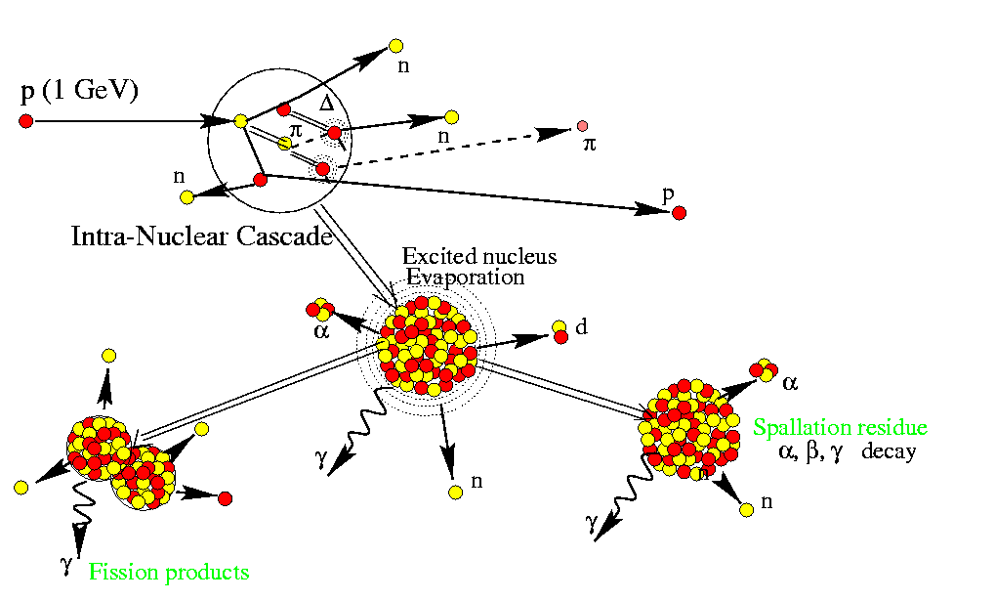
Integral energy release per one beam ion as a function of mass number of the incident ion (GEANT4).

Slide 25
Relative contribution of the energy released in the target in the uranium fission reaction as a function of kinetic energy per nucleon
of the incident ion
(Efis=N*190MeV)

Slide 26

Energy spent for magnetic field maintenance in the synchrotron
E_{spent}~AP/Z,
where Z is the charge and A is the mass number,
P is the momentum of the accelerated ion.
For an isochronous cyclotron E_{spent}~(AP/Z)².
For a linear accelerator E_{spent}~AE_{k}/Z,
E_{k} is the kinetic energy per nucleon of accelerated ion.
Relative efficiency ε_{r}
for ion 2, as compared to ion 1, for different types of accelerators:

Slide 27
Relative (with respect to 1 GeV protons) efficiency of ion energy deposition for beams accelerated in a synchrotron, cyclotron, and a linear accelerator.
synchrotron
cyclotron
linac

Slide 28
The ADS-optimal energy depends on the accelerator type and the type of accelerated ions.
The optimal proton energy for a synchrotron is ~3 GeV, for a Linac, ~1-1.5 GeV, and for a cyclotron, ~1 GeV.
It was demonstrated that for light nuclei, beginning with ⁷Li, with energies > 1 GeV/nucleon, ion beams are considerably (several times) more efficient than a proton beam with an energy of 1-3 GeV.
The optimal accelerator energy for carbon is 2 GeV/nucleon, while for ⁴⁰Ca ions, 4 GeV/nucleon.
The possibility of achieving energy release in a quasi-infinite uranium target equivalent to that of 1 GeV protons with higher efficiency (and twice as small accelerator size!) in the case of acceleration of light ions was demonstrated.
It was shown that ⁷Li beam with an energy of 0.5 GeV/nucleon is equivalent to proton beam with an energy of 2 GeV/nucleon, which allows one to obtain the same energy production with the same or higher efficiency using ⁷Li beams and an accelerator with twice as small size. This is especially topical for the accelerator of an ADS fast reactor.
The experimental studies on irradiation of "Quinta" uranium target at extracted carbon beams of Nuclotron demonstrated the promising character of this research; the future experimental studies with proton and light ion beams up to ⁴⁰Ca in an energy range of 0.5-4 GeV/nucleon are anticipated.

Slide 29
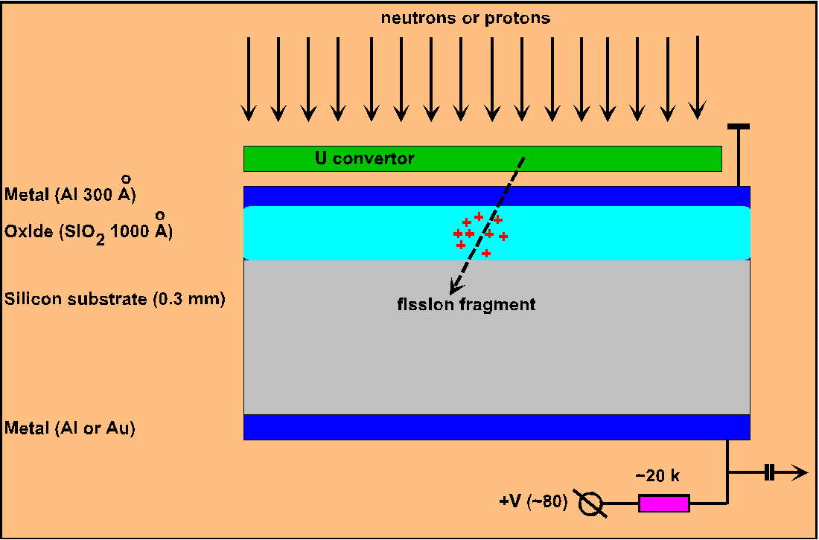
TFBS (thin film breakdown structure) monitor of neutron or proton fluxes

Slide 30
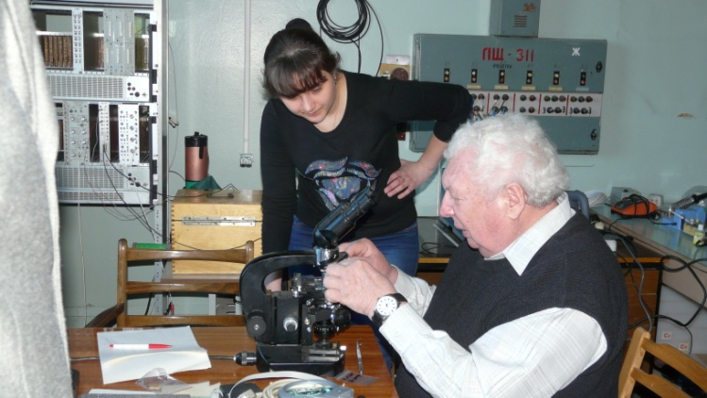
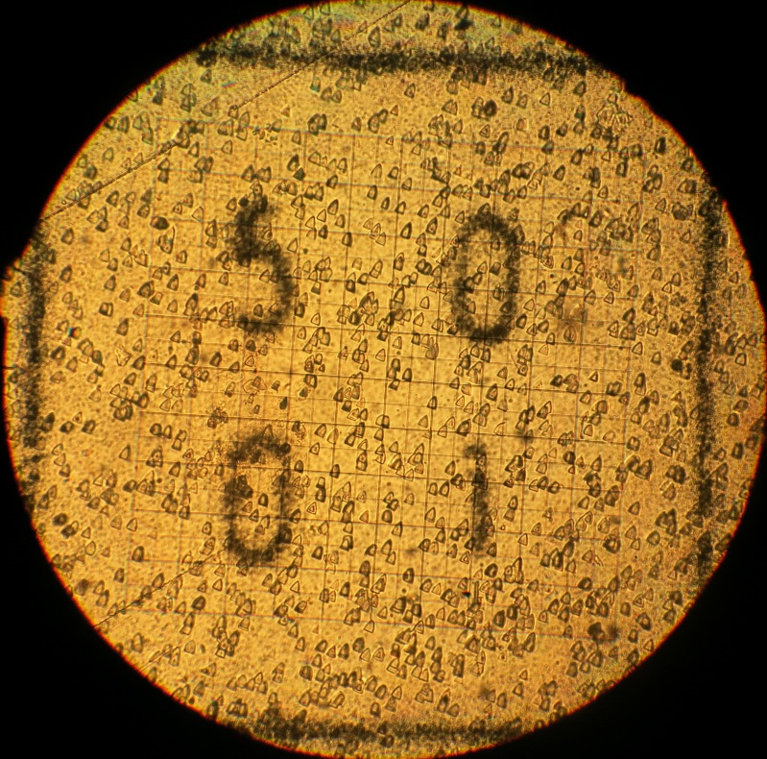

Slide 31
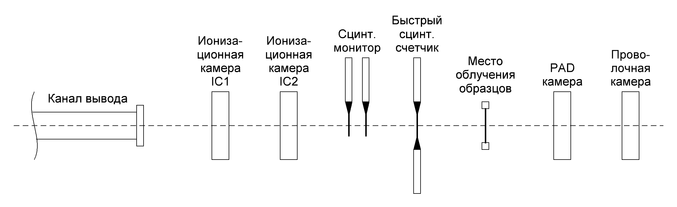
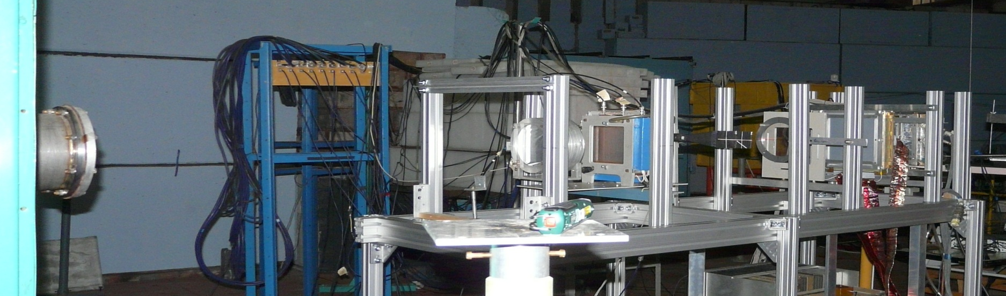
System of monitoring Nuclotron extracted beam for “Quinta” placement
fast scintillation counter
scintillation monitor
Ionization
chamber
Ionization
chamber
place of samples exposure
PAD chamber
Wire
chamber
Beam line

Slide 32
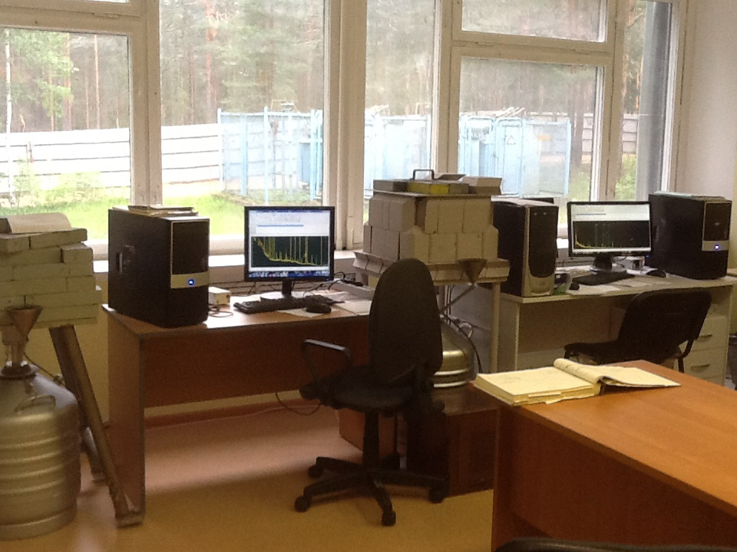
Laboratory of activation measurements in LHEP

Slide 33
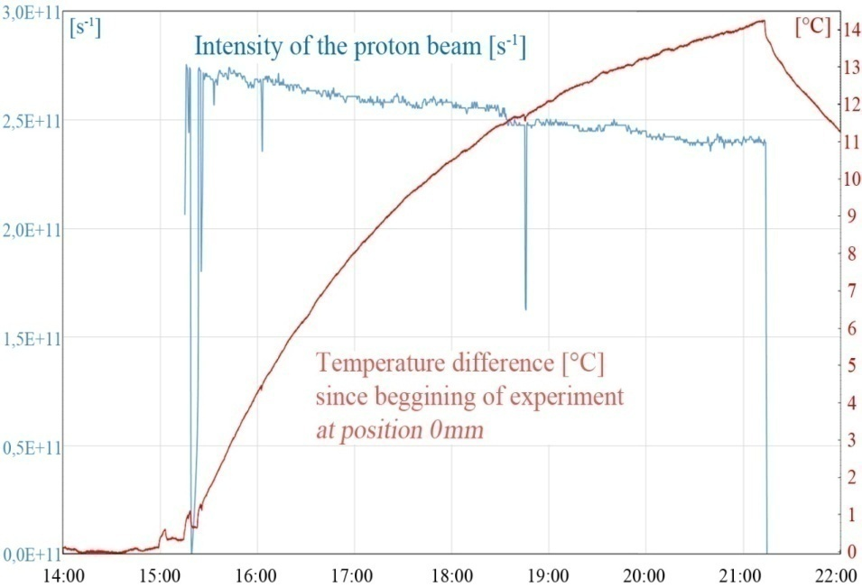
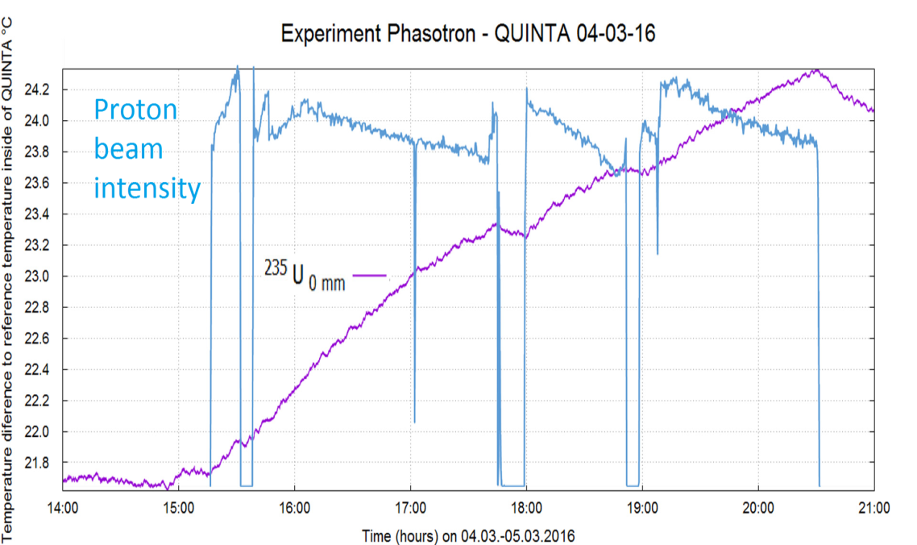
Drops of the proton beam intensity are well reflected by temperature
December 2015 March 2016

Slide 34
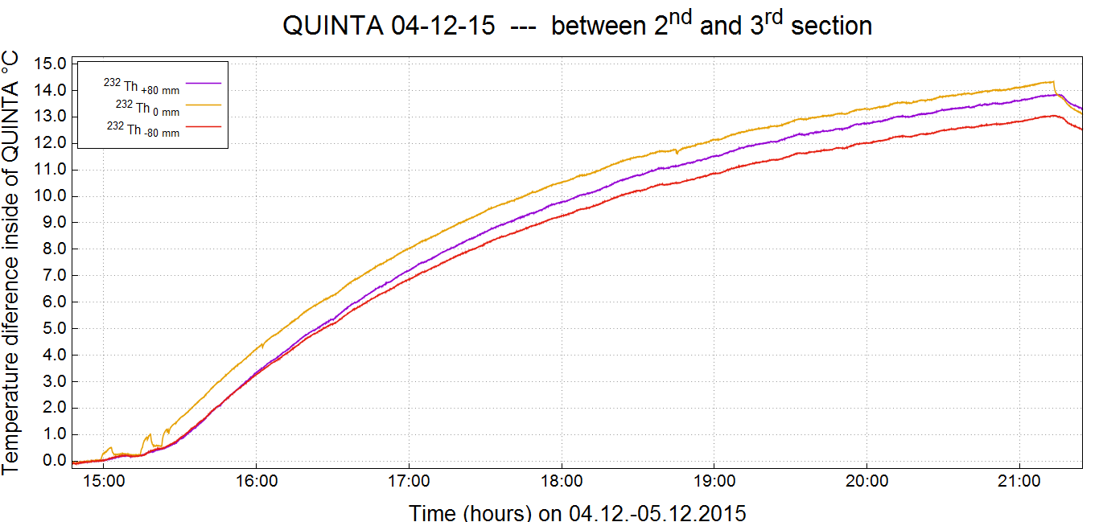
In December run the temperature difference between the beginning and the end of experiment was about 14 °C between 2. and 3. sectiosn with insufficient insulation.
Thorium samples were measured

Slide 35





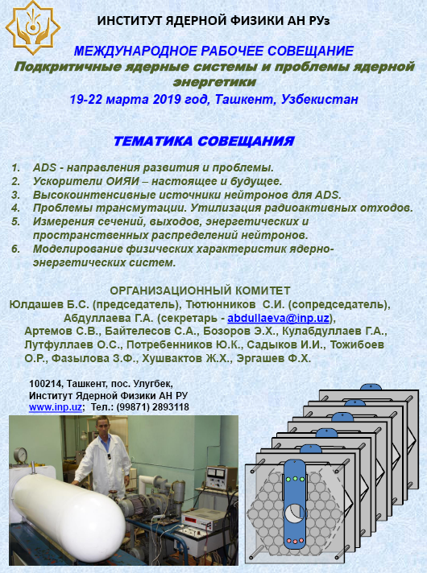
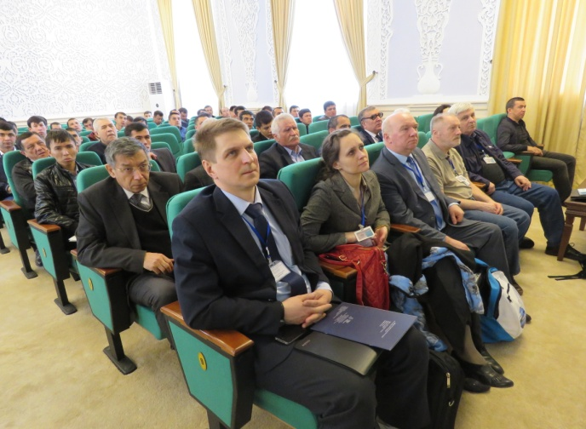
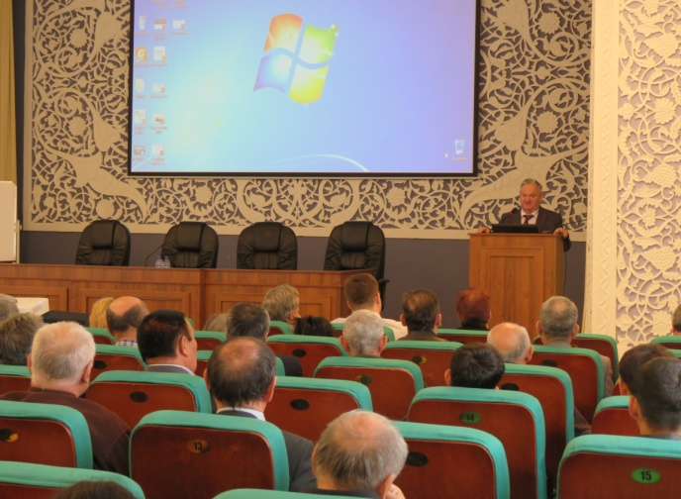
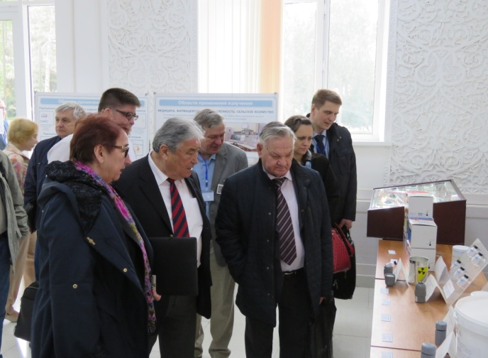
INTERNATIONAL WORKSHOP
Sub-critical nuclear systems and nuclear power issues
19-22 March 2019
Tashkent, Uzbekistan

Slide 36
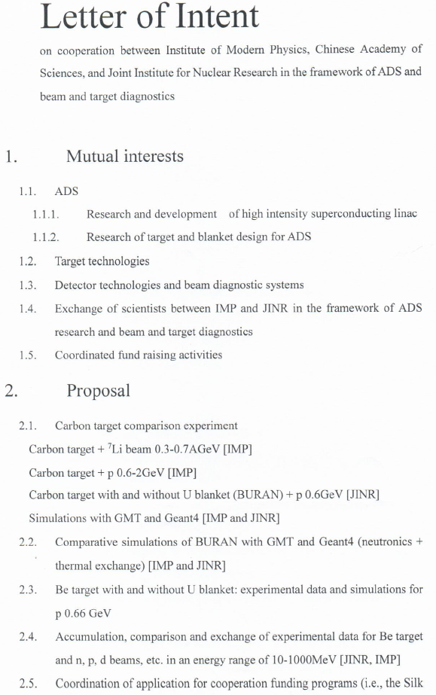
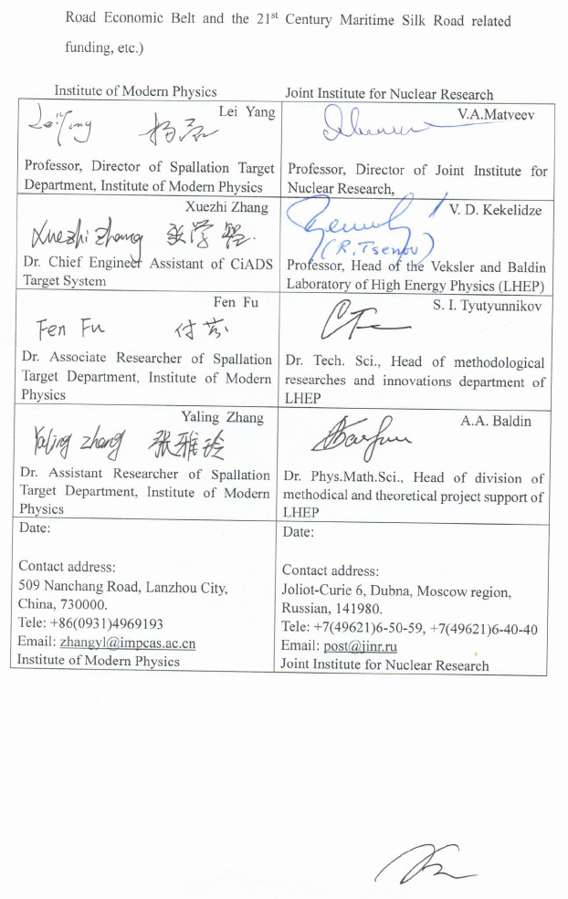

Slide 37
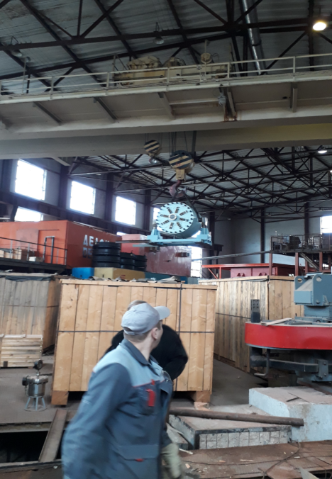
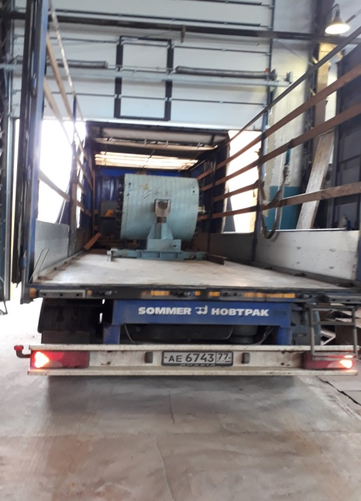
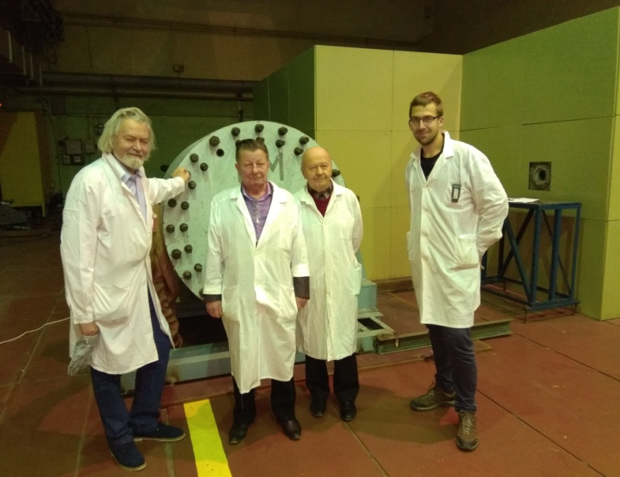
Realization of BURT transportation from VBLHEP to DLNP September 2017, JINR, Dubna
Background measurements, DNLP Phasotron, January 2018

Slide 38



Slide 39
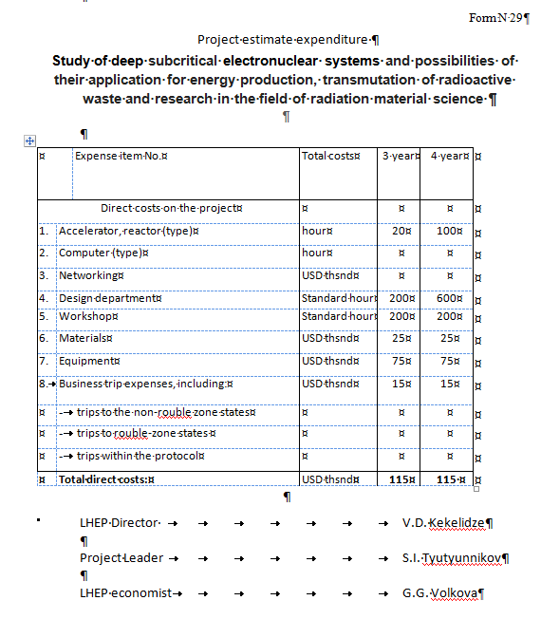

Slide 40
PhD works:
LukášZávorka: Transmutation of Actinides Using Spallation Reactions, FNSPE CTU Prague, 2015
Jitka Vrzalová: Experimental Determination of Neutron Reaction Cross-Sections Relevant for Accelerator-Driven Transmutation Systems, FNSPE CTU Prague, 2016
J. Khusvhaktov et al: Interactionsofsecondaryparticleswith thorium samples in thesetup QUINTA irradiatedwith 6GeV deuterons, August 2016, Nuclear Instruments and Methods in PhysicsResearchSection B BeamInteractionswithMaterials and Atoms 381:84-89, DOI: 10.1016/j.nimb.2016.05.032
R. Hashemi-Nezhad et al: Transmutationof uranium and thorium in theparticlefieldofthe QUINTA sub-criticalassembly, December 2017, Nuclear Instruments and Methods in PhysicsResearchSection A AcceleratorsSpectrometersDetectors and AssociatedEquipment 883, DOI: 10.1016/j.nima.2017.11.048
V. Wagner et al: How to Use Benchmark and Cross-sectionStudies to Improve Data Libraries and Models, June 2016, JournalofPhysicsConferenceSeries 724(1):012052, DOI: 10.1088/1742-6596/724/1/012052
2017
M. Suchopár et al: Monte carlosimulationsof Yttrium reactionrates in Quinta uranium targetJanuary 2017, TheEuropeanPhysicalJournalConferences 138:10003, DOI: 10.1051/epjconf/201713810003
M. Zeman: DeterminationoftheSecondary Neutron Flux attheMassive Natural Uranium Spallation Target, December 2017, PhysicsProcedia 90:69-78, DOI: 10.1016/j.phpro.2017.09.021
2018
M. Suchopár et al: Activationmeasurementof neutron production and transport in a thickleadtarget and a uranium blanket during 4 GeV deuteron irradiation, NIM, 2018
L. Závorka et al: Characterizationof a mixedhigh-energyspallation neutron–proton fieldusingmonoisotopicactivationdetectorsJuly 2018, DOI:10.1016/j.nima.2018.07.009
J. Khushvaktov et al: Monte Carlo simulations and experimentalresults on neutron production in the uranium spallationtarget QUINTA irradiatedwith 660 MeV protons, March 2018, AppliedRadiation and Isotopes 137, DOI: 10.1016/j.apradiso.2018.03.003
2019
P. Tichý et al: Experimentalinvestigation and Monte Carlo simulationsofradionuclideproductioninsidethe Uranium spallationtarget QUINTA irradiatedwith a 660-MeV proton beam, January 2019, TheEuropeanPhysicalJournalConferences 204:04003, DOI: 10.1051/epjconf/201920404003

Slide 41
Only examples of last publications, mainly
Nuclear Instruments and Methods in Physics Research A or B
Our PhD students are first authors

Slide 42
Systematic of last E+T Nuclotron experiment (4. GeV deuterons) was completed
1) Firstly excitation functions for deuteron copper were determined
2) Beam integral for 4 GeV experimend was confirmed
3) Systematic benchmark of neutron fluxes was made

Slide 43
Thank you for attention !

