Slide 1
Project ”GDH & SPASCHARM & NN” A Study of the Nucleon Spin Structure in Strong and Electromagnetic Interactions Experiments with Polarized Beams and Targets Dubna-Protvino-Prague-Moscow-Mainz-Glasgow-Los-Angeles-Basel-Lund-Zagreb-Pavia-Kharkov-Bochum-Bonn-Amherst-Giessen-Halifax-Jerusalem-Kent-Regina-Sackville-Washington-York 2019

Slide 2
Dubna, Dzhelepov Laboratory of Nuclear Problems, JINR
N.A. Bazhanov, N.S. Borisov, A.S. Dolzhikov, A.N. Fedorov, I.V. Gapienko, I. Gorodnov, G.M. Gurevich,
V.L. Kashevarov, A. Kovalik, E.S. Kuzmin, A.B. Lazarev,
A.B. Neganov, Yu.A. Plis, A.A. Priladyshev, A.B. Sadovski,
Yu.A. Usov, Yu.N. Uzikov, V.P. Volnikh
Dubna, Bogolyubov Laboratory of Theoretical Physics, JINR
S.B. Gerasimov, S.S. Kamalov
Dubna, Flerov Laboratory of Nuclear Reactions, JINR
M.P. Ivanov
Leaders of the Project A. Kovalik, Yu.A. Usov
Deputies of the Leaders Yu.A. Plis, Yu.N. Uzikov

Slide 3
1. GDH and meson photoproduction
Experiments with a real photon beam: meson photoproduction on nucleons and nuclei and Compton scattering on nucleons.
The main goals: experimental verification of the Gerasimov-Drell-Hearn (GDH) sum rule, investigation the helicity structure of different reaction channels, electro-magnetic polarizabilities of hadrons, study of the baryon spectra, search for missing baryon resonances, exotic states (dibaryons, narrow nucleon resonances), parity doublets.

Slide 4
2. SPASCHARM (Spin asymmetry in CHARMonia)
Experimental study, at the first step, of single-spin asymmetries in production of various light particles with the use of negative particles (π⁻,K⁻, p⁻) beams of 28 GeV, and later on study of single-spin and double-spin asymmetries in several reactions with polarized proton (10-45 GeV) and antiproton (~16 GeV) beams.
The ultimate goal of the project is to study gluon contribution ∆g(x) to the proton spin at large values of the Bjorken variable x through a study of double- spin effects in charmonium production. (“Spin crisis” is not yet solved.)

Slide 5
3. NN
Measurement of Δσ_{T} and Δσ_{L} in the nd transmission experiment at neutron energies < 16 MeV. Theory predicts a sizable effect of the 3NF. Very limited experimental data exists so far.

Slide 6
From talk of Ch. Keith (Jlab, SPIN-2016)

Slide 7
I. GDH and mesons photo-production
Experiments are performed at MAMI-C (Mainz) with
tagged photons at energy up to 1600 MeV
both circularly and linearly polarized.

Slide 8
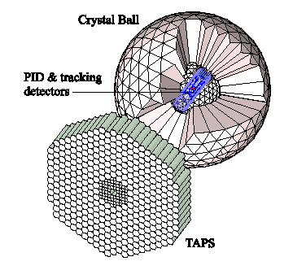
A2 DETECTOR SETUP Because of its high-granularity and large acceptance the CB/TAPS setup is a suitable detector system for measurements of reactions with multi-photon final states like in π⁰ → 2γ, η → 2γ or η → 3π⁰ → 6γ

Slide 9
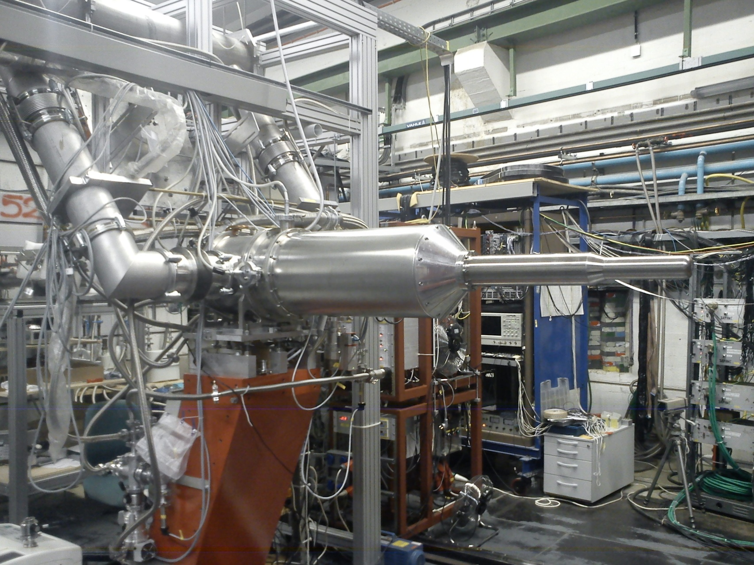
Mainz polarized target

Slide 10
Dubna-Mainz Frozen Spin Target (available since 05.2010).
For the double polarization measurements planned with the Crystal Ball detector on polarized protons and deuterons a specially designed, large horizontal ³He/⁴He dilution refrigerator has been built in cooperation with the Joint Institute for Nuclear Research. Superconducting holding magnet permits longitudinal and transverse polarizations. Butanol and trityl doped deuterated butanol are used in experiments.
Main parameters are:
At a total tagged photon flux of 5 × 10⁷ and a target temperature 30 mK relaxation times of about 2000 hours was obtained.
Target proton density in 2 cm diameter cell: N_{T}≈9.1×10²² cm⁻² (including dilution and filling factors).
Maximum polarizations at 2.5 T are: for protons ≈90%, for deuterons ≈75%.

Slide 11
EXPERIMENTS
1. Experimental verification of the GDH sum rule
Prediction on the absorption of circularly polarized photons by longitudinally polarized hadrons
where к is anomalous magnetic moment, ν_{thr} is pion production threshold (for nucleons) or photodisintegration threshold (nuclei).
2. Helicity dependence of meson photoproduction
Detailed information on resonance properties and multipole transition amplitudes can be obtained by investigation of the helicity structure of different channels:
π⁰ production , (D₁₃(1520), F₁₅(1680))
η production, S₁₁(1535), D₁₃(1520)),
double-pion production, D₁₃(1520), P₁₁(1440), P₁₁(1710)), …..

Slide 12
Electromagnetic polarizabilities
Fundamental properties of composite systems.
Response of the system to applied electric or magnetic field.
Magnetic moments provide information about the ground-state properties of a system, polarizabilities are related to its excited states. Nucleon polarizabilities cause a deviation of the Compton cross section from that predicted for a point-like Dirac particle.
Notes:
3 Electromagnetic polarizabilities are fundamental properties of composite systems such as molecules, atoms, nuclei, and hadrons. They describe the response of the system to applied electric or magnetic field. Whereas magnetic moments provide information about the ground-state properties of a system, polarizabilities provide information about the excited states of the
system.
To understand the scale of these quantities, let us indicate, that the polarizability of ideally conducting sphere equals ~1/4 volume. For atomic systems, polarizabilities are of order 1/10 atomic volume. For hadrons, polarizabilities are much smaller than the volume, typically of order 10⁻⁴ fm³, because of the greater strength of the QCD force as compared to the electromagnetic force. Measurements of polarizabilities provide an essential test for theories of hadron structure and QCD.
12

Slide 13
Compton scattering Hamiltonian (expansion in powers of E and H and their derivatives )
Notes:
5 In expansion of the Compton scattering amplitude in incident photon energy zero-order terms contain the mass and the charge of the proton, while first-order terms include the anomalous magnetic moment, and the second-order terms include electric and magnetic scalar polarizabilities α and β, which
13

Slide 14
Compton scattering Hamiltonian( expansion in E and H and their derivatives )
Subscripts give multipolarities of incident and scattered photons
To date, these four observable have not been individually determined. Only two linear combinations of them have been measured.
Notes:
7 Spin structure of the nucleon manifests itself in the third-order terms, which contain four spin (or vector) polarizabilities γ, describing the response of the nucleon spin to a changing electromagnetic field. The subscripts correspond to combinations of the incident and scattered photon multipolarities. Unlike scalar polarizabilities, the spin polarizabilities have not such intuitive physical interpretation. Some analogy of spin polarizabilities in the classic physics could be the Faraday effect, i.e. a rotation of the polarization plane of the light, propagating an optically active medium.
(Involved one field derivations with respect to time or space.)
14

Slide 15
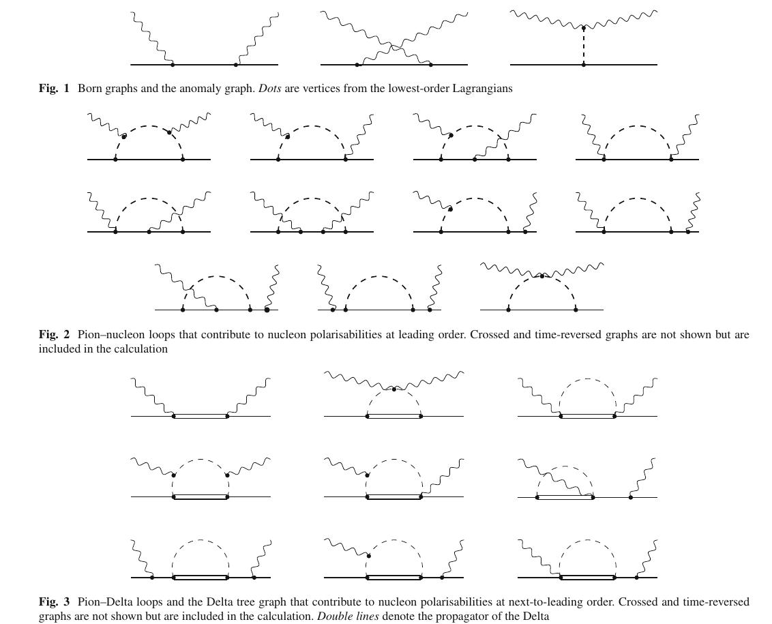
LO, NLO, NNLO in ChPT ( V. Lensky et al EPJ C75 (2015)

Slide 16
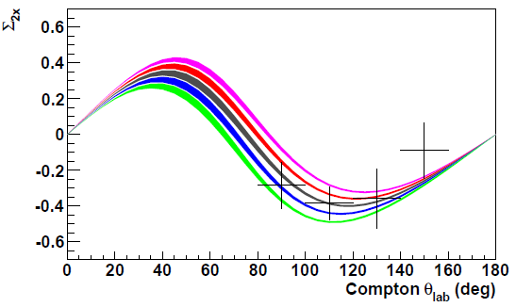
Σ_{2x} asymmetry (theory and Mainz experiment (2015))
Σ_{2x} for E_{γ} =273 – 303 MeV. The green, blue, brown, red and magenta bands are for γ_{E1E1} equal to –6.3, –5.3, –4.3, –3.3, and –2.3, respectively.
(The width of each band represents the propagated errors from α, β, γ₀, and γ_{π} combined in quadrature*.)
* D. Drechsel, B. Pasquini, and M. Vanderhaeghen, Phys. Rep. 378, 99 (2003).
16
Notes:
27 The measured asymmetries Σ_{2x} are shown in the following slide. In addition to statistical uncertainties, the systematic uncertainties from both beam and target polarizations are incorporated in the error bars shown. The curves are from a dispersion theory calculation for values of γ_{E1E1} ranging from -6.3 to -2.3∙10⁻⁴fm⁴. Each curve holds α, β, γ₀ and γ_{π} fixed at experimental values, and γ_{M1M1} fixed at 2.9∙10⁻⁴fm⁴. The width of each band represents the propagated errors from α, β, γ₀ and γ_{π} combined in quadrature. The curves graphically demonstrate the sensitivity of the asymmetries Σ_{2x} to γ_{E1E1}.
16

Slide 17
MAIN RESULTS from MAINZ
1. First ever measurements of the beam asymmetry Σ3 for Compton scattering below pion photoproduction threshold have been performed . Determination of scalar polarizabilities of the proton. ( An alternative to unpolarized Compton scattering)
2.The differential cross sections of the reactions γp→ηp and γp→ ƞʹp have been measured from their thresholds up to the center-of-mass energy W = 1.96 GeV. The observed cusp-behavior was explained by
contribution of the N*(1895)1/2− nucleon resonance. (MAID2017)
3. Most precise, at present, data on the η→3π⁰ decay were obtained from these measurements, providing a sensitive test for the magnitude of isospin breaking in QCD.

Slide 18
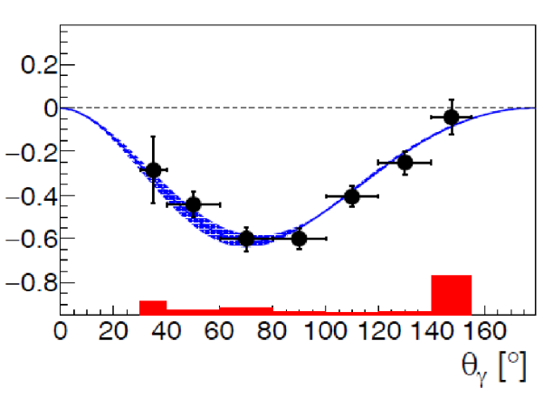
Toward scalar polarizabilities
Beam asymmetry Σ₃ in the range 119-139 MeV.
Points – experiment, the curve – ChPT;
V. Sokhoyan, N.Borisov, G.Gurevich et al. Eur. Phys. J. A 53 No. 2 (2017) 14.

Slide 19
PUBLICATIONS with coauthors from Dubna: N.S. Borisov, G.M. Gurevich, V.L. Kashevarov, A.B. Lazarev, A.B. Neganov, Yu.A. Usov.
1. V. Sokhoyan et al.[A2 Collabortion] Determination of the scalar polarizabilities of the proton using beam asymmetry Σ₃ in Compton scattering. Eur. Phys. J. A 53 No. 2 (2017) 14.
2. V.L. Kashevarov, et al. .[A2 Collabortion] Study of η and η photoproduction at MAMI. Phys. Rev. Lett. 118 Iss. 21, 212001 (2017).
3. S. Prakhov, et al. [A2 Collabortion] High-statistics measurement of the η 3π⁰ decay at the Mainz Microtron. Phys. Rev. C 97 No. 6, 065203 (2018).
4. P. Adlarson et al., . [A2 Collabortion] Measurement of the ω π⁰e⁺e⁻ and η e⁺e⁻γ Dalitz decays with the A2 setup at MAMI. Phys. Rev. C 95 (2017) 035208.
5. P. Adlarson et al., . [A2 Collabortion] Measurement of the π⁰ e⁺e⁻γ Dalitz decay at the Mainz Microtron. Phys. Rev. C 95 (2017) 025202.
PRL -1, PRC -6, PLB-3, EPJ-1

Slide 20
6. L. Witthauer et al., Helicity-dependent cross sections and double-polarization observable E in η hotoproduction from quasifree protons and neutrons. Phys. Rev. C 95 (2017) 055201.
7. M. Dieterle et al., First measurement of the polarization observable E and helicity- dependent cross sections in single π⁰ photoproduction from quasi-free nucleons. Phys. Lett. B 770 (2017) 523.
8. P. Adlarson et al., Measurement of the decay η^{I} π⁰π⁰η at MAMI. Phys. Rev. D 98 (2018) 012001.
9. M. Dieterle et al., Photoproduction of π⁰ Mesons off Protons and Neutrons in the Second and Third Nucleon Resonance Region. Phys. Rev. C 97 (2018) 065205.
10. A. Ka¨ser et al., First measurement of helicity-dependent cross sections in π⁰η photo- production from quasi-free nucleons. Phys. Lett. B 786 (2018) 305.
11. M. Bashkanov et al., Deuteron photodisintegration by polarized photons in the region of the d∗(2380). Phys. Lett. B 789 (2019) 7.

Slide 21
II. SPASCHARM
Goals:
Study of the spin dependent dynamics of strong
interaction and the spin structure of the proton.
A study of the spin effects in dozen of reactions with different polarized beams or/and targets (inclusive, exclusive reactions and elastic scattering will be studied simultaneously).

Slide 22
Motivation for study of asymmetries
ZGS
AGS
FNAL
RHIC
C. A. Aidala, et al., Rev. Mod. Phys. 85 (2013) 655
Asymmetry of inclusive production of pions is non- zero and practically does not depend on energy

Slide 23
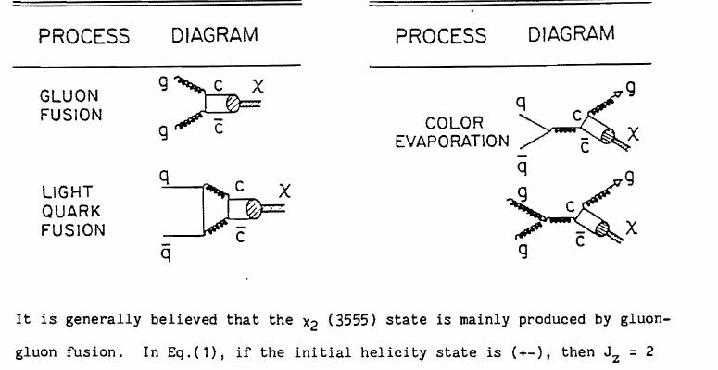
2. Determination of the gluon contribution ΔG/G(x) to the proton spin at large values of the Bjorken variable x.
Gluon contribution to the proton spin first was proposed by
M.E. Beddo et al, Fermilab Proposal N 838, 1991
Double-spin asymmetry A_{LL} measurements in the process:
p→ + p→ → χ_{c2} (J/Ψ) + X, (χ_{c2} → J/Ψ + γ) to study ΔG/G(x).
Simultaneously A_{NN} and A_{N} in J/ψ, χ_{c1}/χ_{c2} – production will be studied.
- A_{NN} measurements for Drell-Yan pairs to study transversity h(x).

Slide 24
The gluon contribution ΔG to the proton spin from the RHIC data analysis ( E.R. Nocera et al. Nucl. Phys.B 887 (2014))
ΔG = 0.20⁺0.06₋0:07 for DSSV14
ΔG = 0.23±0.06 for NNPDFpol1.1
integrated over x= 0.05-1 at Q² = 10 GeV².
Results are model dependent.
SPASCHARM measurements will give a unique
possibility to measure ΔG directly.

Slide 25
For future perspective:
Search for CP violation in the CP neutral antip p-p system with polarized both protons and antiprotons. A new perspective for studying CP -violation, inaccessible for unpolarized particles.
Recent data from the LHCb give for the CP violation in charm particles decay:
ΔA_{CP} = (-0.154±0.029)% ( 10⁻³ )

Slide 26
Dubna polarized frozen-spin target at Protvino
The authors of the project suggest to use the modernized frozen-spin target based at the one, developed earlier at LNP JINR.
In the DNP mode, the magnet poles are in the position when the magnetic circuit is closed, the magnetic field is as high as 2.5 T and the homogeneity is no worse than 10⁻⁴ within the target volume. When the poles are open, the magnetic field is 0.4 T in a gap of 20 cm and the homogeneity is 10⁻². Target material is 1,2-propanediol C3H8O2 (volume 20 cm3) with a paramagnetic Cr(V) impurity. The maximum obtained proton polarization was 93% and 98% for positive and negative values, respectively. In the DNP mode, T = 200 mK.
A transistor with quartz oscillator with output power of 400 mW at a frequency of 67 GHz is used for the dynamic build-up of polarization. In the frozen spin mode the target is maintained at a temperature of 20 mK in the holding magnetic field of 0.45 T. Under these conditions, the spin relaxation time was 1200 h for positive polarization and 800 h for negative polarization.
The target polarization measurement is carried out using a multipurpose Q-meter with phase shift detector at operating frequency of about 102 MHz.

Slide 27
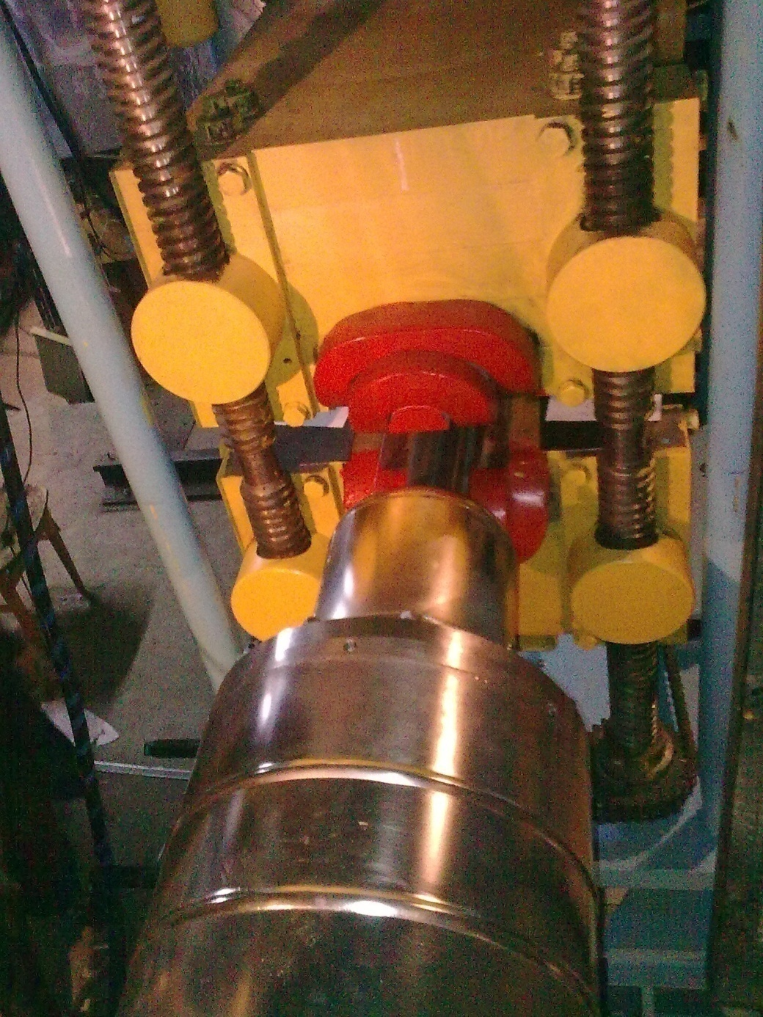
The polarized target magnet

Slide 28
Main results from SPASCHARM
First data on single-spin asymmetries in the SPASCHARM experiment were taken in 2018 (analysis just started).
Publications:
1. Study of single-spin asymmetries with polarized target at the SPASCHARM experiment at U-70 accelerator V.V. Abramov (Serpukhov, IHEP), … N.S. Borisov, A.B. Lazarev, A.B. Neganov, O.N. Shchevelev, Y.A. Usov … et al.. 2017. 5 pp. Published in J.Phys.Conf.Ser. 798 (2017) no.1, 012096.
2. The polarized proton and antiproton beam project at U-70 accelerator V.V. Abramov (Serpukhov, IHEP & Kurchatov Inst., Moscow) et al.. 2018. 7 pp. Published in Nucl. Instrum. Meth. A 901 (2018) 62.
3. Measurements of the Beam and Target Analyzing Powers and Spin Correlation Parameter ANN in Elastic pp Scattering at 45 Gev/c. V.V. Abramov (Serpukhov, IHEP) et al.. 2018, Published in KnE Energ. Phys. 3 (2018) 326.

Slide 29
4. Comparative study of the inclusive asymmetries induced by polarized protons and antiprotons at 16 GeV/c at the U–70 accelerator V.A. Okorokov (Moscow Phys. Eng. Inst.) et al.. Oct 16, 2017. 7 pp. Published in J. Phys. Conf. Ser. 938 (2017) no.1, 012014.
5. Polarized proton and antiproton beams for the SPASCHARM experiment at U-70 accelerator. I.I. Azhgirey et al, Published in J. Phys. Conf. Ser. 798 (2017) no.1, 012177.
6. Beam polarimetry at the SPASCHARM experiment at IHEP U-70 accelerator A.A. Bogdanov (Moscow Phys. Eng. Inst. & Kurchatov Inst., Moscow) et al.. 2017. 5 pp. Published in J. Phys. Conf. Ser. 798 (2017) no.1, 012179.
7. Simultaneous measurements of spin observables AN and ANN in elastic pp scattering (extension of the SPASCHARM program at U-70). V.V. Abramov (Serpukhov, IHEP) et al.. 2017, Published in J. Phys. Conf. Ser. 938 (2017) no.1, 012006.

Slide 30
III. NN- and NNN-interactions
Modern nuclear forces connected to QCD are developing within the ChPT. The NN- and 3NFs- are produced on the same footing using spontaneously broken chiral symmetry. Fundamental low energy constants (LEC) have to be extracted from experimental data on the few–nucleon (hadron) systems. 3NFs
Three-nucleon forces (a,b,c) and contact MEC (d) appearing in ChPT at NNLO.
[C.Hanhart, U. van Kolck, G.A. Miller, PRL 85 (2000) 2905].
3H binding energy, Nd-Nd, NN ->πNN (ANKE@COSY), πNN-> γNN,
NN->deν_{e} , µd->nnν_{µ}

Slide 31
∆ϭ_{L}(nd), ∆ϭ_{T} (nd) as a source of the 3NFs LECs
∆ϭ_{L}(nd) =ϭ_{p} - ϭ_{a} is the difference in the nd total cross section for longitudinally polarized beam and target, parallel and anti-parallel. Similar observable for the transversal polarizations, ∆ϭ_{T}(nd).
Contribution of the 3NFs to ∆ϭ_{L} is of 5-10% as compared to pure NN potential (H. Witala et al. 1999)
The ∆ϭ_{L} (nd) was measured firstly at TUNL for incident neutron energies of 5.0, 6.9 and 12.3 MeV (R.D. Foster et al. PRC 73 (2006)
However, “the obtained data are not of sufficient precision to distinguish the presence or absence of 3NFs contributions to the cross-sections ".

Slide 32
∆ϭ_{T} (nd) will be measured at the Charles University Nuclear Center (Prague) using the transmission method with the polarized neutron beam.
Similar measurements of ∆ϭ_{L}(np) and ∆ϭ_{T} (np) were done yet with P_{z}=(-13.5 ± 1.4)%.
A necessary modernization is in progress to increase
● the deuteron target polarization and
● the intensity and polarization of the neutron beam.

Slide 33
The reaction T(d, n)⁴He with polarized deuterons of
100-150 keV is used to produce the polarized neutron beam (Kaminsky’s method, PRL, 23 (1969) 819).
To produce the polarized deuteron beam:
The first step, channeling of the unpolarized deuteron (200 keV) beam through magnetized Ni film which contains polarized electrons. The Sona method (P.G. Sona, Energ. Nucl. 14 (1967) 295) provides a maximal transfer of the electron polarization to deuterons in the atomic beam.
The second step, usage of the d+³H->⁴He+n reaction. The14-MeV neutrons are produced (at the angle of 90̊ relatively deuteron spin direction ) with almost the same vector polarization as the initial deuterons.

Slide 34
The deuteron vector polarization is measured preliminary using the reaction D(d, p)T .
Knowledge of the tensor polarization P_{zz} allows us to calculate P_{e} =-3P_{zz} and then to find the neutron polarization
P_{n} ≈ P_{d} =2/3P_{e} in the T(d, n)⁴He.
The P_{zz} is found by measurement of the reaction T(d, n)⁴He cross section:
Ϭ(θ)= Ϭ₀[1-0.25(3cos²θ-1)P_{zz}],
here θ is the c.m.s. angle between the d- spin and α-particle direction.
The result is P_{zz} =-0.12±0.04 at T_{d}= 200 keV, therefore, p^{n}_{z}≈0.25.

Slide 35
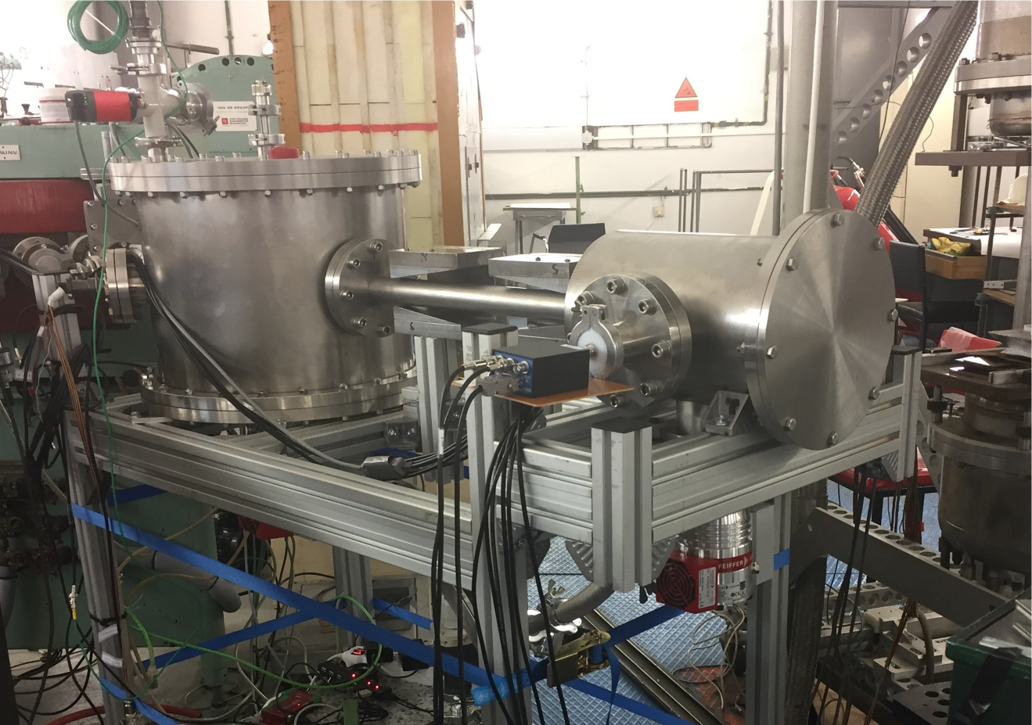
Experimental setup from DLNP.

Slide 36
Error estimation
If the neutron detector efficiency is 10⁻² and solid angle of the polarized target 3×10⁻⁴, then in order
to get statistical error of 7 mb for ∆ϭ_{T} , it is necessary 180 hours of data taking.
At a neutron energy of 14 MeV ∆ϭ_{T} ≈ 300 mb.
An effect of 3NFs decreases the ∆ϭ_{T} by 20 mb .
Thus, the 3NFs effect can be detected.

Slide 37
Main results of the NN part
An experimental setup has been developed
to produce the beam of polarized deuterons at 100- 400 keV
and
to measure tensor and vector polarizations of the deuterons.
2. The deuteron tensor polarization was measured via
the reaction T(d, n)⁴He.
Publications:
Yu.A. Plis et al., Research and Development of the Polarized Deuteron Sources for the Van de Graaff Accelerator. PEPAN 16 (2019) 256-263;
Preprint JINR E13-2018-69. Dubna, 2018;
Report SPIN2018, to be published
This work was supported in part by European Regional
Development Fond, Project “Van de Graff Accelerator…” ,
N0 CZ.02.1.01 (2017-2019)

Slide 38
Working plan: 2020- 2021- 2022
SPASCHARM
Experiments will be carried out using negative particles beams and the Dubna polarized frozen target.
0. Single spin asymmetries will be measured in inclusive production of charged pions and ρ (770), ω(782), η’(958), f0(980), a0(980), f2(1270)…
1. A possibility to measure polarization of hyperons and the alignment of vector mesons will be investigated.
2. Multichannel Cherenkov counters will be added to measure spin effects with K-mesons.

Slide 39
Working plan: 2020- 2021- 2022
GDH
0. New frozen spin target will be commissioned for experiments with Crystal Ball/ELSA facility at the Bonn University.
1. Precision large-acceptance measurements of the beam-spin asymmetry for deuteron photodisintegration in the region of the dibaryon resonance d∗(2380).
2. Study of the spectra of the baryon resonances by measurements of spin observables in meson photoproduction
NN
0.Experiments with channeling of the deuterons at the stand of the polarized deuteron source.
1. Build up of the polarized neutron source on the base of (un)polarized deuteron source and to join it with the frozen polarized deuteron target. Precise measurement the vector and tensor polarizations of the deuterons. Preparation of special devices for usage of new target material based on Trityl-doped butanol.
2. To prepare measurements of the neutron polarization via n ⁴He
scattering.

Slide 40
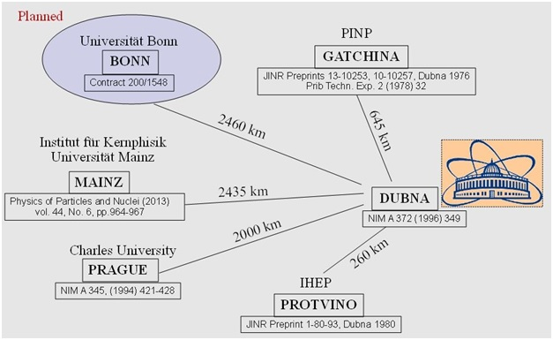
MAP OF ACTIVITY

Slide 41
Form №29
Estimate of the expenses for the Project "SPASCHARM-GDH-NN" (k$)
 | Title of expense item | Total cost | 2020 | 2021 | 2022
1 | R & D agreement expenses | 12.0 | 8.0 | 2.0 | 2.0
2 | Job cost at the LNP’s experimental shop | 3.0 | 1.0 | 1.0 | 1.0
3 | Materials | 66.0 | 22.0 | 22.0 | 22.0
4 | Transport expenses | 4.5 | 1.5 | 1.5 | 1.5
5 | Unforeseen expenses | 6.0 | 2.0 | 2.0 | 2.0
6 | Electronic instruments | 45.0 | 15.0 | 15.0 | 15.0
7 | Travel expenses | 24.0 | 8.0 | 8.0 | 8.0
 | inclusive | 124.5 | 41.5 | 41.5 | 41.5
 | a) to nonruble zone countries | 108.0 | 36.0 | 36.0 | 36.0
 | b) to ruble zone countries | 12.0 | 4.0 | 4.0 | 4.0
 | c) visits to JINR | 4.5 | 1.5 | 1.5 | 1.5
 |  | 285.0 | 99.0 | 93.0 | 93.0

Slide 42
THANK YOU
FOR YOUR ATTENTION!

Slide 44
GDH. Results (Mainz, Bonn)
Protons: Theory GDH_{Int}=204 μb
Exp. (255 ± 5 ± 12) μb (0.2 – 1.8) GeV
Neutrons: Theory GDH_{Int}=233 μb
Exp. 197 μb (0.2 – 1.8) GeV

Slide 45
MAMI electron accelerator
Notes:
14 Block diagram of MAMI C accelerator is shown in the slide. It produces continuous beam of electrons with maximum energy over 1.5 GeV and longitudinal polarization about 85%.
45

Slide 46
Experiments are conducted with the photon beam of the electron accelerator MAMI-C, Mainz, Germany. Main experimental apparatus:
Tagged photon beam (unpolarized, circular and
linear polarization).
2) Detector system:
4π- photon spectrometer CB/TAPS (100% solid angle covering for particles decaying into two or more secondary photons, 97% of 4 for single photons, detection of neutrons and charged particles is also possible at restricted energy regions.
- Crystal Ball (CB) overlaps polar angle range (20 - 160) and TAPS: (1 - 20). CB consists of 672 NaI(Tl) crystals with 15.7 radiation lengths.
- TAPS consists of 366 BaF2 crystals with 12 radiation lengths and is supplemented by 5-mm plastic scintillator in front of each module (VETO).

Slide 47
Spin polarizabilities – Theory and Experiment
γ | ChPT1 | ChPT2 | K-matrix | Lχ | χEFT | DR1 | DR2 | DR3 | Experiment with LEGS Σ₃ data* | Experiment with Mainz Σ₃ data**
E1E1 | -5.4 | -1.3 | -4.8 | -3.7 | -1.1 | -3.4 | -4.3 | -3.8 | -3.5 ± 1.2 | −5.0 ± 1.5
M1M1 | 1.4 | 3.3 | 3.5 | 2.5 | 2.2 | 2.7 | 2.9 | 2.9 | 3.16 ± 0.85 | 3.13 ± 0.88
E1M2 | 1.0 | 0.2 | 1.8 | 1.2 | -0.4 | 0.3 | -0.02 | 0.5 | -0.7 ± 1.2 | 1.7 ± 1.7
M1E2 | 1.0 | 1.8 | 1.1 | 1.2 | 1.9 | 1.9 | 2.2 | 1.6 | 1.99 ± 0.29 | 1.26 ± 0.43
Experimental results for the multipole basis spin-polarizabilities are from the combined analysis of Σ_{2x} (Mainz data) and Σ₃ (LEGS* or Mainz data**) asymmetries using a dispersion model calculation***. The size of the experimental uncertainties is too large to discriminate between these various predictions. One of the largest uncertainties in the analysis is due to the error on γ_{π}, ±1.8. The data on the asymmetry Σ_{2z}, should reduce the uncertainty by a factor of approximately four, which should reduce the uncertainty on M1M1 by a factor of approximately two. Polarizabilities (in units 10⁻⁴ fm⁴): * G. Blanpied et al. (The LEGS Collaboration), Phys. Rev.C 64, 025203 (2001). ** Preliminary. *** D. Drechsel, B. Pasquini, and M. Vanderhaeghen, Phys. Rep. 378, 99 (2003).
Notes:
33 Until now, an analysis of two measured asymmetries has been performed. Results for all four spin-polarizabilities obtained from the combined fit of Σ_{2x} and Σ₃ asymmetries, using the dispersion model calculation, are presented in the last column of the Table (see slide 35), along with previous results for γ₀ и γ_{π}.The table shows generally good agreement between the measured spin-polarizabilities and the predictions of the dispersion theory calculations, the K-matrix theory calculation, and the chiral Lagrangian calculation. The size of the experimental uncertainties, however, is yet too large to discriminate between these various models.
47

Slide 48
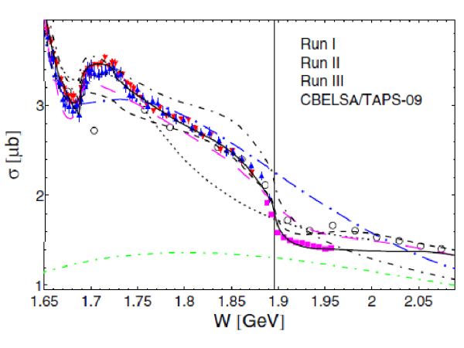
Fig. 2. γp→ηp total cross section.

Slide 49
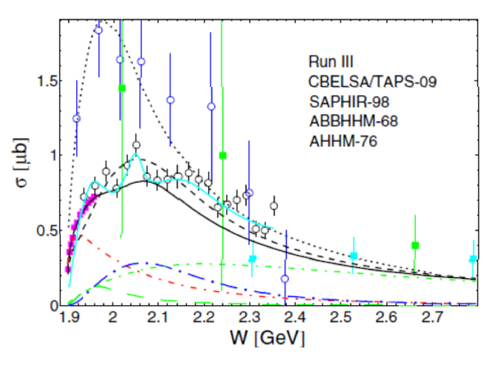
Fig. 3. γp→ ƞʹp total cross section.

Slide 50
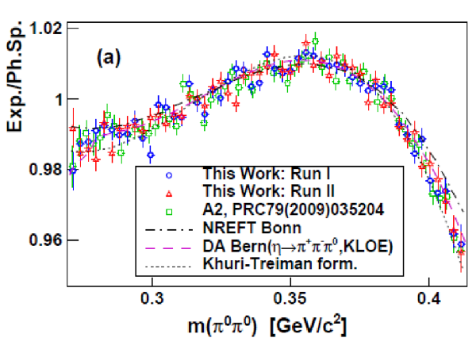
S. Prakhov,…. N.S. Borisov, G.M. Gurevich, et. Al
Phys. Rev. C 97 No. 6, 065203 (2018).

Slide 51
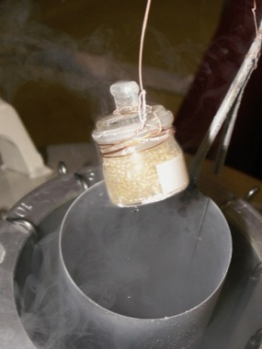
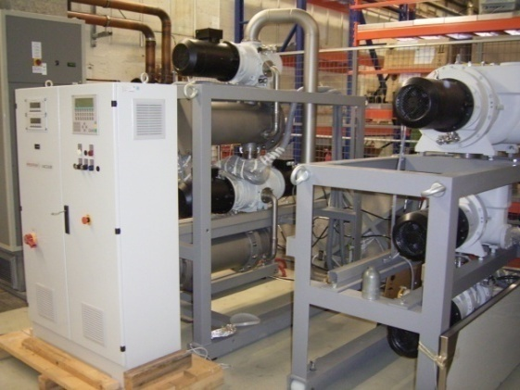
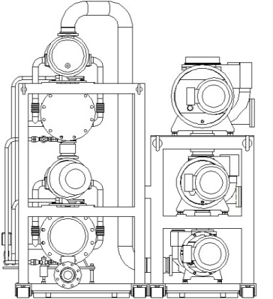
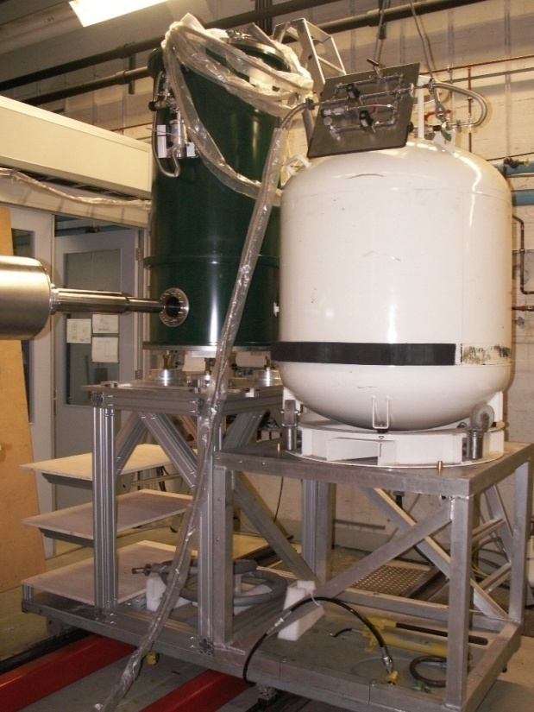
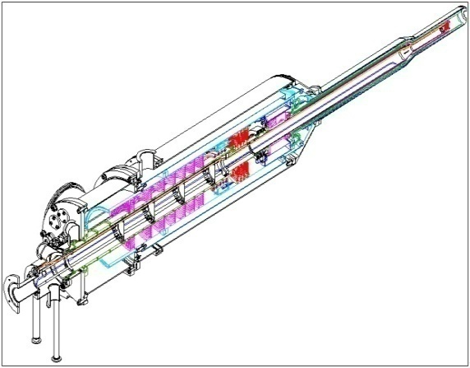
He³/He⁴ Roots
4000m³/h
Vacuum system
Components of the polarized target
for the Crystal Ball detector
Similar to Bonn Target
[C.Bradtke et al., NIM A436, 430 (1999)]
Targetmaterial
[Meyer, Bochum]
H-Butanol
D-Butanol
Mikrowaves
70GHz
Dynamic
Nuclear
Polarization
Horizontal He³/He⁴ Dilutionrefrigerator
(25mKelvin)
with internal
Holding coil
NMR-Apparatus
106MHz
Polarisation meas.
Superconducting
Polarization magnet
5Tesla

Slide 52
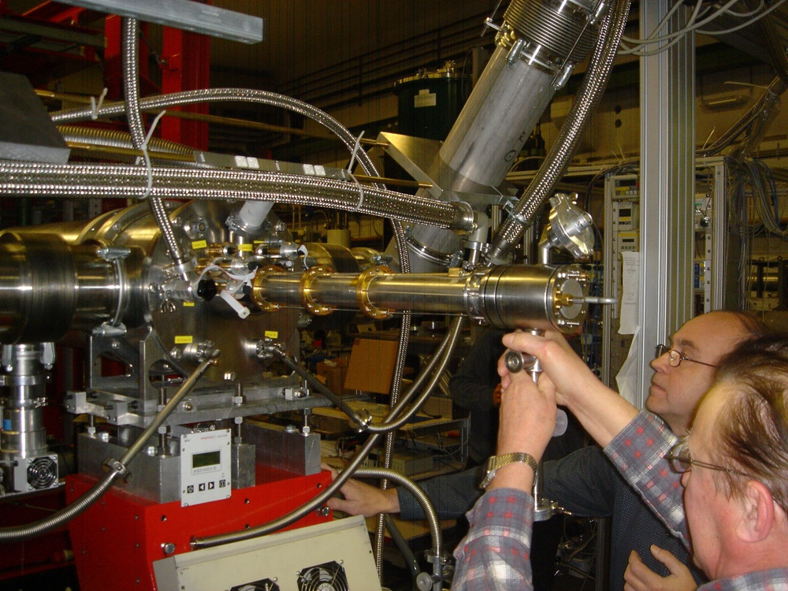

Slide 53
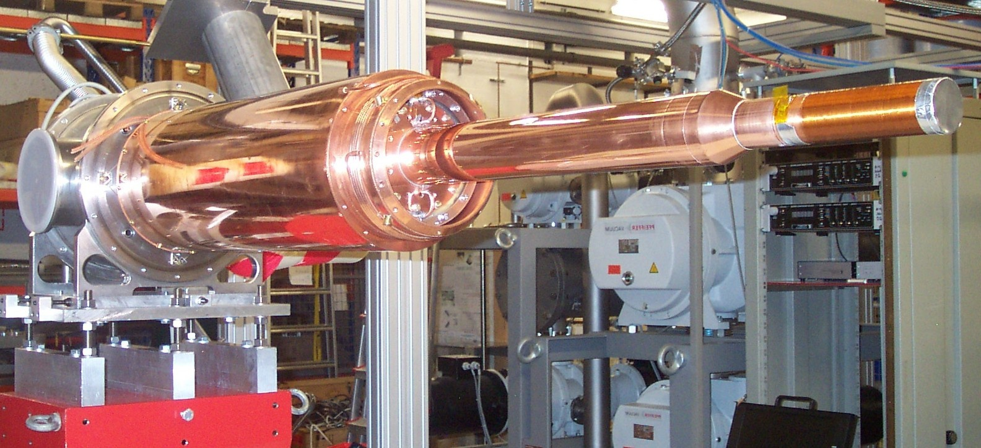
Internal longitudinal Holding coil (solenoid coil manufactured of 0.227-μm multifilamental NbTi cable and consisting of four layers, each having 600 turns wound around a 0.3-mm thick copper holder, T ≈ 1.5 K)

Slide 54
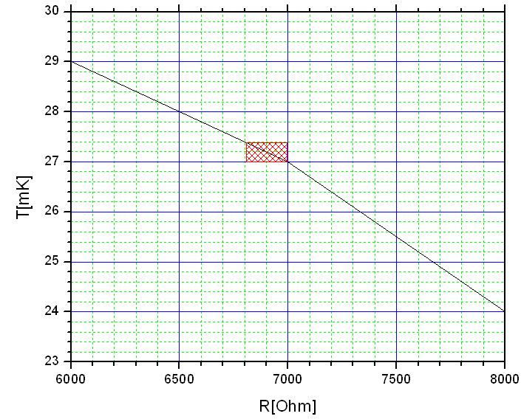
Cryostat Performance
T=24mK
T=27mK
T=29mK
Δt=40h
Temperature stability:
ΔT ~ +- 0.2mKelvin (one day)
(typical one week measurement period).

Slide 55
SPASCHARM spectrometric magnet

Slide 56
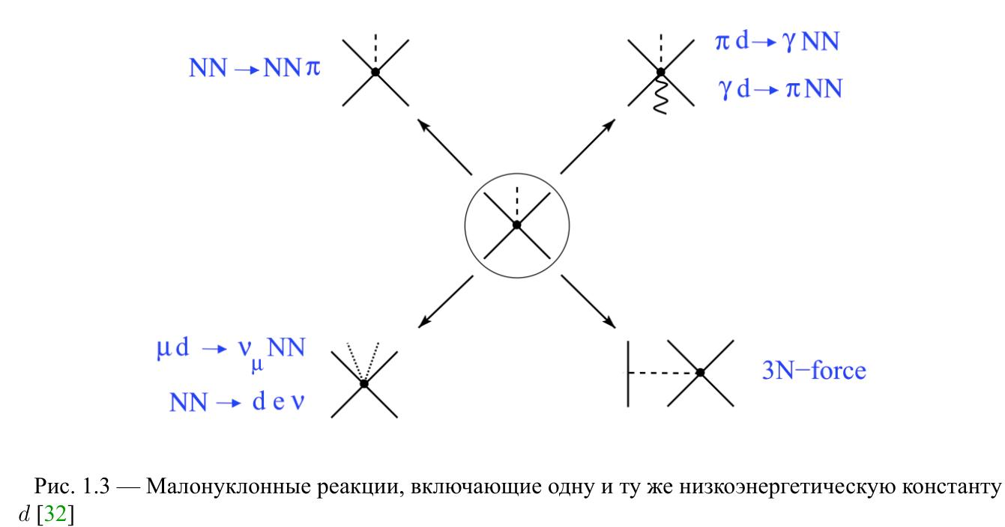
Contact term С_{D}
The pp->{pn}_s π⁻ reaction was used at ANKE@COSY to get the c_{D} term

Slide 57
Working plan
2020:
GDH Commissioning of the new frozen spin target for experiments with Crystal Barrel/ELSA facility at the Bonn University.
SPASCHARM Data taking run will be carried out using a negative particle beam and the Dubna polarized frozen target. The magnet of the polarized target will be optimized (it is necessary to achieve field uniformity at the level of 0.012%). The technical design of the polarized beam-line will be finished while the construction will started (subject to appropriate funding).
NN Experiments on channeling of the deuterons at the stand of the polarized deuteron source.
2021
GDH Precision large-acceptance measurements of the beam-spin asymmetry for deuteron photodisintegration in the region of the exotic six-quark state d∗(2380).
SPASCHARM Data taking run will be carried out using a negative particle beam and a Dubna polarized frozen target. Single spin asymmetries will be measured in inclusive production of charged pions. Conceptual design of the SPASCHARM experiment will be prepared and published (in Russian) as well as the proposal to study systematically spin effects in elastic reactions.

Slide 58
NN Build up of the polarized neutron source on the base of polarized deuteron source and to join it with the frozen polarized deuteron target. The exact measurement the vector and tensor polarizations of the deuterons.
Preparation of special devices for usage of new target material based on Trityl-doped butanol.
2022
GDH Study of the spectrum and properties of the baryon resonances through the measurements of the polarization observables in meson photoproduction.
SPASCHARM Single-spin asymmetry in inclusive production will be measured for such “lying on the surface” resonances like ρ (770), ω(782), η’(958), f0(980), a0(980), f2(1270). The possibility to measure the polarization of hyperon and the alignment of vector mesons will be investigated also. The concept of the polarized beam tagging system will be developed and prototypes of the detectors of the tagging system will be developed and tested.
NN To prepare apparatus for measurements of the neutron polarization via scattering on the ⁴He target.

