Slide 1
Geometry Database for the BM@N experiment: current status and plans
E. Alexandrov, I Aleksandrov, I Filozova

Slide 2
CBM & BM@N
Common features | Deferences
Approaches to the methods of simulations and reconstructions | The sets of Detectors
Software: FAIRSOFT, FAIRROOT RunManager: FairRunSim for the simulation runs FairRunAna for the reconstruction or analysis runs
FairRoot
CBM GeometryDB
BM@N GeometryDB
CBMRoot
BMNRoot

Slide 3
Geometry Database. Current Situation

Slide 4
Basic Definitions
Geometry Module
File in ROOT format with content of detector geometry
Setup Module
Geometry module, link to the mother geometry module, its placement in the mother module (transformation matrix or object of class TGeoMatrix)
Setup
Combination of setup modules which represents the full geometry

Slide 5
CBM Setup Structure

Slide 6
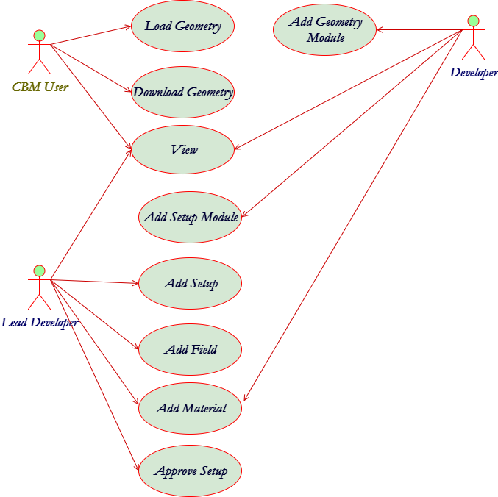
Geometry Database. Use Cases
The Geometry DB is used:
to provide interfaces to view, retrieve and update modules and setups
to store setups as combination of setup modules, magnetic fields and materials
to store setup modules as ROOT files and Transformation matrix

Slide 7
The implementation
GUI (Graphical User Interface) implemented as Web-interface.
  View;
  Edit;
  Download.
API (Application Programming Interface) implemented as macros of the ROOT environment. Any macro can be used as executable file or can be called from other ROOT macros.

Slide 8
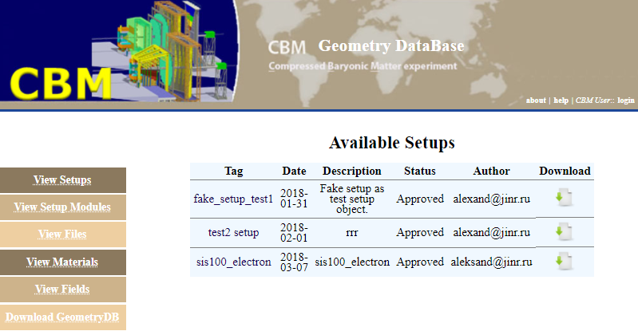
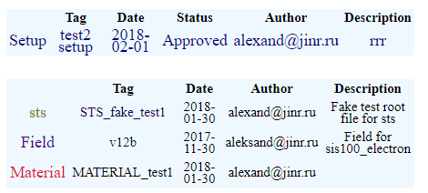

Web-interface. View Mode

Slide 9
Macros
Signature | Description | Call Example | Comment
void getSetupList(); | Get the list of available setups. Print the list of available setups including tag, date of creation, author and description parameters for each approved setup. | getSetupList.c(); | Return the available setups’ list
bool loadSetup(const char* setupTag, const char* moduleName); | Load setup into the CBM/BMN ROOT framework. The Geometry can be used in ROOT framework afterwards. Return FALSE if setup is not loaded, and TRUE if the loading is successful. | bool res = loadSetup(“sis100_electron”, “*”); | “*” – all setup modules to be loaded
bool loadSetup(const char* setupTag, int moduleId); | Load setup into CBM/BMN ROOT environment by module Id to load setup into the CBM ROOT framework. The Geometry can be used in ROOT framework afterwards. Return FALSE if setup is not loaded, and TRUE if loading is successful. | bool res = loadSetup(“sis100_electron”,-1);
bool loadSetup(const char* setupTag, const char* moduleName, const char* xml); | Load setup into the ROOT environment. Geometry can be used in the ROOT environment after this operation. User can use xml file in order to move any setup module during loading. Return false if setup was not loaded because of errors and true if load is successful. | loadSetup("sis100_electron", ”*”, "local.xml") | xml file contains information on the setup modules and their shifts.

Slide 10
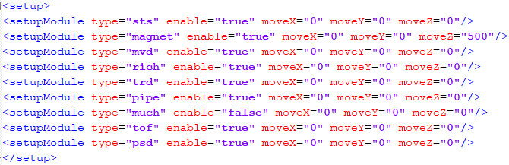
Load setup into CBM ROOT environment with possibility to move any module (3)
XML file content:
If some module type that belongs to setup is absent in XML file the correspond module will be loaded without additional moving.
Return value: Return false if setup was not loaded because of errors and true if load is successful.
Example: loadSetup("sis100_electron", ”*”, "local.xml")

Slide 11
Macros
Macros are used by users to obtain information about existing Setups and to load the needed Setup from Local Geometry DB into the memory of applications.
Requited following environment variables:
DBL_ROOT_PATH – path to data storage
DBL_FILE_PATH – path to sqllite file
TMP_PATH – path to temporary directory used by macro

Slide 12
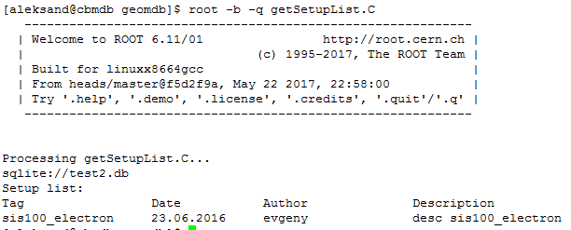
Get List Macros
getSetupList()

Slide 13
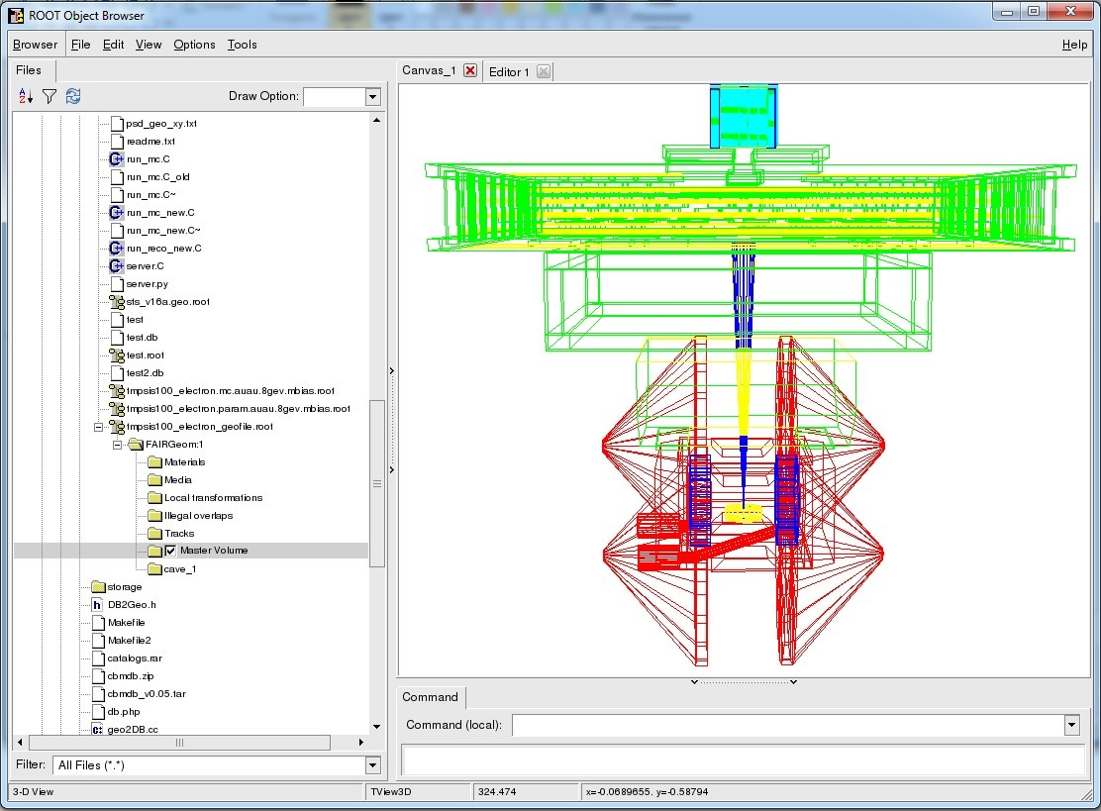
Load Setup Macro
gROOT->LoadMacro(“loadSetup.C”);
TString fun = "loadSetup(\"sis100_electron\“,-1)";
gROOT->ProcessLine(fun.Data());

Slide 14

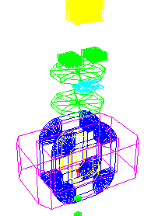
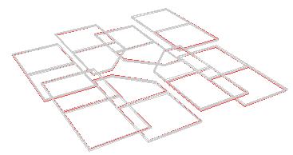
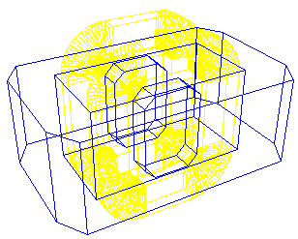
RunManager & Geometry
Simulation
Reconstruction
Other detectors
MWPC
Full Geometry
Silicon
Magnet
Import
FairRunSim
Import
Export
FairRunAna
Full Geometry

Slide 15
Verification of BM@N database (1)
Verification using simulation:
Filling Geometry DB with data for Run6
Run simulation using Geometry DB
Comparison of the original geometry and geometry from DB
Original geometry
Geometry from DB

Slide 16
Verification of BM@N database (2)
Verification using reconstruction:
Reconstruction using original geometry
Reconstruction using geometry file from DB
Comparison of the reconstructions results
Reconstruction for run 6 (10000 events) using original geometry
Reconstruction for run 6 (10000 events) using geometry from DB with simulation

Slide 17
Plans
New Modules (detectors)
  First version of WEB part for create new module is implemented by Irina
  API part for automatic use new modules in API required (in progress)
Change implementation of C++ for exist modules (add revision for module)
  WEB part
  API part

