Slide 1
Development of control system of the NICA
Evgeny Gorbachev on behalf of team LHEP, JINR

Slide 2
Content
Status of the CS infrastructure and services development.
Status of the CS subsystems hardware and software development and production.
Conclusions.

Slide 3
CS structure
Timing/synchronization
Operator interface
Thermometry
Magnetic cycle
Data archiving
Beam diagnostics
Network
Access control
Computing cluster
Vacuum
Monitoring
Distributed storage
Orbit correction
Logging
Services
Infrastructure
RF system
Electron cooling
Injection/extraction
Subsystems

Slide 4
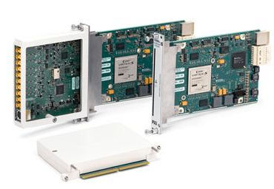
Realization details
Middleware - TANGO controls:
multiplatform CORBA based distributed object-oriented control system framework. Unified interface to any hardware or software.
Frontend layer - NI modular PXI platform:
acquisition boards, analog and digital I/O, signal generators, high speed digitizers and many others.
reconfigurable FPGA modules: FlexRIO, CompactRIO and others.
Recent changes: Developed custom PXIe modules for receiving, fanout and transmitting of trigger signals.
To do: PXI and CompactRIO WhiteRabbit modules.
Service layer – virtual machines running on failover computer cluster.
Client layer - web applications:
cross-platform, flexible, fast and convenient.
Data exchange with TANGO via custom Websockets and REST TANGO devices.

Slide 5
CS computer cluster
High availability and scalability:
Virtual machines are running on Proxmox VE cluster with VM images stored on redundant shared storage. Any VM can be started on any node.
Distributed shared storage CEPH - the data is replicated and distributed between nodes dynamically providing data redundancy, performance and scalability.
Recent changes:
Installed additional dual node Supermicro server for VMs hosting.
Installed additional 10Gb network switch for CEPH network – got rid of the last single point of failure. The data flow in CEPH network is balanced between 2 separate 10Gb switches in PortChannel mode.
Started migration of old servers from spinning disks to enterprise level 1Tb SSD disks which have better reliability (5 DWPD (drive writes per day during 5 years)), much more read/write throughput and IOPS.
To do: collider operation will require more servers for running VMs and especially for the data storage. It’s foreseen another 2 servers for VMs and 3 servers for the data storage.

Slide 6
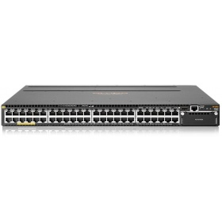
Network infrastructure
4 cabinets with total 8 switches Aruba 3810M. Each has 48 RJ-45 10/100/1000 ports.
Switches are stacked in pairs to increase the reliability.
Use of an IP range unroutable outside JINR.
Provide access from the external world via VPN.
Recent changes:
all 4 rack with switches are mounted along Booster.
Mounting and cabling are in progress and expected to be finished soon.
New fiber optics cables between buildings.

Slide 7
Access control, monitoring and logging
Zabbix to monitor everything (physical servers, VMs, CEPH and backup storage, network, UPSs, TANGO devices).
Custom Role Based Access Control (RBAC) service on the server side: allow device servers to check permissions of clients to execute commands, read or write attributes.
Centralized management of user’s permissions.
Authentication by username/password pair and/or location (IP address).
Simple usage for both TANGO device server and client application. No modifications to Tango library.
TANGO database protection.
Centralized logging service for TANGO devices has been developed.
Logging of all TANGO database changes – can be very useful for identification of the reason of problems.
Flexible interface for administrators to search or filter information in logs.

Slide 8
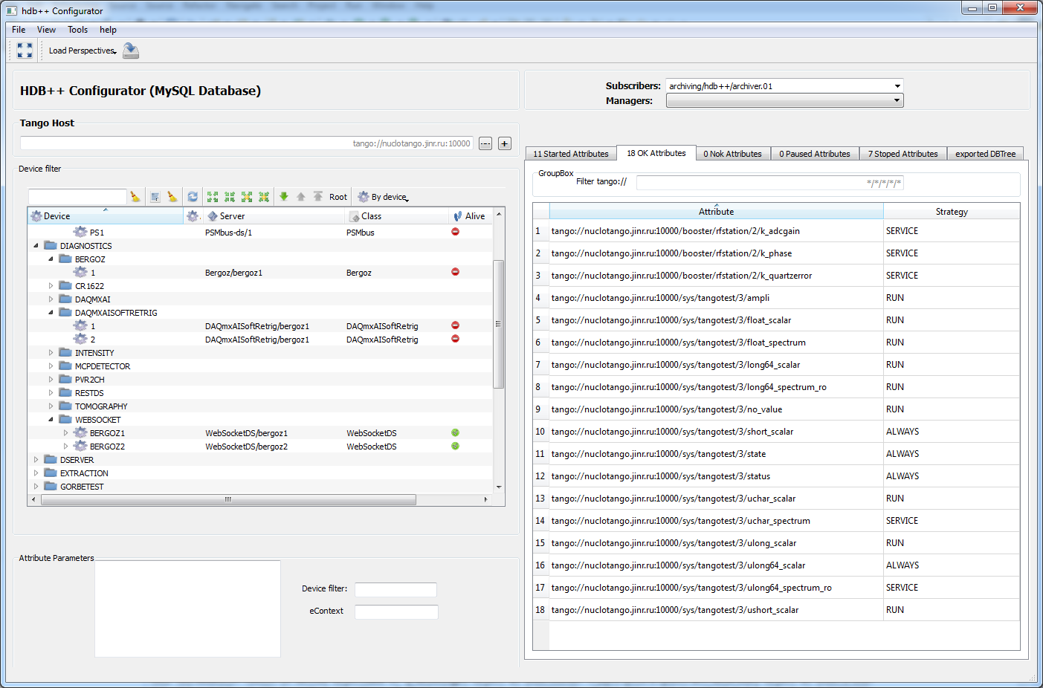
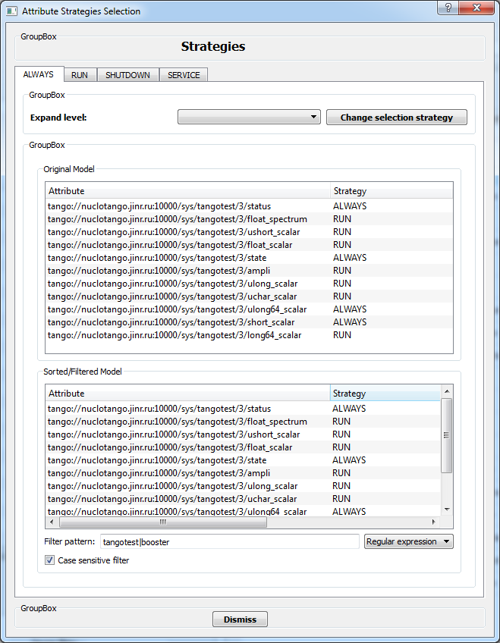
Data archiving
HDB++ archiving system is used for various CS data storage:
Stores TANGO attributes values into a database (SQL or noSQL).
Publish/subscribe via TANGO archiving events – storing only valuable information.
Highly scalable - multiple archivers to distribute load over few databases, servers and disk storages.
Recent changes: HDB++ configuration application has been developed. It allows to
manage all aspects of the archiving: add/remove/start/stop attributes, monitor archiving, distribute archiving to different subscribers.
To do: Working on database management functions: copy, move, delete stored data.

Slide 9
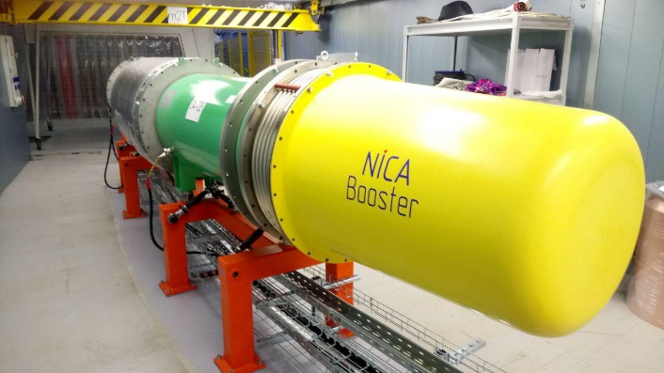
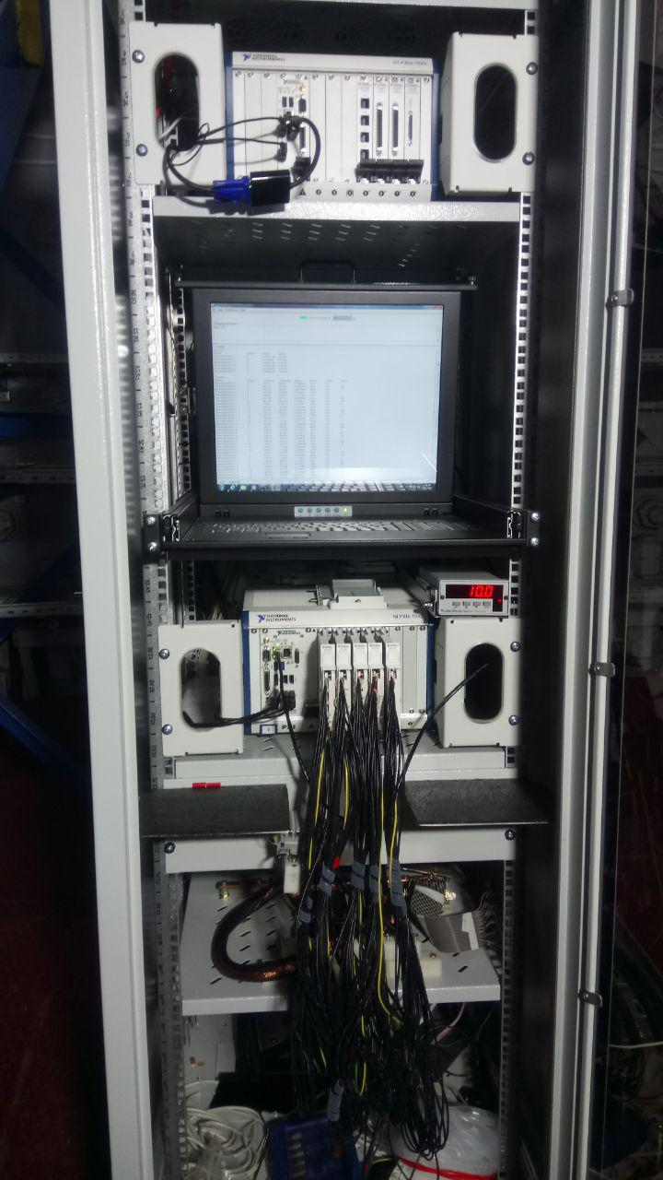
Booster thermometry system
Booster equipment:
4 cabinets with NI PXIe-1082 chassis.
5 NI PXI-4357 modules (24-bit ADC, 20 channels) in each cabinet.
Lakeshore 121 DC current sources.
400 measurement channels in total.
HDB++ archiving – up to 400 values per second
Recent changes:
Hardware is fully assembled.
Cabinets are installed and fully cabled on 3 quadrants of the Booster.

Slide 10
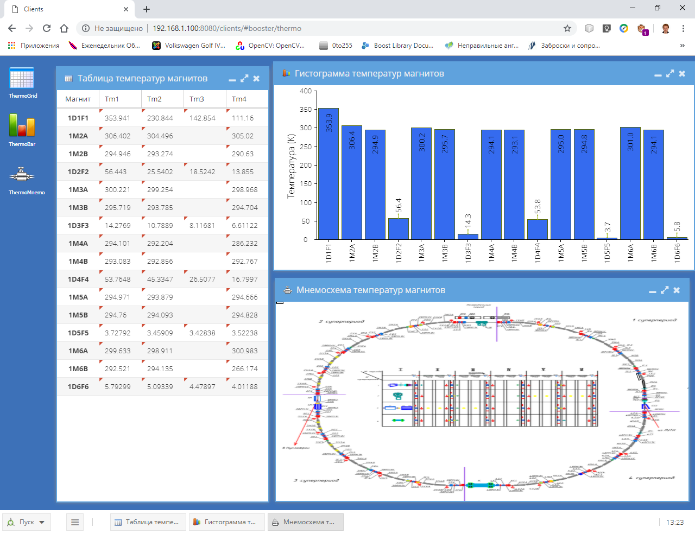
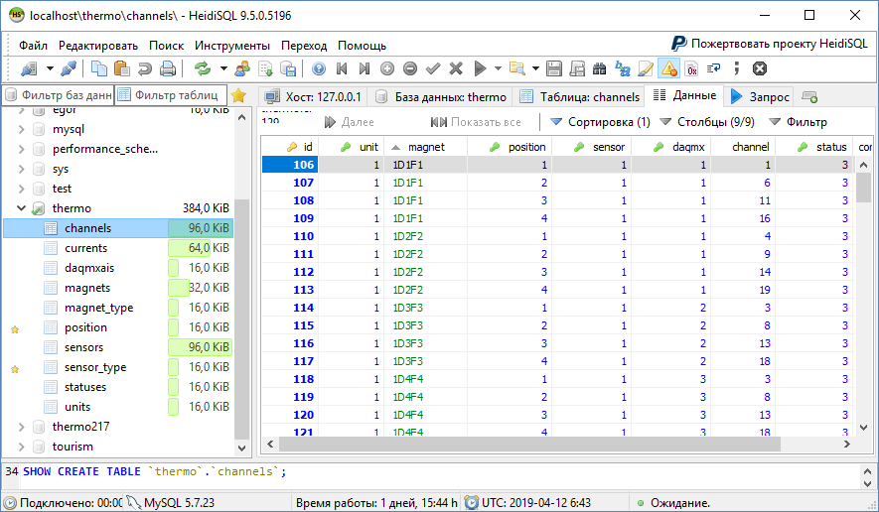
Booster thermometry system
Recent changes:
Tango device servers for hardware calibration, data acquisition, storage and retrieval are fully developed.
Web client for thermometry is developed and tested on 3 Booster quadrants.

Slide 11
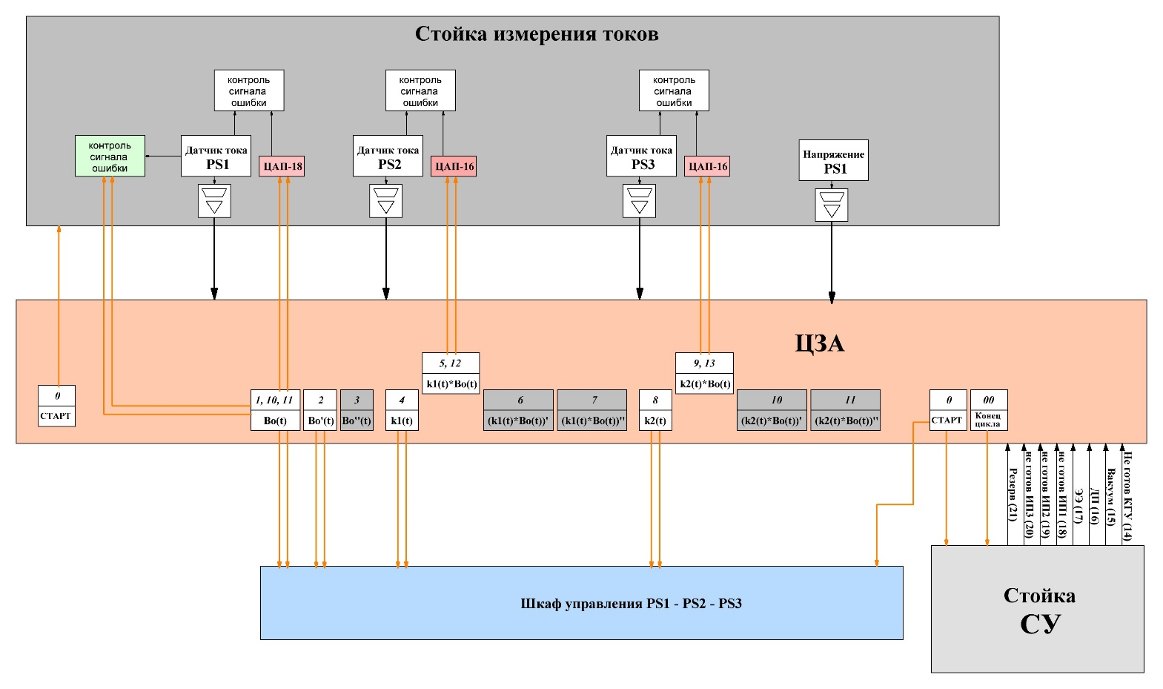
Booster magnetic cycle control
The main task of the system is to produce cycle synchronization signals and series of pulses (B-series) representing main field (current) and it’s first and second derivatives to control 3 dipole magnets and quadruple lenses power supplies:
Power supplies control:
I+ and I-
I’+ and I’-
K₁+ and K₁-
K₂+ and K₂-
(K₁*I)+ and (K₁*I)-
(K₂*I)+ and (K₂*I)-
Interlocks:
PS₁,PS₂,PS₃ ready
Vacuum
Cryogenics
Quench protection
Synchro pulses:
24 synchro pulses at the start and end of specific cycle regions.

Slide 12
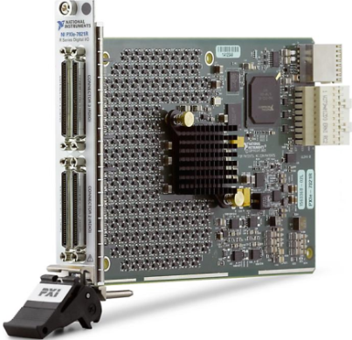
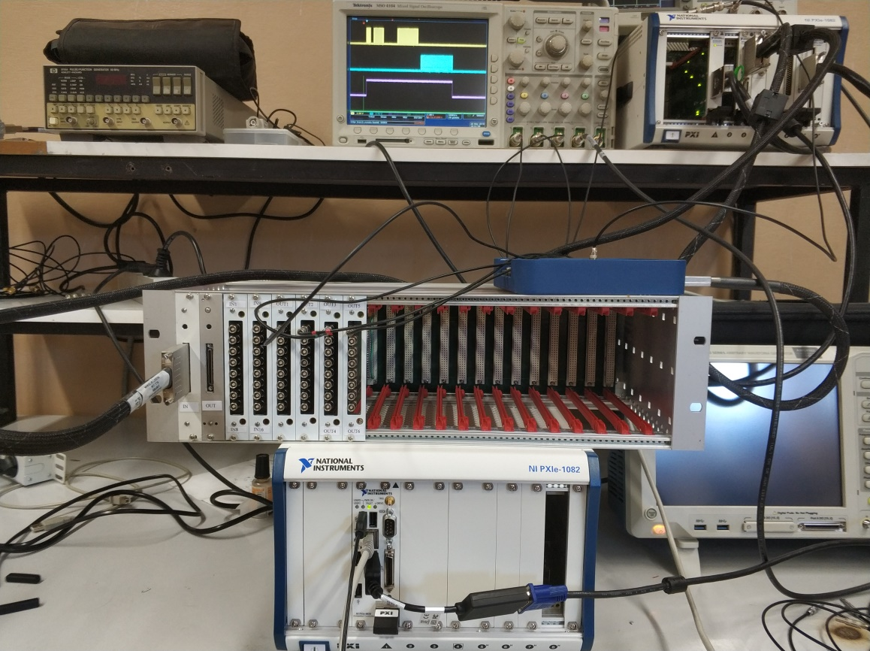
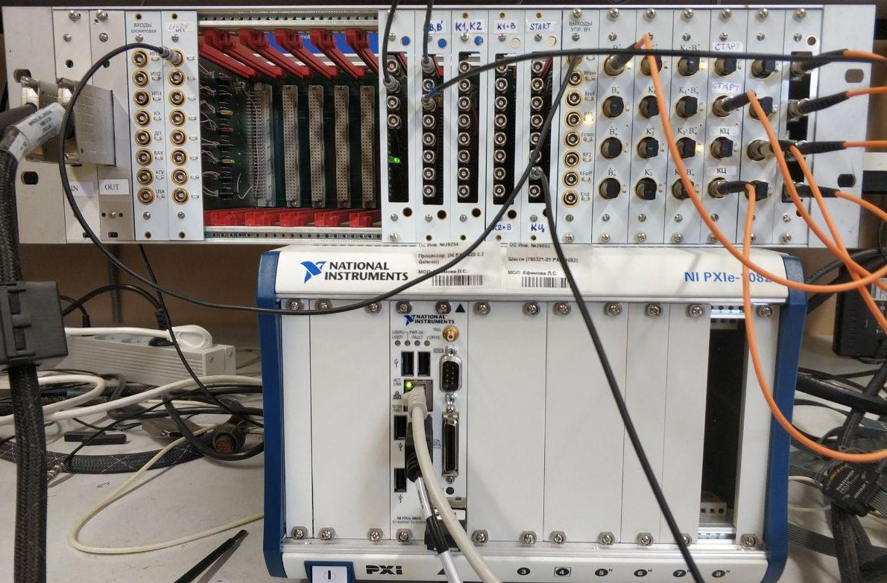
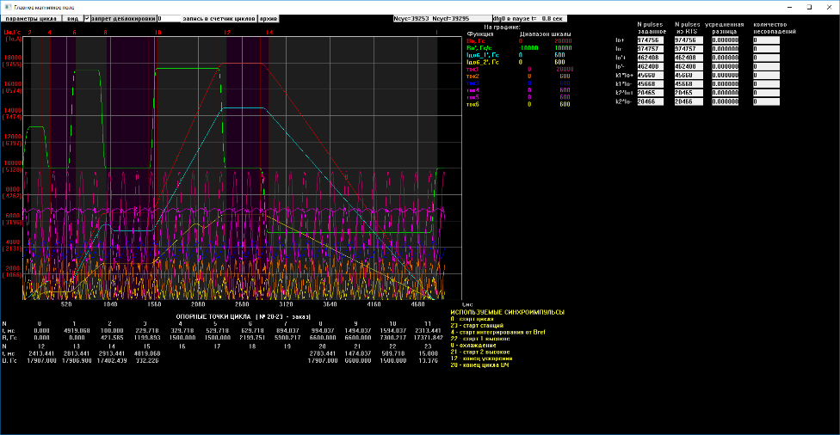
Booster magnetic cycle control
The hardware consists of:
PXI Digital Reconfigurable I/O module NI PXIe-7821R: Kintex 7 160T FPGA, 128 DIO, 512 MB DRAM
3U Euro rack providing digital bus on the backplane and power supply.
A set of digital I/O modules: TTL and optical inputs and outputs.
Recent changes: hardware and software are completely developed and ready for installation at Booster.

Slide 13
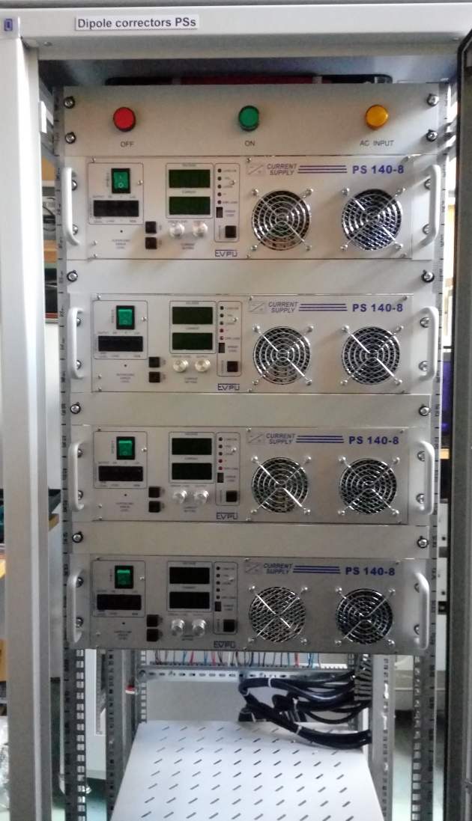
Booster beam orbit correction system
Dipole correctors for Booster:
12 cabinets with 48 PS 140-8 power supplies in total.
Multipole correctors power supplies for Booster:
8 cabinets with 24 PS 140-8 power supplies.
4 NI PXIe-1082 control chassis:
NI PXI-8433 RS485 interface
NI PXIe-6733 16 bit function generators
Recent changes:
Hardware is fully assembled, half of cabinets are installed at Booster and ready for cabling.
TANGO device drivers for correctors control and data acquisition are fully developed and tested on the test bench.
To do:
Operator interface is under development.

Slide 14
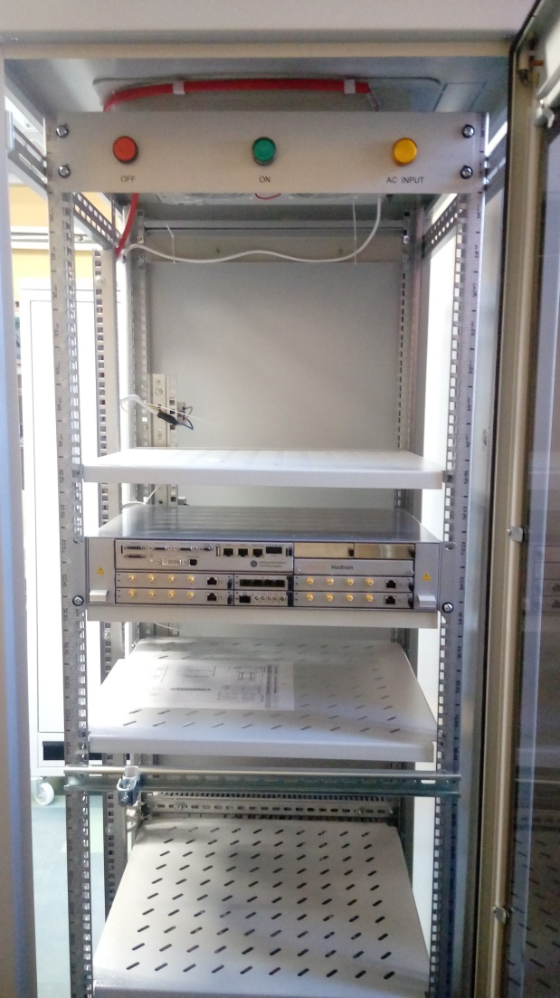
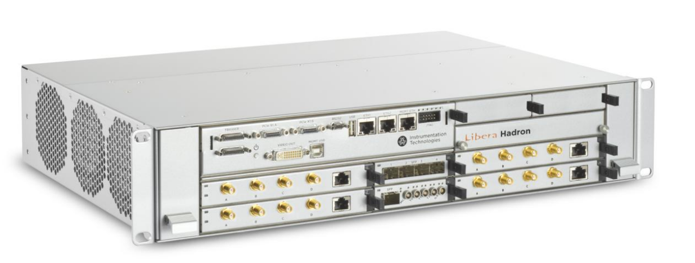
Booster beam diagnostics
Beam orbit and intensity measurements:
4 cabinets, each with
2 Libera Hadron racks (each processing 4 pickups).
8 Power supplies for Amplifier 110
1 cabinet with acquisition electronics for Bergoz parametric and fast current transformers.

Slide 15
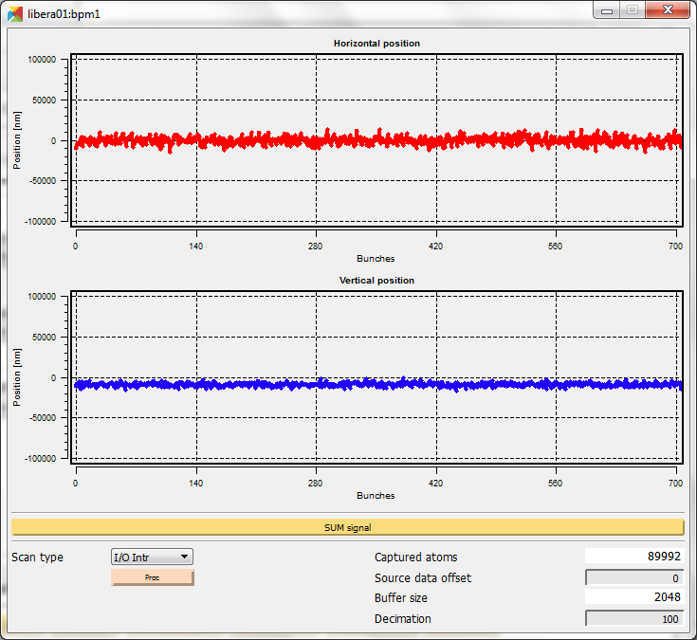
Booster beam diagnostics
Recent changes:
4-channel preamplifiers developed and tested to match pickup impedance with Libera Hadron.
Calibration and measurements routine was developed and tested on the cryogenic test bench. 10um accuracy is reachable with 50um long-term.
Pickups adjustment procedure was developed and tested.
Cabinets with hardware are mounted at Booster and ready for cabling.
TANGO integration is done.
To do:
Operator web applications for beam orbit measurements, tune measurements.
X and Y wire position measurements (nm)

Slide 16
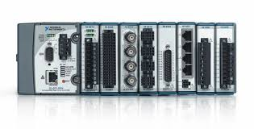
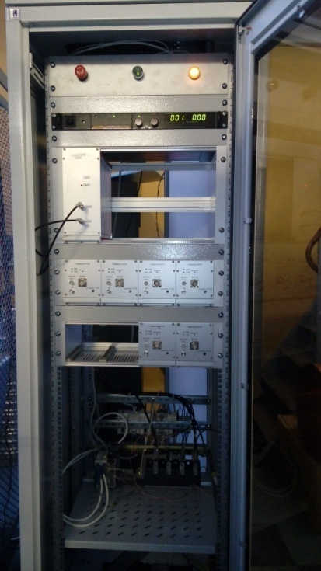
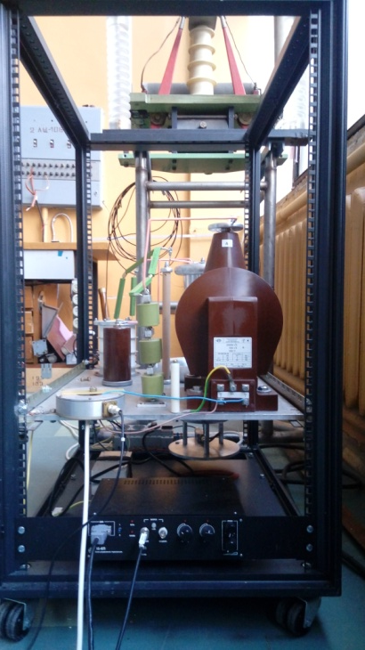
Booster injection
5 inflector plates with thyratron power supplies. CompactRIO based control hardware to manage thyristors, synchronization and data acquisition.
cRIO-9068 chassis
NI 9239 – analog input module
NI 9269 – analog output module
NI 9401 – slow digital I/O module
NI 9402 – fast digital I/O module
NI 9862 – CAN interface module
TANGO device servers
Recent changes: full scale system (5 inflector plates) has been developed.
To do: Web application with operator interface.

Slide 17
Other systems
Developed TANGO interfaces to different external protocols:
TANGO to OPC server (SCADA systems)
TANGO to NI DataSocket (LabVIEW based systems)
TANGO to Modbus (industrial electronic equipment)
TANGO to Profibus, CAN (industrial electronics)
Communication with local control systems:
Booster vacuum system:
TANGO interface to OPC server
Booster E-cooling system.
Preliminary TANGO interface via TCP/IP sockets.
Booster RF system:
TANGO interface via general TCP sockets communications.

Slide 18
Conclusions
The computer cluster, data storage and network infrastructure for Booster is ready.
Most of the Booster control system hardware is ready.
Thermometry, beam diagnostics, orbit correction, magnetic cycle systems are in the process of installation and cabling.
Most of the low level TANGO software is ready.
Some systems missing finished Graphical User Interface (GUI). However, standard TANGO ATK panels can be used.
Thank you for your attention!

