Slide 1
Status of Beam-beam Simulations for NICA
Dmitry Shatilov
BINP, Novosibirsk
NICA MAC 10th Session
Dubna, JINR, 05 June 2019

Slide 2
Introduction
Beam-beam simulations for the NICA collider are more complicated than usual because of specific features:
space charge effects
intrabeam scattering
cooling (both electron and stochastic)
The beam dimensions are formed under the influence of all these
factors, and should be correctly reproduced in simulations. The
longitudinal distribution in such a beam is usually different from
the Gaussian and may resemble a parabola.
It is necessary to solve a complex self-consistent problem in order to obtain the correct 6D distribution and its evolution in time, even without beam-beam.
Beam-beam simulations make sense only after all of the above is implemented in the tracking code. The task is to take the working and proven program (Lifetrac) and add these new features. This work is not yet complete, and we discuss the current status and plans.
D. Shatilov NICA MAC 10, Dubna 2

Slide 3
The Main Features of Lifetrac
The code was created to simulate beam-beam effects in e+e- colliders. Some features and capabilities, such as fast obtaining an equilibrium distribution including the beam tails, may be applicable only to such types of colliders.
Twenty years ago the code was upgraded for use in hadron colliders. Since then, it has been used successfully for Tevatron and HL-LHC.
The lattice is converted from MADX format, including errors and misalignments (if any).
Multi-particle and multi-turn tracking. The code is well parallelized.
Observables: luminosity, emittances and beam sizes, 1D histograms, 2D contour plots in the space of normalized betatron amplitudes, lifetime. Evolution of all of the above in time.
FMA: the footprint, identification of harmful resonances, DA (with and w/o beam-beam and/or space charge).
D. Shatilov NICA MAC 10, Dubna 3

Slide 4
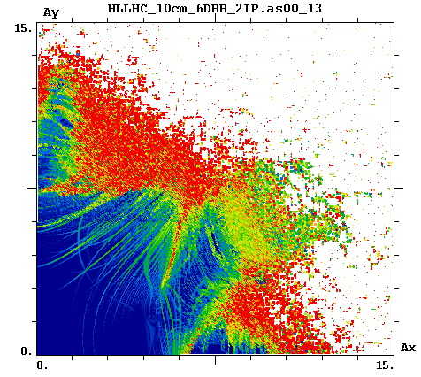
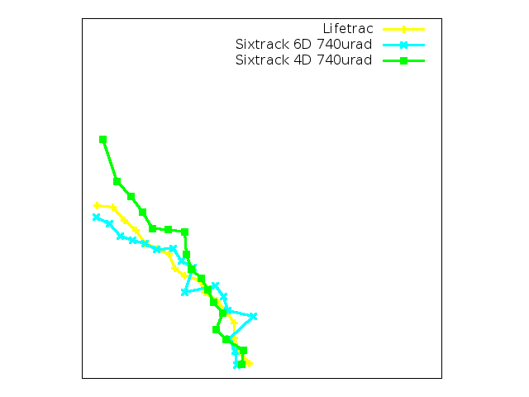
Example: DA for HL-LHC
10⁶ turns DA: Lifetrac vs. Sixtrack β*=10cm, 720 μrad, Np=2.2E11
FMA
Diffusion indexes are coded by colors: blue – stable motion, red – stochastic.
Each point corresponds to a particle trajectory of ∼16k turns. Actually, 4k turns is enough to detect the DA.
D. Shatilov NICA MAC 10, Dubna 4

Slide 5
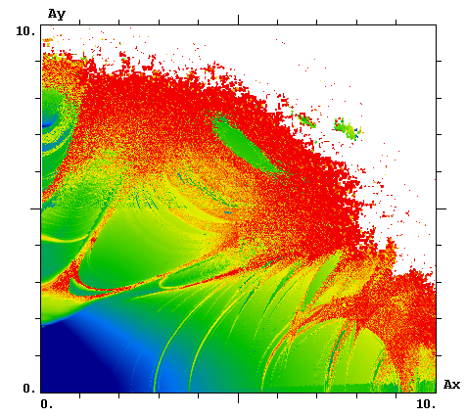
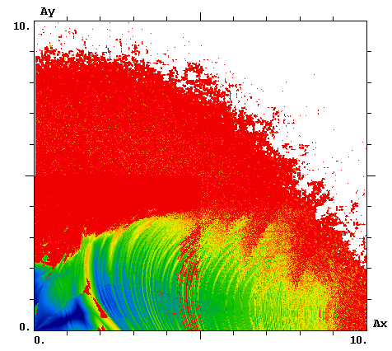
Example: DA for NICA
Lattice as of November 2018, with octupoles and fringe fields, 8k turns.
As = 0 As = 1
Similar pictures can be obtained with account of space charge and beam-beam.
D. Shatilov NICA MAC 10, Dubna 5

Slide 6
Space Charge: Requirements
There are advanced space charge programs that take into account many details, but they are slow and are usually designed for a small number (or even single) of beam passages.
Simplified and faster calculations can be used for boosters, but bunches do not live there for long, therefore the requirements for accuracy and symplecticity are noticeably weakened.
In colliders, beams live a long time and the damping is very weak. Even with cooling, the damping decrements are of the order of 10⁻⁶. This imposes strict requirements on symplecticity.
The standard simulation method is that many special SC elements are placed on the ring, in which particles receive 3D kicks depending on their coordinates. Since the simulation is carried out for a large number of particles and for many turns, the speed of calculations becomes critical.
The potential of space charge is similar to beam-beam, but the 3D kicks cannot be expressed through known functions. Numerical integration is too slow and can only be used for testing. For fast and symplectic calculations, a good approximation of the potential is needed.
D. Shatilov NICA MAC 10, Dubna 6

Slide 7
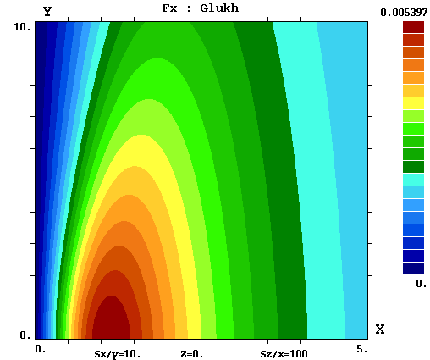
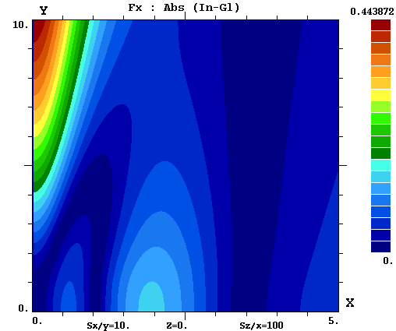
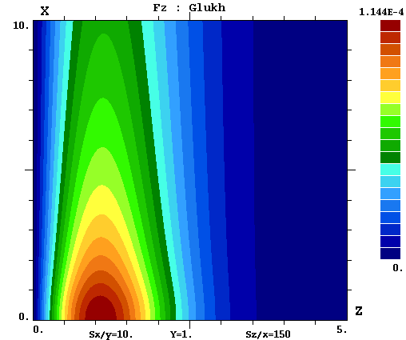
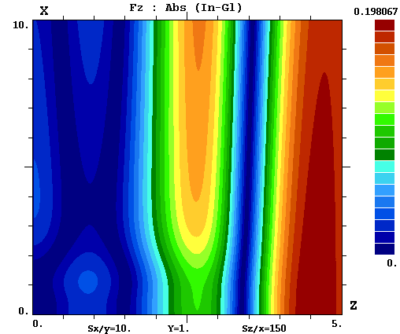
Space Charge Potential: Glukhov’s Approximation
Horizontal kick
Accuracy
A numerical code and GUI were created for integration of exact formulae, with an error of the order of 10^{–4}.
With its help, various approximations were tested in a wide range of parameters.
For the last version, the relative error in the regions where the kicks are not small, is about a few %.
Longitudinal kick
Accuracy
D. Shatilov NICA MAC 10, Dubna 7

Slide 8
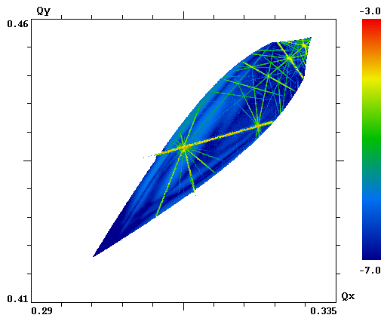
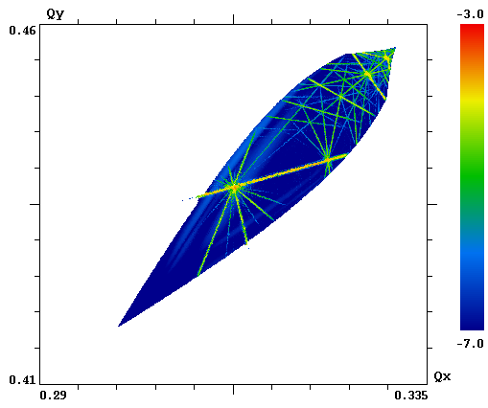
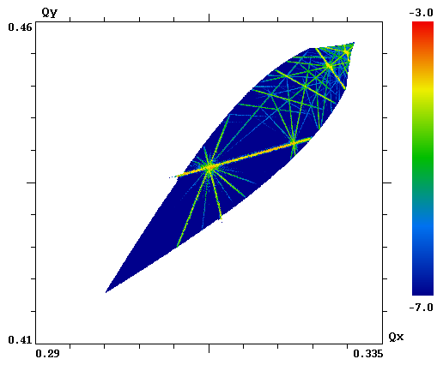
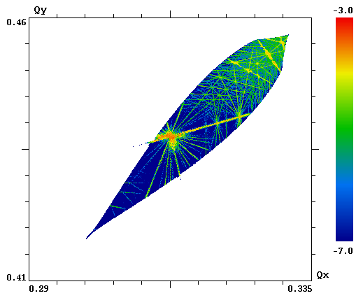
Space Charge: FMA test, A_{s}=0
To avoid interference with the nonlinear lattice, transport transformations between SC elements were replaced by linear 6×6 matrices.
The working point was shifted away from the main coupling resonance, to provide more clear conditions for FMA.
Synchrotron tune was increased several times. This improves the quality of FMA plots and reduces the computation time.
The bunch population was intentionally increased several times to enhance the effect of SC (only for testing).
Numerical integration,
nominal step
Numerical integration,
half step
Bassetti – Erskine
Approximation
D. Shatilov NICA MAC 10, Dubna 8

Slide 9
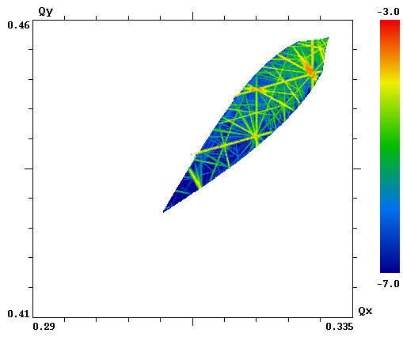
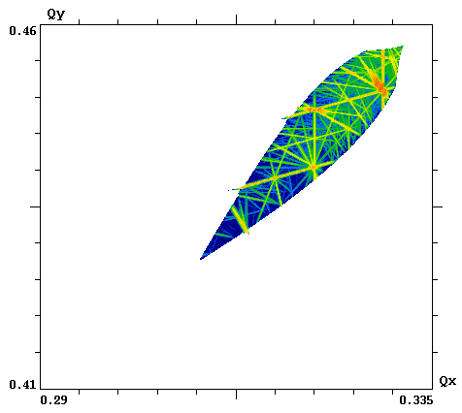
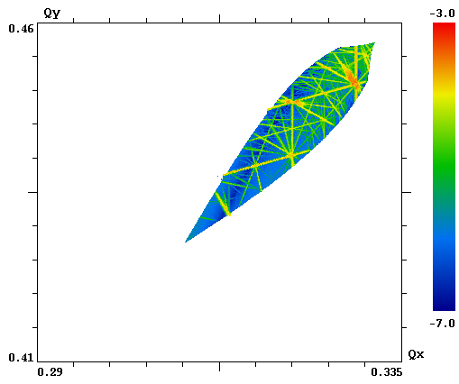
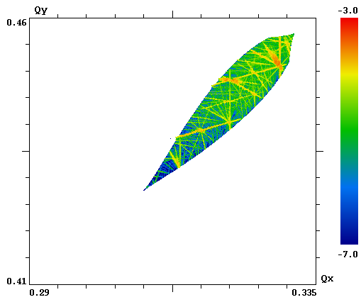
Space Charge: FMA test, A_{s}=1
Numerical integration is more accurate, but slow and produces some noise. It is useful only for tests.
Non-symplecticity can be detected by the colors of background (dark blue becomes light blue).
Despite approximation is symplectic, it creates artefacts in the form of high-order resonances.
Bassetti-Erskine formula for the transverse kicks is quite good. But if the longitudinal kick does not depend on the transverse coordinates, the whole approach becomes non-symplectic.
Numerical integration
Hybrid approach
Bassetti – Erskine
Approximation
D. Shatilov NICA MAC 10, Dubna 9

Slide 10
Space Charge: Discussion
Hybrid approach: the transverse kicks are calculated by Bassetti-Erskine formula, the longitudinal kick – by Glukhov’s approximation. This is not exactly a symplectic way, but it looks better than others.
Non-symplecticity usually makes the results worse, unless it creates artificial damping (that we believe is not our case).
We may proceed with hybrid approach and consider the results as “maybe a little worse than reality”. Since reality is usually much worse than any model, this should be OK.
It also makes sense to test some cases in the future with a full approximation, to see the difference.
We should continue the search for a better approximation. And we already have a tool for testing.
D. Shatilov NICA MAC 10, Dubna 10

Slide 11
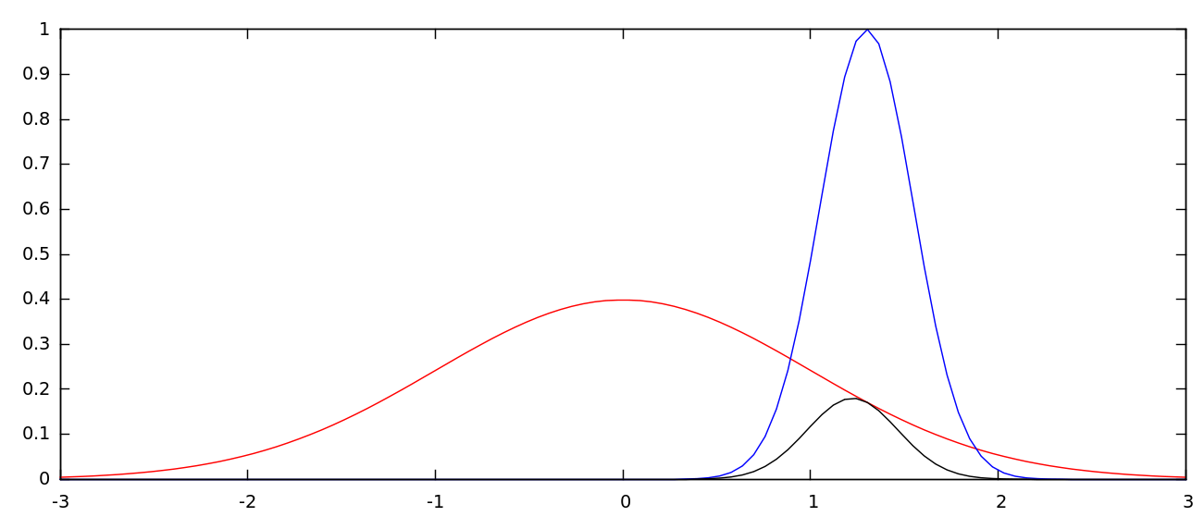
Space Charge: Shielding
A feature of the NICA collider is that the bunch (σ_{z} ≈ 60 cm) is much longer than the radius of vacuum chamber. Because of the shielding, particles practically do not feel the space charge from remote parts of the bunch. We must somehow take this into account.
“new” σ_{z} :
attenuation factor for the longitudinal kick:
z/σ_{z}
z₀ /σ_{z}
Since the field of electric charge is inversely proportional to the square of the distance, the main contribution to the longitudinal field at the point z₀ is given by the region a few σ_{x} ; the rest of the bunch is “shielded” in a natural way.
It can be said that the transverse kick is mainly determined by the linear density at this point, and the longitudinal kick is determined by its gradient at this point, so the effect of shielding by the vacuum chamber is small (especially for the transverse kicks). Nevertheless, it is accounted.
D. Shatilov NICA MAC 10, Dubna 11

Slide 12
Remaining Issues
Non-Gaussian longitudinal distribution. The approach, in which it is represented as a superposition of Gauss and parabola, is currently in the process of implementation and testing. Decomposition coefficients can be obtained from <z²> and <z⁴>.
Intrabeam scattering. It should be introduced in the same points as the space charge. The method proposed by N. Alekseev, A. Bolshakov, E. Mustafin and P. Zenkevich in “Numerical code for Monte Carlo simulation of ion storage” will be implemented.
Electron cooling. The basic formulae received from V. Reva, should be no problem to implement.
Stochastic cooling. The “correct” approach is clear, but its implementation will lead to a significant slowdown of parallel processing. We will probably start with a simplified variant (e.g. ordinary damping decrements, possibly with some dependencies).
All of the above should be done by this autumn.
This will allow to obtain self-consistent bunch sizes. And some time will be needed for testing… The next step: add beam-beam interaction (small modifications are needed for low gamma-factor). By the end of this year, we expect that we will have a complete tool.
D. Shatilov NICA MAC 10, Dubna 12

Slide 13
Summary
Code development for beam modeling in the NICA collider is underway.
The most difficult problem is a qualitative simulation of space charge effects. A [tentative] solution has been found, we can go on with it.
Some other features still need to be implemented in the code, but this should not cause big delays.
Full-scale simulations with all the main effects included will be possible by the end of this year.
D. Shatilov NICA MAC 10, Dubna 13

