Slide 1
NICA Booster: assembling and commissioning
A. Galimov
NICA Machine Advisory Committee,
meeting at Joint Institute for Nuclear Research, Dubna, Russia
June, 6-7, 2019

Slide 2
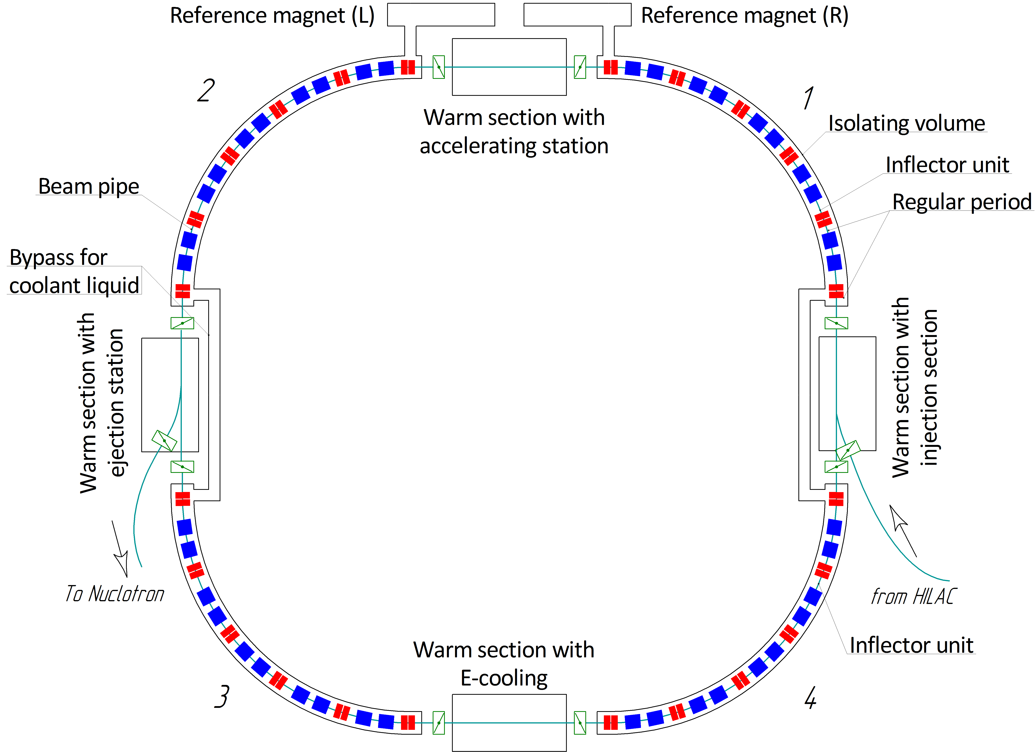
Booster scheme
Assemblies | Q-ty, pcs
Dipoles | 40
Quadrupole doublets | 24
Kit for assembling magnet joints | 45
Bypass for coolant liquid | 2
Warm sections | 4
Section with reference magnets (L, R) | 2
Feed box (L, R) | 2
Vacuum stations (insulation volume) | 26
Vacuum stations (cold beam pipe) | 24
2

Slide 3
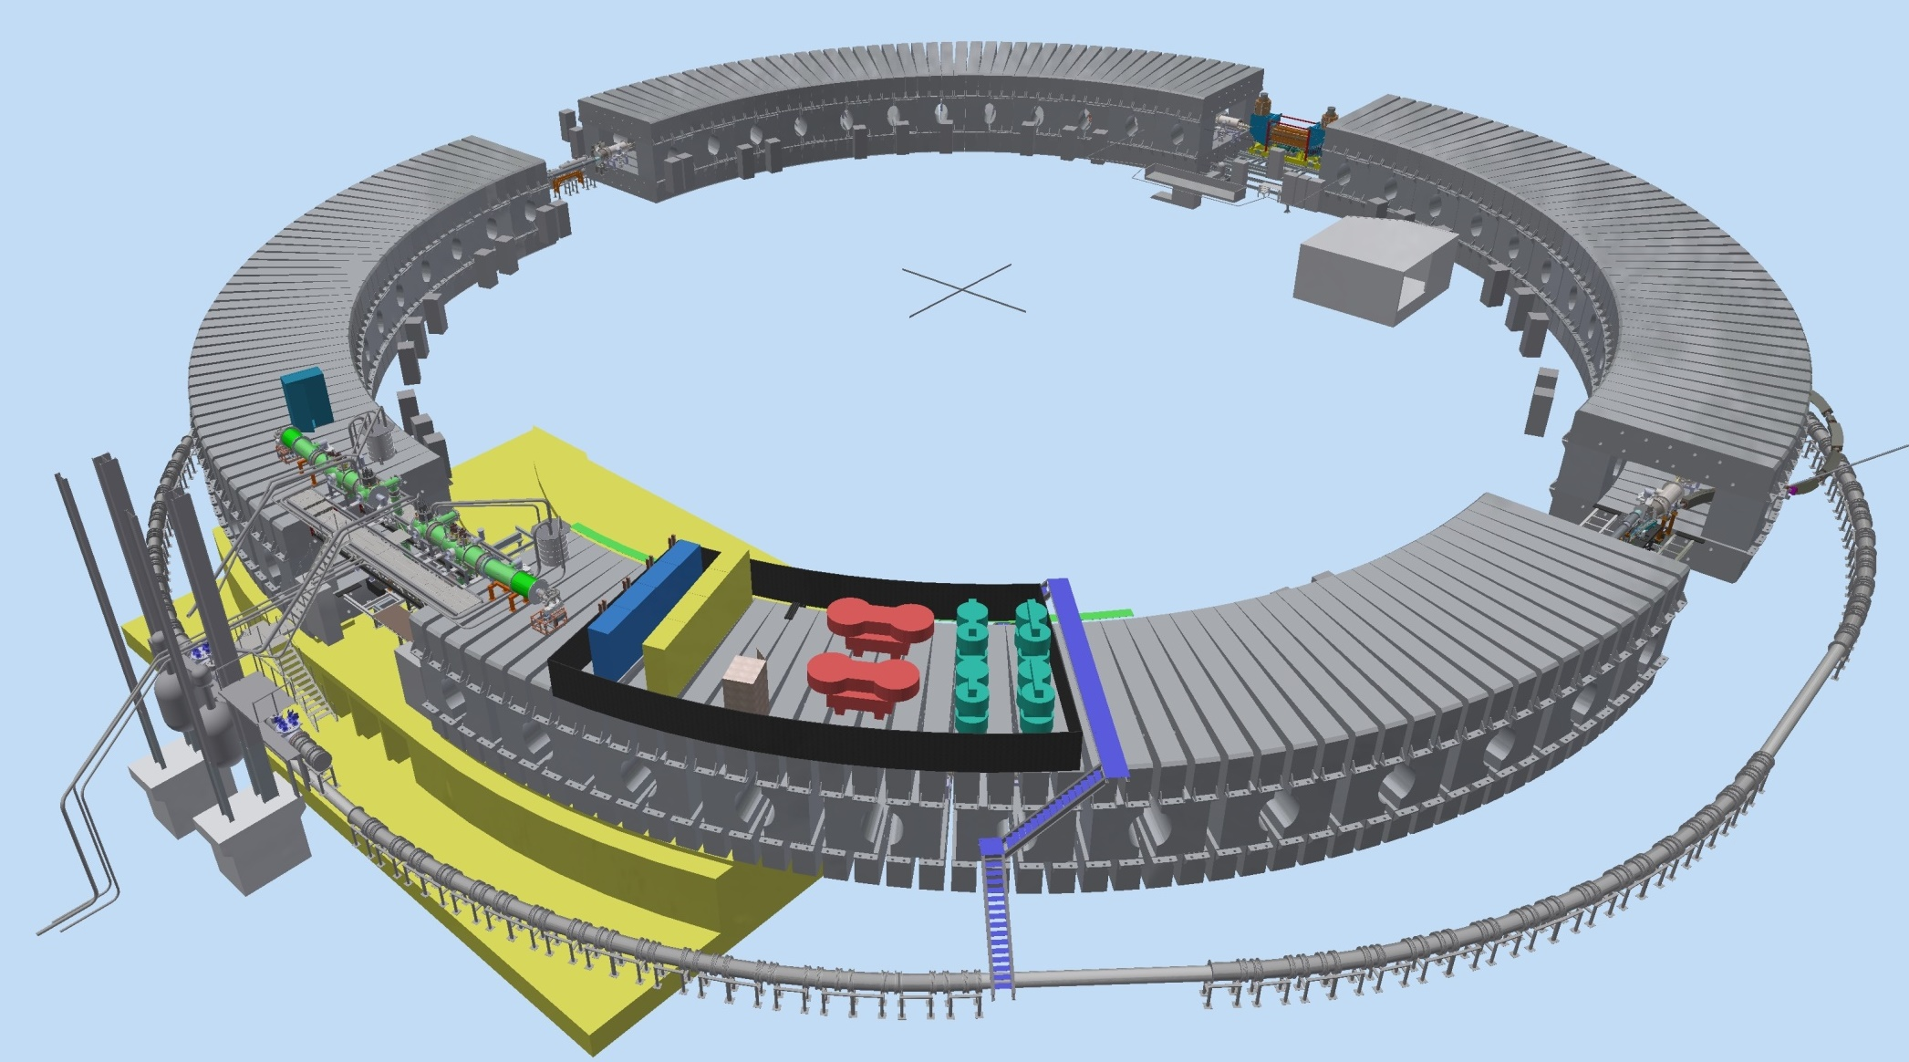
Booster 3D view
E-cooling system
Injection system
Extraction system
Feed box
Power supply
Accelerating station
Nuclotron

Slide 4
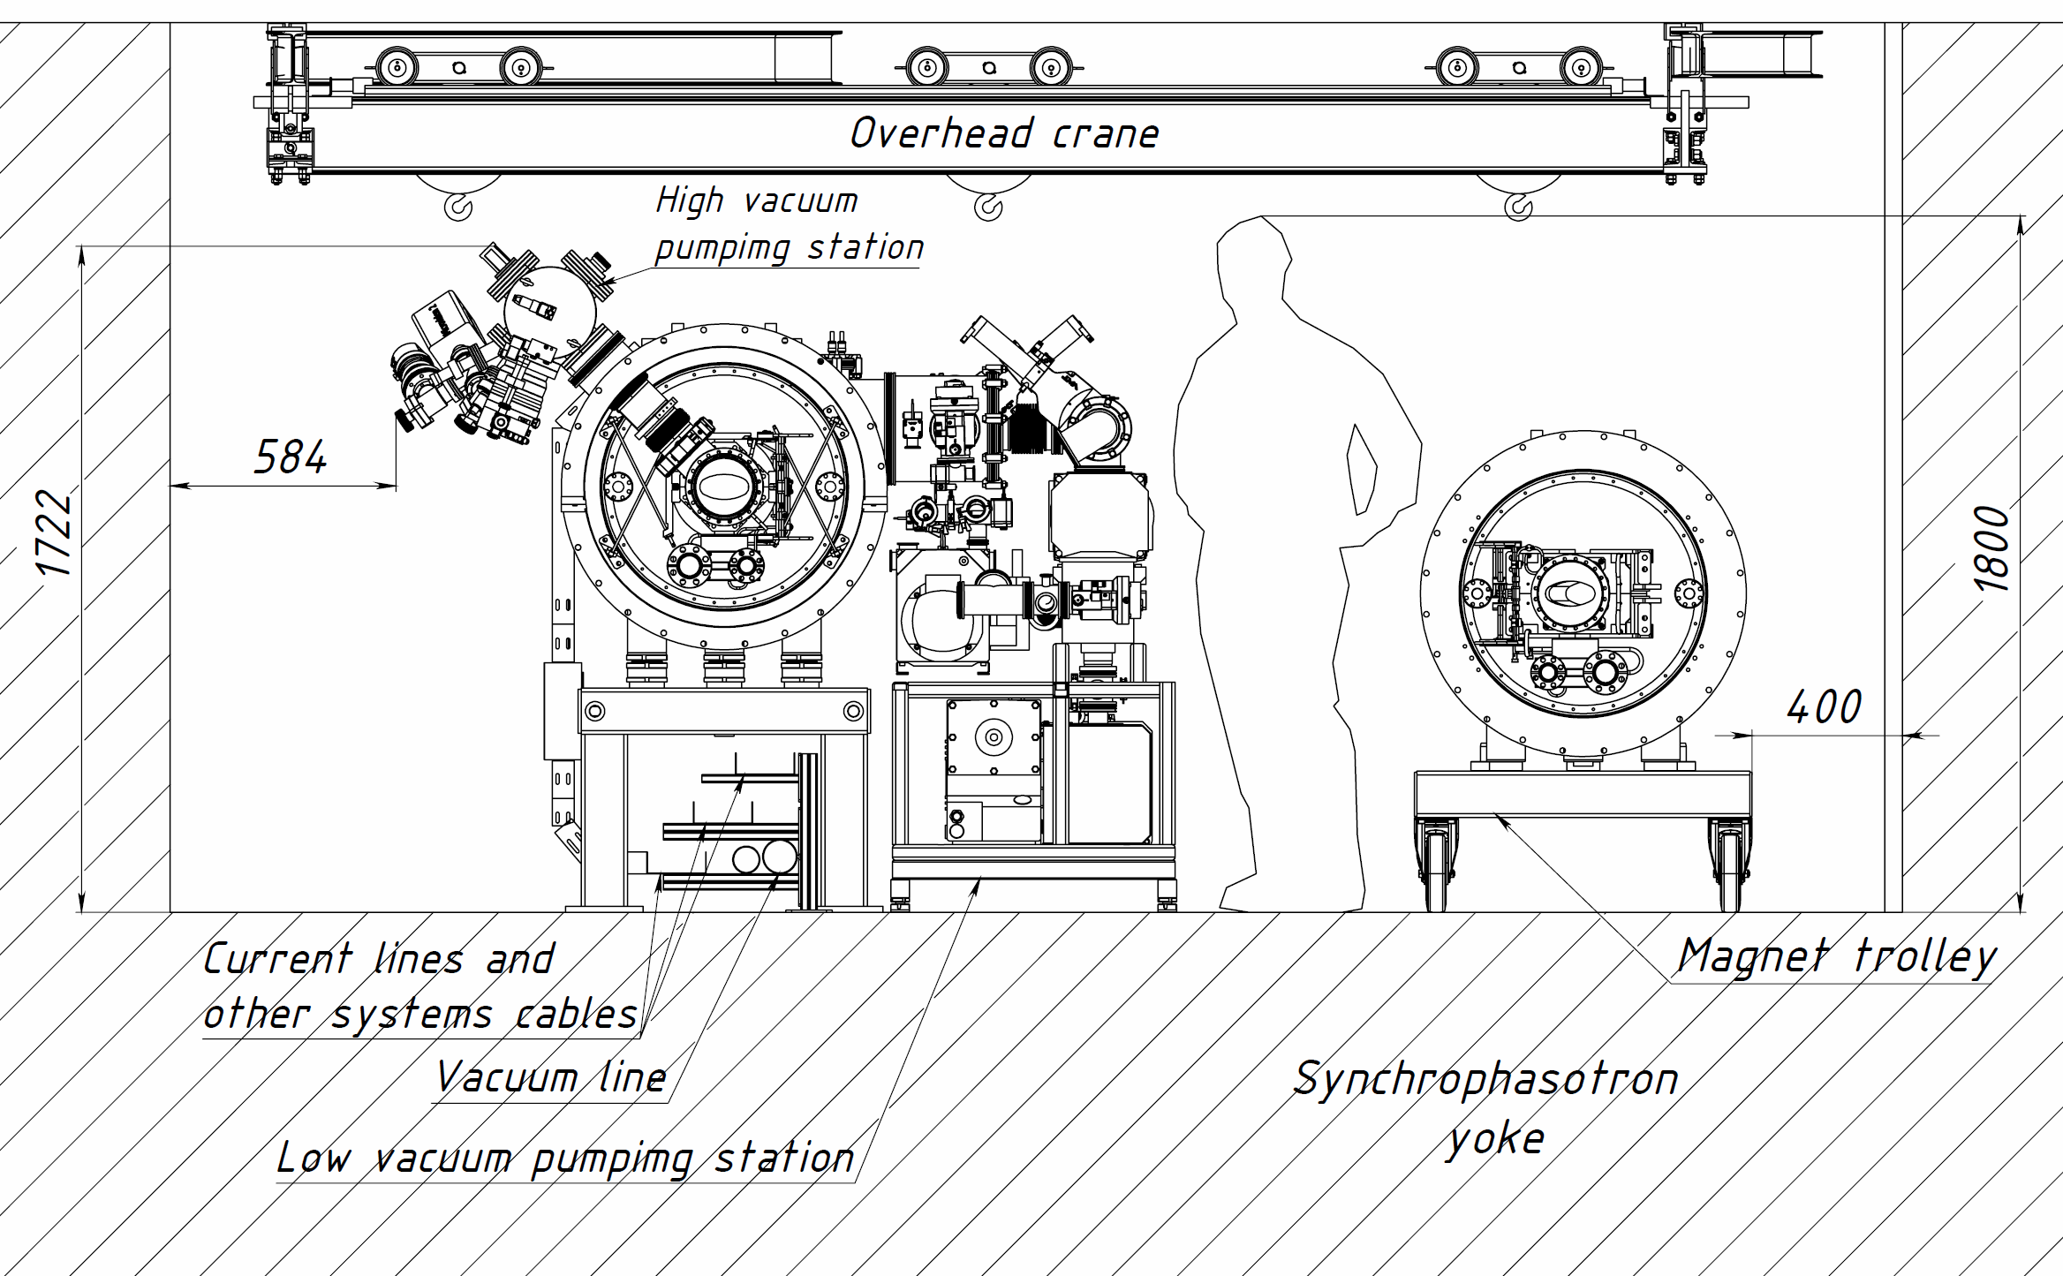
The booster tunnel cross section

Slide 5
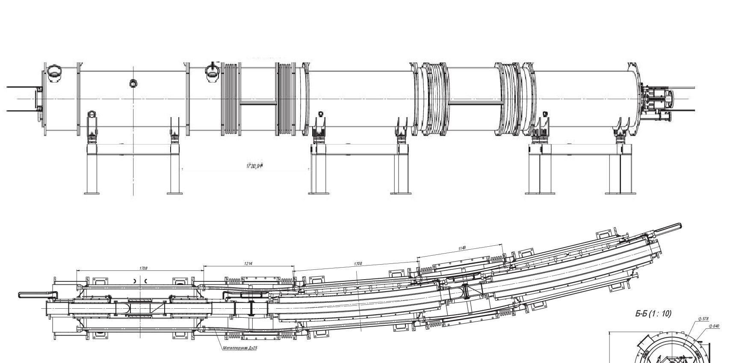
Regular periods
Quadrupole doublet
Dipole module
Dipole module
Beam chamber

Slide 6
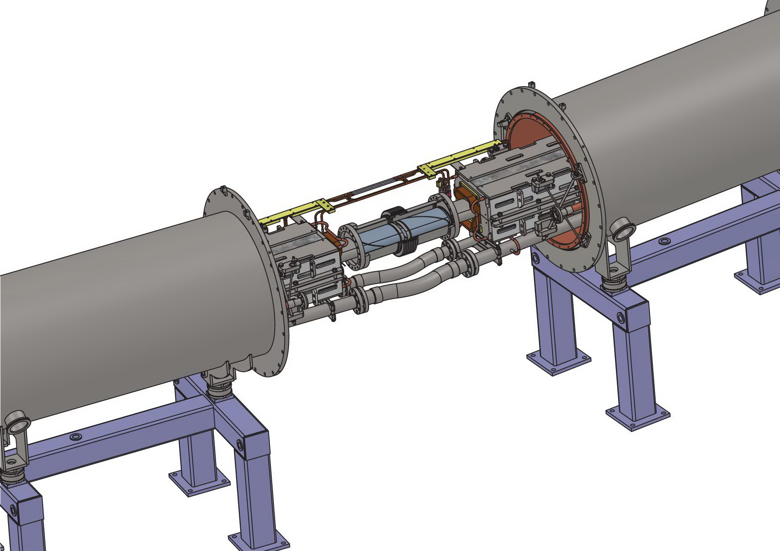
The typical connection (dipole-dipole assembling)
Beam pipe
Bus-bars
Dipole module
Dipole module
Bellows hoses
Supports

Slide 7
Thermal shield and vacuum shell assembling
Dipole-dipole connection
Thermal shield
Vacuum shell

Slide 8
Assembly workflow (part 1)
Regular period
Magnet 1
Magnet 2
Magnet 3
1
Alignment of yoke inside vacuum chamber
2
Transfer modules to position
3
Alignment modules on position
4
Assembling of He and N2 headers lines
5
Soldering of bus-bars
6
Assembling beam channel
7
Vacuum and electrical tests
8
Assembling thermal shield and vacuum vessel
9
Vacuum and electrical tests for half of ring

Slide 9
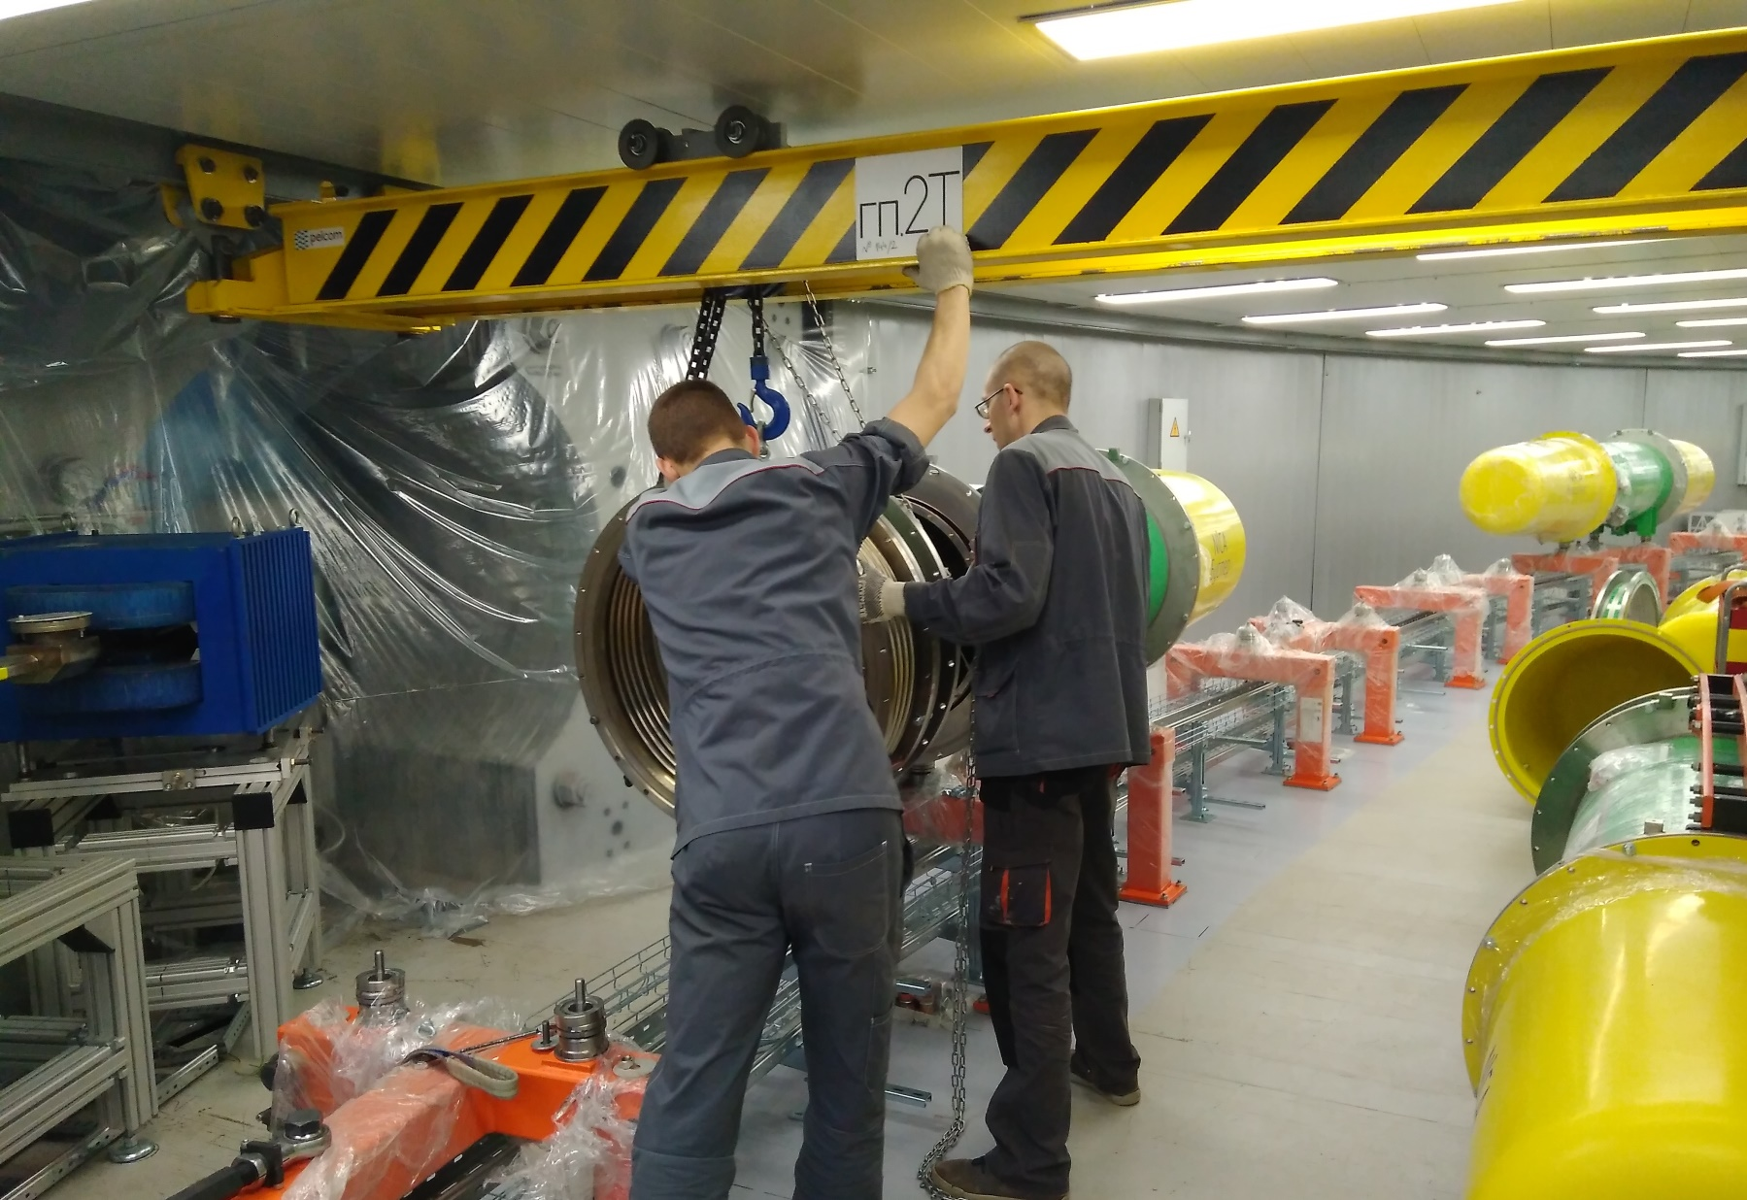
Installation of elements

Slide 10
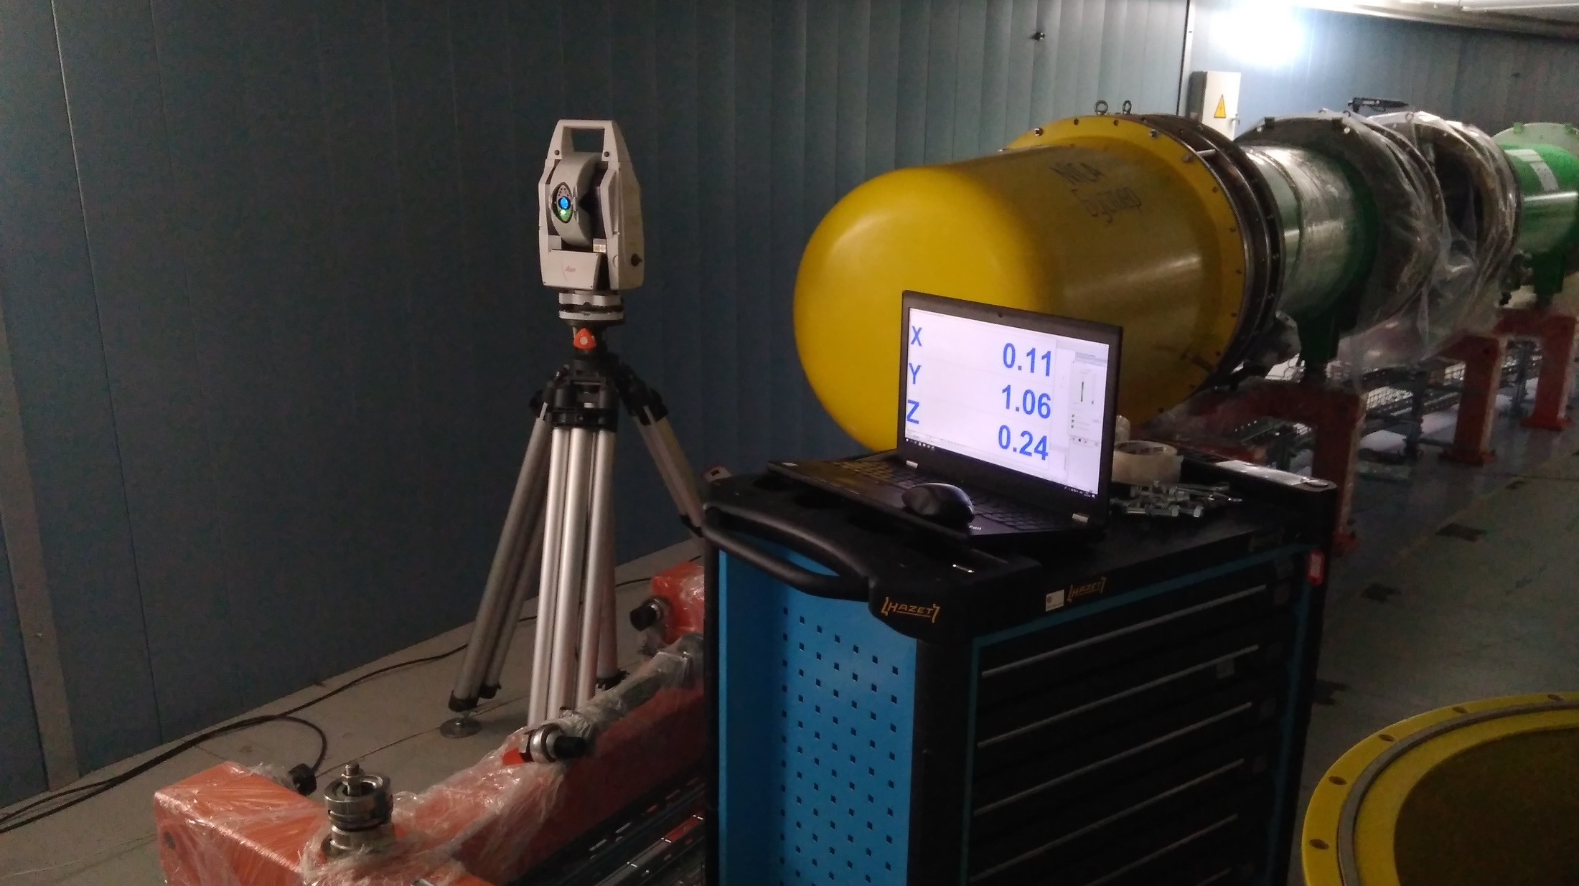
Alignment of magnets on position
• Promizmerenia company

Slide 11
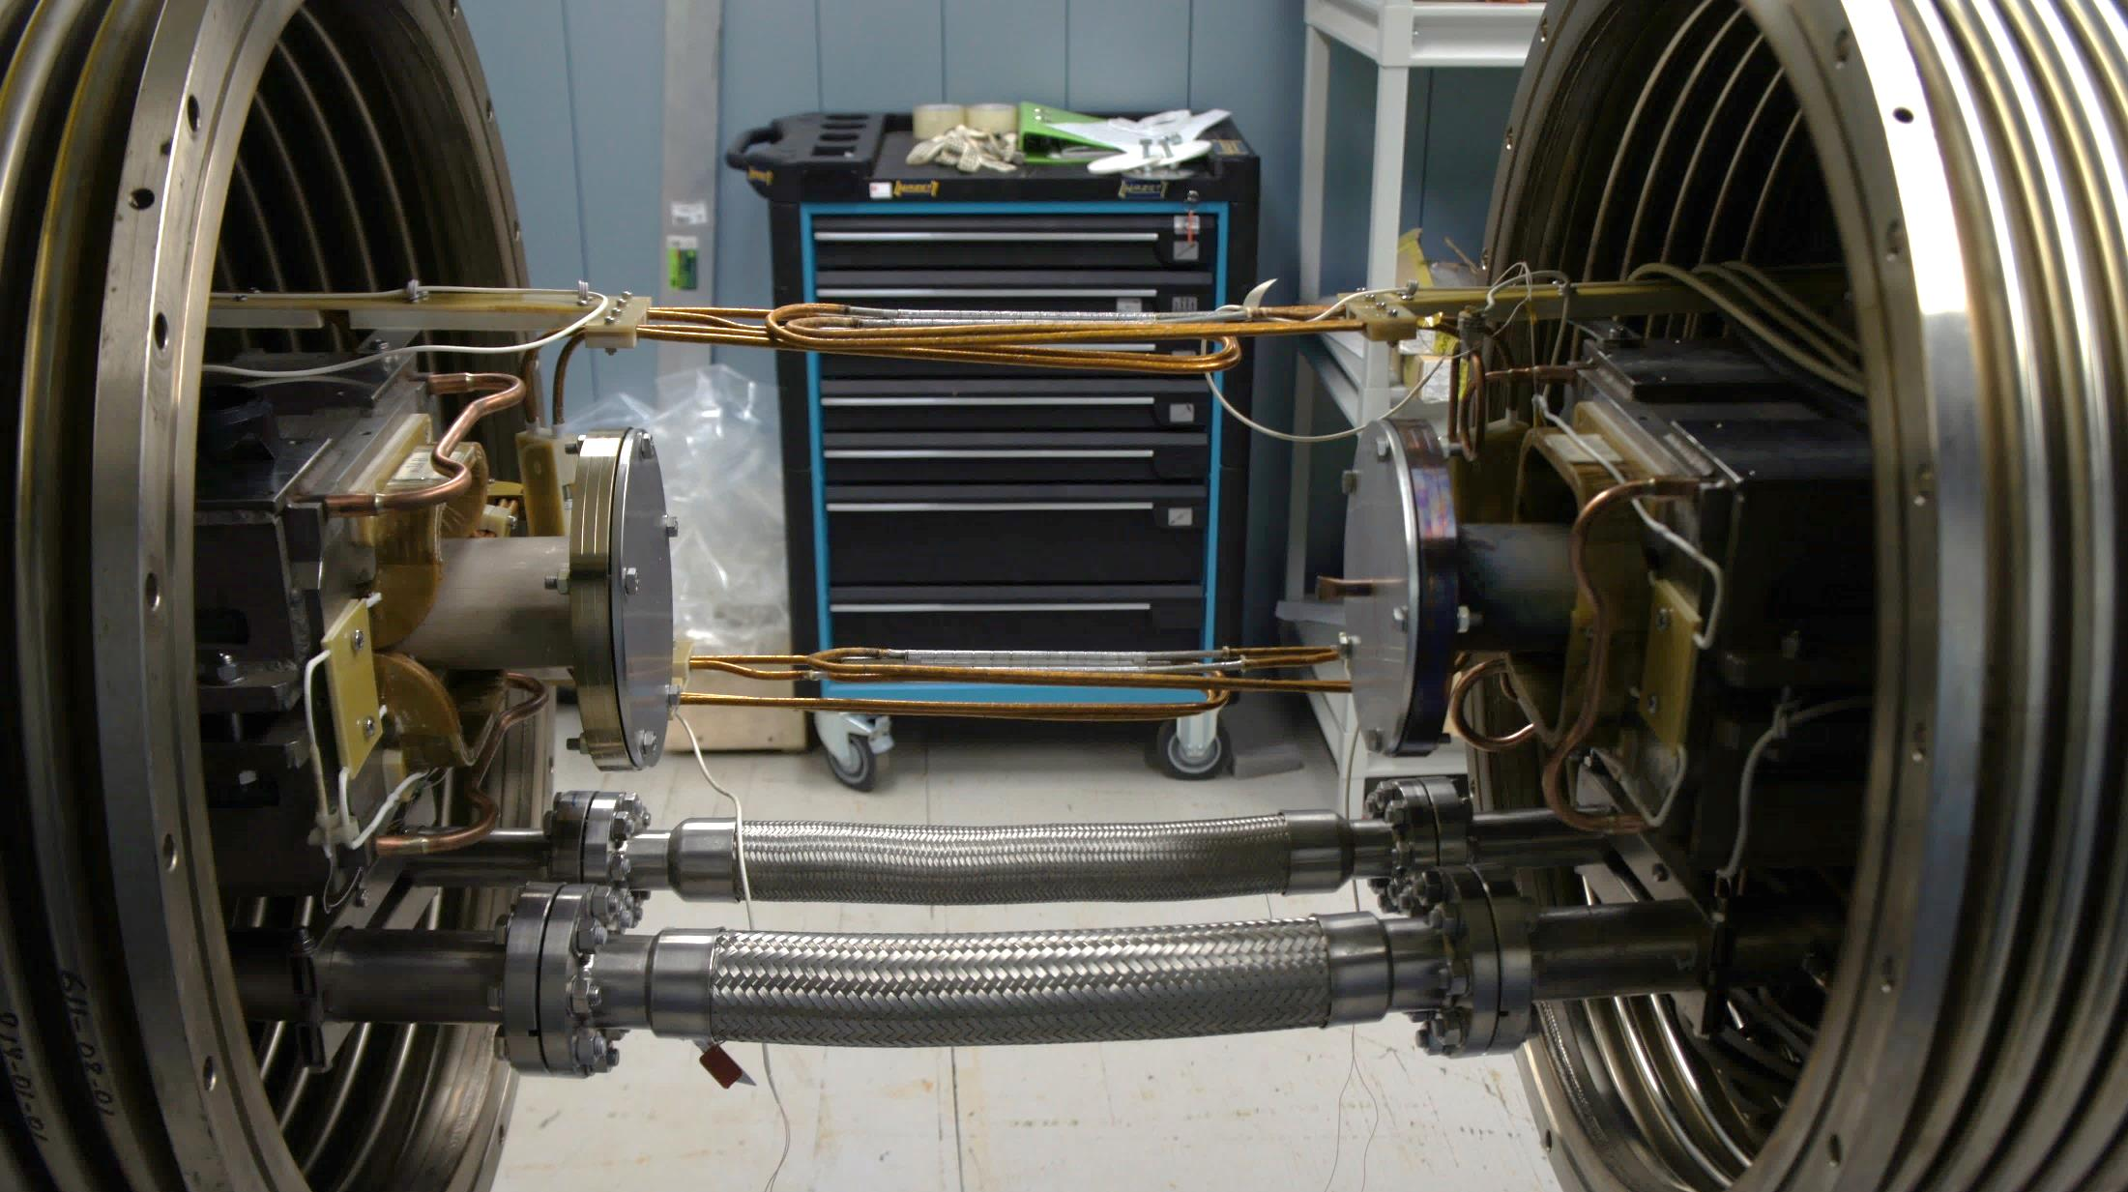
Connection of dipole magnets
11

Slide 12
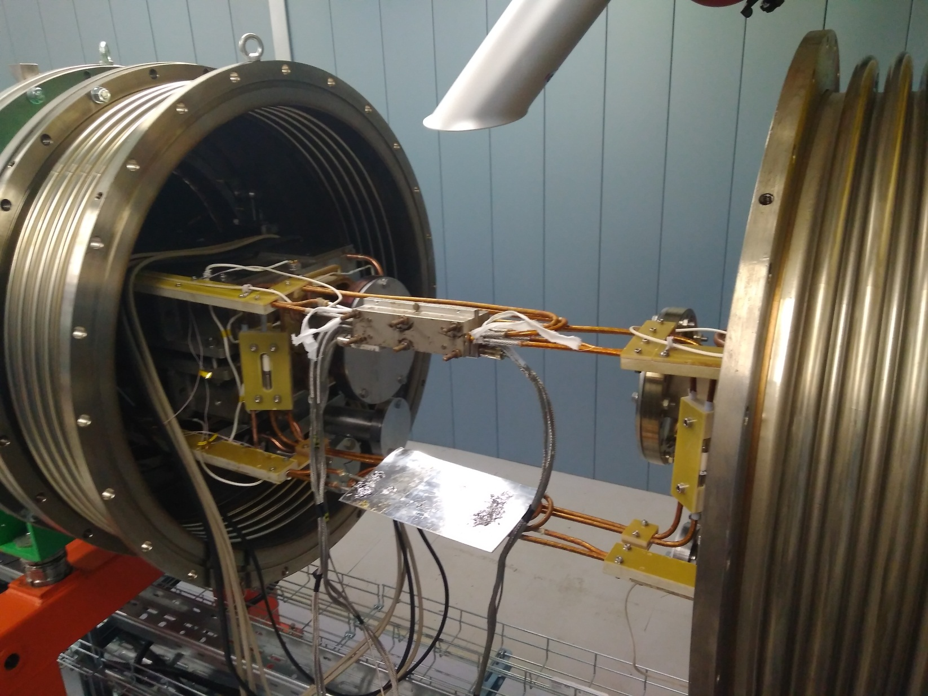
Bus-bars soldering

Slide 13
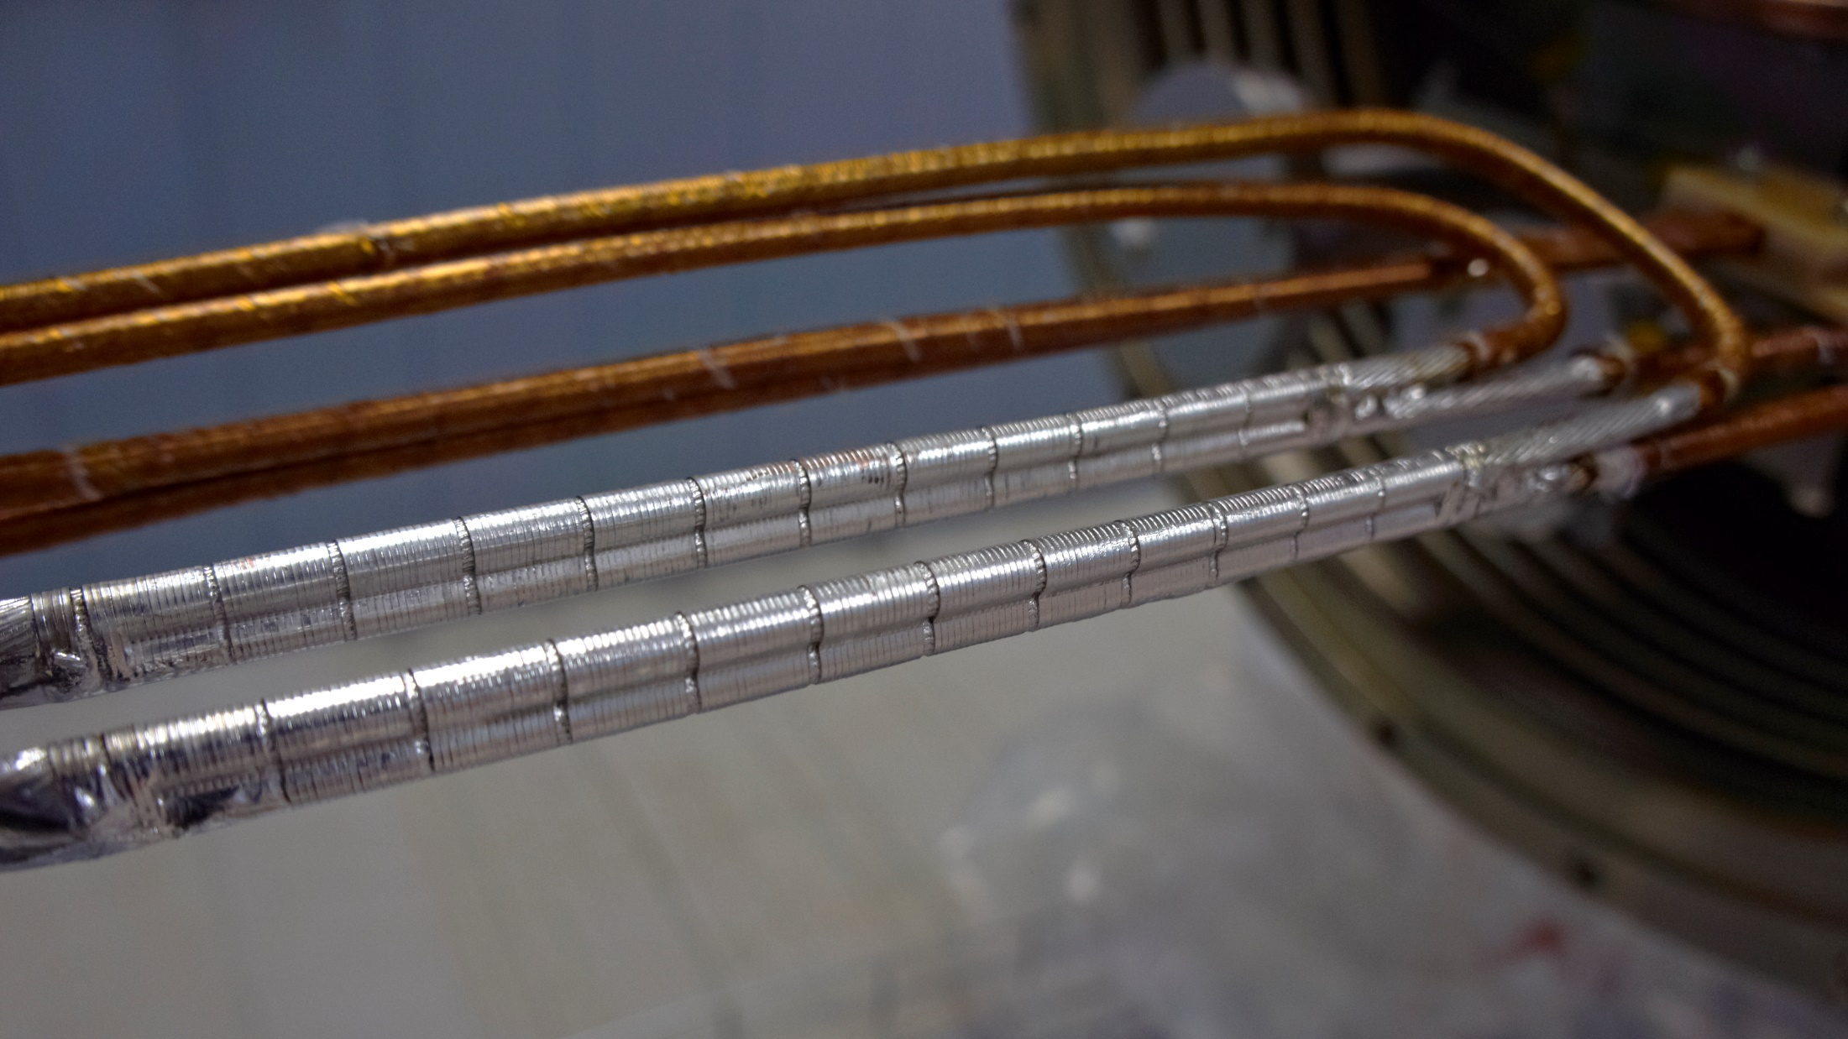
Bus-bars connections
13

Slide 14
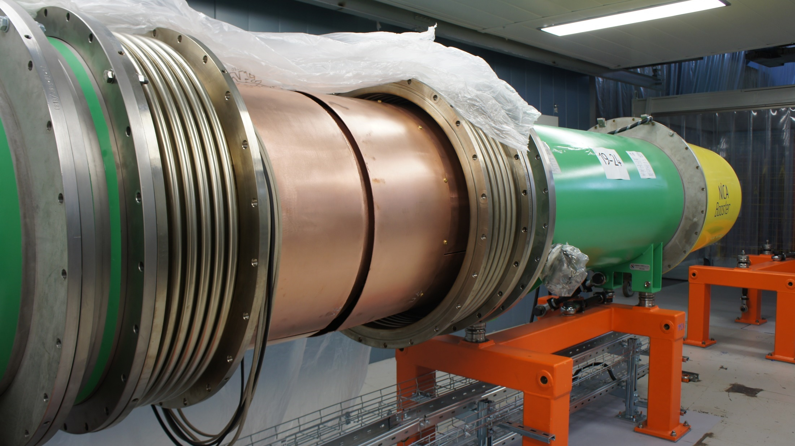
Connection of dipole magnets
14

Slide 15
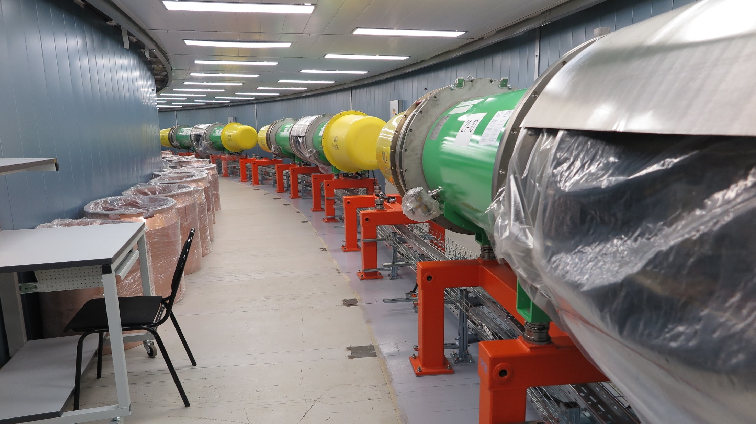
Dipole modules in tunnel
15

Slide 16
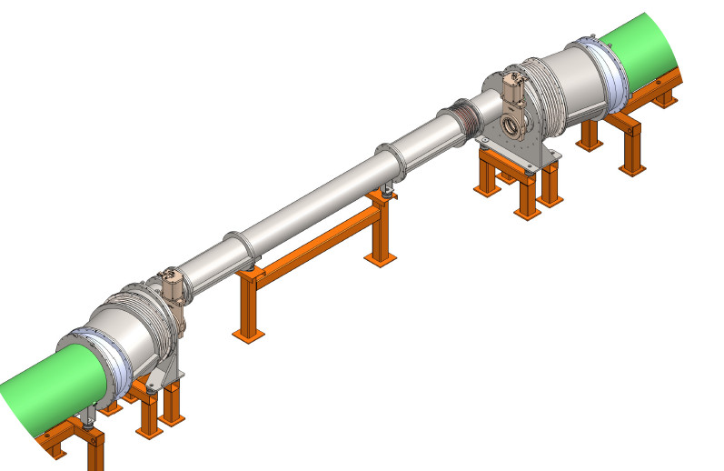
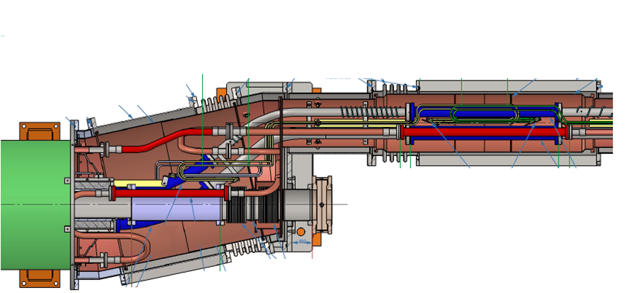
Bypass unit of I and III warm sections
Quadrant I or II
Cold-warm section
Transfer tube
Cold-warm section
All-metal gate
Quadrant III or IV
All-metal gate
Beam pipe
Cold-warm section

Slide 17
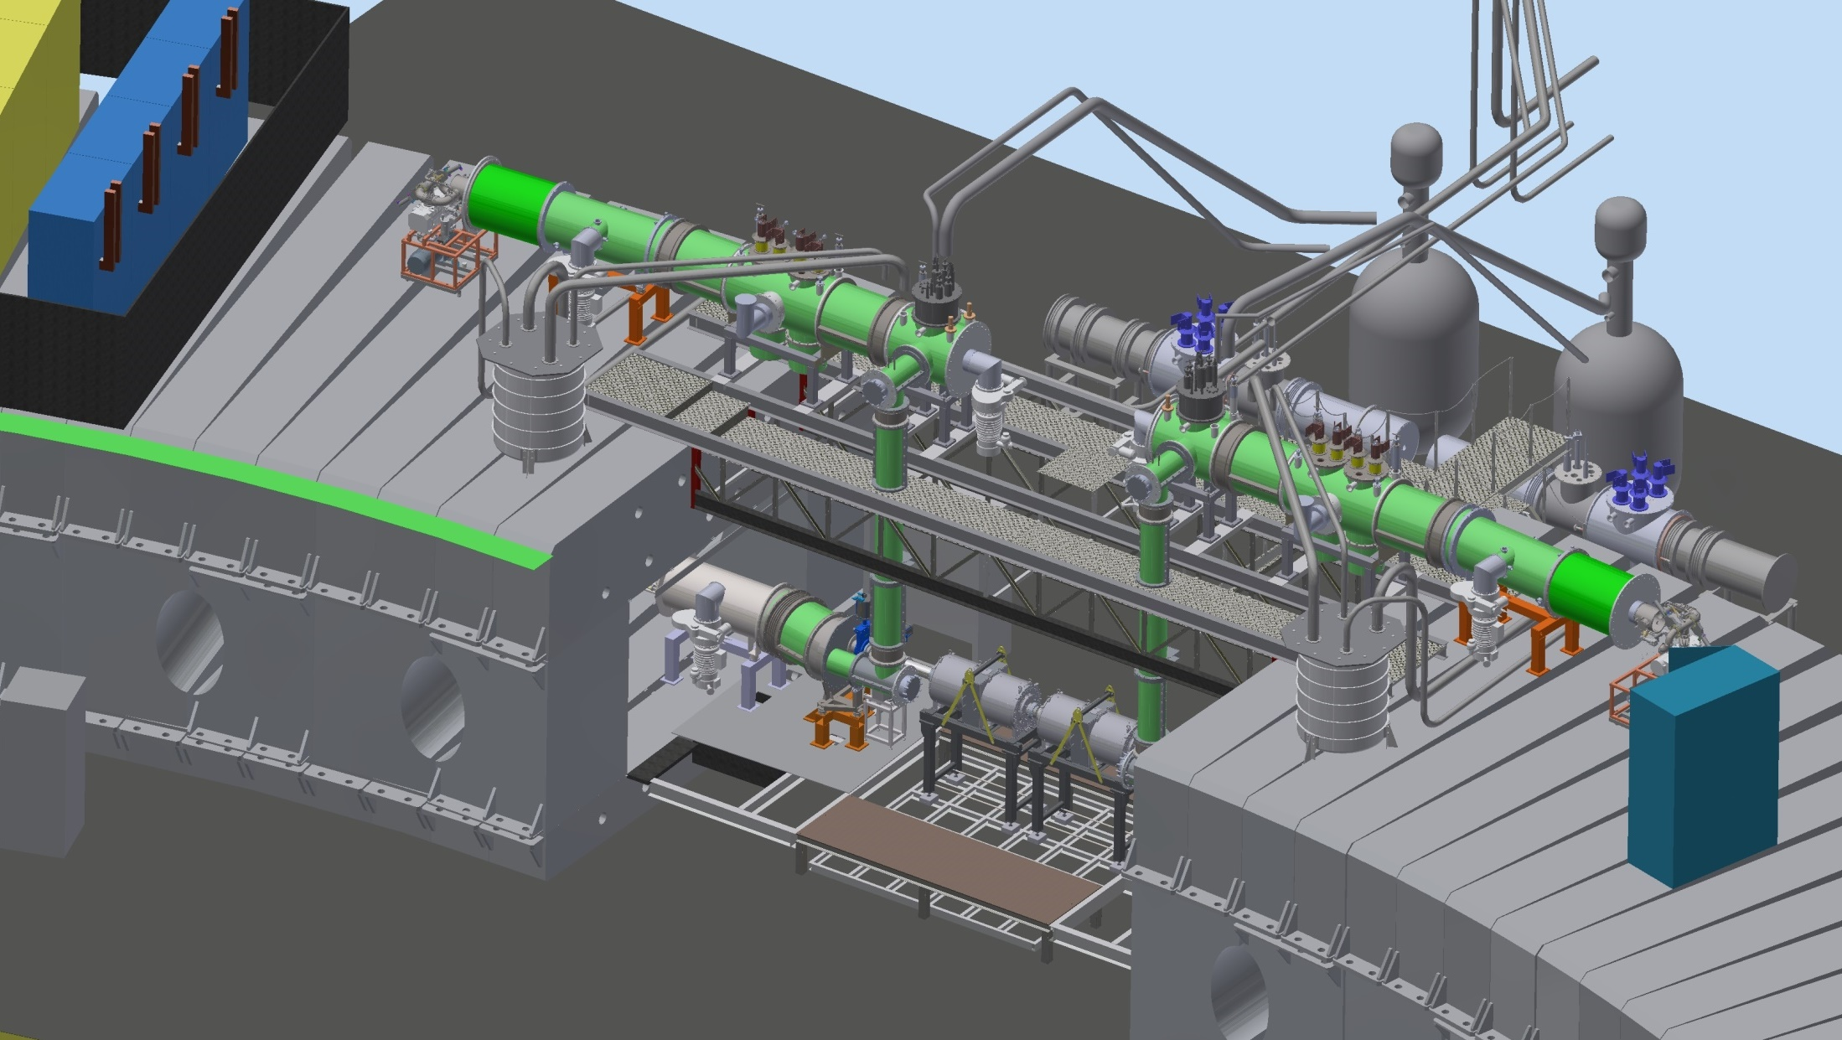
Section with reference magnets
Reference magnet
Cryogenic feeders
Feedboxes
Reference magnet
Accelerating stations
17

Slide 18
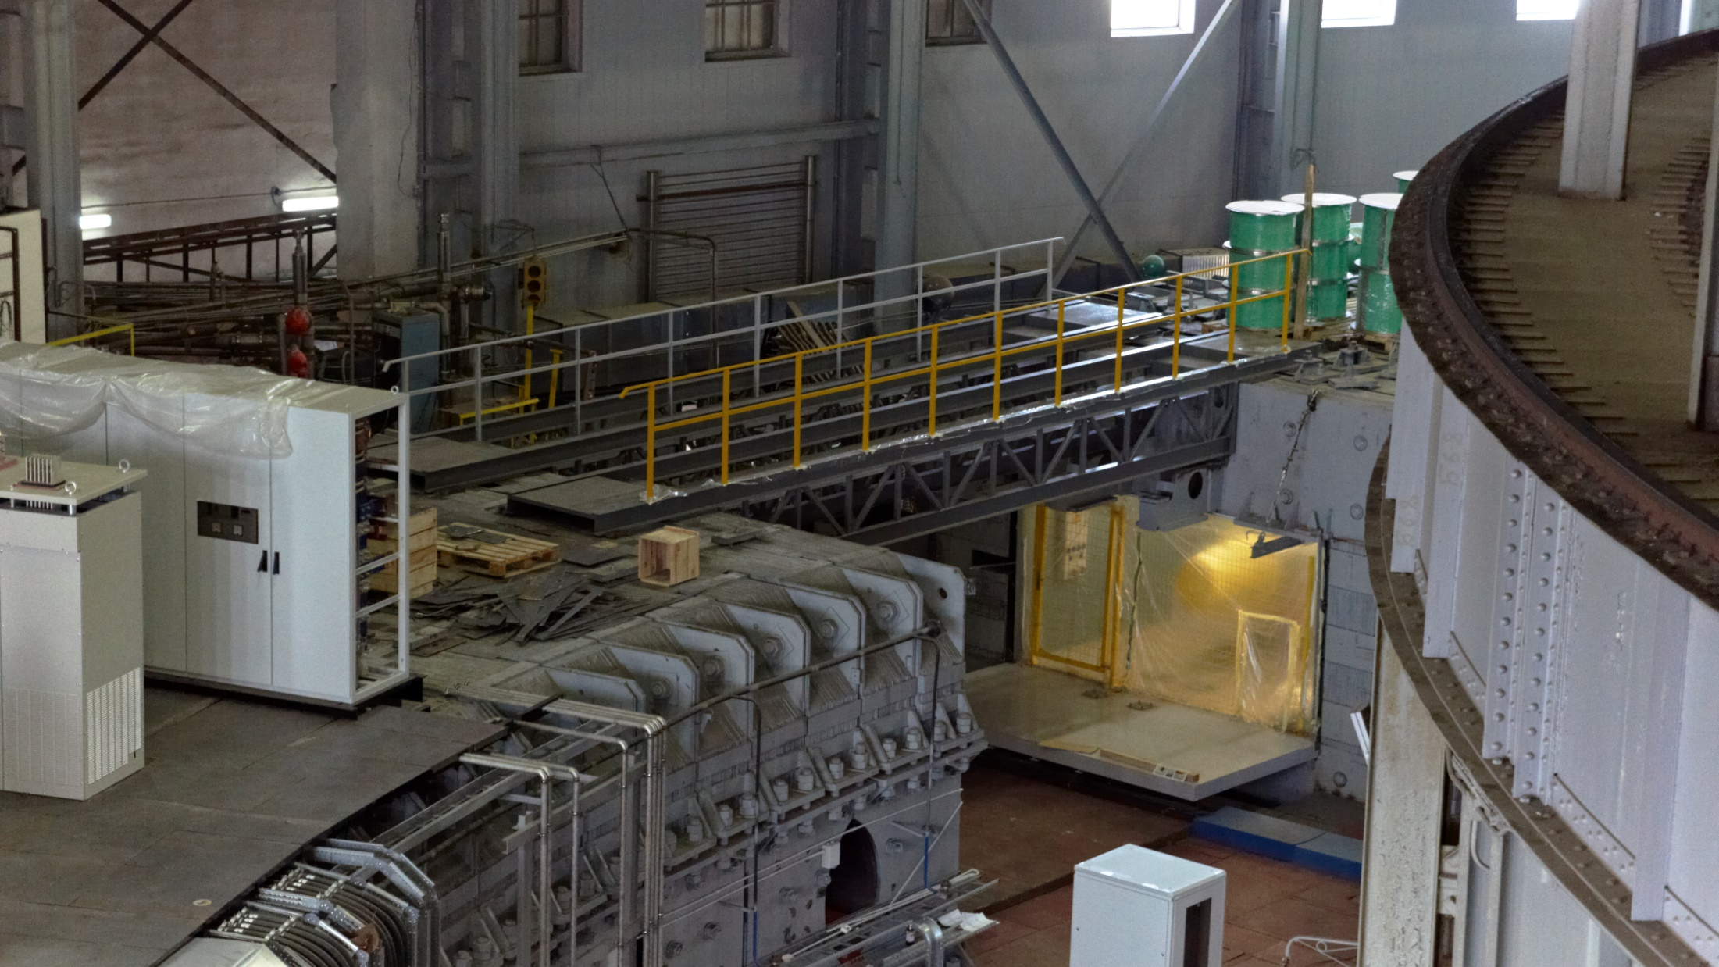
Section with reference magnets

Slide 19
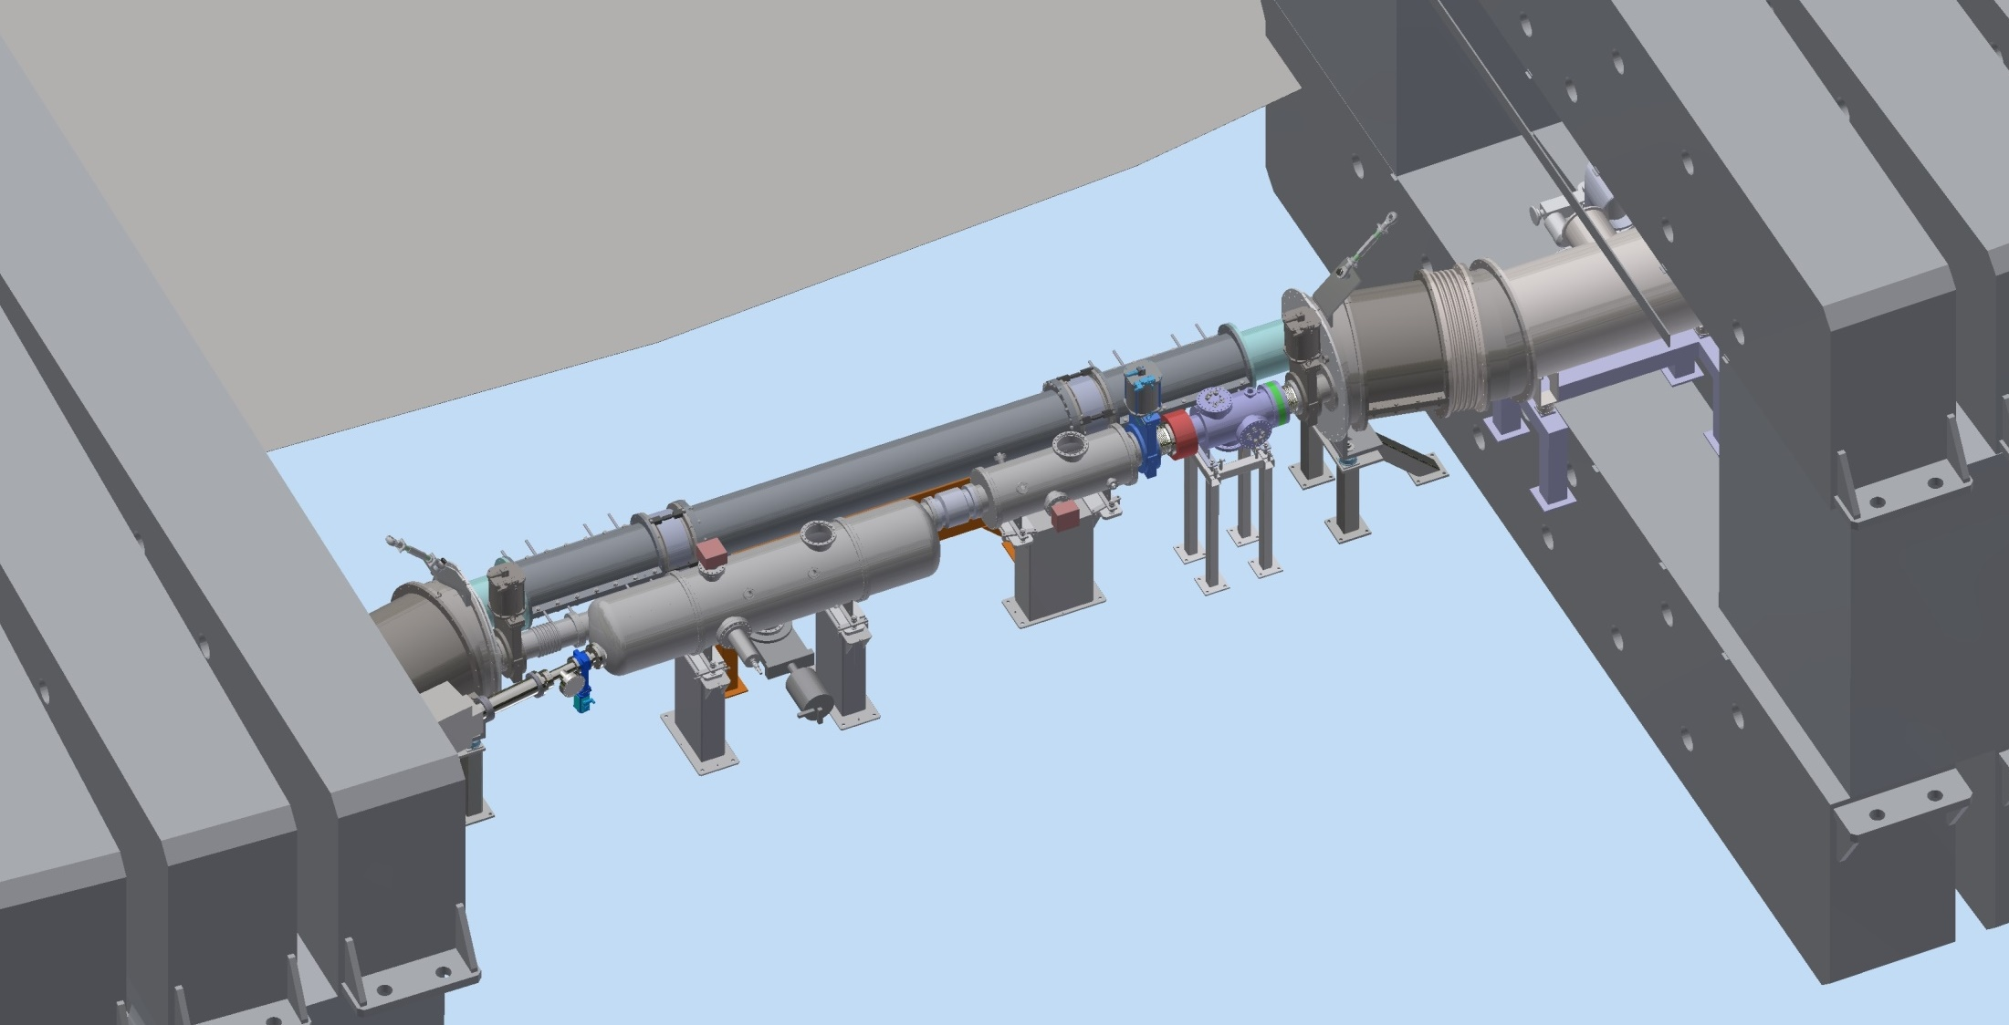
Injection section (First warm gap)
Bypass
Quadrant I
Quadrant IV
Kicker
Electrostatic septum
Injection channel from HILAC

Slide 20
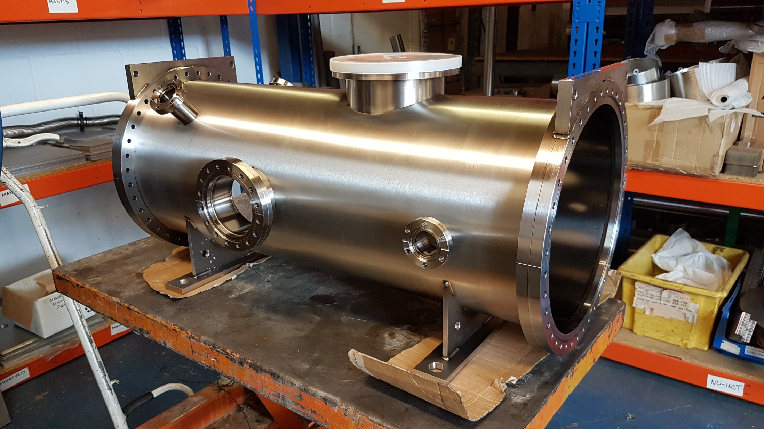
Production of electrostatic septum
• Cryosystems/HiVac companies

Slide 21
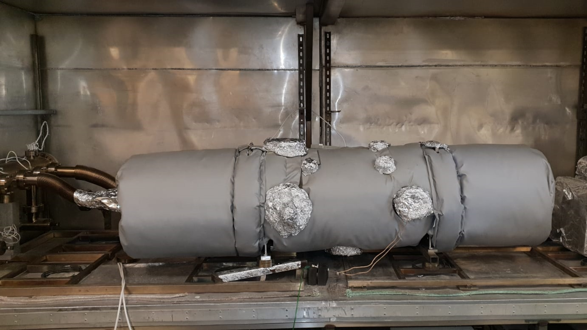
Heating of electrostatic septum
• Cryosystems/HiVac companies
21

Slide 22
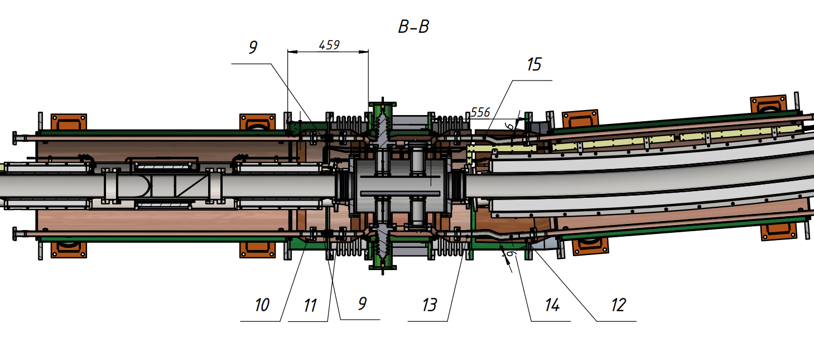
Electrostatic kicker (cold)
Plates

Slide 23
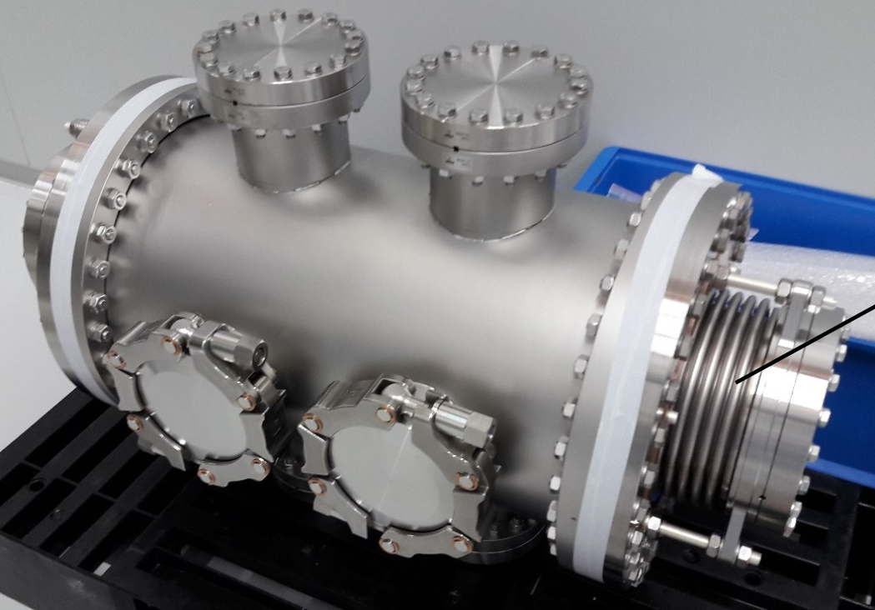
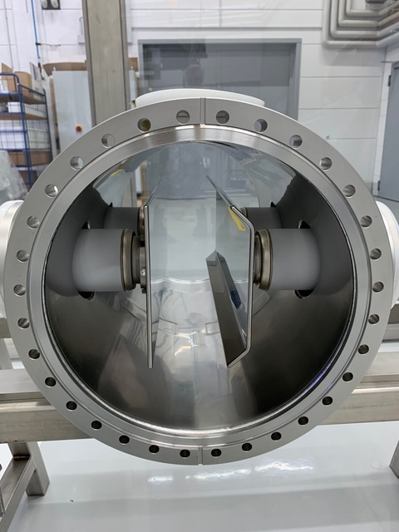
Electrostatic kicker (cold)
• BEVATECH/PINK companies

Slide 24
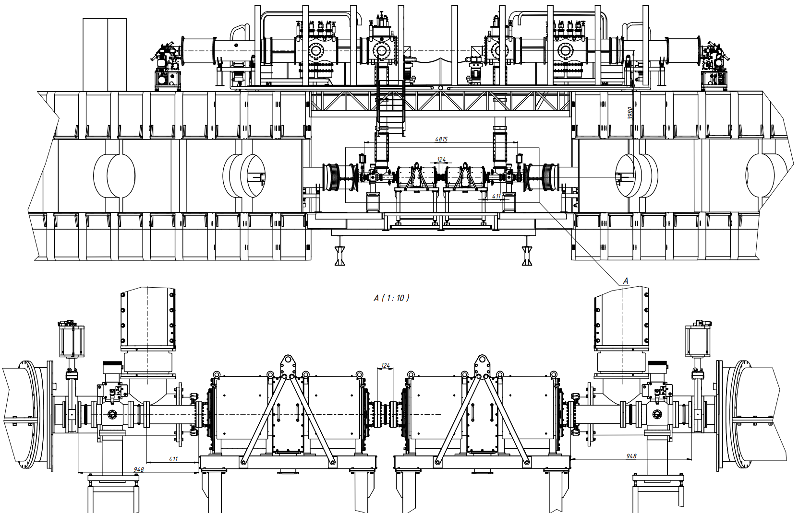
Accelerating stations (Second warm gap)
RF tanks
Pump stations

Slide 25
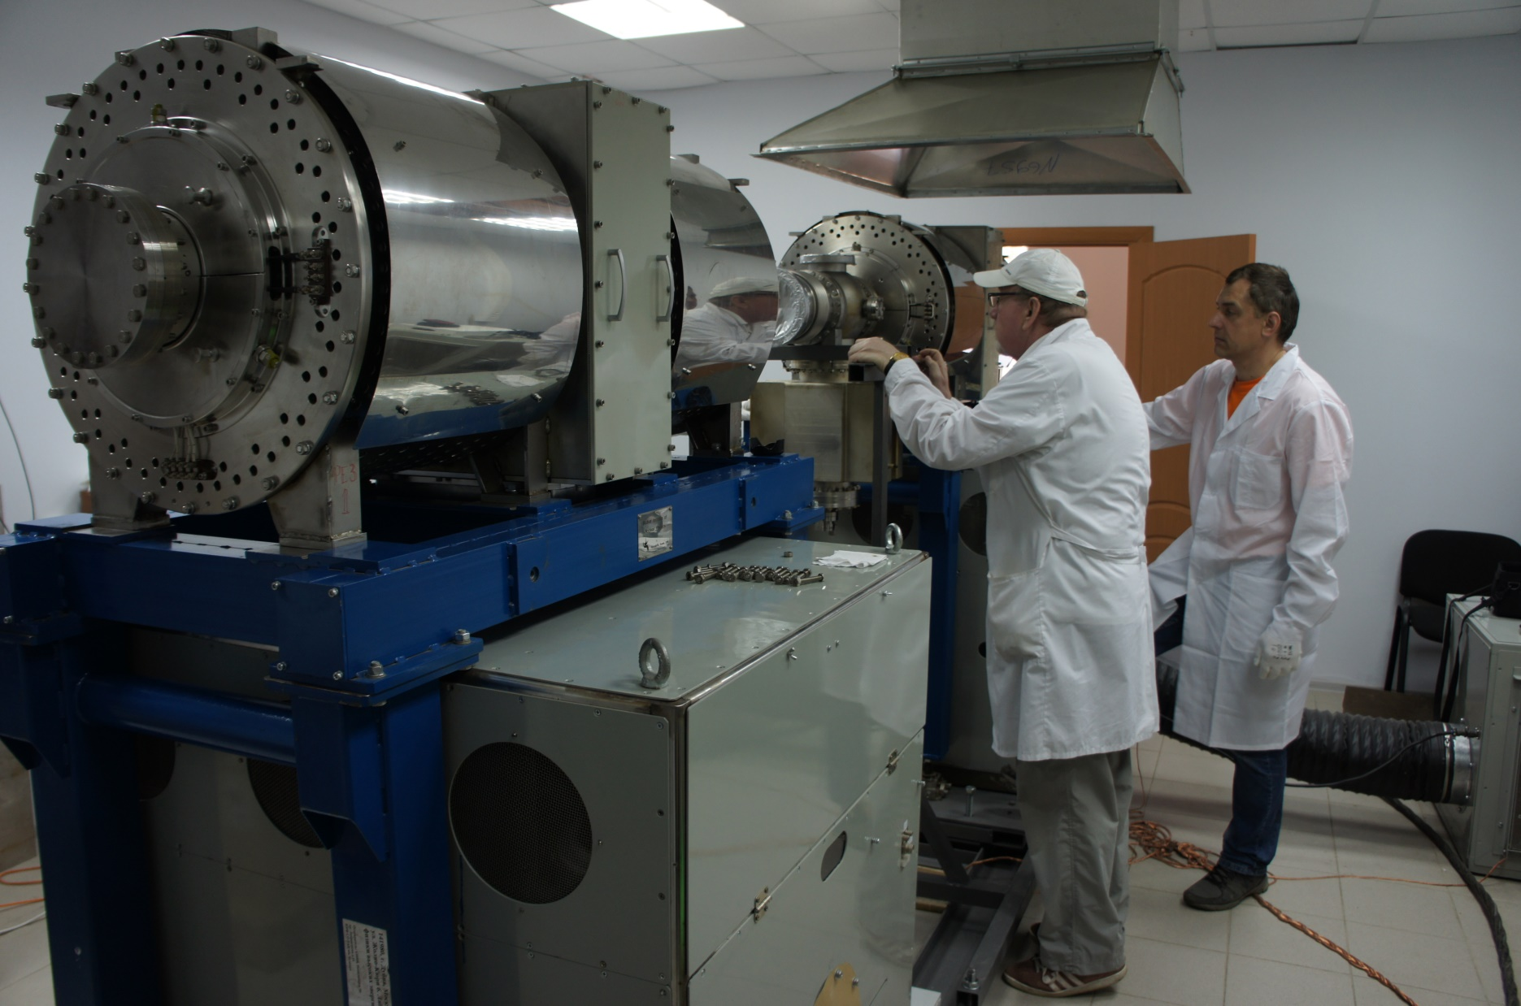
Testing of accelerating stations
• Budker Institute of Nuclear Physics

Slide 26
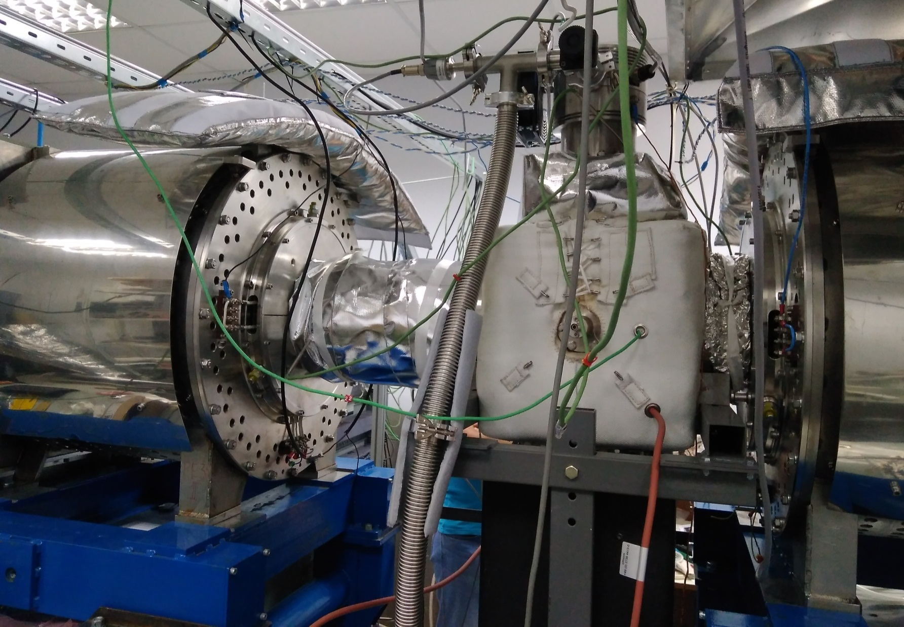
Testing of accelerating stations

Slide 27
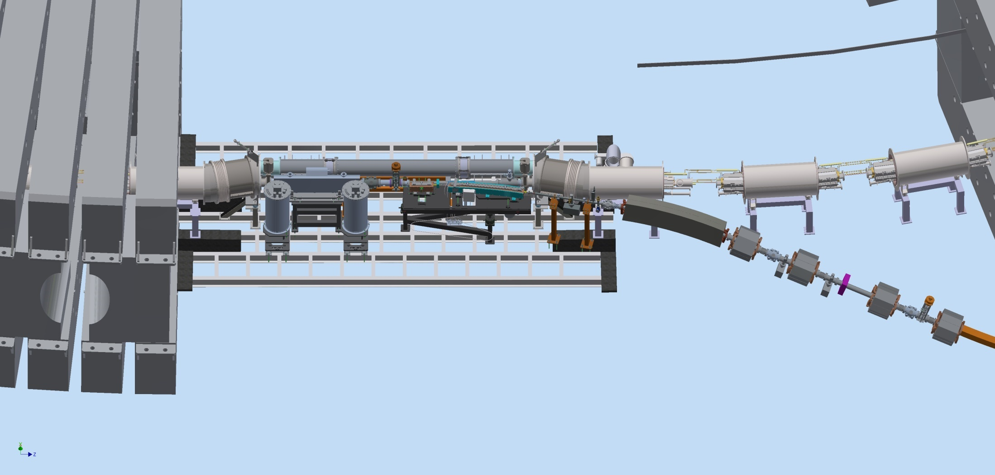
Extraction section (Third warm gap)
Bypass
Quadrant II
Quadrant III
Kicker
Pickup
Septum 1,2
Extraction channel to Nuclotron

Slide 28
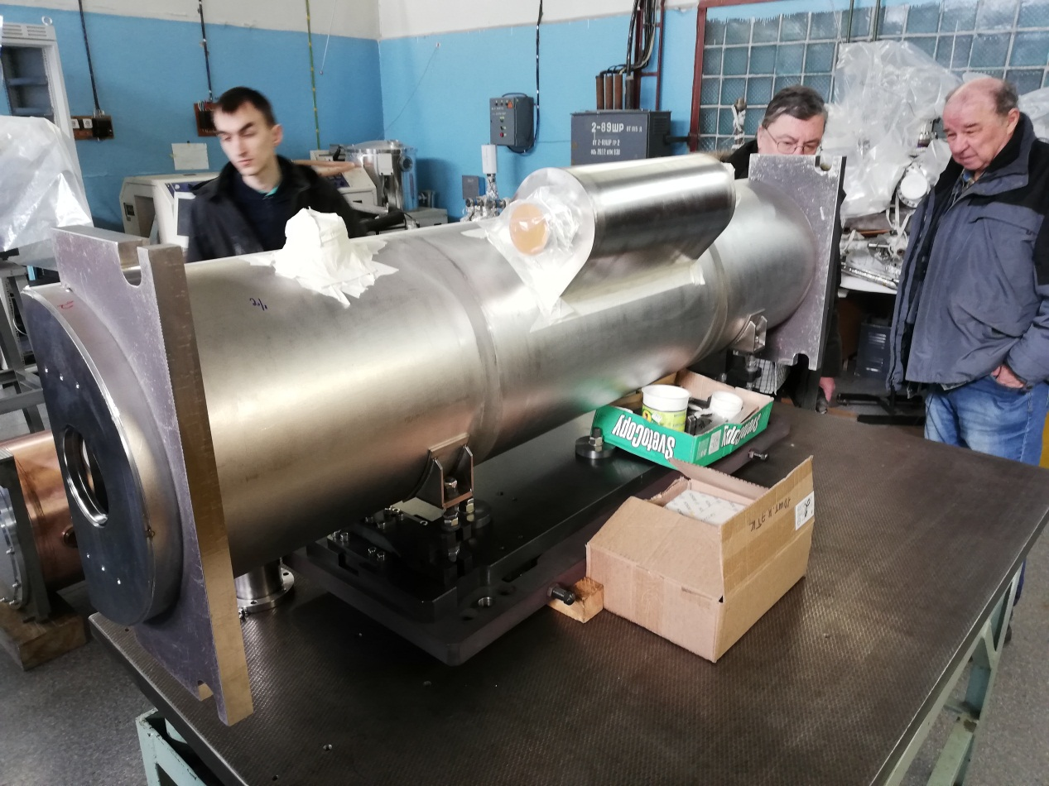
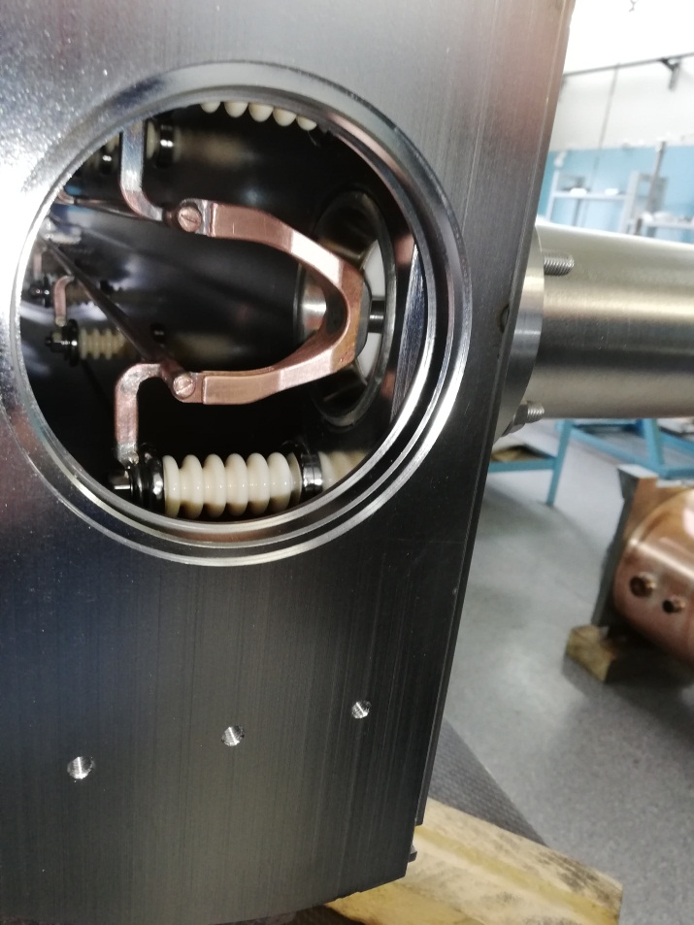
Kiker
• Budker Institute of Nuclear Physics

Slide 29
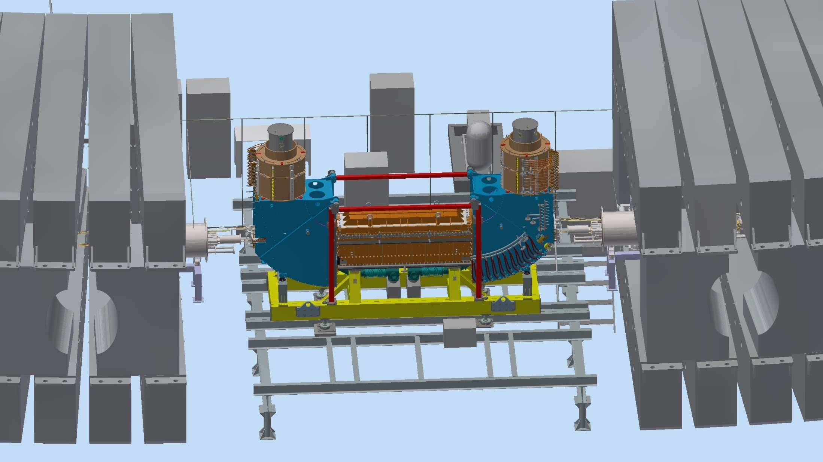
E-cooling (4-th warm gap)

Slide 30
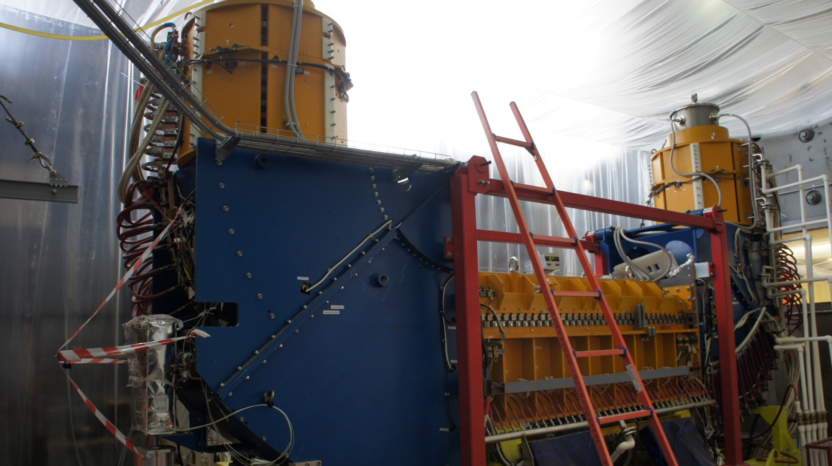
E-cooling (4-th warm gap)
• Budker Institute of Nuclear Physics
30

Slide 31
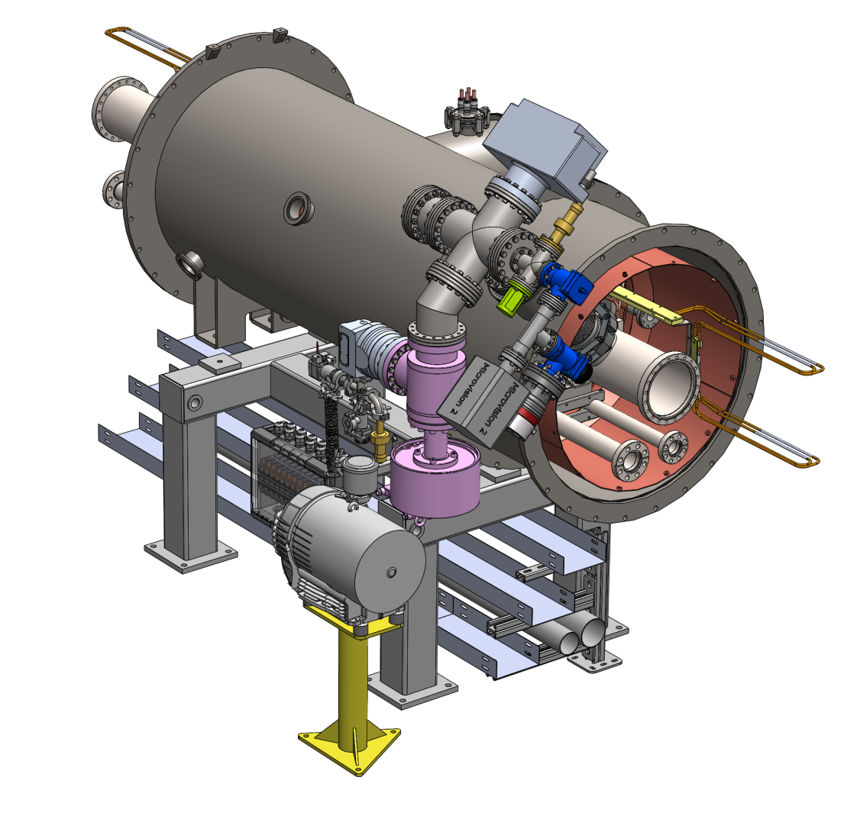
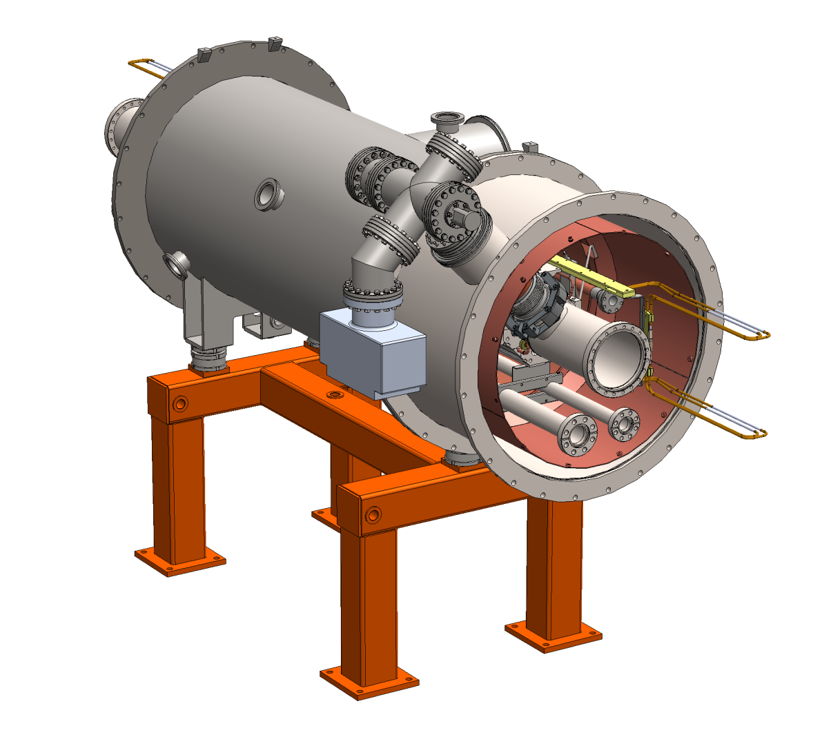
Vacuum system
Pump stations of “cold” beam channel

Slide 32
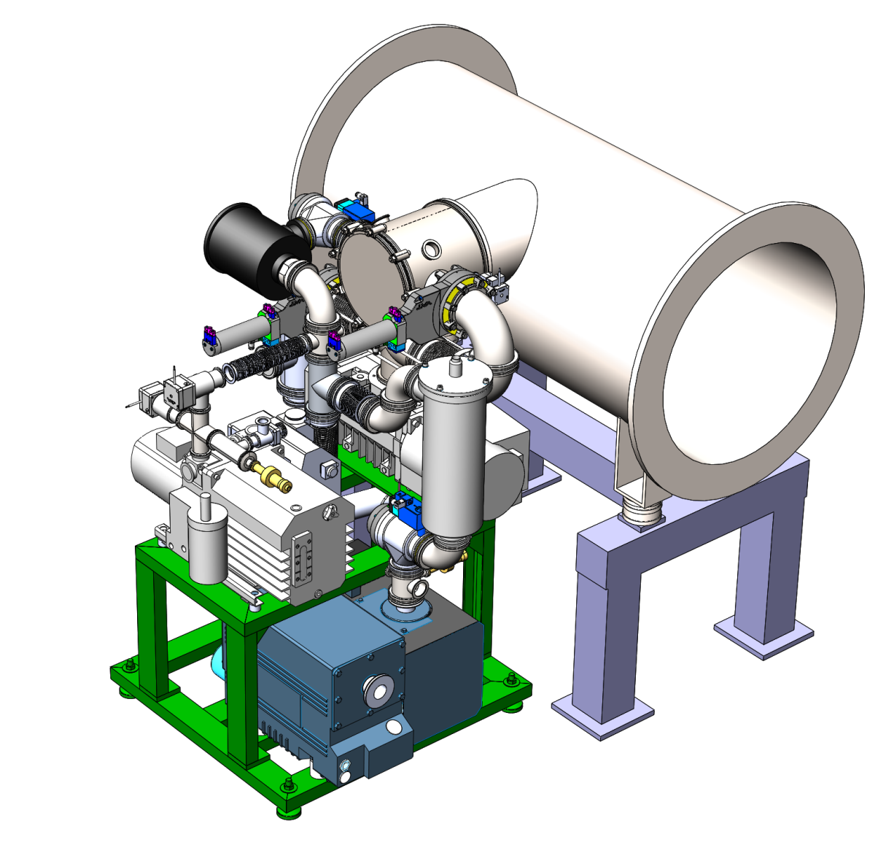
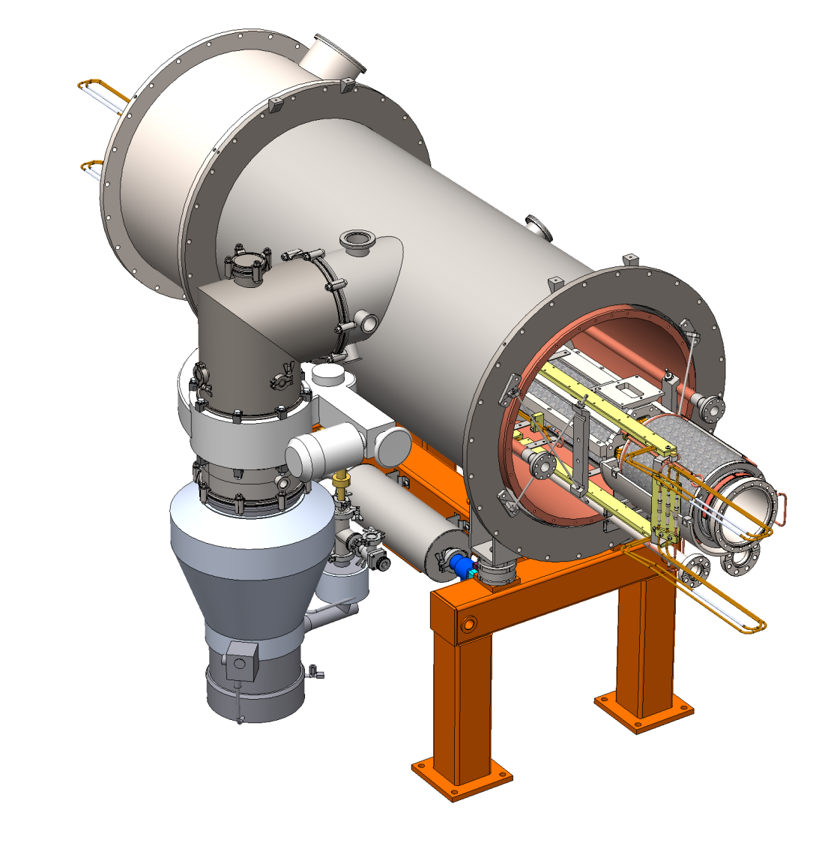
Vacuum system
Pump stations of isolation volumes

Slide 33
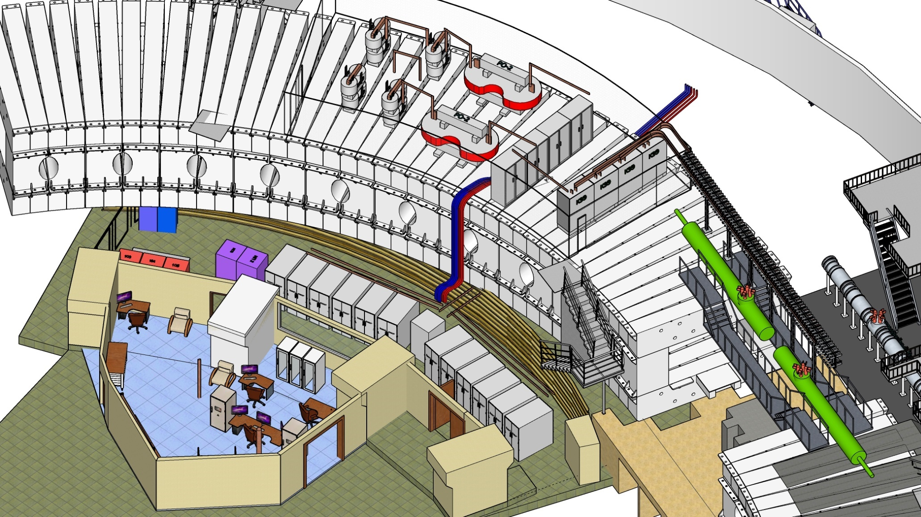
Power supply system
Evacuation energy keys
Switchboards
Current lines
Equivalent load
Power supplies
Control room
33

Slide 34
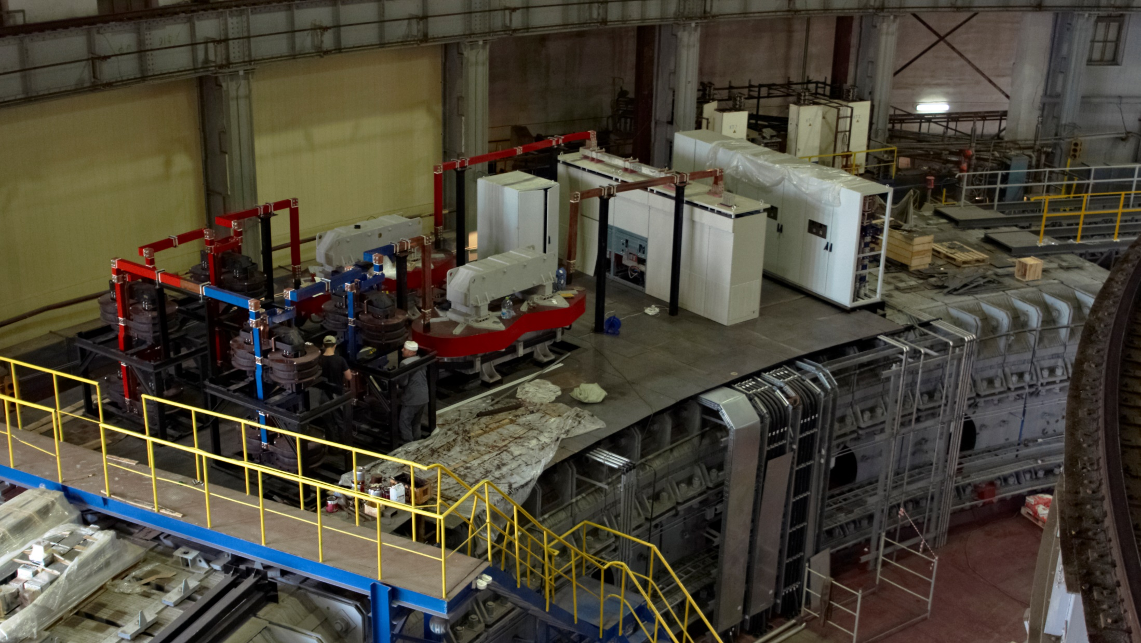
Power supply system
34

Slide 35
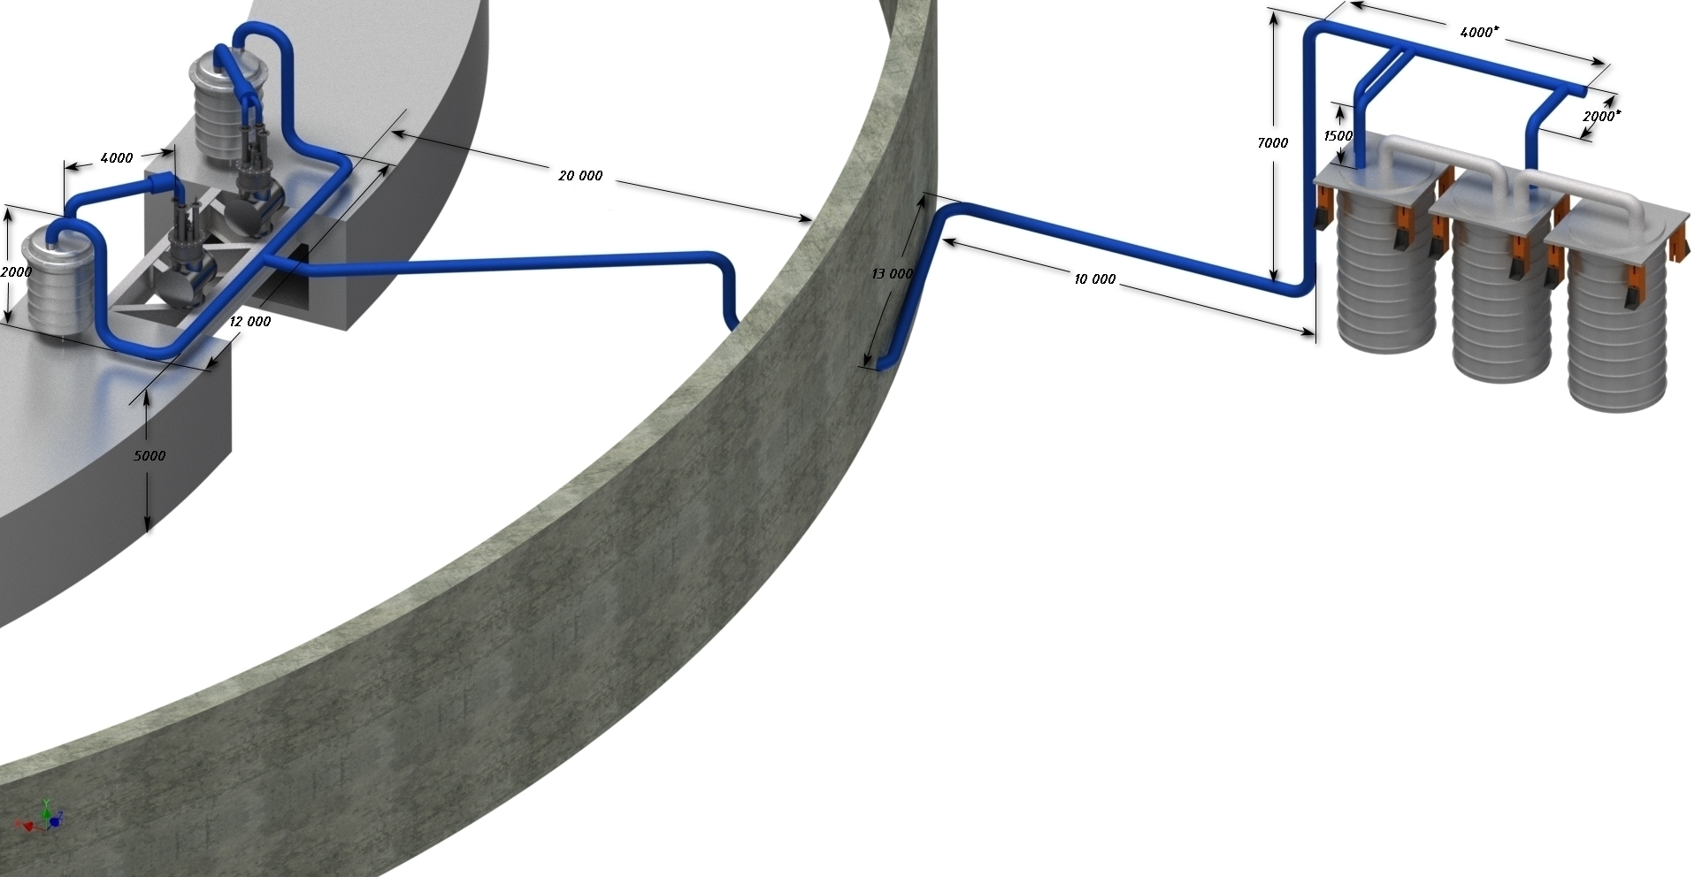
Cooling system
Helium lines
Helium separators
Helium expansion machine

Slide 36
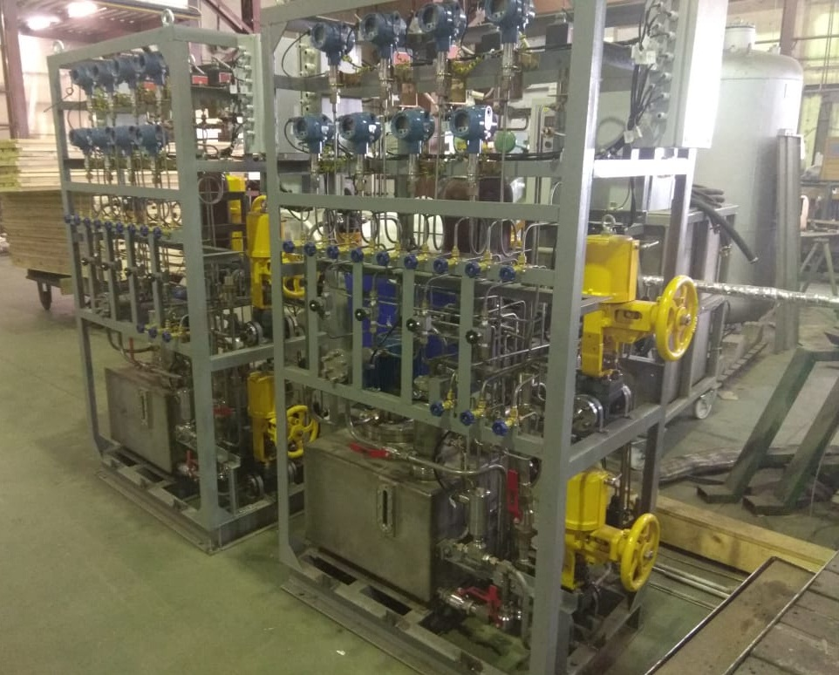
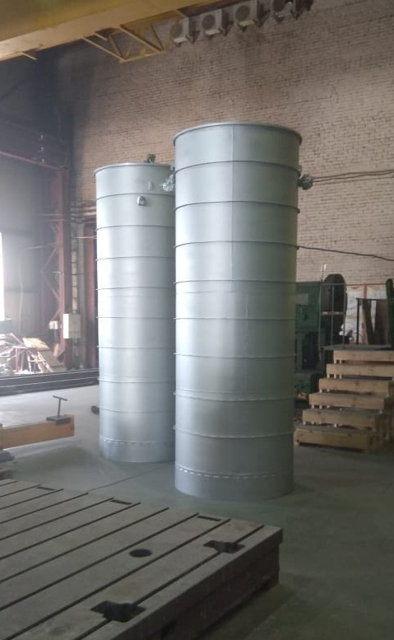
Cooling system
Gas control racks
Parts of expanders
• Helijmash

Slide 37
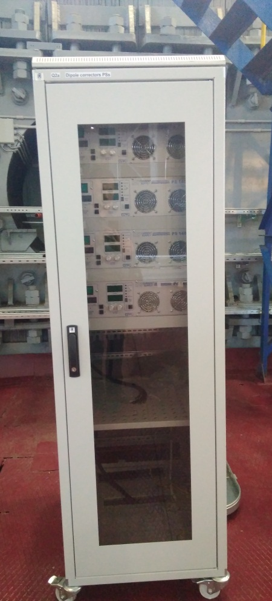
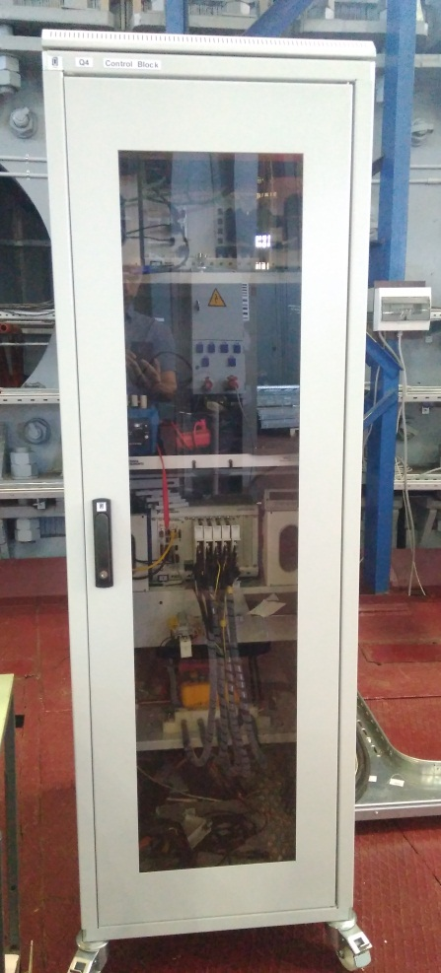
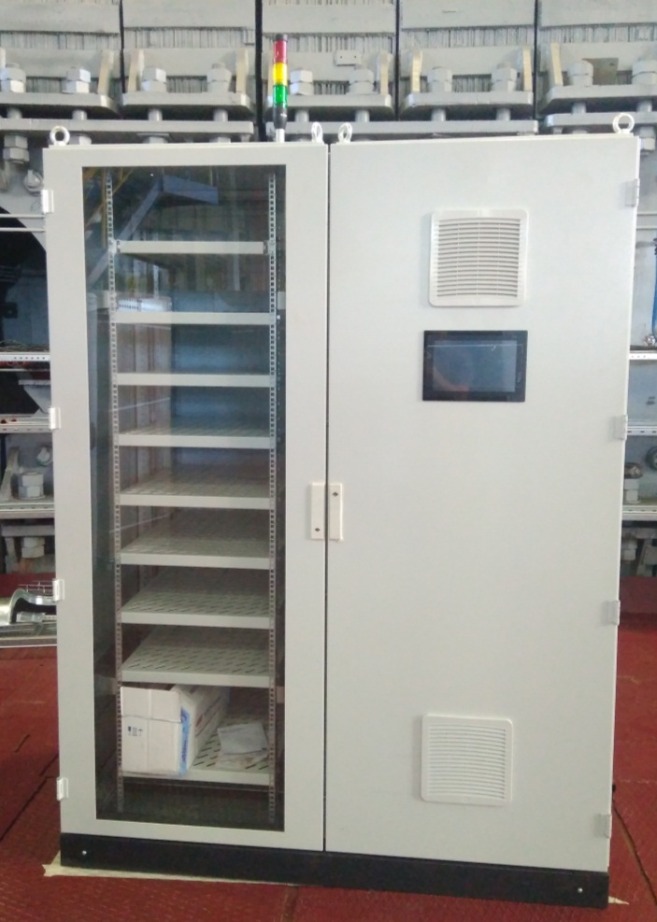
Control and diagnostic systems
Control rack of correctors
Measuring rack of BPM and thermometry
Control rack of vacuum system

Slide 38
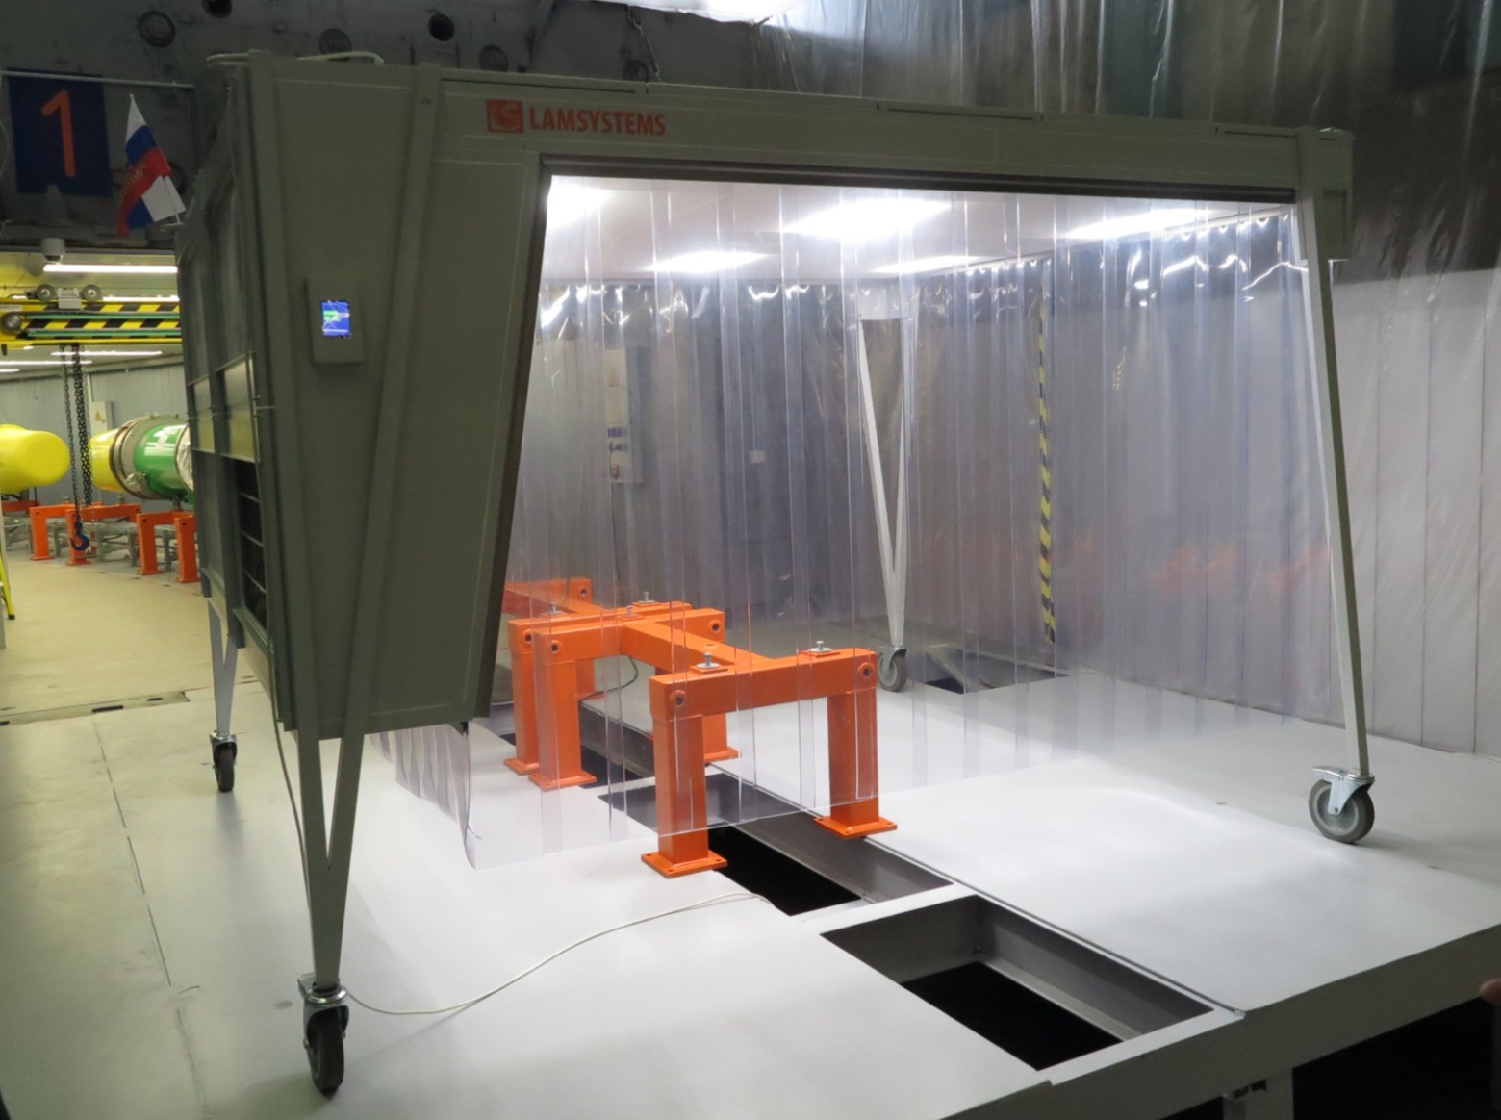
Equipment and instruments (movable clean zone)

Slide 39
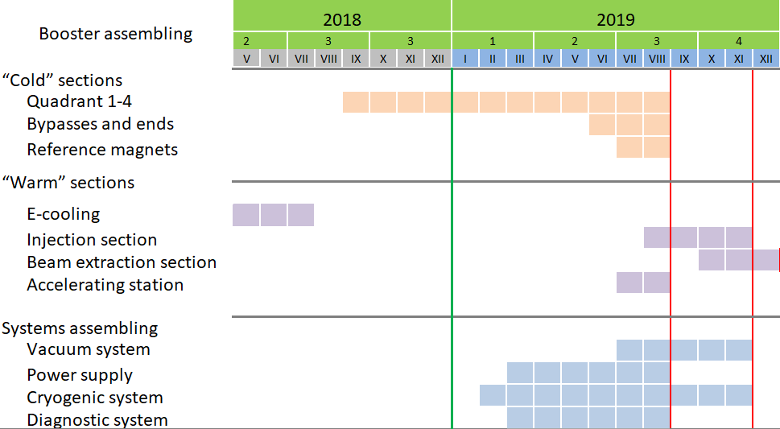
Booster assembling (time-schedule)
Technological commissioning
Commissioning
with beam
Notes:
According to plans and tasks of the NICA project booster first cooling will happen until the end of 2018. At the same time we depend on production of main components. We plan to have more then 70 % magnetic units and all equipment of vacuum systems for first launch till the middle of the next year. To this time E-coolling assembling will finish, and assembling of accelerating sections will be in process.

Slide 40
Documentations and engineering systems
approved documentation (schemes, layouts, instructions, flow charts, etc.) geodetic network; bridge cranes of building; energy supply (380/220V, 50Hz); water system (cooling equipment); movable clean zones for beam pipe and vacuum stations assembling; instruments (helium leak testers, movable pumping stations, laser tracker tools and etc.); interior of Booster tunnel and b.1 completion (floor, walls, light and etc.); compressed air system 6 bar (suppling equipment); storing places for complete products; places for preparing the units and element; | Status in hand ready; ready; in hand in hand ready ready ready in hand in hand ready

Slide 41
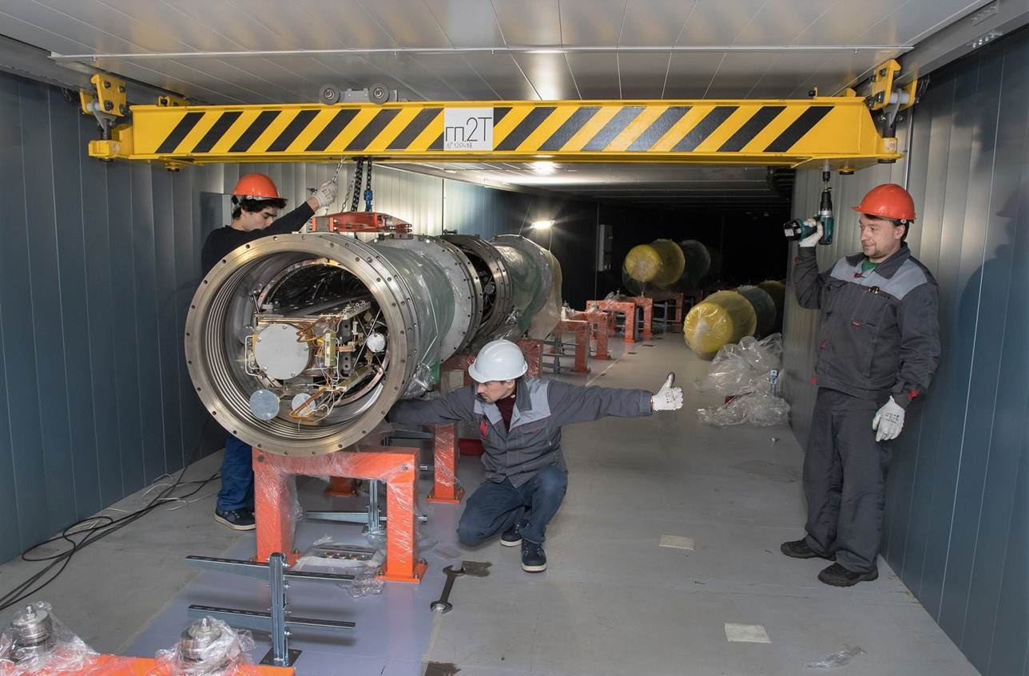
Thank you for attention

