Slide 1


Status of the NICA project development

Slide 2
NICA Stage I (BM@N):
Injection complex: KRION, HILAc, LU20
Synchrotron Booster
BT Line Booster – Nuclotron
Nuclotron upgraded
BM@N Detector setup
NICA Stage II-a (basic configuration):
22 bunches σ ∼ 2 m per ring L=5e25 cm⁻²⋅s⁻¹
Jan 2022
+
Collider equipped with
RF-1
RF-2: 2 cavities per ring Instead 4 (50 kV RF amplitude instead 100 kV)
1 channel of S-cooling per ring (long. cooling)
NICA Stage II-b (full configuration):
22 bunches σ ∼ 0.6 m per ring L=1e27 cm⁻²⋅s⁻¹
+ RF-2 systems in project version
+ RF-3 systems in project version
+ S-cooling in project version
+ E-cooling
MPD:
+ inner tracker systems
+ forward trackers
NICA Stage III (polarized beams and spin physics)

Slide 3
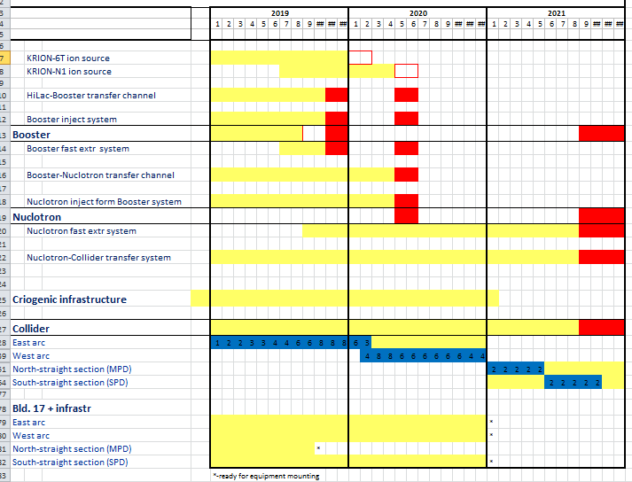
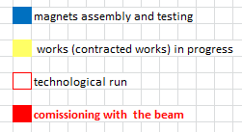
Time-schedule
Booster commissioning
to BM@N
NICA stage 2a
Jan
2022

Slide 4
Facility components’ – status
2019
KRION
Linac HILac
KRION
Linac HILac
Ion sources
Booster (25 Tm)
1(2-3) single-turn injection,
storage of (2 ÷ 4)×10⁹ ions,
acceleration up to 100 MeV/u,
electron cooling, acceleration
up to 578 MeV/u
Ion sources
Linac LU-20
Linac LU-20
Fixed Target Area
Fixed Target Area
Slow resonance extraction
Stripping (80%) ¹⁹⁷Au³¹⁺ => ¹⁹⁷Au⁷⁹⁺
IP-2
Nuclotron (45 Tm)
injection of one bunch
of ≤ 2×10⁹ ions,
acceleration up to
1 - 4.5 GeV/u max.
Nuclotron (45 Tm)
injection of one bunch
of ≤ 2×10⁹ ions,
acceleration up to
1 - 4.5 GeV/u max.
Collider
L ≥ 10²⁷ см⁻²с⁻¹
IP-1
work in progress
assembly
commissioned / existing

Slide 5
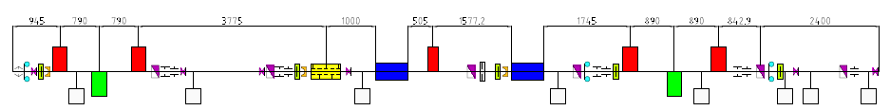
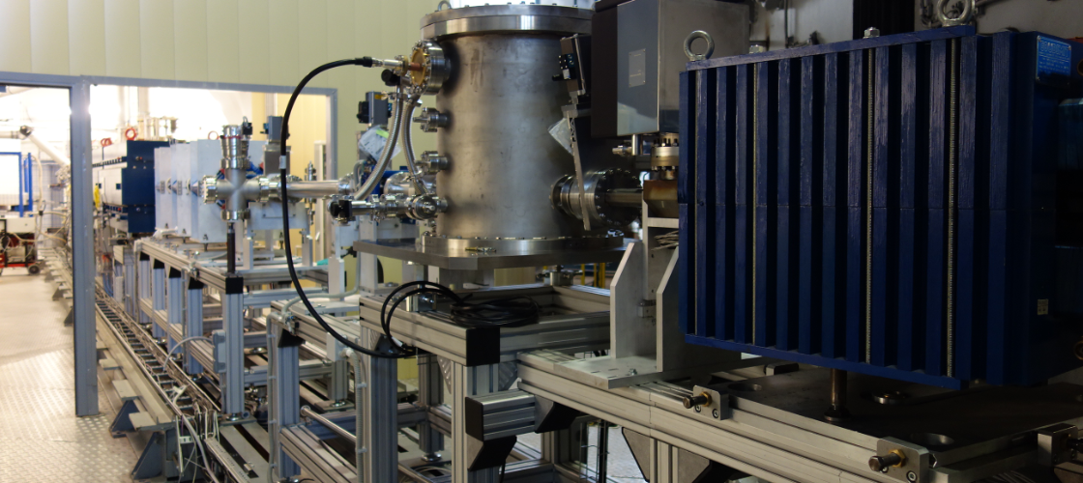
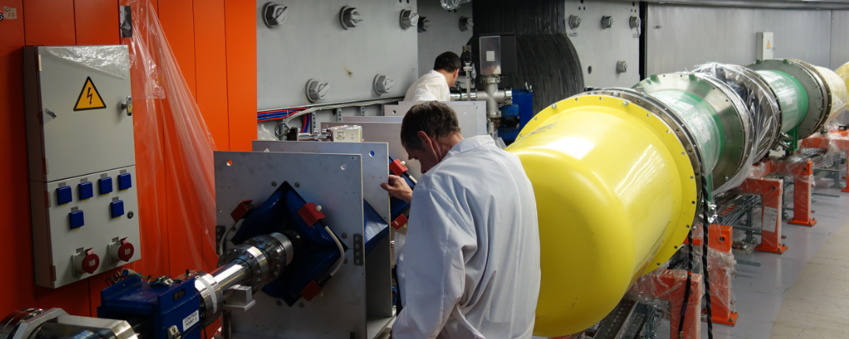
HILAc-Booster transport channel
transport with minimal ion losses
debunching
matching
Separation and adsorption of neighbor charge states of ions.
Provide different schemes of the beam injection into the Booster.
Mounting should be finished this month

Slide 6
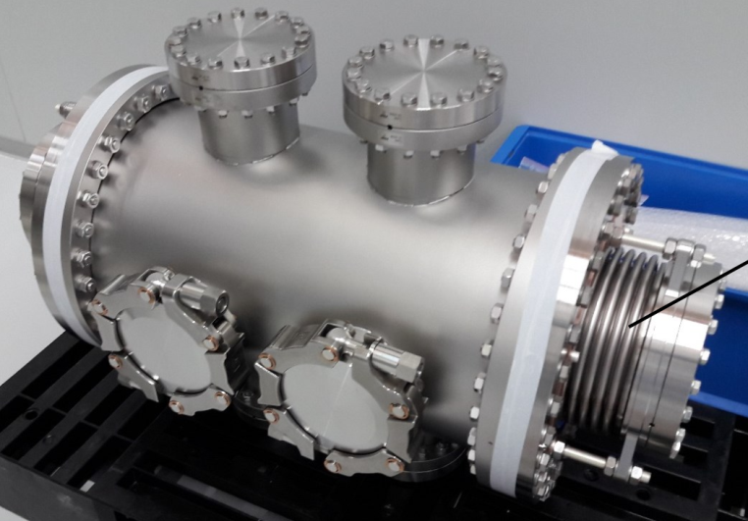
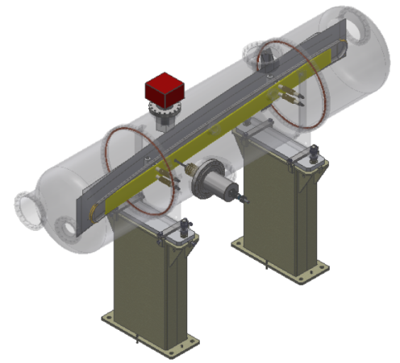
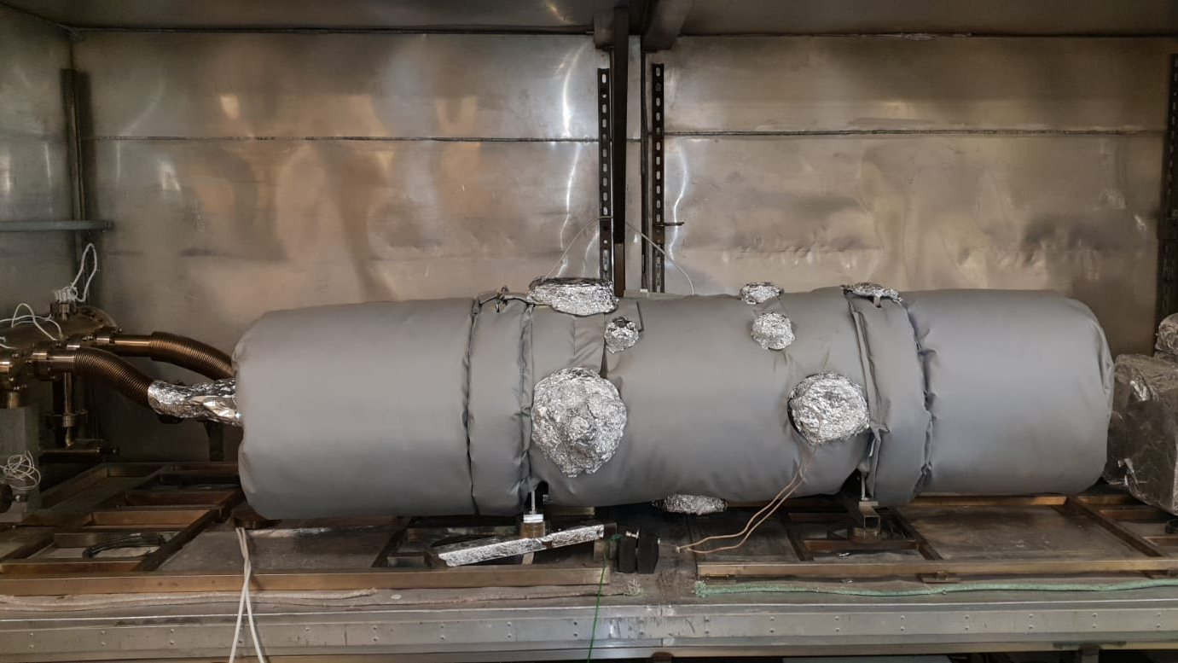
Booster injection system
IP1
ESS
IP2
IP3
ESS + IP2 delivery June 2019 CryoSystems
IP3 delivery
July 2019
Bevatech + Pink
IP1 – ordering in
Aug 2019
injection with minimal ion losses
single-turn injection, multiturn injection, multiple injection.

Slide 7
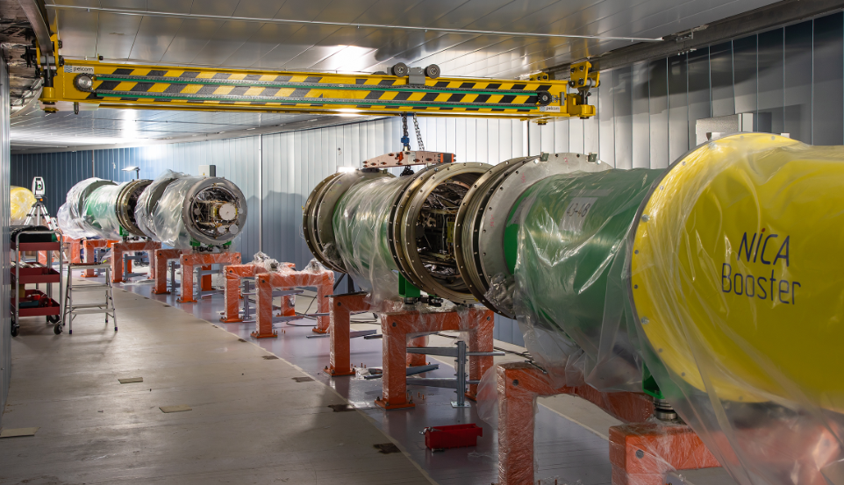
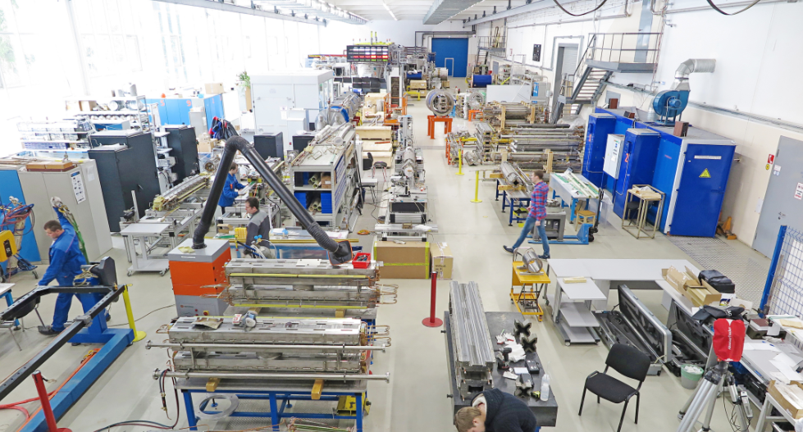
Booster
90% sc-magnets passed tests
50% of magnets delivered to ring tunnel
accelerator infrastructure under mounting
technological run
Sept 2019
run with beam up to the end of 2019

Slide 8
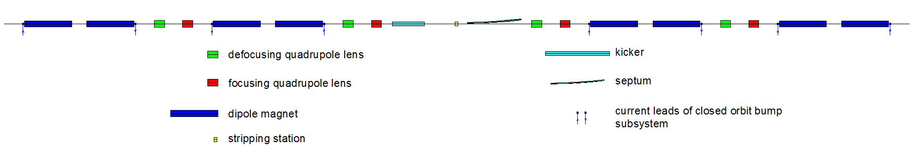
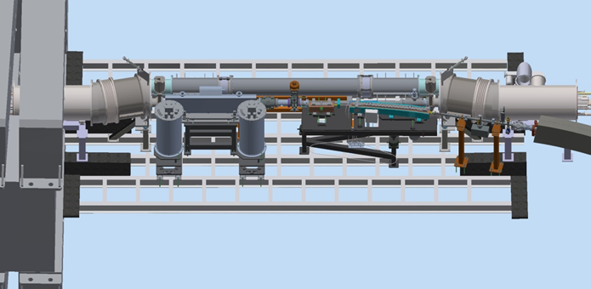
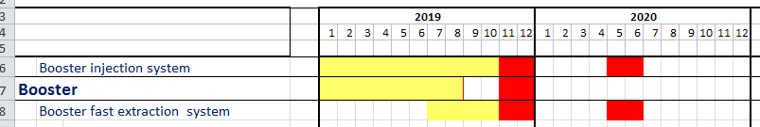
Booster fast extraction system
kicker + septum + stripper + power supplies …. delivery from BINP Sep 2019
kicker
septum
commissioning
final tuning

Slide 9
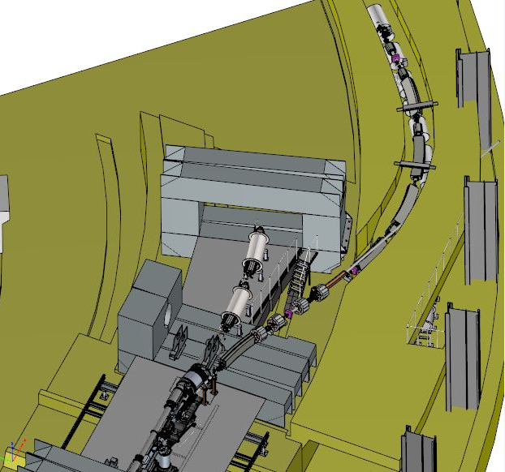
Booster-Nuclotron transport channel
beam transport with minimal ion losses
Separation of neighbor charge states.
under contract with BINP
Channel delivery
March 2020
…April 2020 start mounting

Slide 10
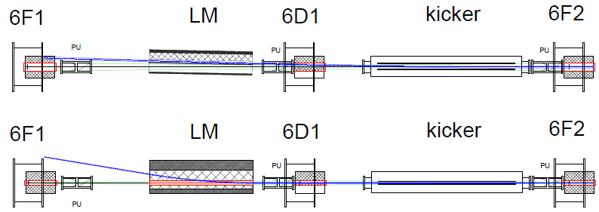
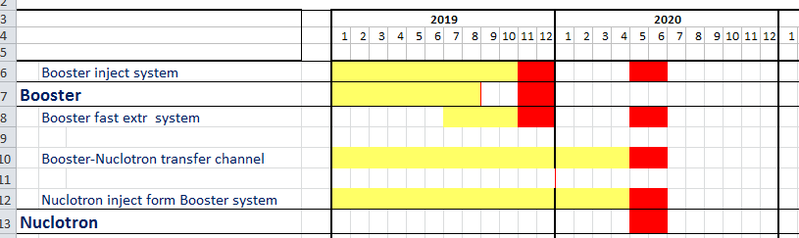
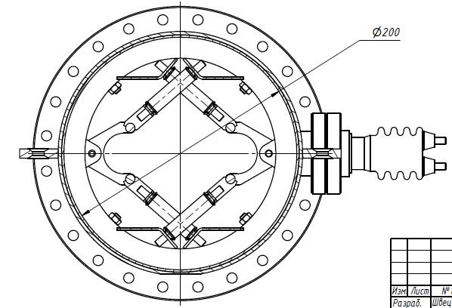
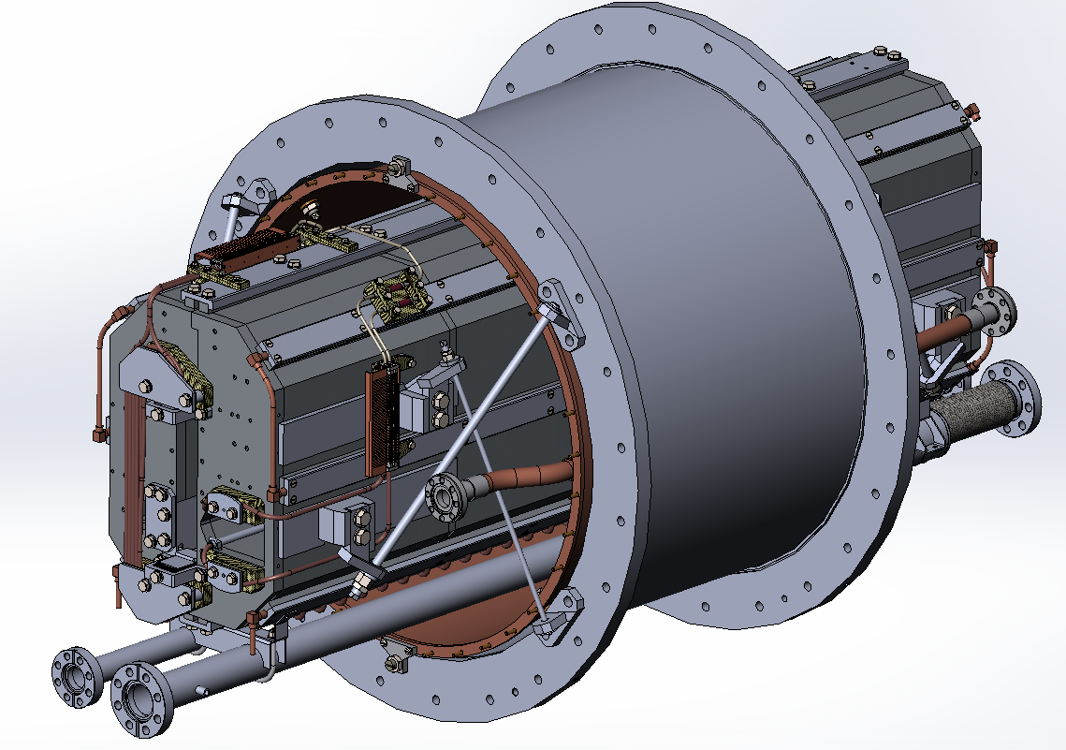
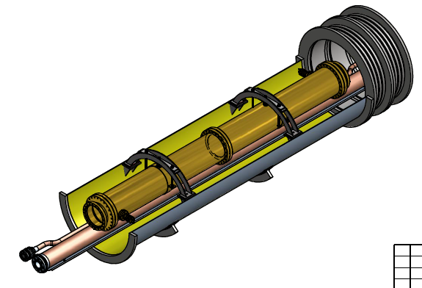
Nuclotron high energy beam injection system
Kicker
Lambertson magnet
Length, m | 2
Max magnetic field, T | 0.1
Max current, kA | 15
Aperture, mm×mm | 86 × 44
Pulse duration, μs: rise plateau fall | free ≥ 0.5 ≤ 0.5
Length, m | 1.5
Max magnetic field, T | 1
Septum thickness, mm | 7
Power supply | DC
Lambertson magnet is based on existing spare yoke for slow extraction system of Nuclotron.
Yoke modification has to be finished.
Development of design of a cold kicker is finishing.
Warm prototype for mechanical tests has been manufactured.
10

Slide 11
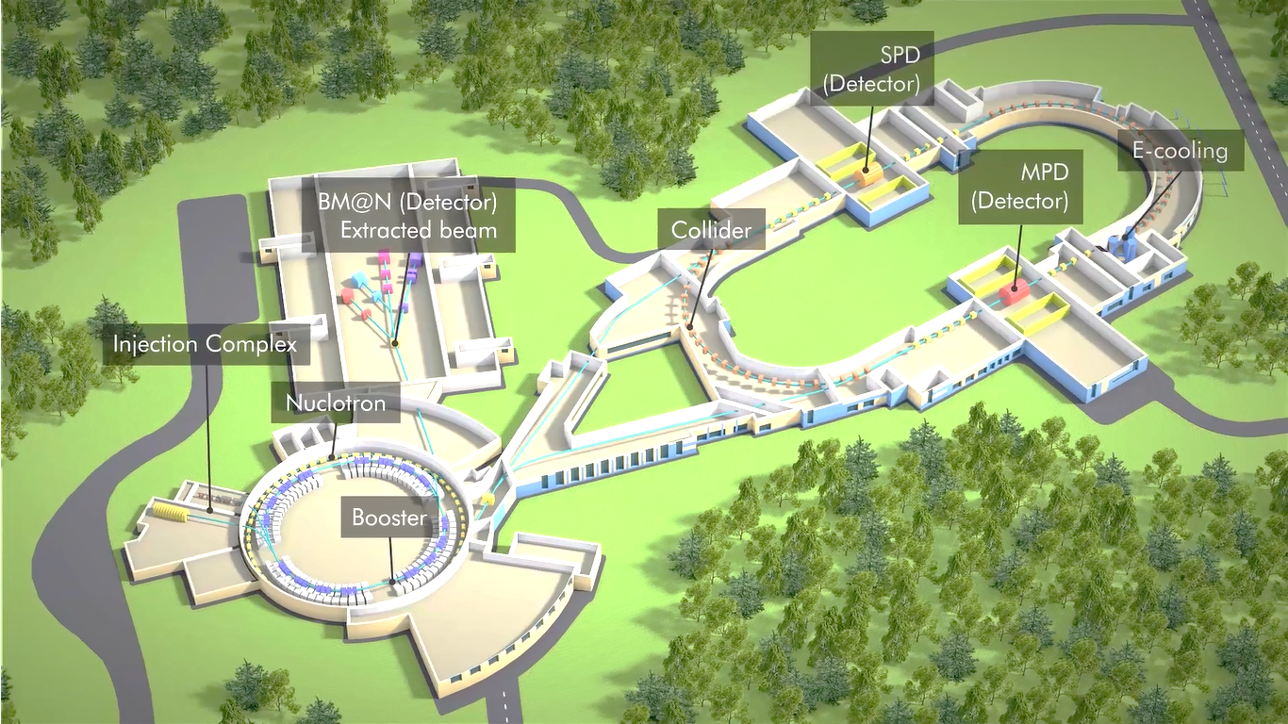
Nuclotron-Collider beam transfer channel
88 magnets
30 power supply racks
45 diagnostic devices
200 beam pipes and bellows
55 vacuum pumps
12 vacuum gates
6 for-vacuum pumps
20 vacuum-meters
8 control racks
Goals
Accumulation of required intensity of ions (with help of barrier bucket system and beam cooling systems of Collider).
under contract with SigmaPhi
Delivery to JINR – until end 2019
July 2020 – start mounting
Commissioning - end 2021

Slide 12
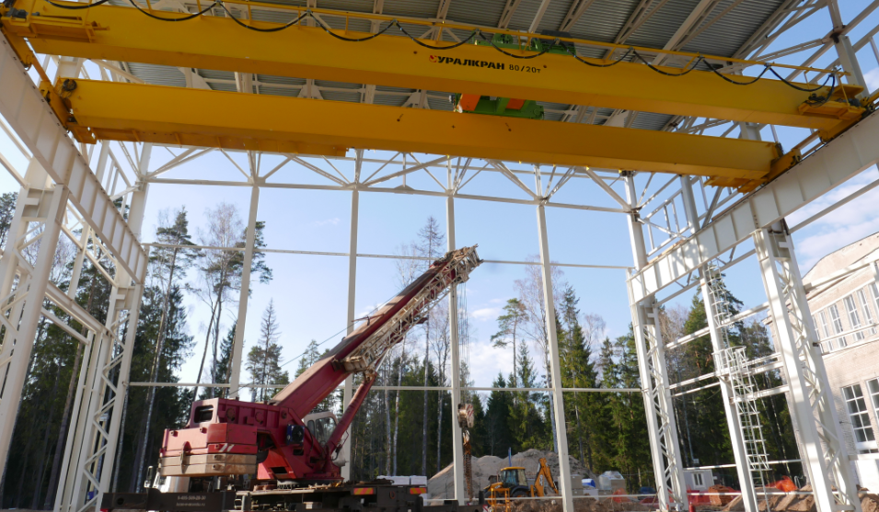
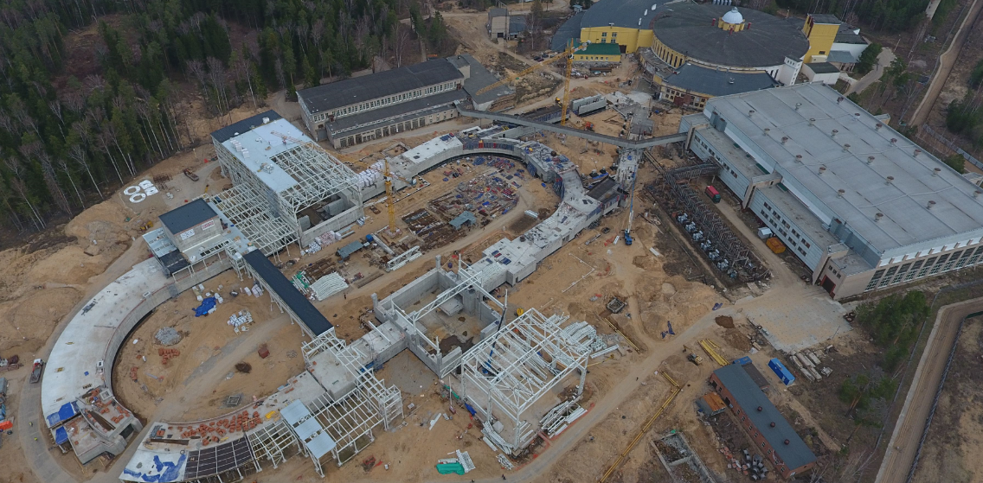
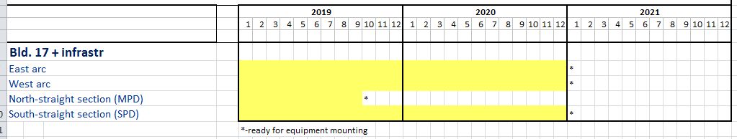
Collider building construction
ring equipment mounting (12 months)
Apr 2019

Slide 13
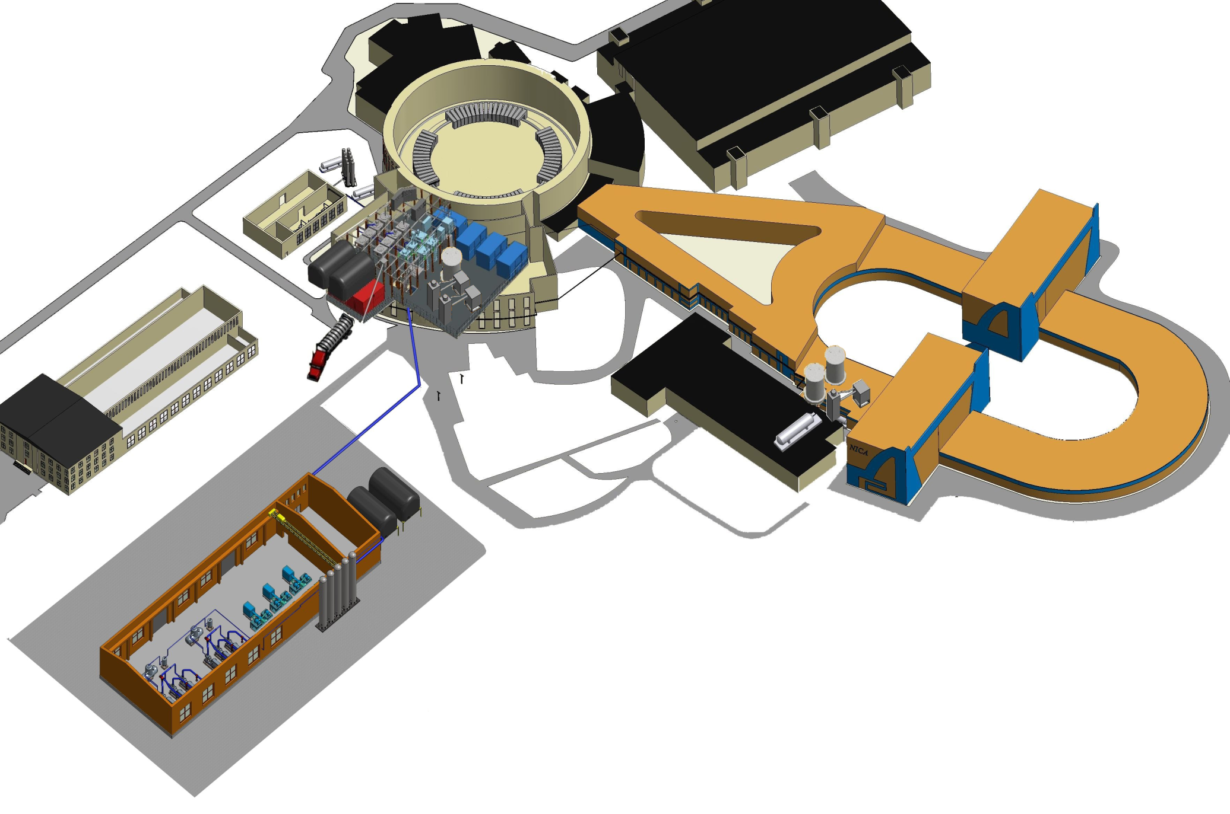
Cryogenics
Delivered Delivery in 2019 Delivery in 2020
1000 l/h helium liquefier OG–1000
draining and oil-purification units MO–800
satellite refrigerators RSG–2000/4.5
of the collider
500 kg/h nitrogen re-condenser RA–0.5 of the Nuclotron and booster
40 m³ liquid helium tank
2x6600 Nm³/h helium screw compressors
satellite refrigerator
RSG–2000/4.5
of the booster
1300 kg/h nitrogen liquefier OA–1.3
3x10740 Nm³/h nitrogen turbo compressors
500 kg/h nitrogen re-condenser RA–0.5 of the collider

Slide 14
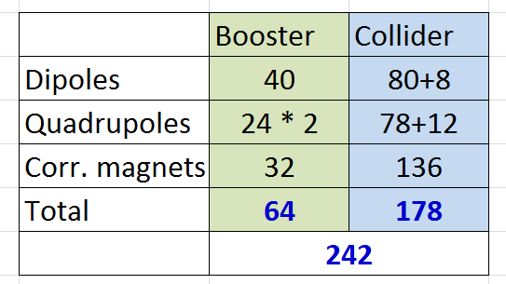
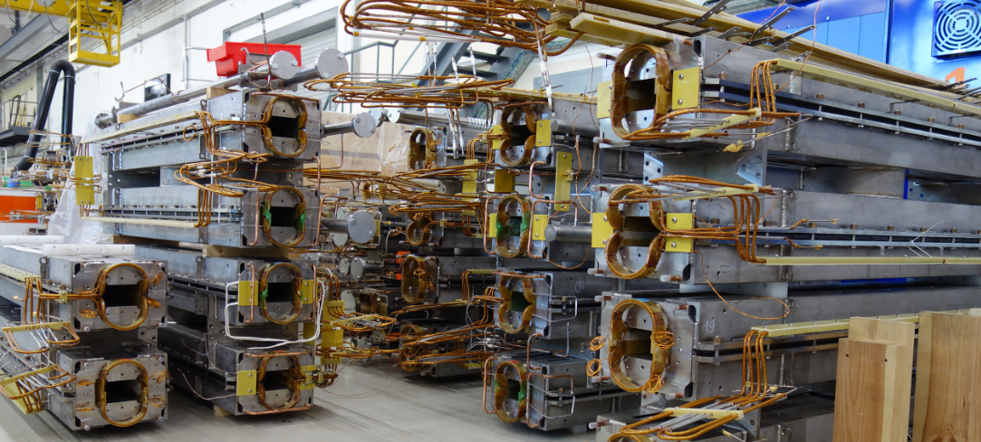
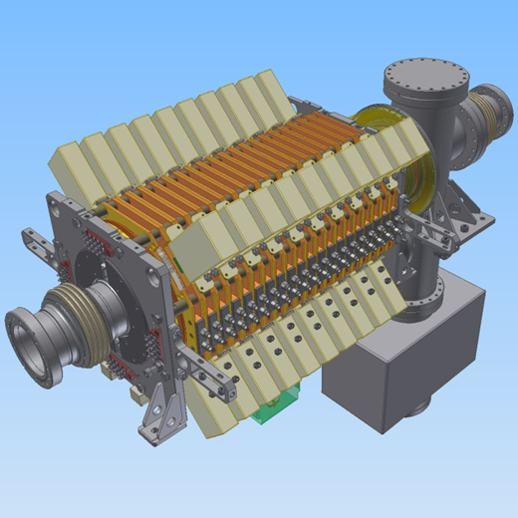
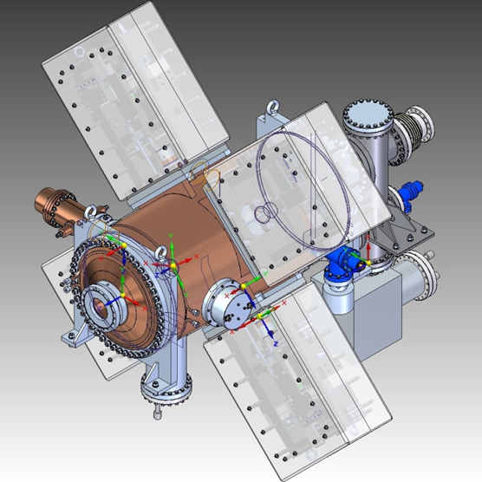
Collider
serial production and testing of sc-magnets started (15 dipoles tested)
RF1- delivery from BINP 2019
RF2- delivery from BINP 2020
RF2, RF3 – delivery from BINP 2021
E-Cooler – delivery from BINP 2021

Slide 15
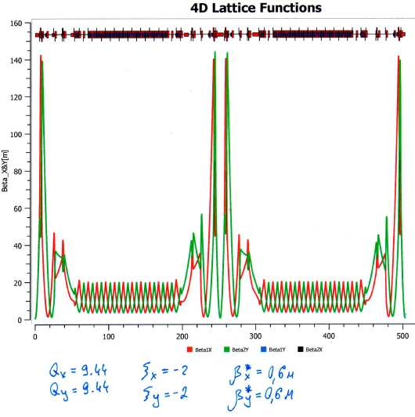
Ring-9 –
quads lengths adjusted to power all magnets in series
MAC-2018
Collider
Lattice
Linear optics
Beam Vertical separation magnets
MPD+Ecool solenoids
RF-system
Corrector magnets:
Closed Orbit
Chromaticity
X-Y-coupling
Octupoles

Slide 16
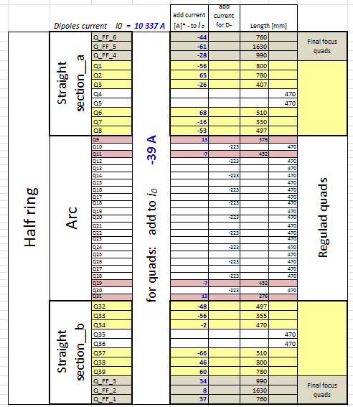
Quads currents and eff length
MAC-2018
Collider
Lattice
Linear optics

Slide 17
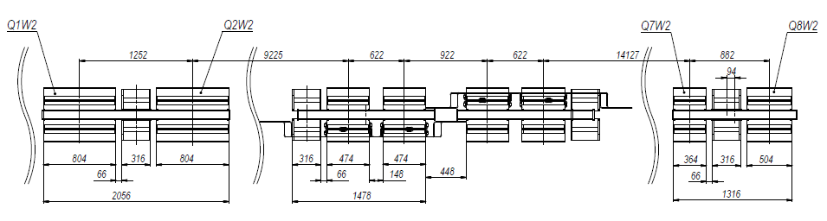
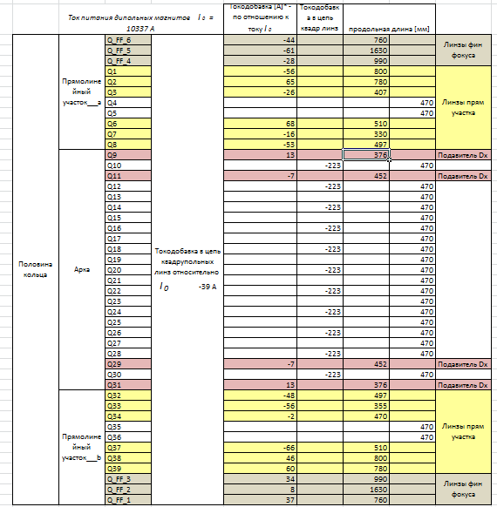
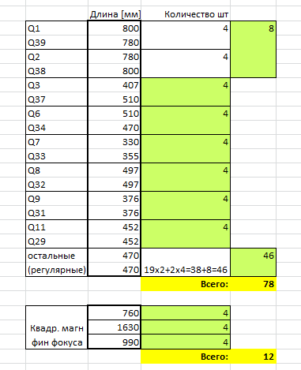
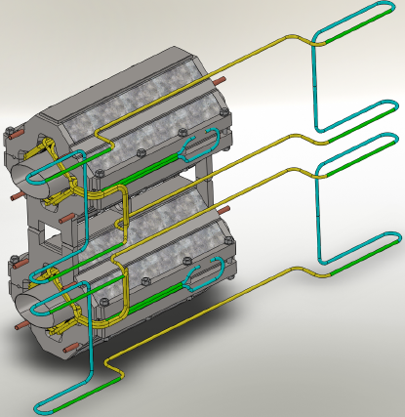
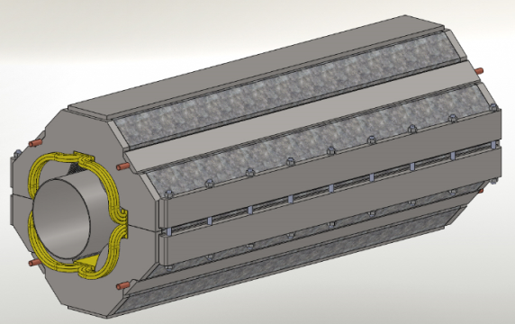
MAC-2018
Collider
Set of collider’s quads for production
5 design type

Slide 18
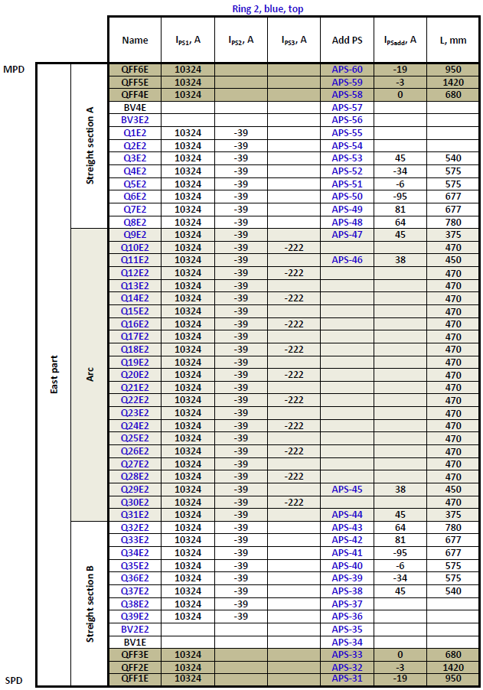
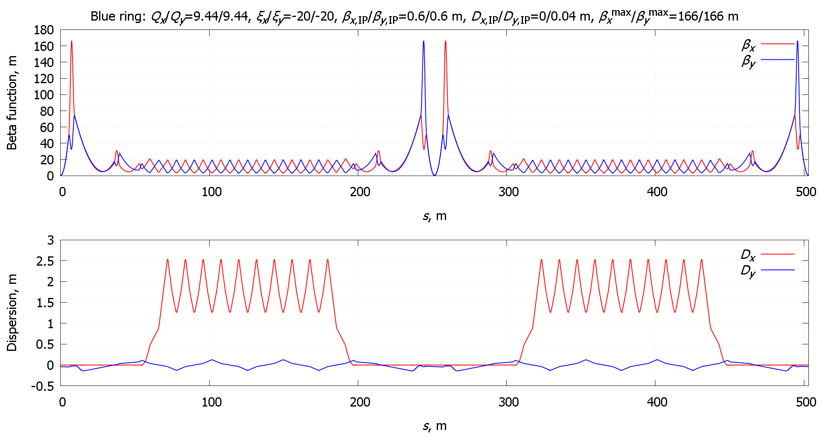
Collider
Optics optimized May 2019

Slide 19
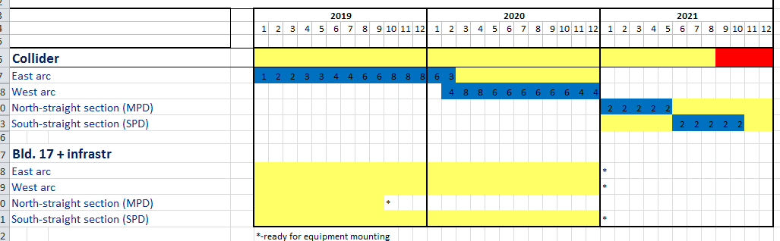
Collider
Systems under active development:
injection & beam dump
stochastic cooling
beam feedback
collimation system
instrumentation
power supplies
timing system
control system
foresee and include in the ring structure (cryostat system) all “objects”, witch should be used in further machine operation
Take all technical solutions
Tendering and production
Plan and perform mounting
Thank you for your attention!

