Slide 1
COLLIDER OPTICS DEVELOPMENT
A.V. Philippov for NICA team Veksler and Baldin Laboratory of High Energy Physics
Joint Institute for Nuclear Research, Dubna, Russia
Xth session of the NICA Machine Advisory Committee
meeting at Joint Institute for Nuclear Research, Dubna, Russia
June 5-6, 2019

Slide 2
OUTLINE
1 NICA optics results: brief overview from the last MAC’18
2 Motivations for new steps of studies of Collider optics
3 Calculation results
3.1 Linear optics (lenses lengths adjustment)
3.2 Coupling suppression
3.3 Chromaticity correction
3.4 Results of the new optics dynamic aperture simulation
4 Conclusion

Slide 3
1 NICA OPTICS RESULTS: BRIEF OVERVIEW FROM THE LAST MAC’18
The tasks completed for the previous MAC’18 meeting (next fie slides).
Compile linear optics structure:
Structural and non-structural elements’ list;
Rings’ setup and on-ring position;
Magnetic parameters (for non-structural elements).
Fixed working point (WP):
Main (9.44/9.44) and additional (9.1/9.1).
XY-coupling correction:
Fixed skew quads in straight sections.
Chromaticity correction:
Fixed chromaticity correction instabilities suppression.
Dynamic aperture correction for two WP:
Magnetic fields errors (systematic and random);
Fringe fields;
Beam-beam effects and synchrotron motions (not solved).
Dispersion correction:
Fixed quads in arcs (skipped).

Slide 4
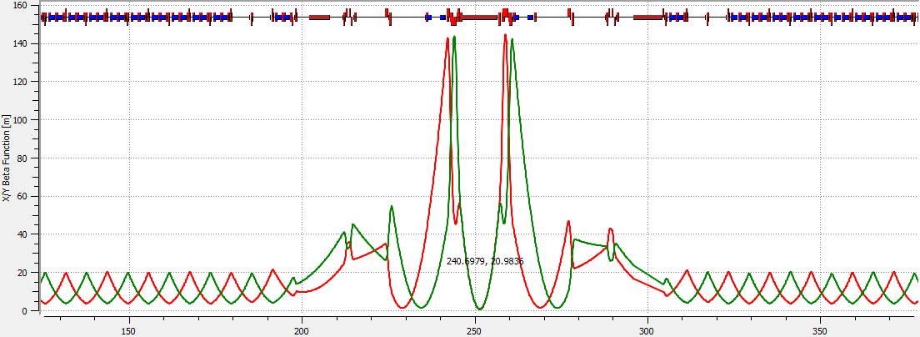
Lattice
Two Beams ⬄ symmetric optics
Ring + vertical beam separation
I

Slide 5
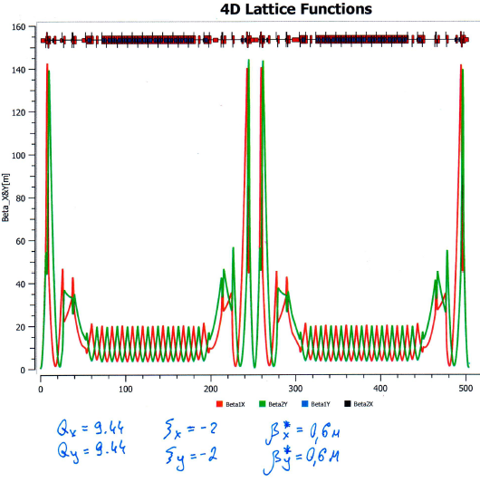
Ring-9 — quads lengths adjusted to power all magnets in series
Lattice
Linear optics
Beam Vertical separation magnets
MPD+E-cool solenoids
RF-system
Corrector magnets:
Closed Orbit
Chromaticity
X-Y-coupling
Octupoles
II

Slide 6
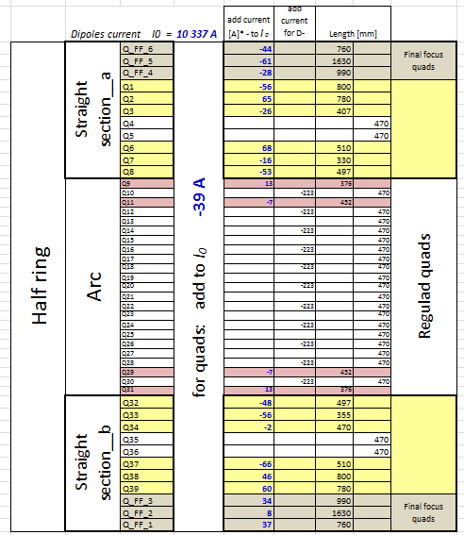
Quads currents and eff length
Lattice
III
Linear optics

Slide 7
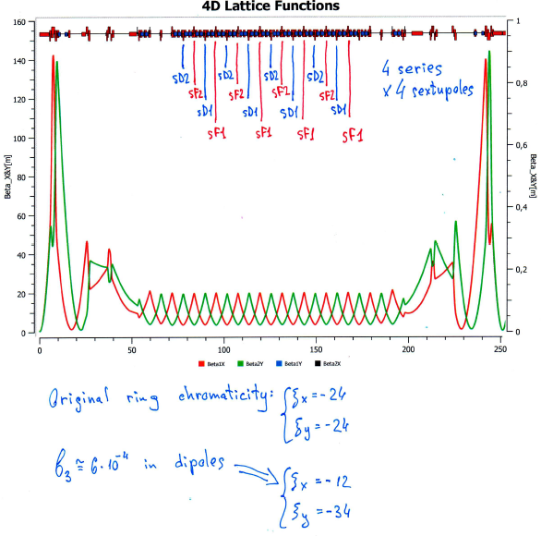
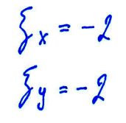
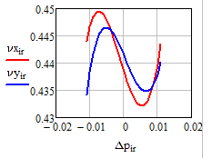
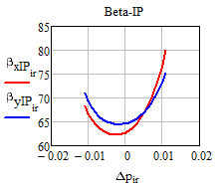
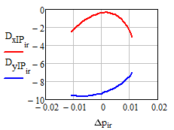
Chromaticity correction
IV
sF1=43 T/m^2
sD1=173 T/m^2
sF2=43 T/m^2
sD2=173 T/m^2

Slide 8
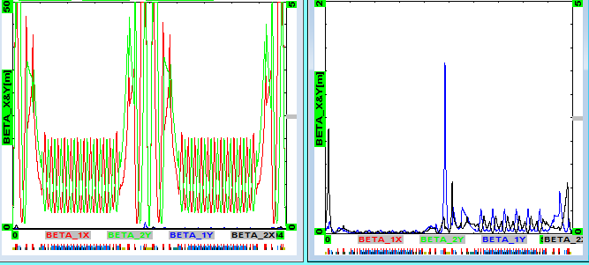
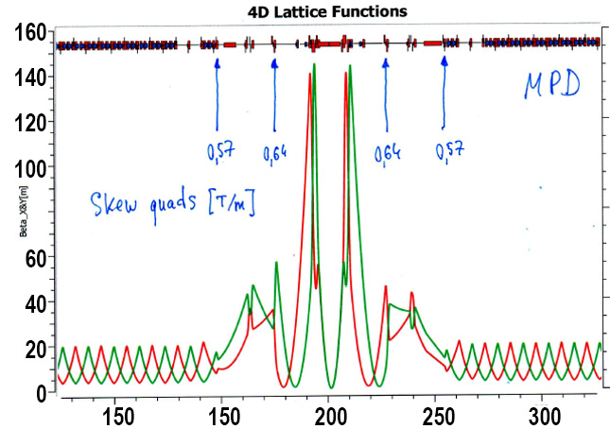
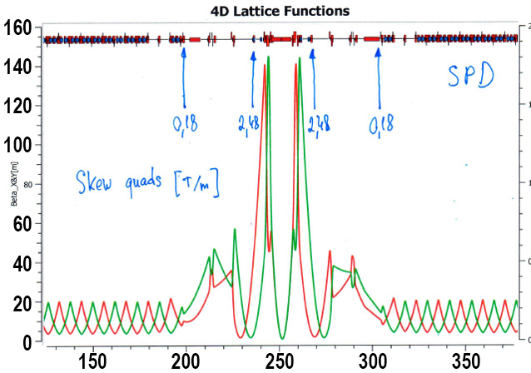
X-Y Coupling suppression
V
4 skew quads /
half ring [T/m]:
-2.48
0.18
0.57
0.64

Slide 9
2 MOTIVATIONS FOR NEW STEP OF STUDIES OF COLLIDER OPTICS
The main motivation reason for new studies of Collider optics is the previous results revision in terms of their completeness and accuracy.
The first task: Checking all the dimensions and positioning of non-structural elements (e-cool, s-cool, feedback system and RF stations) in Collider ring;
The second task: Optimization of the lenses lengths according additional power supplies;
Third task: Updating simulation results for coupling suppression, chromaticity correction and dynamic aperture.
These tasks have been completed.

Slide 10
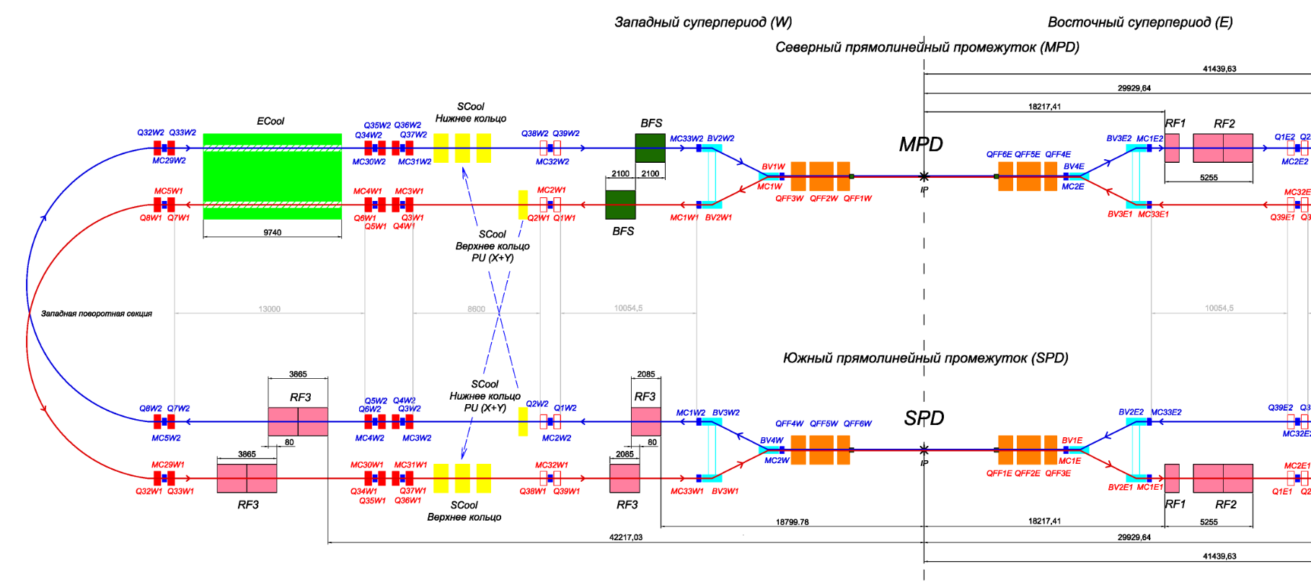
3 CALCULATION RESULTS

Slide 11
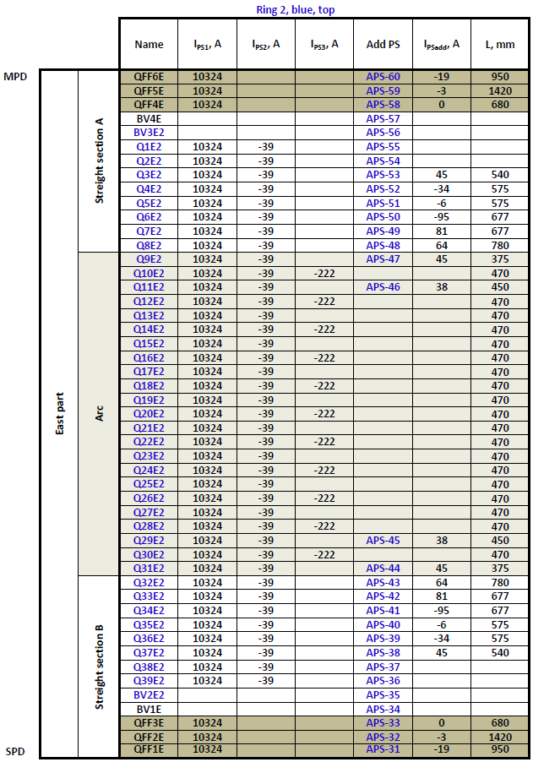
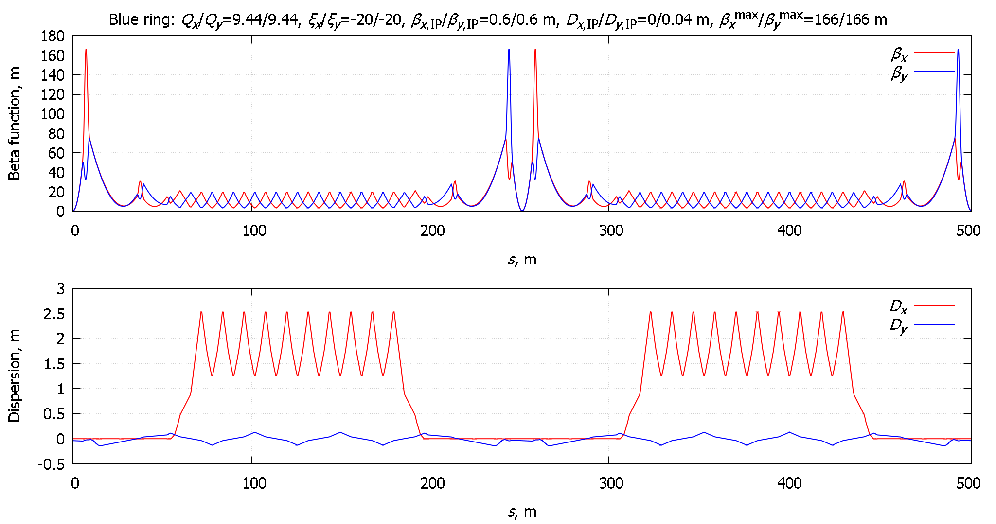
3.1 LINEAR OPTICS (LENSES LENGTHS ADJUSTMENT)
West arc
E-cool
East arc
★
MPD (IP1)

Slide 12
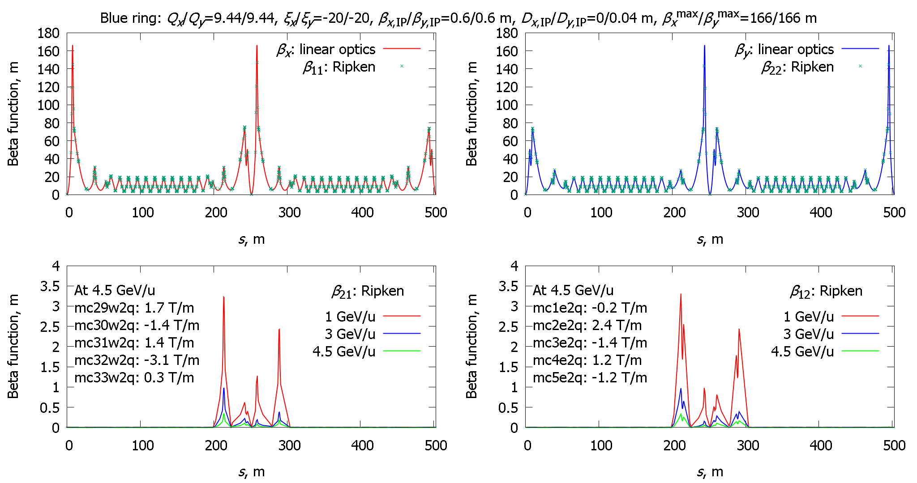
3.2 COUPLING SUPPRESSION
West arc
E-cool
East arc
West arc
E-cool
East arc
★
★
MPD (IP1)
MPD (IP1)
West arc
E-cool
East arc
West arc
E-cool
East arc
★
★
MPD (IP1)
MPD (IP1)
10 skew quadrupoles in north straight section

Slide 13
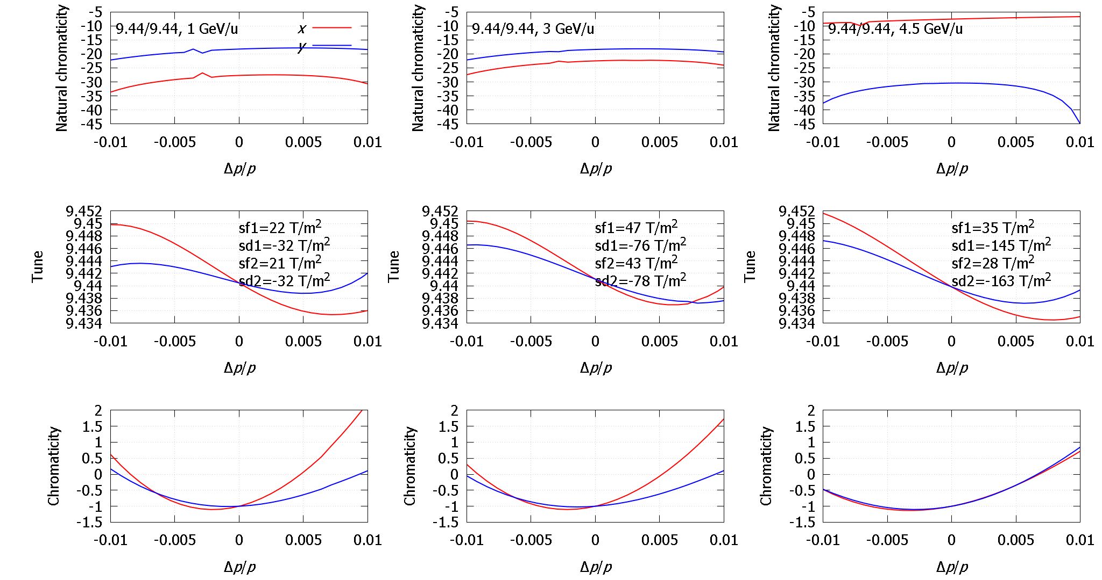
3.3 CHROMATICITY CORRECTION
9.44/9.44, 1 GeV/u
9.44/9.44, 3 GeV/u
9.44/9.44, 4.5 GeV/u
4 sextupoles families in two arcs

Slide 14
3.4 NEW OPTICS DYNAMIC APERTURE ESTIMATION (CONT.)
New approach: using of octupole correctors in arcs. Three octupole families: first and second families corrector near final focus, third families correctors of two arcs.
mc1wo: multipole, knl:={0., 0., 0., koef1};
// ip1 (MPD)
mc2eo: multipole, knl:={0., 0., 0., koef2};
//
mc6e2o, mc7e2o, …, mc28e2o: multipole, knl:={0., 0., 0., koef3};
//
mc6w2o, mc7w2o, …, mc28w2o: multipole, knl:={0., 0., 0., koef3};
mc2wo: multipole, knl:={0., 0., 0., koef2};
// ip2 (SPD)
mc1eo: multipole, knl:={0., 0., 0., koef1};
We have found five optimal settings for dynamic aperture (DA) with value more that $100 π mm⋅mrad$ (exceeds geometric acceptance).

Slide 15
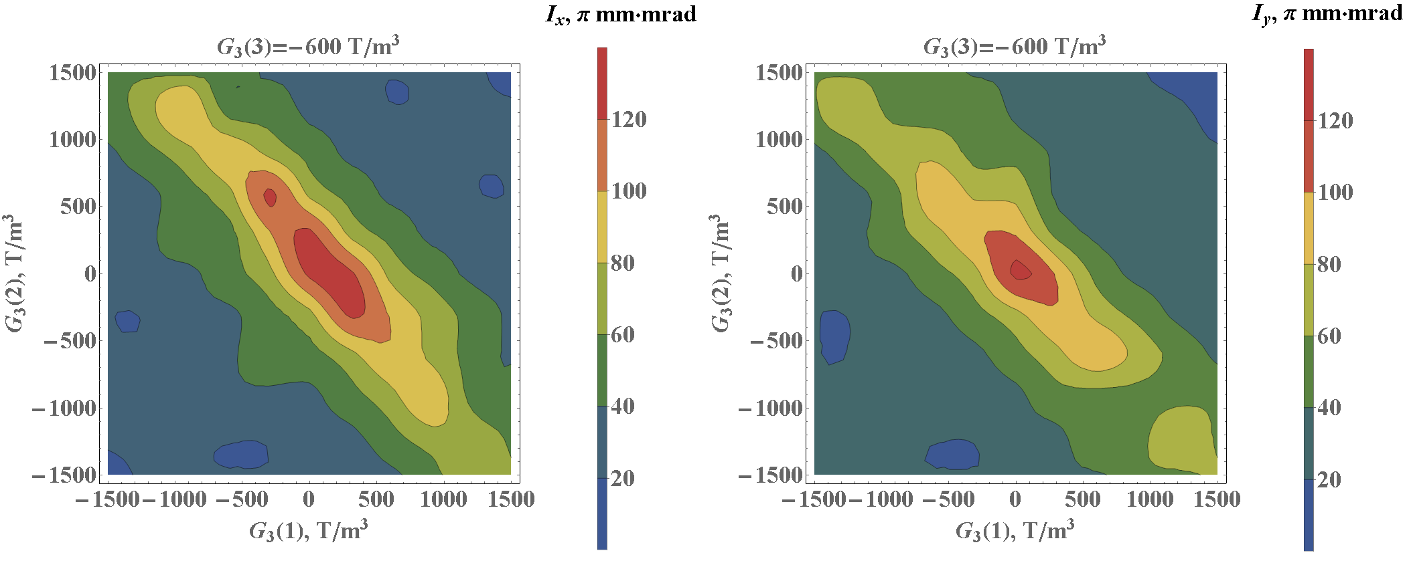
3.4 NEW OPTICS DYNAMIC APERTURE ESTIMATION (CONT.)
$$DA_{x}>120 π mm⋅mrad$$
$$DA_{y}>120 π mm⋅mrad$$

Slide 16
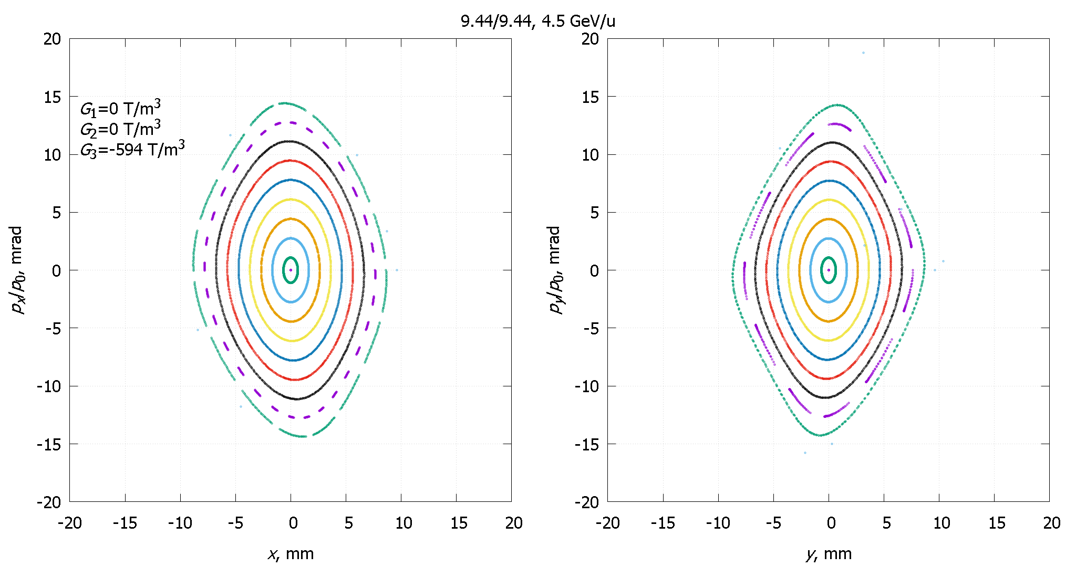
3.4 NEW OPTICS DYNAMIC APERTURE ESTIMATION (CONT.)
9.44/9.44, 4.5 GeV/u
Octupole regime
X
Y
Simple simulations of 10 particles tacking during 5000 turns.

Slide 17
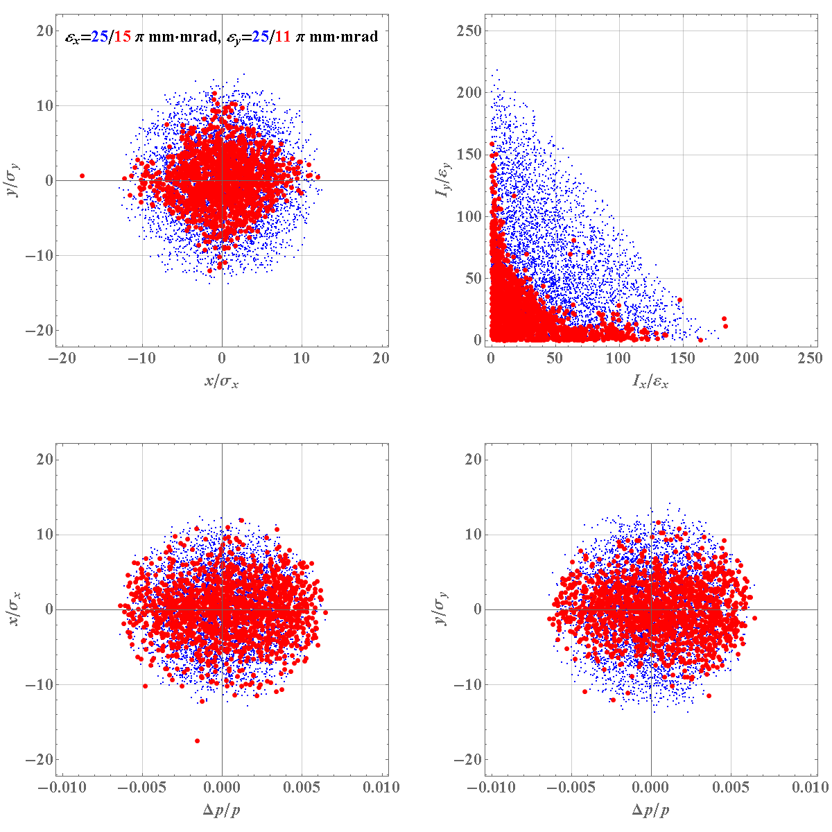
3.4 NEW OPTICS DYNAMIC APERTURE ESTIMATION (CONT.)
Problem statement:
Tracking of 5000 particles uniform distributed in 6D phase space;
100000 turns;
${Δp}/p≠0$;
RF off;
Dynamics in IP1: blue points — initial portrait, red points — after 100000 turns.
$$DA≈10σ$$

Slide 18
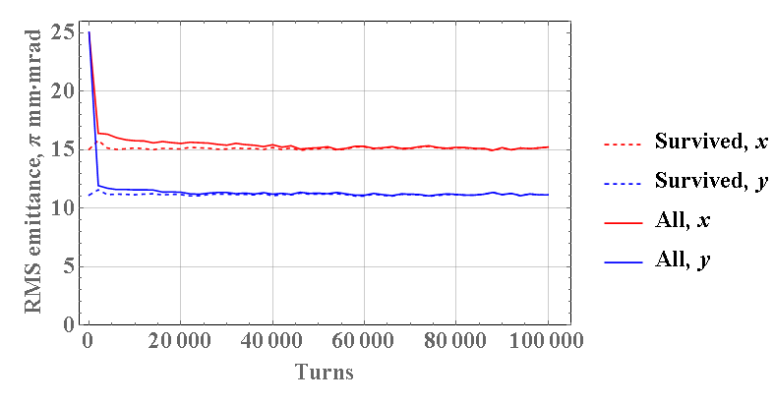
3.4 NEW OPTICS DYNAMIC APERTURE ESTIMATION (CONT.)
RMS emittance evolution

Slide 19
3.4 NEW OPTICS DYNAMIC APERTURE ESTIMATION (CONT.)
Problem statement:
Tracking of 5000 particles uniform distributed in 6D phase space;
100000 turns;
${Δp}/p≠0$;
RF on;
Dynamics in IP1: blue points — initial portrait, red points — after 100000 turns.
$$DA≈10σ$$

Slide 20
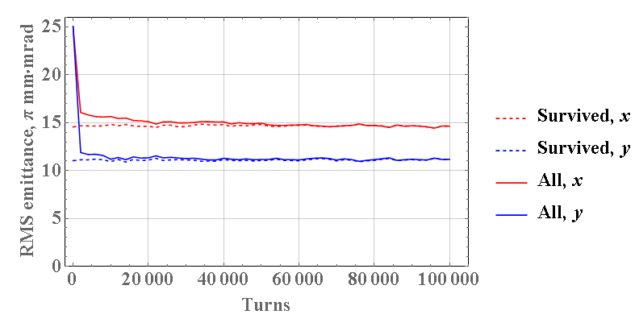
3.4 NEW OPTICS DYNAMIC APERTURE ESTIMATION (CONT.)
RMS emittance evolution

Slide 21
4 CONCLUSION
New Collider optics structure is compiled.
Positions and dimensions of all structural and non-structural elements setup in the Collider ring have been checked.
The following corrections values are found for working point 9.44/9.44:
Coupling correction;
Chromaticity correction;
Maximum of dynamic aperture.
Advantages of the new Collider optics:
Optics are symmetric about the IP1 and IP2;
Geometrical acceptance increases ($51 π mm⋅mrad$);
4 doublets lenses from the Collider ring can be removed.

Slide 22
EXTRA SLIDES: RESULTS OF THE BINP TEAM

Slide 23
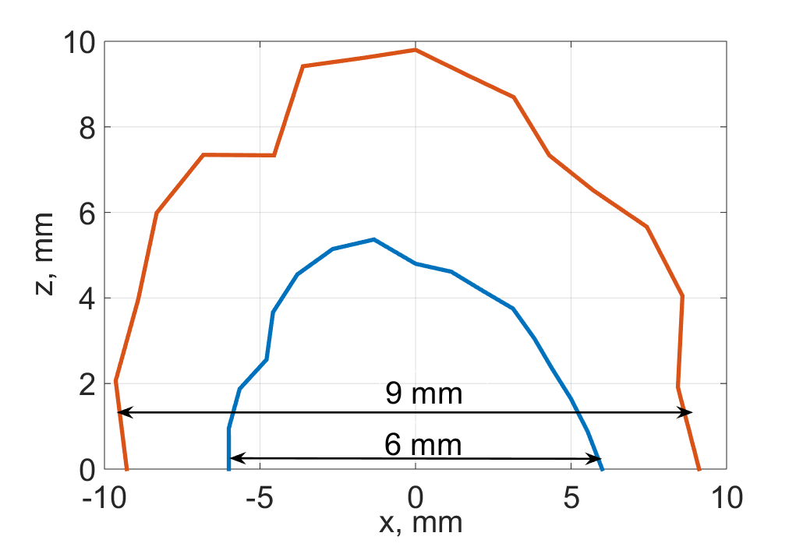
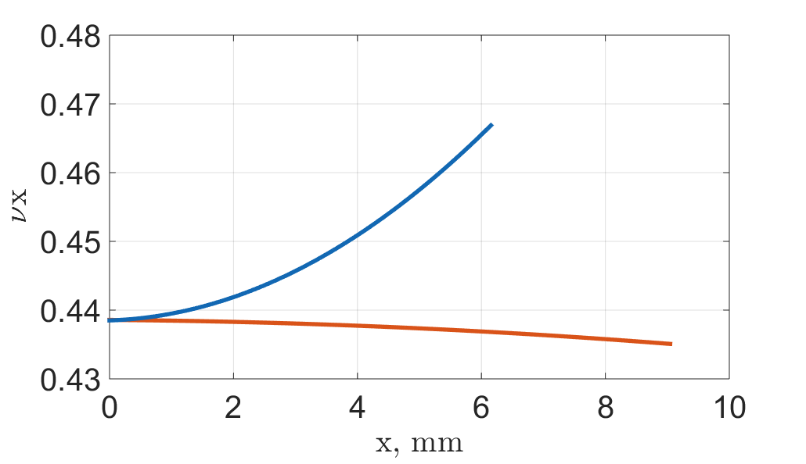
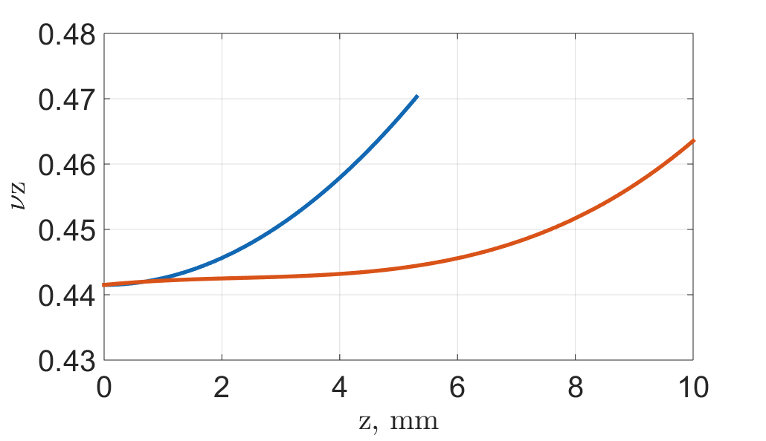
QUADRUPOLE LENSES EDGE FIELDS INFLUENCE TO COLLIDER DYNAMIC APERTURE
The contribution of the lenses edge fields into nonlinear frequency dependence on amplitude significantly exceeds the contribution of chromatic sextupoles. The oscillation amplitude increase leads to a betatron tune shift (both horizontal and vertical) up to the death of the particle at half integer resonance.
0.5
0.5
Dependence of tune vs amplitude. Orange — chromatic sextupoles, blue — sextupoles and edges.

Slide 24
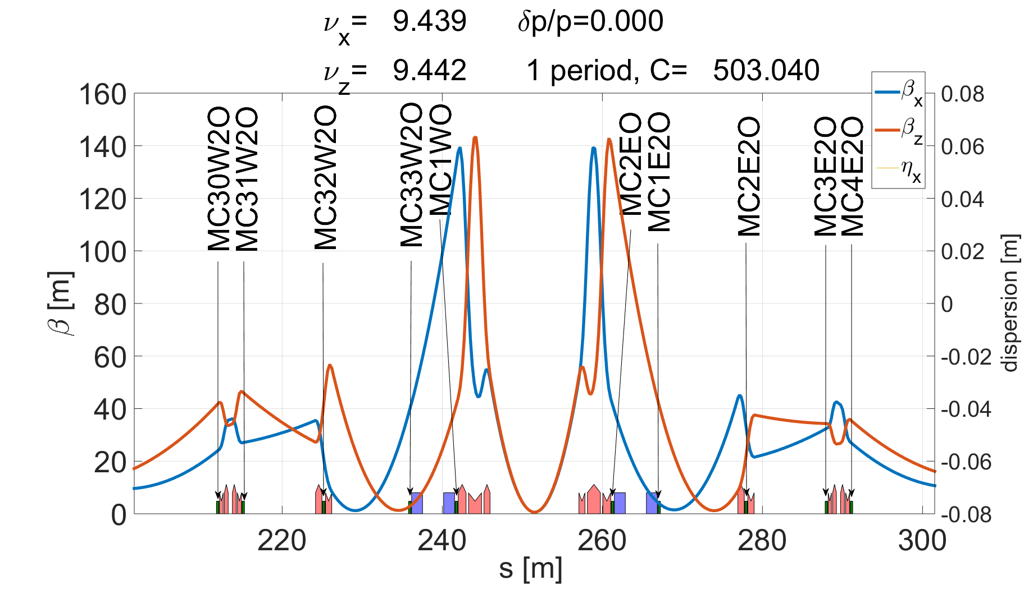
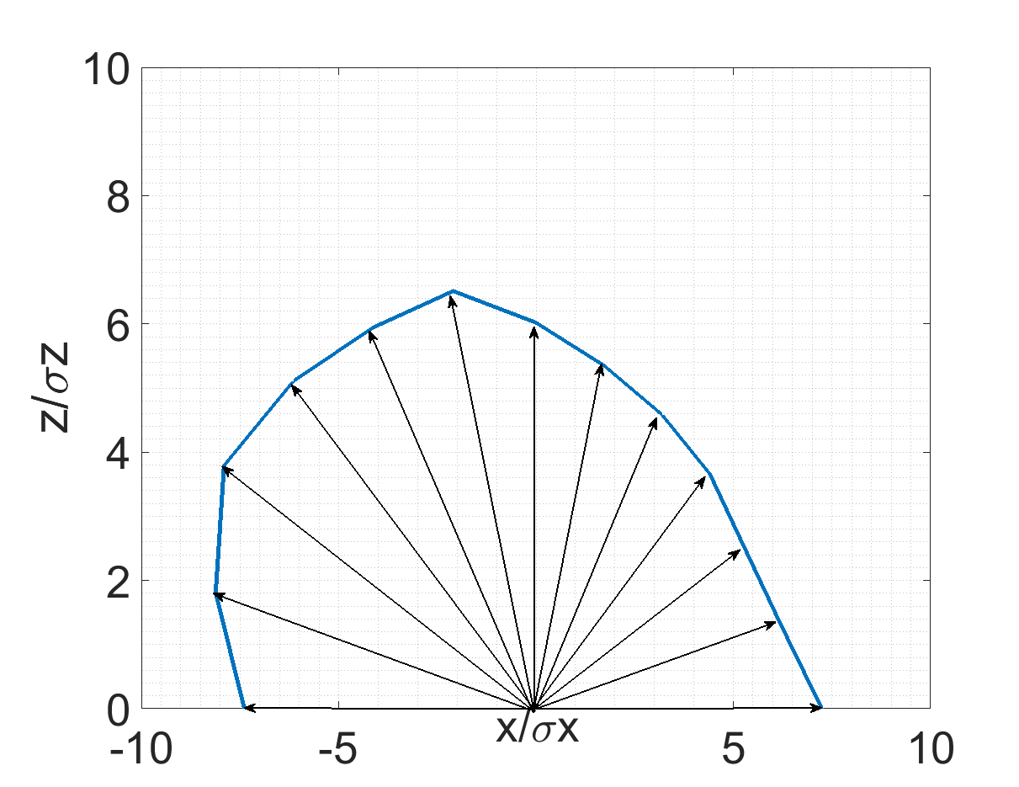
DYNAMIC APERTURE OPTIMIZATION WITH OCTUPOLE LENSES
Multipole correctors combinations in dispersionless section for optimization process at interaction point were considered.
Nonlinear correctors positioning used for optimization process at interaction point.
The aperture increased in the rays. Genetic algorithm (Accelerator Toolbox)

Slide 25
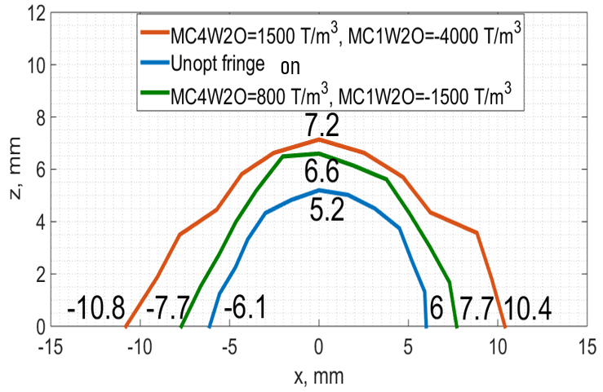
DYNAMIC APERTURE OPTIMIZATION WITH OCTUPOLE LENSES (CONT.)
The best result (corrector length 0.3 m): MC4W2O = 1500 T/m³, MC1W2O = –4000 T/m³
increases the aperture from 6 mm (6σ) to 10 mm (10σ) horizontally and from 5 mm (5σ) to 7 mm (7σ) vertically. Disadvantage: 4000 T/m³ exceeds the allowed 1500 T/m³.
Recommendation: to consider the possibility of developing and setup special octupole lenses (4 pcs.) with a maximum integrated force of more that 4000 T/m³×0.3 m.

