Slide 1
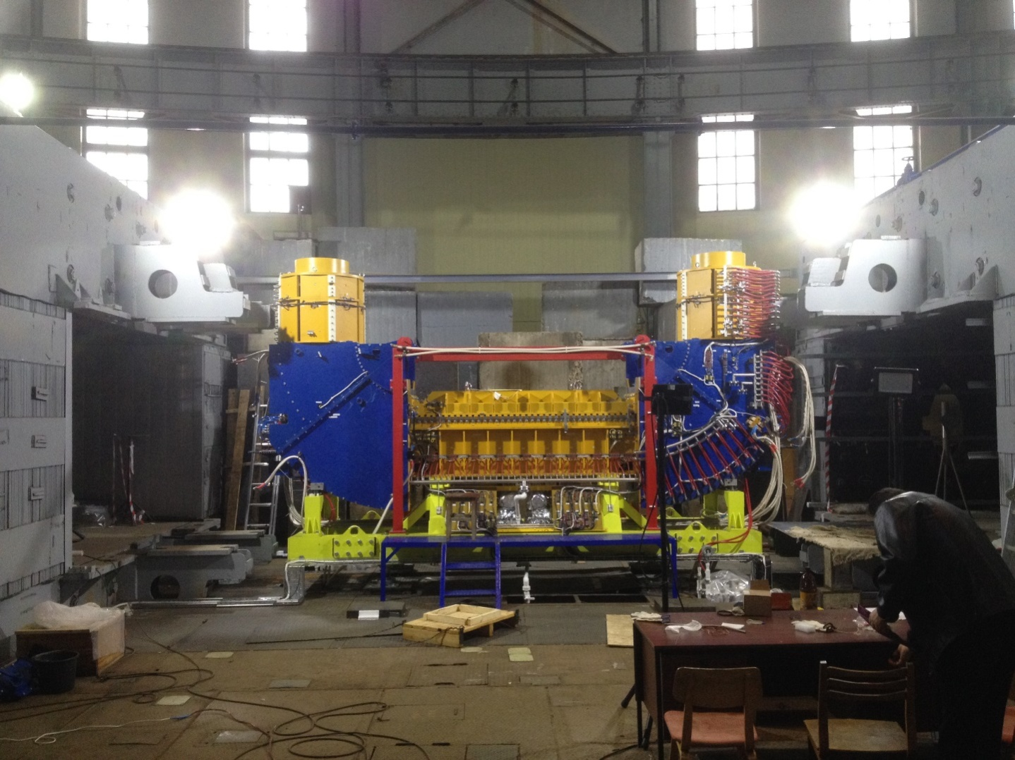
Status of development of electron coolers for Booster 7'
Vasily Parkhomchuk on behalf of BINP and JINR teams
Electron cooler at orbit
Buster between magnets synchrophasotron.
The magnet field of solenoid up to 2 kGauss along beam at cooling straight section.
Electron beam from gun (right) go through cooling section and absorbed at collector (left)

Slide 2
Grandparent of 50kV- LEIR cooler for cooling Pb ions beams.

Slide 3
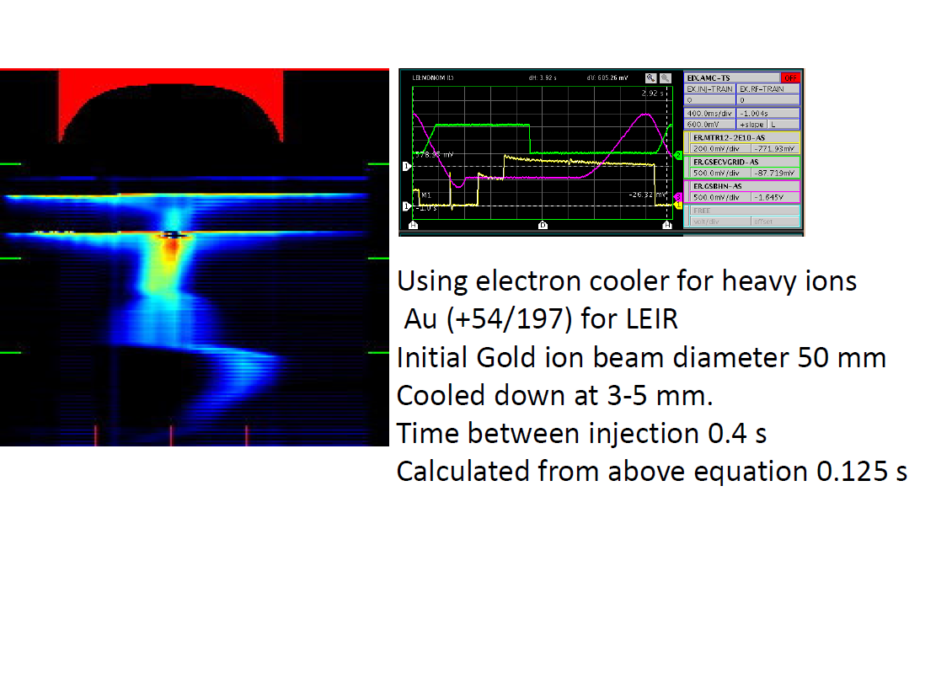
LEIR
Pb beam
Pb beam

Slide 4
Transverse magnet field before aliments (red) and after aliments coils.
Initial effective temperature for 50 kV voltage
θe=4E-4 Teff=80K Tieff=(Mi/me)=2.8E7K
After aliments:
θe=2E-5 Teff=0.2K Tieff=(Mi/me)Te=7E4K
After cooling equilibrium ions temperature:
Tiequlibrium=0.2K

Slide 5
Running with current 100 mA for different cooler voltage 5-30 kV

Slide 6
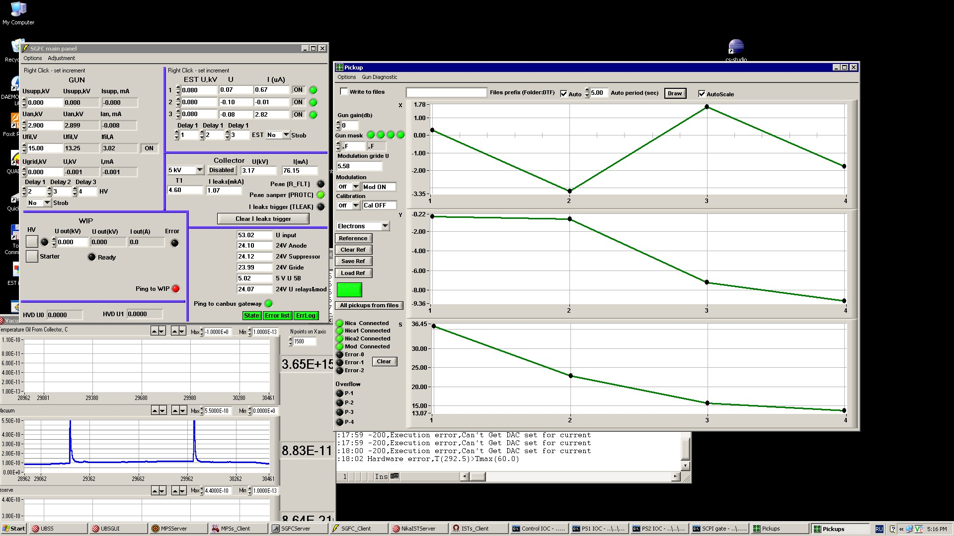
31 May 2019 76 mA 1.74 kV.

Slide 7
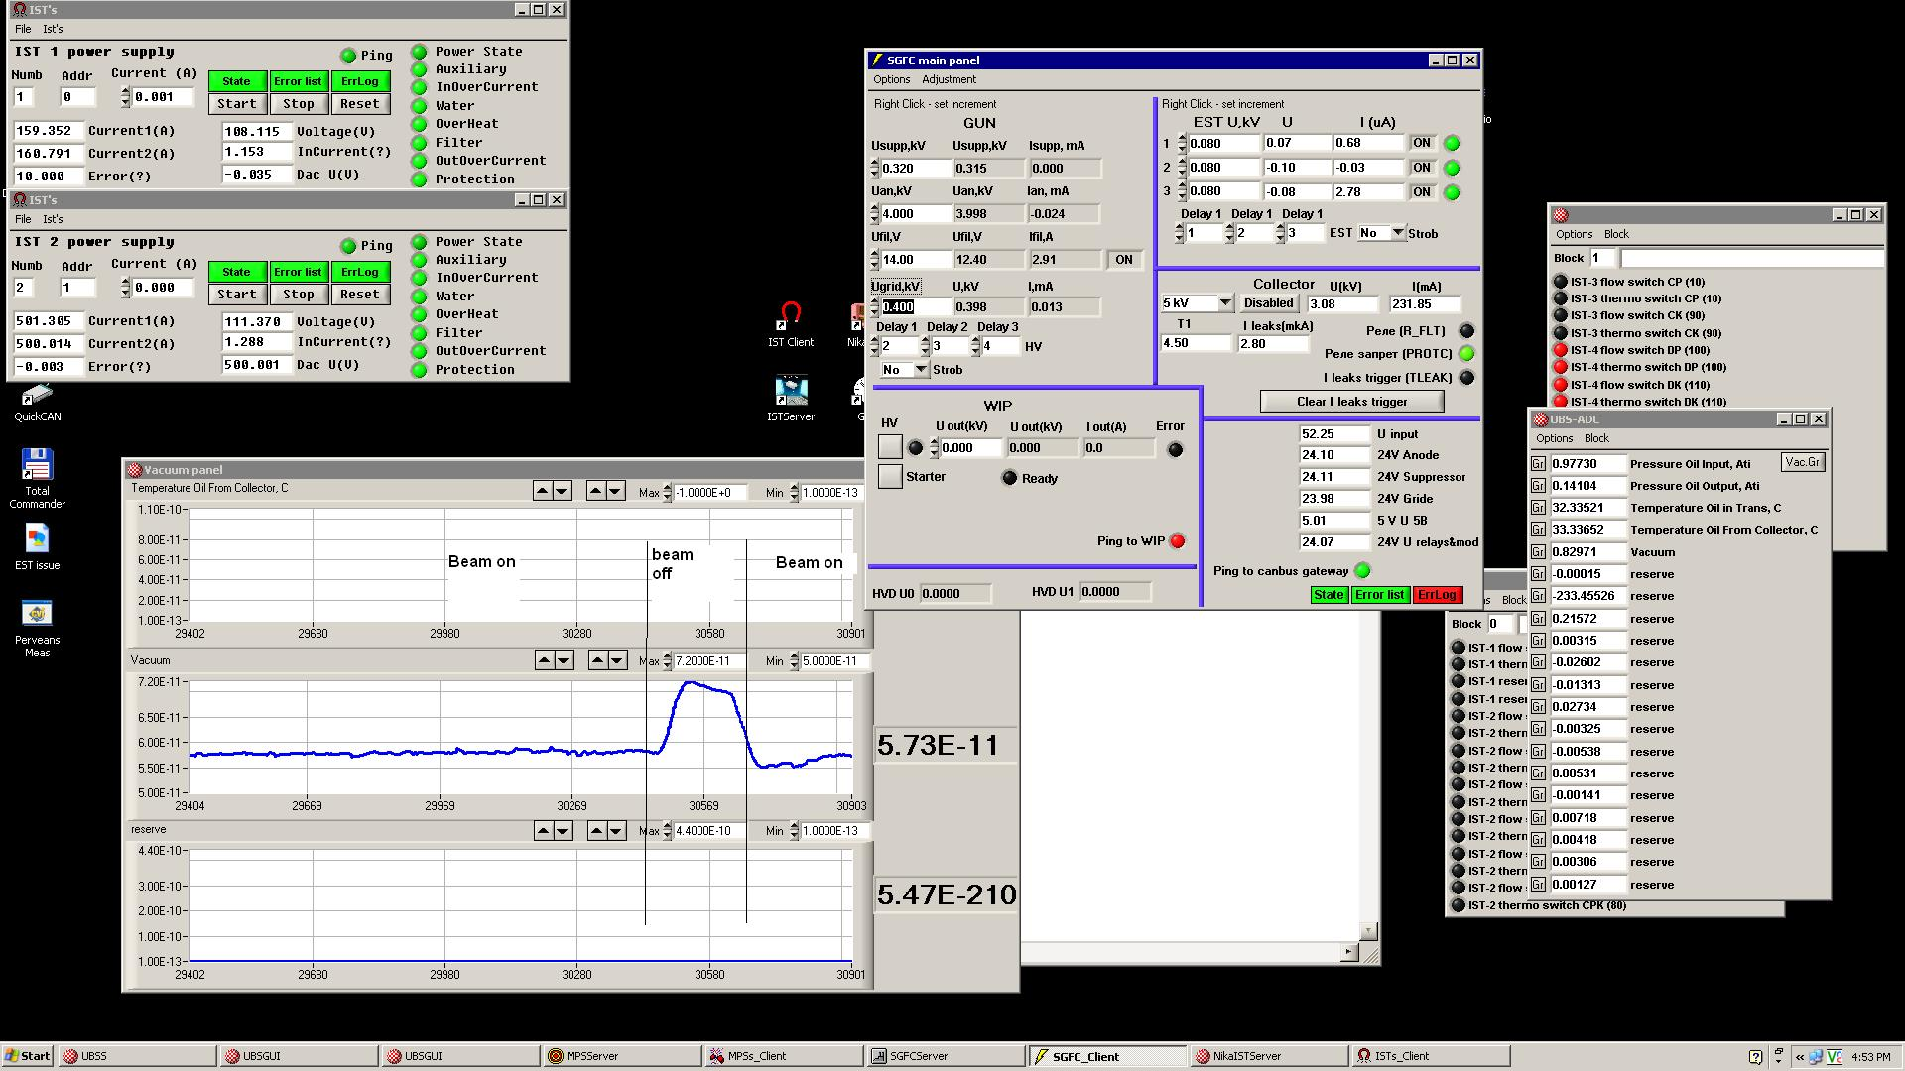
2 June, 2019. Uinj=1.74 kV Je=230 mA Optimal current for cooling on injection energy estimated as 20-50 mA. That many times less reached value current 230 mA. Switch off electron beam increased pressure at vacuum chamber

Slide 8
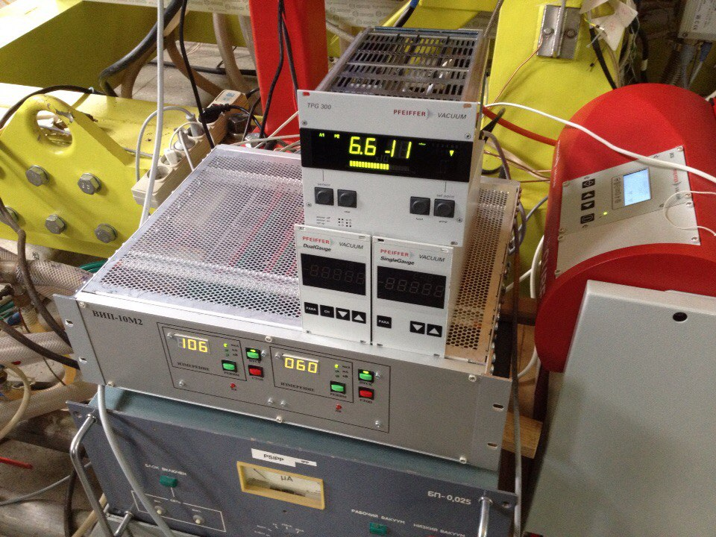
Vacuum in cooler 2-6E-11 Torr.
Cooler ready for first commissioning for cooling ion beam.
Thanks for attention!
More in detail discussion will be at September BINP COOL’19
I invite yours to participate in Novosbirsk

