Slide 1
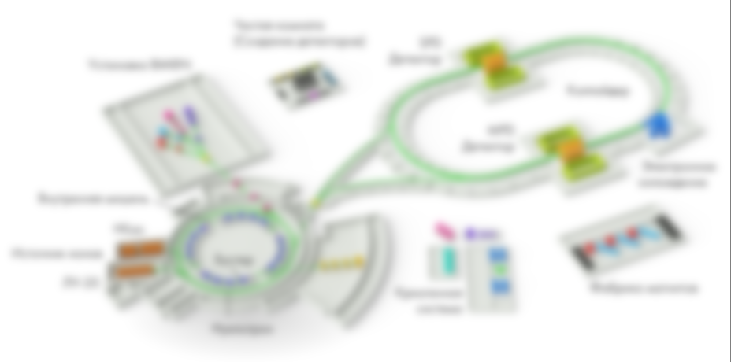

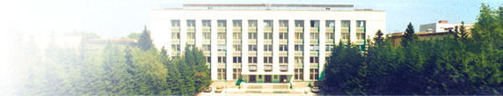
RF systems
of the NICA collider
A.Tribendis
on behalf of the JoINt Rf team
Budker Institute of Nuclear Physics
Siberian Branch of RAS
Novosibirsk
Russia

Slide 2
3 RF systems of the NICA Collider:
Injection, accumulation and acceleration
Barrier bucket system: RF1
V
Frequency | kHz | 522÷587
Barrier voltage (amplitude) Pulse width Number of pulses | kV ns | 5 var, 80 max 4
Accelerating voltage (meander, amplitude) | kV | var, 0.3 max
Stations / ring |  | 1
Stations, total |  | 2
T
t
Stack
Inj
T
t
Acceleration
Bunch formation
Harmonic systems: RF2 RF3
Harmonic number |  | 22 | 66
Frequency | MHz | 11.5÷13.2 | 34.4÷38.7
Accelerating voltage (amplitude) / ring | kV | 100 | 1000
Cavities / ring |  | 4 | 8
Cavities, total |  | 8 | 16

Slide 3
NW
Location of RF cavities in the accelerator tunnel.
NE
2×RF2
ECool
MPD
Vacuum Gate Valves
Groups of 1-5 RF cavities are placed between vacuum gate valves in 8 warm sections, thus forming 10 vacuum units.
1×RF1
5×RF3
W
2×RF2
E
2×RF2
Ring 2 (top)
4×RF3
2×RF3
1×RF1
5×RF3
Ring 1 (bottom)
SPD
SW
SE
2×RF2
Distribution of RF cavities along the collider is dictated by the available free spots.

Slide 4
Example: Location of RF equipment in the NE sector.
NE
RF amplifiers, power supplies, control electronics etc. outside the tunnel
in the limited access area
RF1CE2
RF2-3CE2
RF2-4CE2
RF2-1AE2
RF1PE2
RF2-2AE2
RF2-3AE2
RF2-4AE2
RF3-1AE2
RF3-1/2CE2
RF3-3/4CE2
RF3-5CE2
RF3-2AE2
RF3-3AE2
RF3-4AE2
RF3-5AE2
RF1E2
Radiation shielding
RF feeders & aux. cables run in the grooves under the wall
Radiation shielding
RF2-1E2
RF1DE2
RF2-2E2
RF2-3E2
RF2-4E2
RF3-1E2
RF3-2E2
RF3-3E2
RF3-4E2
RF3-5E2
Single vacuum unit
of 5 RF3 cavities between 2 gate valves
6 000
RF cavities in the accelerator tunnel
A cavity does not have its own vacuum gate valves
⇒ has to be installed air filled and evacuated / baked out in-situ in a group.

Slide 5
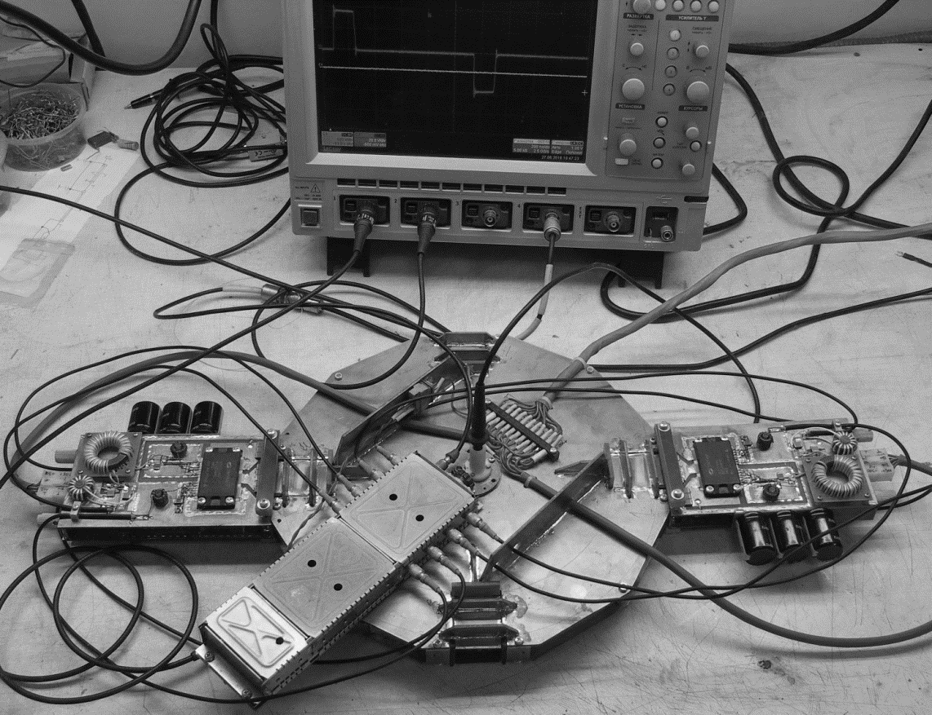
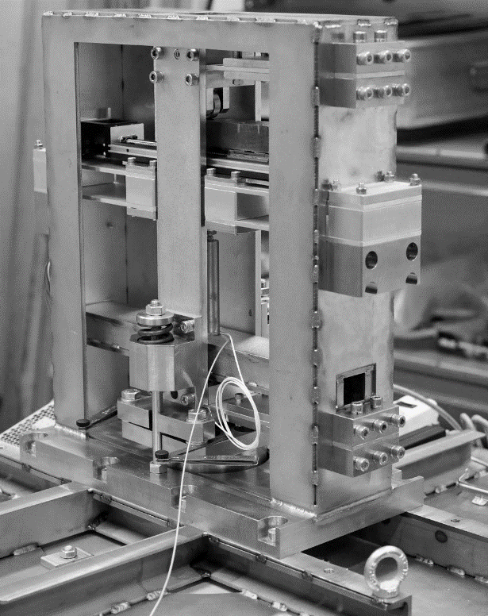
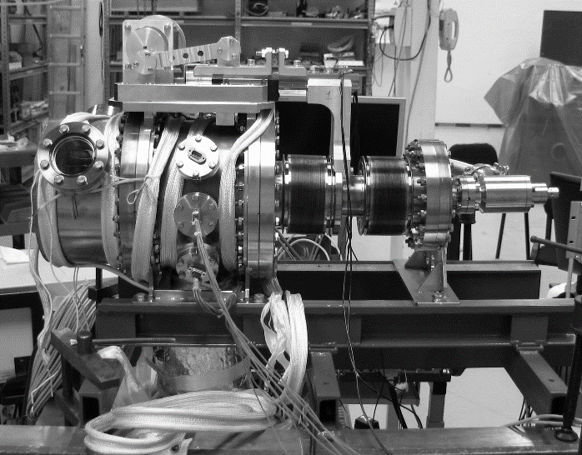
RF systems: R&D and production plan.
 | RF1 | RF2 | RF3
Key part proto | 2016 – gap short 2016 – inductor module | 2017 – tuner gear box
Full size proto |  | 2019 | 2019
RF for NICA | 2019 – 2 pcs | 2020 – 8 pcs | 2020 – 8 pcs 2021 – 8 pcs
Key part prototypes/models
developed and tested
in 2016-17
RF1 inductor module
Movable gap short
RF2 tuner gear box

Slide 6
RF1

Slide 7
Barrier bucket system RF1: the concept.
Pulse generator
= Switching PS
+V DC
Sections:
D – damping (1, 2)
A – accelerating (3- 5)
B – barrier (6-20)
D
D
A
A
A
B
B
a
b
a
b
Air
Vacuum
Ceramic break
A
A
A
B
B
1 2 3 4 5 6 … 20
Switching PS is triggered by external signals thus allowing variation of the output pulse length.
The min gap between two adjacent bipolar pulses is limited to 10ns in order to ensure NO through current.
Example: barrier pulses before merging the already stored and newly injected bunches

Slide 8
Barrier bucket system RF1: 2D.
Agilent Vaclon Plus 300
Ion sublimation combination pump
Vac. chamber heater in thermal insulation
Short gear box
Mechanical decoupling
ellow w/rf shielding
b
b
b
Vac. (beam) chamber
L =
Inductors
Movable gap short
Pulse generators
Ceramic break
Gap closed
While an RF system (1, 2 or 3) is off movable shorts with finger spring contacts close accelerating gaps of the cavities: SAME DESIGN FOR ALL CAVITIES!

Slide 9
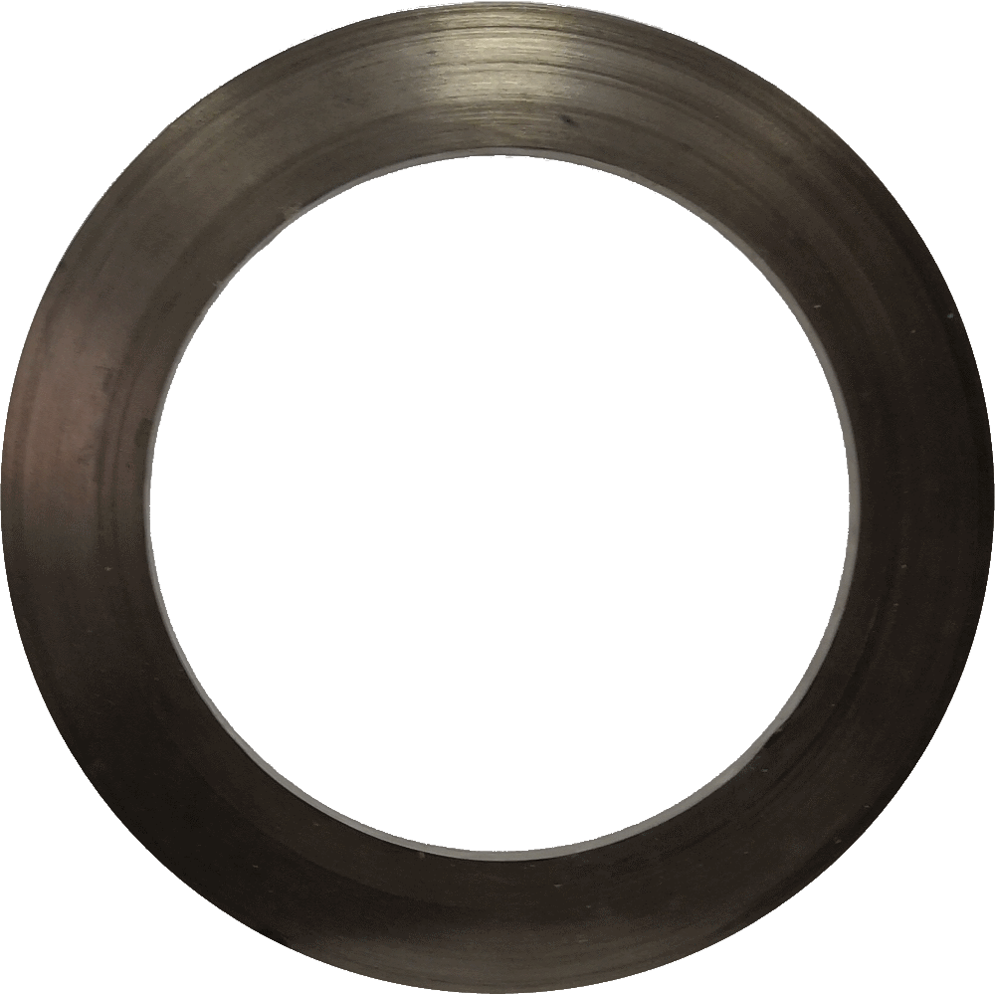
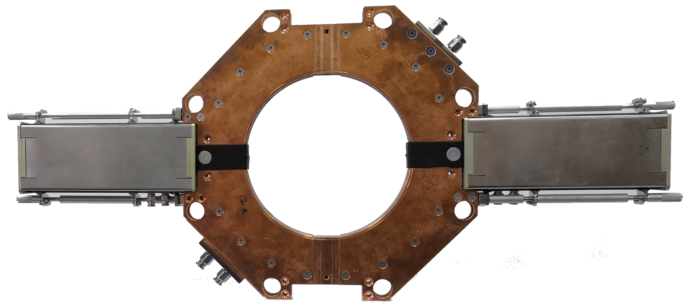
Barrier bucket system RF1: inductor with pulse generators.
Amorphous magnetic alloy (82% Co)
Amet 84XB-M (www.amet.ru)
Cooling water inlet/outlet
f,MHz μ tgδ
0.5 5200 1.67
1.0 3250 1.87
Pulse generator
Cooling channel as seen if end cover is transparent
Coupling loop
(primary coil)
Water cooled copper disks with magnetic core glued in between
Coupling loop
(primary coil)
Pulse generator

Slide 10
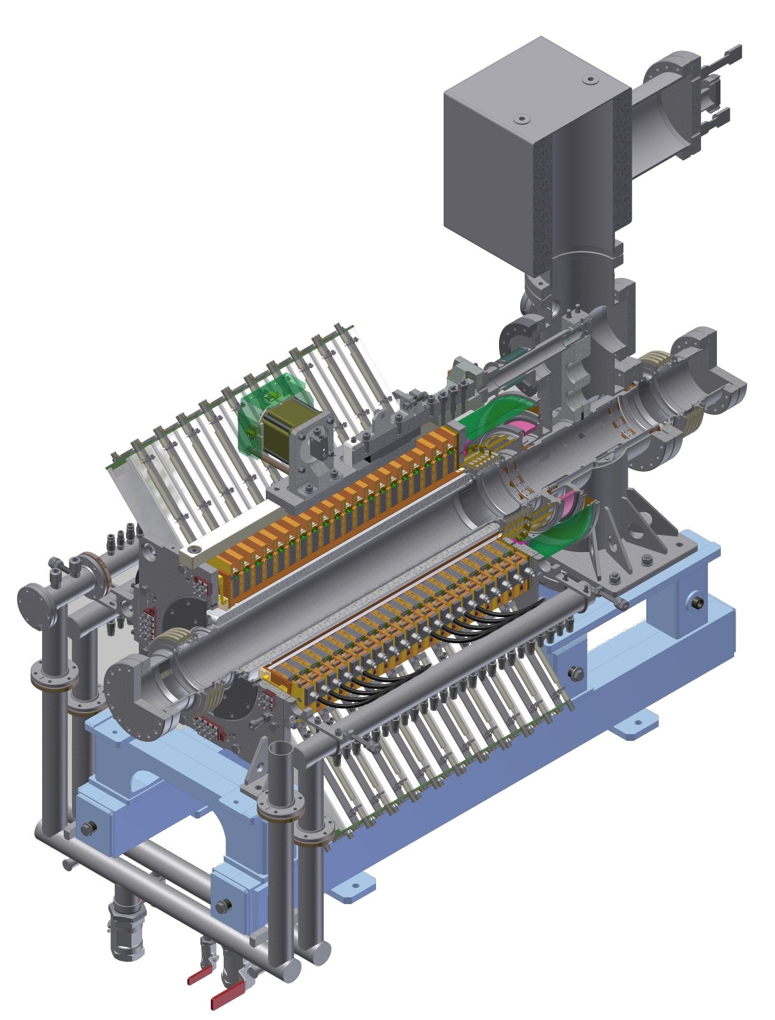
Barrier bucket system RF1: 3D.
Max dissipated power, W
Module | /inductor | /pulse gen | /module
Barrier | 1020 | 90 | 1200
Accelerating | 680 | 60 | 800
Damping | 500 | -- | 500
P_{total} = 21.4kW / station
L_{tot} = 1 405 mm
Water manifolds

Slide 11
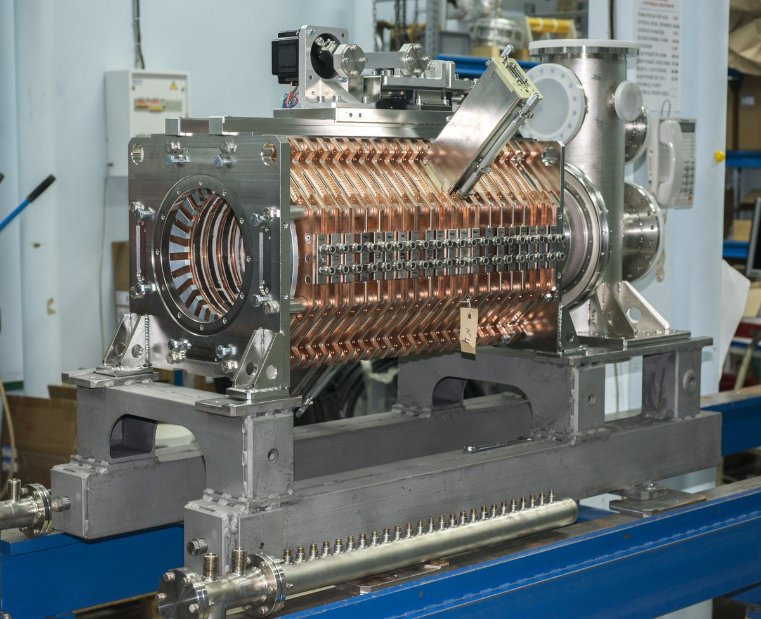
Barrier bucket system RF1: test assembly at BINP.
Short gear box
Pulse generator
Vac. chamber not installed
Ceramic break
Assembly of 20 inductors is spring loaded in long. direction
for thermal expansion compensation

Slide 12
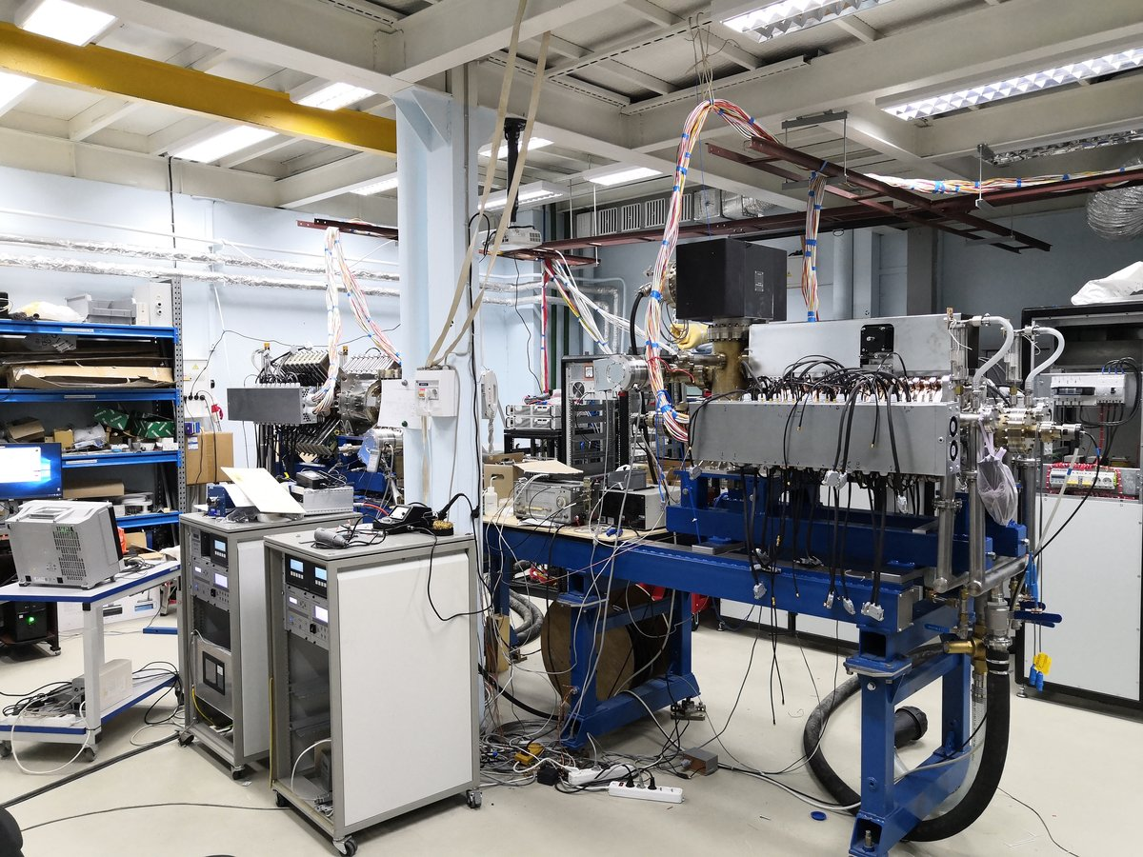
Barrier bucket system RF1: tests at BINP.
RF1E1
Power supply cabinets
(vac. pump below)
RF1E2
(vac. pump above)
Vac. cabinets

Slide 13
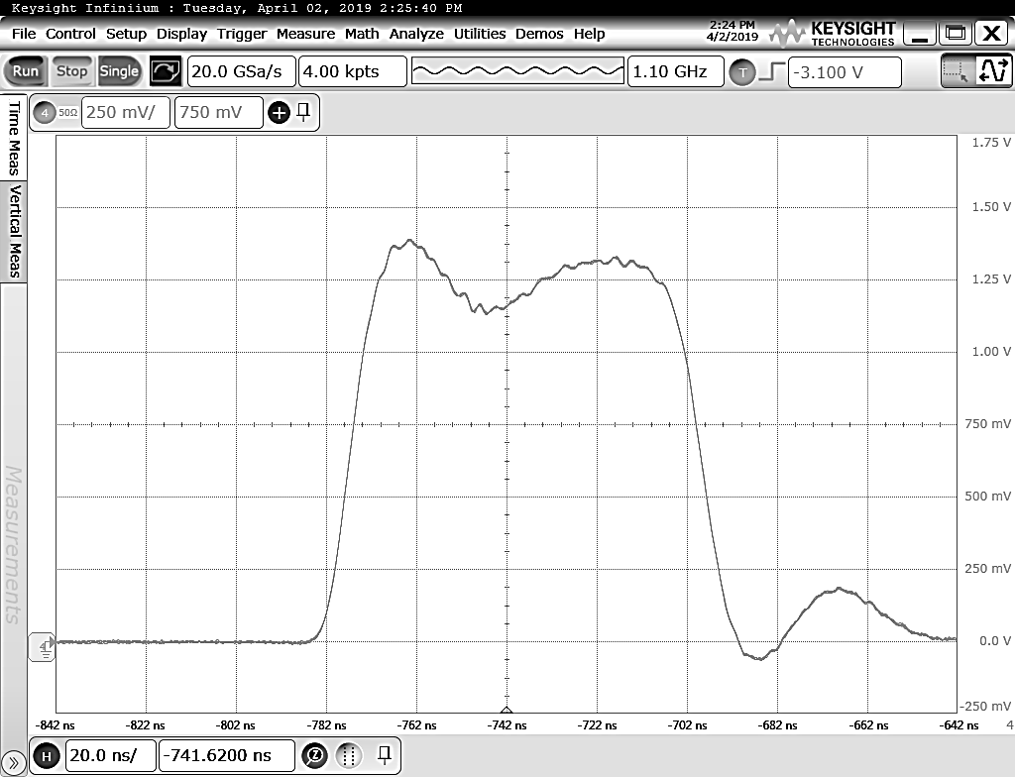
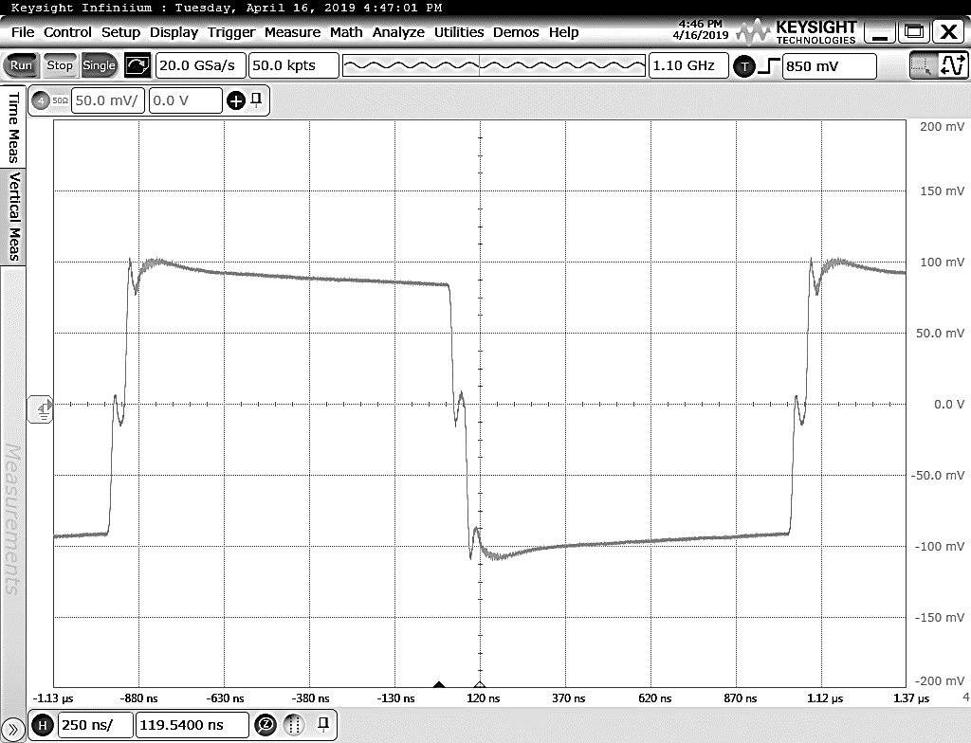
Barrier bucket system RF1: test results.
Barrier pulse
RF1E2
Accelerating meander
(rep. freq.: single shot of 4 barrier pulses)
V_{DC} = 360V
1kV/
V_{DC} = 125V
200V/
5kV
+400V
Rise/fall time ≈ 10ns
-400V
20ns/
250ns/
To do:
1. Operation with movable barriers. 2. Slope correction.
3. Reliability run at max repetition freq. and voltages.
Notes:
Injection at 3Gev/u, σ_{p Nuclotron}=1.2E-4 → 1.21E-4 (ideal rectangular pulses) or 2E-4 (actual pulse shape)
– not essential for the injection rate 1/8s and e-cooling current I_{e}=1A
Stack at 3Gev/u, σ_{p}=3.7E-4 → 3.9E-4 (ideal rectangular pulses) or 4.3E-4 (actual pulse shape)

Slide 14
RF2&3: cavities

Slide 15
Harmonic systems RF2 and RF3: cavities.
Limitations: low frequency, OD < 2⋅(320−50)mm = 540mm, min long. space available
⇒ strongly capacitively loaded coax cavity (with large tuning range!)
Tuner (4 segments)
Dimension, mm |  | RF2 | RF3
L | Cavity length (*) | 1200 | 1000
D | Сavity ID | 490 | 490
а | Aperture ID | 100 | 100
g | Accelerating gap | 5 | 20
d | ∅ tuner | 450 | 410
G | Tuner length | 450 | 210
s | Tuner gap | 2.5÷4.1 | 10÷27
Acc. gap
a
d
D
s
g
G
L
Tuner parameters | RF2 | RF3
Tuning range Δf, MHz | 1.7 | 4.3
Tuner stroke Δs, mm | 1.6 | 17
Precision δs, um (Δϕ_{UI} = 5°) | 0.13 | 0.5
Sensitivity ∂f/∂s, MHz/mm | 0.90÷1.60 | 0.14÷0.60
* - movable gap short not accounted

Slide 16
Harmonic systems RF2 and RF3: cavities.
Tuner gear box
Cavity cylindrical shell
Capacitive freq. tuner
End plate w/coax insert
Movable gap short
Agilent titanium
sublimation pump (TSP)
Agilent Vaclon Plus 150
Ion sublimation combination pump
Short gear box
RF3 prototype cavity

Slide 17
Harmonic systems RF2 and RF3: cavities.
Parameter |  | RF2 | RF3 | Units
Harmonic number |  | 22 | 66
Resonant frequency | f₀ | 11.5÷13.2 | 34.4÷38.7 | MHz
Quality factor (unloaded) | Q₀ | 3 400÷3 700 | 6 600÷7 200
Characteristic impedance | R/Q | 18.8÷21.7 | 50÷58 | Ohm
Shunt impedance | R_{sh} | 65÷80 | 330÷418 | kOhm
Max gap voltage | E_{gap} | 25 | 125 | kV
Max surface field | E_{S max} | 5.2÷5.5 | 8÷8.2 | MV/m
Kilpatrick limit | E_{KP} | 5.6÷5.9 | 7.9÷8.2 | MV/m
Max dissipated power | P_{max} | 4.8 | 24 | kW
Max power density | P_{S max} | 0.6 | 2.8 | W/cm²
Relatively low power losses make it possible to simplify water cooling scheme
in favor of increased mechanical stability of coax inserts of the RF2 cavities
(which are longer than the RF3 cavities)

Slide 18
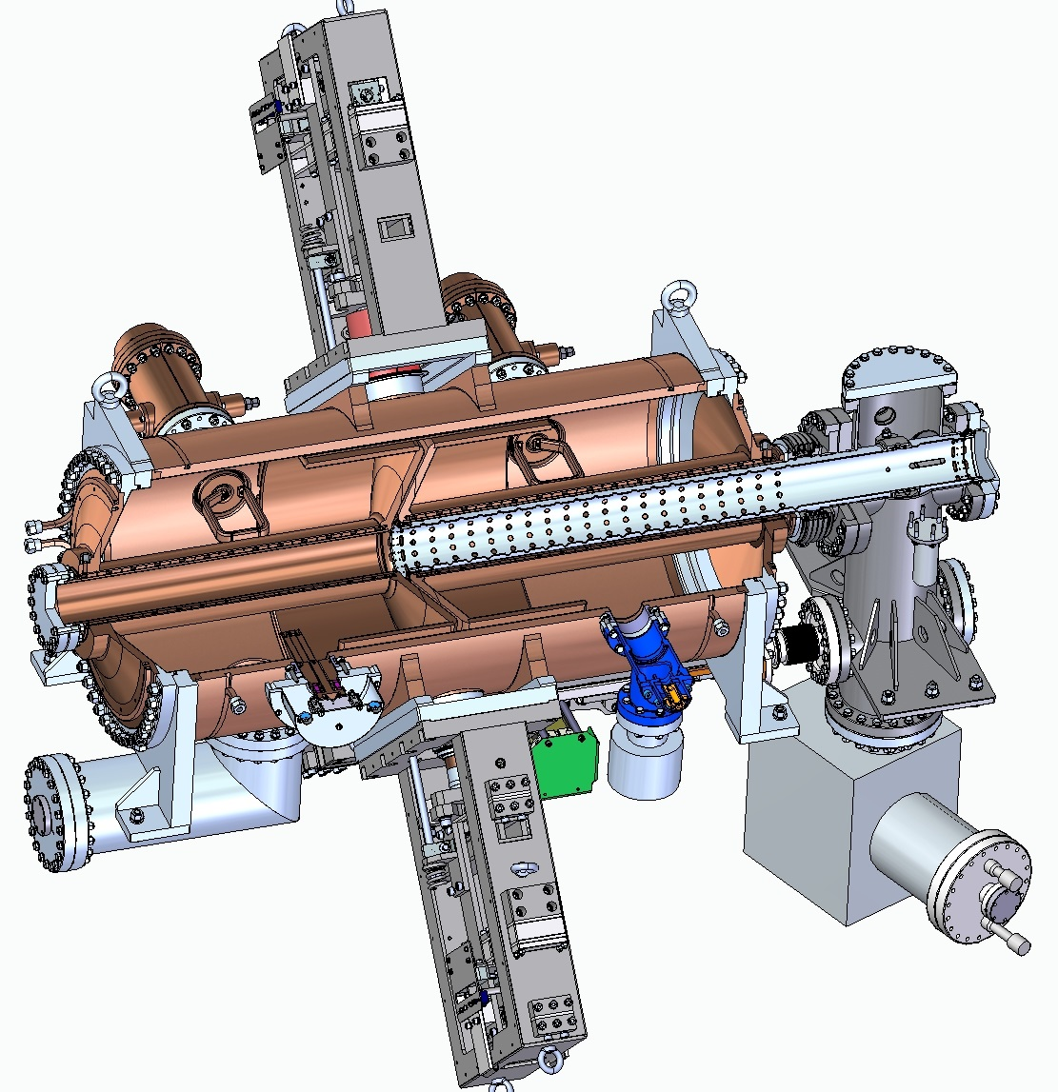
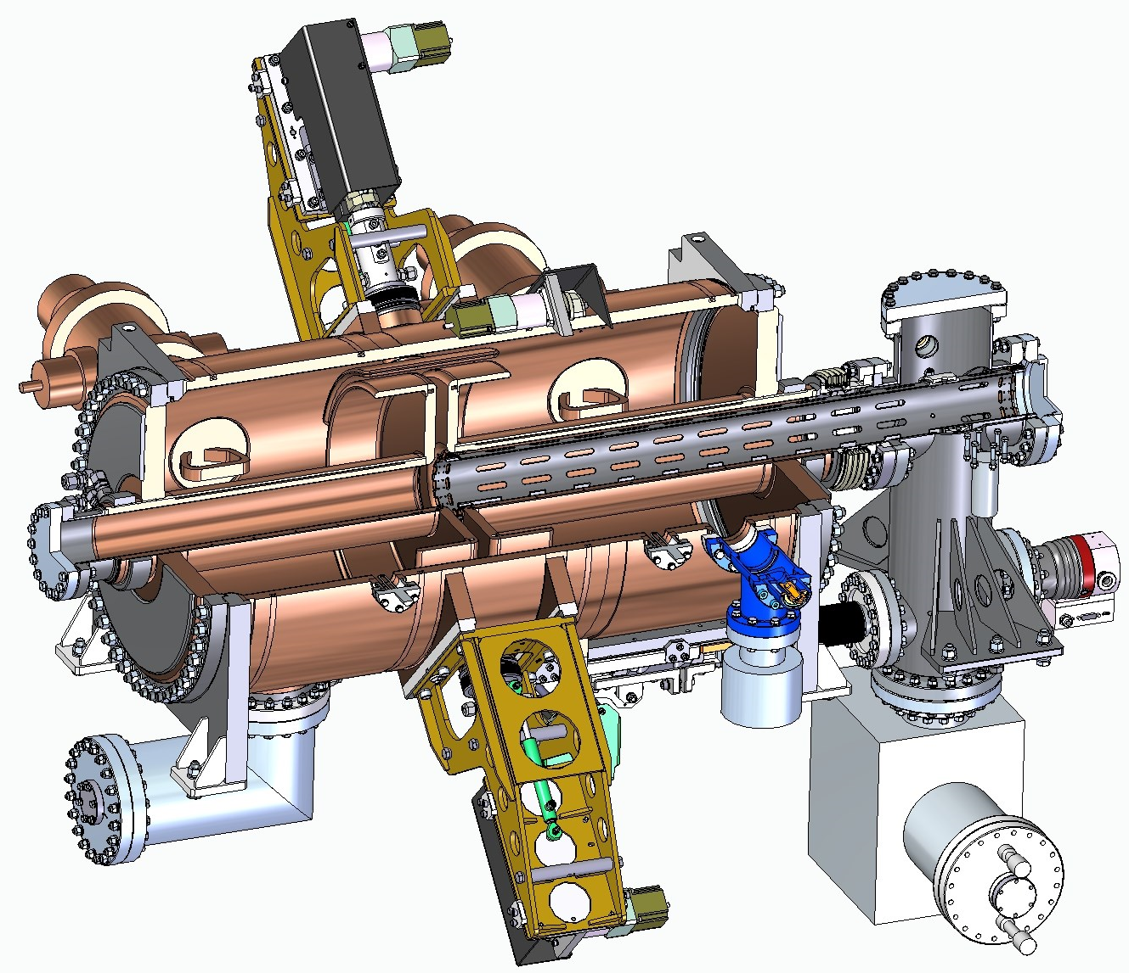
Harmonic systems RF2 and RF3: prototype cavities.
7
7
7
1
7
1
6
2
6
2
4
4
2
2
5
5
3
3
3
3
Water cooling | RF2 | RF3
1. Outer shell | + | +
2. End plates | + | +
3. Inner coax | + | +
4. Coax C: flat | - | +
5. Coax C: cylinder | - | +
6. Tuner segments | - | +
7. Input coupler | + | +
L_{tot} = 1 660 mm
(flange-to-flange)
L_{tot} = 1 626 mm
(flange-to-flange)

Slide 19
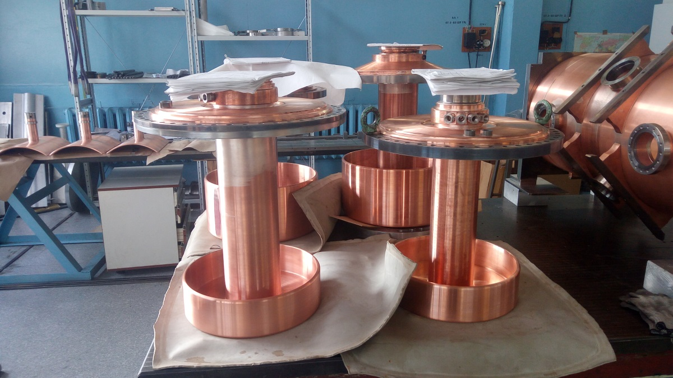
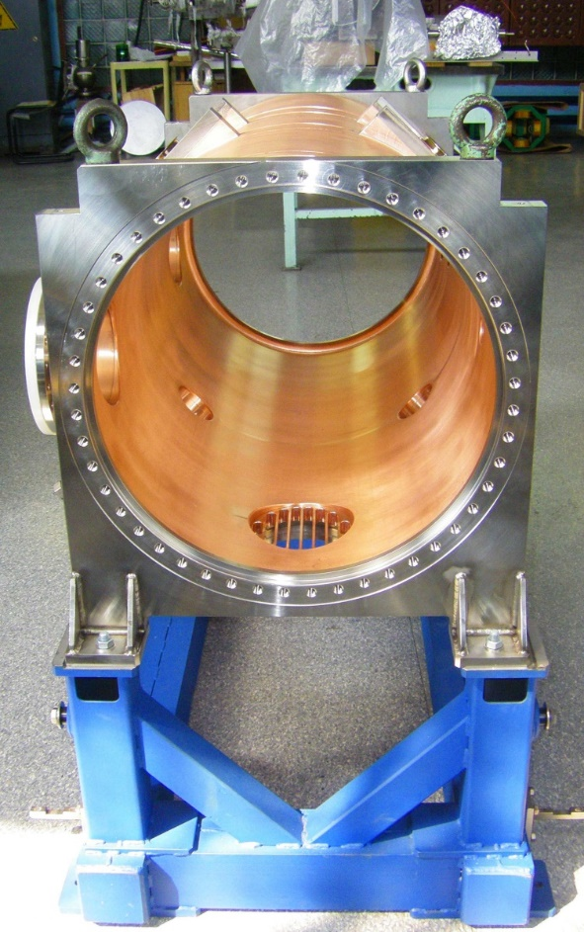
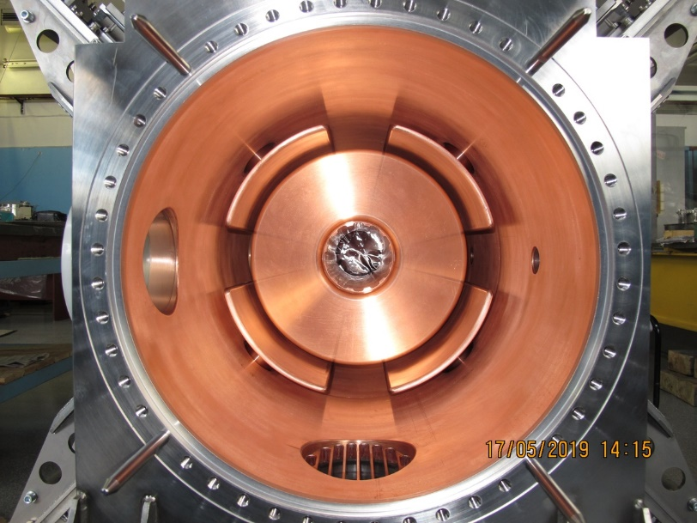
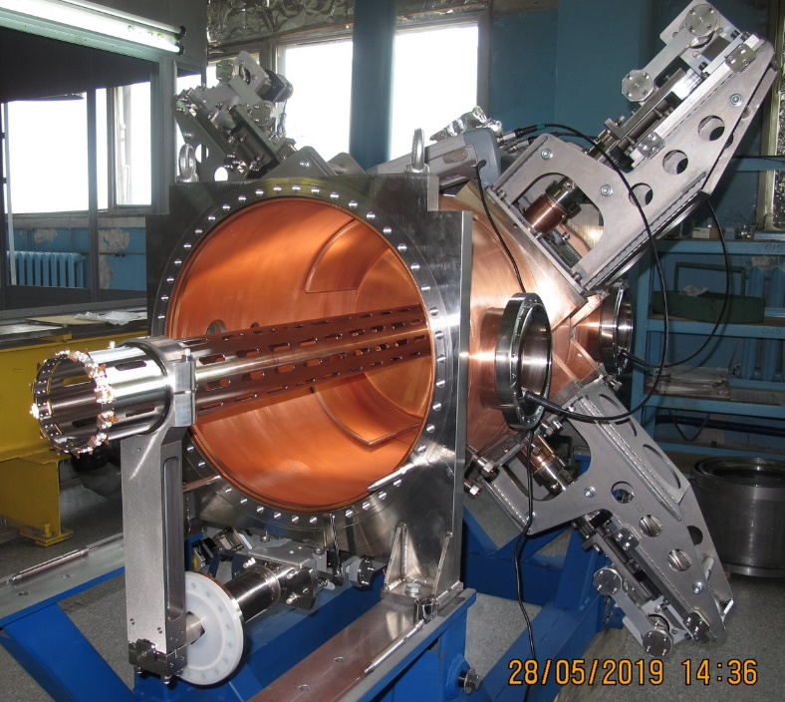
Harmonic systems RF2 and RF3: prototype cavities.
Tuners (RF2)
Cavity shell (RF2)
Cavity shell (RF3)
Coax inserts (front – RF3, back – RF2)
Cavity shell (RF3) with coax insert and tuners …
… and movable gap short

Slide 20
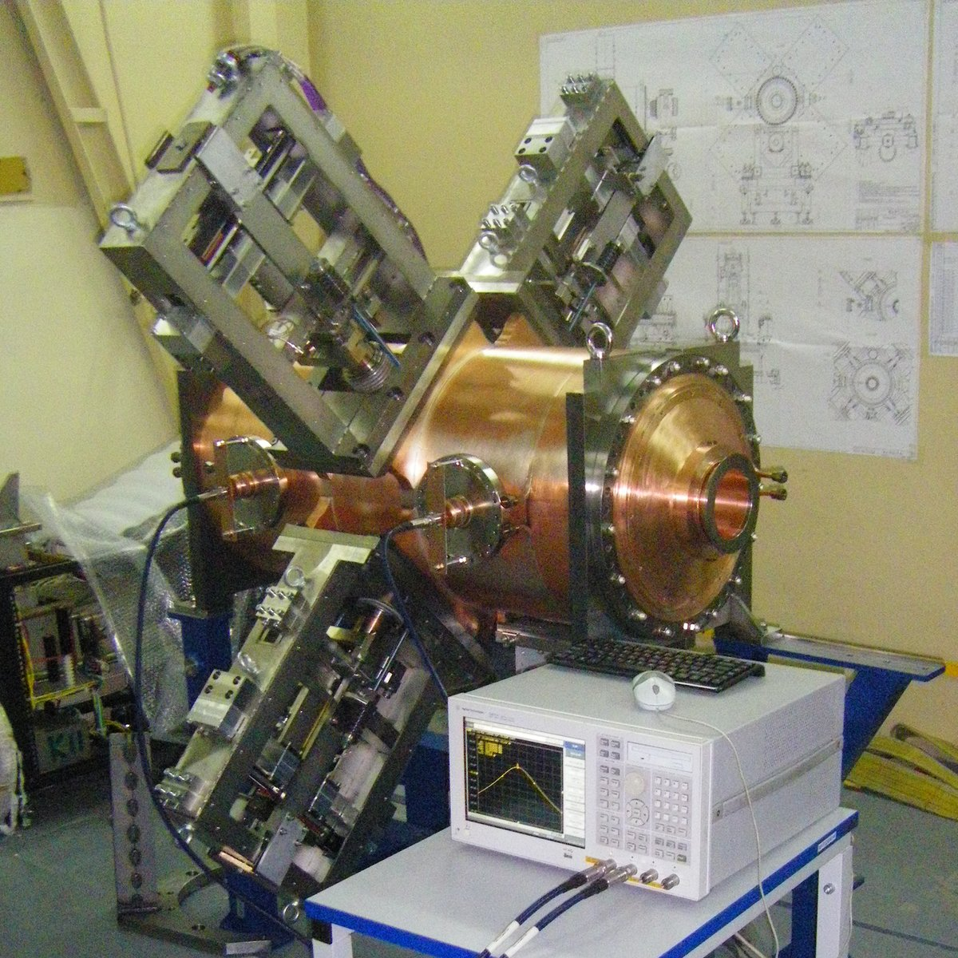
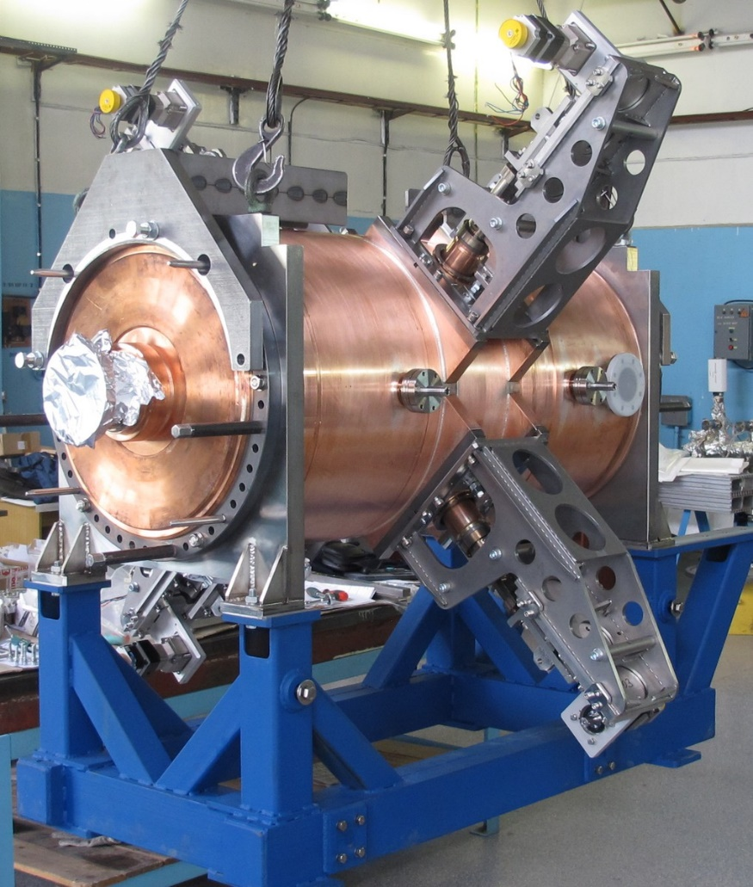
Harmonic systems RF2 and RF3: prototype cavities.
Stepping motor
Stepping motor + piezo
RF2 cavity prototype
RF3 cavity prototype
f₀ = 11.1÷13.6MHz
Q₀ = 3 600 (@ 12.2MHz)
f₀ = 34.1÷39.4MHz
Q₀ = 6 900 (@ 39.0MHz)
Ready for high power tests.
Test assembly at BINP Workshop.

Slide 21
RF2&3: power amplifiers

Slide 22
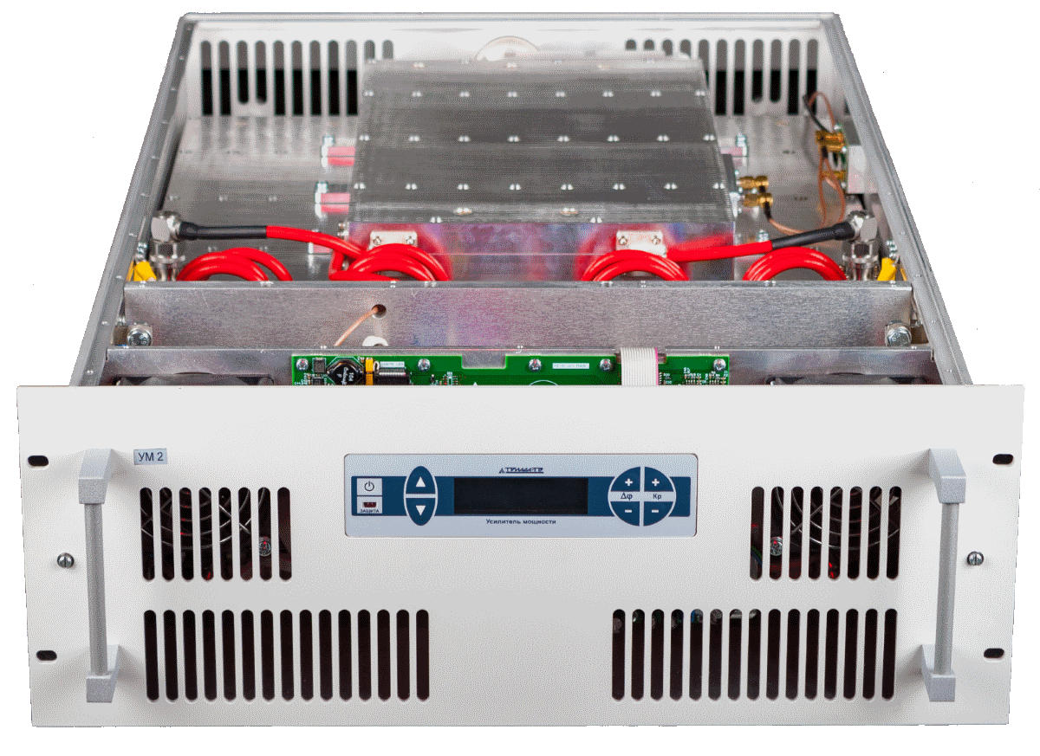
Harmonic systems RF2 and RF3: amplifiers.
Each cavity is driven by a SSA designed and produced by the Triada-TV company (Novosibirsk, Russia, www.triadatv.ru).
Amplifier | RF2 | RF3
Freq. range, MHz | 11÷13.5 | 34÷39
Max. output power, kW | 7 | 40
Mode of operation | CW
Gain, dB | 40
Max. load VSWR at full power | 2
Output | 50 Ohm 1-5/8” coax | 50 Ohm 3-1/8” coax
Cooling | DI water + air
Transistors: MRFX1K80H – RF Power LDMOS by NXP Semiconductors (www.nxp.com)
1.8–400MHz, 1.8kW CW, 65V, VSWR 65:1
Actual regimes: <1.0kW CW, 50V for increased reliability
Power combiners: 3dB directional couplers
4-transistors module
Notes:
LDMOS = laterally diffused metal oxide semiconductor

Slide 23
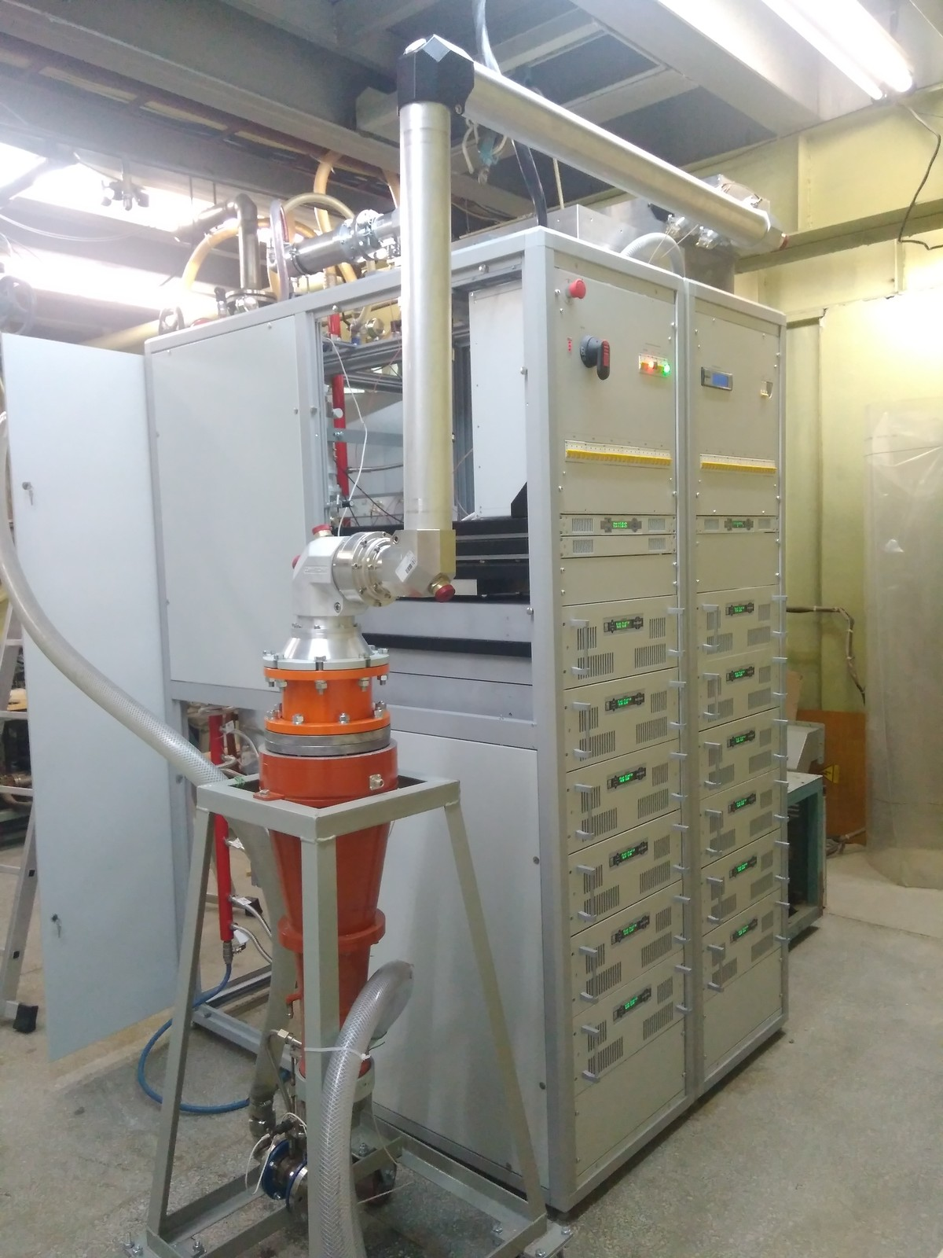
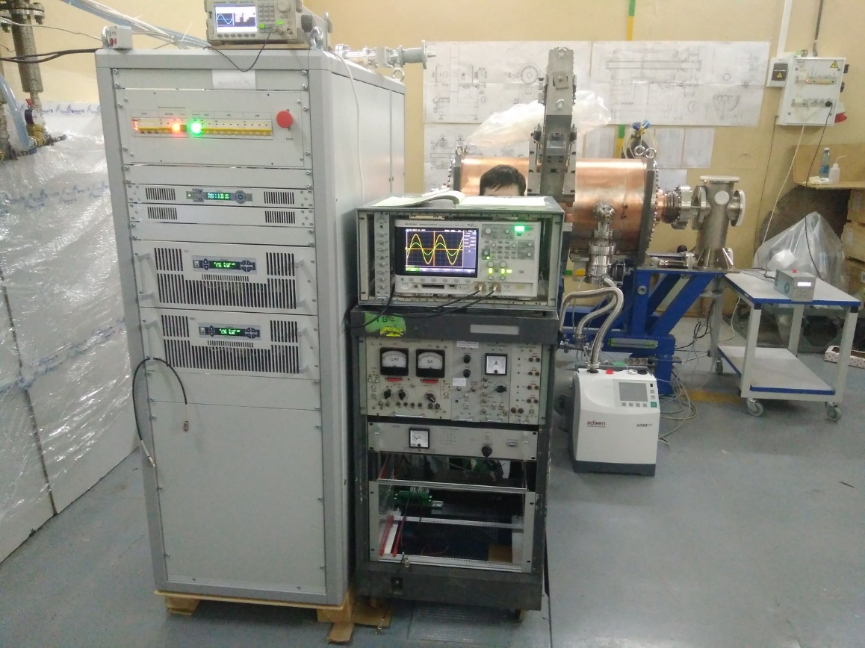
Harmonic systems RF2 and RF3: amplifiers.
Prototype amplifier acceptance tests:
 | RF2 | RF3
Triada-TV | P_{max}, matched | ½ P_{max}, matched *)
BINP | P_{max}, matched | P_{max}, matched
BINP | P_{max}, cavity | P_{max}, cavity
Passed
Passed
To be done
*) – limited by the available 20 kW load
100 kW load
RF2
23-05-2019
RF3
21-05-2019

Slide 24
Harmonic systems RF2 and RF3: amplifiers.
Test logs
7.10 kW
40.38 kW
Передатчик – Работает нормально.
Transmitter – Operates properly.
+ 2 more pages with logged data

Slide 25
Vacuum

Slide 26
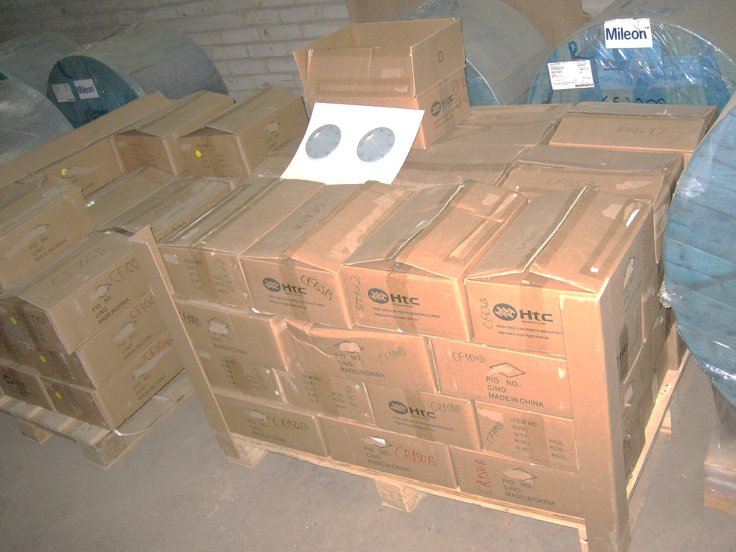
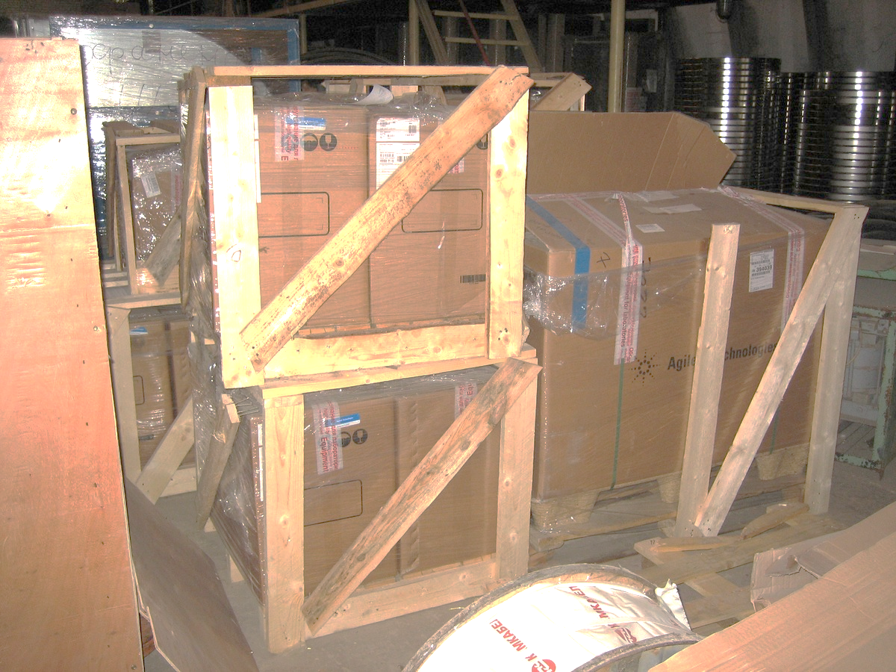
Vacuum: 3×10⁻¹¹ Torr (tech. specs)
NE
SIP300
SIP150+TSP
SIP150+TSP
SIP150+TSP
SIP150+TSP
SIP150+TSP
SIP150+TSP
SIP150+TSP
SIP150+TSP
SIP150+TSP
RF1
RF2
RF2
RF2
RF2
RF3
RF3
RF3
RF3
RF3
SIP300 – Agilent Vaclon Plus 300 ion sublimation combination pump
SIP150 – Agilent Vaclon Plus 150 ion sublimation combination pump
TSP – Agilent titanium sublimation pump
Vac. gauges: Pfeiffer IMR 430, hot cathode, 1.5⋅10⁻¹²÷ 0.75⋅10⁻⁴ Torr
2 / group of 5 cavities, 1 / group of 1÷3 cavities
SIP150+TSP
SIP150+TSP
SIP150+TSP
ВЧ3
ВЧ3
ВЧ3
ВЧ3
ВЧ3
ВЧ3
RF1
RF2
RF2
RF2
RF2
RF3
RF3
RF3
RF3
RF3
SIP150+TSP
SIP150+TSP
SIP150+TSP
SIP300
SIP150+TSP
SIP150+TSP
SIP150+TSP
SIP150+TSP
SIP150+TSP
SIP150+TSP
SIP150+TSP
SIP150+TSP
SIP150+TSP
SW
SE
Vac. pumps, gauges and CF flanges for ALL cavities procured.
Notes:
SIP150 610l/s N2 1380l/s H2
SIP300 720l/s N2 1580l/s H2
TSP 515l/s N2 1200l/s H2

Slide 27
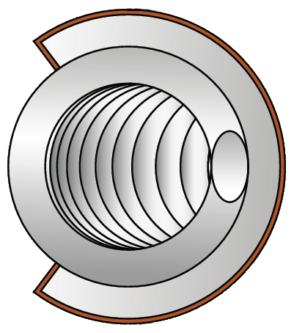
Vacuum: gaskets.
2 types of vacuum gaskets are used in the RF cavities:
spring loaded gaskets at the connections of end plates w/coax inserts-to-cavity shell (RF2, 3)
Conflat® gaskets at all other connections.
Spring loaded gasket compressed between 2 flat SS surfaces:
HTMS High Tech Metal Seals
CSE-046200-6.35M-2/2-1-S50
Advantage: provides “smooth” rf surface, simple flange shape, UHV compatible, reusable (?).
∅462
SIP150
6.35
TSP
RF3 prototype cavity

Slide 28
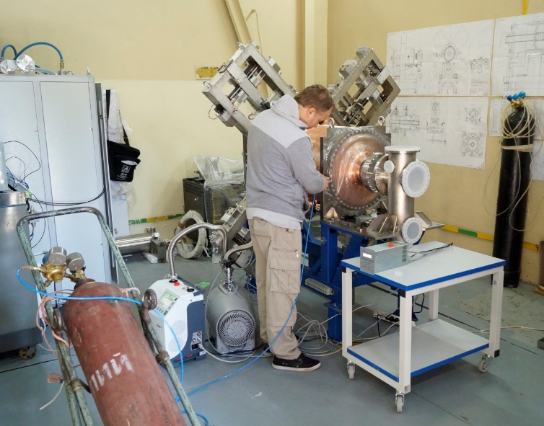
Vacuum: test sequence.
A spring loaded gasket is an attractive solution (particularly for the end wall-to-cavity shell connections) but require special care and experience in designing and assembling the connections.
It is essential to test the cavity connections with HTMS gaskets ASAP.
⇒ Prototype cavity test sequence
Partial assembly (cavity w/o movable gap short):
Pump down with turbo pump only.
Leak check, HTMS joints with special care.
Connect the SSPA, test at full gap voltage.
Complete assembly (cavity w/ movable gap short):
Perform high t° vacuum baking.
Repeat step 2.
Repeat step 3 (if limited by MP in unbaked cavity).
Ok
3⋅10⁻⁷ Torr
Ok
no leak <1⋅10⁻¹¹ mbar⋅l/s
RF2 prototype cavity under vacuum tests.
3⋅10⁻¹¹ Torr

Slide 29
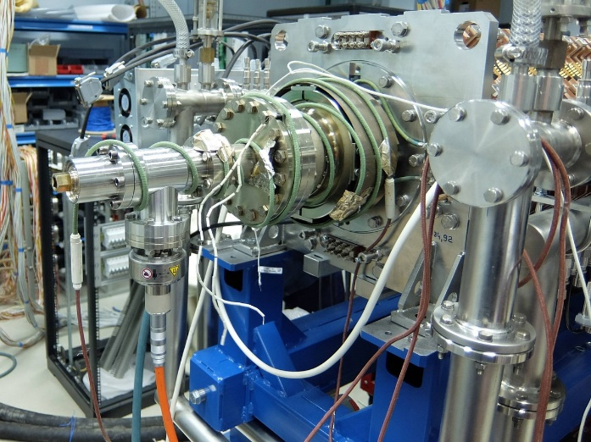
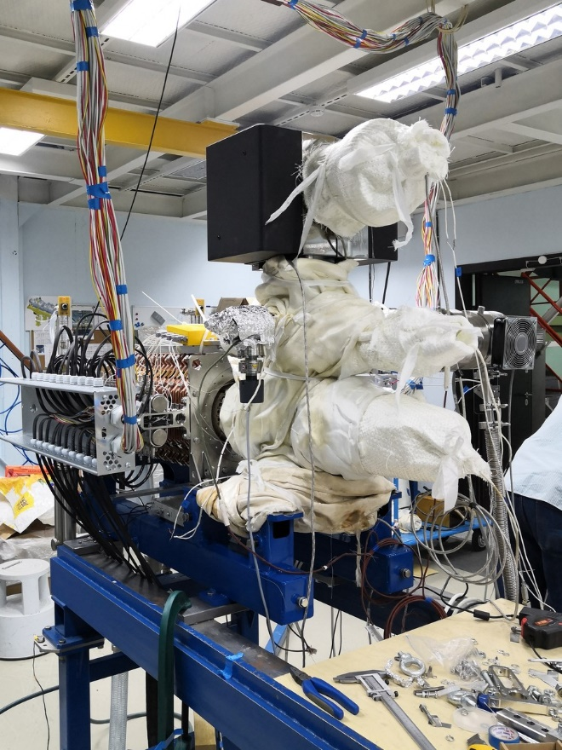
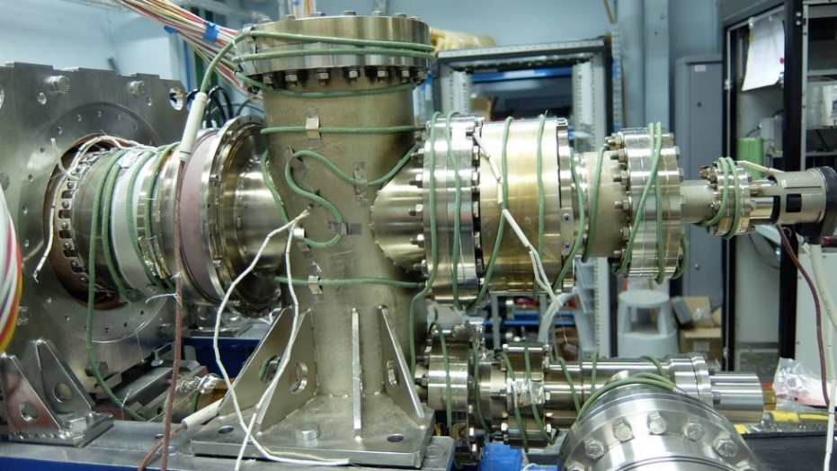
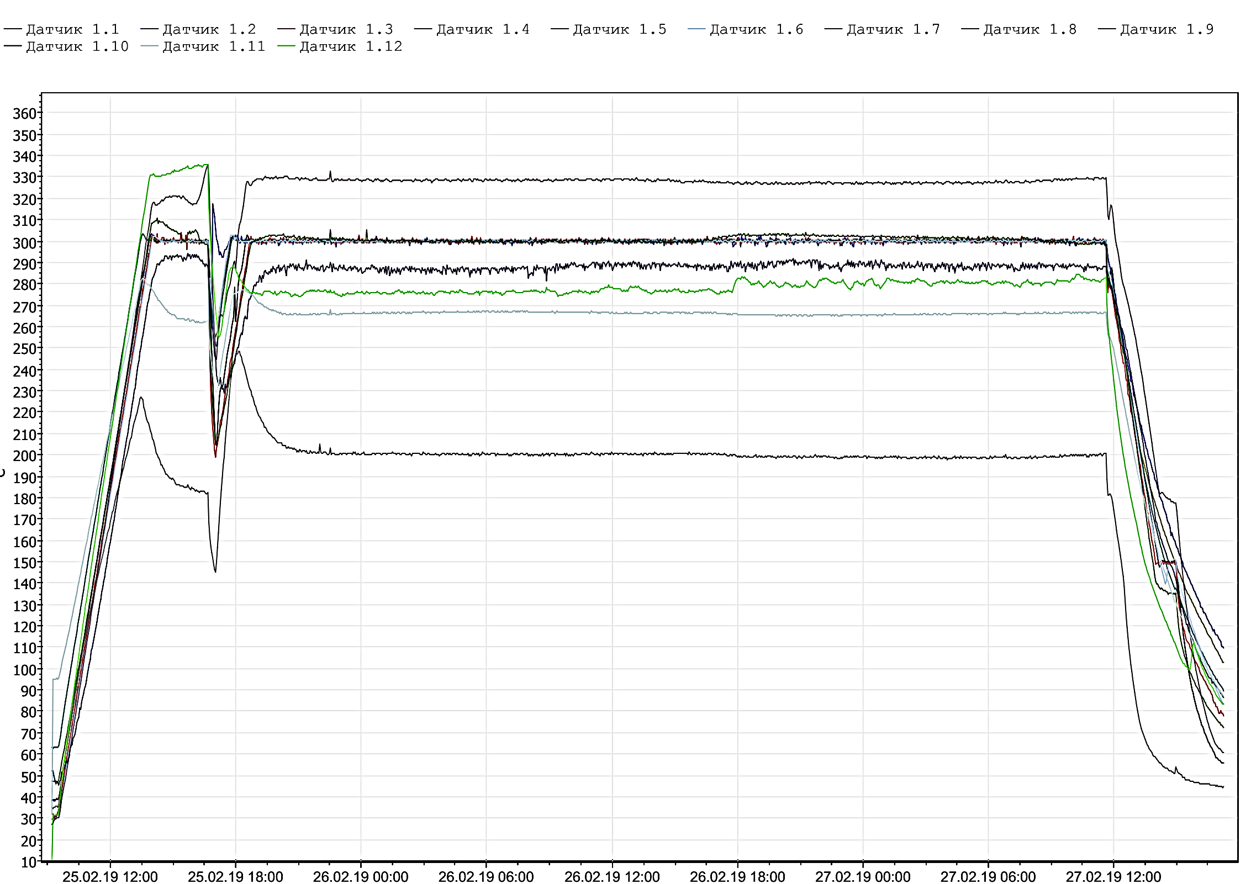
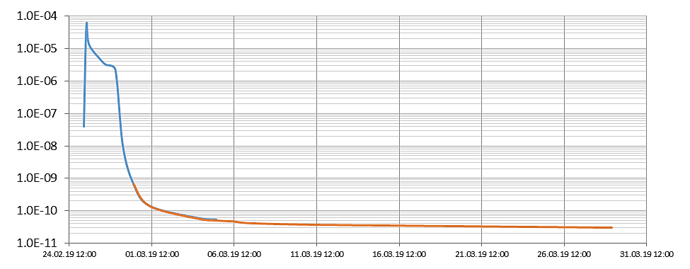
Vacuum: baking.
RF1E2
Baking of ALL cavities is done inside local thermal insulation (jackets) by heat tapes (wires) temporarily mounted on the cavity outer surface:
every single cavity – at BINP
group of cavities – at JINR, in-situ
1
2
3
4
330С
300С
P, Torr
200С
1
4
10⁻⁸
6
45hrs
6
Baking cycle
10⁻¹⁰
RF1E2 2.9
RF1E1 2.8
29/05/2019: ⋅10⁻¹¹ Torr
5days/

Slide 30
RF systems: R&D and production plan.
 | RF1 | RF2 | RF3
Key parts proto | 2016 – gap short 2016 – inductor module | 2017 – tuner gear box
Full size proto |  | 2019 | 2019
RF for NICA | 2019 – 2 pcs | 2020 – 8 pcs | 2020 – 8 pcs 2021 – 8 pcs
RF1 for NICA –
06-07/19 reliability run at max repetition freq. and voltages
08-09/19 operation with movable barriers
10-12/19 shipment to JINR, acceptance tests (?)
RF2,3 proto –
06-09/19 high power and vacuum (incl. baking) tests
10-12/19 shipment to JINR, acceptance tests (?)
RF2,3 for NICA –
09/19 series production start
OFE copper, CF flanges and vac. pumps/gauges – received for ALL cavities
HTMS gaskets – estimated prod. time: 4 months
RF amplifiers – estimated prod. time: 12 months (f8+16 amps)

Slide 31
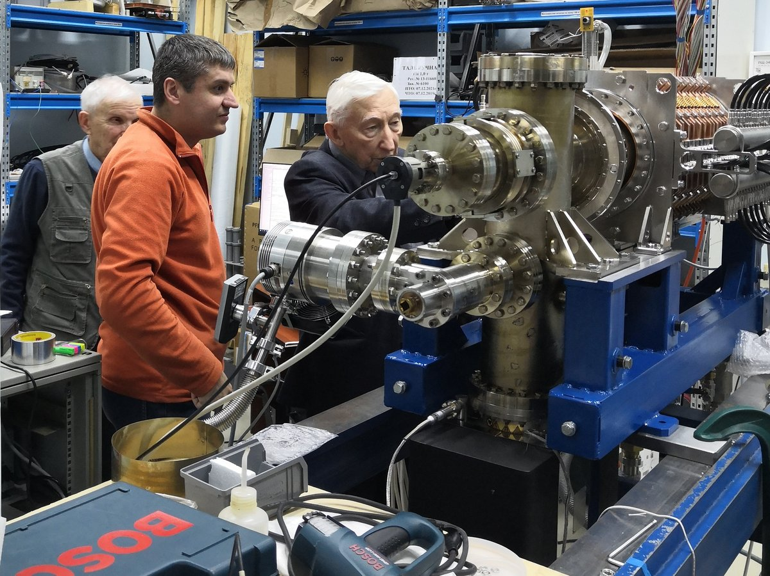
Thank you!
Transferring knowledge between generations …

