Slide 1
Collimation in Collider
O.S.Kozlov, V.I.Shokin
LHEP, JINR, Dubna
Machine Advisory Committee, JINR, Dubna, June 5-6, 2019

Slide 2
Contents
Goals of Collimation in Collider
Collimation principles
Schemes of Collimation for NICA Collider
Collimators design
Conclusions

Slide 3
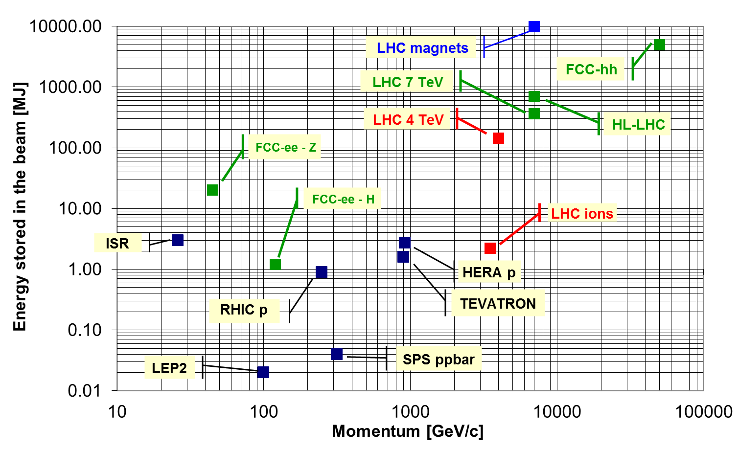
Goals of Collimation in NICA Collider,
stored Energy in the beam
NICA Collider: @ E_{k}=4.5GeV/u and full Intensity of N=5*10¹⁰
→ E_{beam}=7kJ;
for beam life time t_{b}=10h:
→ ions beam loss rate is 1.5*10⁶ ions/sec, 0.2 J/sec=0.2W

Slide 4
Goals of Collimation in NICA Collider
Halo cleaning to protect accelerator components
Superconducting and permanent magnets, superconducting RF cavities .
Passive machine protection as beam absorbers or interceptors First stage of defense in case of accidental failures.
Concentration of losses/activation in well defined areas Ease maintenance by avoiding many distributed high-radiation areas.
Cleaning of beams’ interaction products in IP Protect superconducting elements close to experiments.
Background optimization for experiments (the main goal for NICA) Minimize the impact of halo losses on the quality of experimental data.
Beam tail/halo scraping and diagnostics (movable collimators) Control and probe of the transverse shape of the beam.

Slide 5
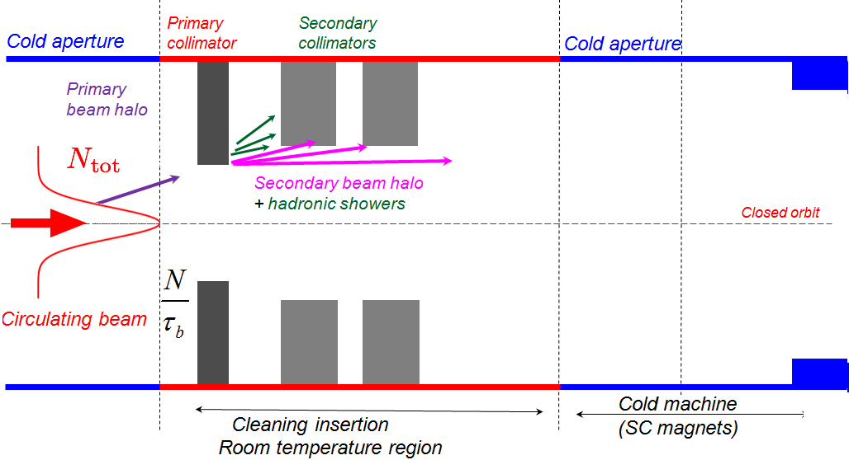
Collimation principles
2-Stage Collimation

Slide 6
Scraper – Collimators Layout

Slide 7
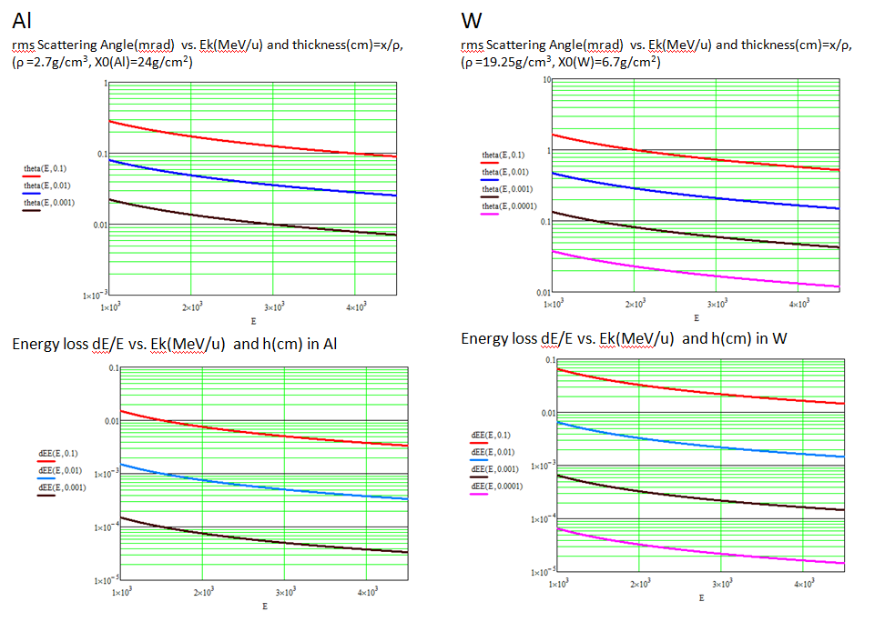
Scrapper – Primary Collimator
Material choice

Slide 8
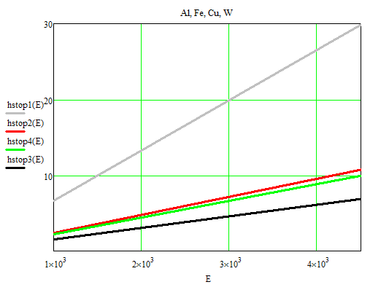
Secondary Collimator (Absorber)
Stopping Energy range for Au⁷⁹⁺ ions,
h_{stop} (cm) vs E_{k} (MeV/u) for different absorber materials
Al
Stopping thickness of W:
h ≥ 7cm for all energy range
Fe
Cu
W

Slide 9
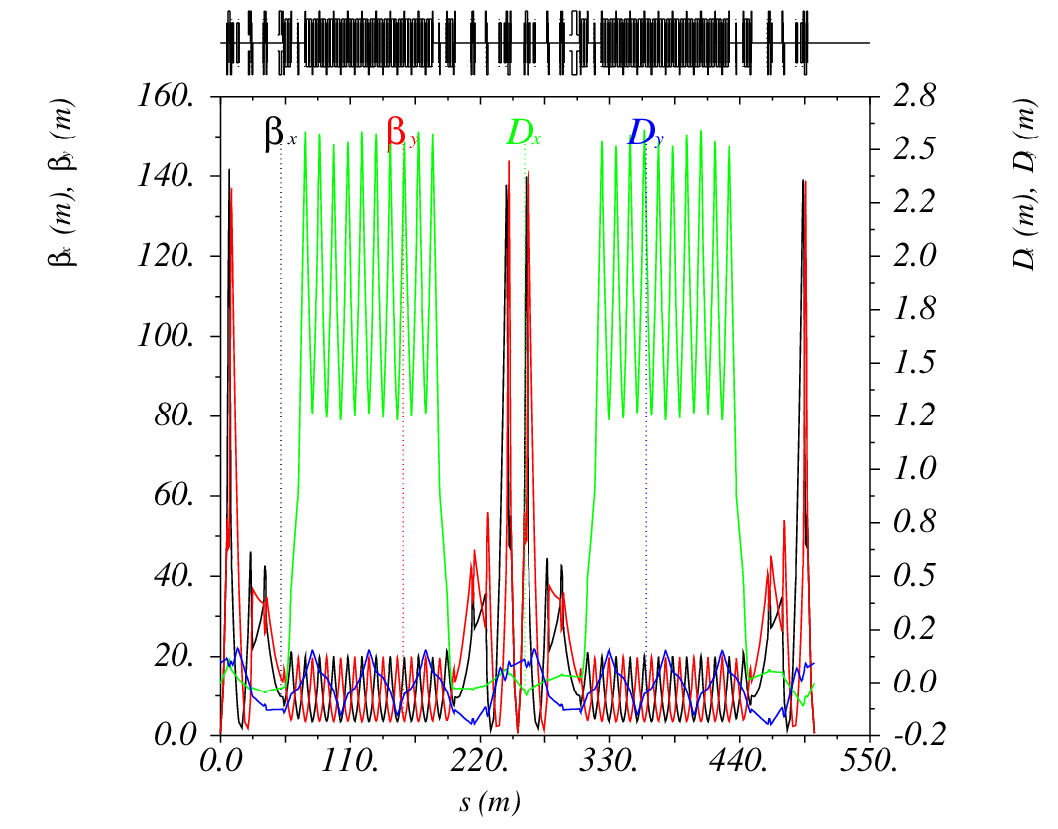
NICA Collider lattice functions
Collider Optics for Qx=Qy=9.44, β*=0.6m

Slide 10
NICA Collider: Rings composition, Straight sections
West half ring
East half ring
Location of collimation elements is possible in the West part
of the Collider for both Red and Blue Rings.

Slide 11
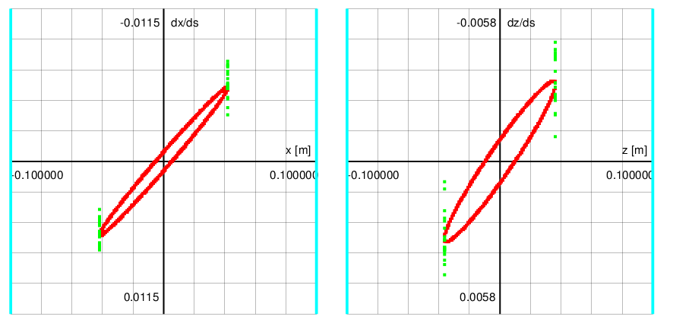
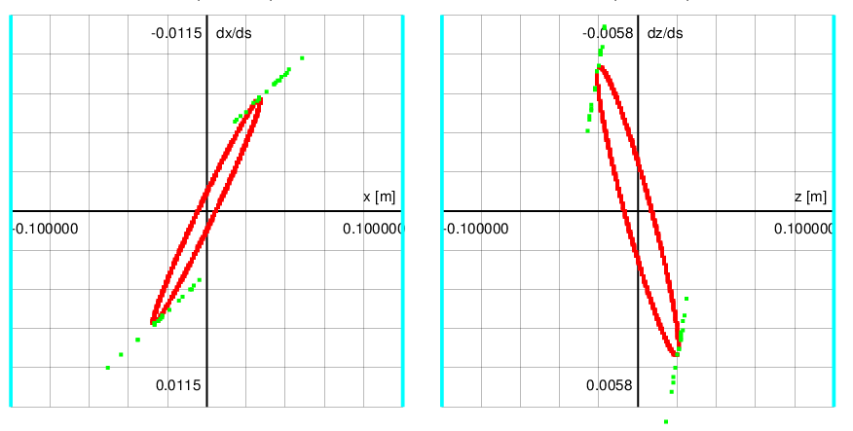
Collimation, halo tracking

Slide 12
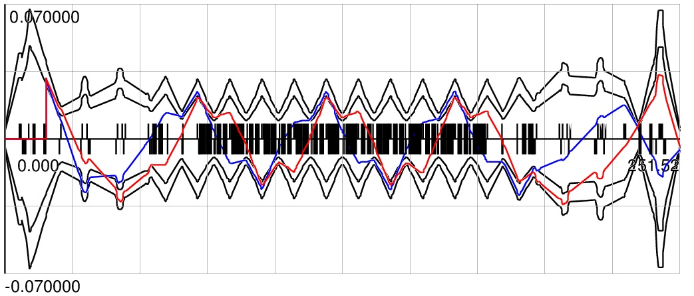
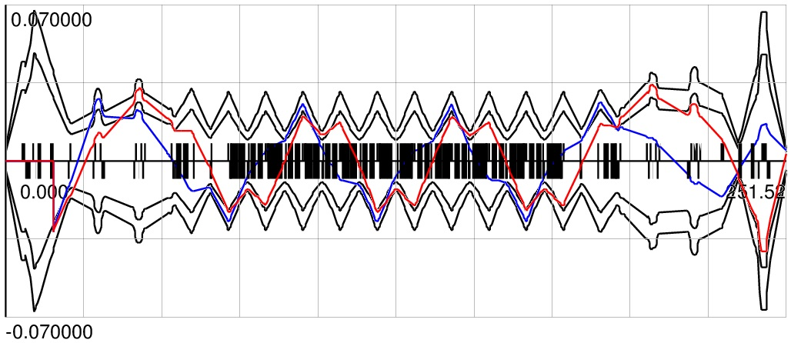
X/Y Betatron Collimation
X-plane
ScrX ColX1 ColX2
⇓ ⇓ ⇓
Xscr1(+)
A _{X,Col}=(6-7)σ_{X}
A _{X,Scr}=5.5σ_{X}
A _{X,Acc}=6σ_{X}
2 Secondary
X-collimators
ScrX2 ColX21 ColX22
⇓ ⇓ ⇓
Xscr2(-)

Slide 13
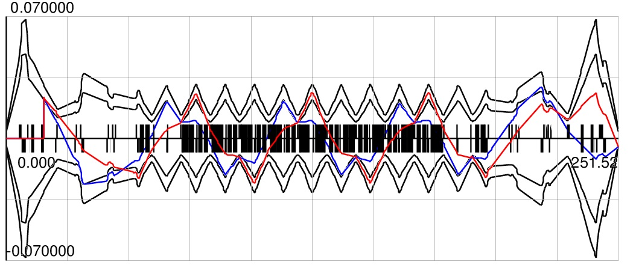
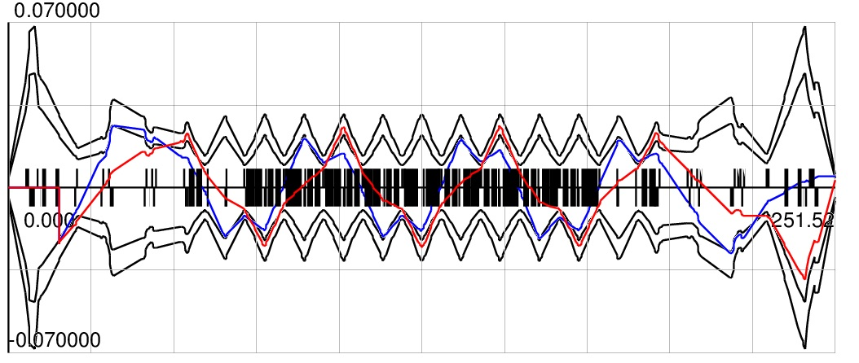
Betatron Collimation X/Y
Y-plane
ScrY ColY1 ColY2
⇓ ⇓ ⇓
Yscr1(+)
A _{X,Col}=(6-7)σ_{X}
A _{X,Scr}=5.5σ_{X}
A _{X,Acc}=6σ_{X}
2 Secondary
Y-collimators
ScrY2 ColY21 ColY22
⇓ ⇓ ⇓
Yscr2(-)

Slide 14
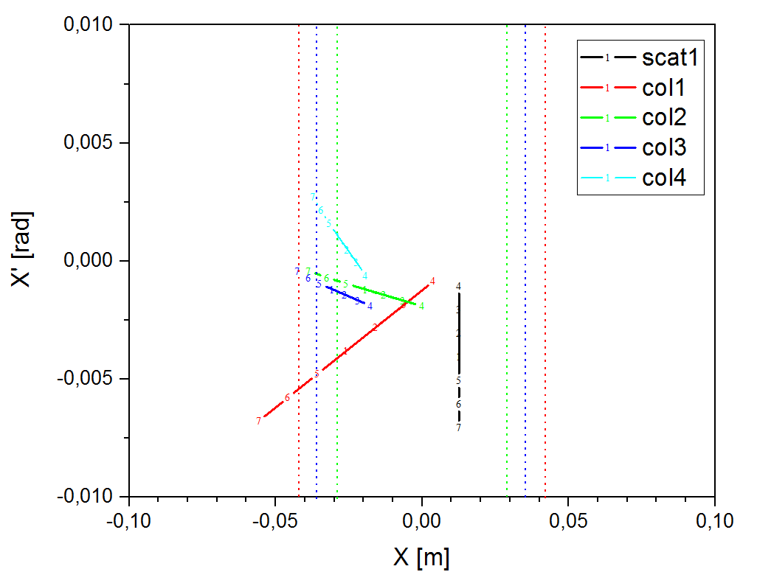
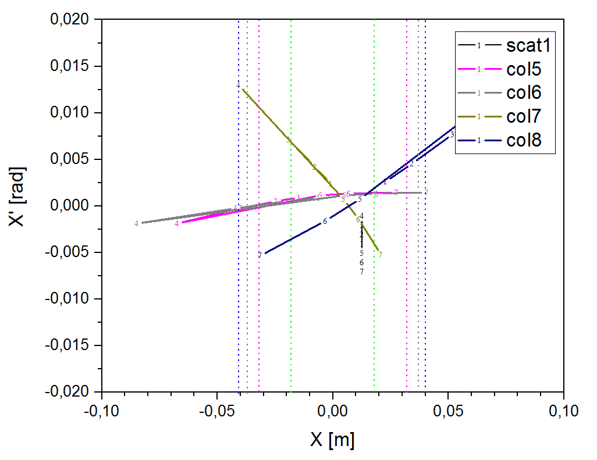
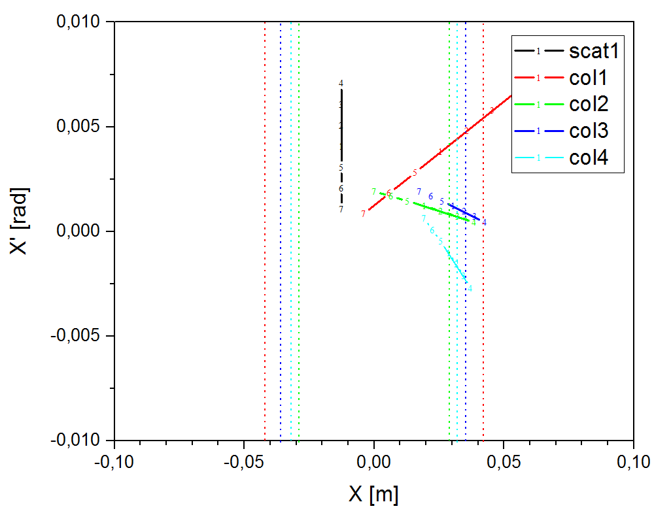
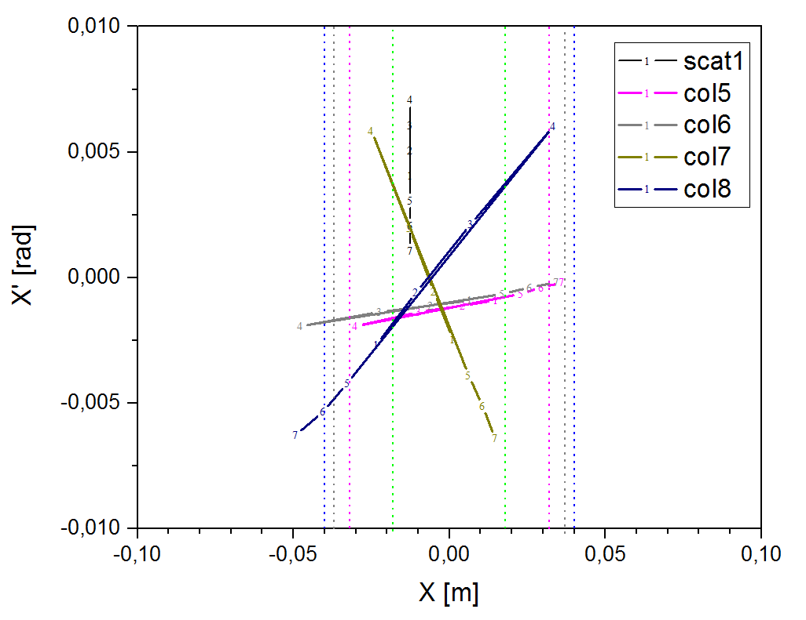
Collimation, scattered ions tracking with apertures
X-Scatterer(+)
X-Scatterer(-)

Slide 15
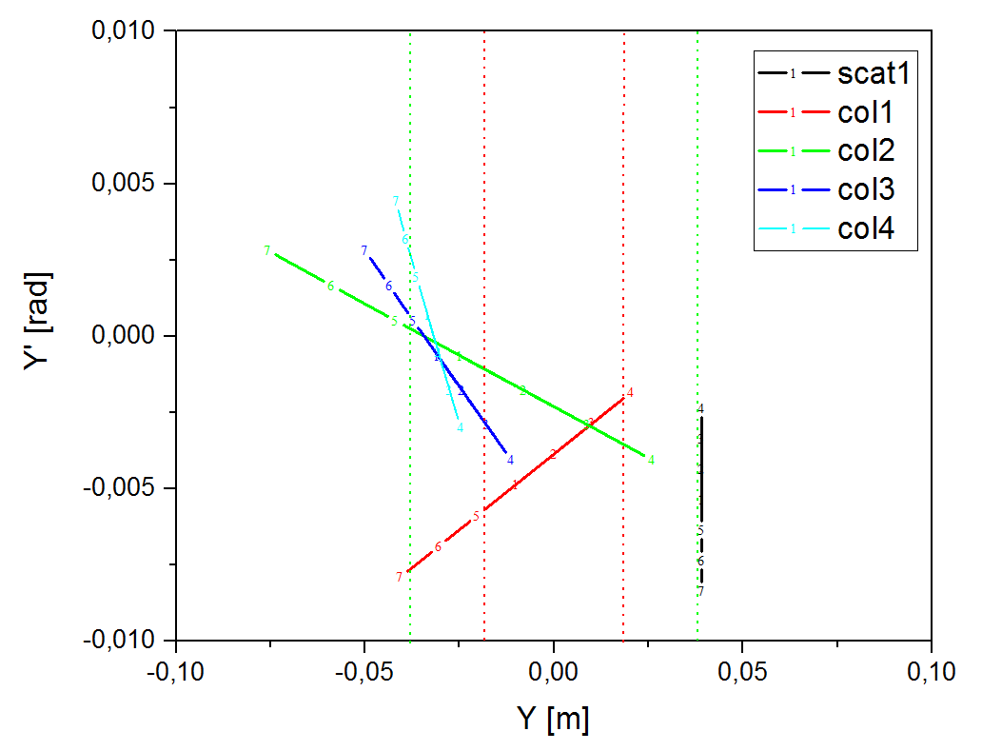
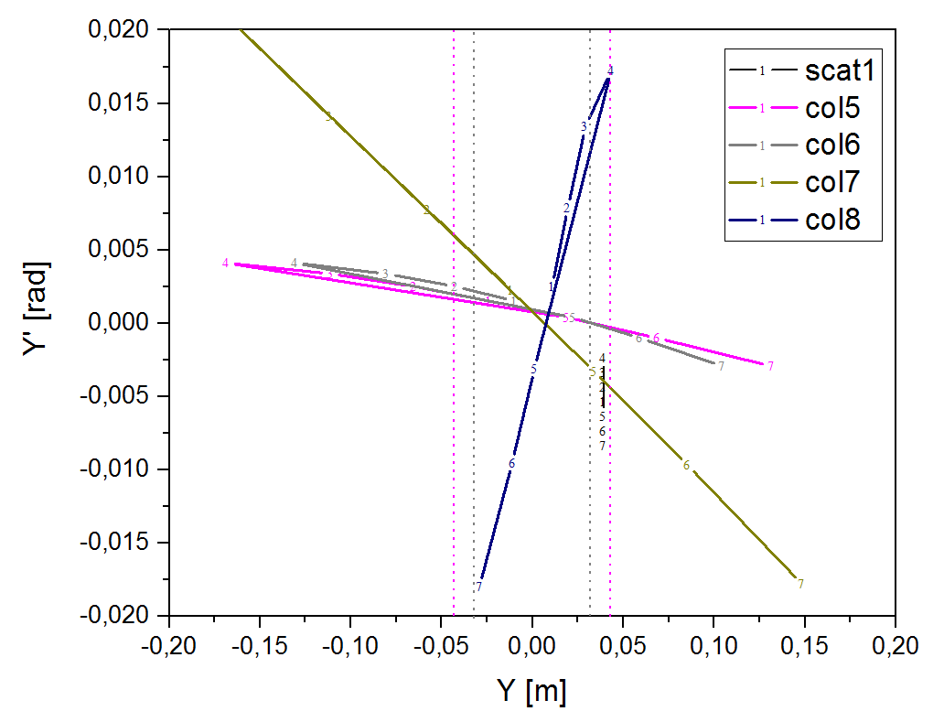
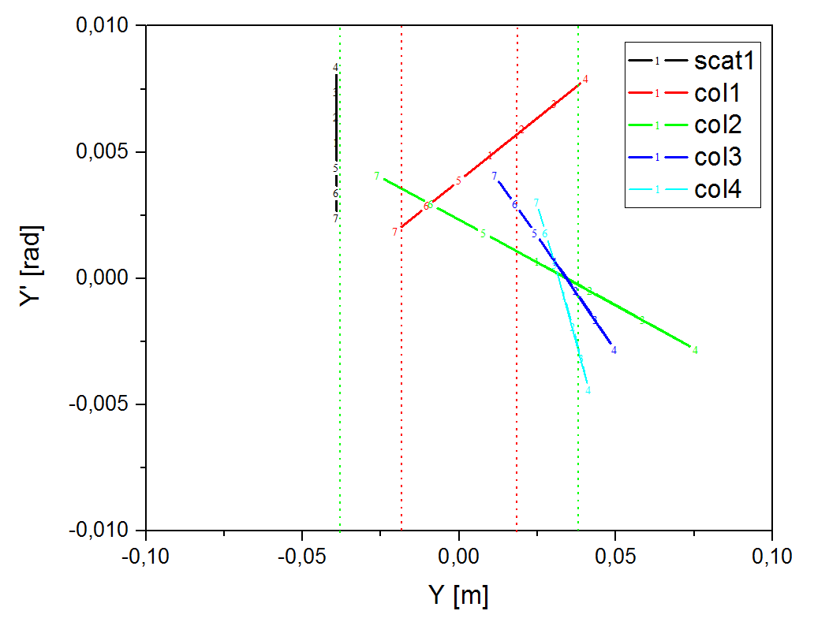
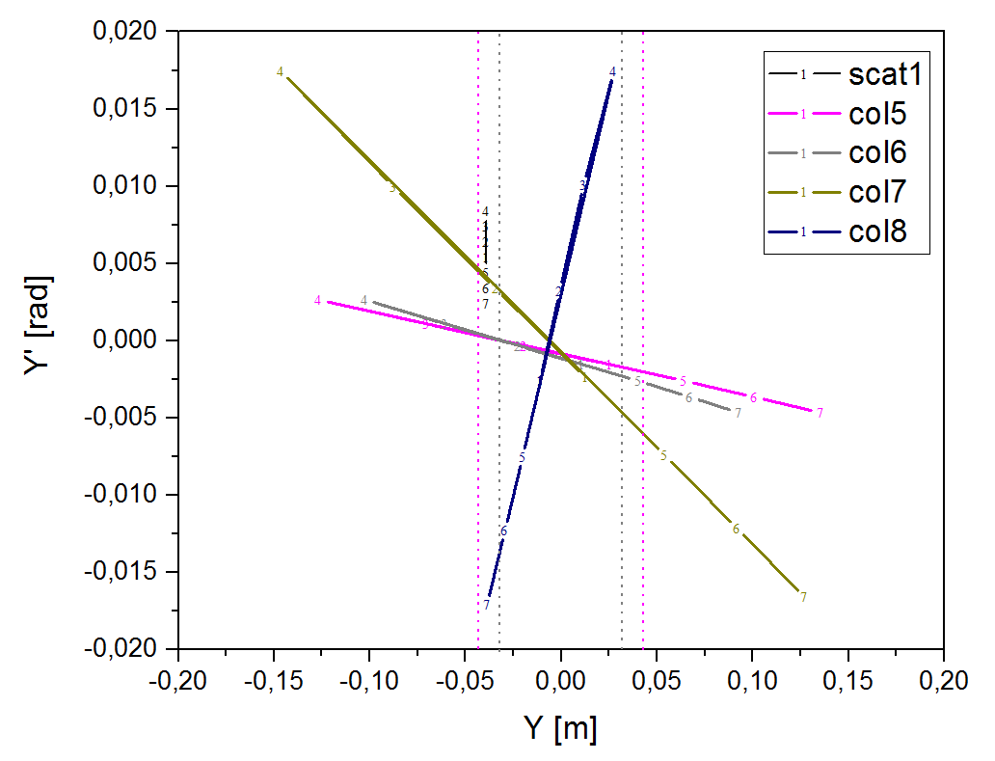
Collimation, scattered ions tracking with apertures
Y-Scatterer(+)
Y-Scatterer(-)

Slide 16
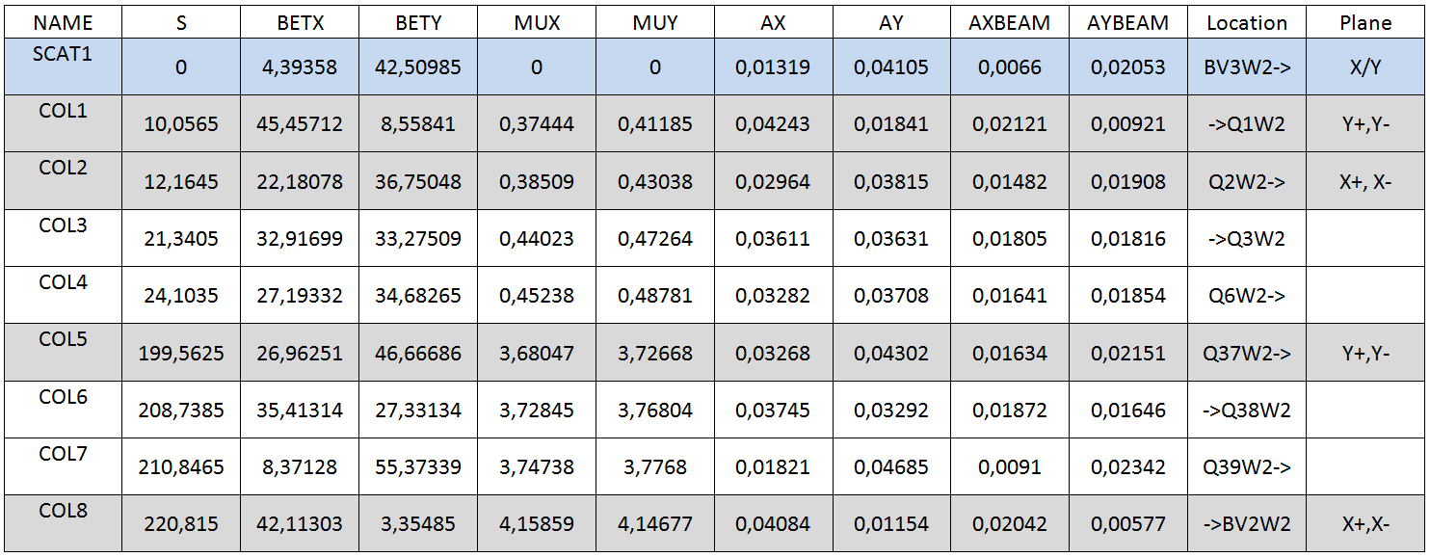
Collimation units location in Collider
Blue Ring
Red Ring

Slide 17
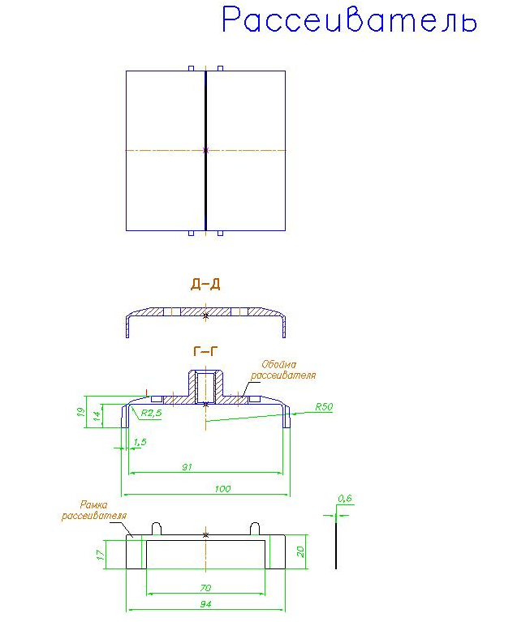
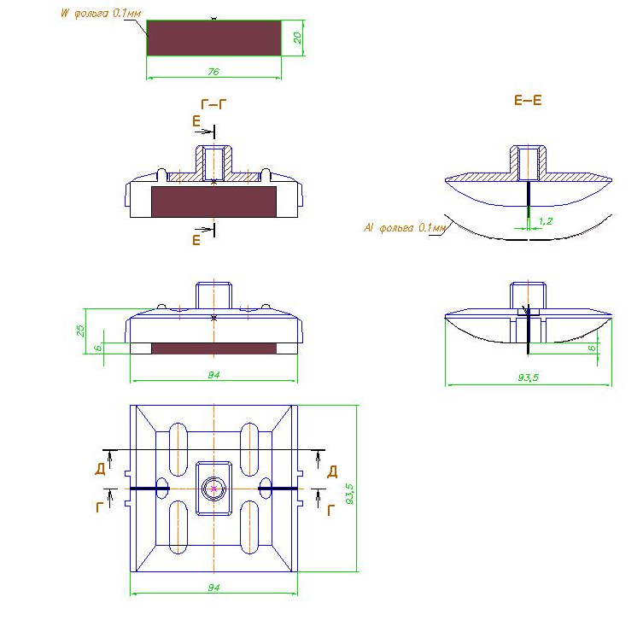
Collimator design: scrapper (foil)
Scrapper, X or Y-plane
20
76
beam⊕
25
93.5
beam→
94

Slide 18
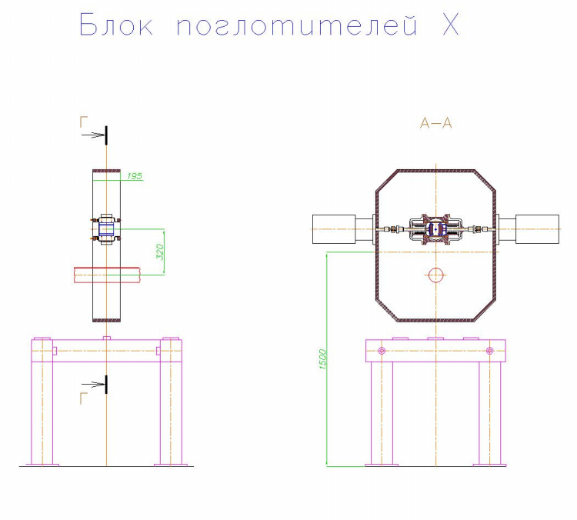
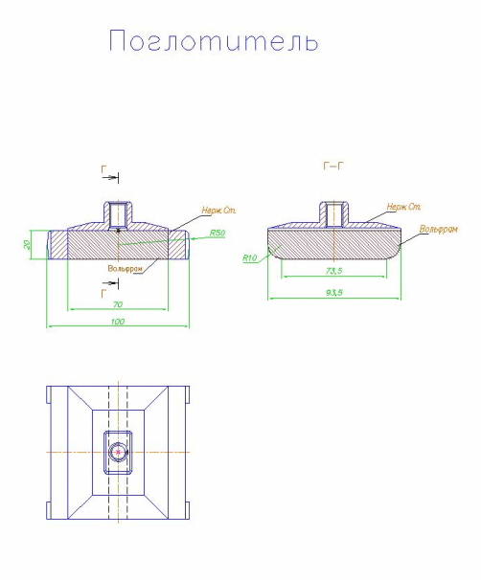
Collimators design
Collimator in X-plane
Absorber
beam⊕
beam→
195
beam•
20
←beam
93.5
320
100
beam→
beam⊕

Slide 19
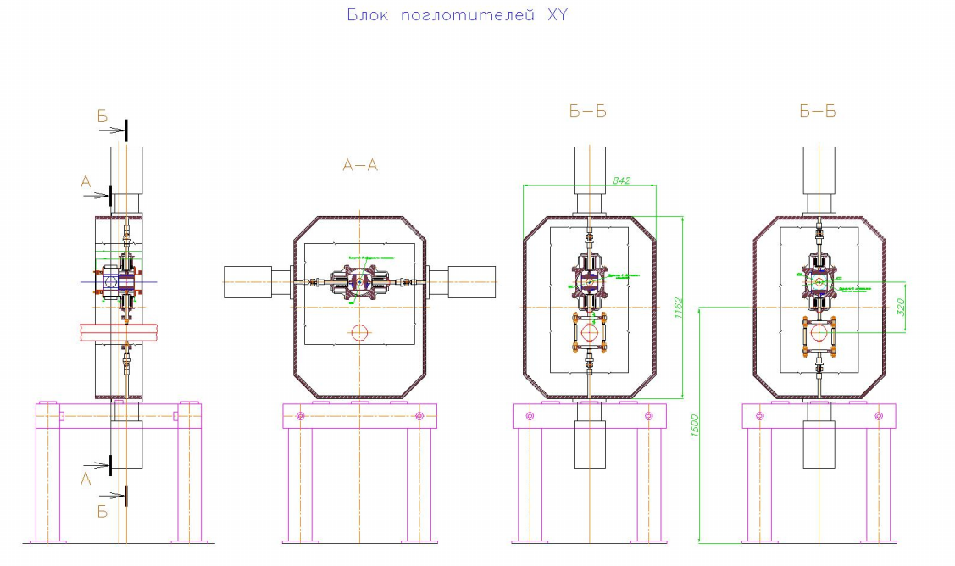
Collimators design
Horizontal and Vertical Collimators block
400
842
beam•
←beam
1162
320
beam→
beam⊕

Slide 20
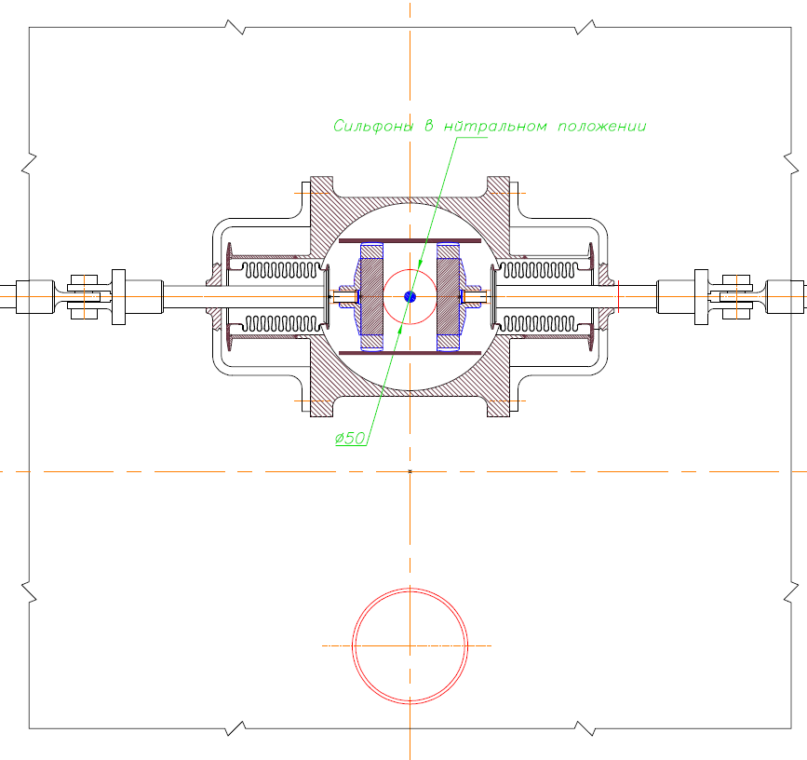
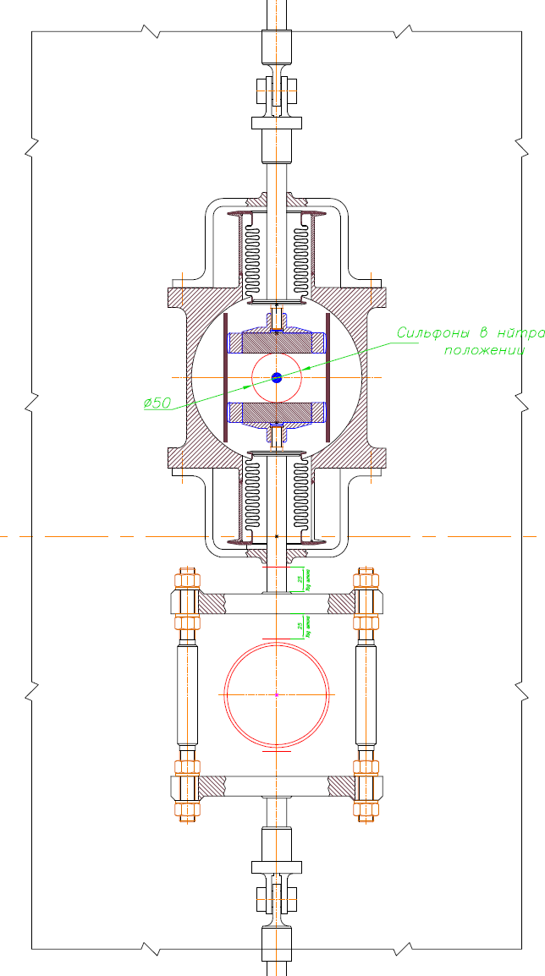
Collimators design: moving systems in X and Y planes
Vert.Collimator
Horiz.Collimator

Slide 21
Conclusions
The scheme of beam halo collimation in NICA collider is considered. The collimation purposes are the optimization of background for MPD experiment, the first stage of machine protection in case of technical fault.
Movable collimators give us the possibilities to measure beam size, beam orbit and alignment of collimation elements.
The movable Scrapers, the Primary collimators, are placed at the edge of the Ring acceptance.
The Secondary collimators are placed outside the acceptance to provide the energy absorption of the scattered ions.
The preliminary calculations of the collimation process were carried out to estimate the possible location of the collimators.
The further simulation of beam collimation depending of the ring optics (betatron tunes) will be continued.
The impedances of collimation devices must be evaluated.

Slide 22
Thank you for your attention!

