Slide 1
Information Technologies @ JINR development strategy
Nikolay Voytishin
on behalf of the LIT strategy group
126th JINR Scientific Council
19.09.2019
Dubna
1

Slide 2
Working and Experts’ Group
International group
Local group
Vladimir Korenkov
Andrey Dolbilov
Valery Mitsyn
Tatyana Strizh
Dmitry Podgainy
Petr Zrelov
Irina Filozova
Vladimir Gerdt
Oxana Streltsova
Nikolay Voytishin
Ian Bird – CERN
Peter Hristov – Bulgarian Academy of Sciences/ CERN
Weidong Li – HEP Institute of Chinese Academy of Sciences
Oxana Smirnova – Lund University/NeIC
Alexei Klimentov – CERN/BNL
Patrick Fuhrmann – DESY
Gaetano Maron – INFN
Meetings and discussions
Conferences
Workshops
Visits/Seminars
2

Slide 3
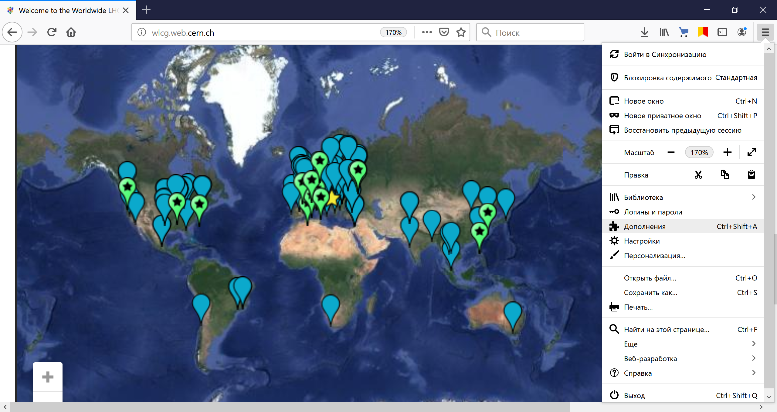
JINR is a part of Worldwide LHC Computing Grid
WLCG:
An international collaboration to distribute and analyse LHC data integrates computer centres worldwide, which provide computing and storage resources, into a single infrastructure accessible by all LHC physicists.
Tier-0 (CERN): data recording, reconstruction and distribution Tier-1: permanent storage, re-processing, analysis Tier-2: simulation, end-user analysis
~170 sites 42 countries
1 000 000 cores
1 EB of storage
> 3 million jobs/day
10-100 Gb links
Worldwide LHC Computing Grid - 2019
3

Slide 4
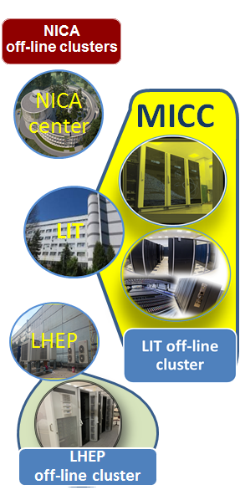
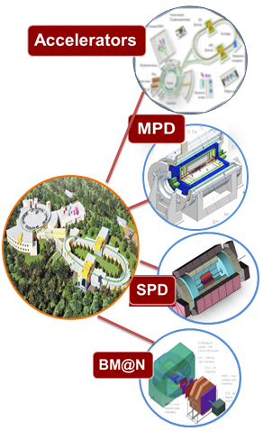
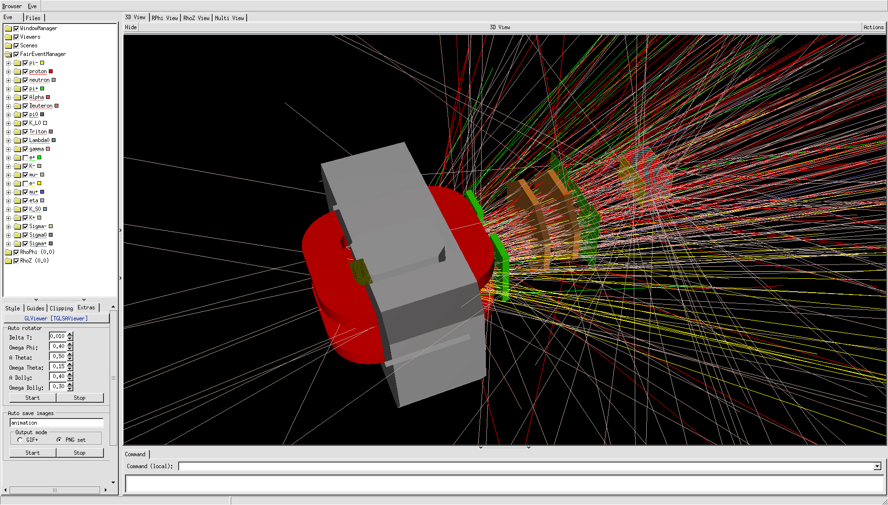
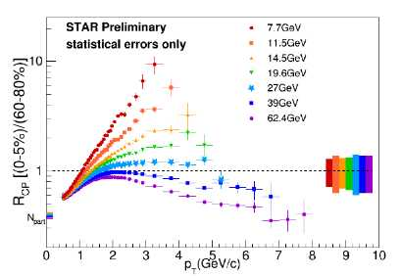
NICA Computing Concept
& Challenges
Worldwide NICA Collaboration
Lattice QCD
calculations
Simulation of nuclear
reactions
Event reconstruction
4
Physics analysis
Notes:
есть несколько экспериментов, есть несколько типов ферм-кластеров для обработки и есть сеть между всеми центрами . Сегодня сделано 400 гбитсек сеть для этого и сегодня активно используем свободные ядра на суперкомпьютере говорун для моделирования и отладки программ обработки/
At present, the Govorun supercomputer is used for both theoretical studies and event simulation for the MPD experiment of the NICA megaproject. To generate simulated data of the MPD experiment, CPU computing components of the Govorun supercomputer, i.e. Skylake (2880 cores) and KNL (6048 cores), are used; data are stored on the ultrafast data storage system (UDSS) under the management of the Lustre file system with a subsequent transfer to cold storages controlled by the EOS and ZFS file systems. UDSS currently has five storage servers with 12 SSD disks using the NVMe connection technology and a total capacity of 120 TB, which ensures low time of access to data and a data acquisition/output rate of 30 TB per second.
The DIRAC software is used for managing jobs and the process of reading out/recording/processing data from various types of storages and file systems

Slide 5
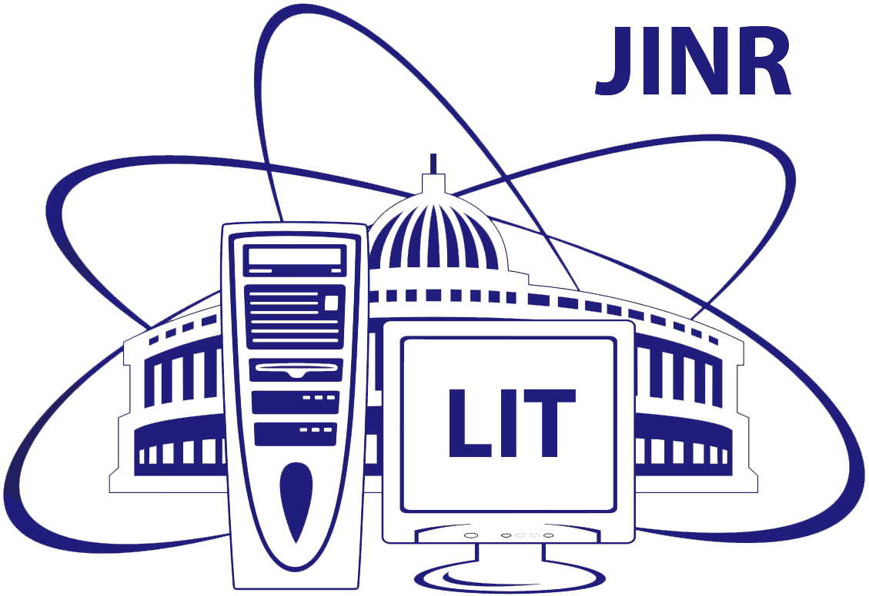
New Joint Computing Platform for
Neutrino Experiments
LIT contribution: engineering infrastructure (electricity, UPS, cooling, network, racks, manpower) | DLNP contribution: computing and storage resources (CPUs/GPUs&disks)
5
Notes:
LIT provides support for IT services, computing infrastructures, trainings, etc. for the JINR neutrino program. The NOvA experiment team was the first to actively use the LIT cloud resources, these resources are also used by the Baikal experiments - GVD and JUNO. This slide shows the ratio of the neutrino experiments in the consumption of cloud resources.
In order to effectively use resources of the information and computing environment of neutrino experiments, in which JINR employees participate, a decision on the creation of a unified neutrino
information and computing platform (environment) based on the MICC resources was made by the directorate of LIT and DLNP.
All hardware resources for neutrino experiments are planned to be purchased due to the budgets of the experiments. The infrastructure support (racks, power supply and cooling)
is provided by the Laboratory of Information Technologies.
Для нейтринной программы ОИЯИ ЛИТ обеспечивает поддержку общих IT – сервисов, вычислительных инфраструктур, проводит тренинги, развертывает и поддерживает дополнительные IT – сервисов по требованию и многое другое. Эксперимент NOvA первым начал активно использовать облачные ресурсы ЛИТ, и теперь обладает наибольшим количеством выделенных ресурсов, за ним следуют эксперименты Baikal -GVD и JUNO. За счет нейтринной программы ЛЯП количество вычислительных ядер в облачной инфраструктуре возросло в 2 раза. На слайде представлено соотношение долей нейтринных экспериментов в потреблении облачных ресурсов.
Для эффективного использования ресурсов информационно-вычислительной среды нейтринных экспериментов, в которых принимают участие сотрудники ОИЯИ, руководствами ЛИТ и ЛЯП было принято решение о создании единой нейтринной информационно-вычислительной платформы (среды) на базе ресурсов МИВК.
Все аппаратные ресурсы для нейтринных экспериментов планируется приобретать за счёт средств самих экспериментов. Инфраструктурное обеспечение (стойки, питание и охлаждение) предоставляется Лабораторией информационных технологий.
5

Slide 6
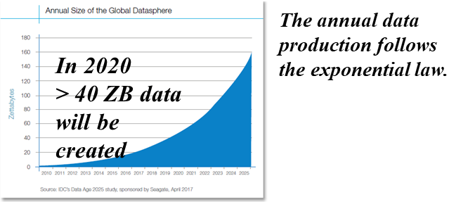
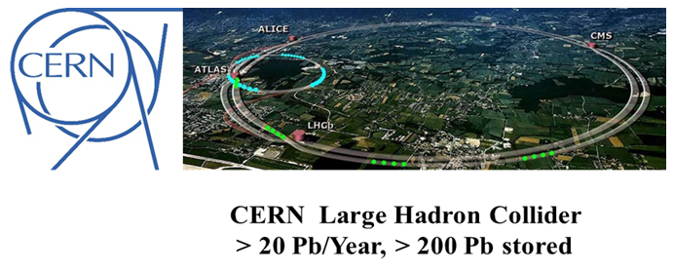
CHALLENGE: R&D of software to acquire, manage, process and analyze large amounts of data to be recorded
Square Kilometer Array radio telescope (SKA)
> 1 Eb/Year (estimation)
Security
Physics Generators
Data Analysis and Interpretation
Data Organisation, Management and Access
Detector Simulation
Data and Software Preservation
Data-Flow Processing Framework
Facilities and Distributed Computing
Software Development, Deployment, Validation and Verification
Conditions Data
Software Trigger and Event Reconstruction
Machine Learning
Visualisation
6

Slide 7
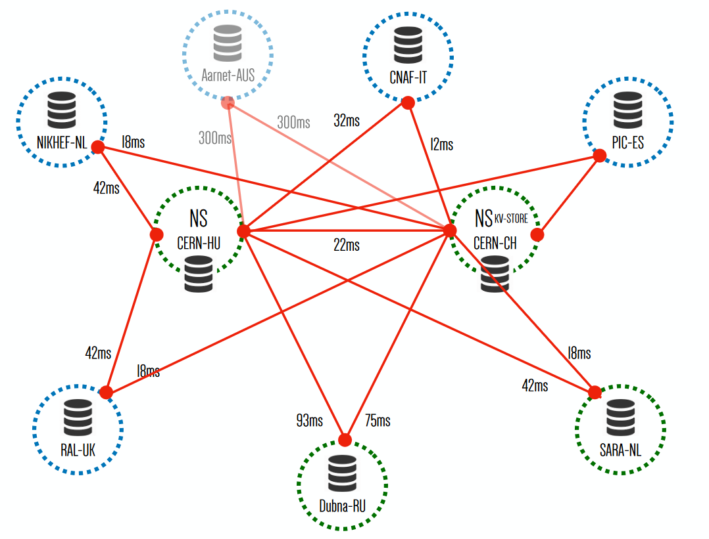
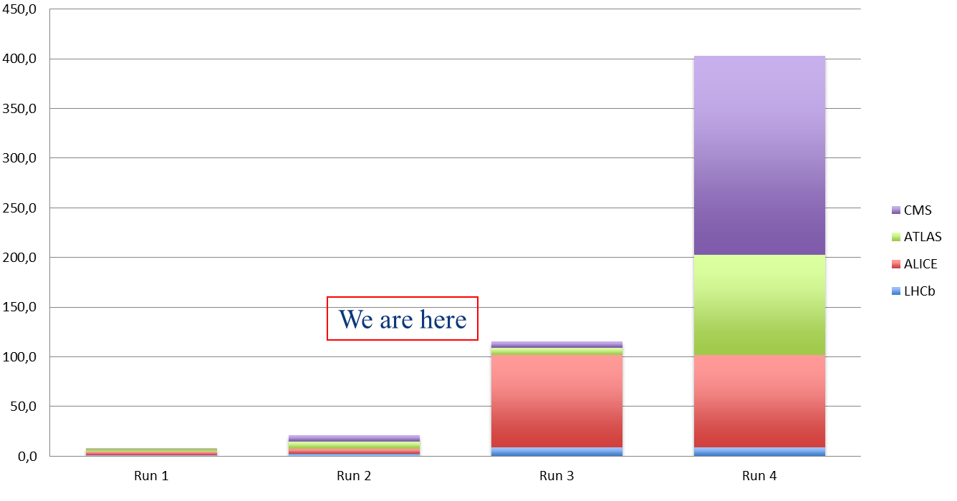
JINR DataLake
EU DataLake
Multifunctional Information and Computing Complex
PB
DataLake deployed at JINR
The new storage system successfully integrated into the MICC structure
It shows great performance for storing and accessing big arrays of information.
It can be applied for all the steps of data handling.
Experimental data volumes
7

Slide 8
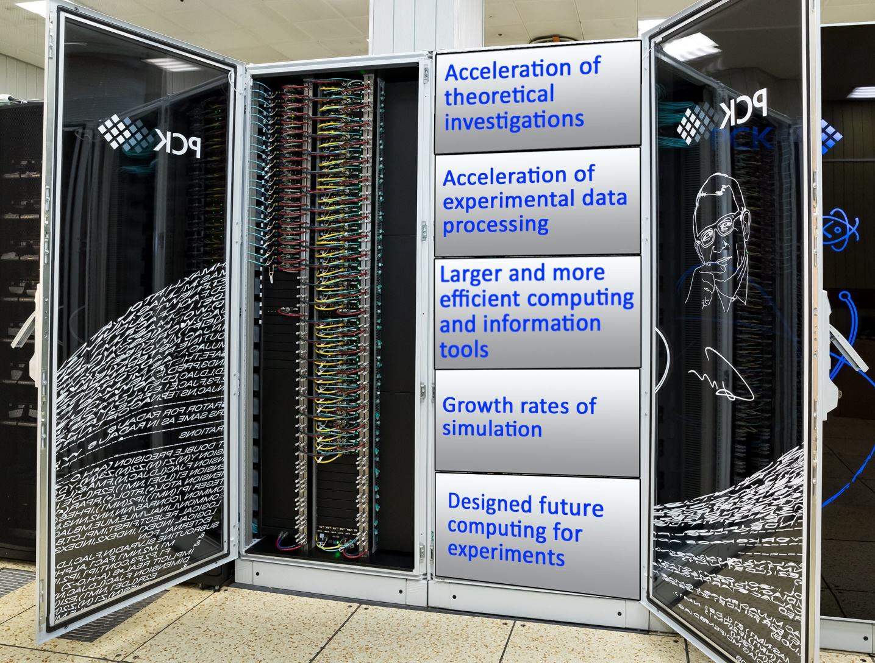
Extension of the HybriLIT heterogeneous platform including the “GOVORUN” supercomputer
Unique heterogeneous and hyper-converged system (500 Tflops for double-precision operations)
Multipurpose high-performance system with direct hot liquid cooling of all system components
The most energy-efficient system in Russia (PUE = 1,06)
First 100% hot liquid cooling of Intel® Omni-Path interconnect
Record power density – up to 100 kW per 42U cabinet
The total enlargement in the performance of CPU and GPU components will amount up to 90 TFlops for double-precision operations per year.
8
Notes:
8

Slide 9
Long-Term Concept of a Scientific IT-ecosystem at JINR
Telecommunication technologies
terabit networks
on-demand networks, networks of networks, software-defined networks, etc.
dynamic resource allocation network systems
networks enabling the large amount of data transfers
networks allowing distributed processing of the exabyte data volume.
EB
9
Notes:
Main topics addressed in the strategy

Slide 10
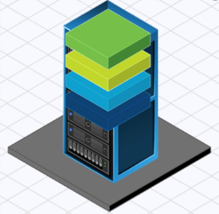
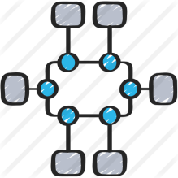
Long-Term Concept of a Scientific IT-ecosystem at JINR
Computing systems
distributed software-configured platform
Storage
Servers
supercomputer (heterogeneous)
Computing System
grid and cloud technologies
Engineering infrastructure
Network
effective use of novel computing architectures
Monitoring & management
10

Slide 11
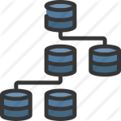
Long-Term Concept of a Scientific IT-ecosystem at JINR
Algorithms and software
complex computing problems
machine learning
data mining
quantum computing
11

Slide 12
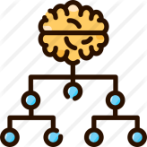
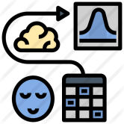
Long-Term Concept of a Scientific IT-ecosystem at JINR
Technologies of data processing and analysis
computing with the use of supercomputers
processing of multi-dimensional and hierarchical data of Exabyte volumes
Big Data analysis and processing
AI and robotics
modeling of computing architectures and workflows
SyMSim
12
12

Slide 13
Long-Term Concept of a Scientific IT-ecosystem at JINR
Information security
new security paradigms including quantum cryptography and neurocognitive principles
novel and up-to-date tools and software systems for data and information protection
13

Slide 14
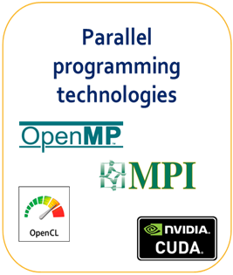
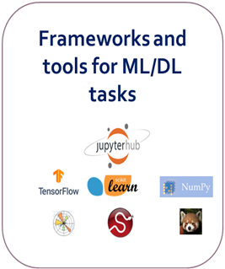
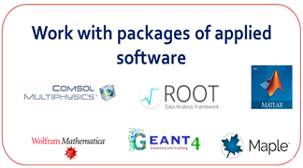
Development of the system for training and
retraining IT-specialists
Training of the Institute staff, students and young scientists from the JINR Member States is carried out within :
activities organized by the JINR University Centre;
the framework of special courses from leading software developers;
conferences and schools organized by JINR;
international cooperation programs at JINR Member States institutes.
14

Slide 15
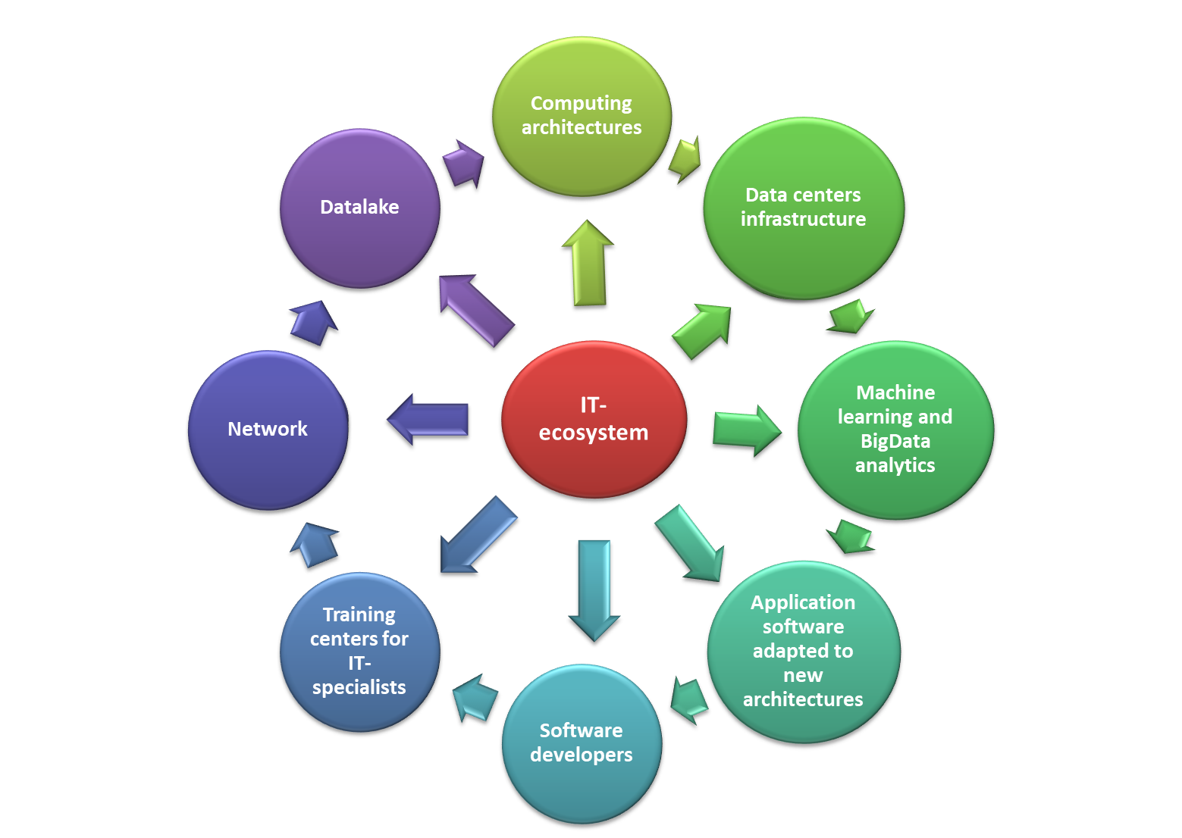
Strategic long-term plan
AIM
Expandable worldwide dynamicaly evolving IT-ecosystem that combines a variety of technological solutions, state-of-art computing concepts and methodologies.
PURPOSES
Significantly reduce the time spent on the implementation of projects that require computing resources and IT expertise
BENEFICIARIES
JINR, its Member States and international collaborators

