Slide 1

PAC on Particle Physics
51st Meeting:
Report to Scientific Council
JINR, September 19, 2019
Itzhak Tserruya

Slide 2
51st PAC-PP agenda June 19-20, 2019
Highlights of the 51st PAC-PP meeting:
Update reports on NICA, MPD and BM@N
Projects seeking continuation:
ALICE, ATLAS and CMS
SCAN-3 and NA64
New project: FASA

Slide 3
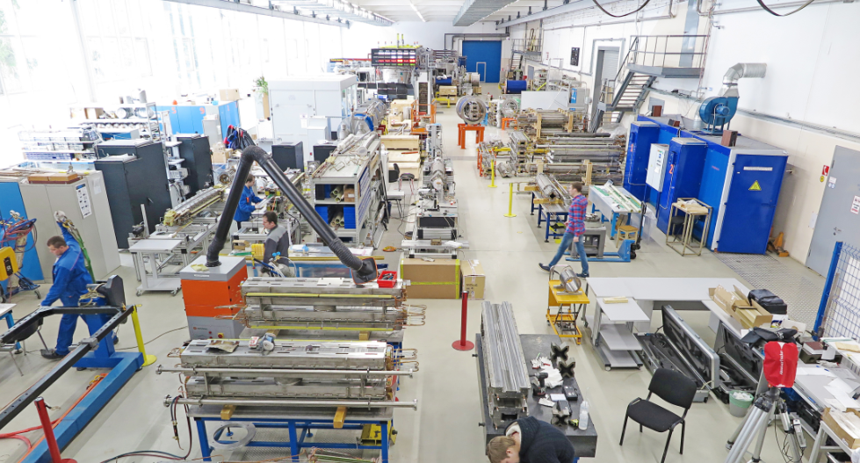
Report on the Nuclotron-NICA project
S. Kostromin
The PAC is pleased to support the active work on the mounting of the Booster superconducting magnets inside the Synchrophasotron yoke and expects the assembly and commissioning with beam to be completed by the end of 2019.
The PAC requests to improve the diagnostics of the accelerator complex in order to be able to deliver to the users well identified beams without contaminations.
Booster
90% sc-magnets passed tests
50% sc-magnets delivered to ring tunnel

Slide 4
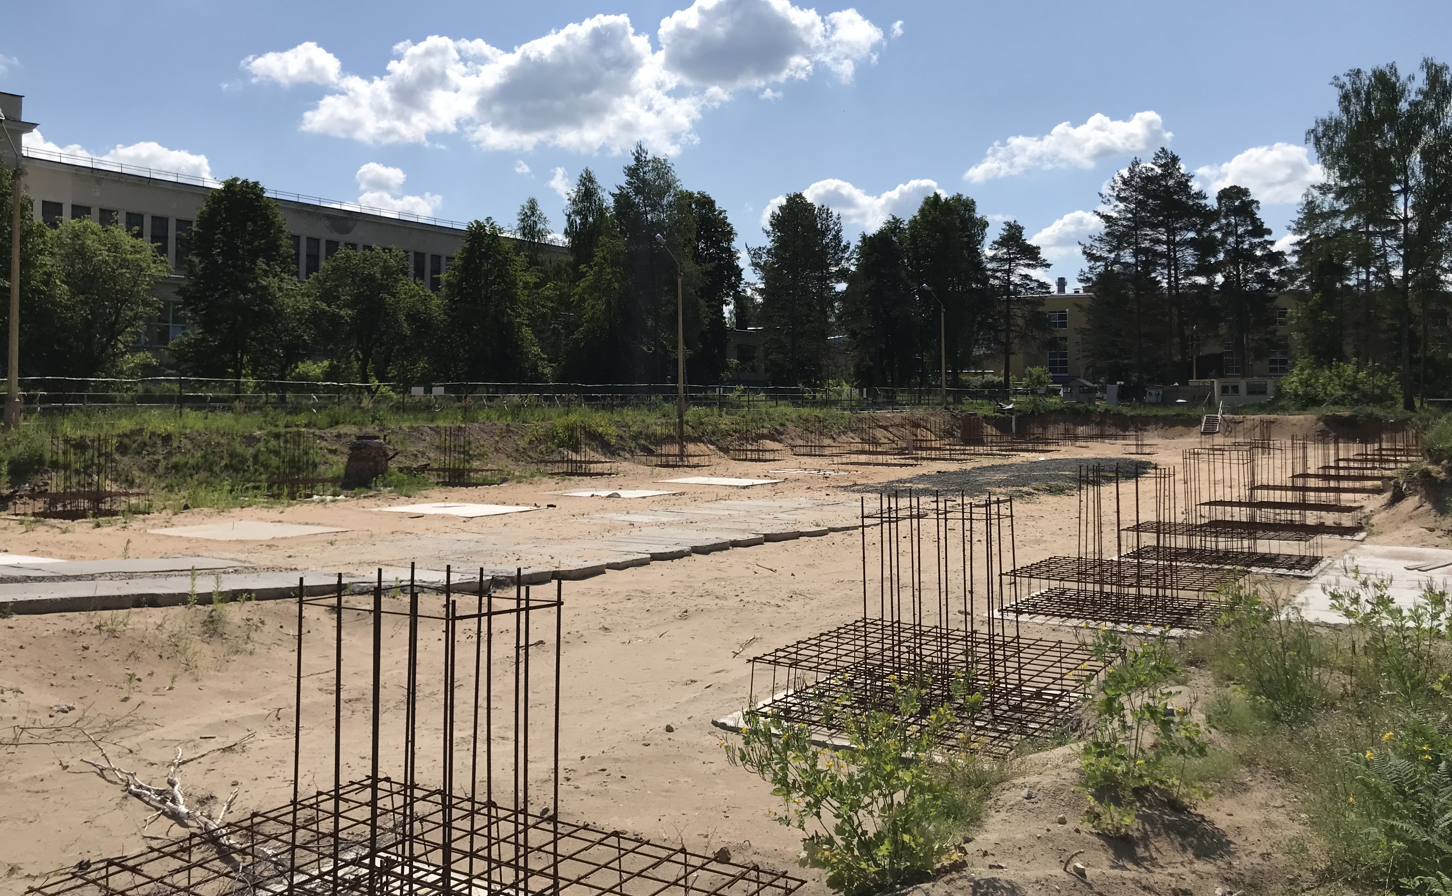
Infrastructure Developments
Yu. Mitrofanova
The Committee acknowledges the progress achieved and welcomes the efforts of the Laboratory to reduce the delay of the construction work schedule for the infrastructure of the collider complex.
Compressor Hall
The original contract with PSJ was terminated last year
New contract signed with LCC Stroytekhinvest, Moscow in May 2019
Expected completion 2020
A

Slide 5
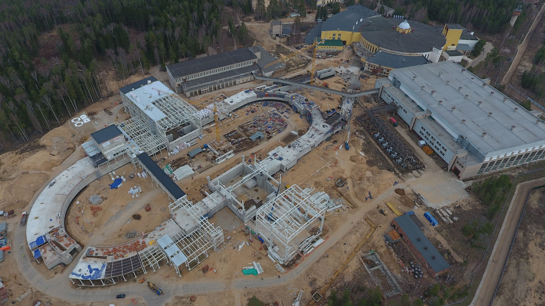
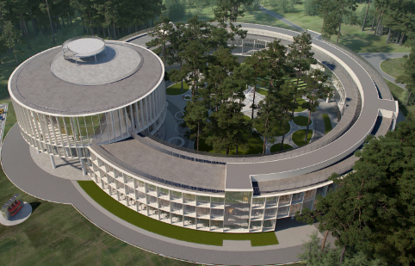
Infrastructure Developments
Yu. Mitrofanova
NICA Collider
MPD building
SPD building
NICA Innovation Center
A

Slide 6
MPD
Adam Kisiel
The PAC welcomes the admission of two new institutions to the MPD collaboration: the University of Warsaw and the China Institute of Nuclear Energy.
The Committee is pleased to note the establishment of the Detector Council, Executive Council and Physics Working Groups of this collaboration.
The PAC is impressed by the magnitude and quality of the simulations already accomplished or those being performed by the PWG.
The PAC welcomes the collaboration efforts to develop the detector elements, as well as its computing and software infrastructure with a view to completing the first stage of the detector by 2021.
MPD stage 1: status
Magnet – assembly & magnetic field measurement – 2019-20
FHCal – production in progress: 100 modules + FE electronics ready by end of 2019
TOF - production in progress: all mRPC assembled by March 2020
FFD – production in progress
TPC – production in progress: FE cards for 24 ROC ready by august 2020
ECAL – TDR completed. Module production: 75% in China, 25% in Russia
Integration – TDR in preparation

Slide 7
MPD simulations
Adam Kisiel
ECAL
Conversions
π⁰ γγ
η γγ
π⁰ γγ (e⁺e⁻) (e⁺e⁻)
η γγ (e⁺e⁻) (e⁺e⁻)
0<p_{T}<0.5 GeV/c
1.0<p_{T}<1.5 GeV/c
Hyperons
Resonances
𝜙(1020) K⁺K⁻
K*(892)⁰ K± 𝜋∓
𝝨(1385)± 𝜋± 𝛬
⍴ π⁺π⁻
2.5<p_{T}<3.0 GeV/c
1.0<p_{T}<1.2 GeV/c
0<p_{T}<0.2 GeV/c
1.0<p_{T}<1.5 GeV/c

Slide 8
BM@N
Mikhail Kapishin
The PAC congratulates the BM@N team for the presentation of first physics results on the production of lambda hyperons and encourages it to shorten the time between data collection and release of preliminary results.
The PAC appreciates the ongoing efforts for the preparation of the BM@N set-up for heavy-ion beams in 2021.
BM@N Preliminary results
𝛬 hyperon production in 4 AGeV C + C, Al, Cu interactions

Slide 9
General considerations on JINR participation in the LHC experiments
Currently, each one of the three LHC themes, ALICE, ATLAS and CMS, has two associated projects, one devoted to operations and physics analysis and the other focused on detector upgrade and R&D, with substantial overlap of the JINR personnel involved in the two projects.
The PAC considers that the separation into two projects is not justified and recommends that the JINR Directorate consider unifying the two activities into one single project in order to better monitor and regulate the execution of the so far distinct projects.
The PAC found it very convenient and useful to simultaneously review the three LHC projects at the same PAC meeting and thus decided to approve them for the same period of time so as to keep synchronized their future submission and review cycles.
In general, the PAC proposes to have a thorough yearly review of each LHC experiment, with oral presentation at the January meetings, and a short written report at the June meetings just pointing to the progress in the fulfilment of the milestones of relevance for the JINR groups.
The PAC requested from each LHC experiment to present at the next PAC meeting of a project-plan/timeline over the next 4 years indicating who is going to work on each subproject together with a series of milestones and deliverables to be used by the PAC to monitor and regulate the execution of the whole project.

Slide 10
Recommendations on projects approved for completion in 2019 and proposed for continuation
CMS- A. Zarubin.
The PAC congratulates the JINR CMS group on the quality of the work carried out in various detector subsystems with major JINR responsibilities (forward muon station and the endcap hadronic calorimeter).
The PAC also commends the operation and service work carried out by the group and, in particular, the performance of the TIER1 computer center.
The Committee notes progress in physics studies with direct participation of JINR members (muon pairs, physics BSM, Higgs couplings, jet production processes).
Recommendation.
  The PAC encourages the group to better balance the detector maintenance and operation work with the physics studies. In particular, the PAC recommends that the JINR CMS group make larger efforts towards a higher productivity in terms of physics analysis and scientific publications, commensurate with the global contribution of JINR to CMS.
  The PAC would like to see a physics analysis plan, which includes subjects that would allow the group to achieve higher visibility, with identified JINR responsibilities and an increased number of young researchers and students involved. In this regard, the presence of a large number of participants with 0.1 FTE is a matter of concern.
  The Committee recommends continuation of JINR’s participation in the CMS project for the period 2020–2023, with first priority, pending the setting in place of corrective actions to address the above-mentioned concerns.

Slide 11
Recommendations on projects approved for completion in 2019 and proposed for continuation
ATLAS – E. Khramov.
The group fulfilled its obligations for the detector operation and maintenance in terms of shifts. Although only 50% of the experts’ operation were covered, the corrective actions have been taken.
The Committee appreciates the progress in the various physics analyses with JINR responsibility (proton structure, physics BSM, search for quantum black holes and pentaquarks, precision measurements of W/Z production cross sections….)
The PAC notes with pleasure the large number of scientific publications with direct participation of JINR members and the consistency of the research subgroups involving several young researchers.
Recommendation.
  Although the proposed activities for the next years are relevant and compelling, the PAC recommends that the group concentrate on studies for which it could achieve a leadership role with a visible impact within the ATLAS collaboration, in terms of coordination roles, involvement of new young researchers, and presentations at major conferences.
  The Committee recommends continuation of JINR’s participation in the ATLAS project for the period 2020–2023, with first priority.

Slide 12
Recommendations on projects approved for completion in 2019 and proposed for continuation
ALICE – V. Pozdnyakov
The Committee takes note of the involvement of the group in physics analysis that have resulted in several publications (femtoscopic correlations, ϒ(1s) and ϒ(2s) nuclear modification factors).
The main efforts of the JINR group in the next years will be focused on the study of femtoscopic correlations, the production of light vector mesons in ultraperipheral Pb-Pb collisions and the production of heavy quarkonia. The group will also contribute to the maintenance and development of the GRID-ALICE at JINR and to the photon spectrometer upgrade.
Recommendation.
  The PAC is concerned with the relatively low visibility of the JINR ALICE team as reflected for example by the lack of talks at the major conferences in the field.
  The PAC also notes that the group, with several senior scientists, needs rejuvenation.
  The PAC strongly encourages the group leader to take actions to attract young scientists and students into the project aiming at a strong impact and visibility.
  The PAC recommends continuation of JINR’s participation in the ALICE project for the period 2020–2023 with first priority, pending the setting in place of corrective actions to address the above-mentioned concerns.

Slide 13
Recommendations on projects approved for completion in 2019 and proposed for continuation
SCAN-3 – S. Afanasiev
The highly excited nuclear matter created in nuclei by a high-energy deuteron beam of the Nuclotron will be studied through observation of its decay products into pairs of particles with opening angle close to 180º. The existing set-up will be upgraded with a new magnetic spectrometer for the detection of charged and neutral particles of the correlated pairs. The measurement of such pairs will enable studies of low-energy ηA interaction, search for η-bound states (η-mesic nuclei) and studies of the Δ-isobar produced and stopped inside nuclear matter.
Recommendation.
    The PAC notes the expertise of the authors in these studies, the large size of the JINR group involved in the project and the very modest requested budget. The PAC recommends continuation of the SCAN-3 project for the period 2020–2022 with first priority, making sure that it does not interfere with NICA operation.

Slide 14
Recommendations on projects approved for completion in 2019 and proposed for continuation
NA64 – D. Peshekhonov
The PAC notes the relevance of the research programme and its potential in the quest for dark matter.
The PAC recognizes the excellent role played by the JINR team in the design, production, test and installation of the straw tube chambers, together with their data acquisition software, online monitoring and visualization, reconstruction and Monte-Carlo simulation.
The PAC also notes that the recommendations made by the PAC for Particle Physics and the PAC for Nuclear Physics at their joint session in January 2019, to improve the ratio of FTE to participants, to attract students and to get involved in data analysis are not properly addressed in the presented material.
Recommendation.
  The PAC decides to postpone any recommendation on the project till the authors present to the PAC, not later than at the next session in January 2020, a revised proposal including an action plan where the previous recommendations mentioned above are addressed.
  Till then, if needed, the PAC recommends that the JINR management provide sufficient resources to the group to allow continuation of their work and commitments.

Slide 15
Proposal of a new project
FASA – S. Avdeev
The main goal of the project is the study of space-time characteristics of hot nuclei formed in the collisions of light relativistic ions with heavy targets. The experiment is carried out using relativistic beams from the Nuclotron and the 4π–FASA detector. Its thirty telescopes will allow spectroscopic and correlation measurements in terms of relative angles (from 10° to 180°) or relative velocities of intermediate-mass fragments. Radial flow as a function of the fragment charge, thermalization in the hot spectator of the target, and the time of disintegration will be studied.
Recommendation
  The PAC notes that similar work on Multi-Fragmentation of Nuclei was carried out some 40 years ago at Fermilab, at CERN -PS and at the BEVATRON and BEVALAC.
  The PAC requests the authors to sharpen their scientific case taking into account these earlier data and to present a convincing case on how they can solve the still open question of break-up or thermalization in the multifragmentation of nuclei.
  The PAC looks forward to receiving an improved proposal with details on the target thickness, the identification power of their telescopes for He and Be isotopes, and a simulation of the performance of the experiment in comparison with theoretical predictions.

Slide 16
Strategic long-range plans
R. Tsenov
The PAC heard with interest the reports concerning the long-range plans of JINR’s development in the area of relativistic heavy-ion and spin physics.
The PAC highly appreciates the JINR Directorate’s efforts towards establishing priorities and shaping up the strategic plans for the future of JINR.
The Committee looks forward to being informed about further developments and proposals to be considered at the next meetings.

Slide 17
Scientific Reports
The PAC heard with interest the report “Neutrinoless double-beta decay: theory challenges” presented by F. Šimkovic and the report “Femto-cyclones and baryon polarization in heavy-ion collisions” presented by O. Teryaev, and thanks the speakers for their presentations.

Slide 18
Presentations by young scientists
The PAC reviewed 17 poster presentations in particle physics by young scientists from DLNP, LIT and VBLHEP.
The Committee selected the poster “Neutrino oscillation analysis in the NOvA experiment” presented by L. Kolupaeva to be reported at this session of the Scientific Council.

Slide 19
Next PAC-PP Meeting – February 3-4, 2020
The next meeting of the PAC-PP will be held on February 3-4, 2020
The following items are proposed to be included in the agenda of the next meeting:
  Follow-up on the to-do-list from this PAC meeting
  Status Report on the Nuclotron-NICA project
  Report from the Coordinator of the Nuclotron experimental programme
  Status Report on infrastructure issues including Nuclotron
  Status report on the MPD project
  Status report on the BM@N project
  Conceptual Design Report of the SPD experiment (and formation of the Collaboration)
  Progress reports on the JINR participation in the LHC experiments
  Revised proposals of NA64 and FASA
  Consideration of new projects
  Reports and recommendations on the projects to be completed in 2020
  Posters from young physicists

Slide 20
Thank you!

