Slide 1
New versions of the FairSoft and FairRoot environments for BmnRoot
K. Gertsenberger
VBLHEP, Joint Institute for Nuclear Research
31 July 2019

Slide 2
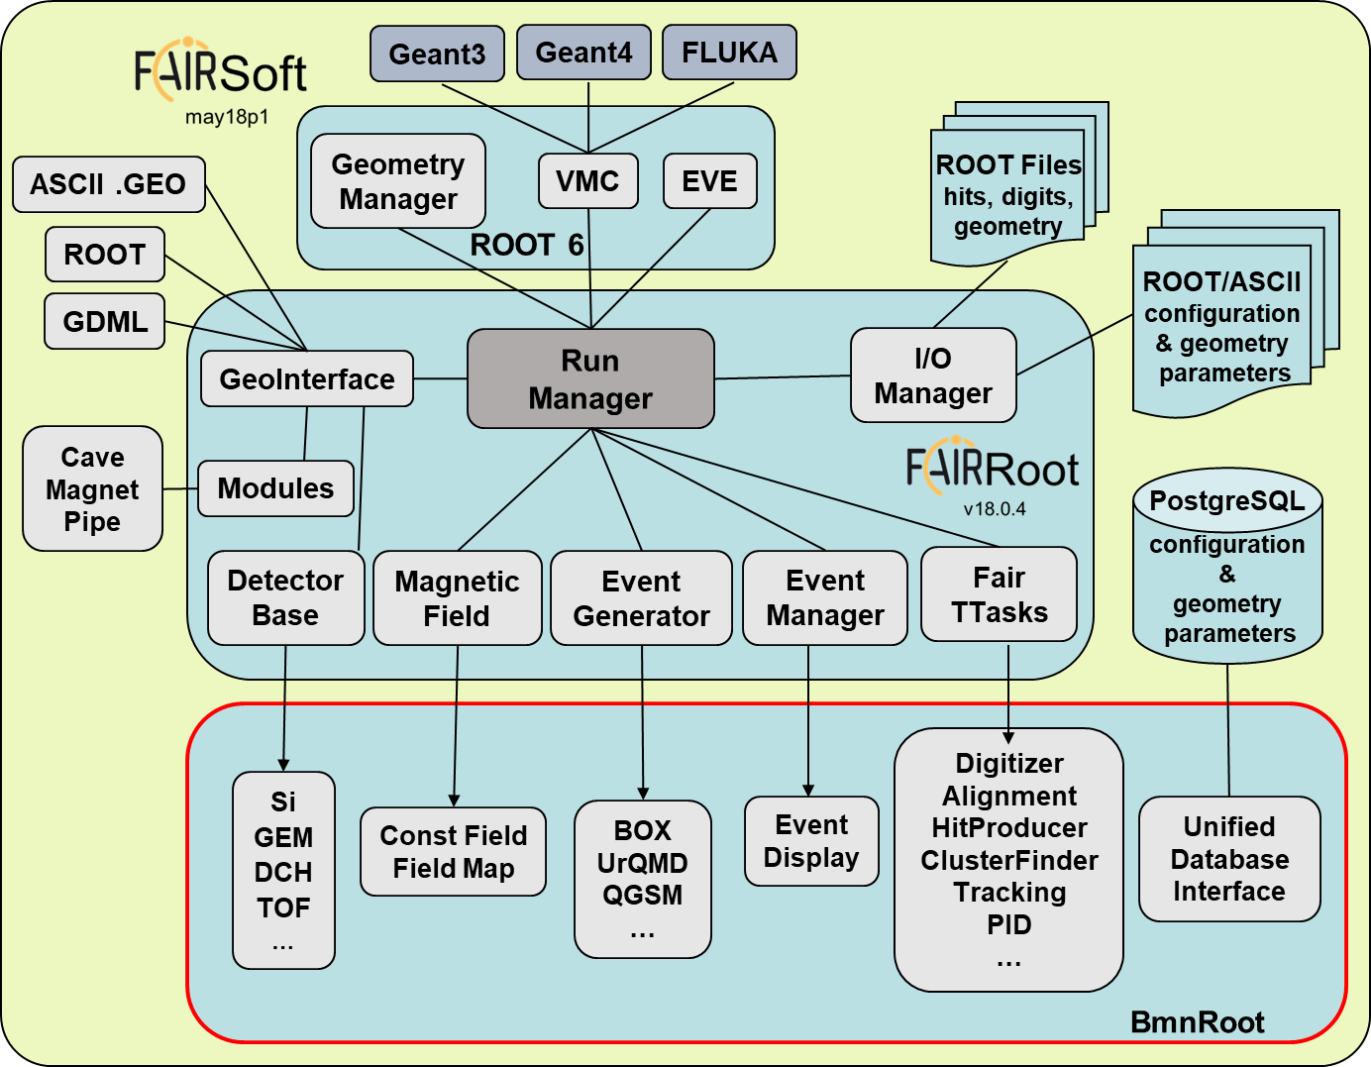
Obsolete Versions
BmnRoot
ROOT 6.12
Soft
may18p1
Root
v.18.0.4

Slide 3
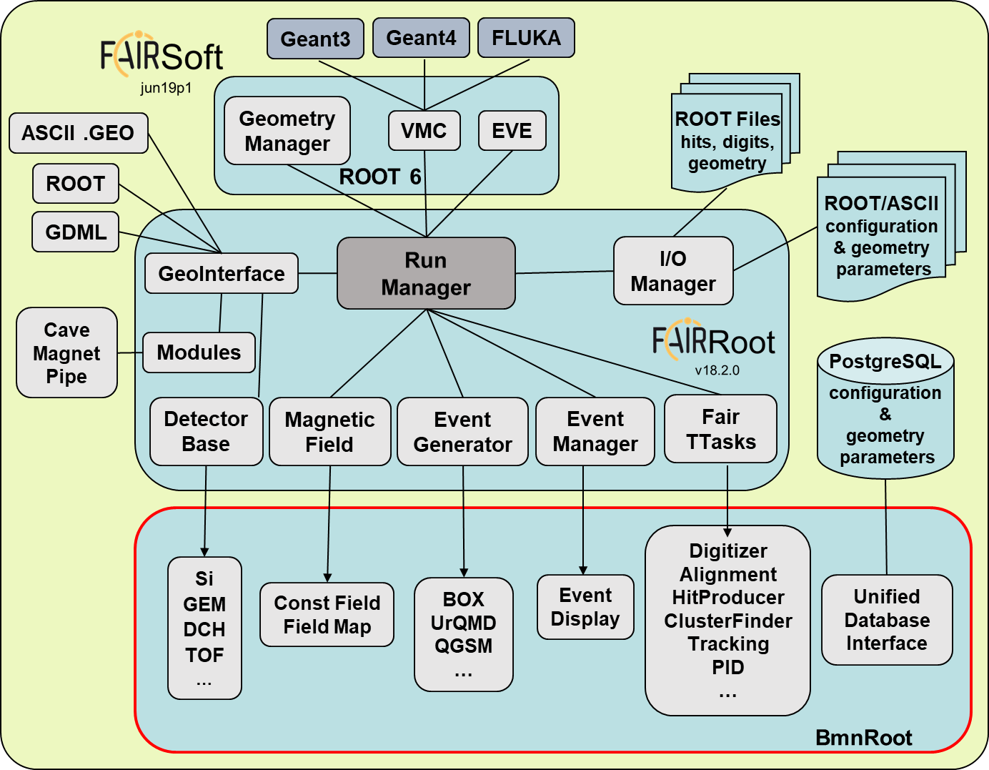
New Versions
BmnRoot
ROOT 6.16
Soft
jun19p1
Root
v18.2.0

Slide 4
New FairSoft with ROOT 6.16
Transition to ROOT 6.16
New functions to work with TTimeStamp in PostgreSQL:
all corrections were accepted in ROOT dev
Patch for ROOT was implemented!
The Patch for ROOT is supplied as a patch for FairSoft jun19p1!

Slide 5
New FairRoot
Corrections of WriteConfigFile for BmnRoot installation:
the corrections were not inserted
Patch for FairRoot was implemented!

Slide 6
BmnRoot compilation
Compilation Warnings:
ISO C++ forbids converting a string constant to ‘char*’class
‘FairLogger::endl’ is deprecated: Line break is now added automatically by the LOG macro, this variable only adds empty space. << FairLogger::endl;
‘void FairLogger::Info(const char*, const char*, const char*, const char*, ...)’ is deprecated: Use 'LOG(info) << content;' macro interface instead.
…

Slide 7
The Installation Procedure
Manual: http://bmn.jinr.ru/software-installation/

Slide 8
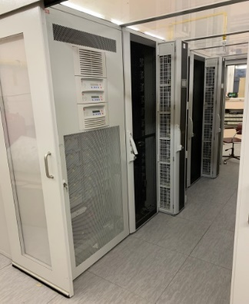
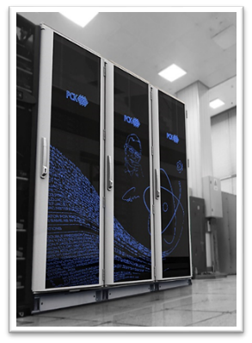
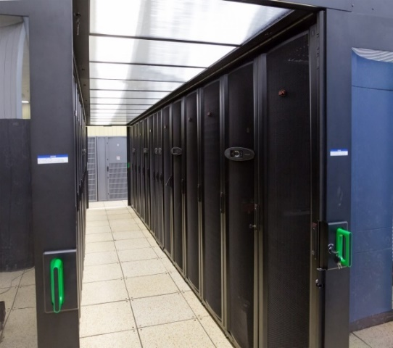
New Software on BM@N Computing Clusters
ready, new → pro
nearest future
nearest future
NICA Cluster
(LHEP, b.215, b.216)
HybriLIT platform
(LIT, b.134)
MICC Tier1/2 Center
(LIT, b.134)
OS: Scientific Linux 7
Exp. software: Local
EOS: 3.3 PB (replicated)
GlusterFS: 320 TB (replicated)
Sun Grid Engine: 3 060 (Intel Xeon cores)
OS: CERN CentOS 7
Exp. software: CVMFS, Modules
ZFS 200 TB,
UltraFast Storage on Lustre 120 TBssd
SLURM: 2880 (Intel Xeon cores)
+ 6048 (Intel Xeon Phi cores)
+ 40 GPU NVIDIA Tesla V
OS: Scientific Linux 6
Exp. software: CVMFS
EOS: 4 PB
Torque/Maui:
Tier2: ~200 IX cores
Tier1: ~500 IX cores

Slide 9
NICA Cluster: from a prototype to the future
Storage
EOS: 0.5 PB distributed FS (replicated)
sim. data: /eos/nica/bmn/sim/
exp. data: /eos/nica/bmn/exp/[raw,digi]
for users: /eos/nica/bmn/users/
OS: Scientific Linux 7
(LHEP, b.215, b.216)
Software
FairSoft:
/opt/fairsoft/bmn/new → jun19p1
FairRoot:
/opt/fairroot/bmn/new → v18.2.0
new versions
SetEnv.sh:
need correction!
Computing
Batch System: Sun Grid Engine
Intel Xeon: 3096 log. cores
Cluster Administrator:
Schinov B. G.
Registration & User Space Quotes
Email to the cluster administrator from the spokesperson or software coordinator (more preferable)
K. Gertsenberger

Slide 10
Thank you for attention!

Slide 11
Mass production for BM@N Run 7
raw_run7.data / run_digi.root
xrdcp
MICC Complex
1 PB available
BM@N experimental data
run_digi.root / bmndst.root
UltraFast Storage
30 TBssd available
Supercomputer GOVORUN
MPD-Scheduler
$ mpd-scheduler raw_run7.xml
<job name="convert_bmn_raw">
<macro path="~/bmnroot/macro/raw/BmnDataToRoot.C">
<file input="/eos/nica/bmn/exp/raw/run7/*">
<put command="xrdcp" path="/lustre/stor/${file_name_with_ext}"/>
<get command="xrdcp" path="/lustre/stor/bmn_run${last_number}_digi.root" output="/eos/nica/bmn/exp/digi/run7/bmn_run${last_number}_digi.root"/>
</file>
</macro>
<run mode="global" count="100" config="~/bmnroot/build/config.sh" work_dir="/lustre/stor"/>
</job>
BmnDataToRoot.C
Xeon Gold (queue ‘skylake’): 2880 cores
Xeon Phi (queue ‘knl’): 6048 cores

Slide 12
Information Systems for online & offline processing
BmnRoot
Run Control System
Online Histogramming
Event Display: offline/online…
Logbook IS
Configuration IS
Event Indexing IS
BM@N Software Ecosystem
Igor ALEXANDROV
Development of a Geometry Database for the BM@N Experiment of Mega-Project NICA
Geometry IS
Condition IS
RFBR Grant 2019 – 2021: Development of Information Systems for Online and Offline Data Processing for the Experimental Setups of the NICA Complex

