Slide 1
BM@N Document Server: propositions and implementation
K. Gertsenberger
VBLHEP, Joint Institute for Nuclear Research
28 August 2019

Slide 2
BM@N Document Server
Main purposes:
Document Server contains all reports, meetings, posters, proceedings materials, articles, theses, grants, video materials, TDR, technical documentation for all experiment systems (manuals, graphics, work detector illustrations), etc.
It allows cataloging hierarchically all the data for quick access to the desired BM@N section
Document Server provides a quick search by the desired criteria and sections (keywords, authors, themes…)
Many convenient tools are highly desirable: subscriptions, favourites for sections and documents…
It also provides an opportunity to analyze the latest achievements on selected BM@N systems and activities of collaboration members

Slide 3
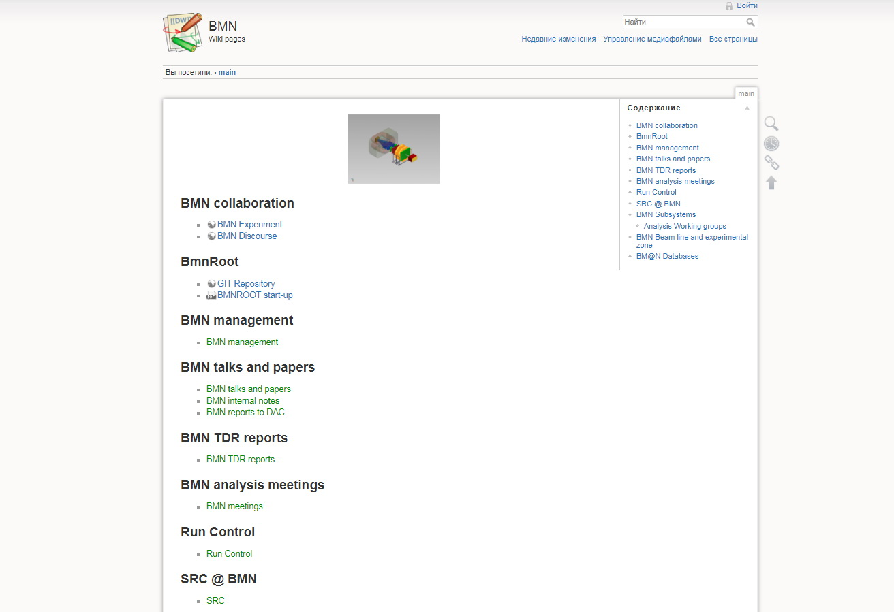
Current BM@N Wiki
Disadvantages as Document Server:
Complex structure
No explicit hierarchical cataloging
No search by specified criteria
No personalizing (e.g. baskets)
No subscriptions
Some unstable conditions

Slide 4
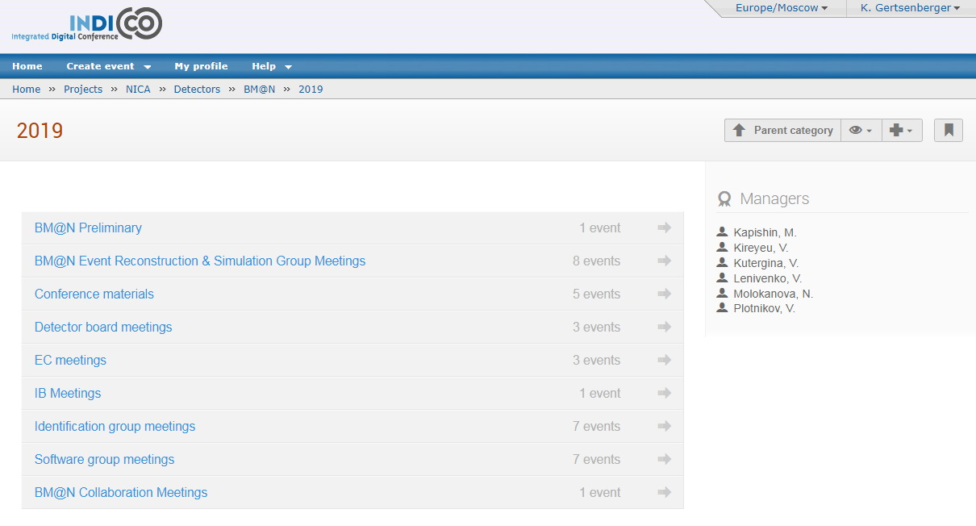
BM@N Indico Sections
No Document System

Slide 5
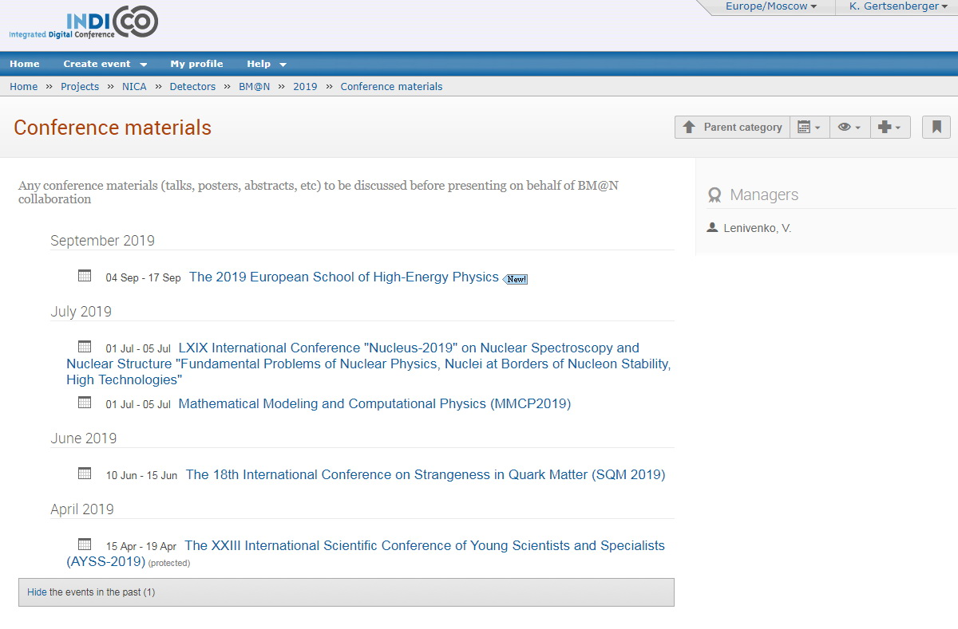
Conference Materials on Indico
It is a required step!

Slide 6
Document Server
in Physics Experiments

Slide 7
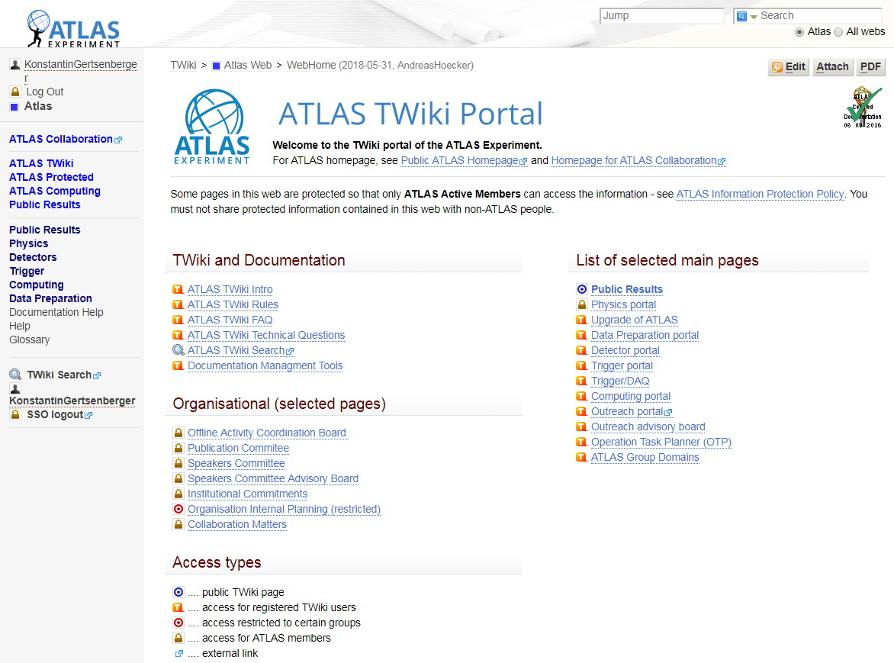
ATLAS TWiki
many docs in a good Web view
search
category and
subcategory
access levels

Slide 8
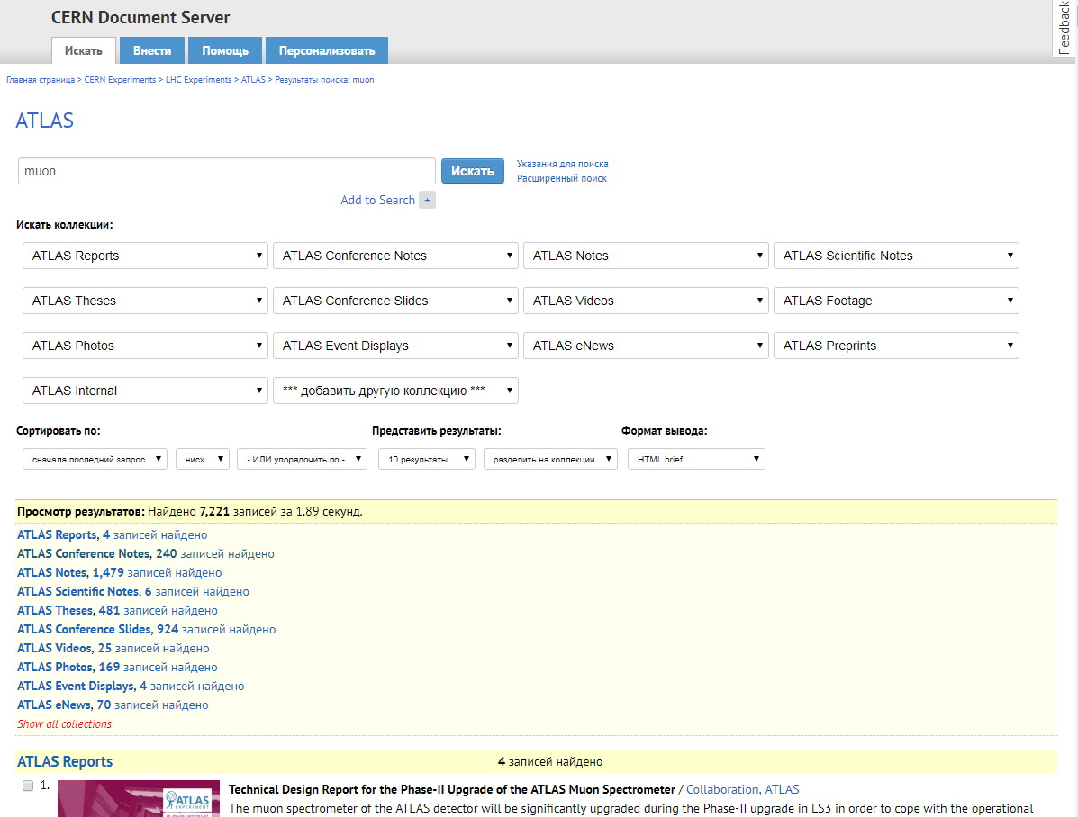
CERN Document Server (CDS)
search by different criteria
filtering by
different sections

Slide 9
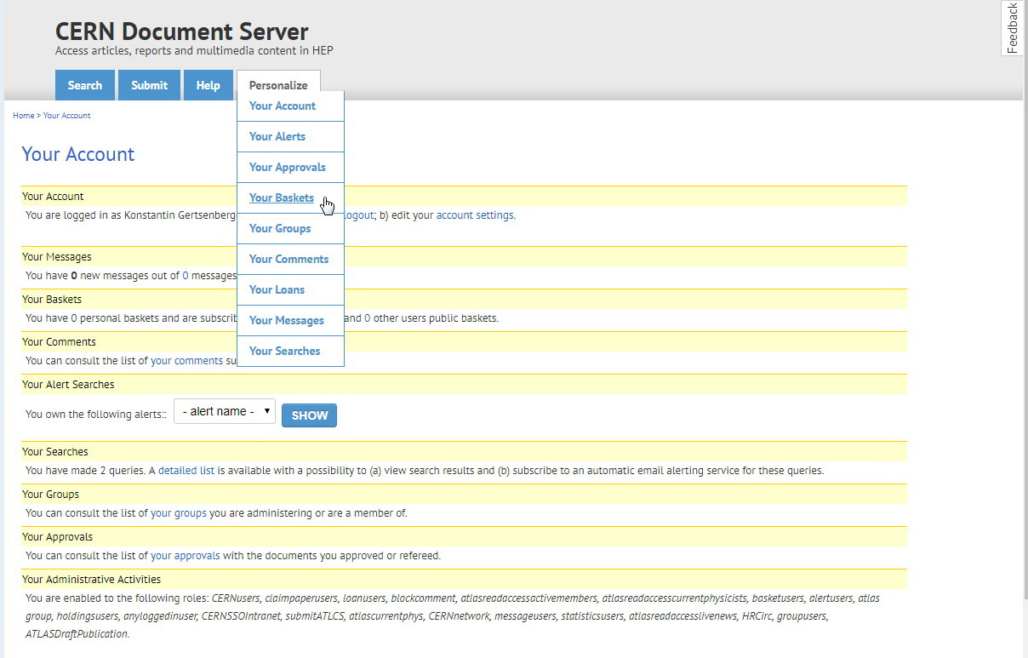
CERN Document Server: personalization
tools:
subscriptions
favourites
messages
….

Slide 10
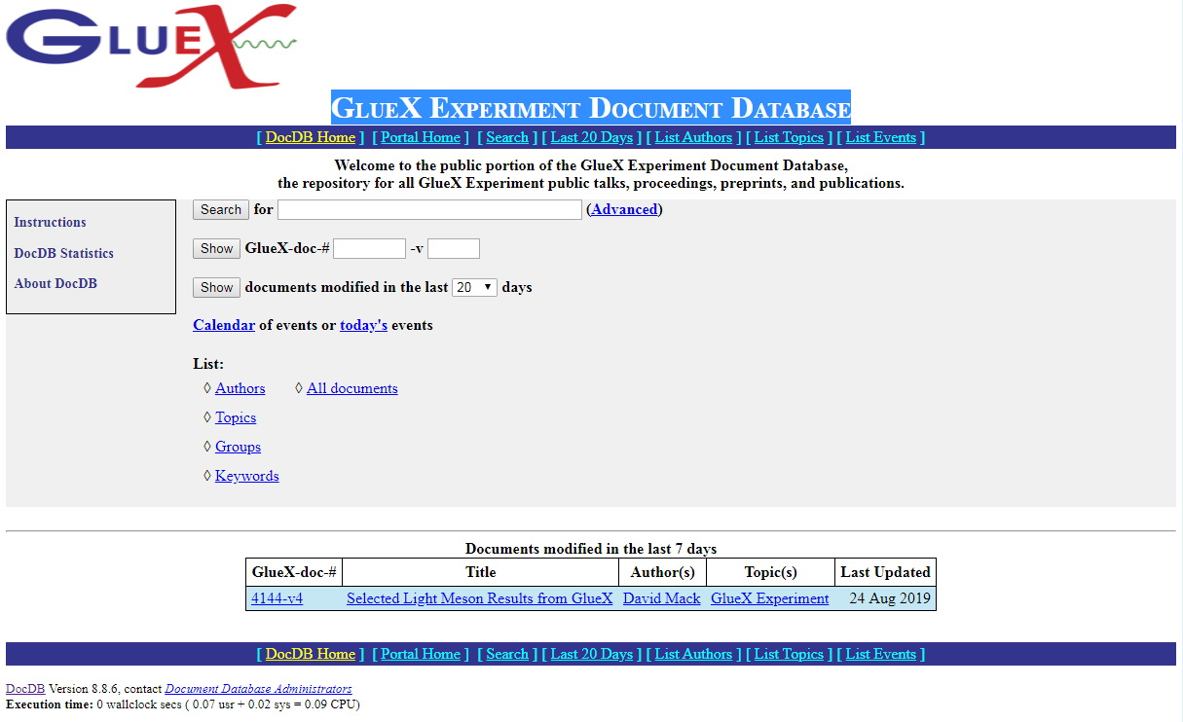
GlueX Experiment Document Database

Slide 11
Summary
Possible solutions:
Develop BM@N Document Server from scratch: Document Database + Web Service – No Manpower
Find and adopt a modern system for BM@N Document Server implementation
Highly Preferable Functions:
Document Server should contain all reports, meetings, posters, proceedings materials, articles, theses, grants, video materials, TDR, technical documentation for all experiment systems, etc.
It allows cataloging hierarchically all the data for quick access to the desired BM@N section
Document Server provides a quick search by the desired criteria and sections (keywords, authors, themes…)
Personalization is highly desirable: subscriptions, favourites for sections and docs

Slide 12
Thank you for attention!

Slide 13
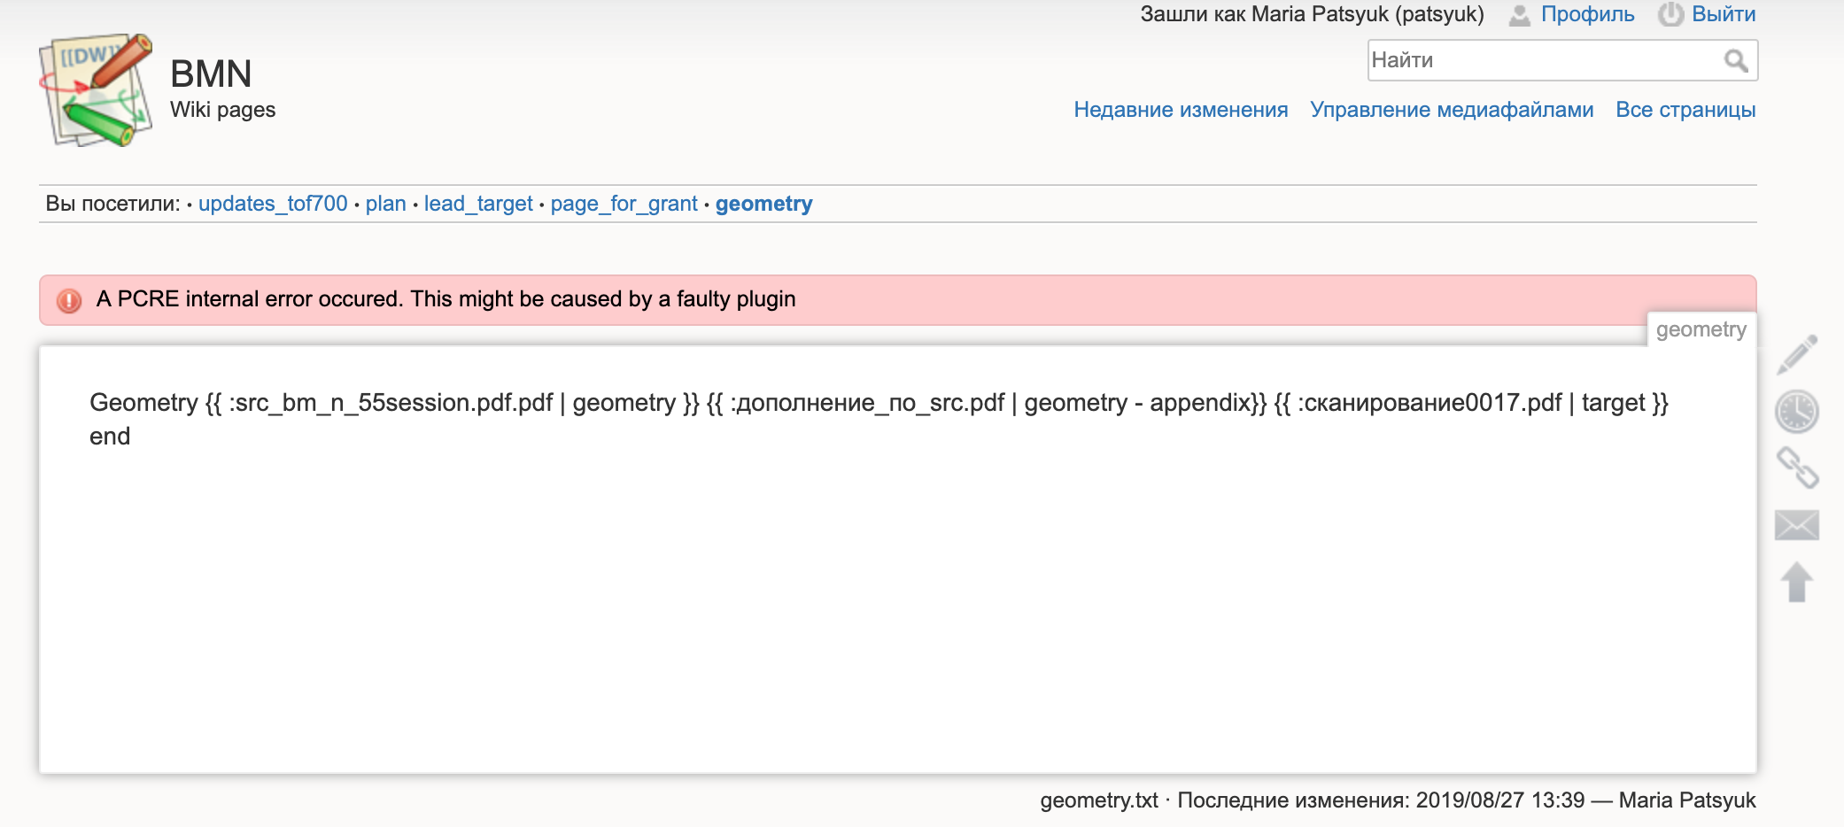
BM@N WiKi unstable work

