Slide 1
Machine Advisory Committee for NICA
NICA status and tasks, new results,
the session content
I.Meshkov
JINR, Dubna June 07-08, 2018

Slide 2
Machine Advisory Committee for NICA
NICA status and tasks, new results, the session content
Outline
1. NICA – from KRION source to MPD:
what we report and what we have to develop.
2. NICA Collider and MPD
3. Organizational issues
3.1. Dynamics dedicated group
3.2. Working meeting BINP-ITEP-JINR, May 21-22
3.3. Intentions and progress in the development of
polarized beams’ mode of the Collider
3.4. Megaproject and “Mega-money”
Outlook: NICA construction schedule
JINR, Dubna 22-23 May 2017

Slide 3
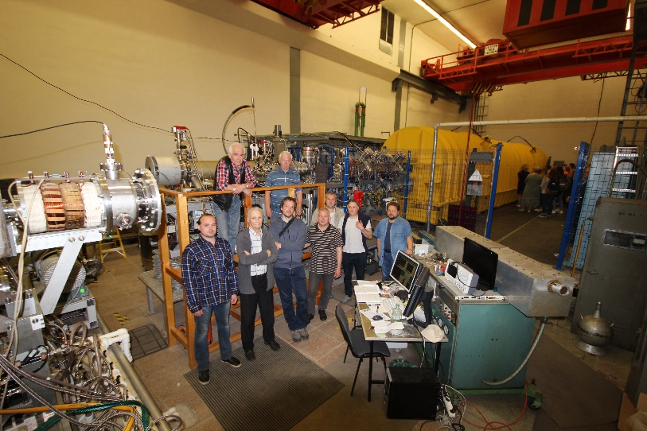
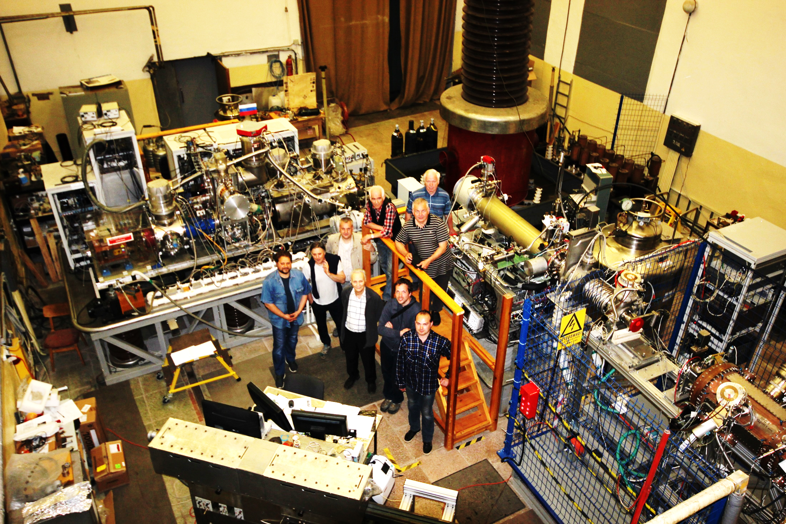
1. NICA – from KRION Source to MPD
1.1. Cryogenic Ion Source (KRION)
Krion-6T (ESIS-type) in May 2017 - May 2018: using for BM@N experiment
- May 2017 – September 2017: preparation on stand;
- October 2017: Krion-6T on the HV platform at LU-20 (Nuclotron injector);
- November – December 2017: test run with RFQ-LU-20 linac =>
=> C6+, Ar16+, Kr26+ ion beams; optimization of operational regimes.
- January-February 2018: test acceleration ions C6+, Ar16+, Kr26+ in RFQ-LU-20 (continued)
- February 24 –April 05, 2018: Nuclotron run #55:
¹²C6+; io nization time ≈ 70 ms, 1x10^9 ppp from Krion-6T: SRC experiment;
⁴⁰Ar16+; ionization time ≈ 85 ms, 4÷5x10^8 ppp from Krion-6T: BM@N experiment;
⁷⁸Kr26+; ionization time ≈ 80 ms, 1÷2x10^8 ppp from Krion-6T: BM@N experiment;
Extraction time from Krion-6T 8 µs.
- April 2018: test run with RFQ-LU20: ²⁴Xe41+; ionization time ≈130 ms, 1÷2x10^8 ppp
from Krion-6T
LU-20
KRION-6T
RFQ
Injection complex of the NICA:
KRION-6T ESIS,
RFQ foreinjector,
Linac LU-20,
and the team after succesful completion of Nuclotron run#55;
Note: to produce Au31+ in Krion-6T one needs ionization time ≈ 8 ÷10 ms.
Ion yield 5e8 Au31+ ppp was obtained (on stand) earlier from Krion-6T; operation regime of ESIS was absolutely different from the regime used in Nuclotron run #55 . The nearest goal for Krion-6T is obtaining (on stand yet) ion yield
197Au31+ either 209Bi35+ (up to 10^9 ions per pulse).
I.Meshkov NICA status NICA MAC June 07-08, 2018

Slide 4
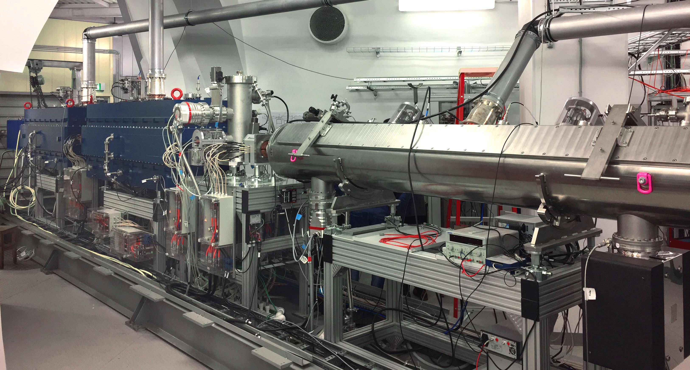
1. NICA – from KRION Source to MPD
1.2. Heavy Ion LinAc (HILAc)
Last beam time in August 2017 with laser source, C³⁺ beam q/A=1/4
Transmission of carbon ions from RFQ to
the exit of HILAC 3.2 MeV/u
was about 60%.
Ready for Booster commissioning on 90%
Phase probe signals:
RFQ (red), IH1 (blue), IH2 (green)
From September 2017 up to May 2018 RUN 55 with injector LU20 and Nuclotron was executed.
During Run 55 the HILAc was not operated
A/q (Target Ion Au³²⁺) | 6.25
Beam current | < 10 emA
Repetition rate | < 10 Hz
Output energy | 3.2 MeV/u
I.Meshkov NICA status NICA MAC June 07-08, 2018

Slide 5
1. NICA – from KRION Source to MPD
1.3. Beam Transfer Line from HILAc to the Booster (BTL HB)
The BTL has been designed and is under mounting:
Thursday 12:20 | Beam transfer channels, injection and extraction systems – status of construction | A. Tuzikov (JINR)
1.4. NICA Booster
The Booster elements are under fabrication and test:
Thursday 11:20 | SC magnets: status of fabrication and test results | H. Khodzhibagiyan (JINR)
Beginning of the Booster mounting is scheduled for September 2018:
Thursday 11:50 | NICA Booster: mounting preparation | A. Galimov (JINR)
First elements of the Booster designed and fabricated at BINP are
RF system and Electron cooler.
The last one is mounted already at the Booster and is now under commissioning:
Thursday 15:50 | Electron coolers for NICA Booster and Collider | V. Reva (JINR)
I.Meshkov NICA status NICA MAC June 07-08, 2018

Slide 6
1. NICA – from KRION Source to MPD
1.5. Beam Transfer Line from the Booster to Nuclotron (BTL BN)
The BTL has been designed by NICA and BINP teams,
is under fabrication at BINP and is scheduled for
commissioning May 2019:
Thursday 12:20 | Beam transfer channels, injection and extraction systems – status of construction | A. Tuzikov (JINR)
I.Meshkov NICA status NICA MAC June 07-08, 2018

Slide 7
1. NICA – from KRION Source to MPD
1.6. Nuclotron
Nuclotron is under upgrade for both BM@N and MPD experiments.
Thursday 10:30 | Nuclotron: results of the 55th run, tasks and plans of the Nuclotron upgrade for BM@N and MPD experiments | A. Butenko (JINR)
For both experiments Nuclotron needs to be equipped with injection system from BTL BN and with fast extraction system after acceleration for transfer to the Collider. Both systems are under Development at JINR:
Thursday 12:20 | Beam transfer channels, injection and extraction systems – status of construction | A. Tuzikov (JINR)
After commissioning of the all elements of the injectors’ chain – KRION, BTL HB, the Booster, BTL BN and upgrade of Nuclotron the fixed target experiment BM@N will operate at the end of 2019 with heavy ions in the energy range from 1 to 4.5 GeV/U using existing slow extraction system and the BTL to bldg. 205.
For providing Collider with heavy ions the Nuclotron is to be equipped with fast extraction system (under design at JINR presently).
I.Meshkov NICA status NICA MAC June 07-08, 2018

Slide 8
1. NICA – from KRION Source to MPD
1.7. Beam Transfer Line from Nuclotron to Collider (BTL NC)
The BTL NC has been designed by NICA team with partial contribution of BINP experts. Further the BTL was developed by SigmaPhi Cº (France) under contract with JINR. Presently the BTL project is in the stage of final design and beginning of fabrication.
Designing and manufacturing the system of injection into Collider is a task for NICA team. It is presently under final design and technological development.
Thursday 12:20 | Beam transfer channels, injection and extraction systems – status of construction | A. Tuzikov (JINR)
I.Meshkov NICA status NICA MAC June 07-08, 2018

Slide 9
2. NICA Collider and MPD
2.1. Ion dynamics in the Collider
The main efforts to develop and optimize Collider optics were devoted to the problem of so called dynamic aperture (DA) that defines essentially life time of the Collider luminosity (single particle dynamics). Significant progress was achieved as a result of coordinated work of collaborating group of JINR, BINP and ITEP.
Thursday 13:35 | NICA Collider: optics overview, nonlinearities and dynamic aperture, choice of working points | S.Kostromin, O. Kozlov (JINR)
I.Meshkov NICA status NICA MAC June 07-08, 2018

Slide 10
2. NICA Collider and MPD
2.1. Ion dynamics in the Collider (continued)
Another unavoidable problem of a collider at high luminosity is a “bouquet” of beam space charge problems. They appear in NICA Collider at ion storage and short bunch formation:
Thursday 14:10 | Beam storage and formation, acceleration/deceleration in the Collider | E. Syresin (JINR)
Beam space charge also affects the particle dynamics during long time of data taking by detector: betatron tune, beam-beam effects, etc. The optimal choice of betatron working point may diminish this effects.
Thursday 13:35 | Two working points – problems of magnets’ tuning (continuation of the talk mentioned above) | S. Kostromin O.Kozlov (JINR)
Particle motion in a cycling accelerator (a collider) can be destabilized by particles’ interaction with inserted elements of vacuum chamber – kickers, RF cavities, pick-up electrodes, and others. Special measures should be taken to avoid or diminish this influence.
Thursday 14:45 | Space charge effects in the Collider, impedances | P. Zenkevich (ITEP) A. Kolomiets (ITEP)
I.Meshkov NICA status NICA MAC June 07-08, 2018

Slide 11
2. NICA Collider and MPD
2.1. Ion dynamics in the Collider (continued)
The next source of a beam instability is the residual gas in the vacuum chamber.
There are two main effects caused by the interaction of the beam particles with the atoms and molecules of the residual gas:
scattering of beam particles on the atoms of the residual gas (single or multi-scattering) that leads to particle loss on the walls of vacuum chamber;
ionization of atoms with a resonant increase in the density of secondary electrons accelerated in the electric field of the ion bunches^{*)}. This leads to the formation of so-called “electron clouds” and their subsequent influence on the stability of the beam.
Thursday 15:10 | Vacuum and electron clouds in the NICA Collider | A. Philippov
^{*)} In RF technique it is well-known “multipactor breakdown”.
I.Meshkov NICA status NICA MAC June 07-08, 2018

Slide 12
2. NICA Collider and MPD
2.2. Cooling methods application in NICA project
Status of electron cooling systems created for NICA at Budker INP are in a well advanced state:
Thursday 15:50 | Electron coolers for the NICA Booster and Collider | V. Reva (BINP)
A long discussion of using Electron Cooler for Collider at any ion energy from 1 to 4.5 MeV/u is presently over.
Otherwise, situation is with stochastic cooling system. Discussion of its application is still in progress:
Thursday 16:25 | Stochastic cooling system: start-up and project modes | A. Sidorin (JINR)
Thursday 16:50 | NICA stochastic cooling system – concept and key parameters | V. Lebedev (Fermilab)
I.Meshkov NICA status NICA MAC June 07-08, 2018

Slide 13
2. NICA Collider and MPD
2.3. Detectors and Machine-Detector Interface
Both BM@N and MPD status is presented in the talk
Friday 11:05 | Status of the BM@N and the MPD experiments | V. Golovatyuk (JINR)
The problem of the machine-detector Interface fro MPD was formulated for the first time shortly before the MAC session’2017. Then the first attempt at such a description was made. Now we present a more developed version:
Friday 11:30 | Machine-detector interface of NICA Collider | A. Smirnov (JINR)
I.Meshkov NICA status NICA MAC June 07-08, 2018

Slide 14
3. NICA instrumentation and infrastructure
In the three following talks we present:
1) the further development of the beam diagnostics:
Friday 9:30 | Beam diagnostics at the NICA — progress and tasks | E. Gorbachev (JINR)
2) the NICA control system:
Friday 9:55 | NICA control system – schemes and parameters | E. Gorbachev (JINR)
3) the NICA infrastructure :
Friday 10:20 | NICA complex infrastructure – status and progress | Yu. Mitrofanova (JINR)
I.Meshkov NICA status NICA MAC June 07-08, 2018

Slide 15
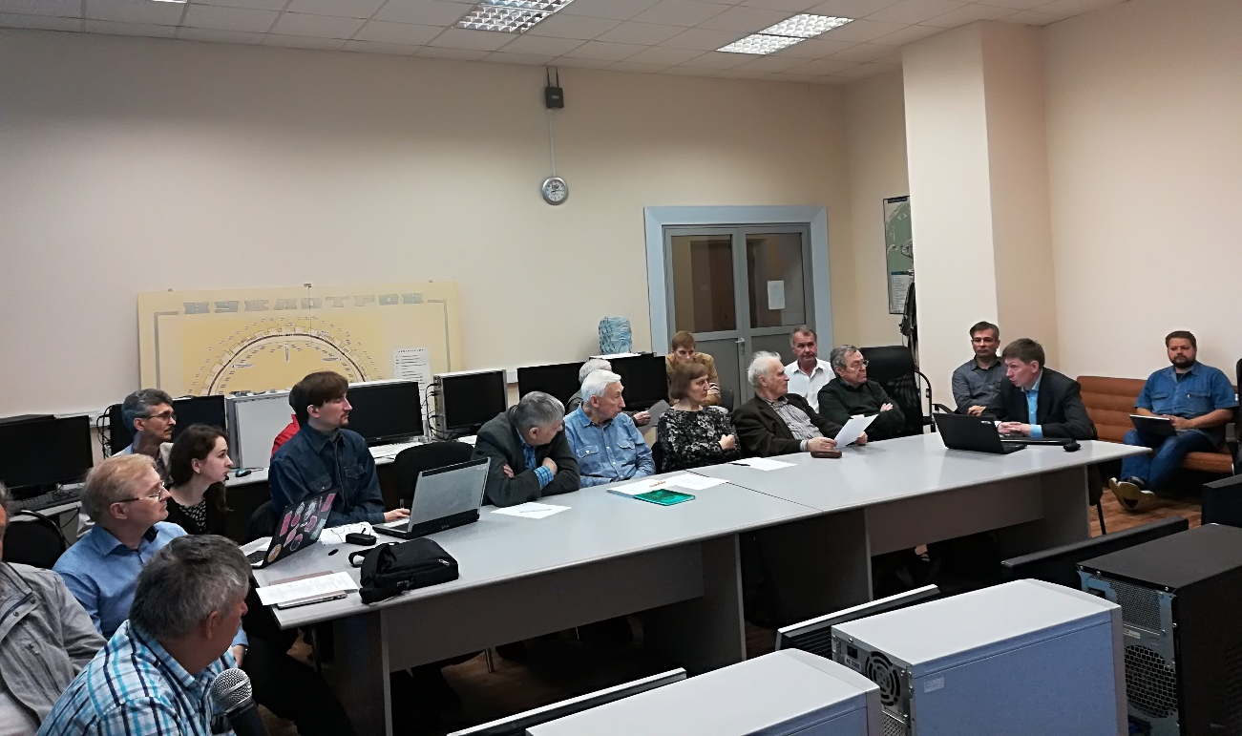
4. Organizational issues
4.1. Dynamics Dedicated Group (DDG)
The group was organized according to recommendation of NICA MAC.
The group conducts regular meetings – both real and virtual, in various number of members depending of a task.
ITEP
1. P.Zenkevich
2. A.Kolomiets
3. A.Bolshakov
JINR
1. S.Kostromin
2. O.Kozlov
3. A.Philippov
4. A.Sidorin
5. A.Smirnov
6.E.Syresin
7. A.Tuzikov
BINP
1. E.Levichev
2. S.Glukhov
3. K.Kariukina
4. A.Krasnov
5. N.Mityanina
6. V.Parkhomchuk
7. V.Petrov
8. E.Rotov
9. D.Shatilov
10. A.Tribendis
3.2. DDG Meeting May 21-22, 2018
NICA Collider
Fermilab
V. Lebedev
I.Meshkov NICA status NICA MAC June 07-08, 2018

Slide 16
4. Organizational issues
4.2. DDG Working Meeting, May 21-22, 2018: NICA Collider
Program of The Meeting
I. Lattice and magnets, single particle dynamics
1. S.Kostromin, O.Kozlov (JINR): Collider ring lattice, estimates of nonlinearities in the magnets, corrections, results of magnets field measurement
2. K. Kariukina (BINP): Increase of dynamic aperture by octupole correctors
3. A.Sidorin(JINR): Start-up mode of the NICA
II. Effects of the beam space charge
4. S.Glukhov (BINP): Simulation of beam space charge in the Collider (formulas, analysis, results)
5. N.Mityanina (BINP): Beam storage and formation in the Collider, acceleration by barrier RF voltage, space charge effects
6. P.Zenkevich (ITEP) – Space charge effects in the Collider
7. A.Kolomiets (ITEP) – Impedances of the inserted elements of the Collider
8. A.Philippov: “Electron cloud” effect in the Collider
III. Cooling methods and particle dynamics in the Collider
9. V.Parkhomchuk: What can we wait from electron cooling application
10. A.Sidorin – Status of construction of the stochastic cooling system of the Collider
I.Meshkov NICA status NICA MAC June 07-08, 2018

Slide 17
4. Organizational issues
4.3. Intentions and progress in the development of
polarized beams’ mode of the NICA
Two groups developing polarized beam mode
Yu. Shatunov (BINP) A.Kovalenko (JINR)
Both groups have presently own scheme for acceleration polarized protons and
deuterons from the polarized particle source up to Collider, storage and collide
at well controlled polarization.
On June 25, the working seminar is planned analyze both proposals and try to
Formulate an optimal version.
Afterwards the formulated solution will be presented to an independent
examination and then submitted to the NICA MAC.
In 2018 the SPD collaboration was formed. It conducts now regular meetings
considering different schemes of the Spin Physics Detector. Insertion of the SPD
Into Collider will be made together with NICA group.
I.Meshkov NICA status NICA MAC June 07-08, 2018

Slide 18
4. Organizational issues
4.4. Megaproject, “Mega-money” and “Mega-problems”
April 27, 2016 – NICA Megaproject
April 27, 2016
Order of The Government of Russian Federation
₽ 8.8 billion Russian Federation +
₽ 8.7 billion JINR
2008
2012
2016
Since 2017 the funding of the NICA project is sufficient.
The main limitation of the rate of the project development is due to
the insufficient staff and a delays of beginning of the fabrication
(strictly defined technological cycle) at delayed completion of the
designing works.
I.Meshkov NICA MAC 22-23 May 2017

Slide 19
4. Organizational issues
4.5. NICA construction schedule
Component | Developer | Commissioning date
 |  | Plan | Corrected
NICA Stage I (BM@N)
1. Heavy ion source KRION | VBLHEP JINR | Nov. 2018 | Nov. 2018
2. HILAc | BEVATECH+VBLHEP | Commissioned (2016)
3. Booster synchrotron | VBLHEP JINR | Dec. 2018 | July 2019
3.1. RF system | BINP | Ready for mounting
3.2 E-Cooler for Booster | BINP | Ready for mounting
4. BTL Booster—Nuclotron | BINP | Feb. 2019 | Nov. 2019
5. Nuclotron upgrade, injection from BTL BN | VBLHEP JINR | Nov. 2019 | Nov. 2019
6. BTL Nuclotron—BM@N upgrade | VBLHEP JINR | Feb. 2019 | Nov. 2019
7. BM@N experiment with Au⁷⁹⁺ | VBLHEP JINR | Nov. 2019 | Feb. 2020

Slide 20
4. Organizational issues
4.5. NICA construction schedule (continued)
Component | Developer | Commissioning date
 |  | Plan | Corrected
NICA Stage IIa (Basic configuration)
8. Nuclotron upgrade, fast extraction to BTL NC | VBLHEP JINR | Nov. 2019 | Dec. 2019
9. BTL Nuclotron—Collider | SigmaPhi (France) | 1 December 2019 (contract) ?
10. Collider – Stage IIa 10.1. RF systems RF-1 RF-2 (2 RF stations per ring) 10.2. Stochastic cooling (1 Channel/ring) 10.3. Beam dump system | VBLHEP JINR BINP BINP JINR & FZJ VBLHEP JINR | Dec. 2020 Dec. 2020 Dec. 2020 Dec. 2020 Dec. 2020 Dec. 2020 | Dec. 2020 Dec. 2020 Dec. 2020 Dec. 2020 Dec. 2020 Dec. 2020

Slide 21
4. Organizational issues
4.5. NICA construction schedule (end)
NICA Stage IIb (Full Configuration)
11. Collider – Stage IIb | VBLHEP JINR | July 2023
11.1. RF systems RF-2 (2 RF stations per ring) RF-3 (8 RF stations per ring) | BINP BINP/INR RAS (?) | December 2021 December 2021
11.2. Stochastic cooling 2 channels per ring | VBLHEP JINR/Izhevsk Cº | October 2022
11.3. Electron cooler | BINP | December 2021
11.4. Feed back system 1 channel per ring | VBLHEP JINR | October 2022
12. MPD – NICA Stage IIb | VBLHEP JINR | December 2022
NICA Stage IIb (Full Configuration) |  | 2023
NICA Stage III (polarized beams and spin physics) | 2025

Slide 22
4. Organizational issues
4.6. Plan of the IXth Session of the NICA MAC
It was decided for this session
to shorten the talks and have more discussions.
The discussion time in the Program looks as following:
Thursday 17:25 | Summary of the day, discussion 30′
Friday 12:00 | General discussion of the status and problems of the NICA accelerator complex project (requests to MAC, etc.) 55′
Friday 15:00 | General discussion of the status and problems of the NICA accelerator complex project (requests to MAC, etc.) – continuation, 40′
Friday 16:00 | Closed session: discussion and formulation of MAC resolution 1 h 15′
Friday 17:15 | Presentation of the MAC resolution; proposal of the next session, 35′

Slide 23
Outlook: NICA civil construction
! Buildings of the Collider and BTL NC | Strabag Co | According to the contract: Nov. 2015 + 43 months = = July 2018
JINR, Dubna 07-08 May 2018

Slide 24
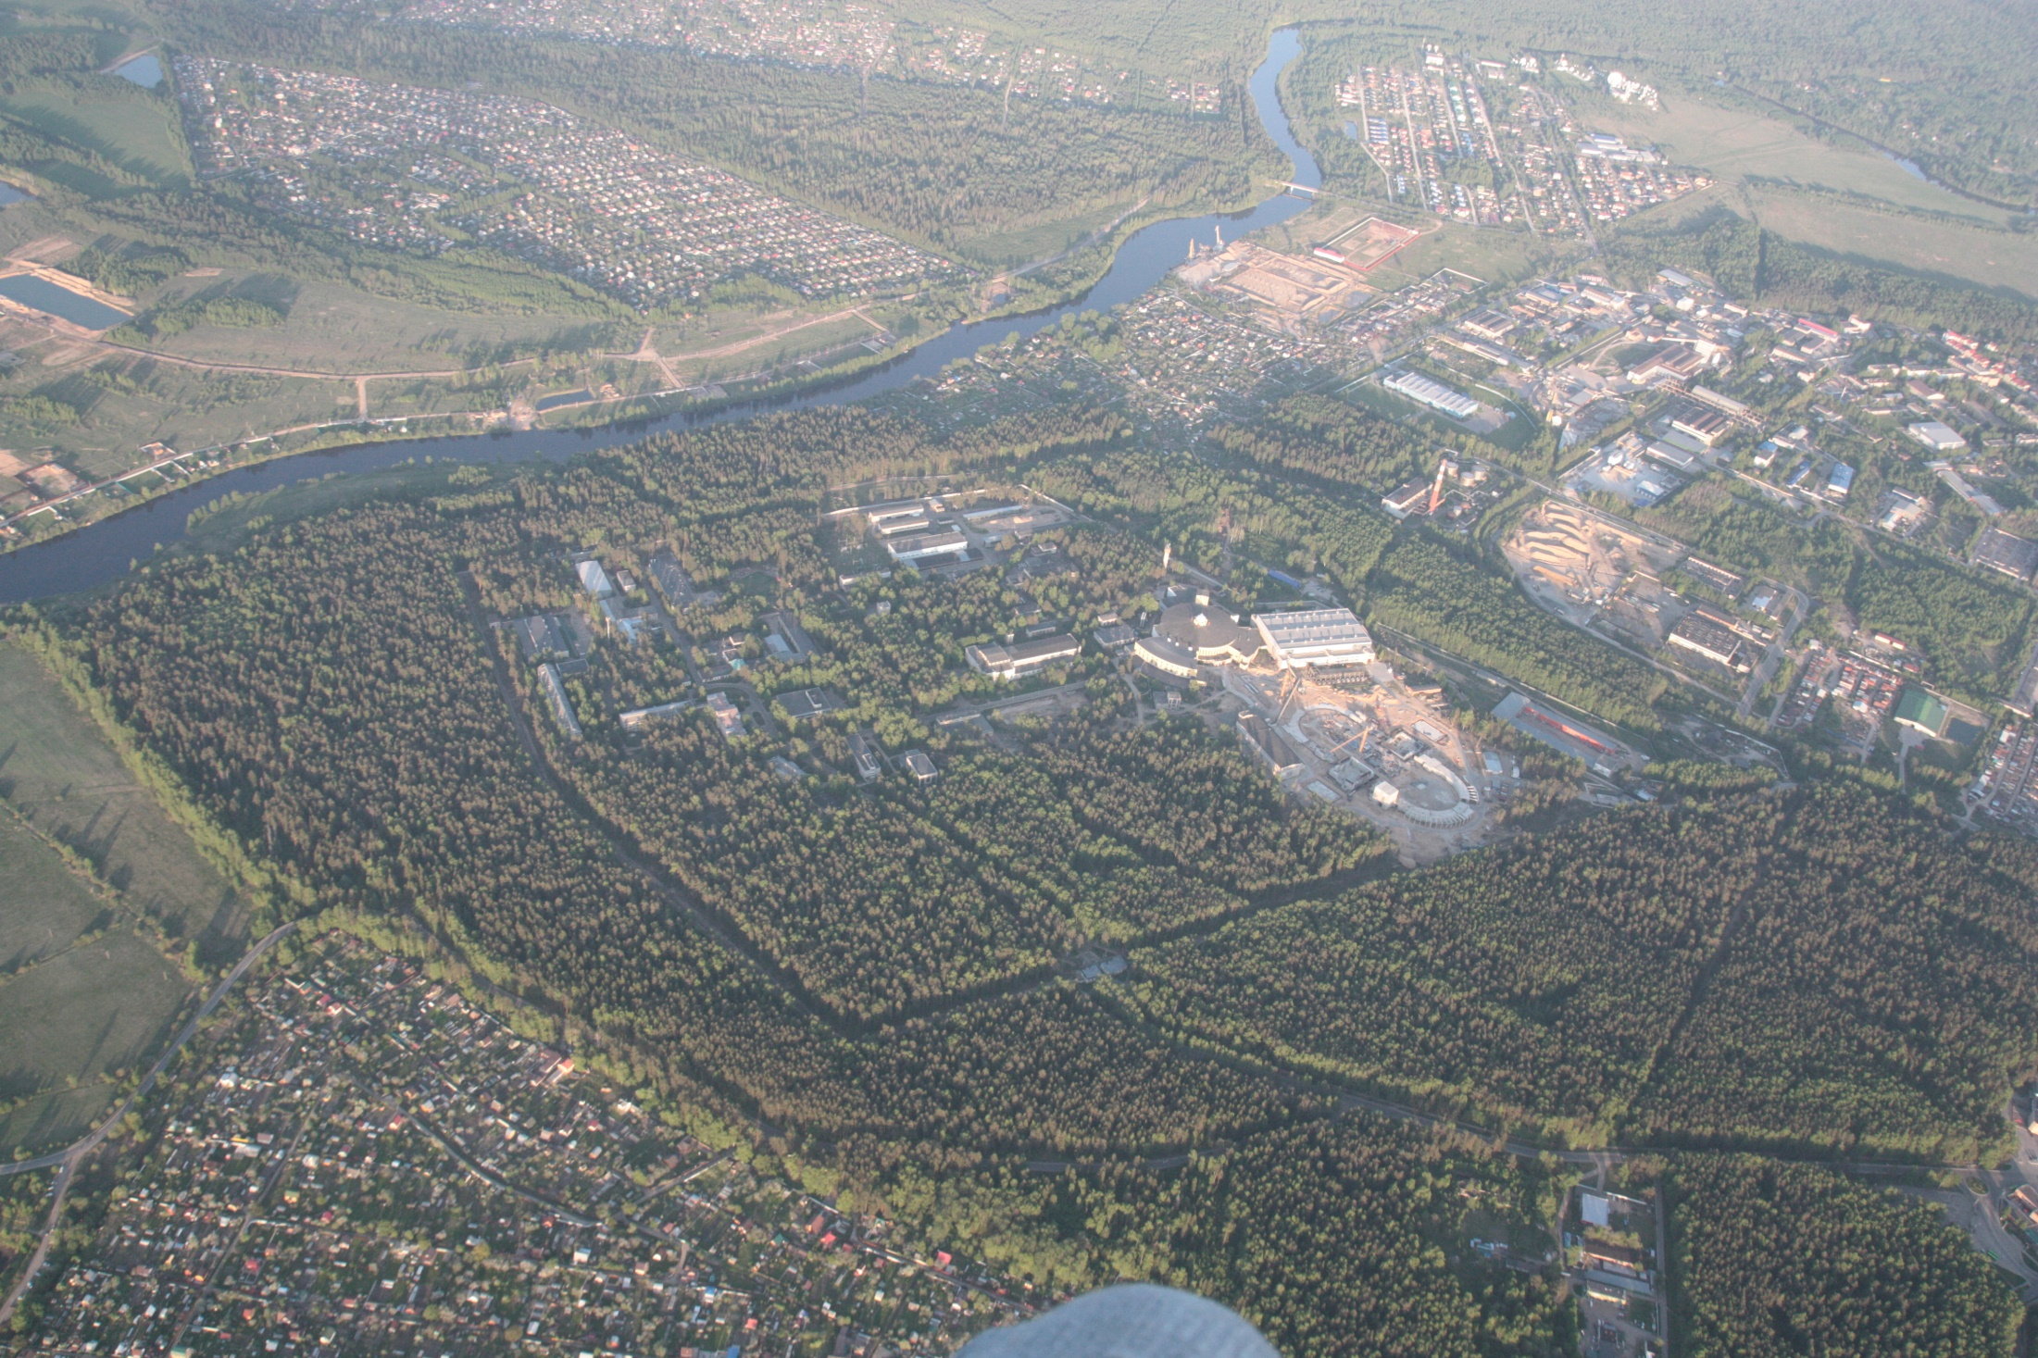
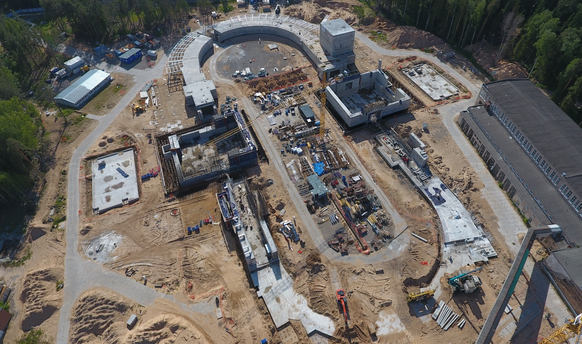
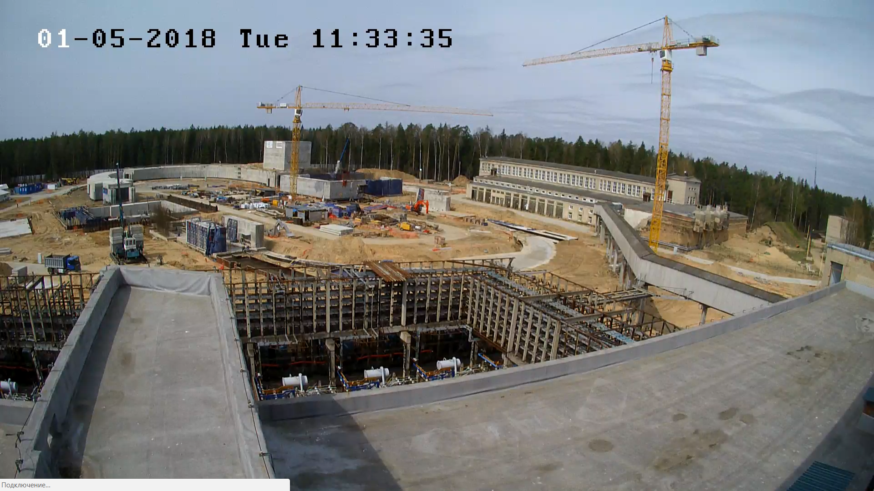
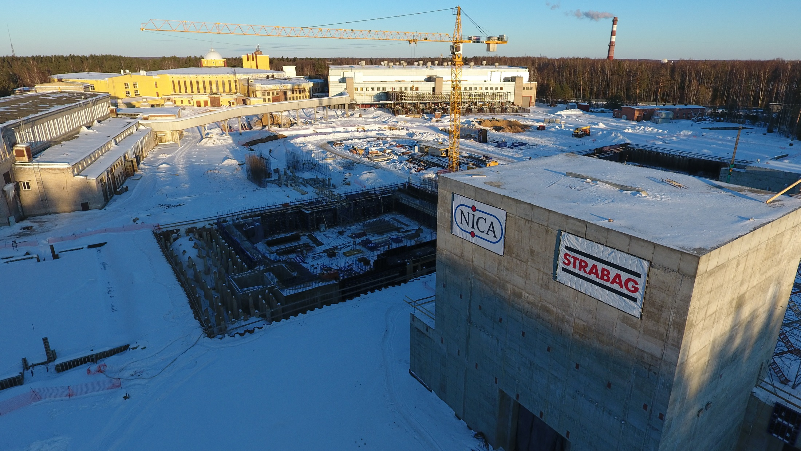
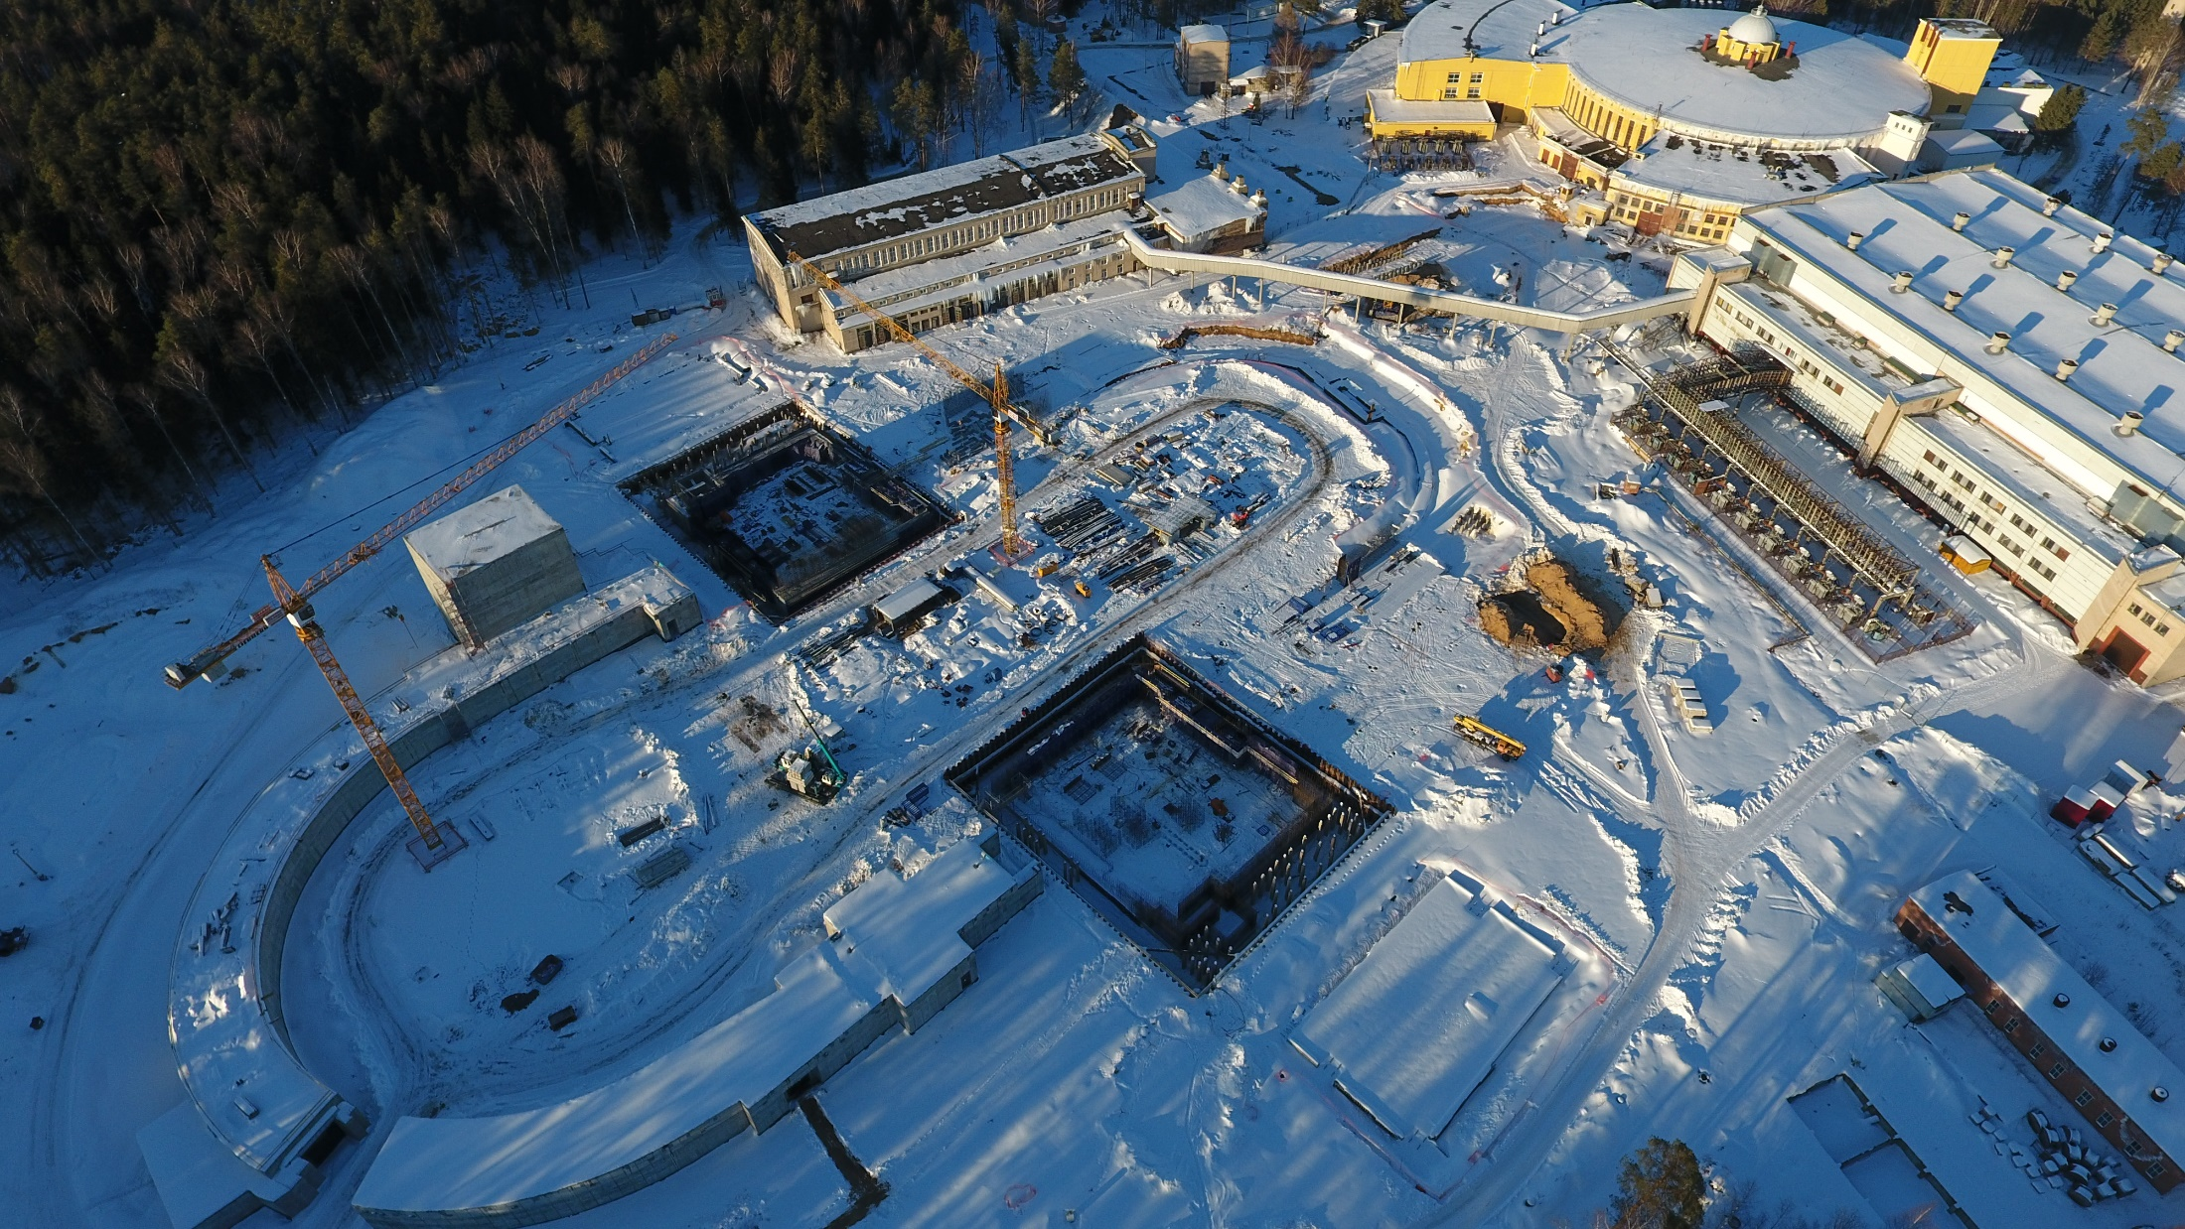
May 2018
May 06, 2018
March 2018
March 2018
May 01, 2018
Thank you for your attention!

