Slide 1
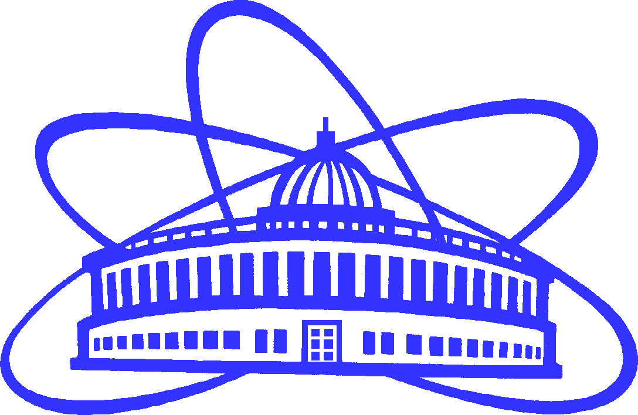
QUALITATIVE AND QUANTITATIVE ANALYSIS OF
ARSENIC AND MERCURY
IN HUMAN REMAINS OF THE XVI-XVII CENTURIES
FROM THE MOSCOW KREMLIN NECROPOLISES
BY NEUTRON ACTIVATION ANALYSIS
AT THE IREN FACILITY
AND THE IBR-2 REACTOR OF FLNP JINR.
T.D. Panova, A.Yu. Dmitriev,
S.B. Borzakov, C. Hramco

Slide 2
DETERMINATION OF THE ORIGIN
OF THE MEDIEVAL GLASS BRACELETS
DISCOVERED IN DUBNA, MOSCOW REGION, RUSSIA
USING THE NEUTRON ACTIVATION ANALYSIS.
S.O. Dmitrieva, M.V. Frontasyeva, A.A. Dmitriev, A.Yu. Dmitriev.
Physics of Particles and Nuclei Letters. 2017. V. 14. No 1. Pp. 239–243.
The bracelets №1, №2, №4, №5, №7 belong to the ancient Russian potassium-lead-siliceous (K-Pb-Si) type. Researchers consider that such glass composition was used in the metropolitan workshops of ancient Rus’ in Kiev, as well as in Novgorod.
The bracelets №3, №6, №8, №9, №10 belong to the ancient Russian lead-siliceous type (Pb-Si) of glass. According to scientists, lead-siliceous glass was produced only in the provincial workshops in Smolensk, Polotsk.

Slide 3
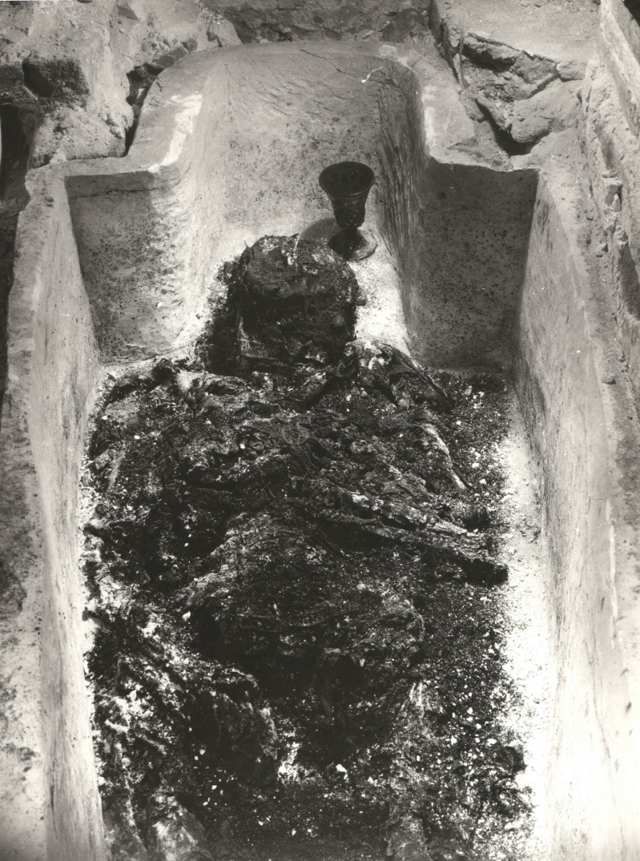
Introduction
The death circumstances of some representatives of the Russian state highest nobility of the 15th - early 17th centuries still cause controversy among historians. This is due to the lack of accurate data in written sources or different interpretations of the information presented in these sources. Studies of burial places of the members of the Royal family of Ivan the Terrible, carried out in 1963-1964, allowed us to obtain the data about the microelement composition of the remains of people of the Russian Middle Ages for the first time. However, the interpretation of these results, both in the 1960s and today, remains ambiguous, including the foreign historical literature.
The remains of Ivan the Terrible in the grave.

Slide 4
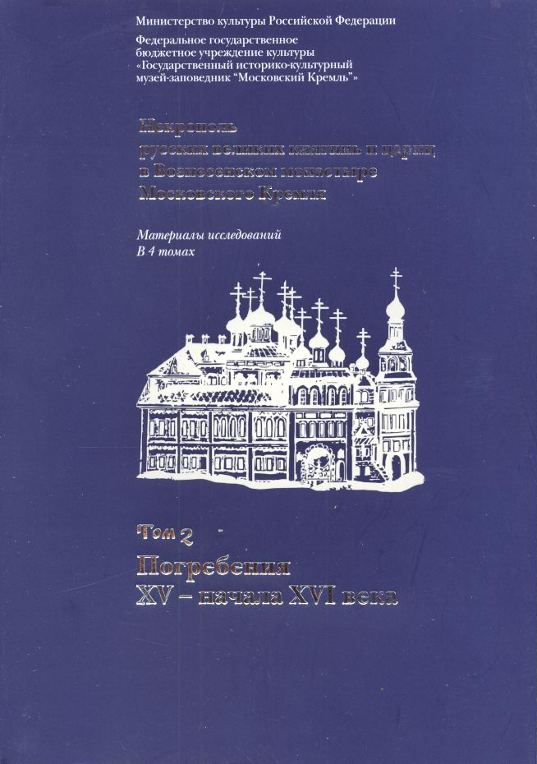
Introduction
In the 1990s and at the beginning of the 21st century, with the help of modern research methods, the burials of Russian Grand Duchesses and Tsarinas from the necropolis of the Ascension Cathedral of the Moscow Kremlin were studied. These studies allowed to expand significantly the database on the microelement composition of bone tissue of people of XV-XVII centuries.
The main objective of this study is to check the results obtained previously by other methods of analysis (chemical, X-ray fluorescence) by the method of neutron activation analysis (recognized as primary in international analytical practice). The main detectable elements are arsenic and mercury.

Slide 5
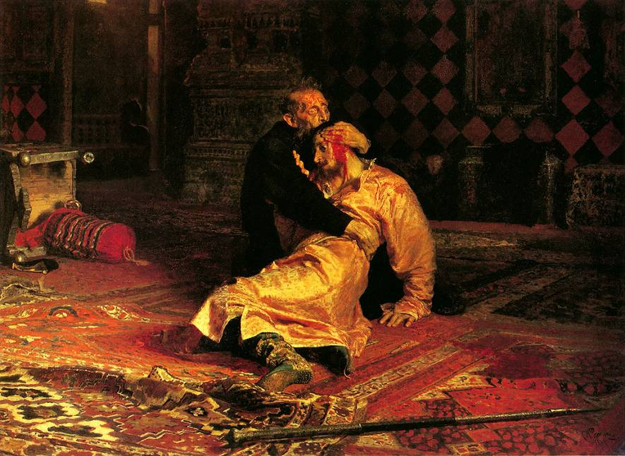
The samples for the study were transferred to the Frank Laboratory of Neutron Physics (FLNP) of the Joint Institute for Nuclear Research (JINR) in February 2017. Information about the names of historical figures, from whose burial places the samples were taken, was reported only after the completion of the study. Sample 1 is the rib fragment from the burial of the son of Tsar Ivan the Terrible, Tsarevich Ivan Ivanovich (died in 1581).
I. Repin. "Ivan the Terrible kills his son".
1883 - 1885.
Sample 1 (rib bone) before cleaning.

Slide 6
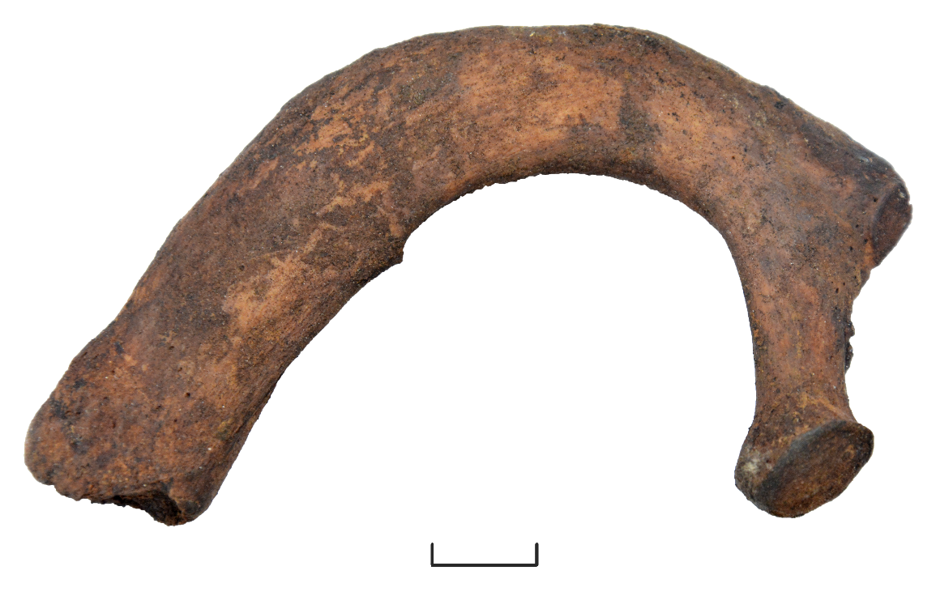
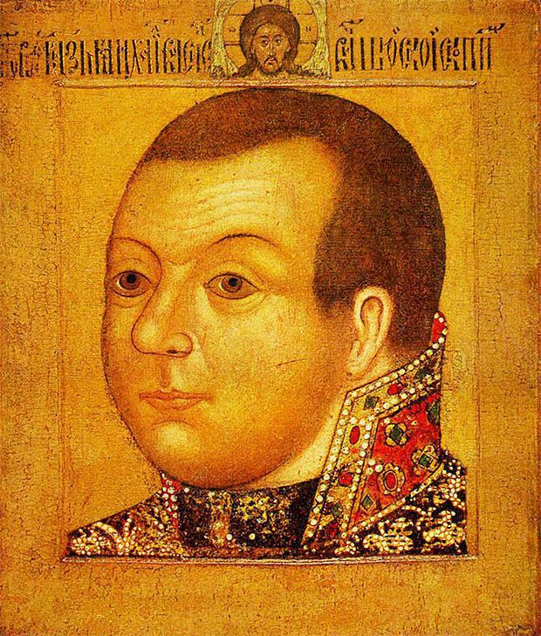
Sample 2 is the rib fragment from the burial place of Prince Mikhail Vasilievich Skopin-Shuisky (died in 1610).
Unknown author.
Prince M. V. Skopin-Shuisky.
Sample 2 (rib bone) before cleaning.

Slide 7
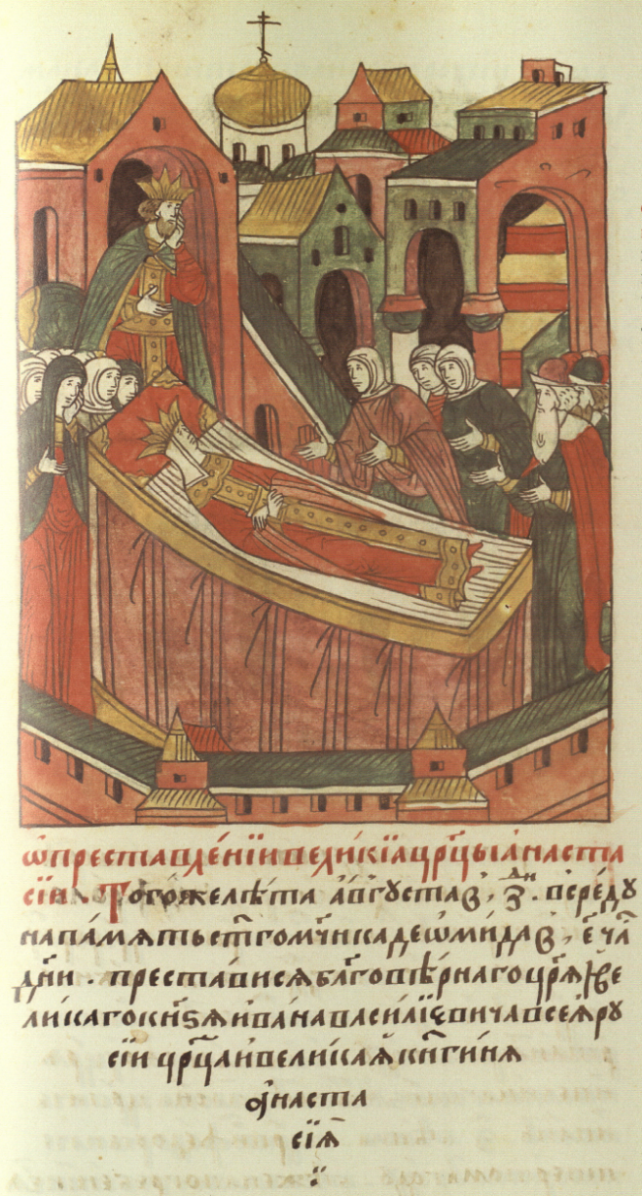
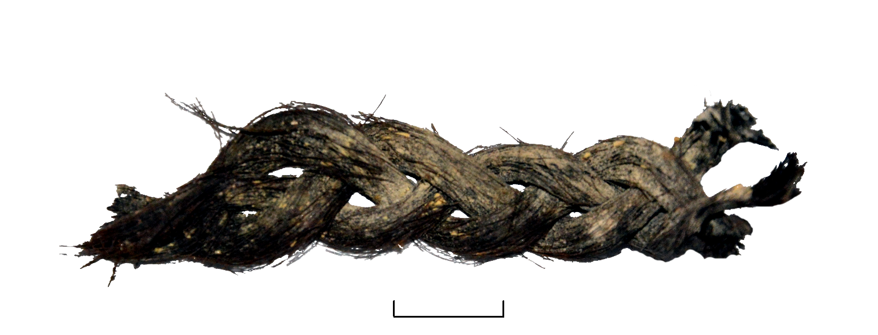
Sample 3 (Fig. 3) are elements of hair of the first wife of Tsar Ivan Vasilievich the Terrible - the first Russian Tsarina Anastasia Romanovna (died in 1560).
Sample 3 (the strand of hair) before cleaning.
The samples were studied by neutron activation analysis in February-April 2017. We performed two independent experiments using the basic facilities of FLNP JINR A the IREN research facility and the IBR-2 reactor.
The death of the great Tsarina Anastasia. Miniature of the second half of the XVI century.

Slide 8
Preparation of the bone tissue for irradiation
Two sets of samples were prepared for the experiments. Working with fragments of the skeleton and the hair required different approaches.
Rib bones have a porous internal structure, so the samples required very careful cleaning to prevent the saturation by components of the detergent. Cotton wool soaked in distilled water was used to remove rough surface contaminants (sand, dust, etc.). Bone surface soaked with water assisted to a partial swelling of contaminations of organic nature (decay). The bone fragments were carefully wiped with cotton wool soaked in a 3% solution of sodium bicarbonate for removal of such contaminations. The bone fragments were washed with large amount of distilled water (about 0.5 l) using a laboratory polypropylene vessel for washing to remove the remains of cleaning solution from the samples surface. The bone was held on weight using stainless steel tweezers.
Cleaned sample 1.

Slide 9
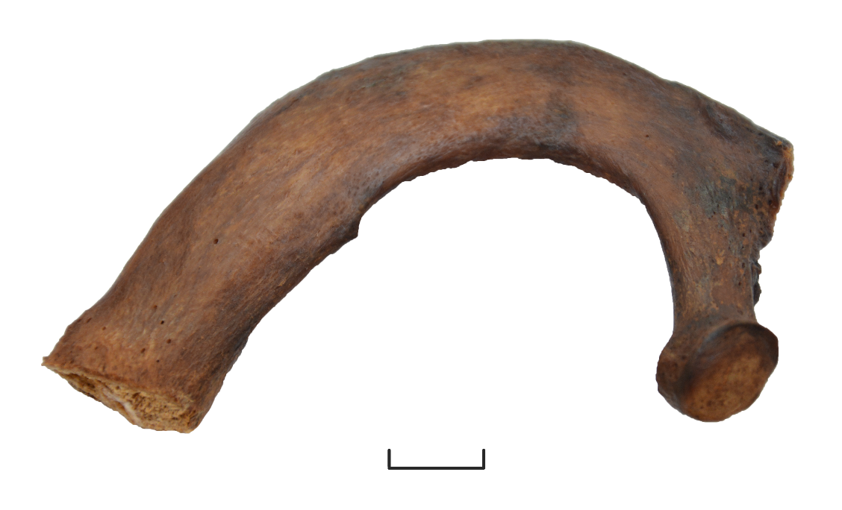
Remains of organic compounds were removed from the surface of the samples using cotton wool soaked in 96% ethyl alcohol. All operations for removal of contaminants were performed by repeated wiping of the samples using pieces of cotton wool, soaked with the appropriate cleaning solutions, until the termination of the wool contamination.
Since the porous ends of the bones could absorb a certain amount of cleaning solutions and the removed particles of contaminations, small sections of the ends of the ribs were removed after cleaning. Figs. below show the image of the bone tissue after cleaning.
Samples of bone tissue were dried in a drying oven during the day at temperature of 40 ◦C. This provided evaporation of maximum possible water quantity.
Grinding the samples to a powder was performed using a planetary mill, equipped with agate cup and balls. The grinded samples were dried for 72 h at temperature of 40 ◦C to constant weight.
Cleaned sample 2.

Slide 10
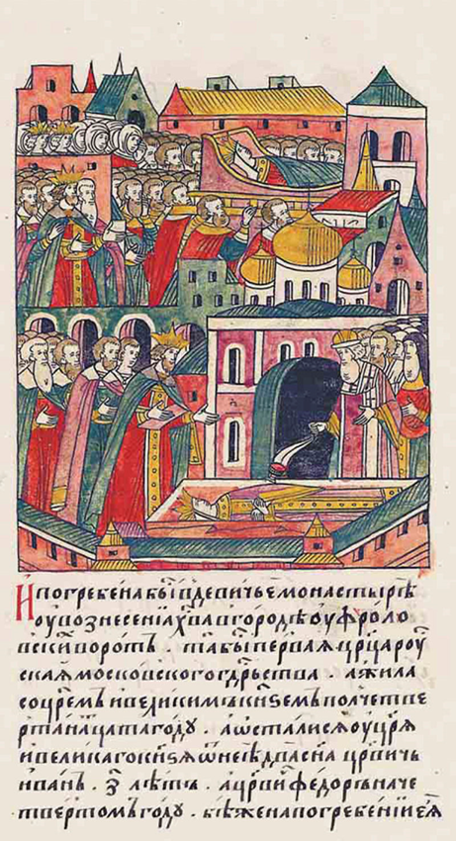
Preparation of hair fragments for irradiation
To remove surface contaminations, the fragments of the hair (about 3.5 g) were divided into three parts. Each part was soaked three times in 100 ml of acetone during 10 min, every two minutes the content of the cup was gently mixed. Cleaned hair was placed between two sheets of filter paper and was kept for 24 h at room temperature.
Burial of the great Tsarina Anastasia. Miniature of the second half of the XVI century.

Slide 11
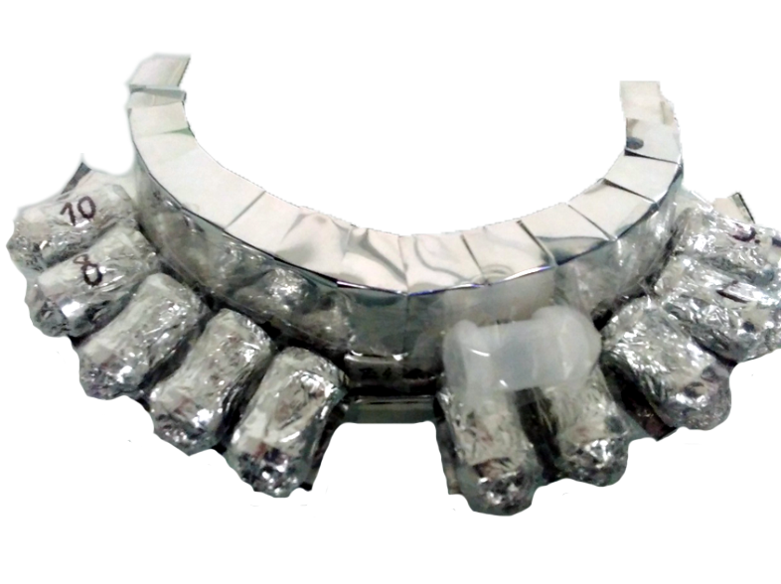
Samples and standards preparation for irradiation
To carry out the study, the standard materials from the National Institute of Standards and Technology (USA) have been irradiated together with the
samples.
Masses of the standards (7 pieces) and samples for irradiation at the IREN research facility were approximately 1 g. Weighed samples were packed in plastic bags. Each packed sample was placed in an individual plastic container.
The aluminum substrate with containers containing packed samples and standards for irradiation at the IREN research facility.
Masses of the standards (10 pieces) and samples for irradiation at the IBR-2 reactor were about 0.1 g. Weighed samples were packed in aluminum capsules. All capsules were placed in one aluminum container.
The hardware-software tool for automation of samples weight registration, created at FLNP JINR, was used for weighing.

Slide 12
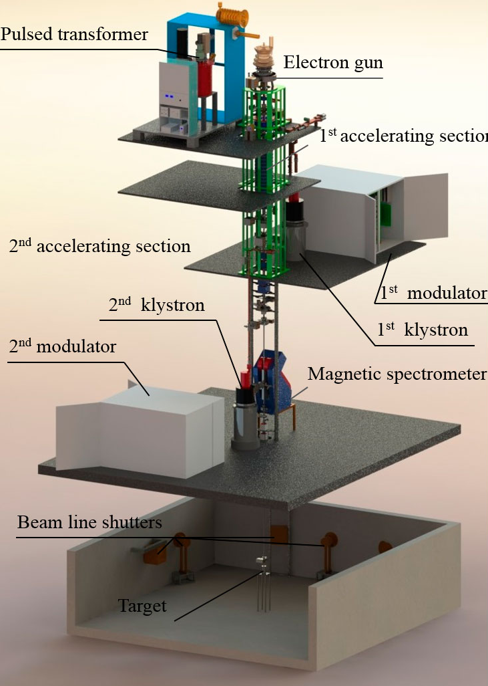
Irradiation
The first set of samples and standards was irradiated at the IREN facility in March 2017 for 115.5 h. The IREN installation worked in the following mode: the maximum energy of electrons was 55 MeV, the average current was 2.4 μA. The flux densities of the thermal and resonance neutrons at the facility were determined by the cadmium difference method. Copper samples served as indicators. The flux density of the thermal neutrons was about 6.0 · 10⁷ cm⁻² · s⁻¹, the flux density of the resonance neutrons at 1 eV was 7.6 · 10⁶ cm⁻² · s⁻¹.

Slide 13
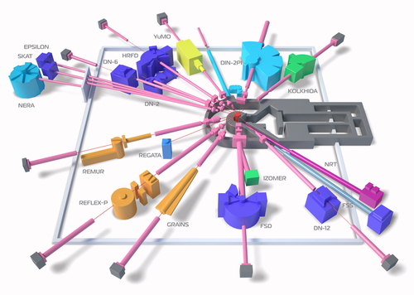
Irradiation
3
The second set of samples and standards was irradiated in the third channel of the IBR-2 reactor. The total irradiation time was about 15 days. The flux density of the thermal neutrons was about
5.2 · 10¹¹ cm⁻² · s⁻¹,
resonance neutrons - 7.5 · 10¹⁰ cm⁻² · s⁻¹.

Slide 14
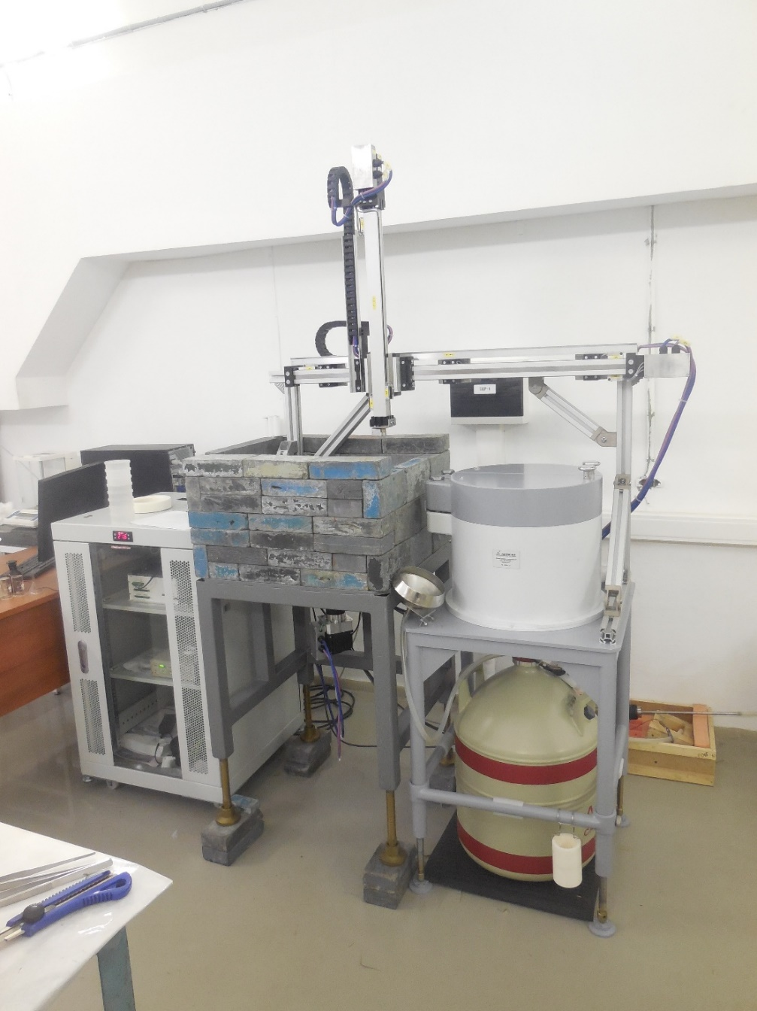
Data acquisition and analysis
Gamma spectra of induced activity of samples were measured twice after irradiation using the automation system for measurement of spectra (see fig) developed at FLNP JINR. This automation system includes a high-purity germanium detector with high resolution produced by Canberra, electronics, sample changer, and software. The energy resolution of the detector is 1.8 keV for the 1173 keV line of ⁶⁰Co, relative efficiency is 40%.
Automation system for spectra measurement.

Slide 15
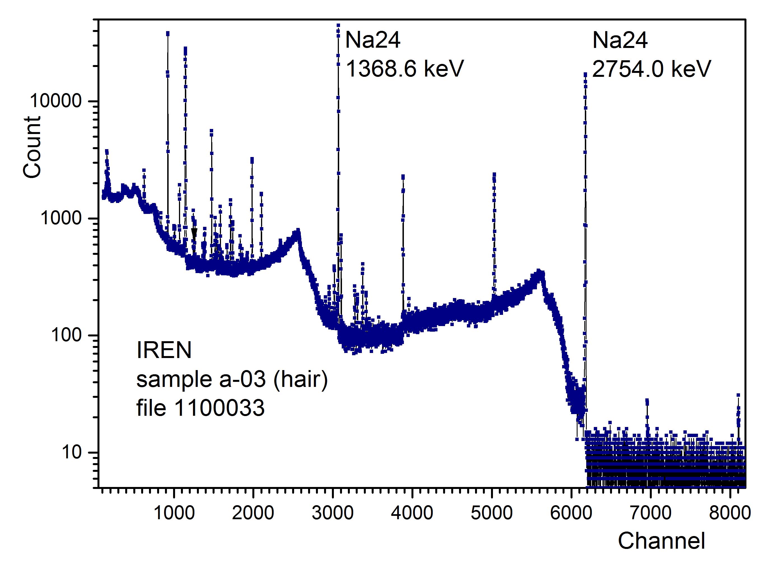
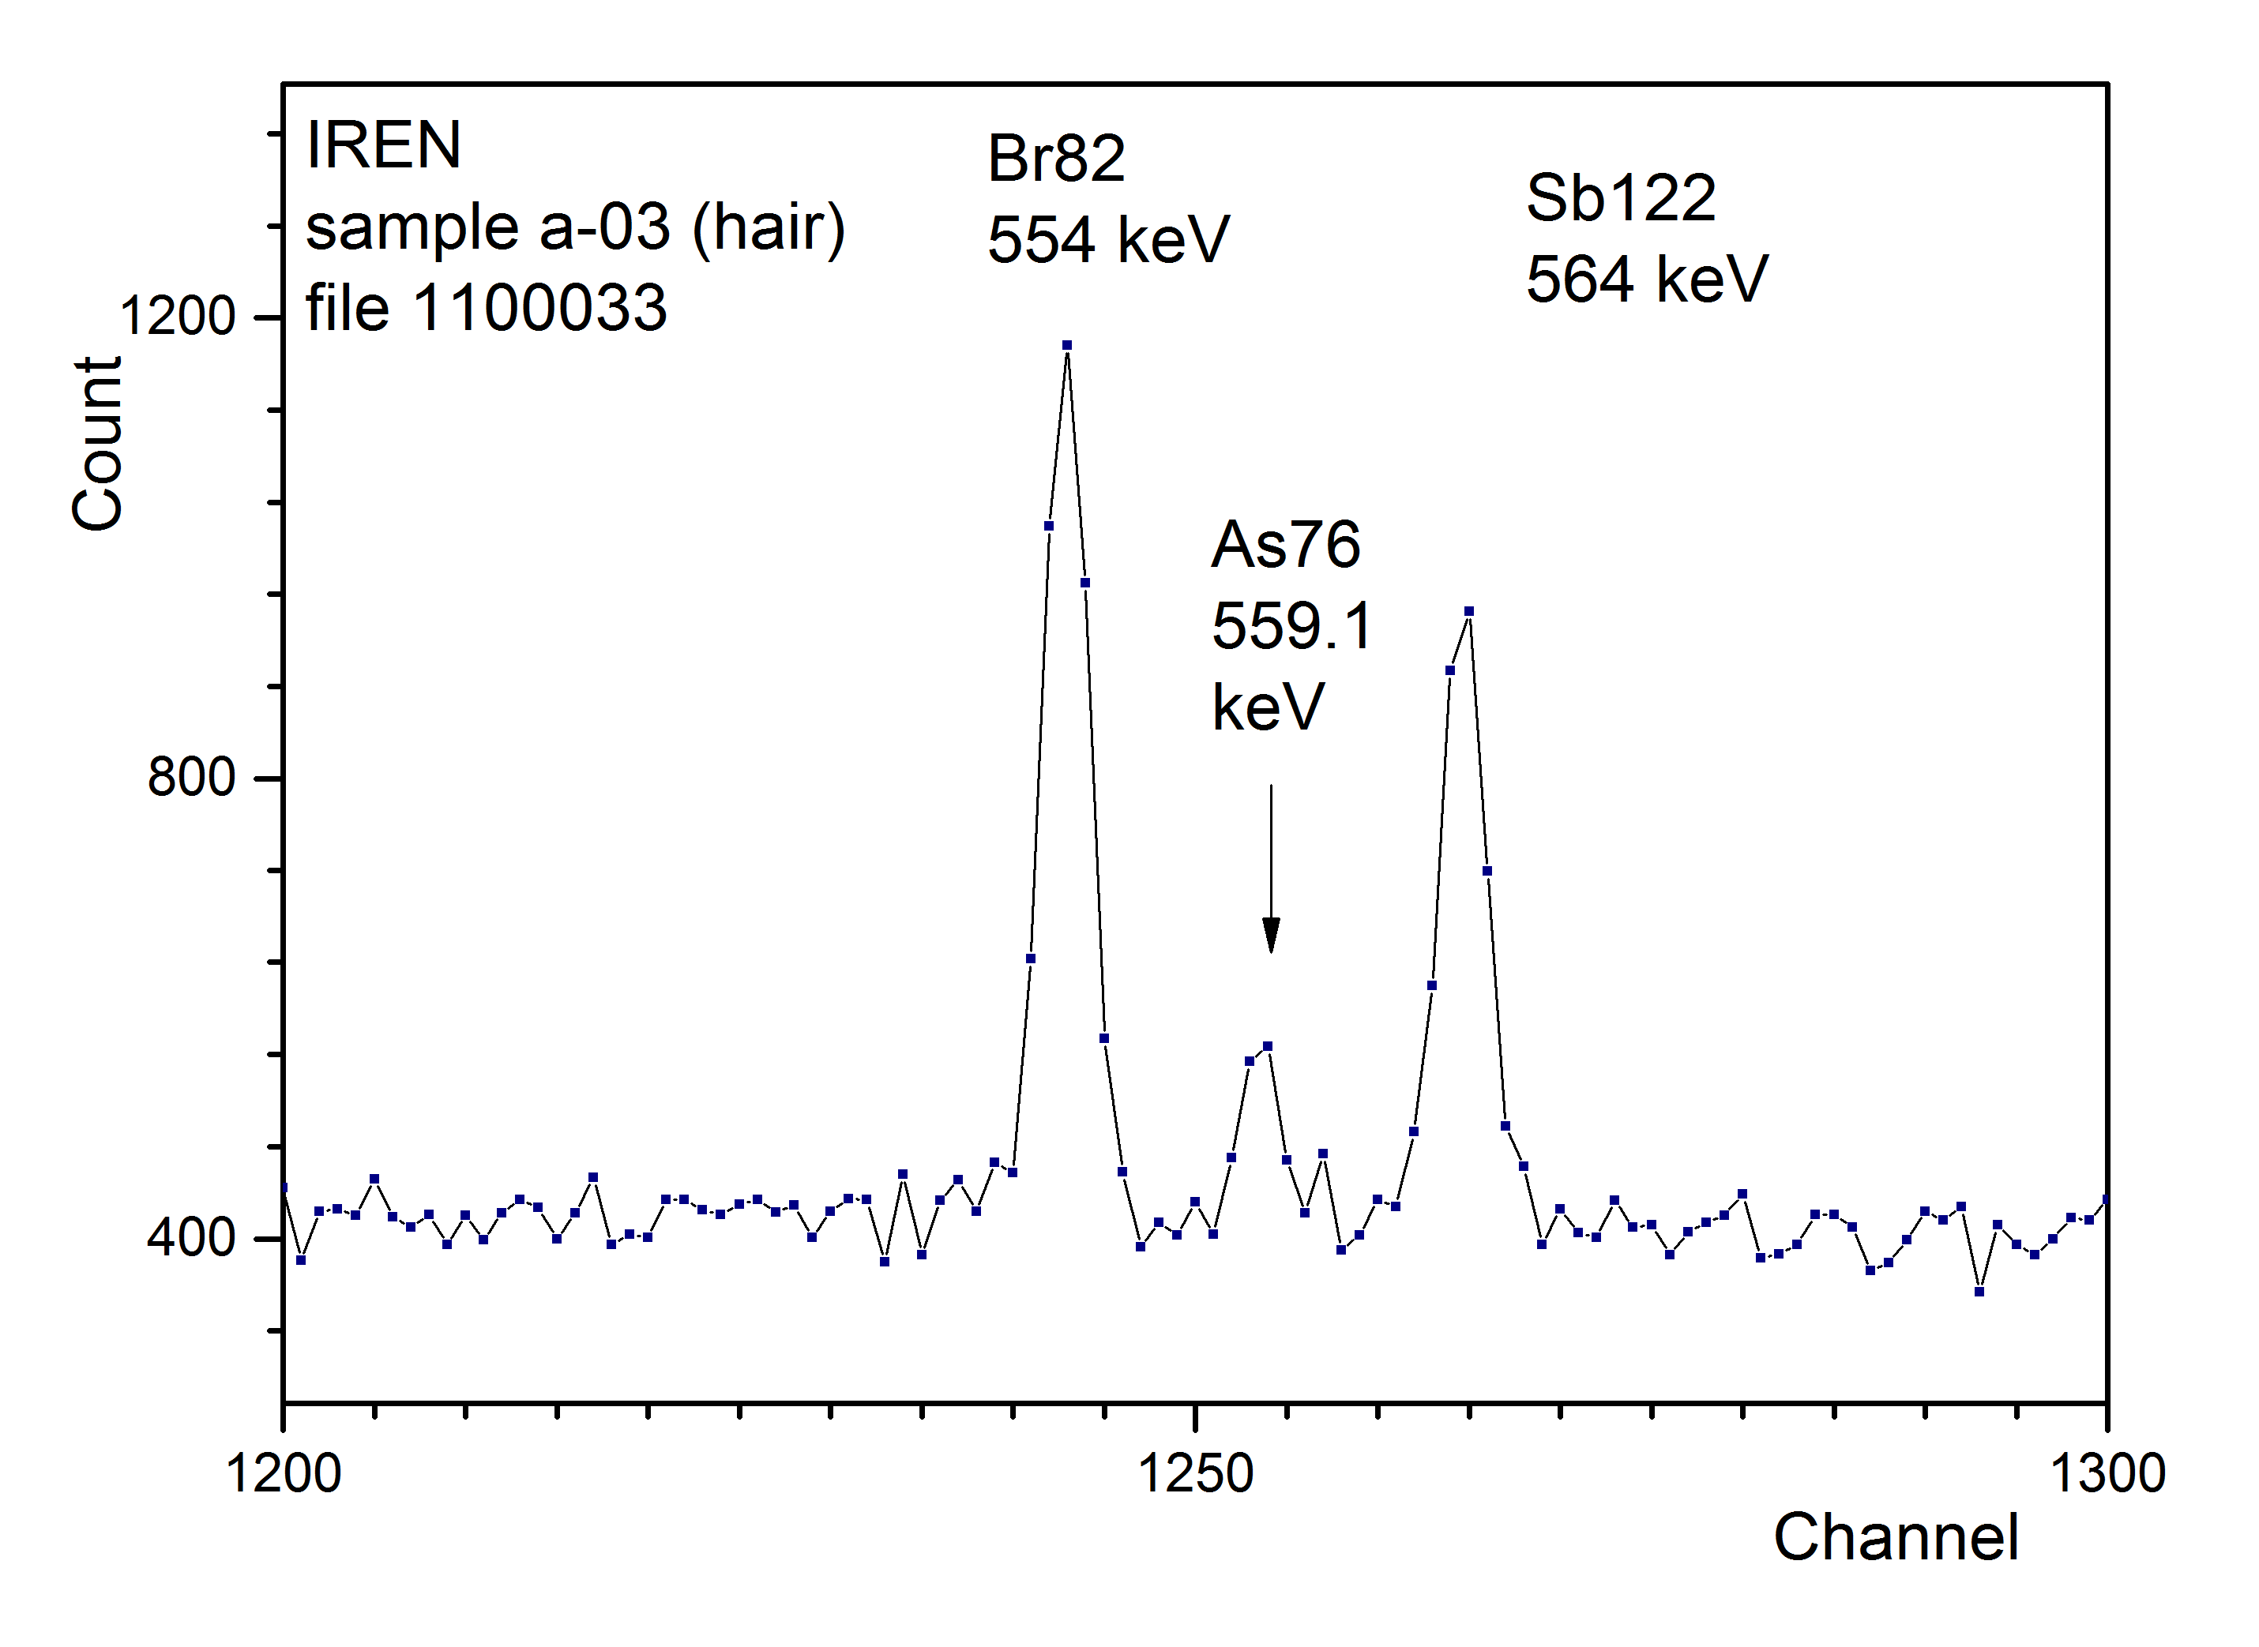
Data acquisition and analysis
The first measurement was carried out a few hours after the end of irradiation at the IREN facility...
The full spectrum and the spectrum fragment of the sample 3 irradiated at the IREN facility
(the first measurement)

Slide 16
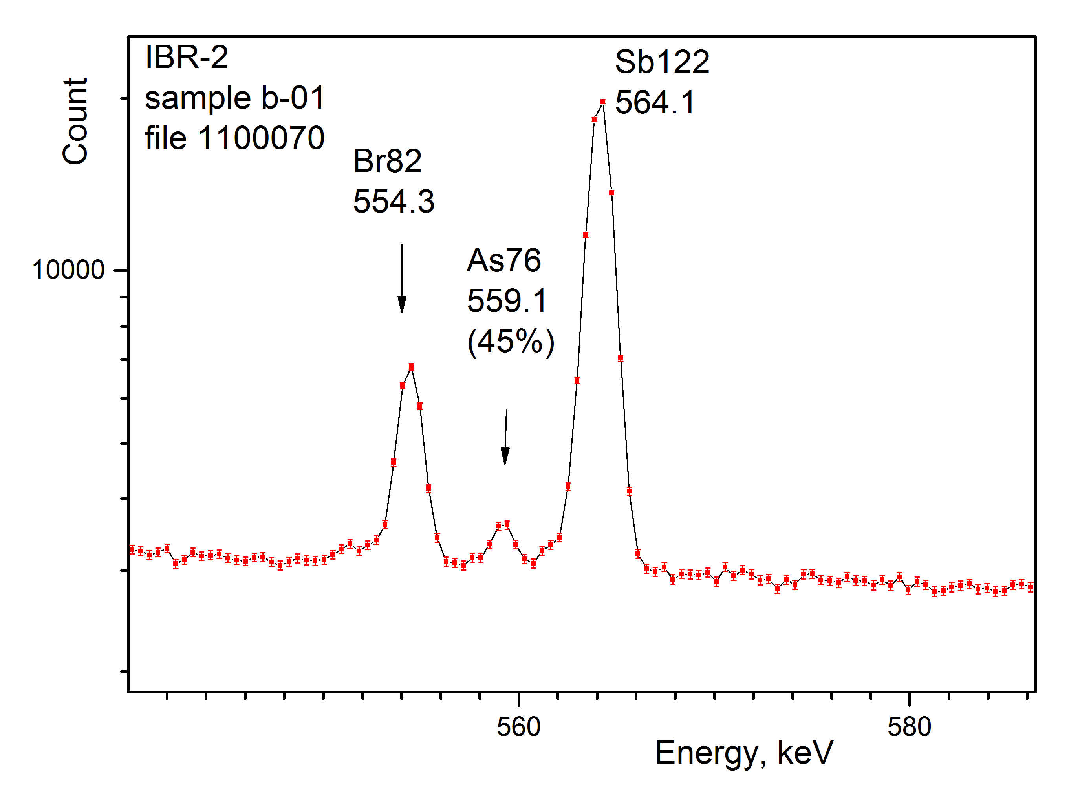
Data acquisition and analysis
…and several days after irradiation of the samples at the IBR-2 reactor (taking into account the radiation situation).
The spectrum fragment of sample 1 irradiated at the IBR-2 reactor
(the first measurement)

Slide 17
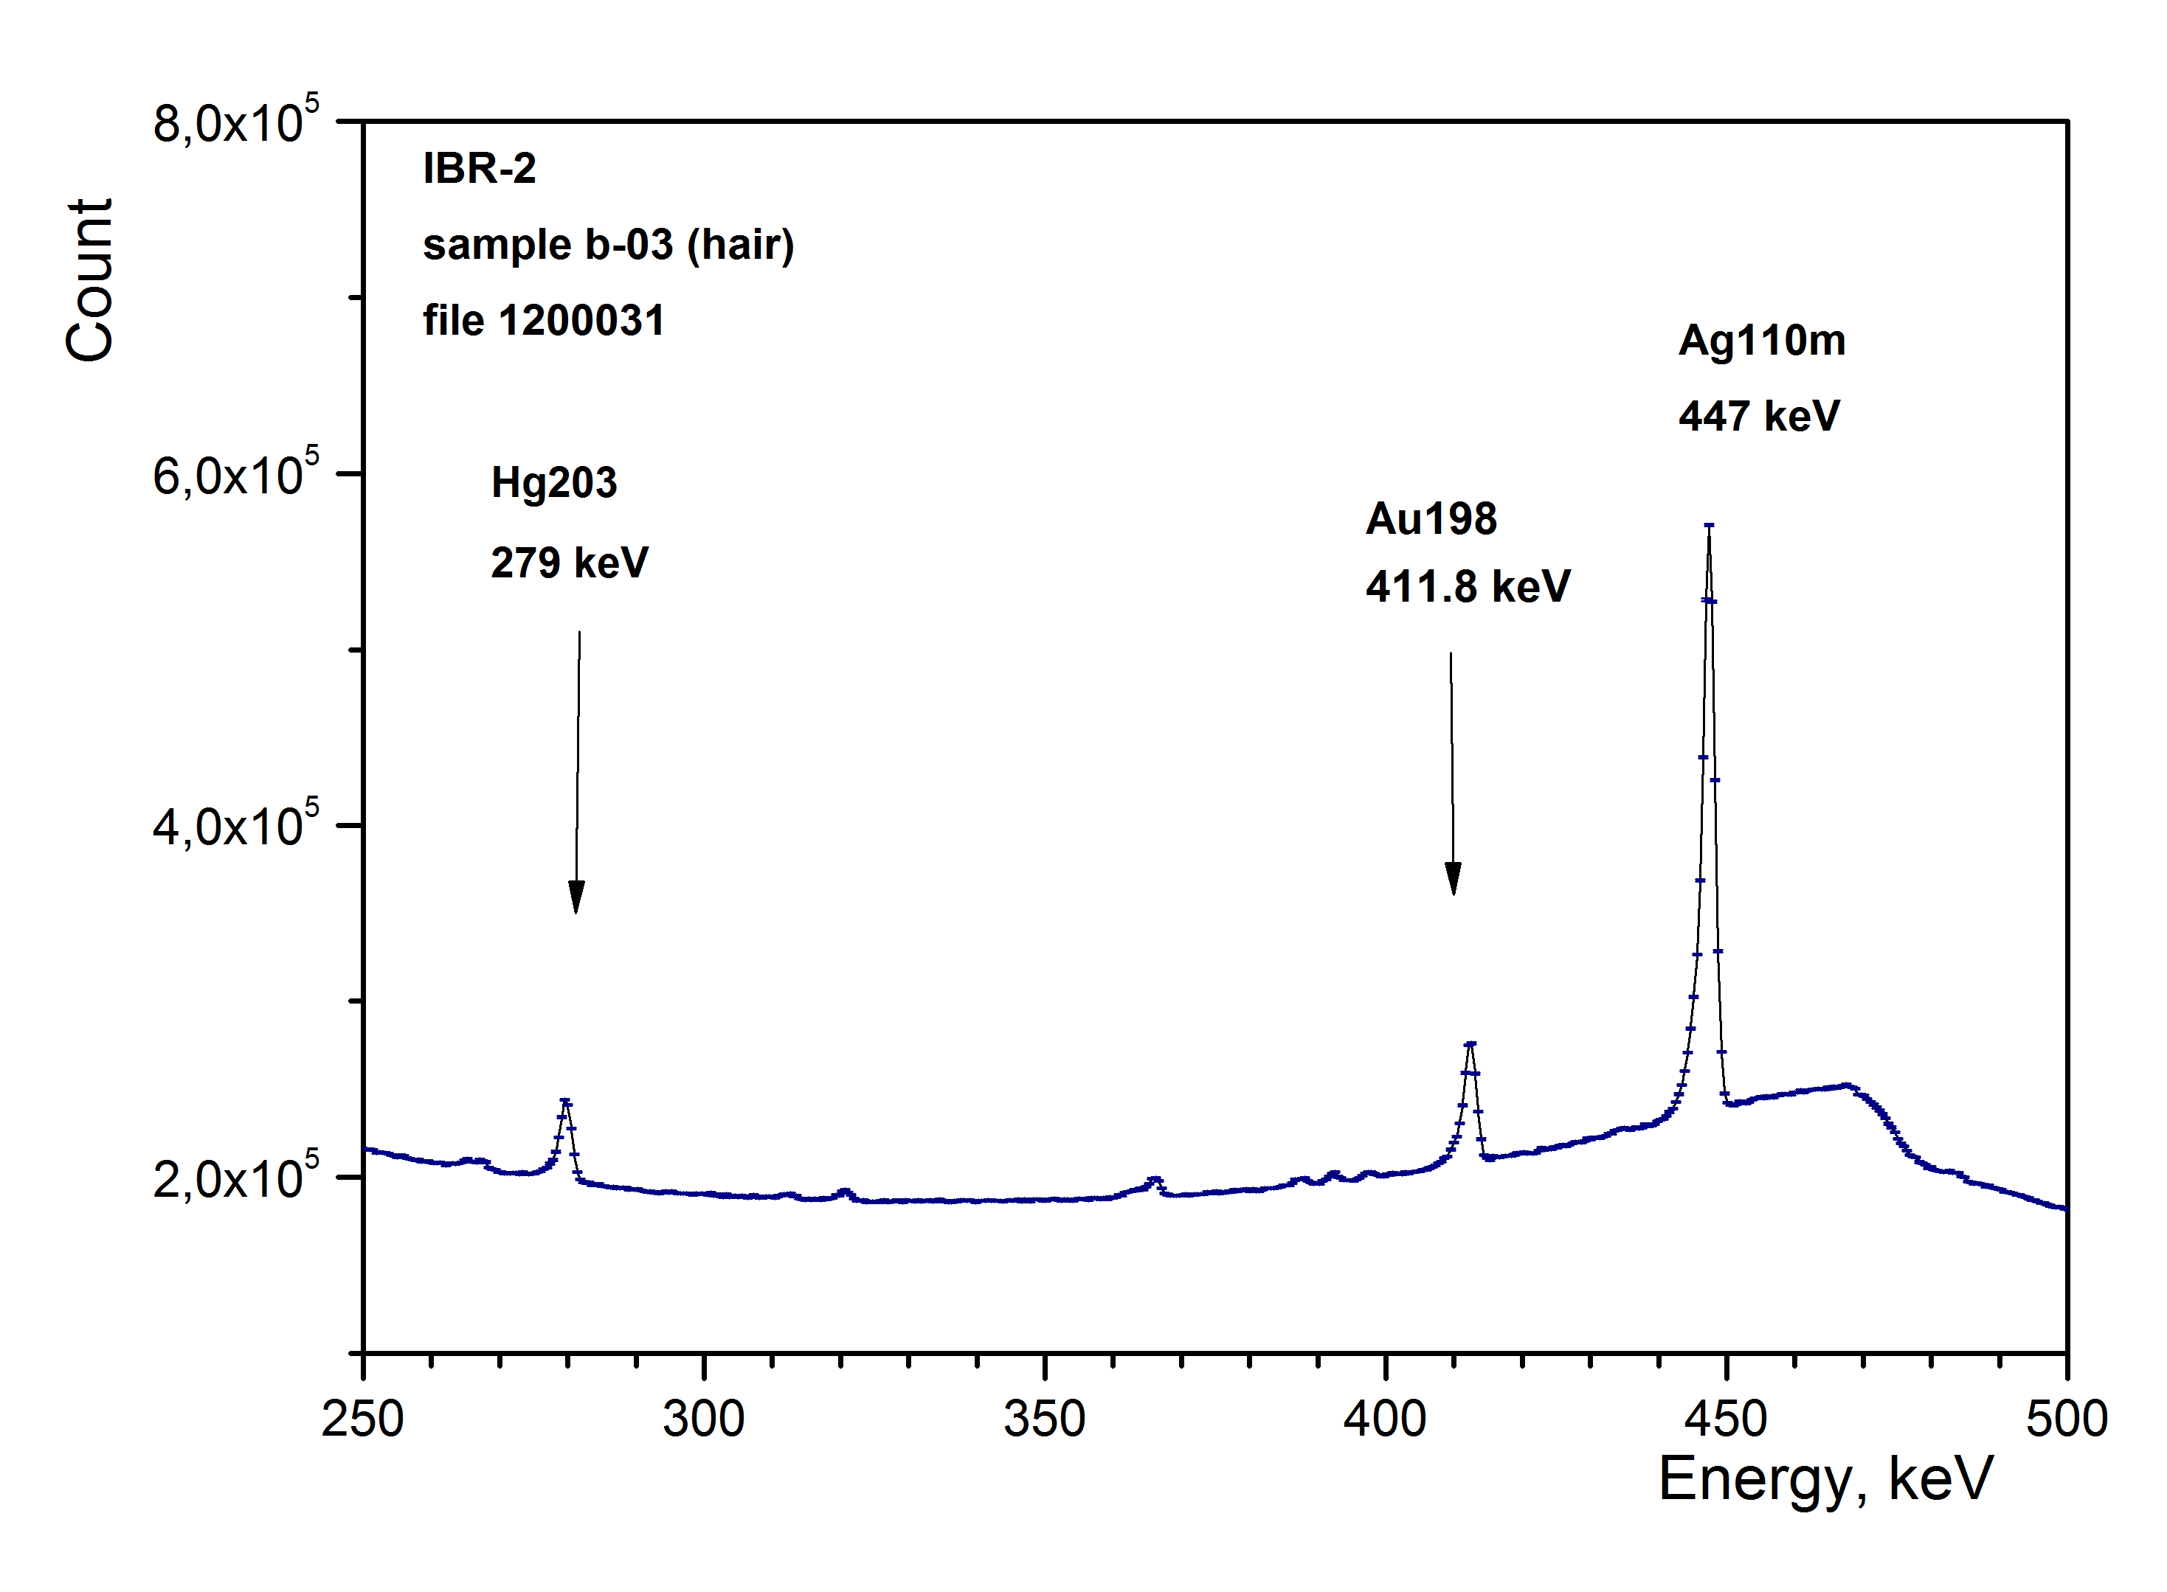
Data acquisition and analysis
The second measurement was carried out about three weeks after the end of irradiation.
The Genie-2000 software was used for measurements and analysis of the spectra.
The spectrum fragment of sample 3 irradiated at the IBR-2 reactor
(the second measurement)

Slide 18
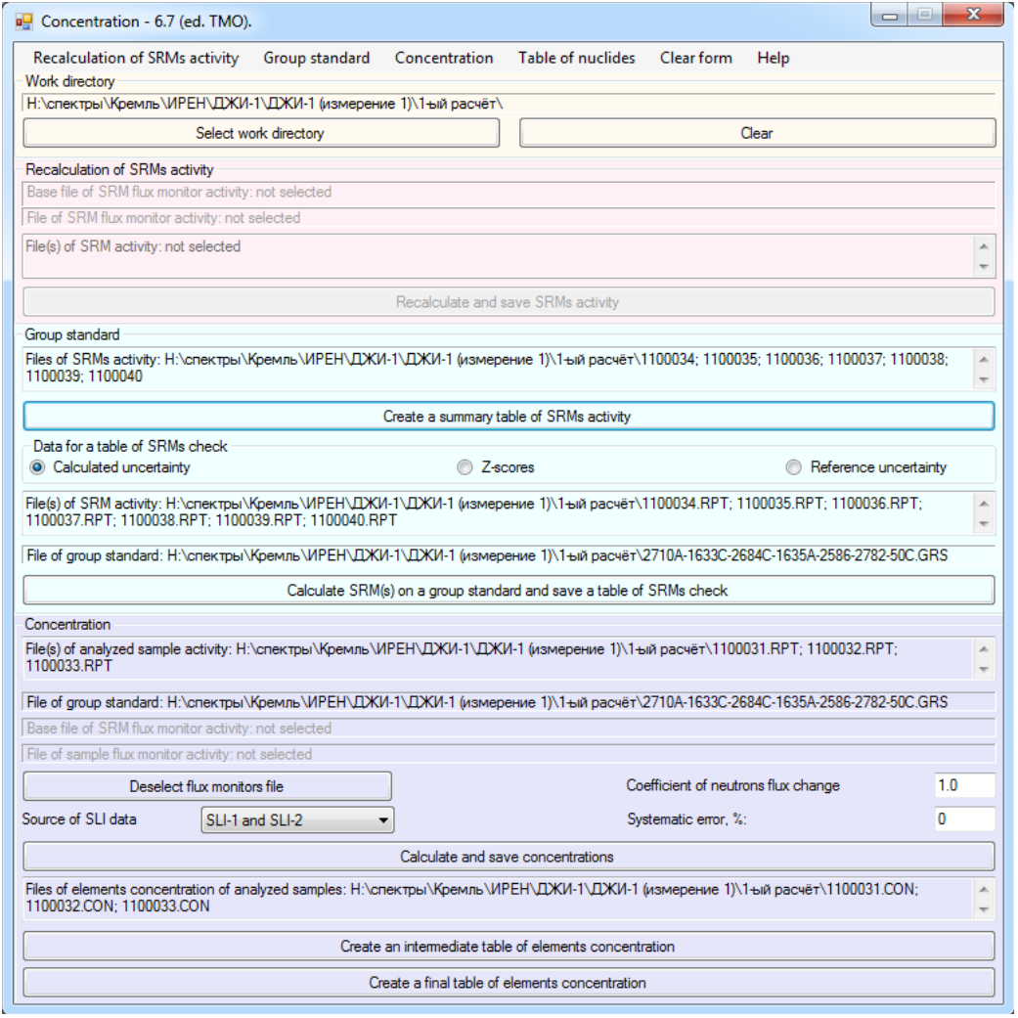
Data acquisition and analysis
Calculations of mass fraction of elements were made by two methods: the
relative (using the standards, the elemental composition of which is well-known and certified) and the absolute one (based on the equation of activation).
The Concentration software, created at FLNP JINR, was used to calculate the mass fraction of elements by relative method. Nuclear constants from were applied.
The main window of the program
to calculate mass fractions.

Slide 19
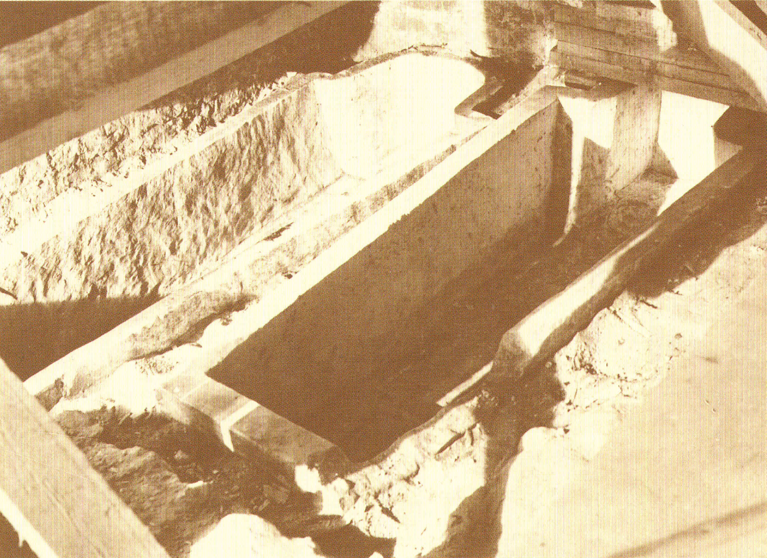
Quality control of analytical studies
Thus, we carried out two experiments. In these experiments we used two facilities for irradiation of samples – the IREN research facility and the IBR-2 reactor. Two sets of spectra of induced activity for each sample were measured after irradiation. The obtained data were used to calculate the mass fraction of elements by two methods – relative and absolute. These calculations were performed by three authors independently.
The enumerated actions have effectively ensured the quality of analytical studies – QC.
The graves of Tsarevich Ivan (left) and Tsar Theodore (right) after their remains were removed for study. Photo 1963.

Slide 20
Mass fraction calculation using the absolute method
Activation equation :
where: m_{x} – mass of the irradiated element; М – atomic mass; λ – the decay constant, s⁻¹;
N_{γ} – number of detector counts for given line; Φ_{res} – the resonance neutron flux at 1 eV, n/(cm² s);
N_{a} – Avogadro’s number, mole⁻¹; ε(E_{γ}) – the photo peak efficiency of the detector;
Φ_{th} – the thermal neutron flux, n/(cm² s); σ_{th} – the thermal neutron activation cross section, barn;
I_{res} , barn – the resonance integral; θ – isotopic abundance; γ – the gamma-ray abundance;
t_{irr} – the irradiation time, s; t_{d} – the decay time, s; t_{meas} – the duration of the measurement, s.
For calculations by absolute method we used the following values:
Isotope | Thermal neutron activation cross section σ_{th}, barn | Resonance integral I_{res}, barn | Content f, % | Half-life T_{1/2}, days
⁷⁶As | 4.48 ± 0.1 | 61 ± 4 | 100 | 1.00778 ± 0.0020
²⁰³Hg | 4.85 ± 0.05 | 4.2 ± 0.2 | 29.7 | 46.612 ± 0.018
Isotope | Gamma line energy E_{γ}, eV | Output, %
⁷⁶As | 559.1 | 45
⁷⁶As | 657.1 | 6.2 ± 0.3
²⁰³Hg | 279.1967 | 81

Slide 21
Results
The results of the calculations are summarized in Table 1. The results of determination of mass fraction of additional elements are presented in Table 3.
Table 1. Mass fraction of arsenic and mercury in the samples
Sample number | Arsenic (As) |  | Mercury (Hg)
 | Mass fraction, mg/kg | Relative uncertainty, % | Mass fraction, mg/kg | Relative uncertainty, %
1 | 0.19 | 30 | 0.36 | 19.1
2 | 0.23 | 30 | 0.2 | 29.5
3 | 1.18 | 18.3 | 46.6 | 2.5
Table 2. Mass fraction of arsenic and mercury in the scalp hair and rib bones of modern humans [19].
Sample type | Mass fraction, mg/kg
 | Arsenic (As) | Mercury (Hg)
Hair | <= 0.05 | 0.145 ± 0.009
Rib bones | < 0.1 | <= 0.008

Slide 22
Results
Table 3. Mass fraction of some additional elements in the samples
Sam. num. | Iron (Fe) |  | Zinc (Zn) |  | Silver (Ag)
 | Mass fract., mg/kg | Relat. uncer., % | Mass fract., mg/kg | Relat. uncer., % | Mass fract., mg/kg | Relat. uncer., %
1 | 1210 | 8 | 624 | 4 | 0.131 | 15
2 | 1373 | 7.3 | 460 | 4 | 4.8 | 10
3 | < 1170 | - | < 100 | - | 3460 | 14
Sam. num. | Antimony (Sb) |  | Gold (Au)
 | Mass fract., mg/kg | Relat. uncer., % | Mass fract., mg/kg | Relat. uncer., %
1 | 0.21 | 24 | 7.5∙10⁻⁵ | 19
2 | <0.1 | - | 1.3∙10⁻² | 30
3 | 2.72 | 16 | 6.4 | 11

Slide 23
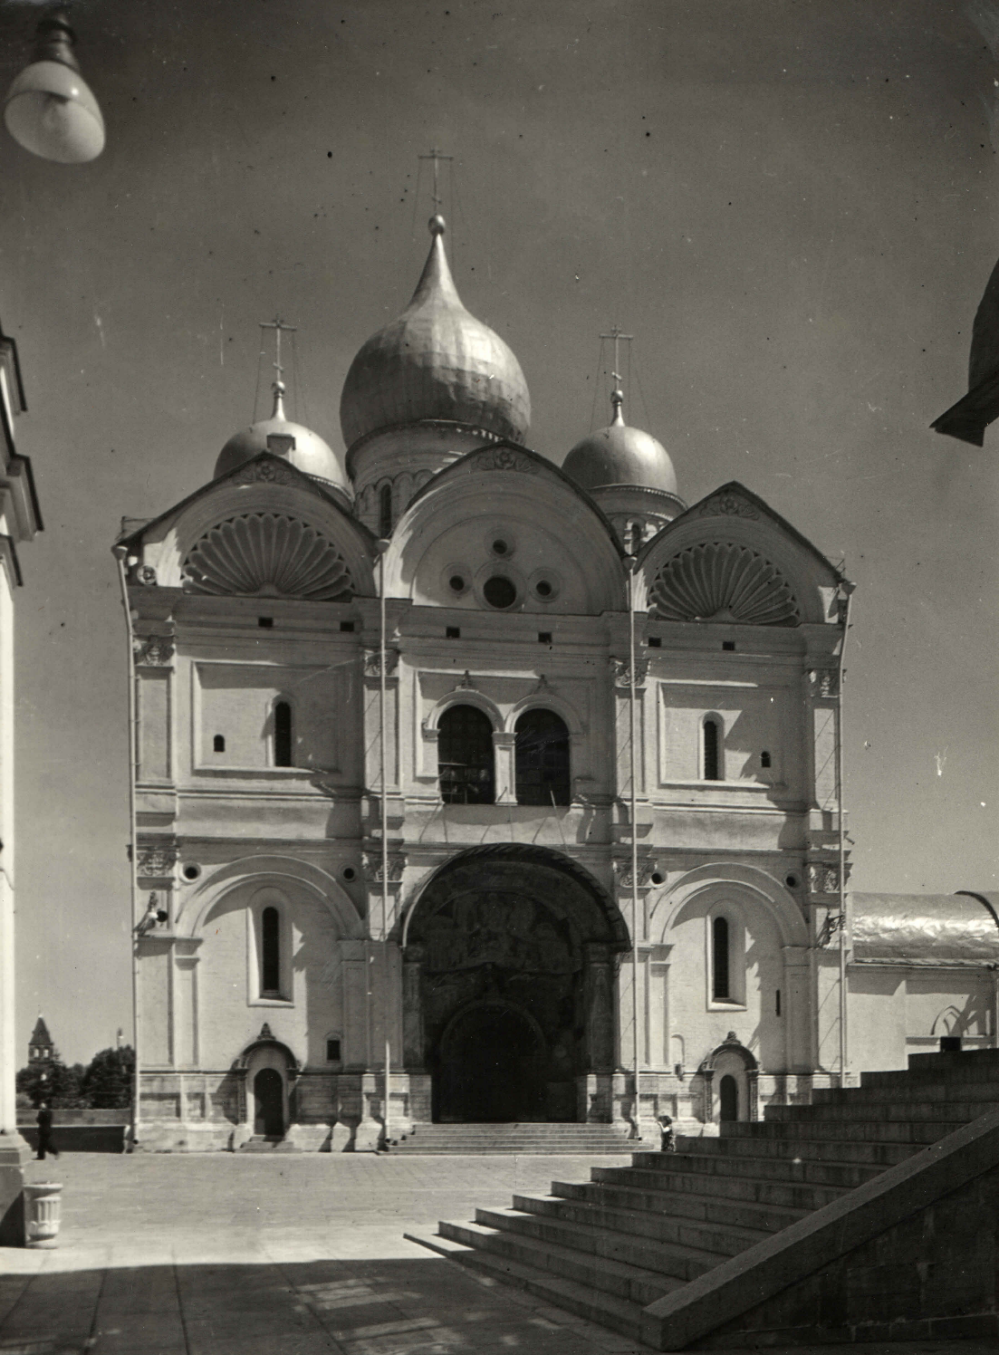
Analysis of the results
As a result of the qualitative analysis, the presence of mercury and arsenic was established in all fragments of remains from burial places of the Moscow Kremlin.
Quantitative analysis of the presence of mercury fully confirmed the acute poisoning of the first Russian Tsarina Anastasia, as the mercury content in her hair was extremely high. The young woman (she died at the age of about 27) could not accumulate such quantity of harmful substance using medieval cosmetics and medicines. The Tsarina became a victim of intrigues of the court nobility, who tried to remove representatives of the Zakharins-Koshkins family (ancestors of the Romanovs) from the royal encirclement.
Archangel Cathedral - the burial place (tomb) of the Russian tsars. Built in 1505-1508. Photo 1960s.

Slide 24
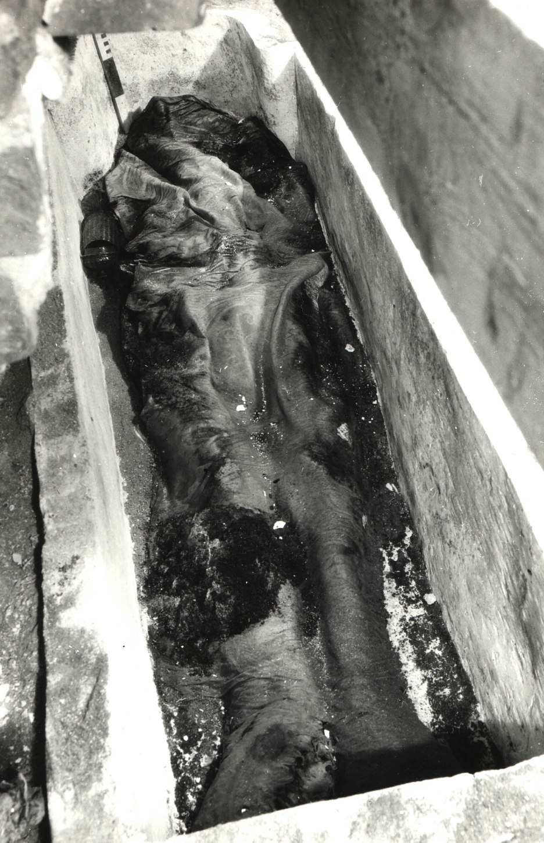
Analysis of the results
The increased content of mercury was detected in the bone remains of Tsarevich Ivan and Prince Mikhail, that correlates with the results of chemical analysis of materials from their burials in 1964 (mass fraction of arsenic and mercury in the hair and rib bones of modern people from [19] are given in Table 3). However, the reasons of the admission of mercury into the organisms of these young people were different, as well as the reasons of their death.
The remains of Tsarevich Ivan.
The opening in 1963.

Slide 25
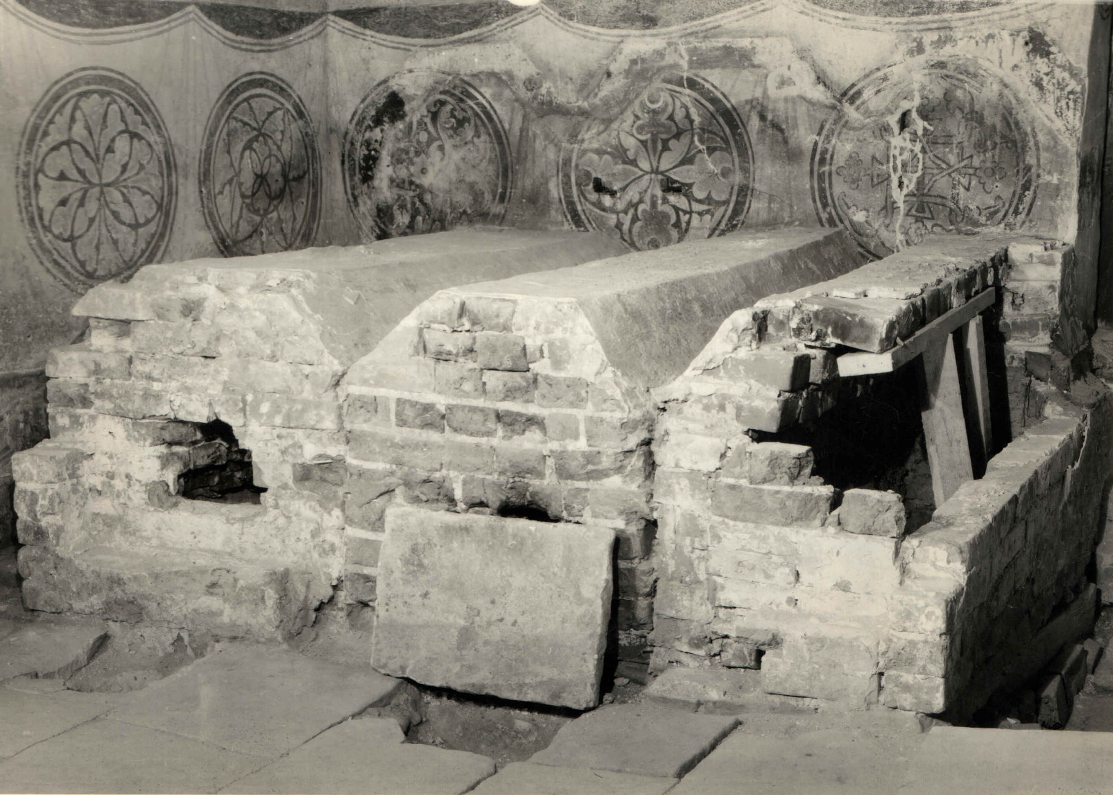
Analysis of the results
For many years Tsarevich Ivan was treated with mercury ointments from venereal disease (syphilis). Therefore, by the age of 27 (he died at this age from a craniocerebral trauma) he developed the chronic poisoning of the organism with this harmful element.
The tombstones over the graves of Ivan the Terrible
and his sons in the process of dismantling in 1963.

Slide 26
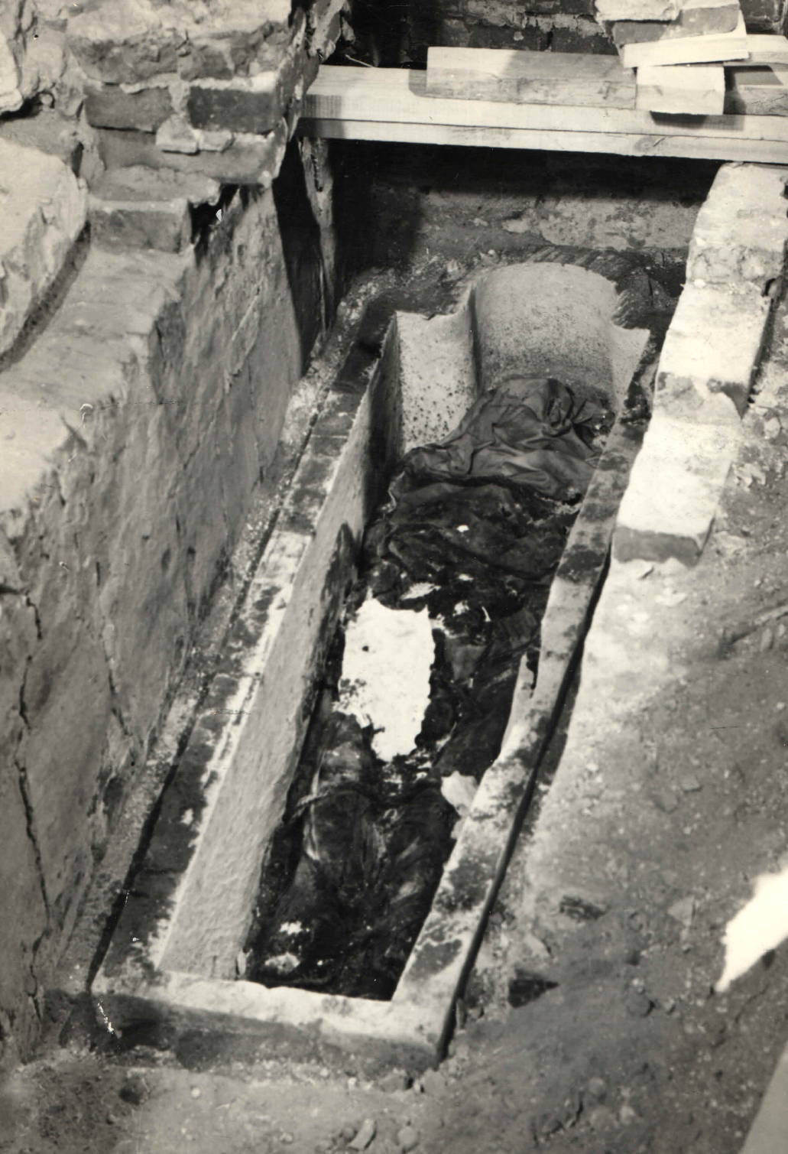
Analysis of the results
Prince Mikhail Skopin-Shuisky died suddenly at the age of about 23. The death of a young healthy man and well-trained warrior was explained as poisoning by his contemporaries. Signs of poisoning were showed up suddenly at the feast and indicate an acute poisoning in the gastrointestinal form (in this case, it was possible using the combined composition of the poison – mercury and arsenic).
The remains of M. V. Skopin-Shuysky in the grave. 1963.

Slide 27
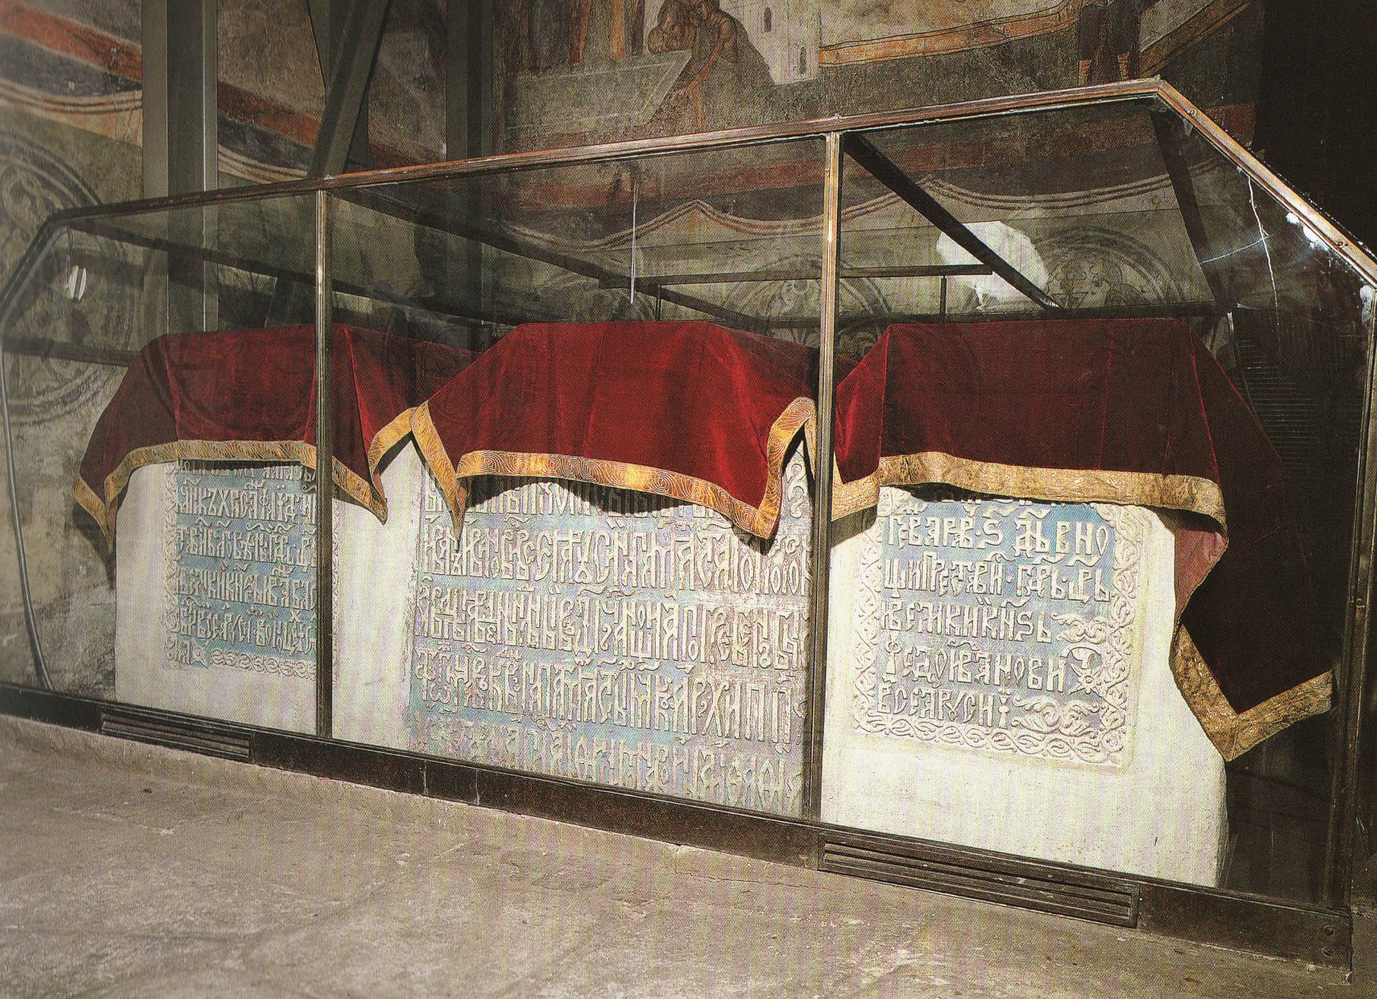
Analysis of the results
The obtained results of neutron activation analysis give the opportunity to introduce into scientific circulation more accurate values of the content of mercury and arsenic in samples from the burial places of Russian historical figures of the second half of the 16th - early 17th century.
Tombs of Tsar Ivan the Terrible (left) and his sons, Tsar Theodore (right) and Tsesarevich Ivan in the Archangel Cathedral.

Slide 28
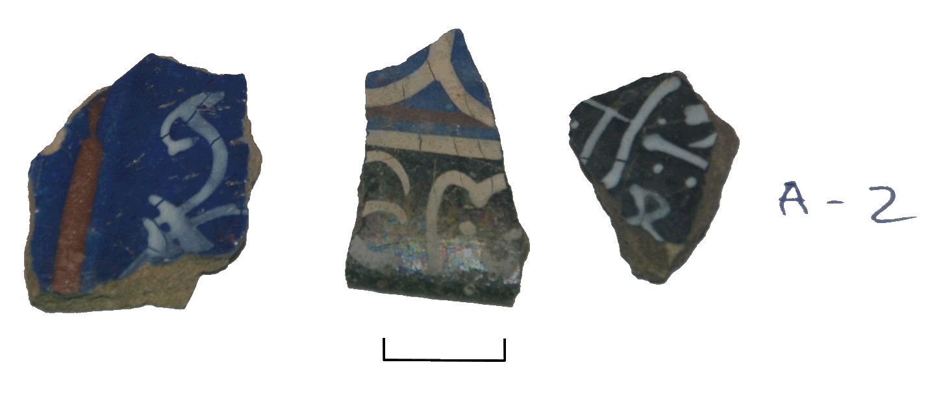
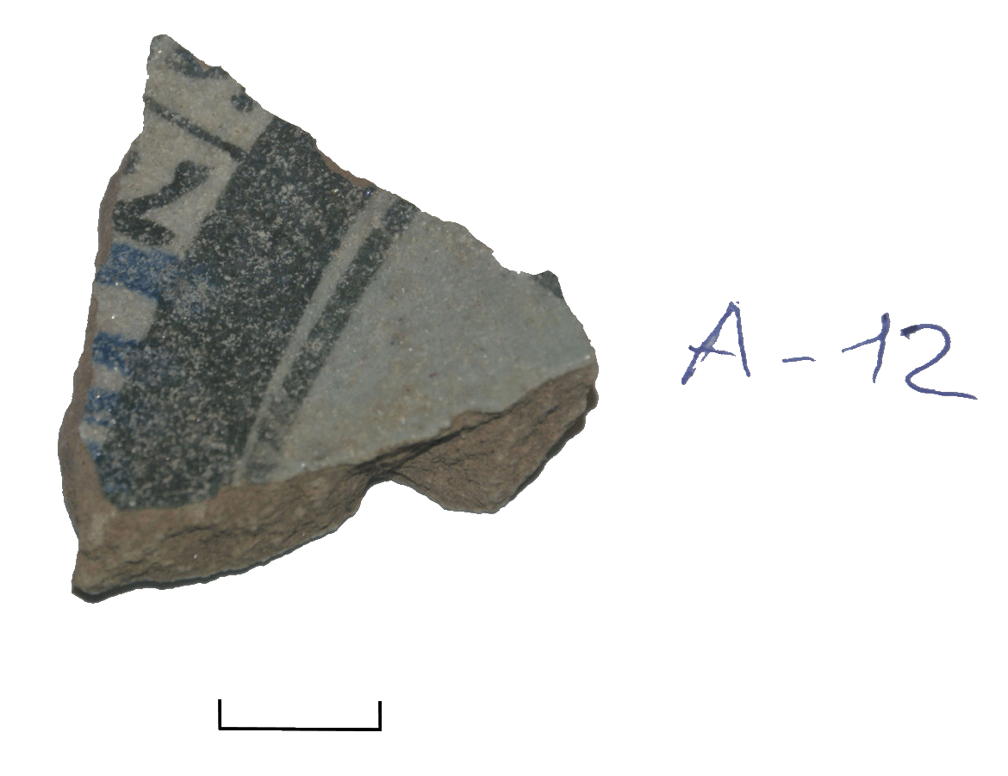
Plans for the future
We are going to continue our collaboration with the Moscow Kremlin museums.
Also we start to interact with the Institute of Archaeology Russian Academy of Sciences. We received about thirty medieval ceramic samples from the Institute of Archaeology to determine elemental composition. Archeological glass and alloys have been well studied, but the ceramic is a very large and understudied theme.

Slide 29
Acknowledgements
The authors acknowledge:
employees of the IREN research facility (chief engineer V.G. Pyataev);
and employees of the third channel of the IBR-2 reactor (team leader M.V. Bulavin) for cooperation;
as well as T.M. Ostrovnaya S.S. Pavlov for consultations in spectra analysis.

Slide 30
References
State Scientific Research Institute of Forensic Medicine of the Ministry of Health of the USSR. Moscow. March 12, 1964. In the Commission of the Ministry of Culture of the USSR on the opening of tombs in the Archangel Cathedral. Expert information on the materials of the study of remains from the sarcophagus of Ivan the Terrible, his sons - Ivan and Fedor, as well as Skopin-Shuisky (in Russian).
De Madariaga I. Ivan the Terrible. The First Tsar of Russia. M., 2007. P. 477-494 (in Russian).
Necropolis of Russian Grand Duchesses and Tsarinas in the Ascension Cathedral of the Moscow Kremlin. V. 2. Burials of the XV - the Beginning of the XVI Century / Ed. T.D. Panova. M., 2015 (in Russian).
Bode P., Greenberg R.R., De Nadai Fernandes E.A. Neutron Activation Analysis: A Primary (Ratio) Method to Determine Si-Traceable Values of Element Content in Complex Samples // CHIMIA. 2009. V. 63, No. 10. P. 678-680.
Anan'ev V.D., Frolov A.R., Furman W.I., Gurov S.M., Kobets V.V., Kuatbekov R.P., Logachev P.V., Meshkov I.N., Pavlov V.M., Pyataev V.G., Shirkov G.D., Shvets V. A. , Skarbo B.A., Soumbaev A.P., Tretiyakov I.T. Intense Resonance Neutron Source (IREN) - New Pulsed Source for Nuclear and Applied Investigations // Part. Nucl., Lett. 2005. V. 2, No. 3(126). P. 11-18; http://www1.jinr.ru/Pepan_letters/panl_3_2005/01_anan.pdf
Belikov O.V., Belozerov A.V., Becher Yu., Bulycheva Yu., Fateev A.A., Galt A.A., Kayukov A.S., Krylov A.R., Kobetz V.V., Logachev P.V., Medvedko A.S., Meshkov I.N., Minashkin V.F., Pavlov V.M., Petrov V.A., Pyataev V.G., Rogov A.D., Sedyshev P.V., Shabratov V.G., Shvec V.A., Shvetsov V.N., Skrypnik A.V., Sumbaev A.P., Ufimtsev A.V., Zamrij V.N. Physical Start-Up of the First Stage of IREN Facility // Proc. of ISINN-17. Dubna, 2010;
http://isinn.jinr.ru/proceedings/isinn-17/pdf/Shvetsov.pdf

Slide 31
References
Dragunov Yu.G., Tretyakov I.T., Lopatkin A.V., Romanova N.V., Lukasevich I.B., Ananiev V.D., Vinogradov A.V., Dolgikh A.V., Edunov L.V., Pepelyshev Yu.N., Rogov A.D., Shabalin E.P., Zaikin A.A., Golovnin I.S. Modernization of the IBR-2 Pulsed Research Reactor // At. Energ. 2012. V. 113, No. 1. P. 29-34 (in Russian).
Zorina D.Yu., Kozyreva M.S., Goryainova Z.I., Dmitriev A.Yu., Batsevich V.A., Frontasyeva M.V. Neutron Activation Analysis of Hair of Children of Ongudaysky District, the Altai Republic. JINR Preprint P18-2012-110. Dubna, 2012 (in Russian);
http://www1.jinr.ru/Preprints/2012/110(P18-2012-110).pdf
Standard Reference Materials. https://www.nist.gov/srm
Dmitriev A.Yu., Dmitriev F.A. Automation of Registration of Sample Weights for High-Volume Neutron Activation Analysis at the IBR-2 Reactor of FLNP, JINR // Proc. of ISINN-23. Dubna, 2016; http://www1.jinr.ru/Preprints/2015/056(D10-2015-56)_e.pdf
Shabalin E.P., Verkhoglyadov F.U., Bulavin M.V., Rogov F.D., Kulagin E.N., Kulikov S.A. Spectrum and the Neutron Flux Density in the Irradiation Channel of Beam No. 3 of the IBR-2 Reactor // Part. Nucl., Lett. 2015. V. 12, No. 2(193), P. 505-516.
Pavlov S.S., Dmitriev A.Yu., Chepurchenko I.A., Frontasyeva M.V. Automation System for Measurement of Gamma-Ray Spectra of Induced Activity for Multi-Element High Volume Neutron Activation Analysis at the Reactor IBR-2 of the Frank Laboratory of Neutron Physics at the Joint Institute for Nuclear Research // Part. Nucl., Lett. 2014. V. 11, No. 6(190). P. 1143-1149;
http://www1.jinr.ru/Pepan_letters/panl_2014_6/06_pavl.pdf

Slide 32
References
Pavlov S.S., Dmitriev A.Yu., Frontasyeva M.V. Automation System for Neutron Activation Analysis at the Reactor IBR-2, Frank Laboratory of Neutron Physics, Joint Institute for Nuclear Research, Dubna, Russia // J. Radioanal. Nucl. Chem. 2016. http://link.springer.com/article/10.1007/s10967-016-4864-8
Kuznetsov R.A. Activation Analysis. M.: Atomizdat, 1974 (in Russian).
Dmitriev A.Yu., Pavlov S.S. Automation of the Quantitative Determination of Elemental Content in Samples Using Neutron Activation Analysis on the IBR-2 Reactor at the Frank Laboratory for Neutron Physics, Joint Institute for Nuclear Research // Phys. Part. Nucl. Lett. 2013. V. 10, No. 1(178). P. 58-64 (in Russian); http://www1.jinr.ru/Pepan_letters/panl_2013_1/07_dmit.pdf
Belanova T.S., Ignatyuk A.V., Pashchenko A.B., Plyaskin V.I. Radioactive Capture of Neutrons: Reference Book. M.: Energoatomizdat, 1986.
http://nucleardata.nuclear.lu.se/toi/radSearch.asp
Voronova N.V., Panova T.D. The Tsarina Was Plagued by Slanders and Poisons... // Science in Russia. 1998. V. 3, P. 66-70 (in Russian).
Zaichick S., Zaichick V. The Scalp Hair as a Monitor for Trace Elements in Biomonitoring of Atmospheric Pollution // J. Environment and Health. 2011. V. 5, Nos. 1/2. P. 106-124.
Buzhilova A.P. Anthropology as a Historical Source // Proc. of the Department of Historical and Philological Sciences of the Russian Academy of Sciences. 2007. M, 2009. P. 73-80 (in Russian).

