Slide 3
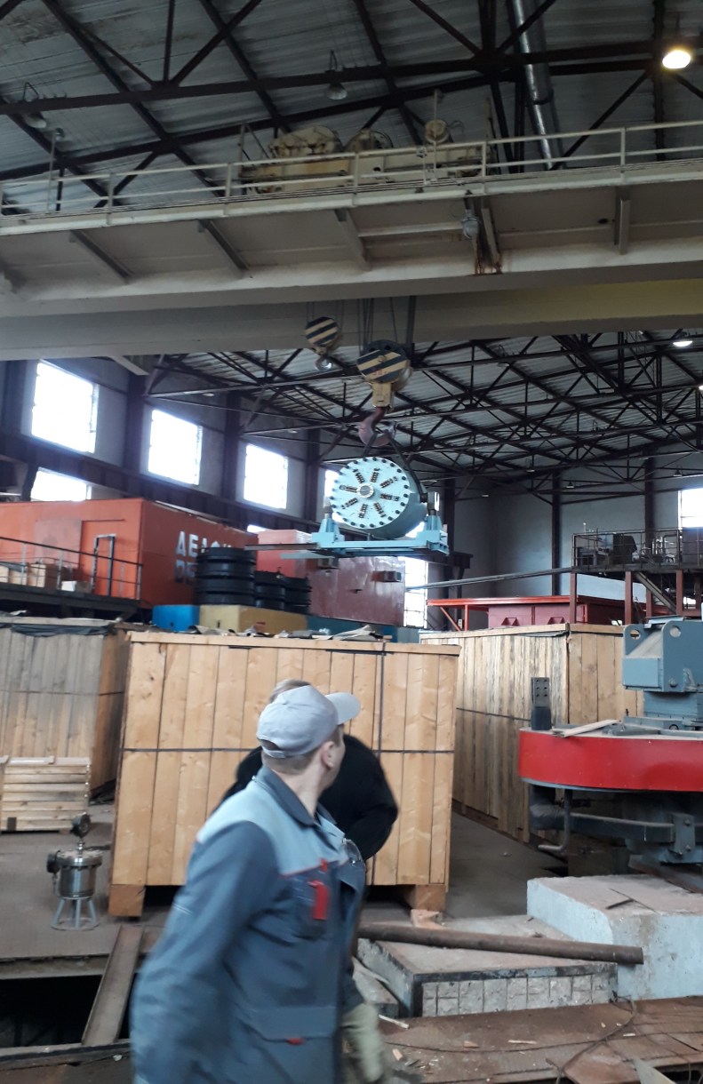
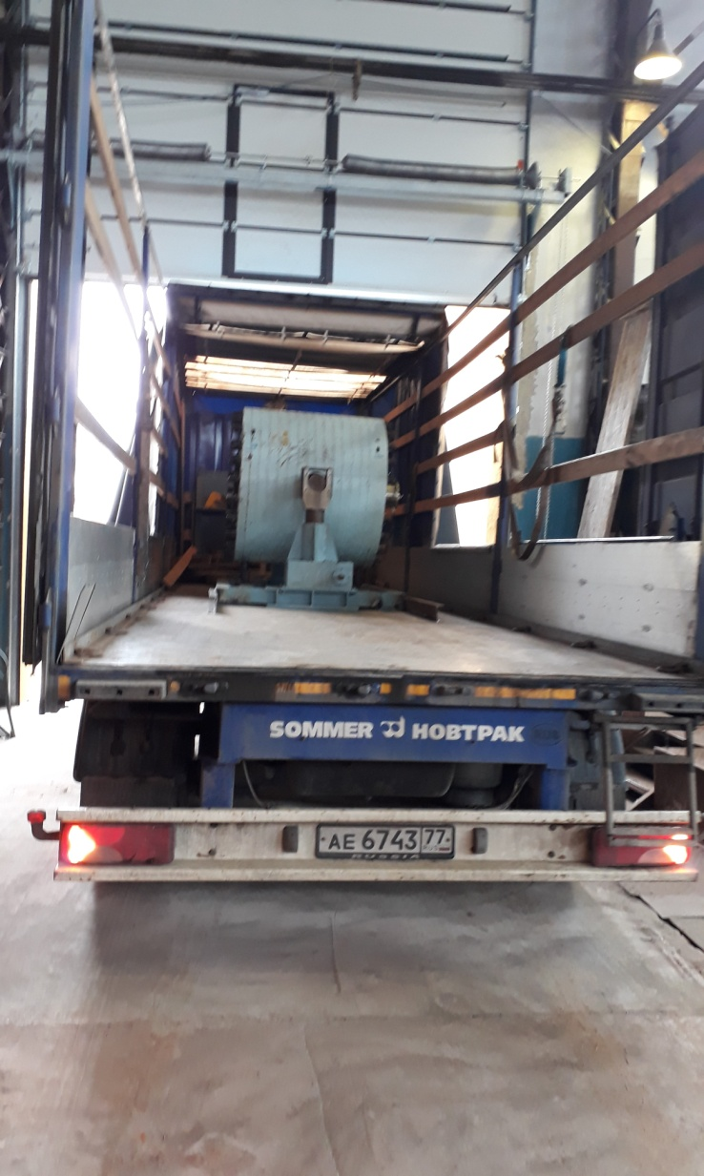
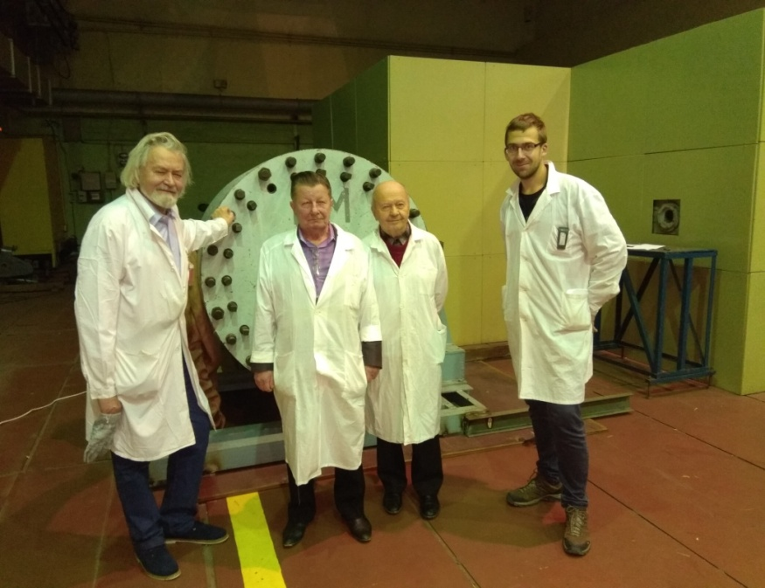
Realization of BURT transportation from VBLHEP to DLNP September 2017, JINR, Dubna
Project Report «E&T»
Our project started in 2017 at the Laboratory of High Energy Physics, topic 1107.
We participated in the First Research Coordination Meeting on Accelerator Driven Systems (ADS) Applications and Use of Low Enriched Uranium in ADS
24 to 29 September 2017 and reported the current results.
Background measurements, DNLP Phasotron, January 2018

