Slide 1
High-pressure neutron diffractometer DN-6 for investigation of microsamples under extreme conditions : recent results
E.V. Lukin, D.P. Kozlenko, S.E. Kichanov, B.N. Savenko, A.V. Rutkauskas
Joint Institute for Nuclear Research
Frank Laboratory of Neutron Physics
Notes:
Good day, everyone. Thank you for introduction! In my talk I will present the last activities on upgrading of High-pressure neutron diffractometer DN-6 for investigation of microsamples under extreme conditions. Also I would like present you some results of our experiments with various anvils cells especially with diamond anvils cells.

Slide 2
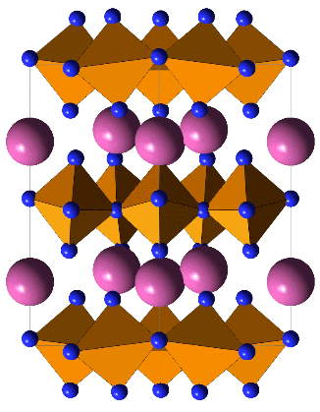
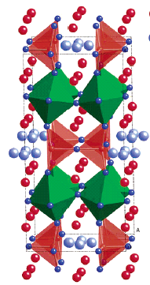
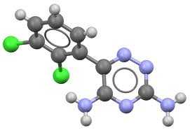
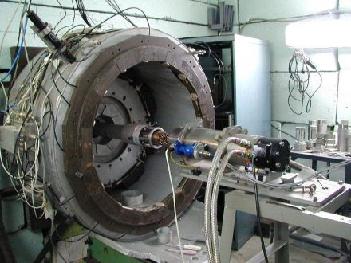
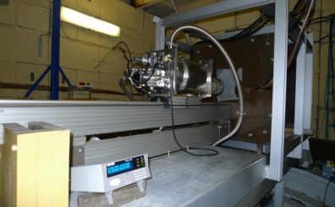
Neutron Diffraction at High Pressures: Modern State-of-Art Technique, actively developed at leading world neutron centers
LLB (France): G6.1
ILL (France): D20
IR-8 (Russia): DISK
ISIS (UK) – Pearl
PSI (Switzerland): HRPT
SNS (USA):SNAP
J-Parc (Japan): PLANET
IBR-2 (Russia):
DN-12 and new DN-6 diffractometers
Notes:
First of all I have to notice that the Neutron diffraction at high pressure is a modern state-of–art technique, actively developed at leading world centers. Like as LLB, ILL,IR-8, ISIS, PSI, SNS and J-Parc. In Dubna on our reactor IBR-2 there are two high-pressure diffractometers: old one DN-12 located on 12th beamline of reactor and new one DN-6 established on 6th high flux beamline in 2012 year. The difference between these two facilities was already notice in report of my colleague Sergey Kichanov in 2013. Just remind that the overall gain factor at that time was 12 in favor of dn6.

Slide 3
Capabilities of the DN-6 diffractometer in comparison with analogous diffractometers available in other European neutron centers
 | DN-6 diffractometer at IBR-2 | G6.1 diffractometer at LLB (France) | Pearl diffractometer at ISIS RAL (UK)
d-spacing range | 0.6-11 Å | 3-60 Å | 0.5-3.2 Å
Capabilities | Crystal and magnetic structure simultaneously | Magnetic structure only | Crystal structure only
Pressure range | 12 GPa (sapphire anvils) 35 Gpa (diamond anvils) | 7 GPa (sapphire anvils) 20 GPa (diamond anvils) | 10 GPa (WC anvils)
Exposition time | 4-12 h (sapphire) 24-48 h (diamond) | 4-12 h | 4-10 h
Notes:
Now I can say with confidence that the capabilities of DN-6 diffractometer in comparison whit analogous diffractometers available in other European neutron centers are quite the same and in some times exceed the last ones. For instance, neutron diffraction patterns of sample under pressure about 35 Gpa in diamond anvils cells were already obtained in 2015. However, exposition time is still up to 2 days for one pressure point in diamond cells compared with synchrotron sources. That’s why all our activities in a field of modernization are concentrated on increase of beam flux and efficiency of detector system: broadening the solid angle of detector rings.

Slide 4
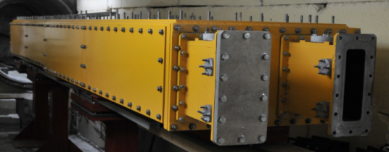
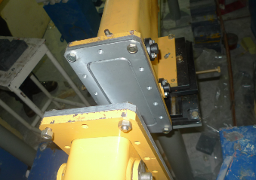
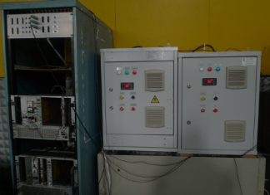
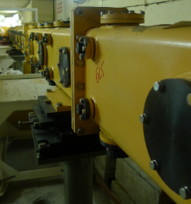
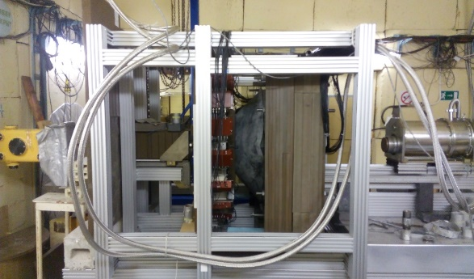
DN-6 diffractometer: general information
Head part of neutron guide
Close circle refrigerator
Detector
system
Background
chopper
Tail part of
neutron guide
Notes:
Before my talk about last year activities I would like to describe the general components of dn6 diffractometer. The neutron guide of the diffractometer consists of three parts: a splitter separates the neutron beam into two beamlines 6a and 6b. The Background chopper synchronized with pulses of the reactor is located before the splitter to cut unnecessary tails of TOF spectra. The curved mirror neutron guide reducing the flux of fast neutrons. Until middle of 2017 there were a straight section smoothing neutron beam profile after curved one and a collimator placed after the neutron guide, releasing a beam of 5 mm in diameter from the total beam formed by neutron guide. The sample is surrounded by the neutron wide solid angle detector system.

Slide 5
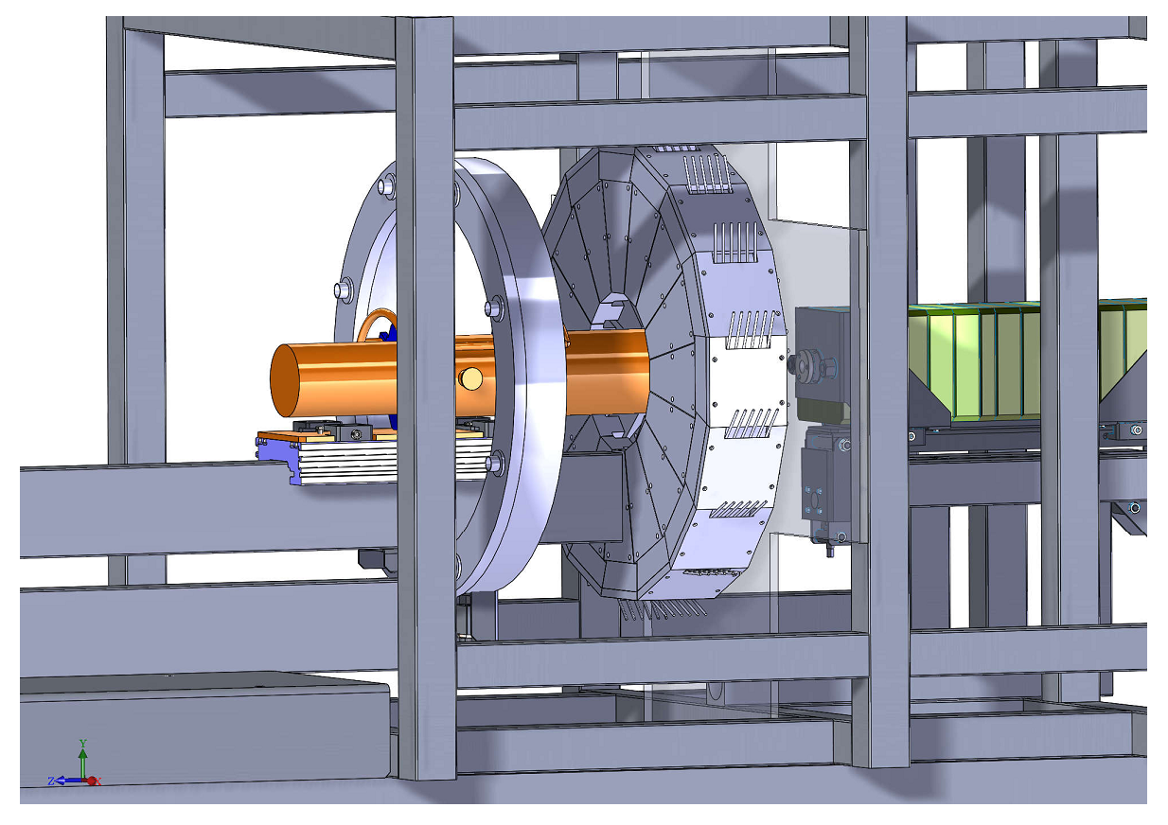
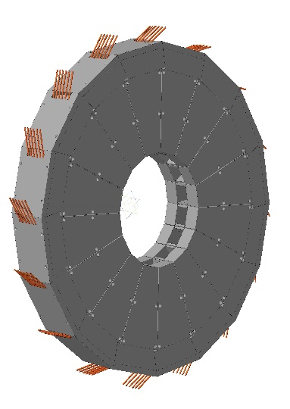
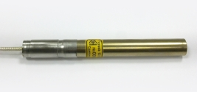
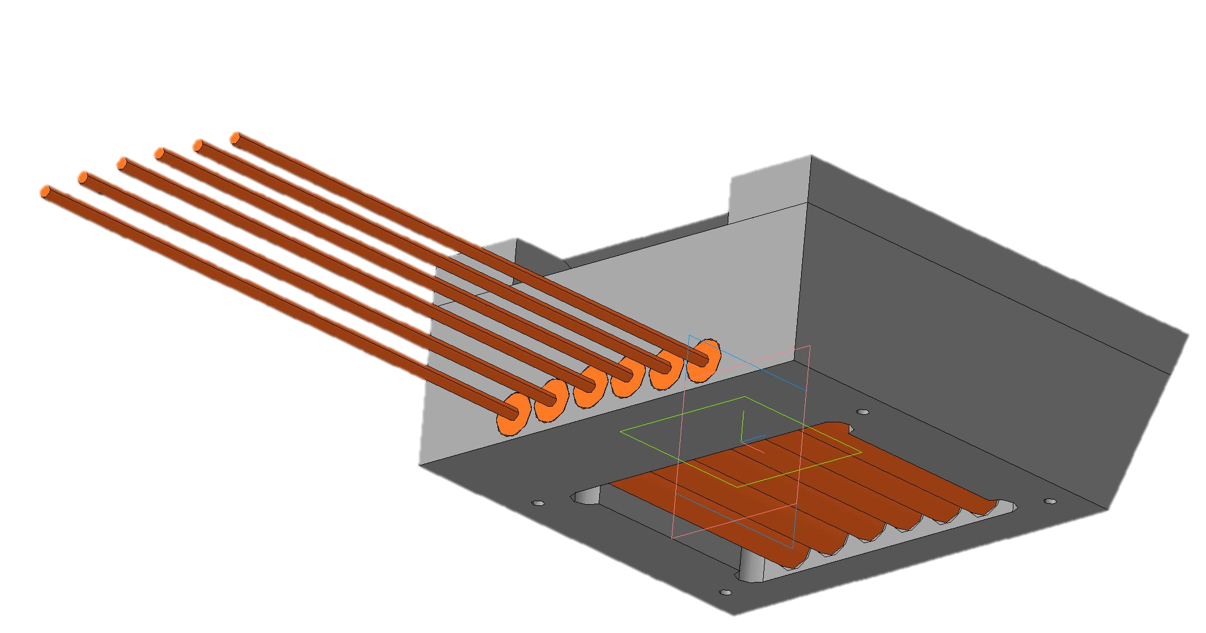
DN-6 diffractometer: 90 deg. detector ring (design 2015)
96 independent neutron counters group in
6 subrings within
16 counters in each subring
87-93 2θ deg. covering
He filled neutron counter (8 bar)
Notes:
Detector system of diffractometer consists of two rings. The first ring occupies scattering angles from 87 to 93 degrees. It consists of 16 independent modules arranged in a circle. Each module includes six independent neutron counters with He3 gas pressure of 8 atmospheres. The ring is made of borated polyethylene covering from the inner side by plates of cadmium. It was developed in 2015.

Slide 6
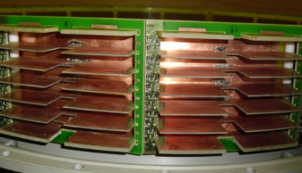
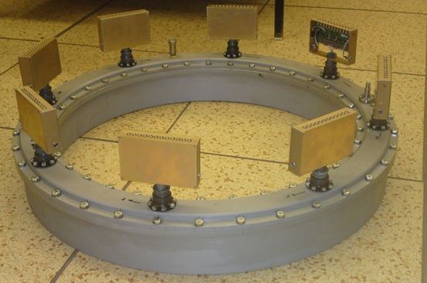
DN-6 diffractometer: 45 deg. detector ring
96 detector elements in same gas volume group in
6 subrings within
16 elements in each subring
He filled (4 bar)
Notes:
The second detector is divided into 16 sectors in the same gas volume. It covers scattering angles from 37 to 42 degrees. Each sector consists of a frame with six anode wires separated by textolite plates that act as cathodes. The total number of independent detection elements as in the case of the first ring is 96. The working pressure of He3 in this ring is 4 atmospheres.

Slide 7
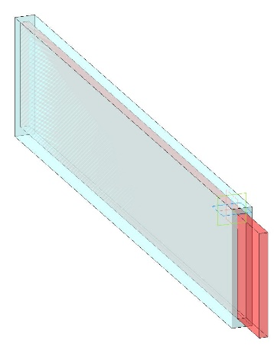
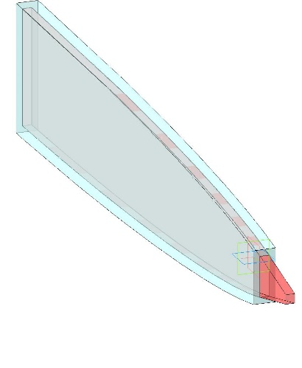
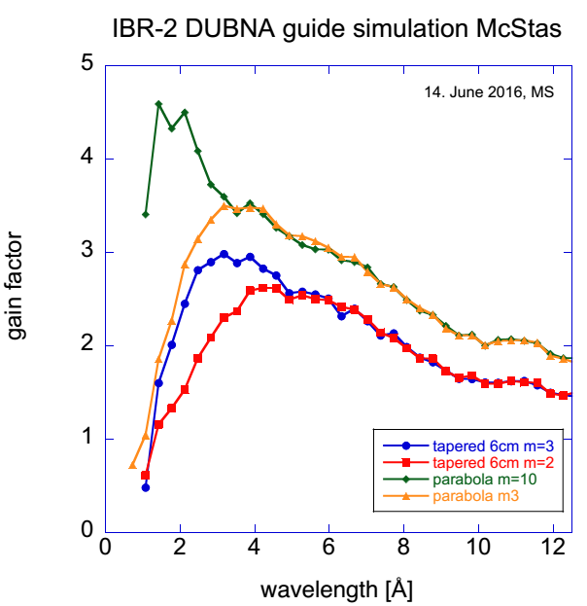
DN-6 diffractometer: neutron guide upgrade suggestions (2016)
Parabolic tapering
neutron guide
Entrance: 15mmx180mm
Exit: 15mmx60mm
Focus: 15mmx10mm
Liner neutron guide
Entrance: 15 mmx180 mm
Exit: 15 mmx180 mm
Length: 7 meters
Coating (all sides): ⁵⁸Ni (m=1)
Calculated gain factors after various
focusing neutron guides for DN-6 diffractometer
Notes:
By the middle of 2016, it became clear that too much time was spent on experiments with diamond anvils cells. Possible errors in the alignment and collimation of the cell with respect to the neutron beam were detected on neutron spectra only after 6-8 hours of the experiment. On the other hand, the use of only 5 percent of the neutron beam due to the collimator, located after the direct section of the neutron guide, led to the decision to replace the direct part of the neutron guide with the neutron focusing device. The first principles with vertical convergence of focusing device are shown here. The calculated gain factors for various shapes and coatings allowed to chose the most optimal variant of focusing device.

Slide 8
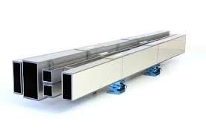
DN-6 diffractometer: new focusing guide design
(2016-2017)
Design: vertical parabolic tapered neutron guide
Guide profile:
-Profile (hor./vert.): parallel/parabolic tapered (linar appr.)
Cross section:
-Entrance: 180.00 mm(h)x 15.00 mm(w)
-Exit: ~60 mm (h)x 15.00 mm(w)
Reflectivity:
-Top/bottom R_{ave}=92%
-Sides R_{total}~99,5%
First three units:
Coating: Ti/Ni
-Top/bottom m=3
-Sides m=1
Last unit:
Coating: Ti/Ni
-Top/bottom m=5
-Sides m=1
Notes:
So. The development of a new focusing device was entrusted to the Swiss neutronics company. Our laboratory already had a successful experience of cooperation with this company. in 2016, the company developed a neutron guide for a Fourier diffractometer. For our purposes they offer vertical parabolic tapered neutron guide with the parallel profile in horizontal plane an parabolic tapered in vertical. This guide consist of 4 mirror section, 3 of which have coating of top and bottom mirrors m3 and the last one m5. The total average reflectivity of top and bottom mirrors despite the high degree of curvature is 92%. The reflectivity of sides mirrors is 99%

Slide 9
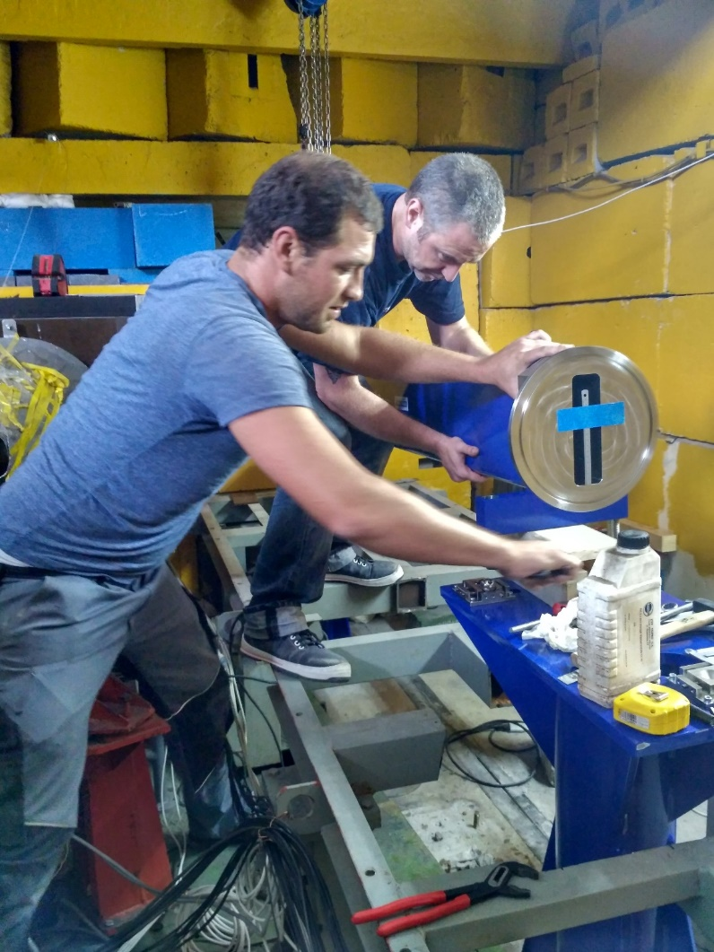
DN-6 diffractometer: new focusing guide installation
( July 2017)
Sometimes it was easy
Sometimes not
Notes:
I have to say big thanks to these guys, Alexander Hunt and Nico Shapper, for their hardly work on installation of neutron guade.

Slide 10
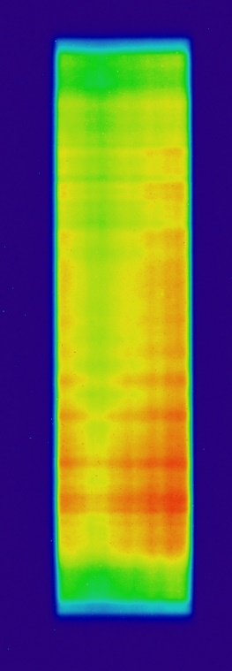
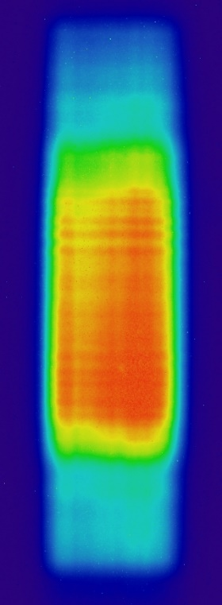
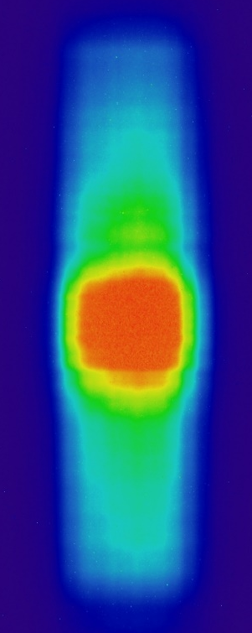
DN-6 diffractometer: new focusing neutron guide
0 cm
45 cm
87 cm
Notes:
The length of the new focusing device is 7 meters. The intensity distributions on the various distances to the flange of the focusing device were obtained during the first September cycle of IBR-2 with the help of a neutron tomograph . The most optimal focusing distance was found and the diffractometer was aligned with respect to this point. On the right there are the neutron patterns of vanadium before and after modernization, as well as their ratio-gain factor. Average gain is 6-7. The diffractometer slightly lost its resolution because of the angular divergence, but still remains quite comparable with the resolution of diffractometer dn-12.

Slide 11
DN-6 parameters
Parameters | DN-6 | DN-12
Neutron flux at sample position Before upgrade After upgrade | ~0.5×10⁷ n/cm²/s ~2.7×10⁷ n/cm²/s | ~1.5×10⁶ n/cm²/s
Distance: Moderator-sample Sample-detector | 30.0 m 0.5 m | 26.0 m 0.4 m
Resolution Δd/d (d=2 Å) Before upgrade After upgrade | 2θ=90°: 0.011 0.013 | 2θ=90°: 0.012
Exposition time per pressure point | 2-48 h | 12-36 h
Sample volume | 0.01-2 mm³ | 2 mm³
Pressure range | 40 GPa (DAC) 10 GPa (WC) 8 GPa (sapphire anvils) | 10 GPa (WC anvils) 8 GPa (sapphire anvils)
The total DN-6 gain factor from neutron flux improving become ~ 60
Notes:
Due to the high neutron flux on the sample after modernization and wide solid angle of the detector system the gain factor of DN-6 compared with the DN-12 is about 60. It is enabled to reduce both the time of the experiment with the high-pressure cells and to expend the pressure region up to 40 GPa, because the opportunity to use not only sapphire anvils but also WC and diamond anvils is become.

Slide 12
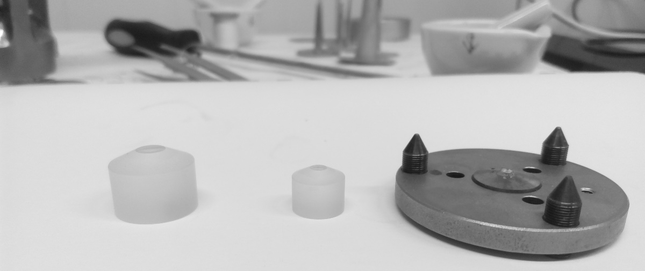
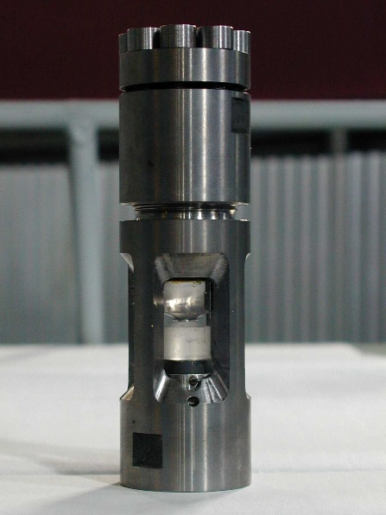
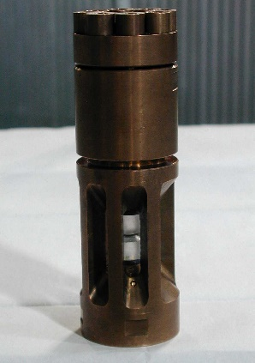
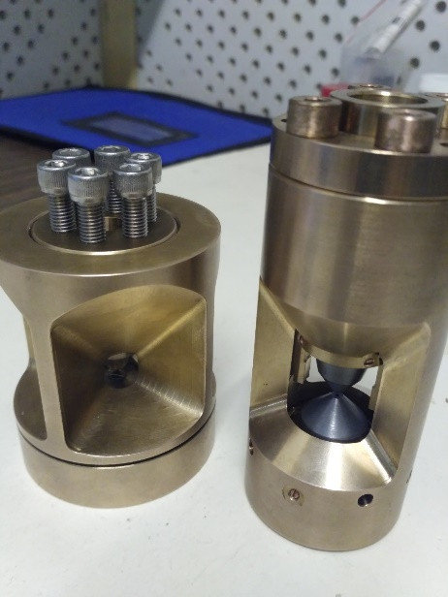
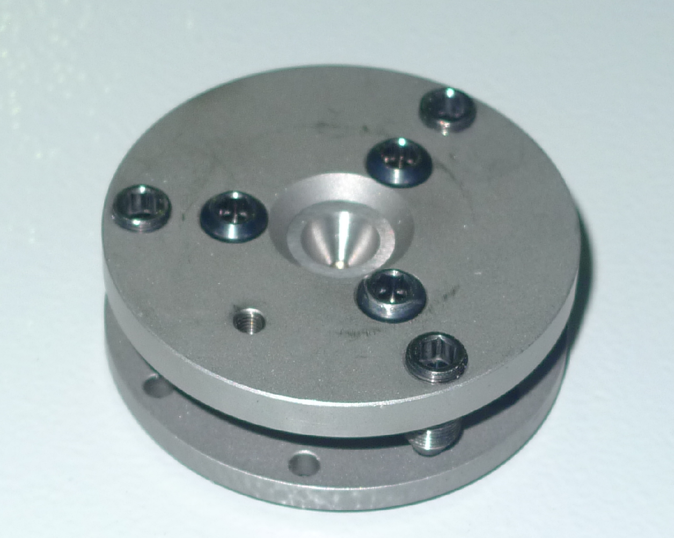
DN-6 diffractometer: high pressure anvils and cells
Types of anvils used in high pressure experiments
Culet size - 4 mm
Culet size – 0,4 ÷ 1,2 mm
Culet size - 2 mm
Types of cells used in high pressure experiments
Sapphire anvils cells
Diamond anvils cells
Almax Plate DAC
Notes:
Now it is used three types of anvils in high pressure experiments on the beamline: sapphire with a standard culet size 4 mm for pressure up to 7 GPa sapphire with reduced culet size 2 mm for pressure up to 13 GPa and a diamond with culet size from 0.4 to 1.2 mm. Cells for the first two types of anvils for both at room and low temperature experiments are widely used in both high pressure diffractometers. The diamond anvils cells adapted for the DN-6 diffractometer was designed and manufactured by the end of 2017 and ready now for high-pressure experiment preparation.

Slide 13
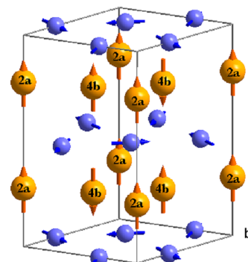
DN-6 diffractometer:
Experiments with standard sapphire anvils
Conventional high-pressure diffraction experiments with compounds
with high absorption cross section elements
Sample | Pressure
YCo₄B (abs xs(¹⁰B))=3835 barn | 6.8 GPa
DyMnO₃ (abs xs(Dy))=2840 barn | 7 GPa
multiferroic DyMnO₃ with complex magnetic structure
Notes:
The high-pressure diffraction experiments with high absorption compounds in standard sapphire anvils due to high brilliance of diffractometer are reasonable on dn6. Such experiments in pressure region up to 7 Gpa successfully carried out on DN-6.

Slide 14
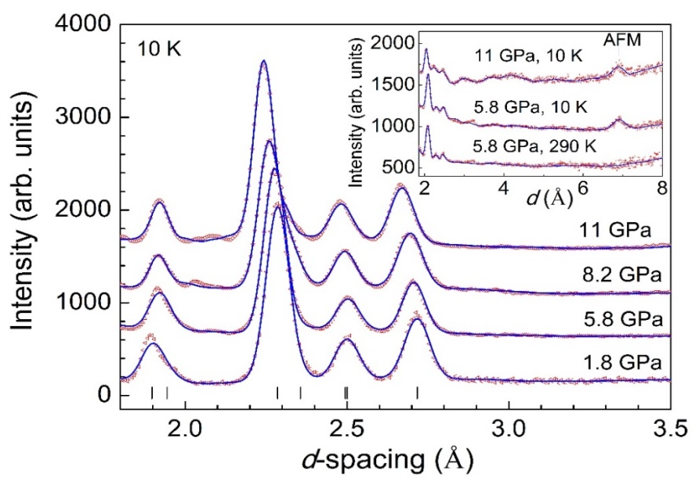
DN-6 diffractometer:
experiments with small sapphire anvils
Culet size is 4 mm
Culet size is 2 mm
H = 1 mm
D= 2 mm
V~3 mm³
P_{max}~8 GPa
H = 0.4 mm
D= 0.8 mm
V~0.2 mm³
P_{max}~13 GPa
Copper(II) oxide CuO
Pressure up to 11 Gpa
Temperature down to 4 K
Exposition of one P-T point – 4 h
Crystal and magnetic structure data
suitable for Rietveld treatment
Phys. Rev. B 95
Notes:
The success of the experiments with the standard sapphire anvils prompted us to increase the region of ​​the pressure from 8 to 13 GPa by use of sapphire anvils with a reduced culet size. The volume of the sample reduces that did not stop to get the quality neutron patterns. In the figures the neutron patterns of copper oxide obtained at pressures up to 11 GPa from the first and second detection rings are shown. It should be noted that these patterns are clearly distinguishable and suitable for analysis by the Rietveld method.

Slide 15
DN-6 diffractometer:
experiments with small sapphire anvils
Culet size is 4 mm
Culet size is 2 mm
H = 1 mm
D= 2 mm
V~3 mm³
P_{max}~8 GPa
H = 0.4 mm
D= 0.8 mm
V~0.2 mm³
P_{max}~13 GPa
Magnetite Fe₃O₄
Pressure up to 12.8 Gpa
Temperature down to 4 K
Exposition of one P-T point – 4 h
Crystal and magnetic structure data
Notes:
There is another example of diffraction data from magnetite. For comparison, on this patterns are shown the powder diffraction data under ambient pressure, from the sample in standard sapphire anvils and in reduced sapphire anvils. The appearance of the statistical background in the patterns is still not preventing analysis of the structure of the investigation compound.

Slide 16
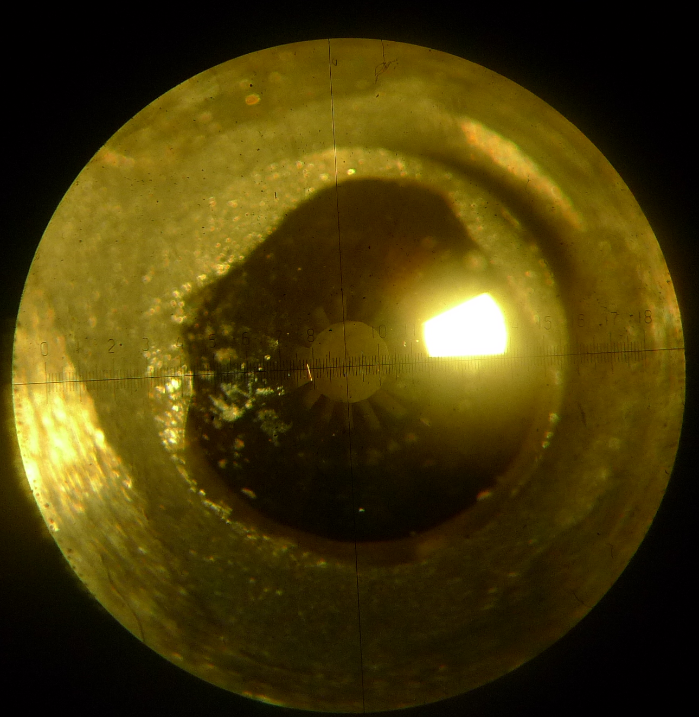
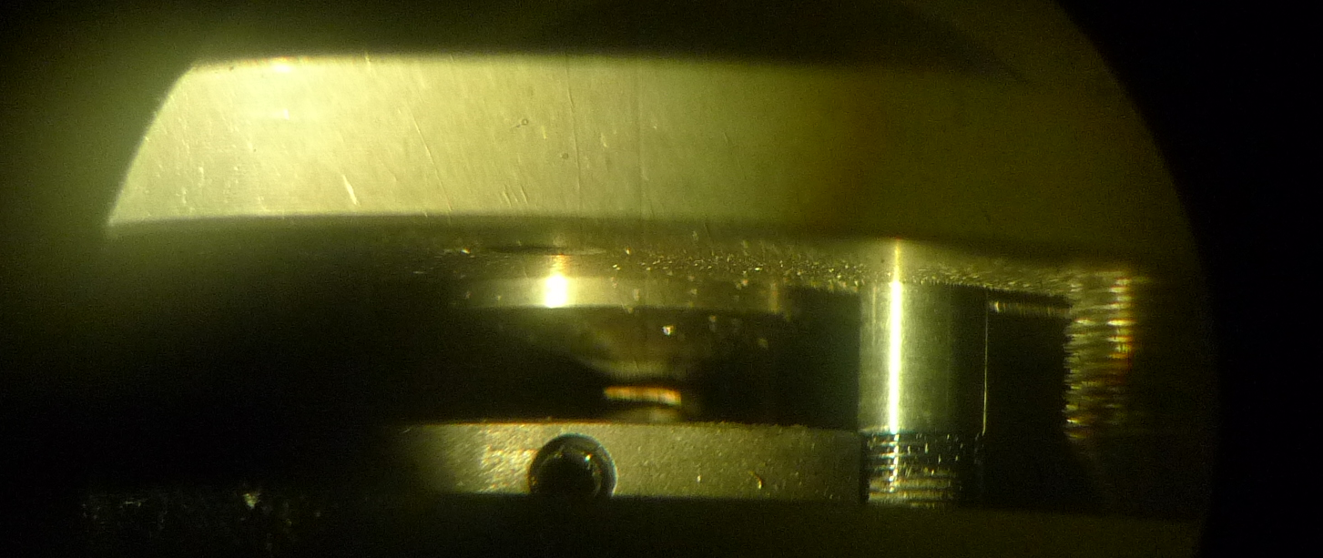
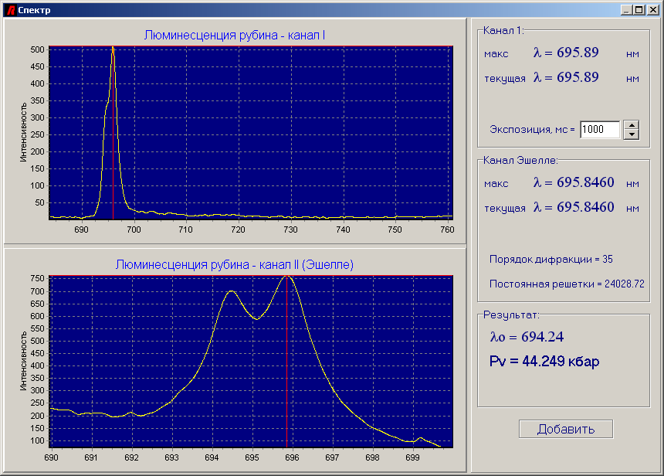
DN-6 diffractometer:
experiments with diamond anvils cell
Ruby ball
H = 0.1 mm
D= 0.4 mm
V~0.02 mm³
P_{max}~40 GPa
0.4 mm
0.8 mm
Boehler-Almax Plate DAC
Culet size from 0.4 to 1.2 mm
Notes:
One of the most important tasks is the implementation of the high pressure diamond anvils cell on the DN-6 diffractometer. The Boehler (Б’ёле)-Almax Plates are currently used for this purpose, since they have an aperture 2thetta from 0 to 40 degrees and vertical 90 degrees opening. The diameter of the diamond anvils culet size varies from 0.4 to 1.2 mm. Basically diamonds are used with culet size 0.6 and 0.8 mm. For the last one the volume of the sample in a diamond anvil cell is 0.02 cubic millimeters.

Slide 17
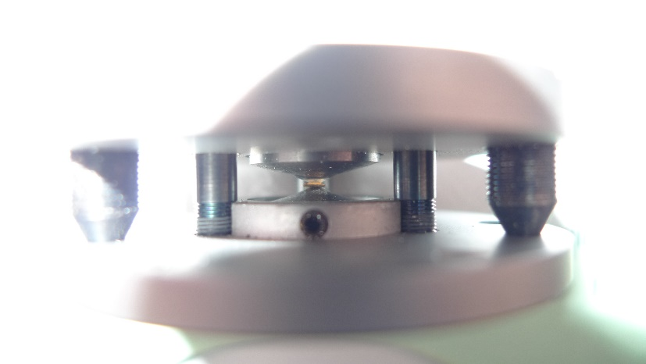
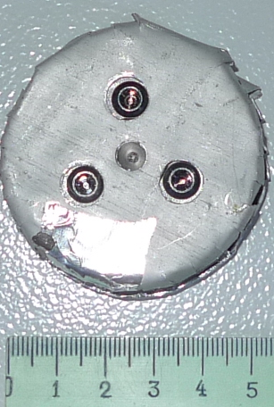
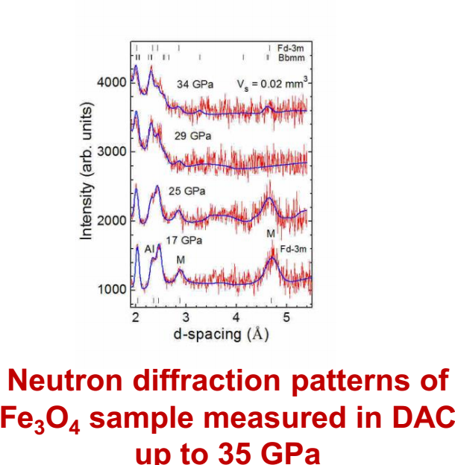
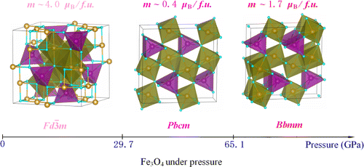
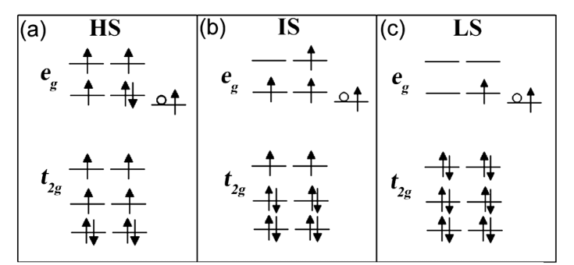
DN-6 diffractometer:
experiments with diamond anvils cell
Culet size – 0.8 mm
Volume – 0.02 mm³
Pressure - 35 GPa
Exposition time – 48 h
J. Am. Chem. Soc., 2012, 134 (33), pp 13780–13786
PRL 100, 045508 (2008)
Notes:
Despite the fact that the sample volume decreased more than 2 orders of magnitude compared with conventional high pressure experiments on DN12 diffractometer, we were able to identify the neutron diffraction patterns fit it by the Rietveld method. The time spent on the one point of pressure is about 48 hours and higher. To get good neutron diffraction data on low background, it was necessary to conduct a well sample preparation for the experiment.

Slide 18
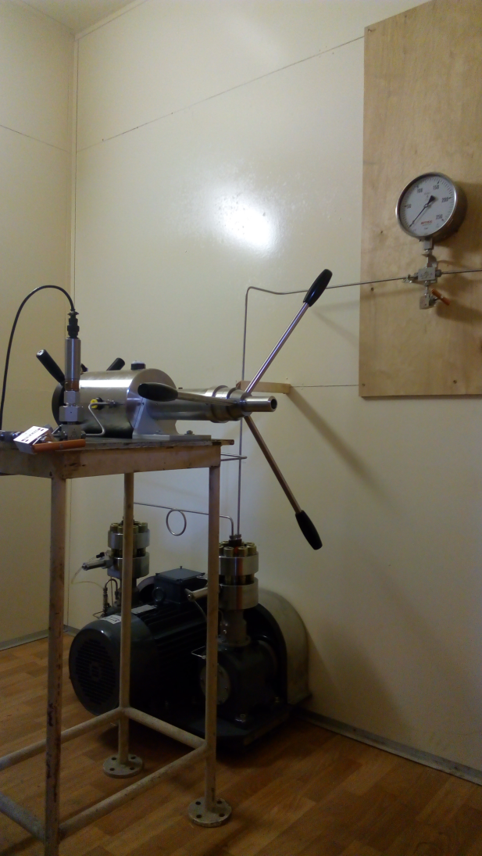
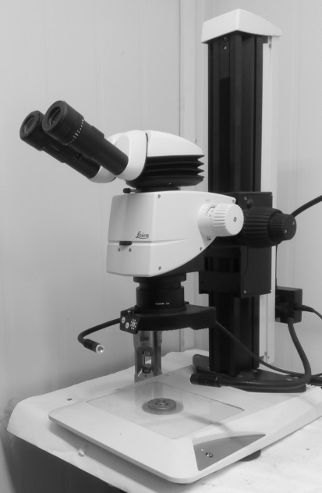
DN-6 diffractometer: sample preparation
Sample preparation room
Hole drilling machine
Microscope
Gas loading system
Notes:
For this purpose, we have all the necessary equipment: Hole drilling machine-for drilling holes by spark in the Gasket for sample. Microscope for adjusting the anvil, the sample, and cadmium slit collimator, gas loading system-for creating a gas medium transmitting the pressure within the volume of the sample in order to obtain the hydrostatic pressure.

Slide 19
Thank you for attention

