Slide 1
IAEA support to studies related to atmospheric pollution:
Past and present projects
Román Padilla Alvarez & Danas Ridikas
Physics Section
Department of Nuclear Sciences and Applications

Slide 2
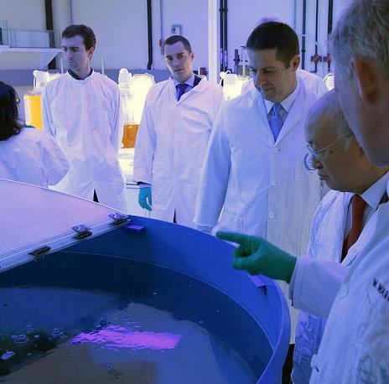
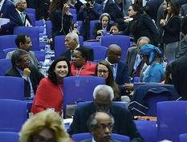

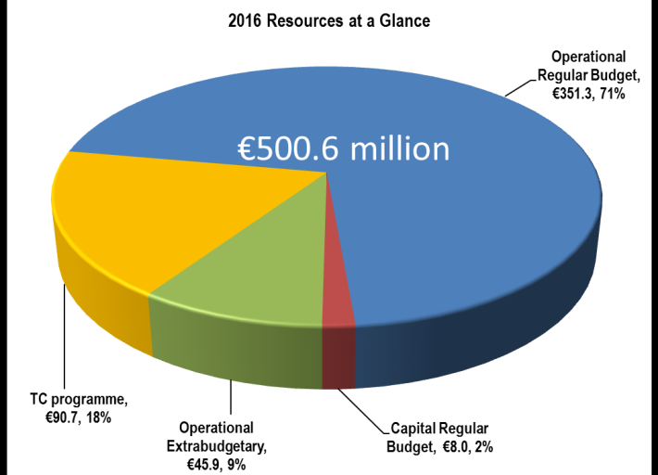
After 60 years…
HQ in Vienna
Laboratories in Seibersdorf and Monaco + Vienna
Regional offices in Toronto and Tokyo.
Liaison offices in New York and Geneva
170
Member States
(as of May 2018)
2500+staff
from
over 100 countries
Notes:
Today, the IAEA has 3x as many Member States as in 1957.

Slide 3
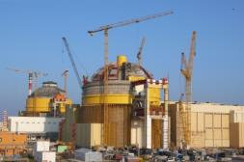
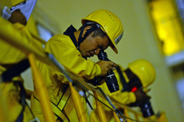
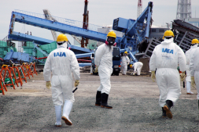
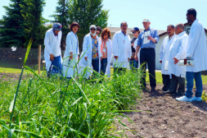
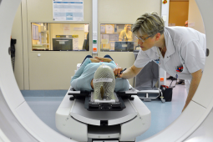

Organization
Director General’s Office for Coordination (DGOC) includes the secretariat of the policy-making organs, legal affairs, internal oversight services and press and public information.
Departments (6)
Nuclear Energy
Safeguards
Nuclear Safety and Security
Technical
Cooperation
Nuclear Sciences and Application
Management
3
Contact: D.Ridikas@iaea.org
Notes:
DGOC: is essential to support the Director General in performing his or her responsibilities. It provides overall policy coordination, external relations with Member States and stakeholders, policy planning and strategy, as well as coordinating the activities of NY and Geneva offices, which liaise with the UN and its agencies.
TC manages IAEA's Technical Cooperation programmes, which help Member States use nuclear techniques, where they offer an advantage over conventional methods, to address important development challenges.
NE fosters the efficient and safe use of nuclear power by supporting existing and new nuclear programmes around the world, catalyzing innovation and building indigenous capability in energy planning, analysis, and nuclear information and knowledge.
SG are activities by which the IAEA can verify that a State is living up to its international commitments not to use nuclear programmes for nuclear-weapons purposes.
NS formulates and implements the IAEA's nuclear safety and security programme, which encompasses the Agency's activities to protect people and the environment from radiation exposure, and responds to the needs of its Member States related to nuclear safety and nuclear security.
NA carries out research and development of various nuclear technologies in human health, food agriculture, environment and physical and chemical sciences.
Management includes budget and finance, administration, HR, IT, and procurement.

Slide 4
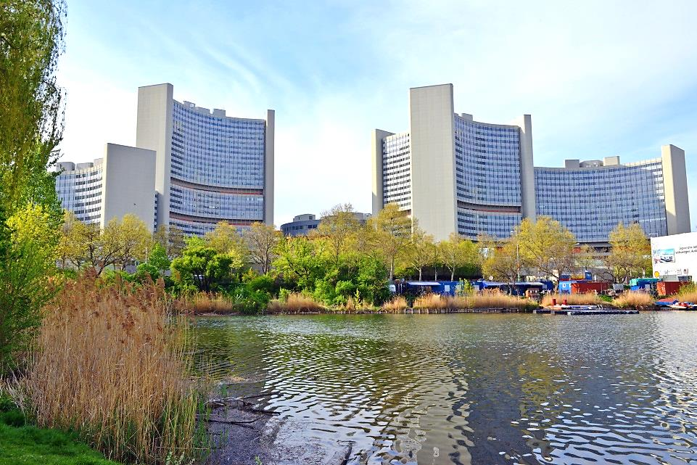

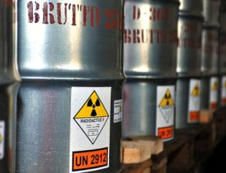
Three Pillars - Main Areas of Activity
Safeguards
&
Verification
Safety
&
Security
Science
&
Technology
4
Contact: D.Ridikas@iaea.org
Notes:
As you may know, the IAEA’s mission and activities are based on three pillars.
Through safeguards and verification, the IAEA works to prevent the further spread of nuclear weapons.
Through safety and security, we work to protect people and the environment from harmful radiation exposure.
And finally through the use of science and technology, we work to mobilize the peaceful applications of nuclear science and technology. The Department of Nuclear Sciences and Applications together with the Department of Nuclear Energy supports the third pillar as contents specialists, and the Department of Technical Cooperation for technology transfer and capacity building.

Slide 5

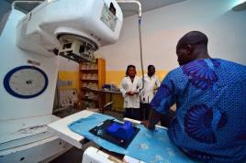
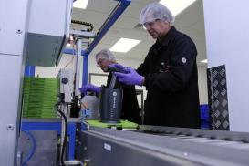
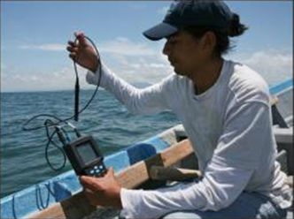
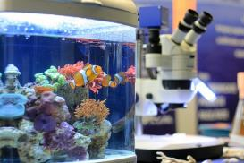
Science and Technology
Food & Agriculture
Human Health
Science & Industry
Promoting food security and sustainable agricultural
development
Improving the diagnosis and treatment of diseases and nutrition
Providing knowledge & expertise for
science & industry
Water Resources
Environment
Making more, and cleaner water available to more people
Understanding and protecting the environment
5
Contact: D.Ridikas@iaea.org
Notes:
Nuclear technologies make a significant contribution to the achievement of the Sustainable Development Goals. We work for example in food and agriculture, human health, water resource management, the marine and terrestrial environment and radioisotope production and radiation technology.

Slide 6
Division of Physical and Chemical Sciences
Nuclear/Radiation Sciences & Applications
Water resources management
Nuclear Data
Data Development
Data Services
Physics
Accelerator Applications
Nuclear Instrumentation
Nuclear Fusion
Research reactor applications
Atomic and Molecular Data
Radioisotope products & Radiation Technology
Radioisotope production, radiotracers in industry
Radiopharma-ceuticals
Radiation technology applications
Isotope Hydrology
Isotopic (3H) methods for Ground water assessment; prediction; models etc.
6
Contact: D.Ridikas@iaea.org

Slide 7

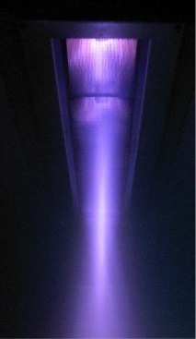
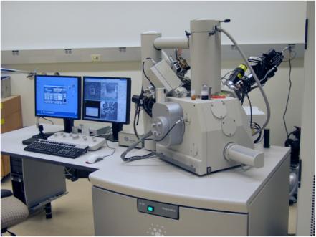
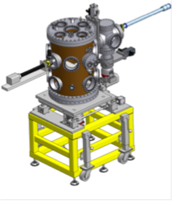
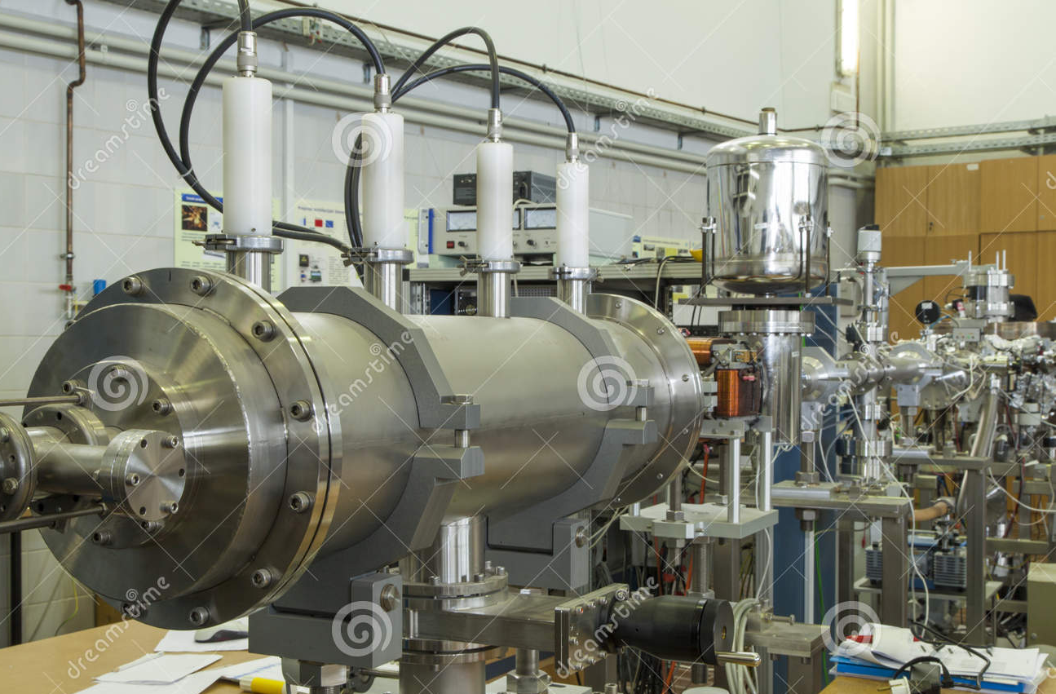
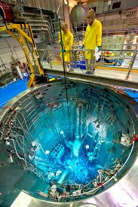
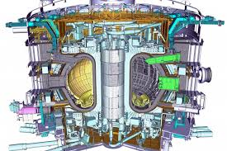
Physics Section - Programmatic Structure
Accelerators
Instrumentation
Research Reactors
(Applications)
Fusion

Slide 8
Outline:
Why IAEA supports environmental studies?
  Rationale
  Nuclear Techniques suitable to support air pollution studies
IAEA activities in support of air pollution studies
  Coordinated Research Projects
  Publications
  TC projects
    Regional
      Common objectives
      Adopted strategy
      Obtained results
  Cooperation with other organizations
    IES / JRC (EU)
    ANSTO (IAEA collaborating Centre)
  Physics/NSIL activities supporting air quality
Concluding remarks
8

Slide 9
Why IAEA supports env. studies…
Use and promotion of nuclear techniques
Enhanced knowledge on the man-made pollution on environment
Increased public awareness (social concern)
Governmental commitment for better well-being
Regional efforts
  Identification of pollution sources
  Study of trans-boundary migration
9

Slide 10
Standards
Goal | Pollutant | Concentration | Time
US National Ambient Air Quality Standards | PM2.5 PM10 Ozone NO₂ SO₂ | 15 µg/m3 35 µg/m3 150 µg/m3 0.075 ppm 100 ppb 53 ppb 75 ppb 0.5 ppm | 1 year 24 hours 24 hours 8 hours 1 hours 1 year 1 hour 3 hours
European Commission Air Quality Standards | PM2.5 PM10 Ozone NO₂ SO₂ | 25 µg/m3 50 µg/m3 120 µg/m3 40 µg/m3 200 µg/m3 125 µg/m3 350 µg/m3 | 1 year 24 hours 8 hours 1 year 24 hours 24 hours 1 hours
WHO Air Quality Guidelines | PM2.5 PM10 Ozone NO₂ SO₂ | 10 µg/m3 25 µg/m3 20 µg/m3 50 µg/m3 100 µg/m3 40 µg/m3 200 µg/m3 20 µg/m3 500 µg/m3 | 1 year 24 hours 1 year 24 hours 8 hours 1 year 1 hour 24 hours 10 mins
Source: Zhu et al WMO/ IGAC Impacts of Megacities on Air Pollution and Climate,
GAW Report No. 205, September 2012.
10

Slide 11
Why Study Fine Particles ?
Health implications
PM2.5 travel deep into the lungs, have direct access to the blood stream.
Absorb and scatter visible light
Fine particles are many times more efficient at scattering visible light than coarse particles - pollution can be seen!
Travel large distances
Fine particles stay in the atmosphere for days and weeks → transported across countries.
Affect climate
Fine particles may have a negative climate forcing effect comparable to the positive forcing of greenhouse gases. Better understanding needed for climate modelling.
11

Slide 12
Major stakeholders at national scale:
Government
Public funds, regulations
Applied R&D Analysis supporting characterization
Education
Human capacity building
Directly involved with environmental care & RA
Applied statistics / modeling
(interpretation)
NGOs
Public awareness
12

Slide 13
Air pollution assessment, involves…
New knowledge
Meteorological
Transport Modeling
Interpretation / conclusions
Source apportionment
Source models
Risk assessment
Environmental
Legislation
Facts gathering
Receptor models
Toxicology
studies
Continuous monitoring
(APM, gases)
Laboratory characterization
Findings on alterations
Cumulative effects
Biomonitors
Other
13

Slide 14
Air pollution assessment, involves…
New knowledge
Meteorological
Transport Modeling
Interpretation / conclusions
Source apportionment
Source models
Risk assessment
Environmental
Legislation
Facts gathering
Receptor models
Toxicology
studies
Composition
Gaseous
Elemental
Mineralogical
Laboratory characterization
Findings on alterations
Mass concentration
Other
14

Slide 15
Airborne particulate matter characterization
New knowledge
Meteorological
Transport Modeling
Interpretation / conclusions
Source apportionment
Source models
Risk assessment
Environmental
Legislation
Facts gathering
Receptor models
Toxicology
studies
Composition
Gaseous
Elemental
Mineralogical
Laboratory characterization
Findings on alterations
Mass concentration
Other
15

Slide 16
Source apportionment and transport modelling…
New knowledge
Meteorological
Transport Modeling
Interpretation / conclusions
Source apportionment
Source models
Risk assessment
Environmental
Legislation
Facts gathering
Receptor models
Toxicology
studies
Composition
Gaseous
Elemental
Mineralogical
Laboratory characterization
Findings on alterations
Mass concentration
Other
16

Slide 17
Which nuclear techniques can be applied to ES?
Laboratory
Composition
Chemical
NAA, XRF, IBA, SEM-EDS
Mineralogical
XRD, SEM-EDS
Structural
Micro scale: SEM-EDS
Radiological
DR, α & γ - spectrometry, β - counting, Rn
17

Slide 18
Completed CRPs (air pollution studies)
 |  |  |  |  |  |  |  |  |  | J13009: Accident Severity During Air Transport of Radioactive Material
J12008: Atmospheric transport model evaluation studies |  |  |  |  |  |  |  | E41011: Validation and Application of Plants as Bio-monitors of Trace Element Atmospheric Pollution, analysed by Nuclear and Related Techniques
 |  |  | E41008: Applied research on air pollution using nuclear related analytical techniques |  |  |  |  |  |  |  | `
 |  |  |  |  |  |  | E41010: Assessment of levels and health-effects of airborne particulate matter in mining, metal refining and metal working industries using nuclear and related analytical techniques
1989 | 1990 | 1991 | 1992 | 1993 | 1994 | 1995 | 1996 | 1997 |  | 1998 | 1999 | 2000 | 2001 | 2002 | 2003 | 2004 | 2005 | 2006
18

Slide 19
Completed IAEA Regional CRPs
(air pollution studies)
 |  | F23010: Nuclear analytical techniques in atmospheric and surface water pollution studies
 |  |  |  | E41009: Applied research on air pollution using nuclear related analytical techniques in Asia and the Pacific
 |  |  |  |  |  |  |  |  | F31002: Isotopic composition of precipitation in the Mediterranean Basin in relation to air circulation patterns and climate
1991 | 1992 | 1993 | 1994 | 1995 | 1996 | 1997 | 1998 | 1999 | 2000 | 2001 | 2002 | 2003 | 2004 | 2005
19

Slide 20
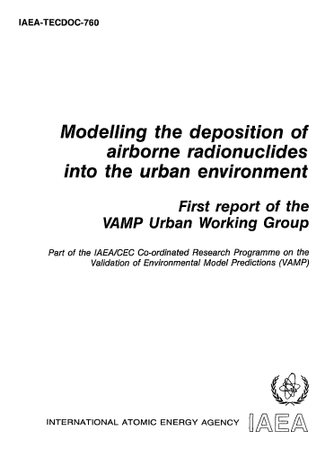
IAEA publications on air pollution studies
 | Modelling the Deposition of Airborne Radionuclides into the Urban Environment IAEA TECDOC 760 Subject Classification: 0609-Radiation protection IAEA-TECDOC-760 15.00 Euro; Language: English Date Published: 1994
20

Slide 21
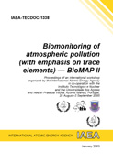
IAEA publications on air pollution studies
 | Biomonitoring of Atmospheric Pollution (with Emphasis on Trace Elements) – BioMAP and BioMAP II IAEA TECDOCs 1152 and 1338 Subject Classification: 1300-EnvironmentIAEA-TECDOC-1338(ISBN:92-0-100803-1) 15.00 Euro; Language: English Date Published: 1997, 2003
21

Slide 22
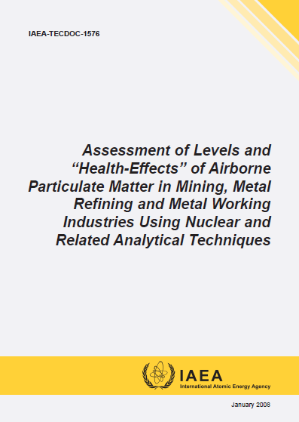
IAEA publications on air pollution studies
 | Assessment of Levels and "Health-Effects" of Airborne Particulate Matter in Mining, Metal Refining and Metal Working Industries Using Nuclear and Related Analytical Techniques IAEA TECDOC 1576 IAEA-TECDOC-1576(ISBN:978-92-0-110407-6) 15.00 Euro; Language: English Date Published: 2008
22

Slide 23
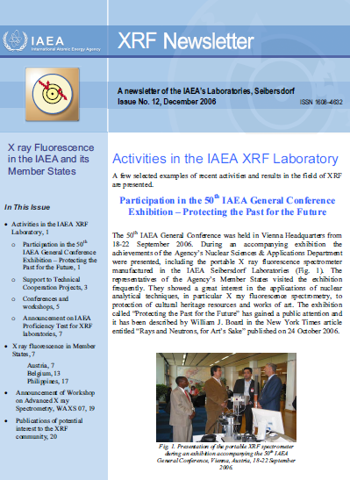
IAEA newsletters
XRF Newsletter by Physics/NSIL:
Activities at SEIB XRF laboratory
Technical Meetings and CRPs
Conferences and Workshops
Support to Regional TC Projects
Announcements
Publications of potential interest
XRF at Member States
www-pub.iaea.org/books/IAEABooks/View_Newsletters/109/XRF-Newsletter
23

Slide 24
TC Inter-Regional Projects
(Training Courses)
1976 | 1977 | 1978 | 1979 | 1980 | 1981 | 1982 | 1983 | … | 1992 | 1993 | 1994 | 1995 | 1996
 | INT5050: TC on Nuc. Tech. for Chemical Residue & Pollution Problems |  |  | INT5072: TC on Chemical Residue and Pollution Problems |  |  | INT9047:Air Pollution Control |  | INT2008: TC on Environmental Pollution Studies and Monitoring | INT2009: TC on Nuclear Techniques in Environ-mental Research |  |  | INT7013: TC on Nuclear Techniques in Environ-mental Research
 |  |  |  |  |  |  |  |  | INT8028: TC on Nuclear Tech. in Air Pollution Monitoring and Research
24

Slide 25
TC Regional Projects
… | 1999 | 2000 | 2001 | 2002 | 2003 | 2004 | 2005 | 2005 | 2006 | 2007 | 2008 |  | 2009 | 2010 | 2011 | 2012 | 2013 | 2014 | 2015 | 2016 | 2017 | 2018
 | 7007: Content of Atmosp Cont. APM (4) |  | 7010 : Biomonitors, N&RT (13) |  |  |  |  |  | 7011: Assessm Atm. Poll by APM (8) |  |  | 2013: NT & Biomon. (13) |  |  |  |  |  |  |  |  |  | 7023: Ass. Atm. Aerosol in urban areas
 | RAS8082: Isotopic & Rel. Techn. to Assess Air Pollution (16) |  |  |  | 7013: Info about Urban Air Quality Manag. (16) |  |  |  |  | 7015: Character. & Source Ident. of APM Pollution in the Asian Region (16) |  |  |  |  |  | 7023: Supporting Sustainable Air Pollution Monitoring Using Nuclear Analytical Technology (14) |  |  |  | 7029: Impact of urban APM on Air Quality (14)
 |  |  |  |  |  |  |  |  |  |  |  |  |  |  |  |  |  | 0072: Evaluating and mapping air pollutants (7) |  | 0076: Urban NATs ARASIA (7) |  |  | 0078: Source App Long Range Transp (7)
 |  |  |  |  |  |  | RER8009 AP mon. Medit. (11) |  |  |  |  |  | 2009 Seasonal variations in APM (12) |  |  | 1008: Supporting Air Quality Manag (22) |  | 1013: Supporting Air Quality Manag. II (22) |  | 1015: Apportioning sources at regional scale (22) |  | 7011: Enhancing the Inventory of source profiles
 |  |  |  |  |  |  |  |  |  | RAF4019: Urban Zone Air Pollution Monitoring (16) |  |  |  |  |  |  |  |  |  | 7016: Appotioning air pollution at reg. scale (21)
25

Slide 26
TC Regional Projects using Biomonitors
Regional Project | Outcome
2001-2005 - RLA7010 (13 countries): Application of Biomonitors, Nuclear, and Related Techniques in Atmospheric Pollution Studies (ARCAL LX) | Appropriate biomonitors for atmospheric pollution using plants (lichens and bromeliads) were identified in all countries More than 20 scientific papers in international publications Each participating country created databases and distribution maps on trace element levels in biomonitors
2007-2009 – RLA2013 (12 countries): Correlation Studies between Atmospheric Deposition and Sanitary Problems in Latin America: Nuclear Analytical Techniques and the Biomonitoring of Atmospheric Pollution (ARCAL LXXXIX) | Established correlations between atmospheric pollution due to toxic elements and hospital records or epidemiological data
2017-2018 – SIL 1001: Identifying Air Pollution Elements in Lichens as Bio-Indicators in Major Cities Using X-Ray Fluorescence and Atomic Absorption Spectrophotometry Methods | Knowledge on the status of air pollution in major cities of the country enhanced
26

Slide 27
Current TC Regional Projects (APM)
Regional Project | Outcome
RER7011: 21 countries Establishing and Improving Air Pollution Monitoring | Systematic high quality data on APM elemental contents utilised in support of identification and apportionment of major sources of air pollution at regional scale
RAS0076: 7 countries Investigating Atmospheric Particulate Matter and Pollution Source Contributions in Urban Environments Using Nuclear Analytical Techniques (ARASIA) | Pollutants and pollution source fingerprints identified to advise the decision makers on air pollution management.
RAS7029: 17 countries Assessing the Impact of Urban Air Particulate Matter on Air Quality | Enhanced awareness on air particulate matter impact on human health, visibility and historic monuments
RAF7016: 23 countries Apportioning Air Pollution Sources on a Regional Scale | Air quality management in African countries through systematic air pollution monitoring using NATs and better understanding of contributing pollution sources improved.
RLA7023: 15 countries Assessing Atmospheric Aerosol Components in Urban Areas to Improve Air Pollution and Climate Change Management (ARCAL CLIV) | Air pollution and climate change management improved
27

Slide 28
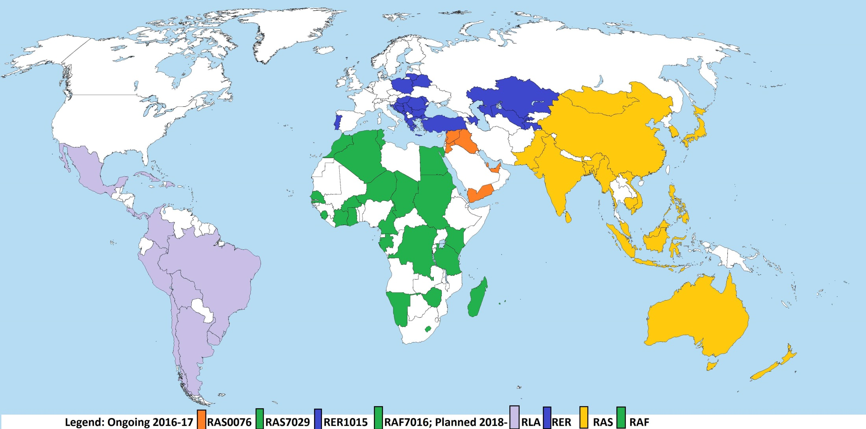
83 countries involved in APM studies within TC Regional Projects
28

Slide 29
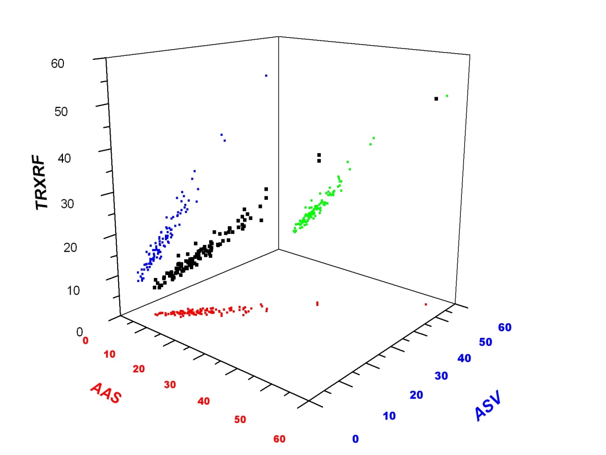
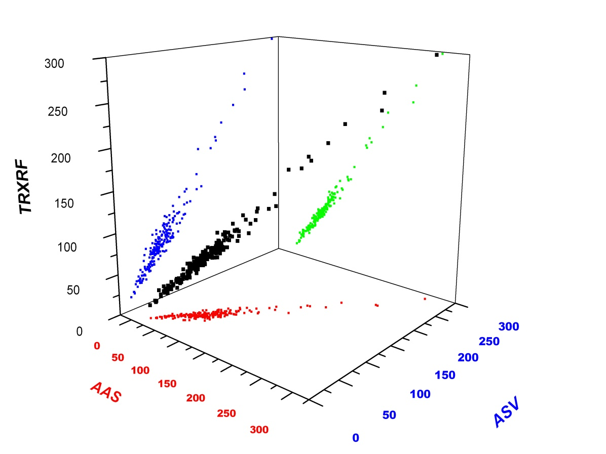
Results from RLA7010:
Validation of analytical procedures
Total Reflection X Ray Fluorescence (TRXRF)
Flame Atomic Absorption Spectroscopy (FAAS)
Anodic Stripping Voltammetry (ASV)
Pb
Zn
A. Montero, J. Estévez, R. Padilla, D. Lopez, Analytical performance of some methods for the determination of trace elements in lichens used as air quality assessment, Journal of Radioanalytical and Nuclear Chemistry, Vol. 281 (2009) 569-575.
29

Slide 30
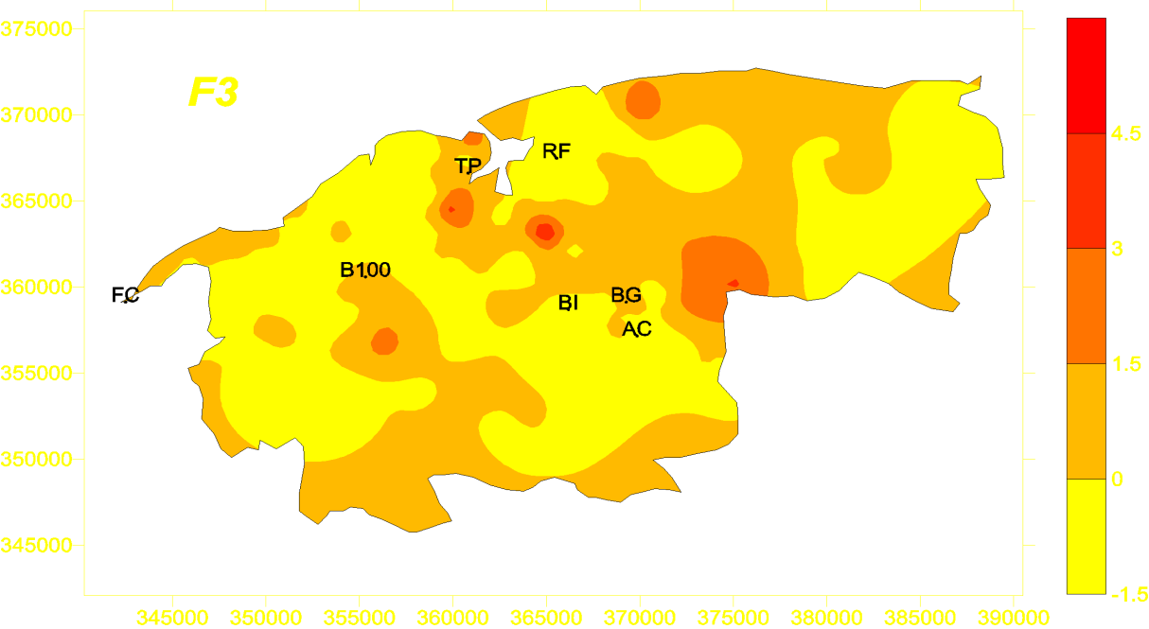
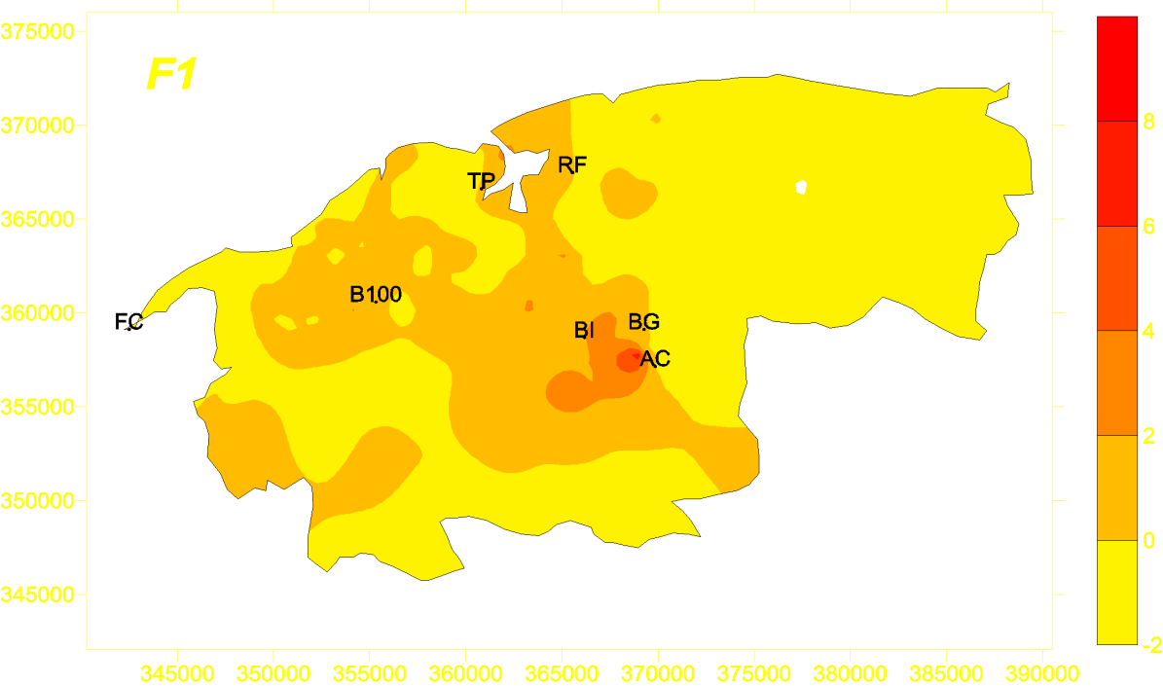
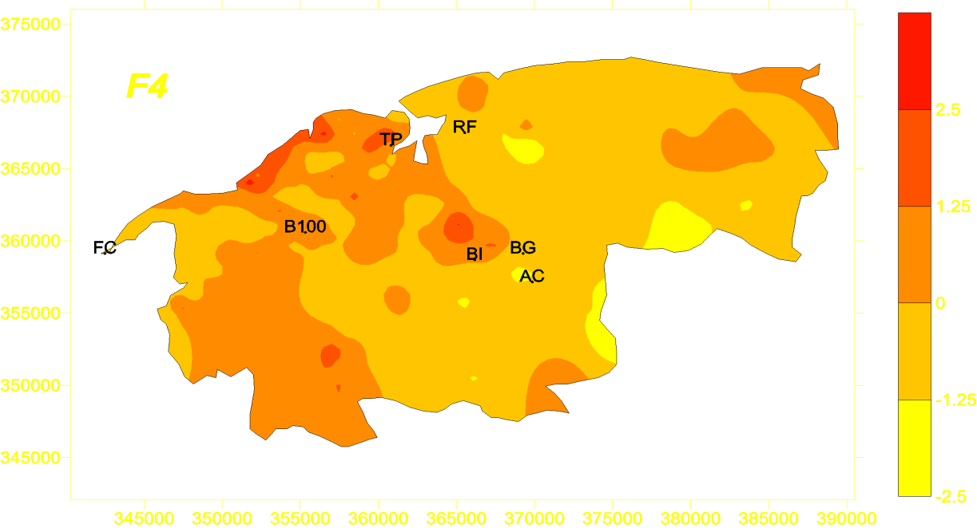
Results from Biomonitoring in Havana
Z. Herrero Fernández; J.R. Estevez Álvarez; A. Montero Álvarez; I. Pupo González; J. Araújo dos Santos Júnior;M. Ortueta Milan; G. Mesa Pérez; D. Leyva Bombuse, M. Rodríguez González; D. Hernández Torres; N. Alberro Macias; N. Blanco Hernandez, R. Padilla Álvarez, Multielement analysis of lichen samples using XRF methods. Comparison with ICP-AES and FAAS, X-Ray Spectrometry 45 (2016), 77-84
Factor 3 (Ca y Sr)
Cement factory
Factor 4 (Pb)
Vehicular exhaust
Factor 1 (Cd & Zn)
City Waste incineration.
30

Slide 31
Common objectives of projects on APM
Verification of compliance to admissible levels of pollutants
Source apportionment
  Identification of sources through fingerprint profiles and their corresponding contribution
Transboundary transport
Creation of databases
31

Slide 32
Verification of compliance to admissible levels of pollutants
Dr Manousakas, RER1015, Final report inter-comparison exercise for the use of source apportionment tools
32

Slide 33
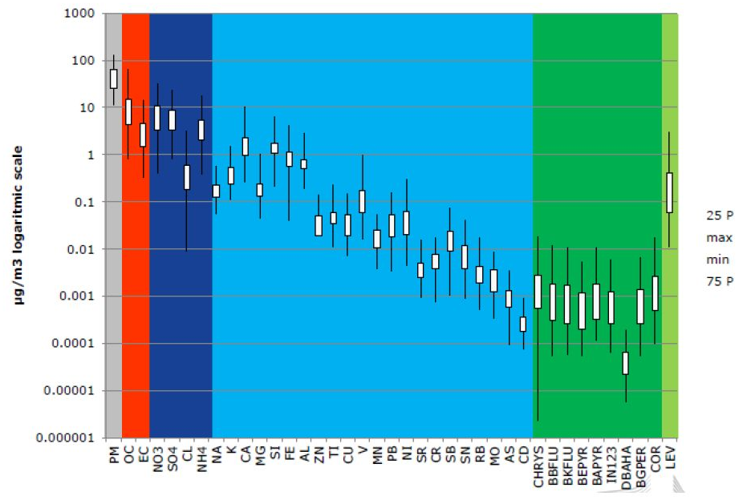
Source apportionment:
Selection of measurands
Dr Manousakas, RER1015, Final report inter-comparison exercise for the use of source apportionment tools
33

Slide 34
Source apportionment:
Identification of source profiles
Dr Manousakas, RER1015, Final report inter-comparison exercise for the use of source apportionment tools
34

Slide 35
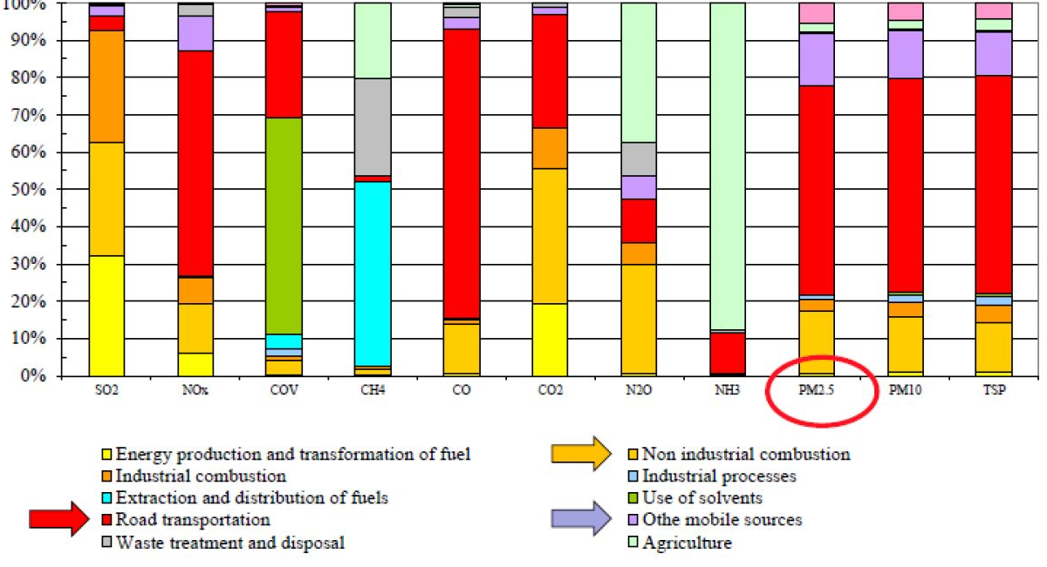
Source apportionment:
Inventories
Dr Manousakas, RER1015, Final report inter-comparison exercise for the use of source apportionment tools
35

Slide 36
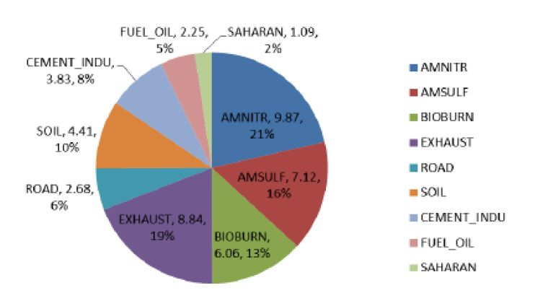
Source apportionment:
Inventories
Dr Manousakas, RER1015, Final report inter-comparison exercise for the use of source apportionment tools
36

Slide 37
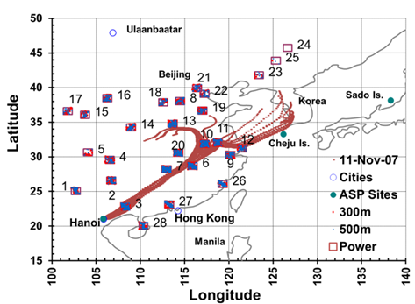
Transboundary transport
Dr David Cohen, Technical Workshop RAS0076, Vienna, 2016
37

Slide 38
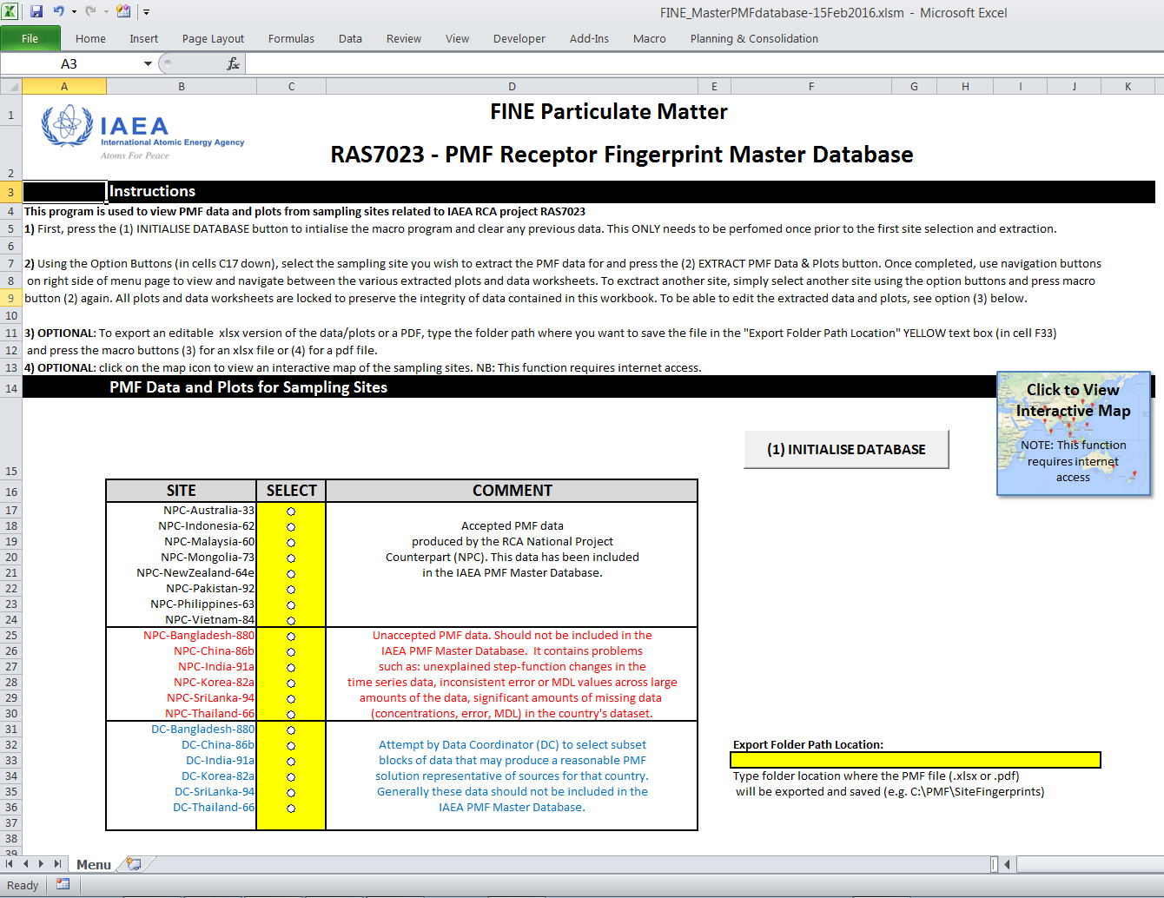
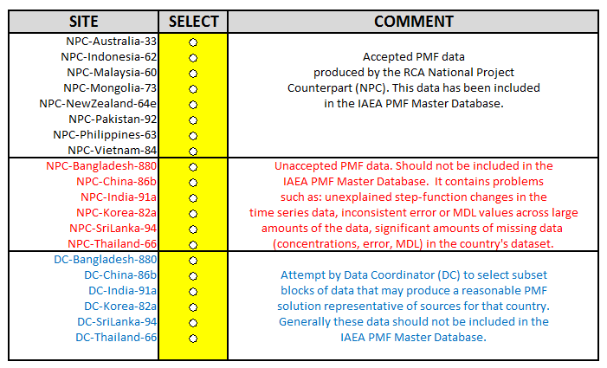
RCA: ASFID Database
38
Dr David Cohen, Technical Workshop RAS0076, Vienna, 2016

Slide 39
Common strategy
Synchronized sampling
    Urban sites
    One station by country
    Agreed sampling timeframe: minimum one year
    Every third day / Twice a week
    24 h sampling
Low volume samplers (price constraint)
39

Slide 40
Common strategy
Measurement techniques
    Preference to non-destructive (small amount of collected material)
    Gravimetric (PM2.5 mass concentration)
    Black carbon: reflectometry, aethalometry (MABI)
    Elemental (PIXE, PIGE, XRF)
    Ion chromatography (IC) for NO_{x}, SO_{x}, NH₄, etc)
40

Slide 41
Interpretation of results
Source apportionment
    Receptor models
    Positive Matrix Factorization (EPA PMF5)
Transboundary transport
    Back trajectories
    GNU (free software) tool OPENAIR on R platform (www.r-project.org/)
41

Slide 42
RCA Fine PM2.5 Mass by Country 2001-14
US EPA PM2.5 goals – 12 µg/m³ annual average (grey line)
– 35 µg/m³ 24 hr max (red line)
42
Dr David Cohen, Technical Workshop RAS0076, Vienna, 2016

Slide 43
RCA Fine PM2.5 Sulfate by Country 2001-14
Clearly China, Malaysia, Mongolia and Vietnam have fine sulfate problems.
43
Dr David Cohen, Technical Workshop RAS0076, Vienna, 2016

Slide 44
RCA Fine PM2.5 Black Carbon by Country 2001-14
Clearly Bangladesh, India, Mongolia, Philippines and Sri Lanka have black carbon problems.
44
Dr David Cohen, Technical Workshop RAS0076, Vienna, 2016

Slide 45
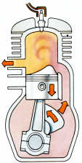

RCA: Main findings and results
50-55%
high sulfate pollution in Hanoi from
coal-fired power stations in China
70-75%
high soil events in Hanoi from Gobi desert region
13 of 15
countries now have their own pollution programs with local EPAs
Two stroke
engines banned in Dhaka
Indonesian Government to expand sampler network to 12
and install a 2MV tandem in BATAN
Hanoi University of Science bought a 3MV NEC tandem to do air
pollution studies
Fine particle
standards introduced in Manila, Colombo and Kuala Lumpur
Four countries
now banned
leaded petrol use
Bangkok to buy a 2 MV Tandem
45
Dr David Cohen, Technical Workshop RAS0076, Vienna, 2016

Slide 46
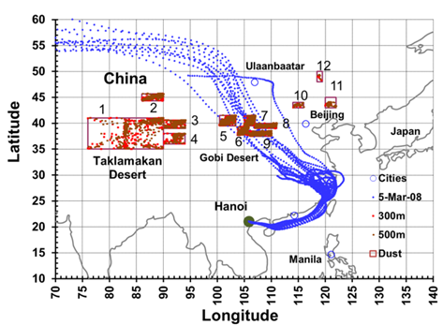
RCA: Main findings and results
46
Dr David Cohen, Technical Workshop RAS0076, Vienna, 2016

Slide 47
Follow up: development of tutorials/guides
Sampling guidelines and protocol
Analytical characterization of APM samples by EDXRF
Analytical characterization of APM samples by Ion Beam Analysis Techniques
Source apportionment using PMF EPA-5 software
47

Slide 48
Cooperation with other organizations
Practical arrangement signed between IAEA and JRC/EC (Brussels, February 15 2017)
48

Slide 49
Cooperation with Inst. Env. Sust./JRC
Lecturing in RER 1008, RER 1015 RTCs
Organization of an inter-comparison exercise on identification of source profiles
Access to IES databases on source profiles
Dr Manousakas, RER1015, Final report inter-comparison exercise for the use of source apportionment tools
49

Slide 50
RB activities supporting air quality:
PT exercises organized at NSIL
 | AIRFILTER 2003 | PTXRF/02 2005 | PTXRF/03 2005 | PTXRF/06 2009 | PTXRF/12 2015 | PTXRF/14 2018
Type of sample | Dust on filter | Lichen | Dust on filter | Grass mixture | Plant | Dust on filter
Number of participants | 16 | 31 | 24 | 42 | 48 | >80
Results received from | 8 | 17 | 12 | 19 | 37 | ongoing
Techniques (% of results) | NAA, PIXE, XRF, ICP-MS, PIGE | XRF, PIXE | NAA, XRF, PIXE, AAS | XRF, NAA | XRF | XRF, PIXE, NAA, ICP-MS
Elements reported | 39 | 30 | 45 | 31 | 41
Total results | 147 | 259 | 175 | 237 | 503
Outliers | 19 | 7 | 29 | 32 | 45
www.pt-nsil.com
50

Slide 51
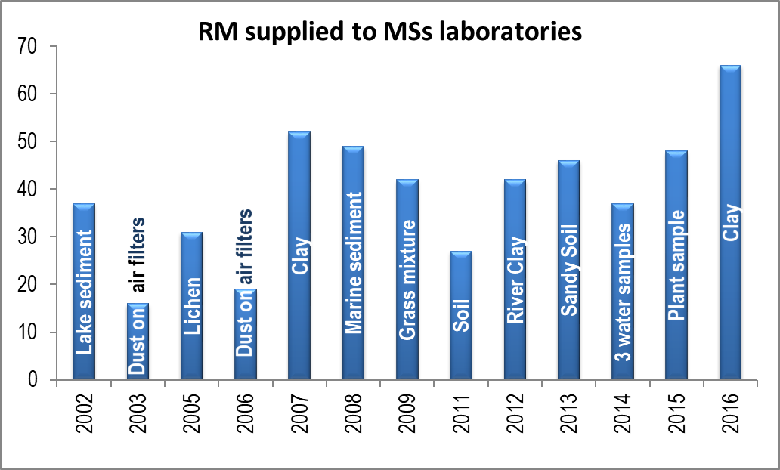
PT exercises organized at NSIL
Compliant with ISO/IEC17043 (2010): Conformity assessment — General requirements for proficiency testing
51

Slide 52
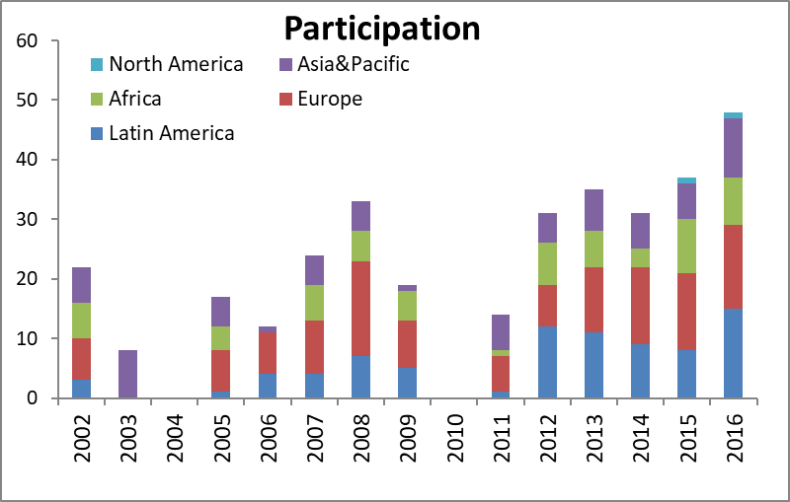
PT exercises organized at NSIL
Compliant with ISO/IEC17043 (2010): Conformity assessment — General requirements for proficiency testing
52

Slide 53
RTC on method validation and QA/QC on APM analysis by PIXE and XRF
XRF facilities at NSIL, Seibersdorf (ST-XRF, TXRF, HHXRF)
IBA through remote access to Institute Ruder Boskovic (Zagreb, Croatia)
  RAF 7016, 8-19 May 2017, 12 participants
  RER 7011, 3-14 Dec 2017, 15 participants
  RLA 7023, 15-25 Oct 2018, 15 participants
53

Slide 54
Facilitating access to accelerator facilties
IAEA Xspe end station at Elettra Sincrotrone (Trieste, Italy)
  40 % of available beam time
  Through TC projects as SV
IBA through forthcoming CRP2123 (second half of 2018)
  Brazil, Mexico
  Croatia, Greece
  South Africa
  India, Australia
54

Slide 55
Acknowledgements
Dr. Alfredo Montero, CEADEN, Havana, Cuba
Dr. Manousous Manousakas, NCSR “Demokritos”, Athens, Greece
Dr. Susana Almeida, Campus Tecnológico e Nuclear, Instituto Superior Técnico, Universidade de Lisboa
Dr. David Cohen, ANSTO
55

Slide 56
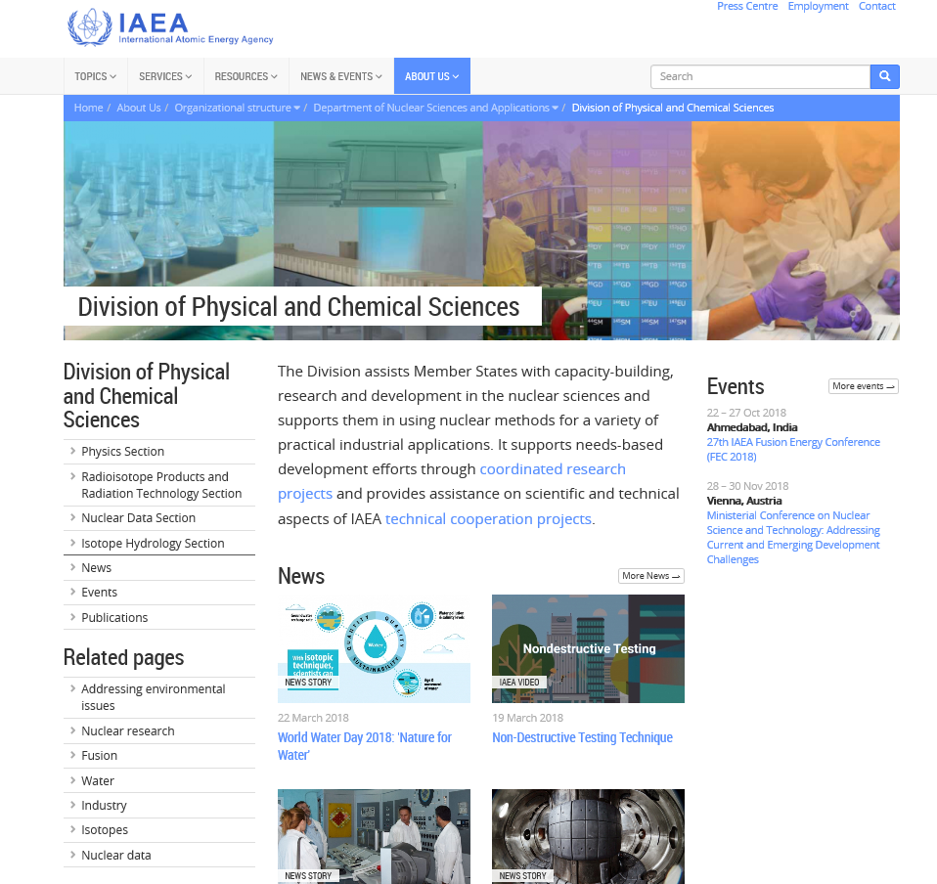
https://www.iaea.org/about/organizational-structure/department-of-nuclear-sciences-and-applications/division-of-physical-and-chemical-sciences
Thanks for your
time and attention…
56

