Slide 1
Energy distributions in FHCal and approaches for centrality measurements.
M.Golubeva and A.Ivashkin
INR RAS (Moscow)
This study was done with LA-QGSM model in MPDRoot.
Only FHCal was considered.
LA-QGSM model has no markers of spectators.
Therefore, the identification of spectator’s and non-spectator’s contribution is impossible.

Slide 2
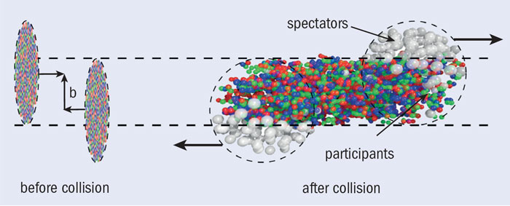
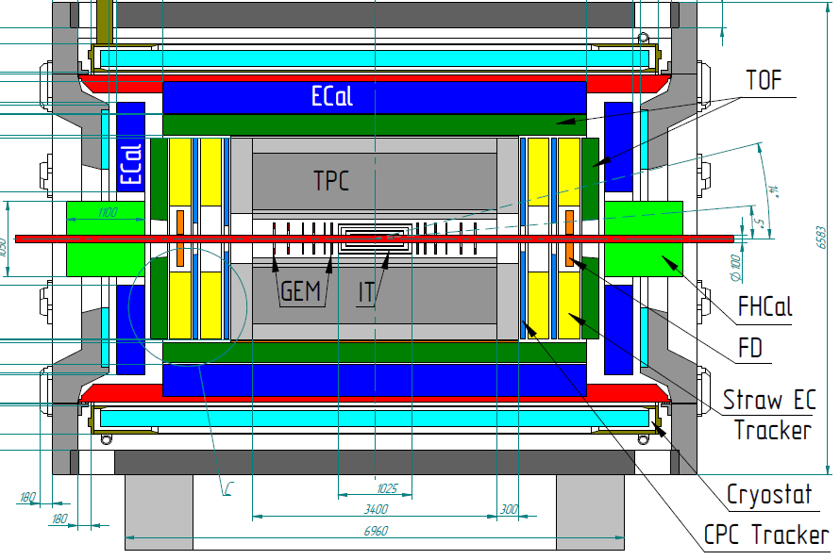
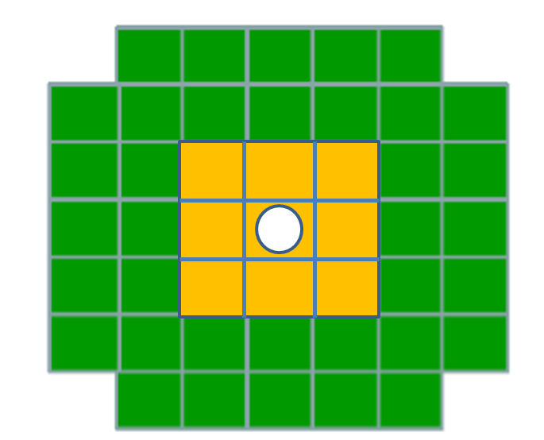
MPD tools for centrality measurements.
Two approaches for centrality measurements :
a) Participant region (TPC/TOF)
b) Spectator region (FHCal)
In this report we will discuss only spectator region (FHCal).

Slide 3
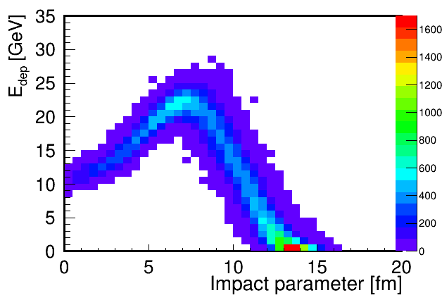
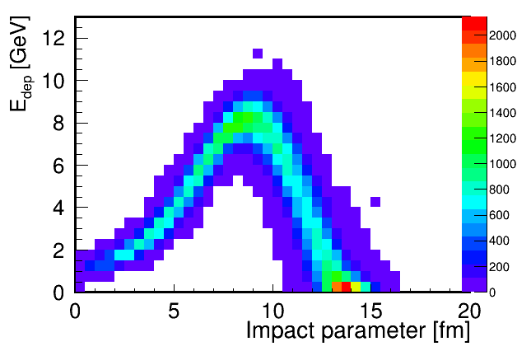
Energy depositions in FHCal.
Non-spectator’s
contributions.
FHCal detects not only the spectators but also the produced particles and wounded nucleons from participant region.
There is an ambiguity in FHCal energy deposition for central/peripheral events due to the fragments (bound spectators) leak into beam hole.
Is it possible to overcome these two problems?

Slide 4
Transverse energy distributions in FHCal modules.
Impact parameter b< 6 Impact parameter b> 6
Y [cm]
Y [cm]
X [cm]
X [cm]
Y [cm]
Y [cm]
X [cm]
X [cm]
Transverse energy distributions are wider for central events and narrow for the peripheral collisions.
Can we use this feature to avoid the above drawbacks?

Slide 5
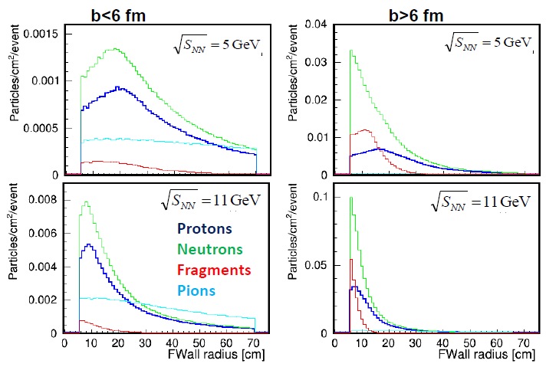
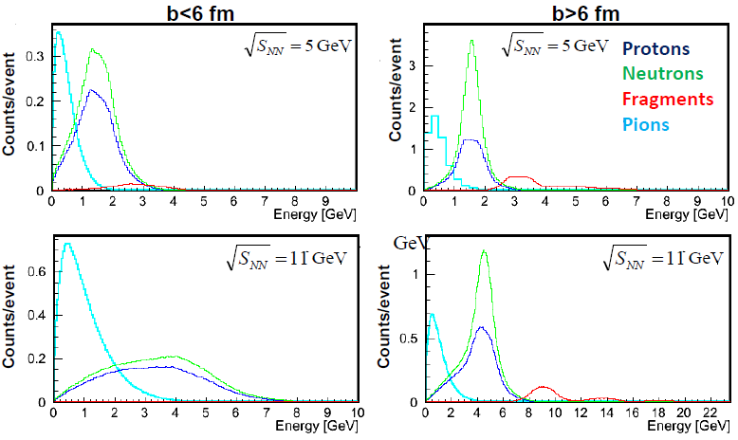
Occupancies and energies of different particles at front of FHCal.
occupancy
energy
Pions are almost uniformly distributed at the face of FHCal.
The shapes of proton/neutron spots are quite different for central/peripheral events.
Fragments (bound spectators) contribute small part of energies to FHCal (they touch the inner surface of FHCal in beam hole and do not deposit energy in FHCal).

Slide 6
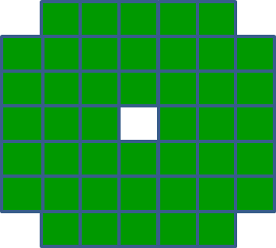
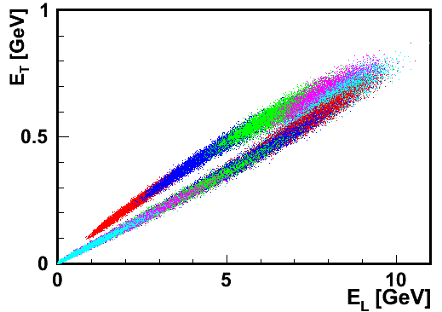
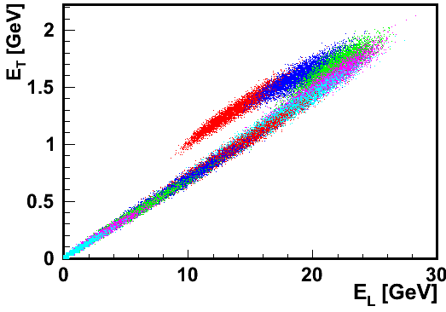
Construction of two energy components in FHCal.
$$Ei$$
Transverse energy: $ET=\sum{Ei sinθi}$
and
Longitudinal energy: $EL=\sum{Ei cosθi}$
$$θ$$
Cone of spectators
$$Ei$$
Central events
Central events
Peripheral events
Peripheral events
Each color bin is 10% of b-centrality.
Each color bin is 10% of b-centrality.
Two branches in (E_{T}, E_{L}) correlations.

Slide 7
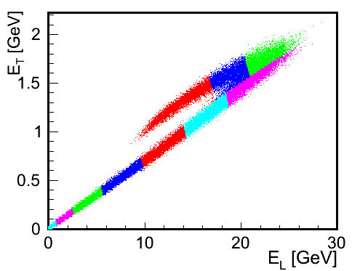
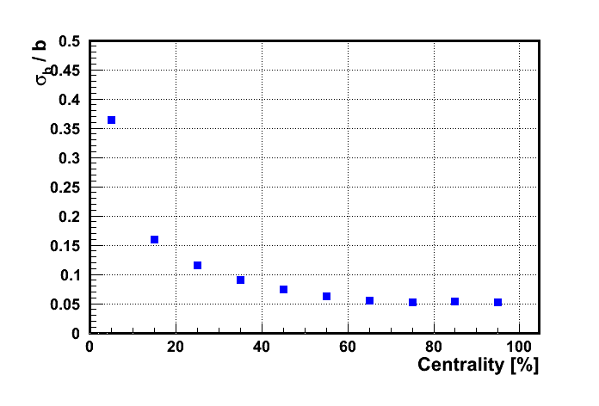
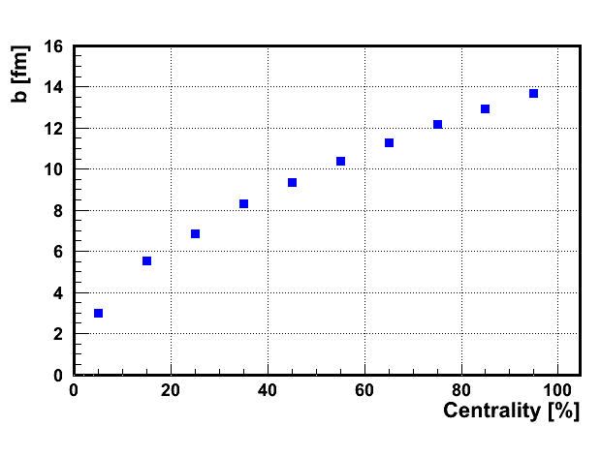
Centrality determination with ElEt bins (10. 20, … 100 % of events)
Evaluation of centrality from (E_{T},E_{L}) energy distributions.
Each color bin is 10% fractions of the total number of events (fraction of the total inelastic nucleus-nucleus cross section).
Dependence of impact parameter on centrality.
Dependence of resolution of impact parameter on centrality.

Slide 8
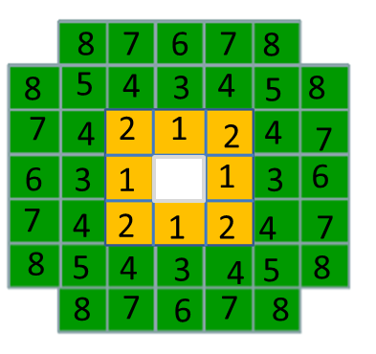
Let’s consider the angular distribution of deposited energies
in FHCal in differential way
8 groups of FHCal modules with the same polar angle.
Number of modules equals to 4 or 8 depending on group.
8
6
4
5
1
2
3
7
Summary energy in each group of modules is normalized to number of modules in this group.
The normalized energy in each group depends on the polar angle.
The error is ~1/E, where E is energy in given group of modules.
This dependence is fitted by the line E(θ)$=GE\text{x}\text{θ}+Ec$, where:
G_{E} is transverse energy gradient and
E_{c} is central energy (at θ=0⁰).

Slide 9
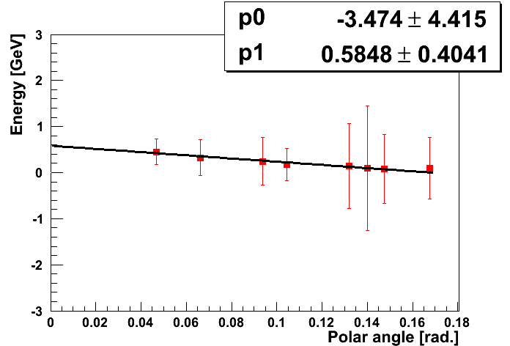
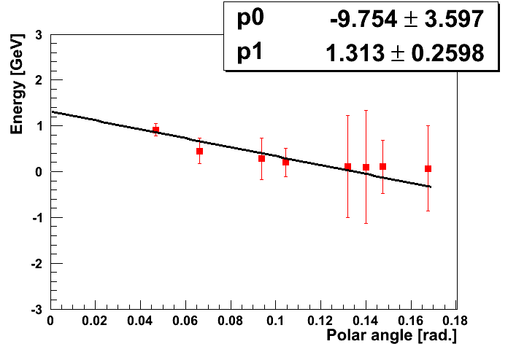
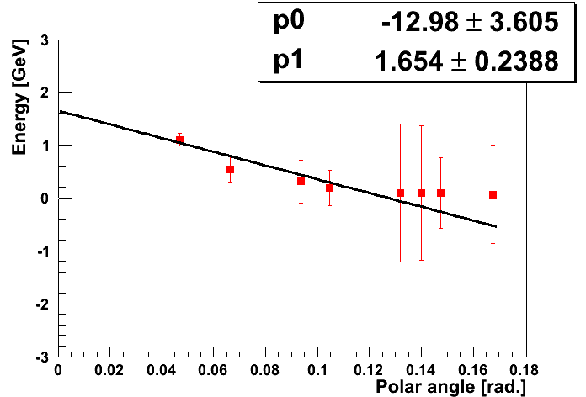
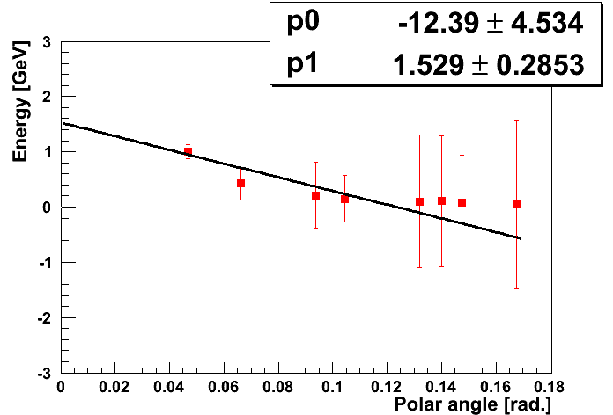
Dependence of energy deposition on polar angle
E($θ$)$=GE\text{x}θ+EC$
$\text{= }\text{p}\text{0}\text{x}θ+p1$
Centrality 0-10%
Centrality 10-20%
Centrality 20-30%
Centrality 30-40%
Fit line is below of last point. This point could be associated with non-spectator energy. Shall we subtract this energy from all points?

Slide 10
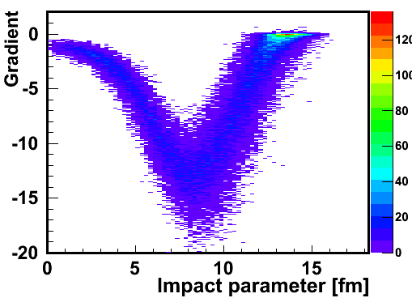
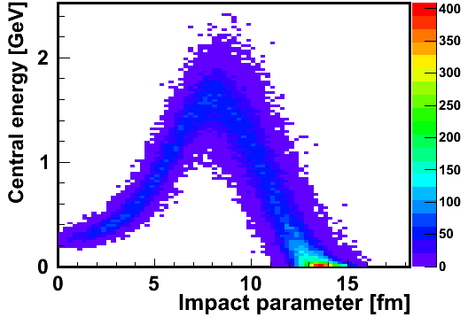
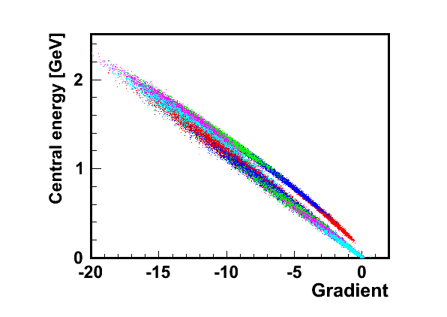
Correlations of fitted parameters.
$$GE$$
$$EC$$
E($θ$)$=GE\text{x}θ+EC$
Each color bin is 10% of b-centrality.
Transverse gradient and central energy are anti-correlated.
Almost straight line in (G,E_{c}) diplot reflects the fact that the maximum polar angle with E=0 is rather similar for all events.
$$EC$$
Central events
Peripheral events
$$GE$$
Let’s subtract from energies in all points the energy in last point.

Slide 11
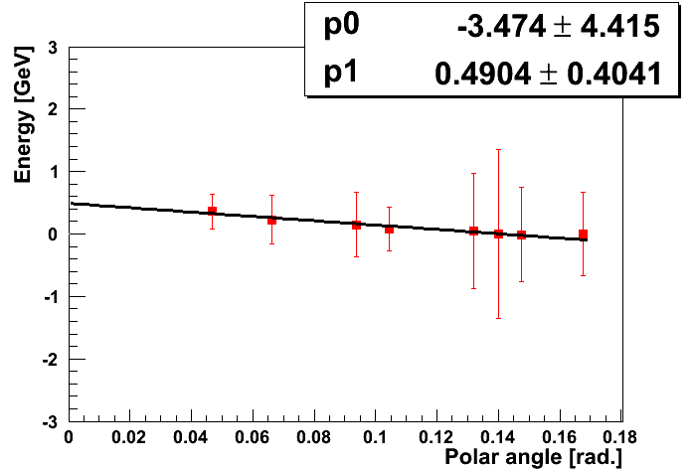
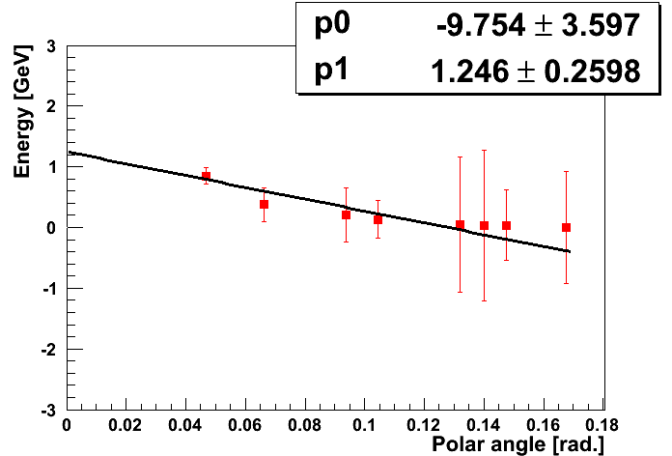
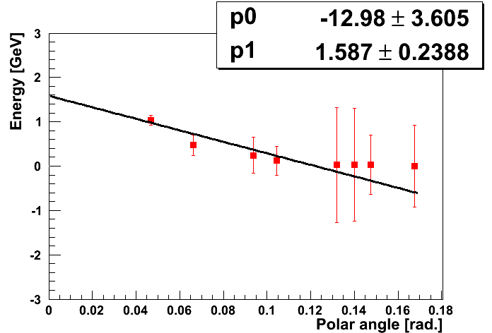
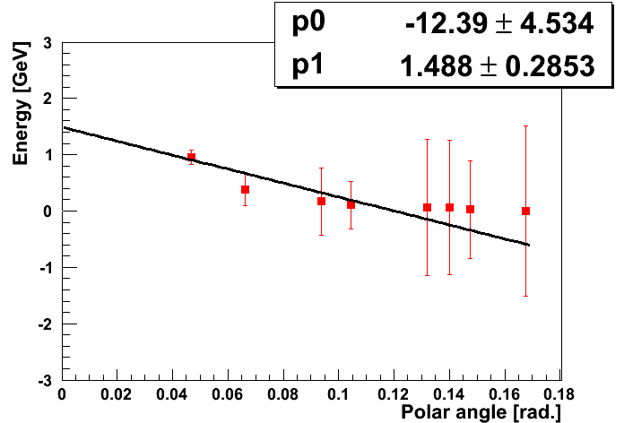
Dependence of energy deposition on polar angle after subtraction.
Centrality 0-10%
Centrality 10-20%
Centrality 20-30%
Centrality 30-40%

Slide 12
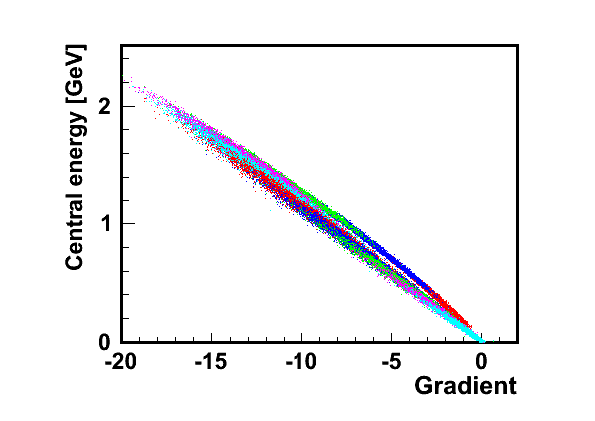
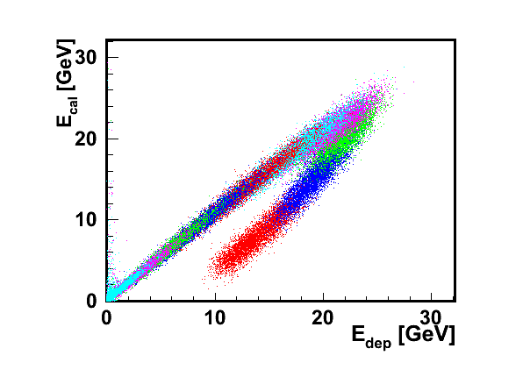
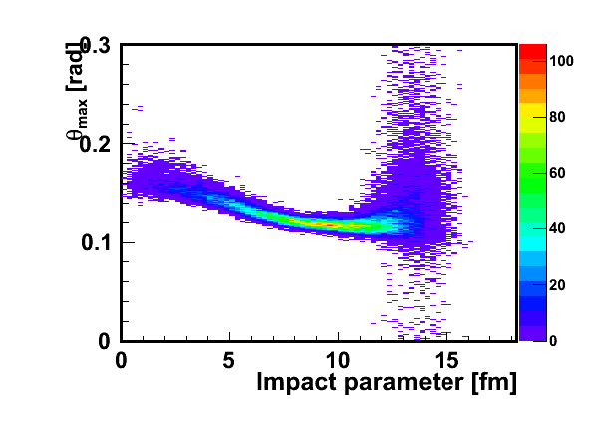
Parameters after subtraction of the energy in the last point.
Two branches in (G_{E},E_{c}) diplot for central and peripheral events are closer.
Integration of function over the calorimeter surface provides another observable:
E_{cor} – corrected energy.
Good separation of central and peripheral parts of events is visible.
$EC$ [GeV]
E($θ$)$=GE\text{x}θ+EC$
$$GE$$
Each color bin is 10% of b-centrality.
$θmax=−Ec/$G_{E}
Corrected energy E_{cor} [GeV]
Deposited energy

Slide 13
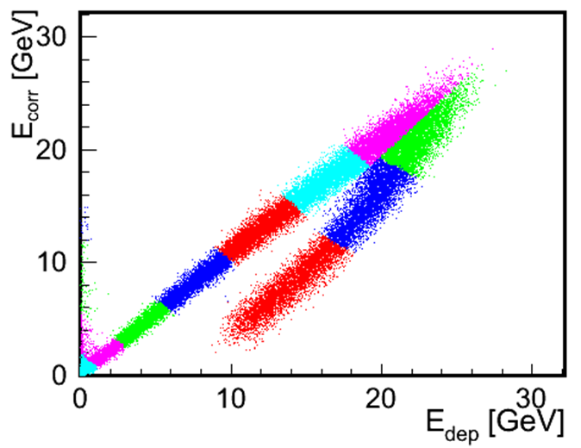
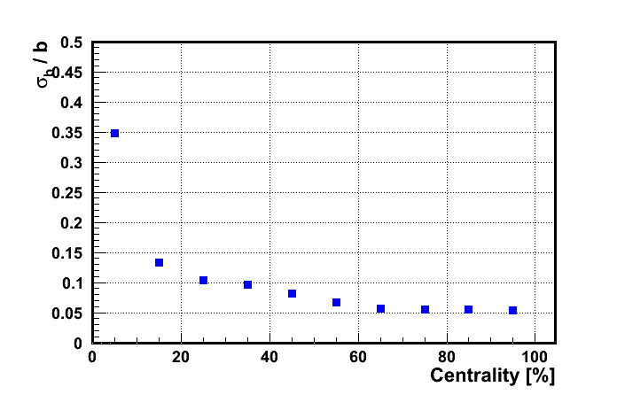
Evaluation of centrality from the FHCal energy distributions.
Each color bin is 10% fractions of the total number of events (fraction of the total inelastic nucleus-nucleus cross section).
Corrected energy
Dependence of impact parameter on centrality.
Dependence of resolution of impact parameter on centrality.

Slide 14
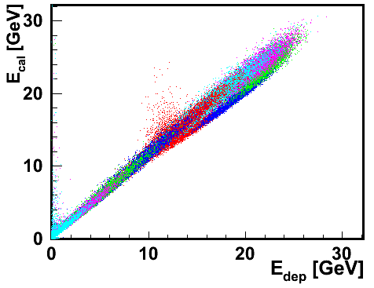
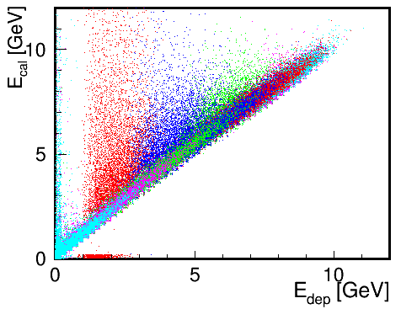
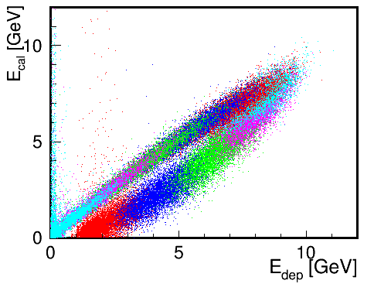
Energy correlations before and after subtraction of the energy
in last point
Each color bin is 10% of b-centrality.
Corrected energy
Corrected energy
before
before
Deposited energy
Deposited energy
after
after
Corrected energy
Corrected energy
Deposited energy
Deposited energy

Slide 15
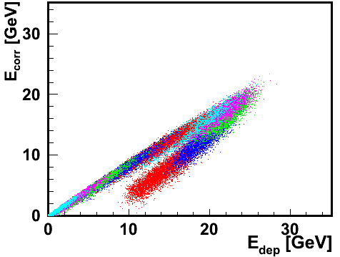
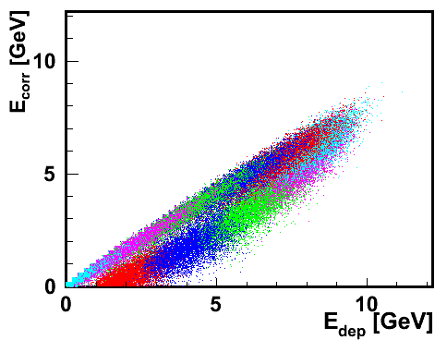
Simple subtraction of the normalized energy in outer modules from energies in all modules
No fitting procedure!
Lack of energy,
No energy in beam hole,
Worse separation of central/peripheral events.

Slide 16
Centralities in FHCal
Corrected energy
Dependences of resolutions of impact parameter on centrality.

Slide 17
Conclusion
The transverse energy depositions in FHCal modules were considered.
A few types of energies (transverse, longitudinal, corrected) were constructed.
Clear central/peripheral events separation is observed in the energy correlations.
The observed correlations provide the tool for evaluation of the centrality classes with FHCal alone.
The developed method allows to (partially) subtract the non-spectator contribution in FHCal energy.
It might be possible to study the properties of the spectator’s spots.
The number of free (protons, neutrons) spectators could be evaluated.
The energy of escaped into beam hole fragments can be estimated from the number of free spectators (using the models or experimental data).
Other generators (with markers of the spectator) are needed for further study of the spectator/non-spectator contributions.

Slide 18
Thank you!

Slide 19
Backup slides

Slide 20
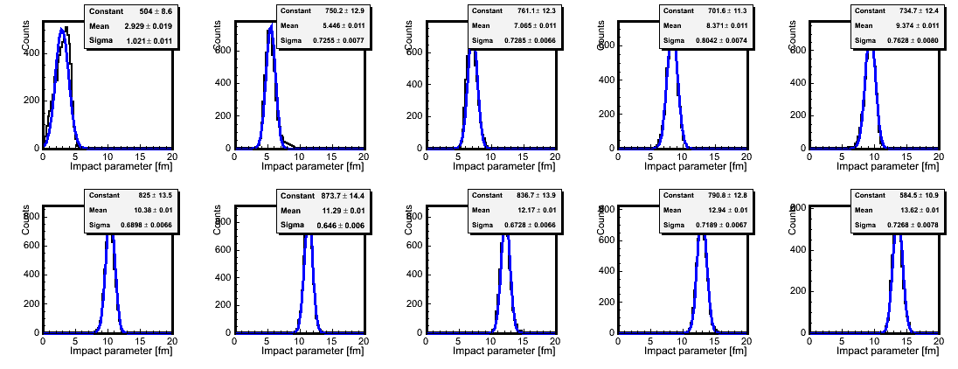
Centrality determination with EdepEcalc bins (10. 20, … 100 % of events

Slide 21
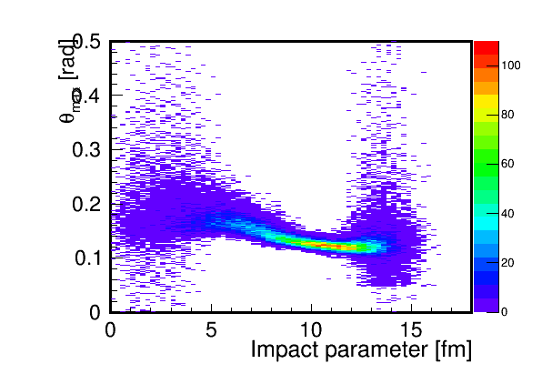

Slide 22
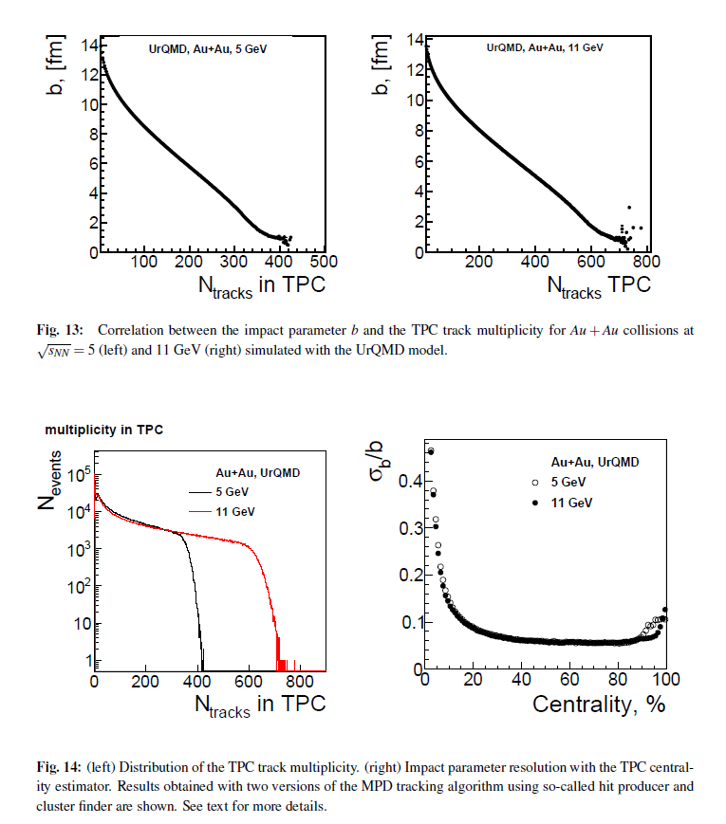
FHCal TDR

Slide 23
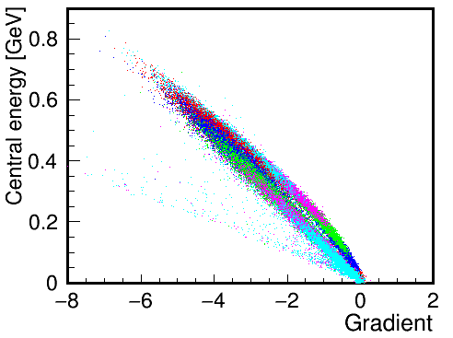
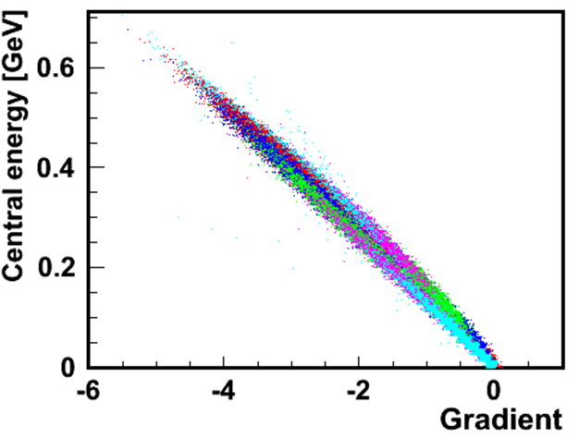
Fit parameters before and after subtraction of the energy in last point
before
before
Central events
Peripheral events
Peripheral events
Central events
after
after
Central events
Central events
Peripheral events
Peripheral events

