Slide 1
Status of works concerning the Solenoid installation and switching on
Electrical power supply system
Water cooling system
Cryogenic system
Control system

Slide 2
Electrical power consumption
PS SC: 25 kW
PS TRIM 1: 210 kW
PS TRIM 2: 58.5 kW
Vacuum Pumps: ≈ 10 kW
Control System (with instruments): ≈ 10kW

Slide 3
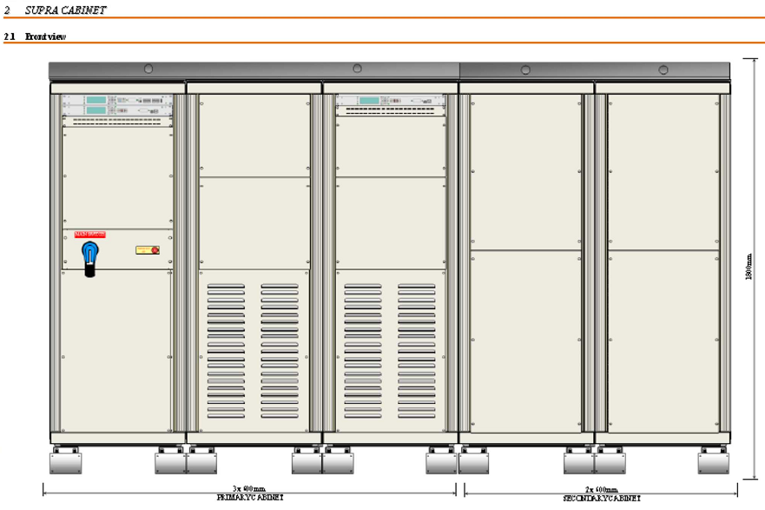

Slide 4
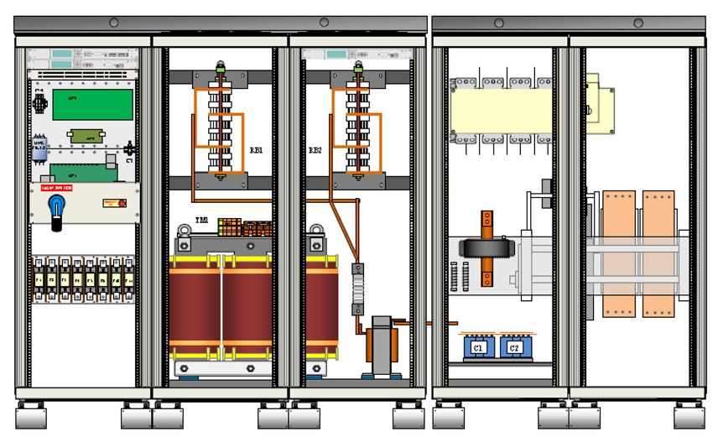

Slide 5

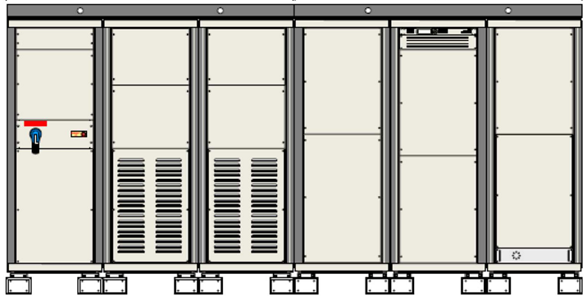

Slide 6
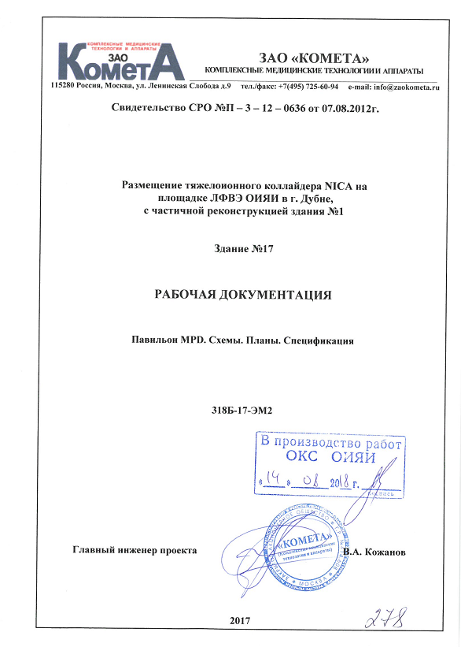

Slide 7
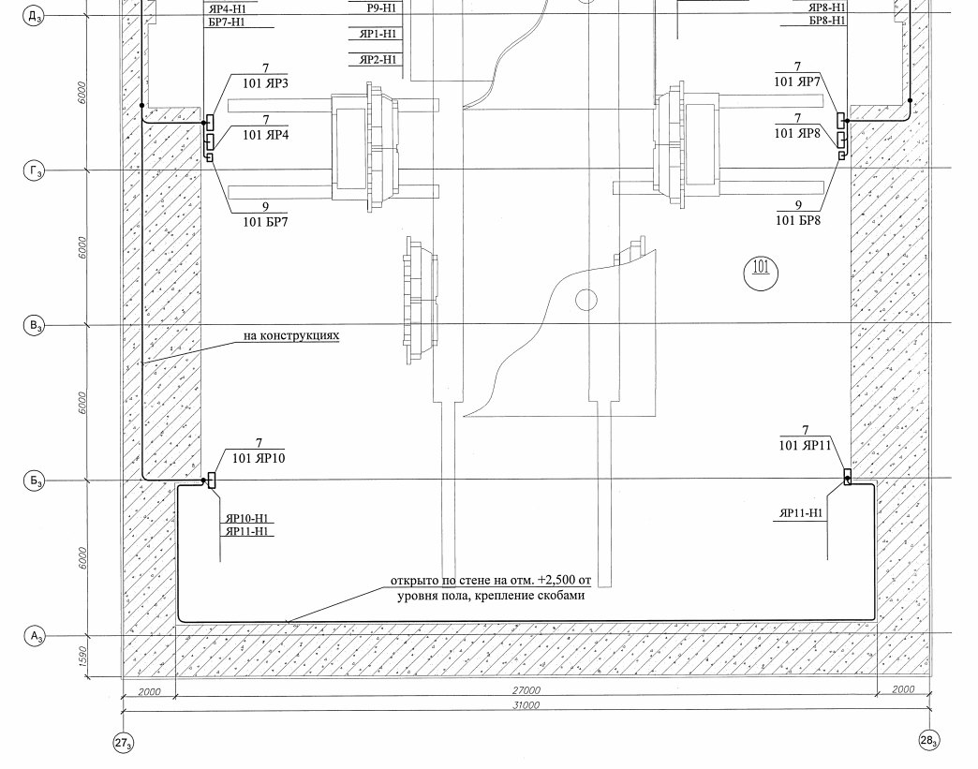

Slide 8
What is necessary to do:
Engineering project of connections
Installation and commissioning once the MPD hall is ready

Slide 11
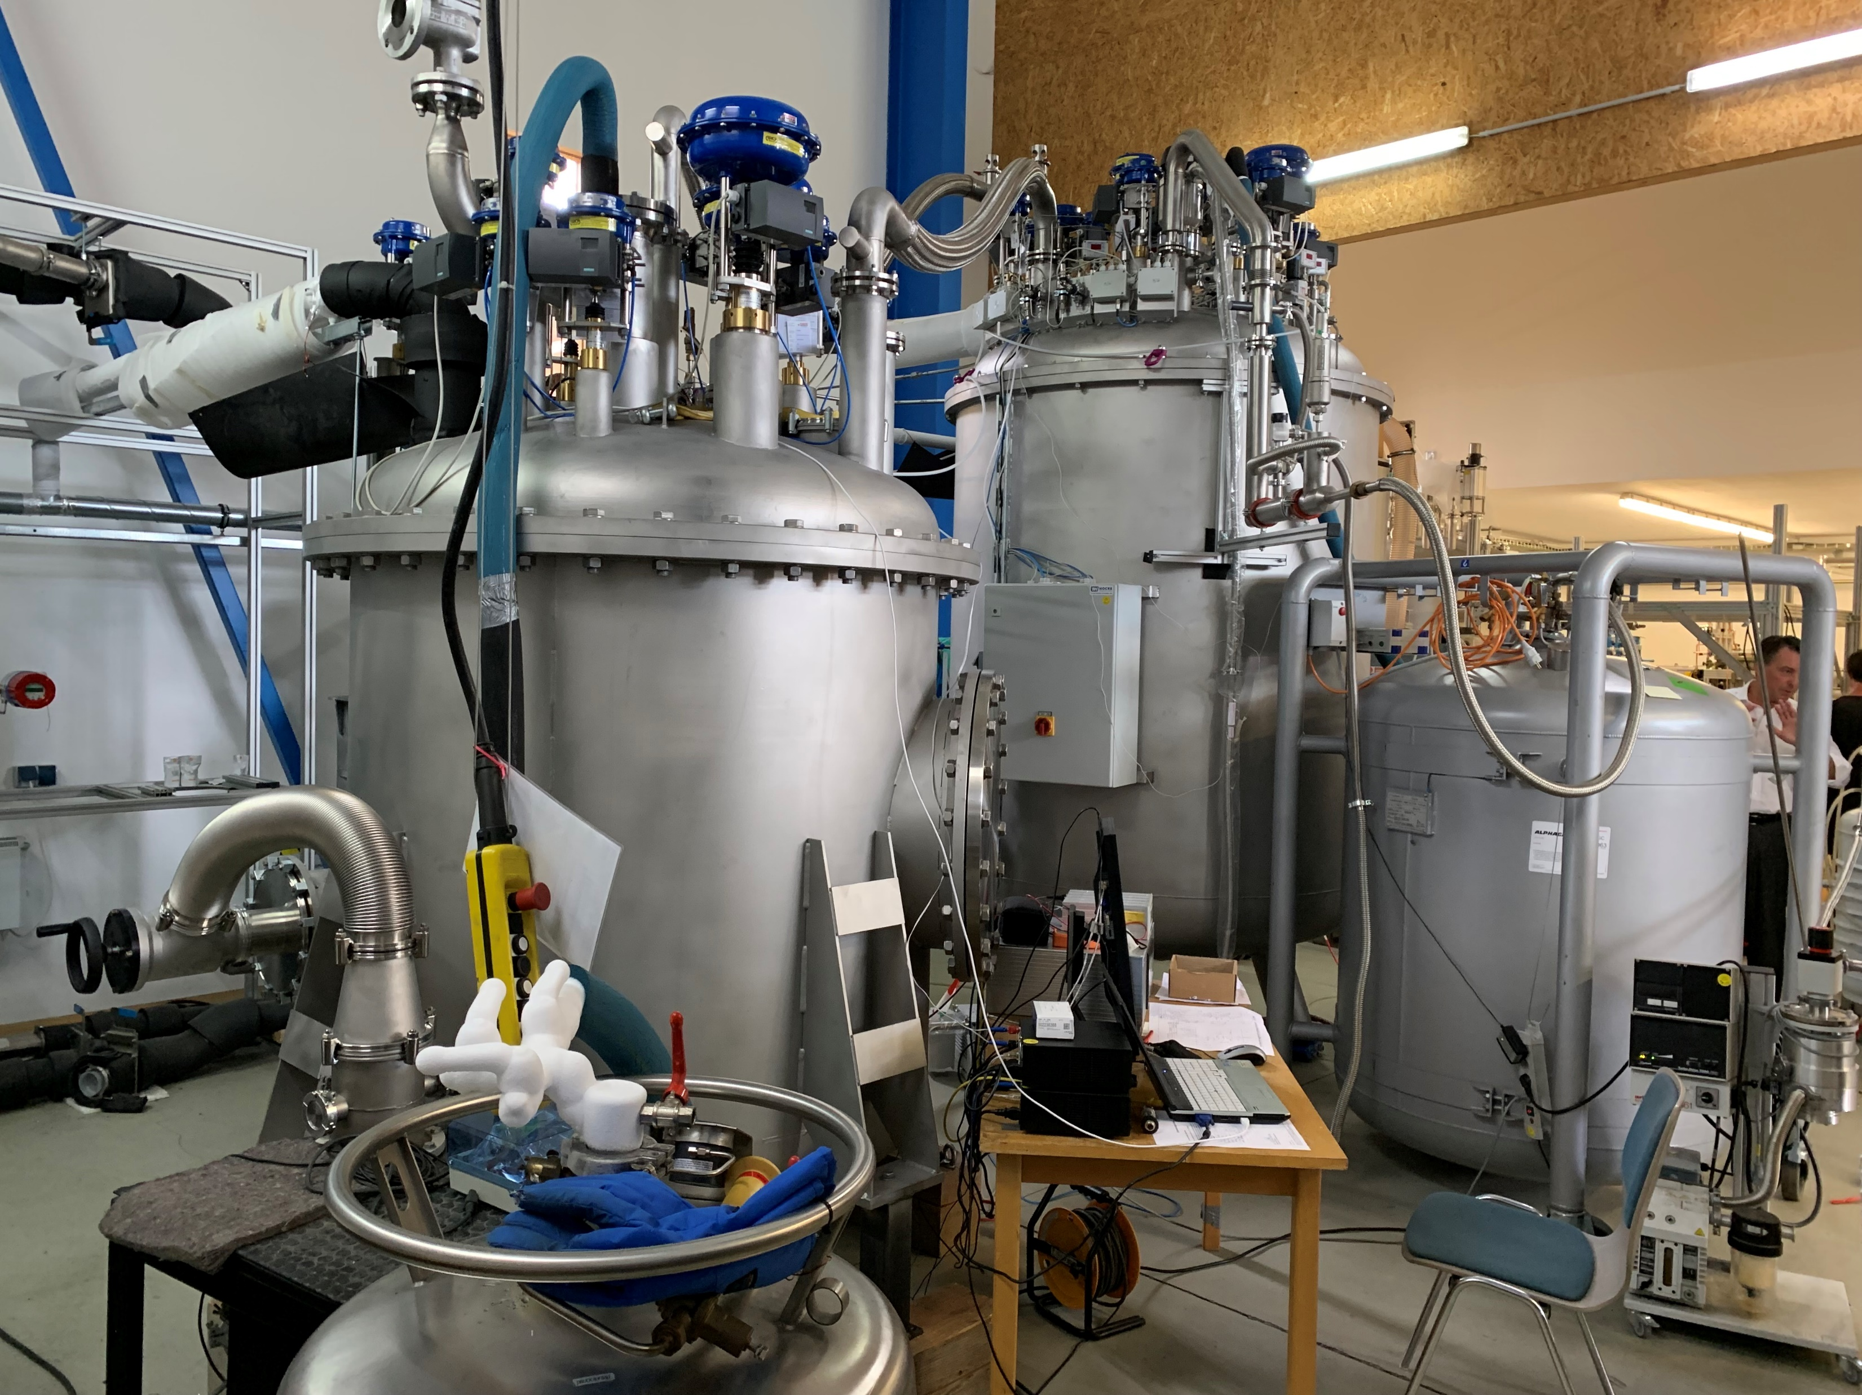

Slide 16
What is necessary to do:
To finalize the engineering project
To procure the pipelines
To procure the nitrogen heating device
To build temporary warm pipeline between the buildings #1B and #17
To procure LN2 and LHe vessels
To assemble the temporary LN2 system (like the one in #217 bld.)
To assemble the pipelines with refrigerator inside the MPD hall

