Slide 1
Decay $B_{s}→K^{∗0}μ^{+}μ^{−}$ in covariant confined quark model
Aidos Issadykov, Mikhail A. Ivanov

Slide 2
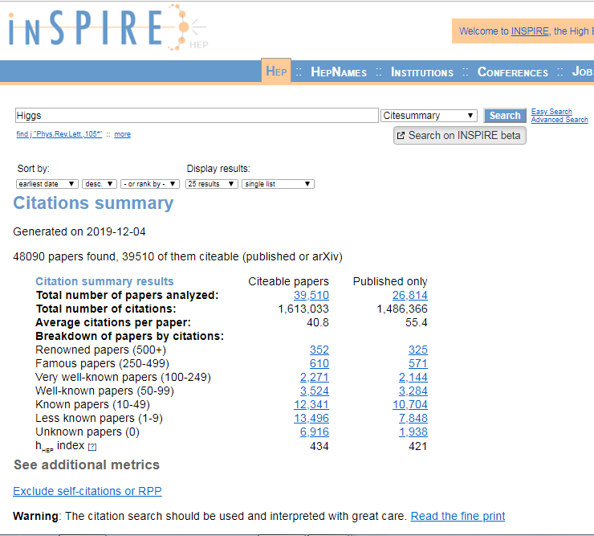

Slide 3
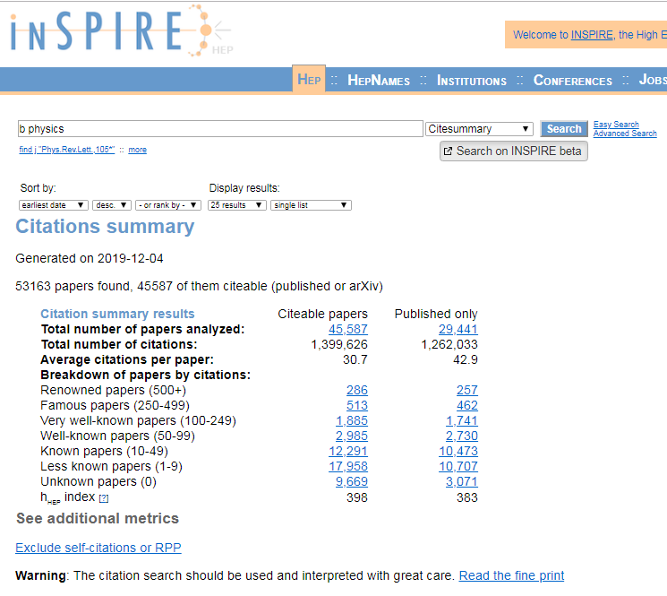

Slide 4
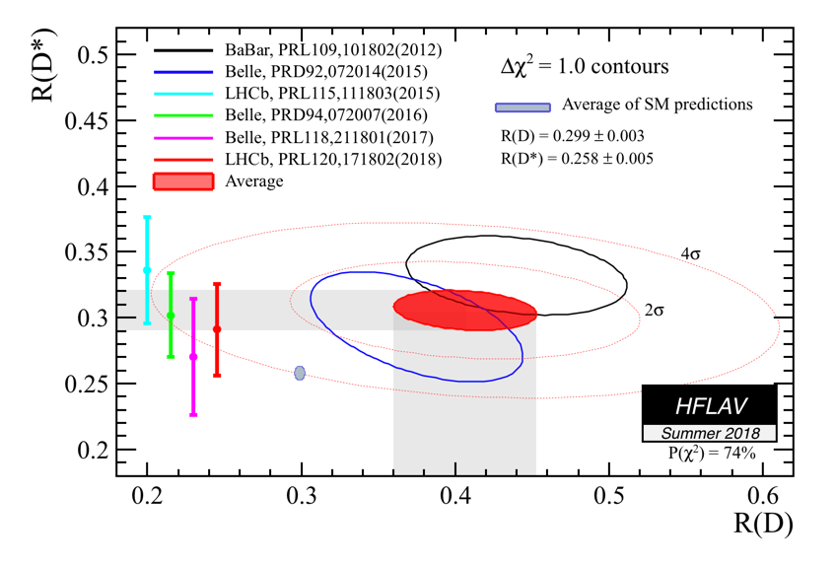
b-c transition
(One of ) the largest discrepancies between SM and measurement
Up to 4.1 σ disagreement

Slide 5
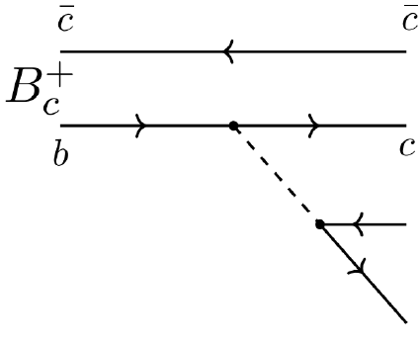
Semileptonic decays of B_{c} meson
*R. Aaij et al. Phys.Rev.Lett. 120 (2018) 121801

Slide 6
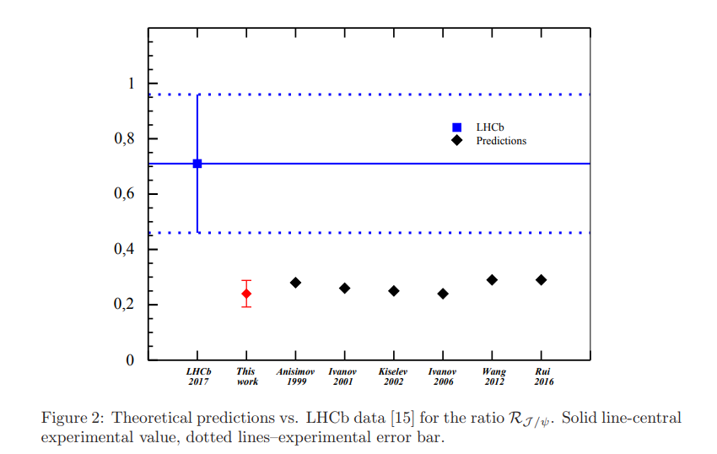
Branching ratios of semileptonic $B_{c}$ decays
*A. Issadykov, Mikhail A. Ivanov, Phys.Lett. B783 (2018) 178-182

Slide 7
Nonleptonic decays of B_{c} meson
LHCb collaboration(nonleptonic):
*R. Aaij et al. [LHCb Collaboration], JHEP 1309 (2013) 075
*R. Aaij et al. [LHCb Collaboration], JHEP 1609 (2016) 153

Slide 8
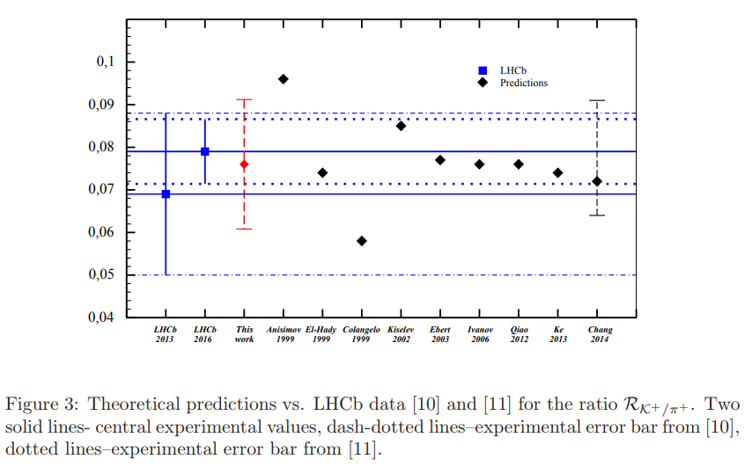
Ratios of branching fractions
*A. Issadykov, Mikhail A. Ivanov, Phys.Lett. B783 (2018) 178-182

Slide 9
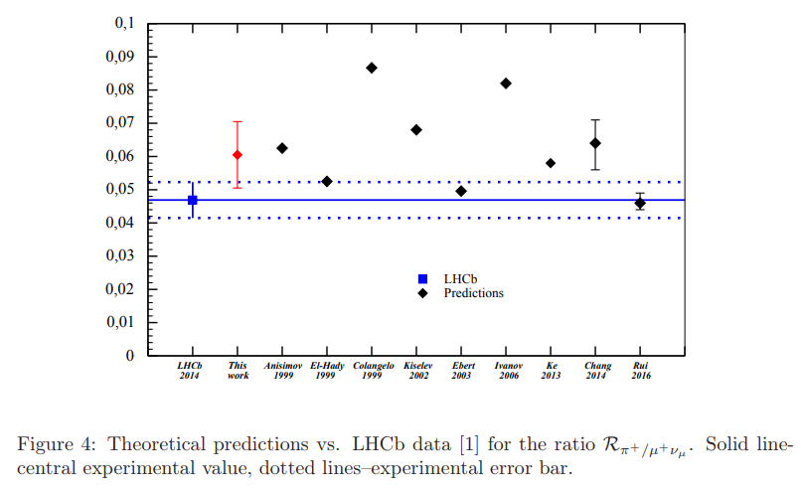
Ratios of branching fractions
*A. Issadykov, Mikhail A. Ivanov, Phys.Lett. B783 (2018) 178-182

Slide 10
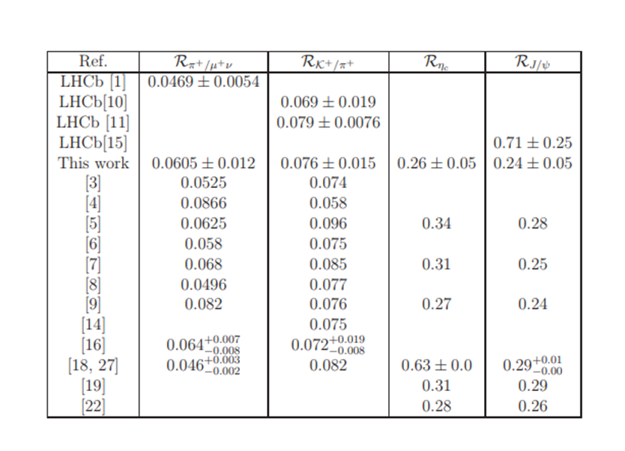
New physics in B_{c} meson decays?

Slide 11
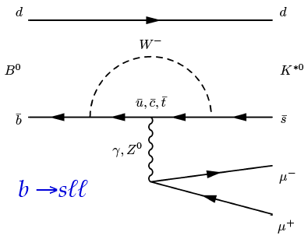
Rare decays of B meson
Loop-level decays b → sℓ⁺ℓ⁻:
forbidden at tree-level in SM
sensitive to NP contributions in loops

Slide 12
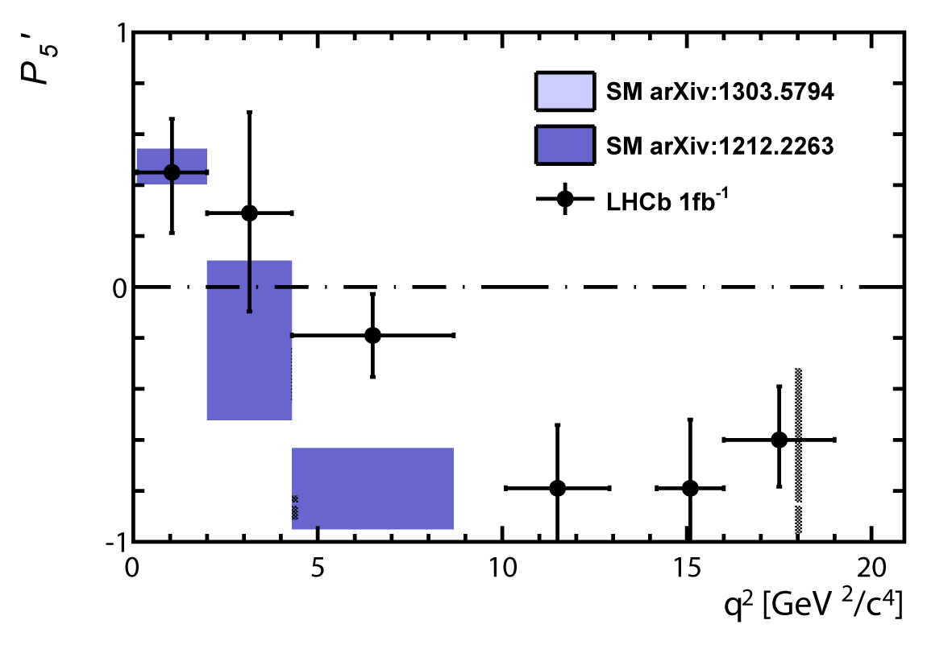
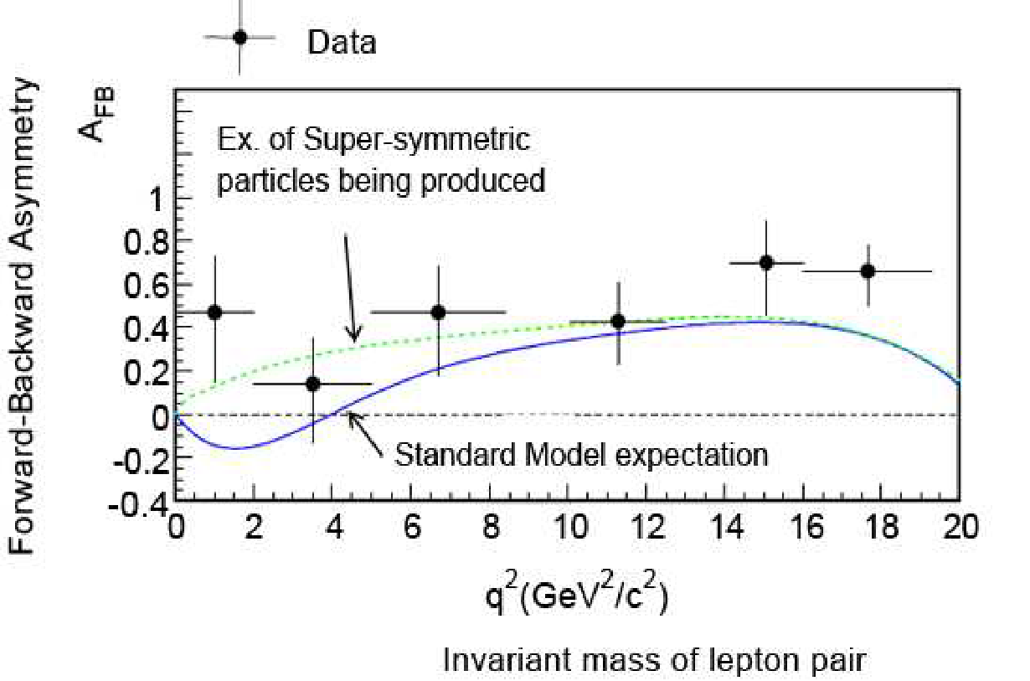
Rare decays of B meson
3.4 σ
~ 3 σ
*Phys.Rev.Lett. 111 (2013) 191801

Slide 13
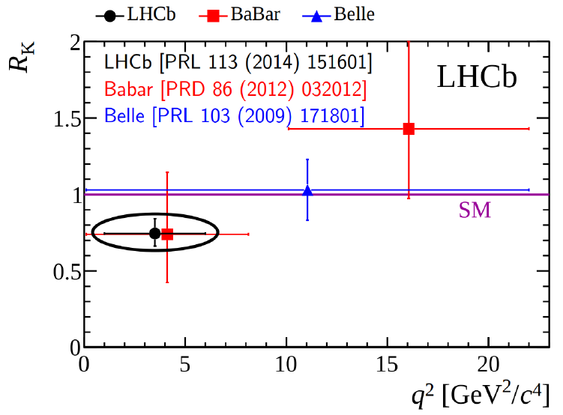
$$R_{K^{}}$$

Slide 14
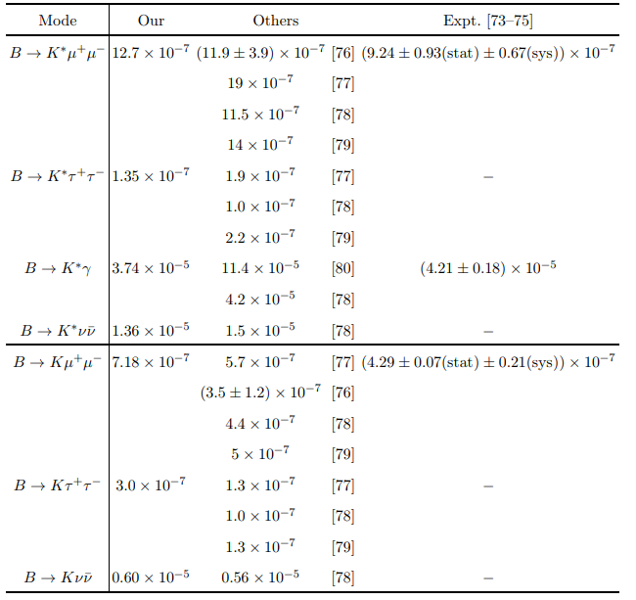
$\text{b} \text{→} \text{s} \text{transition}$

Slide 15
“b-s anomaly”
В→K* 𝜇⁺𝜇⁻
В_{s}→ $φ$𝜇⁺𝜇⁻
В_{s}→𝜇⁺𝜇⁻
up to 3 σ ??
about 2.2 σ
less than 2 σ
Phys.Rev. D91 (2015) no.7, 074007 (arXiv:1502.05280)
Phys.Rev. D93 (2016) no.9, 094022 (arXiv:1602.07864)
Phys.Part.Nucl.Lett. 15 (2018) no.4, 393-396 (arXiv:1807.04996)

Slide 16
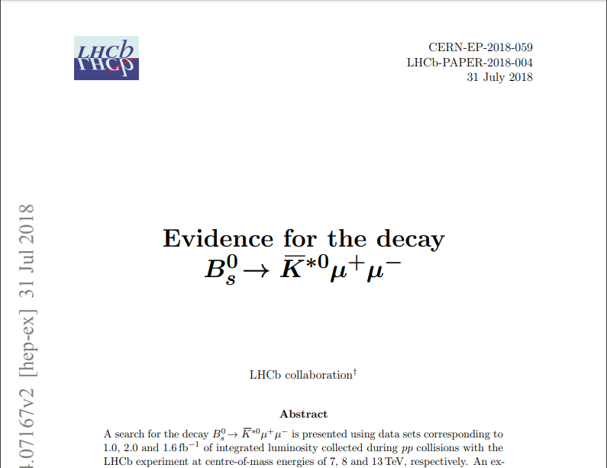
b-d transition

Slide 17
Effective Hamiltonian
$\text{b}\text{ → }\text{s} \text{transition}$ :
$\text{b}\text{ → }\text{d} \text{transition}$ :

Slide 18
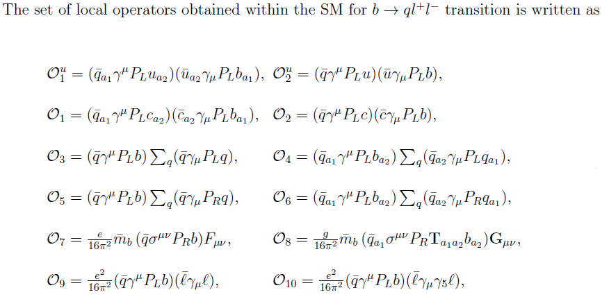
Effective Hamiltonian

Slide 19
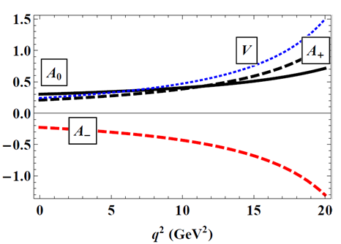
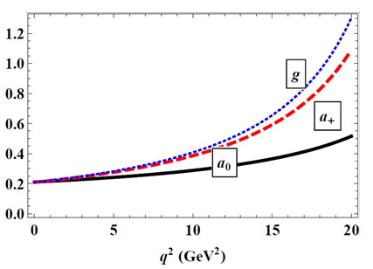
Form factors of B_{s} → K*⁰ decay
*Aidos Issadykov, EPJ Web Conf. 204 (2019) 08003

Slide 20
Form factors of B_{s} → K*⁰ decay
*Lcsr

Slide 21
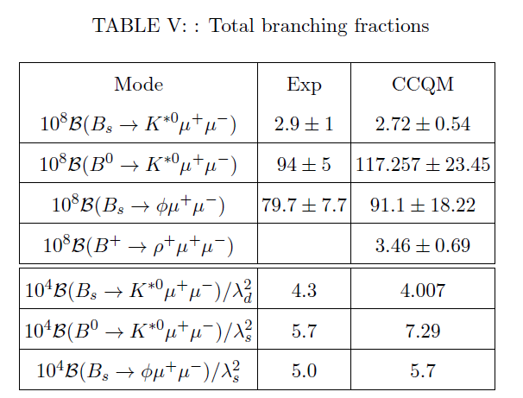
Branching ratios

Slide 22
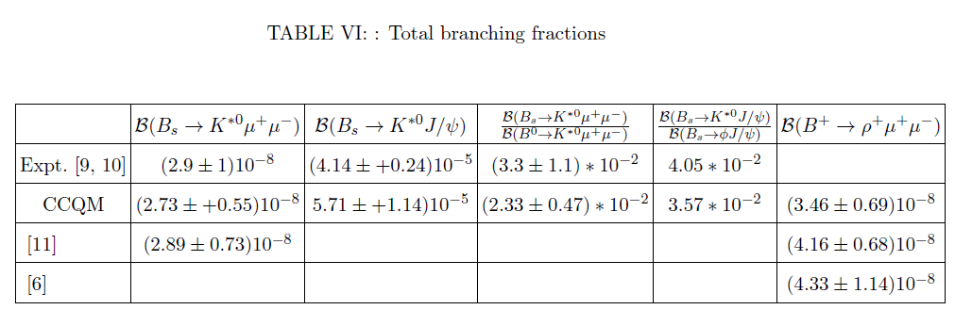
Branching ratios

Slide 23
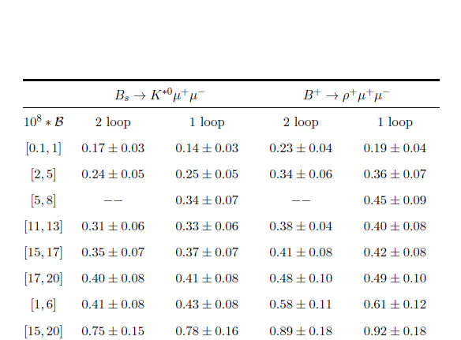
Binned branching ratios

Slide 24
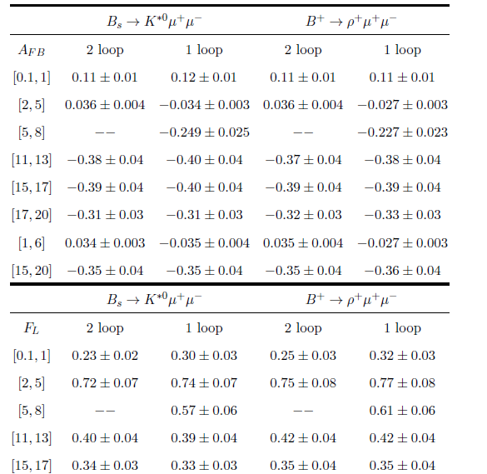
Binned angular observables

Slide 25
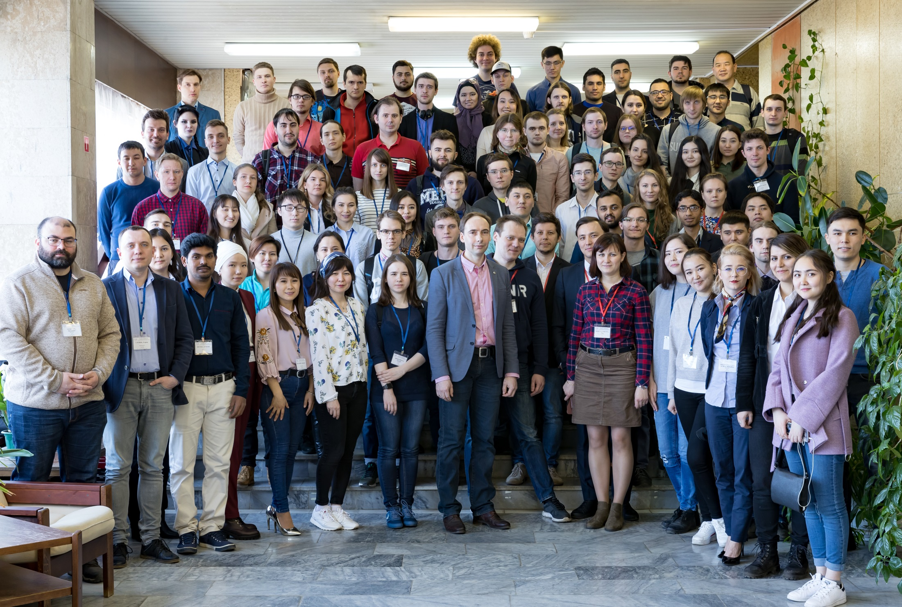
Thank you for your attention

Slide 26
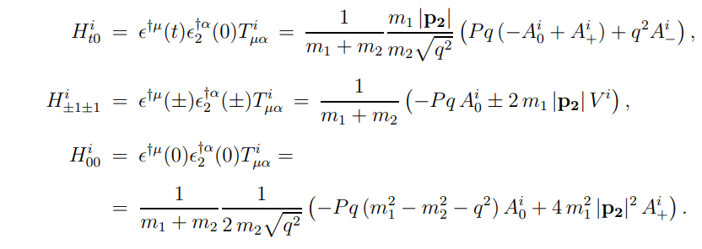

Slide 27
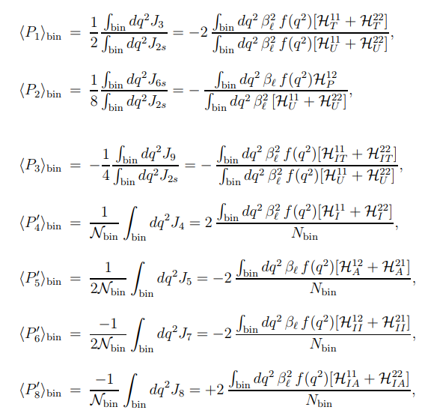

Slide 28
