Slide 1
Proposal for 2022 – International Year of Basic Sciences for Sustainable Development
M. Spiro
President of IUPAP
Chair of the Steering Committee for the proclamation of an International Year of Basic Sciences for Sustainable Development in 2022 (IYBSSD 2022)
Notes:
Taken from the brochure which is on Own Drive and which you are invited to read and comment

Slide 2
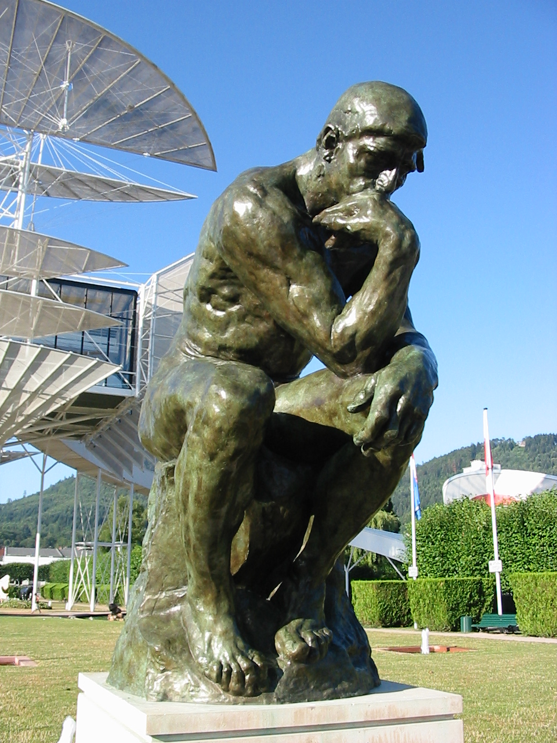
2022
IYBSSD
International Year of Basic Sciences for Sustainable Development Basic Sciences under the spotlight
Basic Sciences are a key tool to provide a multi-cultural dialogue, with “scientific diplomacy” a known and demonstrated means to contribute to a more peaceful world
Leading Union
htpps//www.iybsd.org

Slide 3
Rationale (1)
Although it is generally recognized that science is useful for society, quite often, basic sciences, curiosity driven, are not considered as they should deserve, in the discussions concerning the societal, environmental and economic development.
After the International Year of Physics, the International Year of Chemistry, the International Year of Mathematics, the International Year of Astronomy, of Crystallography, of Light, of the Periodic Table of Elements, it is time to plan an International Year of Basic Sciences for Development
Basic Sciences, curiosity driven, construct the pool of knowledge which future generations will use for their development→ sustainability!

Slide 4
Rationale (2)
2022 would be a good time to celebrate Basic Sciences for Development (fit well with UNESCO and UN agenda, IUPAP (International Union of Pure and Applied Physics) and many other unions centenary, 100 years Niels Bohr Nobel award, , Stern and Gerlach, Compton scattering, 200 years Brazil independence, mid-sustainable goals agenda)

Slide 5
EXAMPLES
The WEB was born at CERN from the needs of global collaboration for fundamental science.
The success of Google, the second largest company in the world, comes from a brilliant mathematical idea.
Artificial intelligence relies on statistical methods and will have an influence on all aspects of society.
Cellular phones come from the discovery of transistors, integrated circuits, WiFi astronomy spin-off developments.
GPS accuracy is a spin-off of Einstein General Relativity, and the improvement in accuracy of atomic clocks based on quantum technology
The discovery of DNA has revolutionized Medicine
The Genome Project has opened the way to gene therapies.
The development of innovative instrumentation for Basic Sciences has many impacts for Health and Development: PET, MRI, Adaptative Optics.
The rapid uptake of the generation and storage of renewable energy depends on advances in physics, chemistry and materials science.
Reduction in pollution and green chemistry rely on basic advances in chemistry
…

Slide 6
Support for IYBSD – 2022 (1)
The proposal of 2022 as the International Year of Basic Sciences for Development was well received and got the oral and then formal support of the representatives of ICSU (International Council for Science), ISSC (International Social Sciences Council)→now ISC, IUPAC (International Union for Pure and Applied Chemistry),IAU, IMU,IUBS, IUCR, IUMRS, IUGG, ICTP (Abdus Salam International Center for Theoretical Physics), EPS (European Physical Society), CERN (European Organization for Particle Physics), JINR (Joint Institute for Nucelar Research) and IRD (Institut de Recherches pour le Développement), SESAME, Weizmann Institute. The proposal was presented to the Jordan ambassador to UNESCO and received a firm support to bring this project to UNESCO, with the support of Nigeria, Russia and Vietnam. It was also discussed with the director at UNESCO, of Science Policy and Capacity Building, Executive Secretary of IBSP (International Basic Sciences Program at UNESCO), very supportive of the initiative. IBSP is giving its support.

Slide 7
Support for IYBSD – 2022 (2)
The resolution for the proclamation of an International Year of Basic Sciences for Sustainable Development in 2022 was adopted by the UNESCO Executive Board in October 2019 and the UNESCO General Conference in November 2019
It was also welcomed by the World Science Forum2019 in Budapest
It will have to be proclaimed by the United Nations General Assembly

Slide 8
Tentative list of topics
Basic Sciences and Multicultural Dialogue
Basic Sciences, Education and Human Development
Basic Sciences and Women (figures, empowering women, role models)
Basic Sciences, Innovation and Economy
Basic Sciences and Life Sciences
Basic Sciences and Global Challenges
Basic Science as a Global Public Good
Basic Sciences and the sustainable development goals

Slide 9
SOME EVENTS
Centenary of IUPAP in Geneva can be a pillar event of IYBSSD : CERN can play a major role
Use ISC regional offices and UNESCO centres to organize events
The IYBSSD 2022 events could be global, regional, national in developed and in developing countries. We have to foresee some centralized funding to help (especially to attend the events)

Slide 10
SOME possible resulting ACTIONS
Institutionalize full implementation of open access publishing for all research papers connected to Fundamental Research, i.e. curiosity driven. This will allow free access to Universities to all published material in Basic Sciences
More generally promote Open Science in all Basic Sciences.
Promote inclusive collaboration in Fundamental Research (teams from developed countries together with teams from developing countries, gender balance…)
Organize top level international scientific or educational events in developing countries with many side events. International Scientific Unions should be mobilized for that purpose.
Promote training and education to Basic Sciences in developing countries..

Slide 11
Steps (tentative schedule)
2018 Formal recommendation by IBSP for 2022 – International Year for Basic Sciences for development (done)
2019 Formal approval by the General Conference of UNESCO (November) (done)
Enlarge the circle of Unions, Partners and Academies (in progress, thanks to ISC ..)
2020 Approval by the UN General Assembly (December) → need some lobbying!
2021 Detailed Preparation of Regional and International events
2022 International Year of Basic Sciences for Sustainable Development

Slide 12
Budget issue for the preparation of IYBSSD 2022 (needed centralized budget)
Publicity material 50 K
Lobbying 50 K
Seed funds to initiate events (visits to potential host authorities..) 50 K
Collect statistics which could be advertized in 2022 50 K
Total 200 K

Slide 13
Thank You
We count on You All for All that!!!

