Slide 1
Developing a Toolkit for Task Characteristics Prediction Based on Analysis of Queue’s History of a Supercomputer
Mahdi Rezaei
Moscow Institute of Physics and Technology
Alexey Salnikov
Moscow Institute of Physics and Technology,
Moscow State University
Alexander Shiryaev
Moscow Institute of Physics and Technology
9th International Conference ”Distributed Computing and Grid Technologies in Science and Education” (GRID’2021), Dubna, Russia

Slide 2
Developing a Toolkit for Task Characteristics Prediction Based on Analysis of Queue’s History of a Supercomputer
Prediction in HPC systems:
Resource management in High Performance Computing (HPC).
SLURM as a job schedulers to manage workload on HPC systems.
Major drawback of SLURM.
9th International Conference ”Distributed Computing and Grid Technologies in Science and Education” (GRID’2021), Dubna, Russia

Slide 3
Developing a Toolkit for Task Characteristics Prediction Based on Analysis of Queue’s History of a Supercomputer
Features of the task flow
User’s resource estimation lacks accuracy.
Underestimation and Overestimation of resource allocation.
Therefore, we need to construct a software which can predict the required resources based on historical data.
9th International Conference ”Distributed Computing and Grid Technologies in Science and Education” (GRID’2021), Dubna, Russia

Slide 4
Developing a Toolkit for Task Characteristics Prediction Based on Analysis of Queue’s History of a Supercomputer
Our approach
A supervised machine learning (ML) system is being built based on the collection of statistical data from reference queue systems.
Predictive analytics tasks, that means regression and classification.
A plugin in practical applications used by the system user was studied.
Results indicated that:
adding more features to the dataset improves the prediction accuracy.
the plugin allows practical use of the proposed machine learning algorithms for user decision making.
9th International Conference ”Distributed Computing and Grid Technologies in Science and Education” (GRID’2021), Dubna, Russia

Slide 5
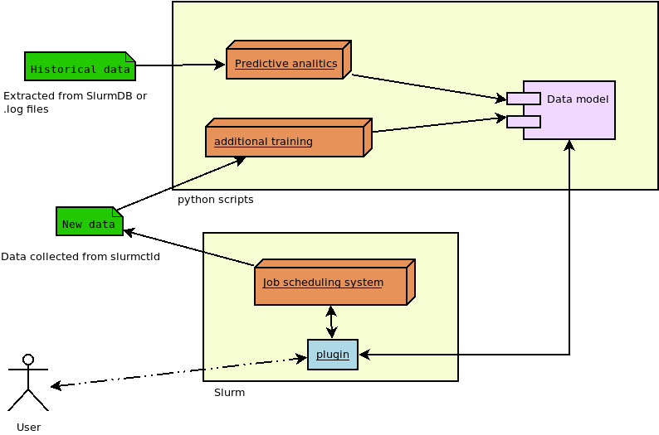
Developing a Toolkit for Task Characteristics Prediction Based on Analysis of Queue’s History of a Supercomputer
Block diagram of our proposed system
9th International Conference ”Distributed Computing and Grid Technologies in Science and Education” (GRID’2021), Dubna, Russia

Slide 6
Developing a Toolkit for Task Characteristics Prediction Based on Analysis of Queue’s History of a Supercomputer
Machine Learning
9th International Conference ”Distributed Computing and Grid Technologies in Science and Education” (GRID’2021), Dubna, Russia

Slide 7
Developing a Toolkit for Task Characteristics Prediction Based on Analysis of Queue’s History of a Supercomputer
Predictive analytics
Predictive analytics is the use of statistical data, and machine learning techniques to identify the likelihood of future outcomes based on historical data.
There are two types of predictive models:
Classification model
Regression model
9th International Conference ”Distributed Computing and Grid Technologies in Science and Education” (GRID’2021), Dubna, Russia

Slide 8
Developing a Toolkit for Task Characteristics Prediction Based on Analysis of Queue’s History of a Supercomputer
Regression vs Classification
Classification algorithms are used when the output is a discrete label.
Regression is useful for predicting continuous outputs.
In this project we use regression algorithms to predict the amount of required resources (CPUs and time slots) and classification algorithms to check failure of jobs due to resource underestimation.
9th International Conference ”Distributed Computing and Grid Technologies in Science and Education” (GRID’2021), Dubna, Russia

Slide 9
Developing a Toolkit for Task Characteristics Prediction Based on Analysis of Queue’s History of a Supercomputer
Construction features and custom modelling for our ML
We used the Python programming language.
We used TensorFlow.
We used scikit-learn libraries.
9th International Conference ”Distributed Computing and Grid Technologies in Science and Education” (GRID’2021), Dubna, Russia

Slide 10
Developing a Toolkit for Task Characteristics Prediction Based on Analysis of Queue’s History of a Supercomputer
Algorithms used for regression
MLP: Multilayer Perceptron
RFR: Random Forest Regression
LR: Lasso Regression
KNN: K-Nearest Neighbor Regression
OLSR: Ordinary least-squares regression:
SVR: Support Vector Regression
RR: Ridge Regression
PR: Polynomial Regression
CARTR: CART (Classification and Regression Trees) Regression
Algorithms used for classification
Naive Bayes classifier
Kernel Support Vector Machines (SVM)
CART classification
9th International Conference ”Distributed Computing and Grid Technologies in Science and Education” (GRID’2021), Dubna, Russia

Slide 11
Developing a Toolkit for Task Characteristics Prediction Based on Analysis of Queue’s History of a Supercomputer
Plugin
9th International Conference ”Distributed Computing and Grid Technologies in Science and Education” (GRID’2021), Dubna, Russia

Slide 12
Developing a Toolkit for Task Characteristics Prediction Based on Analysis of Queue’s History of a Supercomputer
Why plugin?
To implement our system on real clusters we designed a plugin.
Our plugin is dynamically connected SPANK plugin and while executing srun and sbatch commands, takes control on them.
The plugin by default is connected to Slurm plugstack.conf configuration file.
9th International Conference ”Distributed Computing and Grid Technologies in Science and Education” (GRID’2021), Dubna, Russia

Slide 13
Developing a Toolkit for Task Characteristics Prediction Based on Analysis of Queue’s History of a Supercomputer
Types of plugins
Static. Connected by adding plugin’s source code in a special way into the SLURM source code and somehow rebuilding the SLURM.
Dynamic. Connected to the SLURM through a special interface SPANK (without access to the SLURM source code). This type, requires adding parameters to the plugstack.conf configuration file.
9th International Conference ”Distributed Computing and Grid Technologies in Science and Education” (GRID’2021), Dubna, Russia

Slide 14
Developing a Toolkit for Task Characteristics Prediction Based on Analysis of Queue’s History of a Supercomputer
Experiments
9th International Conference ”Distributed Computing and Grid Technologies in Science and Education” (GRID’2021), Dubna, Russia

Slide 15
Developing a Toolkit for Task Characteristics Prediction Based on Analysis of Queue’s History of a Supercomputer
Data preparation
Collected statistics of Bluegene/P system installed at the Faculty of Computational Mathematics and Cybernetics, Lomonosov Moscow State University named after M.V Lomonosov.
This statistic includes information of jobs which have been run during almost 12 months in 2017.
To train our ML, two sets of features are used: per_job features and per_user features.
9th International Conference ”Distributed Computing and Grid Technologies in Science and Education” (GRID’2021), Dubna, Russia

Slide 16
Developing a Toolkit for Task Characteristics Prediction Based on Analysis of Queue’s History of a Supercomputer
per_job features
Feature | Description
time_limit | time requested by the user for the job
num_cpus | the number of processors requested for the job
id | task id as defined in the job scheduling system
name | user-specified task name
user | Username
group | user group
task_class | task class
state | the status of a job that has been completed or deleted
required_time | the time during which the task is executed. This time will be predicted for newly submitted jobs.
required_cpu | the number of processors used by the job at runtime. This number will be predicted for newly submitted jobs.
9th International Conference ”Distributed Computing and Grid Technologies in Science and Education” (GRID’2021), Dubna, Russia

Slide 17
Developing a Toolkit for Task Characteristics Prediction Based on Analysis of Queue’s History of a Supercomputer
per_user features
Feature | Description
used_portion_of_time_limit | the reasonableness of the runtime requested by the user
avg_aborted_task | percentage of interrupted tasks submitted by the user
average_congestion | average system load by user
average_cpus | average number of CPUs requested
duration | average waiting time in queue
wait_time / time_limit | Average ratio of time in queue to requested time
average_time_limit | Average time set by user
9th International Conference ”Distributed Computing and Grid Technologies in Science and Education” (GRID’2021), Dubna, Russia

Slide 18
Developing a Toolkit for Task Characteristics Prediction Based on Analysis of Queue’s History of a Supercomputer
Plugin design
Our plugin is called as MLSP (Machine Learning Slurm Plugin).
This application is divided into 2 subsystems:
fit-subsystem which trains models and
predict-subsystem which predicts the start time of the submitted job using present models.
The language to develop our plugin is C programming.
9th International Conference ”Distributed Computing and Grid Technologies in Science and Education” (GRID’2021), Dubna, Russia

Slide 19
Developing a Toolkit for Task Characteristics Prediction Based on Analysis of Queue’s History of a Supercomputer
Solution methods
Several options for solving this problem were considered:
modify the Slurm source code,
write a "fat" plugin for Slurm that would run including user code,
write a "thin" plugin for Slurm, and do the main work in a separate demon Linux, written on comfortable language programming.
9th International Conference ”Distributed Computing and Grid Technologies in Science and Education” (GRID’2021), Dubna, Russia

Slide 20
Developing a Toolkit for Task Characteristics Prediction Based on Analysis of Queue’s History of a Supercomputer
Alternative method
Writing a thin plugin avoids rebuilding Slurm while changes occur.
Rebuilding Slurm is pretty useless
In addition, during development, you will have to write more C code.
Writing the thin plugin will also allows us to decouple the work of training the model from the launch Slurm. But for a separate application you need your own scripts /configuration files to run.
9th International Conference ”Distributed Computing and Grid Technologies in Science and Education” (GRID’2021), Dubna, Russia

Slide 21
Developing a Toolkit for Task Characteristics Prediction Based on Analysis of Queue’s History of a Supercomputer
Alternative method
A dynamically connected SPANK plugin, which will add the option “--predict-time” and take control on executing the srun and sbatch commands.
The plugin is connected by default in the Slurm plugstack.conf configuration file. There you can also set arguments for the plugin.
The plugin must be developed in the language C programming.
9th International Conference ”Distributed Computing and Grid Technologies in Science and Education” (GRID’2021), Dubna, Russia

Slide 22
Developing a Toolkit for Task Characteristics Prediction Based on Analysis of Queue’s History of a Supercomputer
Component development
Main application
Spank plugin
9th International Conference ”Distributed Computing and Grid Technologies in Science and Education” (GRID’2021), Dubna, Russia

Slide 23
Developing a Toolkit for Task Characteristics Prediction Based on Analysis of Queue’s History of a Supercomputer
Main application
The application in this case was called MLPD (Machine Learning Python Daemon).
The main file of the mlpd.py application contains the function mlpd (), which implements the application. The main application must support training the model and responding to HTTP requests and is a Linux daemon.
Thus, the application can be divided into 2 subsystems:
model training (fit subsystem) and
predictions time by the current model (predict subsystem).
9th International Conference ”Distributed Computing and Grid Technologies in Science and Education” (GRID’2021), Dubna, Russia

Slide 24
Developing a Toolkit for Task Characteristics Prediction Based on Analysis of Queue’s History of a Supercomputer
SPANK plugin
The plugin in this case was named MLSP (Machine Learning Slurm Plugin).
The main SPANK plugin file is a dynamic librarymlsp.so whose source file is mlsp.c.
The code is divided into 2 large parts:
main - for working with Slurm.
auxiliary – for work with the server.
9th International Conference ”Distributed Computing and Grid Technologies in Science and Education” (GRID’2021), Dubna, Russia

Slide 25
Developing a Toolkit for Task Characteristics Prediction Based on Analysis of Queue’s History of a Supercomputer
Working with Slurm and SPANK
The system must be told that user is using SPANK.
Furthermore, it is necessary to register the --predict-time option before processing.
9th International Conference ”Distributed Computing and Grid Technologies in Science and Education” (GRID’2021), Dubna, Russia

Slide 26
Developing a Toolkit for Task Characteristics Prediction Based on Analysis of Queue’s History of a Supercomputer
Working with the server
The predicttime() function accepts the argc and argv[] as startup arguments and should do the following steps:
Prepare and execute an HTTP request.
Show the answer.
9th International Conference ”Distributed Computing and Grid Technologies in Science and Education” (GRID’2021), Dubna, Russia

Slide 27
Developing a Toolkit for Task Characteristics Prediction Based on Analysis of Queue’s History of a Supercomputer
Evaluation
9th International Conference ”Distributed Computing and Grid Technologies in Science and Education” (GRID’2021), Dubna, Russia

Slide 28
Developing a Toolkit for Task Characteristics Prediction Based on Analysis of Queue’s History of a Supercomputer
Regression
Regression with per-job features.
per-user features added to the dataset.
R-squared statistic, a common measure of accuracy, and MSE (Mean Squared Error) were used to evaluate our regression model.
Changes in the value of these criteria are compared.
9th International Conference ”Distributed Computing and Grid Technologies in Science and Education” (GRID’2021), Dubna, Russia

Slide 29
Developing a Toolkit for Task Characteristics Prediction Based on Analysis of Queue’s History of a Supercomputer
Table 1. Regression with per_job features
 | Required number of CPU |  | Required time
Model | MSE | R² | MSE | R²
MLP | 0.18 | 0.29 | 0.37 | 0.47
RFR | 0.01 | 0.99 | 0.31 | 0.56
LR | 0.21 | 0.17 | 0.45 | 0.36
KNN | 0.06 | 0.77 | 0.40 | 0.43
OLSR | 0.17 | 0.21 | 0.45 | 0.37
SVR | 0.11 | 0.20 | 0.22 | 0.13
RR | 0.17 | 0.21 | 0.45 | 0.37
PR | 0.19 | 0.21 | 0.40 | 0.44
CARTR | 0.01 | 0.96 | 0.37 | 0.48
9th International Conference ”Distributed Computing and Grid Technologies in Science and Education” (GRID’2021), Dubna, Russia

Slide 30
Developing a Toolkit for Task Characteristics Prediction Based on Analysis of Queue’s History of a Supercomputer
Table 2. Regression with added per_user features
 | Required number of CPU |  | Required time
Model | MSE | R² | MSE | R²
MLP | 0.07 | 0.72 | 0.33 | 0.54
RFR | 0.02 | 0.98 | 0.3 | 0.57
LR | 0.20 | 0.22 | 0.45 | 0.37
KNN | 0.06 | 0.75 | 0.36 | 0.49
OLSR | 0.20 | 0.22 | 0.44 | 0.37
SVR | 0.21 | 0.17 | 0.15 | 0.37
RR | 0.20 | 0.22 | 0.37 | 0.44
PR | 0.10 | 0.61 | 0.34 | 0.51
CARTR | 0.01 | 0.96 | 0.34 | 0.53
9th International Conference ”Distributed Computing and Grid Technologies in Science and Education” (GRID’2021), Dubna, Russia

Slide 31
Developing a Toolkit for Task Characteristics Prediction Based on Analysis of Queue’s History of a Supercomputer
Classification
Tasks that will be removed from execution
Tasks that will complete successfully.
Classifiers were used:
We used the F1 statistic score (F1-score)
Changes in the value of this criterion are compared.
9th International Conference ”Distributed Computing and Grid Technologies in Science and Education” (GRID’2021), Dubna, Russia

Slide 32
Developing a Toolkit for Task Characteristics Prediction Based on Analysis of Queue’s History of a Supercomputer
Classification using per_job features
 | Naive Bayes classifier |  |  | Kernel Support Vector Machines |  |  | CART classification
 | Precision | Recall | F1-score | Precision | Recall | F1-score | Precision | Recall | F1-score
Job completed | 0.89 | 0.88 | 0.88 | 0.88 | 0.87 | 0.87 | 0.90 | 0.89 | 0.89
Job removed | 0.15 | 0.16 | 0.16 | 0.10 | 0.11 | 0.10 | 0.13 | 0.14 | 0.14
Baseline accuracy | 79.2 % |  |  | 78 % |  |  | 80.64 %
9th International Conference ”Distributed Computing and Grid Technologies in Science and Education” (GRID’2021), Dubna, Russia

Slide 33
Developing a Toolkit for Task Characteristics Prediction Based on Analysis of Queue’s History of a Supercomputer
Classification using per_user features
 | Naive Bayes classifier |  |  | Kernel Support Vector Machines |  |  | CART classification
 | Precision | Recall | F1-score | Precision | Recall | F1-score | Precision | Recall | F1-score
Job completed | 0.88 | 0.87 | 0.87 | 0.89 | 0.88 | 0.89 | 0.90 | 0.90 | 0.90
Job removed | 0.11 | 0.13 | 0.12 | 0.15 | 0.16 | 0.15 | 0.14 | 0.14 | 0.14
Baseline accuracy | 77.92 % |  |  | 79.76 % |  |  | 81.44 %
9th International Conference ”Distributed Computing and Grid Technologies in Science and Education” (GRID’2021), Dubna, Russia

Slide 34
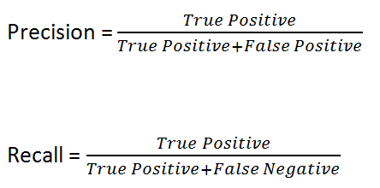
Developing a Toolkit for Task Characteristics Prediction Based on Analysis of Queue’s History of a Supercomputer
Precision and Recall
What proportion of positive identifications were actually correct?
What proportion of actual positives have been identified correctly?
9th International Conference ”Distributed Computing and Grid Technologies in Science and Education” (GRID’2021), Dubna, Russia

Slide 35
Developing a Toolkit for Task Characteristics Prediction Based on Analysis of Queue’s History of a Supercomputer
F1 might be the best measure to use when we need to find a balance between Precision and Recall and there is an uneven distribution of classes.
9th International Conference ”Distributed Computing and Grid Technologies in Science and Education” (GRID’2021), Dubna, Russia

Slide 36
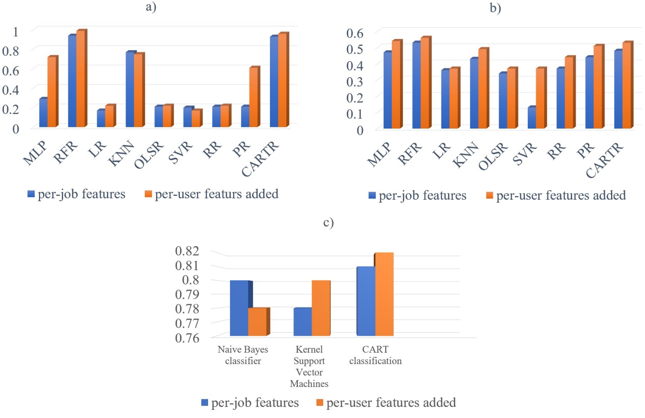
Developing a Toolkit for Task Characteristics Prediction Based on Analysis of Queue’s History of a Supercomputer
(a) R² values in the regression problem to predict the number of required CPUs (b) R² values in the regression problem to predict the required time (c) F1-score of the classification value.
9th International Conference ”Distributed Computing and Grid Technologies in Science and Education” (GRID’2021), Dubna, Russia

Slide 37
Developing a Toolkit for Task Characteristics Prediction Based on Analysis of Queue’s History of a Supercomputer
Conclusions and future work
The accuracy of the prediction is related to the number and type of features.
Adding computed per-user features to the dataset improved prediction accuracy.
The possibility of writing a plugin to apply our machine learning system in practical applications was studied. It was found that the plugin allows practical use of the machine learning algorithms in decision making.
It is planned to use this component to evaluate our algorithms on a real cluster to find the best method to predict the resources.
Moreover, we need to increase the number of supported libraries (not only Tensorflow) to save the model to a file. Furthermore, we need to make a plugin that looks for all environment variables to obtain the best predictions.
The data retrieved from the database to be used on the servers where security is in high priority, should be anonymized.
9th International Conference ”Distributed Computing and Grid Technologies in Science and Education” (GRID’2021), Dubna, Russia

Slide 38
Thank you

Slide 39
Developing a Toolkit for Task Characteristics Prediction Based on Analysis of Queue’s History of a Supercomputer
9th International Conference ”Distributed Computing and Grid Technologies in Science and Education” (GRID’2021), Dubna, Russia

