Slide 2
The use of distributed clouds for scientific computing
GRID 2021, Dubna, 5-9 July
Nikolay Kutovskiy¹, Igor Pelevanyuk¹, Dmitry Zaborov²
¹Joint Institute for Nuclear Research
²Institute for Nuclear Research, Russian Academy of Sciences
9 July 2021

Slide 3
Member-States Clouds
Organization | Country | CPU cores | RAM GB
Joint Institute for Nuclear Research | JINR | 80 | 320
Plekhanov Russian Economic University | Russia | 132 | 608
Astana branch of the Institute of Nuclear Physics | Kazakhstan | 84 | 840
Institute of Physics of the National Academy of Sciences of Azerbaijan | Azerbaijan | 16 | 96
North Ossetian State University | Russia | 84 | 672
Academy of Scientific Research & Technology - Egyptian National STI Network | Egypt | 98 | 704
Institute for Nuclear Research and Nuclear Energy | Bulgaria | 20 | 64
St. Sophia University «St. Kliment Ohridski» | Bulgaria | 48 | 250
Scientific Research Institute of Nuclear Problems of the Belarusian State University | Belarus | 132 | 290
Total |  | 614 | 3524

Slide 4
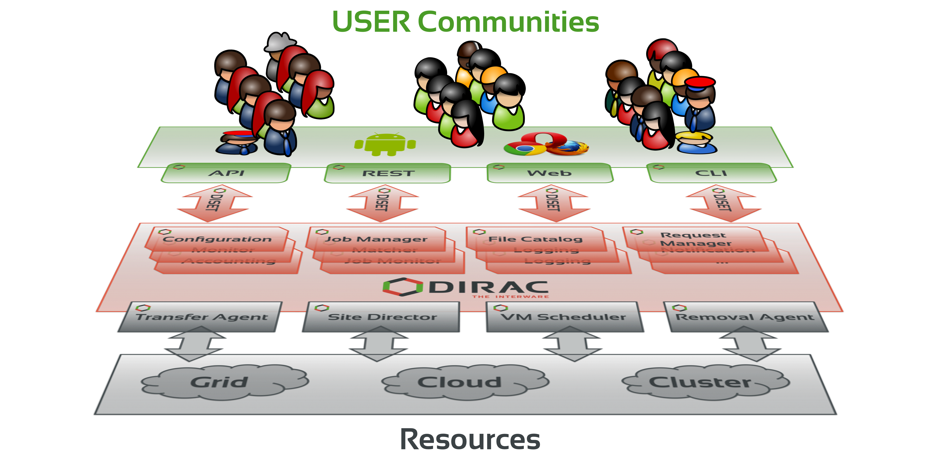
What is DIRAC?
DIRAC provides all the necessary components to build ad-hoc grid infrastructures interconnecting computing resources of different types, allowing interoperability and simplifying interfaces. This allows to speak about the DIRAC interware.
Web
CLI
API
REST

Slide 5
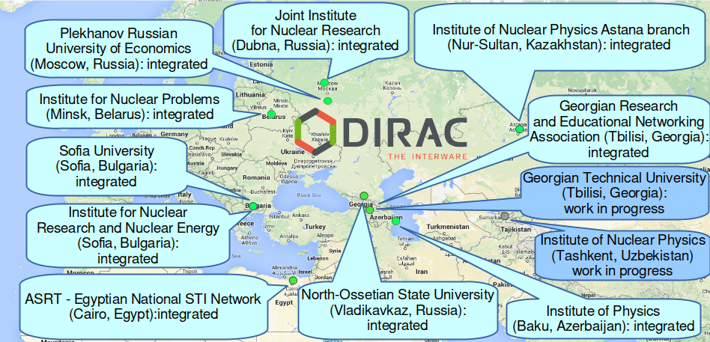
Member-States Clouds
Integration of clouds supports only job submission in High-Througput Computing mode.

Slide 6
Standard job schema
1. Initial configuration
2. Input data download
3. Processing
4. Output data upload
5.Finalization
All these steps written in shell script. Shell script is complex, requires some knowledge of distributed infrastracture and should be written by specialist.

Slide 7
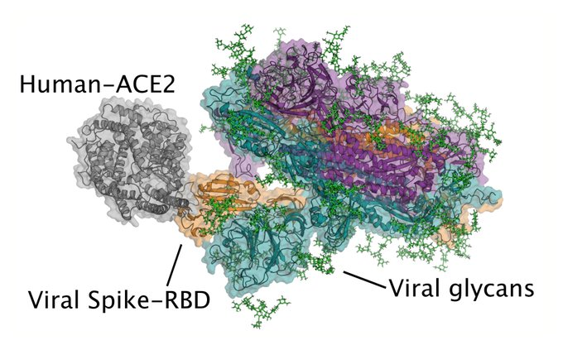
First case: Folding@Home
Folding@home (FAH or F@h) is a distributed computing project aimed to help scientists develop new therapeutics to a variety of diseases by the means of simulating protein dynamics. This includes the process of protein folding and the movements of proteins, and is reliant on the simulations run on the volunteers' personal computers.
The project utilizes central processing units (CPUs), graphics processing units (GPUs), and other devices. With heightened interest in the project as a result of the COVID-19 pandemic, the system achieved a speed of approximately 1.22 exaflops by late March 2020 and reaching 2.43 exaflops by April 12, 2020, making it the world's first exaflop computing system.

Slide 8
Folding@Home on clouds
It was decided to use idle cloud resources to participate in F@H.
Our priorities:
Do not interfere with other VMs
Control of the usage
Accounting
Only COVID-19 jobs accepted
Special shell script was designed to start on cloud vm, and launch Folding@Home client in single job mode.
Single job mode means that client asks Folding@Home central job distribution service for just one job and after its execution it client terminates itself.

Slide 9
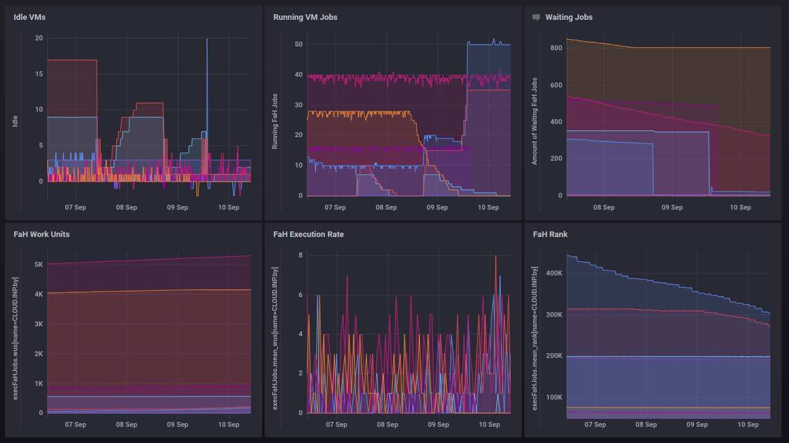
Folding@Home on clouds
Dedicated user was created in DIRAC: foldingathome
Job script was designed
Mass job submission procedure was established to submit Folding@Home jobs to the DIRAC Job Queue.
Monitoring system was created to collect data about running virtual machines on local and remote clouds.

Slide 10
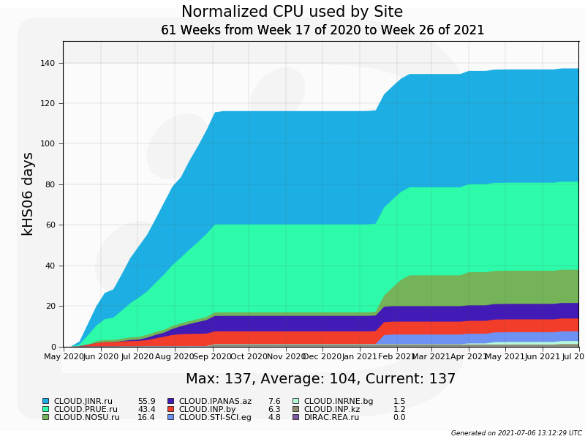
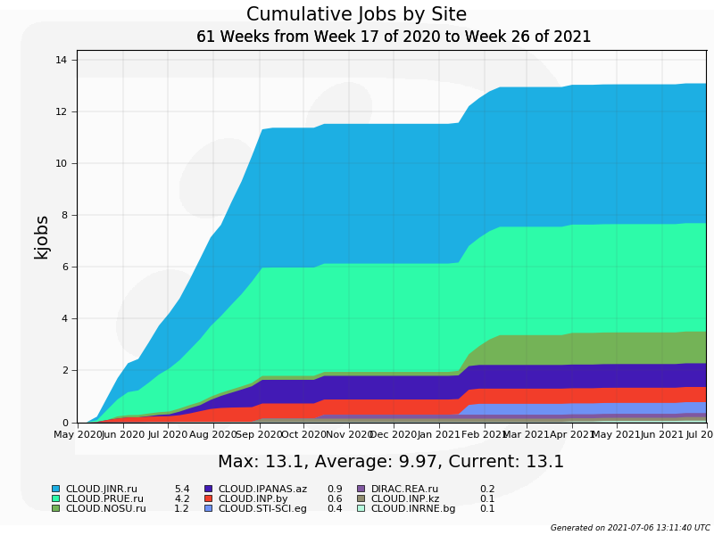
Folding@Home results
Used normalized time:
Total – 138000 HS06 days
(total walltime: 23.5 years)
Total jobs:
~13000
Average job lasts for 15 hours
That experience was important to prove stable cloud operations during lasting workload

Slide 11
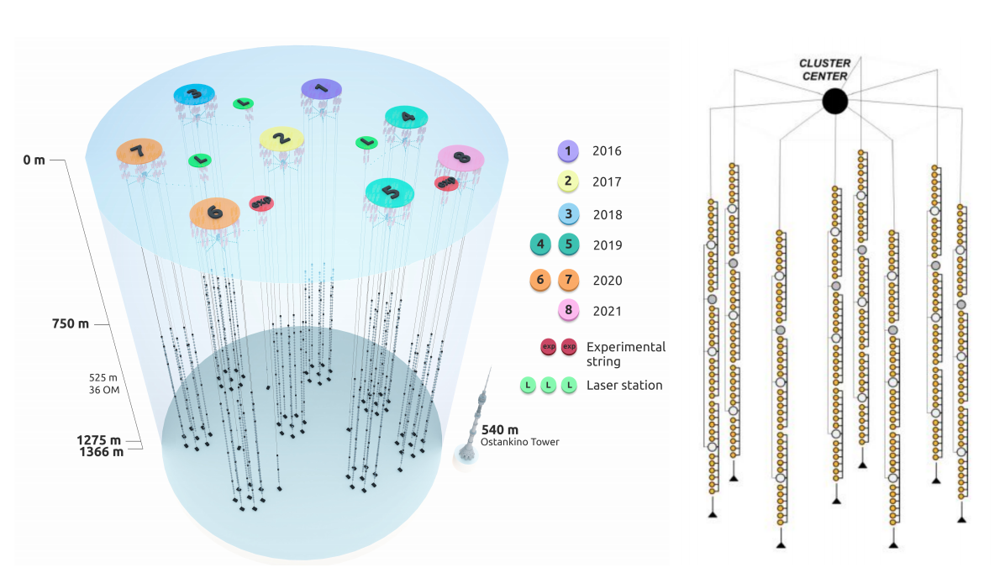
Baikal-GVD: Monte-Carlo
The Baikal Gigaton Volume Detector (Baikal-GVD) is a cubic-kilometer scale underwater neutrino detector currently under construction in Lake Baikal, Russia. In 2021 8 clusters are in operation, yet another 6 are planned to be installed by the end of 2024. Data taking is ongoing. Monte-Carlo data also required for research.

Slide 12
Baikal-GVD simulations*
● Atmospheric muons
– CORSIKA 5.7 + QGSJET
– 1 yr effective livetime
● Detector simulations
– Muons propagated with MUM
– Simplistic parameterized shower model
– Custom detector simulation code
~ 9 800 000 events reconstructed
* From Dmitry Zaborov talk on VLVnT 2021 - Very Large Volume Neutrino Telescope Workshop Valencia, 18 - 21 May 2021: Dmitry Zaborov and Grigory Safronov - Observations of muon neutrinos with Baikal-GVD arXiv:2106.06288 https://indico.ific.uv.es/event/3965/contributions/14869/

Slide 13
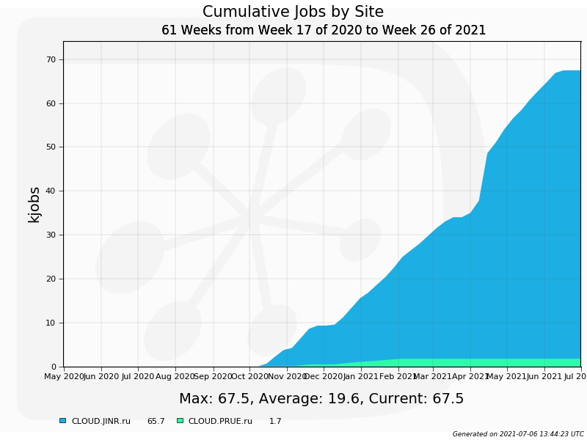
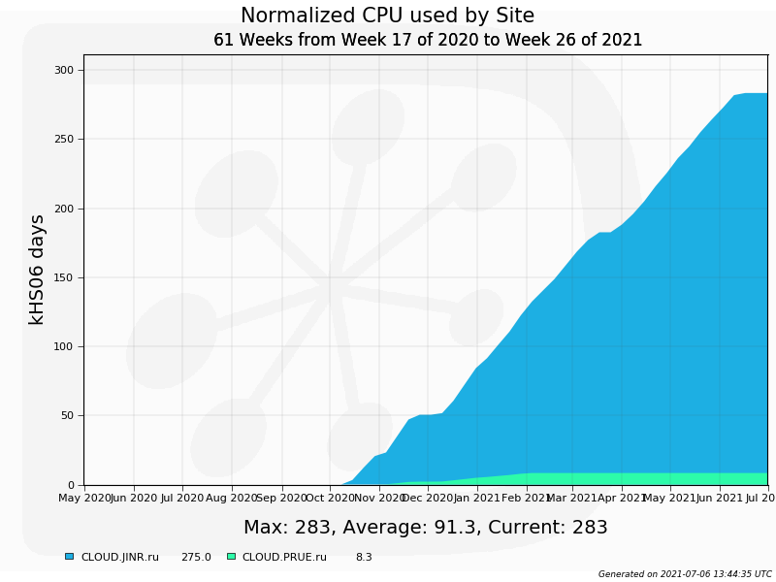
Baikal-GVD stats
Used normalized time:
Total – 280000 HS06 days
(total walltime: 47 years)
Total jobs:
~67000
Average job lasts for 6 hours
Almost constant job execution rate.

Slide 14
Conclusion
Folding@Home jobs and subsequent Baikal-GVD jobs became first massive/real/usefull workload executed on JINR and Member-States clouds via DIRAC.
Clouds proved to be effective computing resource for HTC jobs.
Main concern on remote clouds is a network connection. With slow network results upload may consume significant amount of time. More active use of clouds may justify upgrade of both network speed and resource amount.

