Slide 1
JINR
Tier1 & Tier2/CICC
accounting system
Kashunin I., Mitsyn V., Strizh T.
July 2021

Slide 2
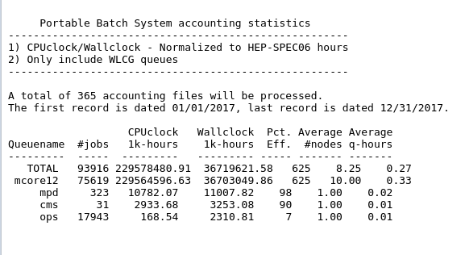
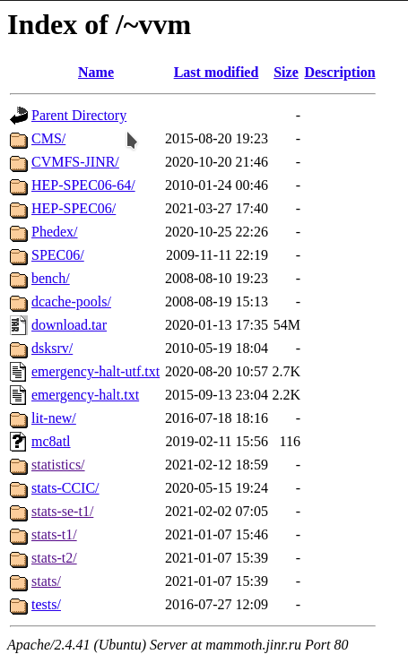
Old accounting system
The control, computing
and disk servers
1

Slide 3
Goals
Define the main parameters of the accounting system
Collect batch data statistics in a database
Calculate the main parameters of the accounting system and display them in the console
Visualize data into the monitoring system
Migrate data from the old accounting system to the new one
2

Slide 4
Main accounting system parameters
Number of jobs
HS06 CPUclock in hours
HS06 Wallclock in hours
Number of cores per job
Computing cluster efficiency
The control, computing
and disk servers
3

Slide 5
Gathering data script formulas
sacct --starttime $from_date --endtime $end_date --format =JobID,Jobname,stat,TotalCPU%20,Elapsed%20,account,NCPUS,end
HS06_wallclock – astronomical time to complete the task;
HS06_cpu_time – total processor time consumed by the task at all cores of all processors.
eff = cluster efficiency
K = HS06 coefficient
Ncore – number of cores per job
4

Slide 6
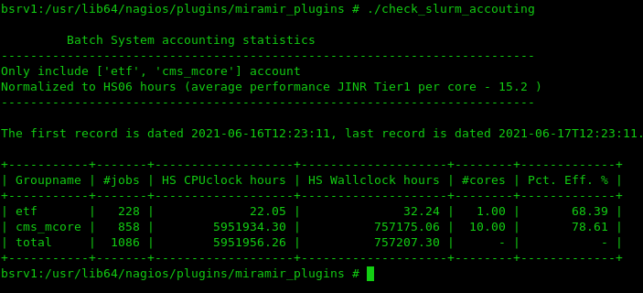
New CMS Tier1 accounting system (console implementation)
Litmon-01
General view
of the complex
5

Slide 7
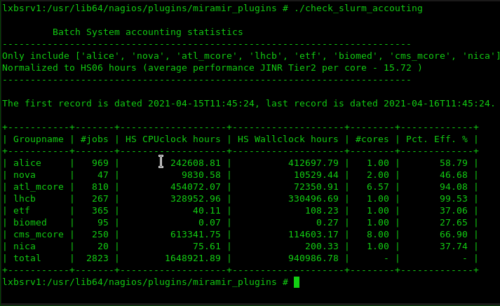
New Tier-2/CICC accounting system (console implementation)
Litmon-01
General view
of the complex
6

Slide 8
Comparison of EGI and JINR
March 2021
 | EGI | JINR
HS06_cpuclock | 100920785 | 101352044
HS06_wallclock | 14094995 | 14156227
Efficiency | 71.6% | 71.6%
The difference between EGI and JINR is about 0.4%.
7

Slide 9
Data acquisition and processing algorithm
Batch system database
Crontab
Data acquisition
script
Console
output
Linux user
Grafana
The control, computing
and disk servers
8

Slide 10
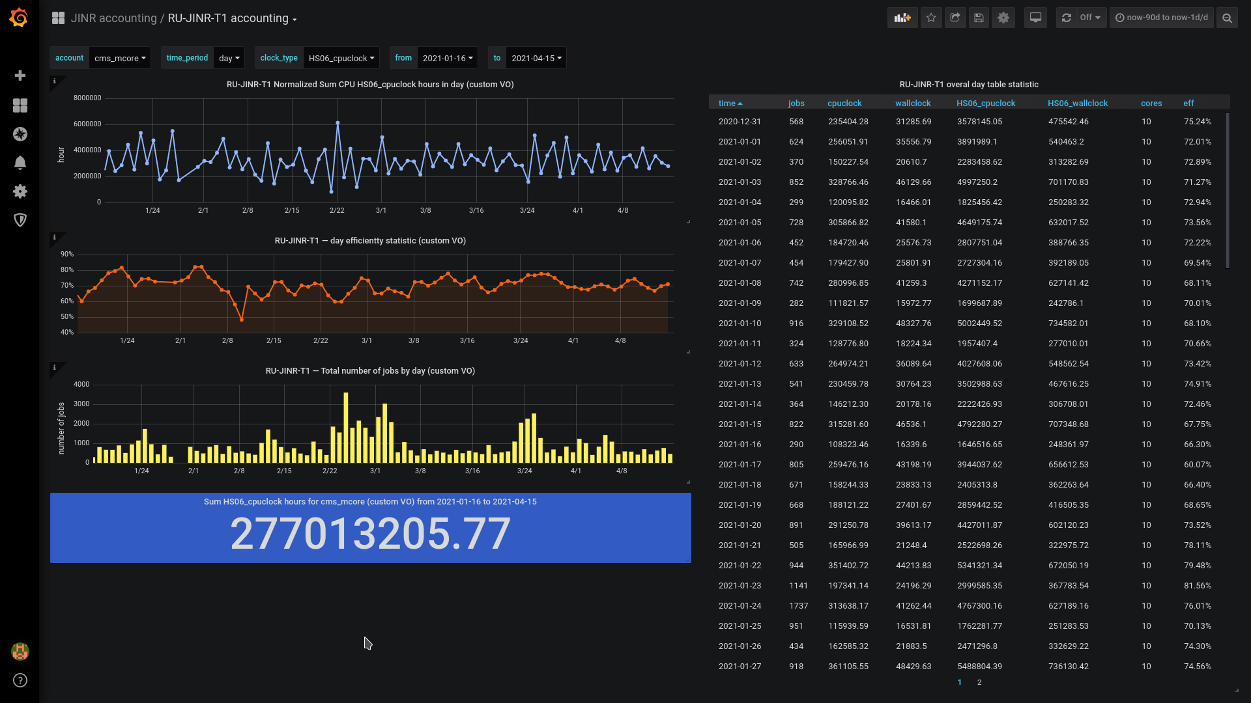
New Tier1 accounting system (visualization)
Litmon-01
General view
of the complex
9

Slide 11
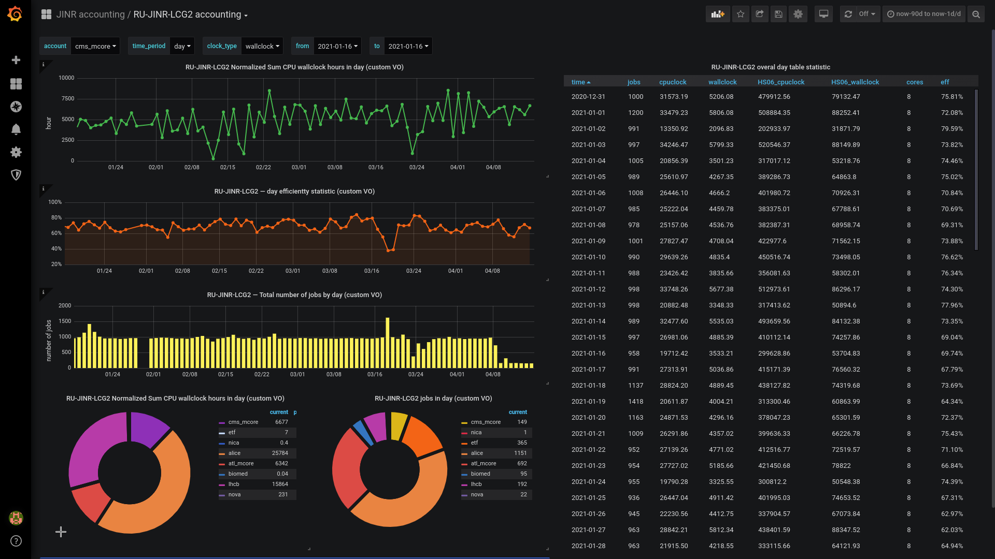
New Tier2/CICC accounting system (visualization)
Litmon-01
General view
of the complex
10

Slide 12
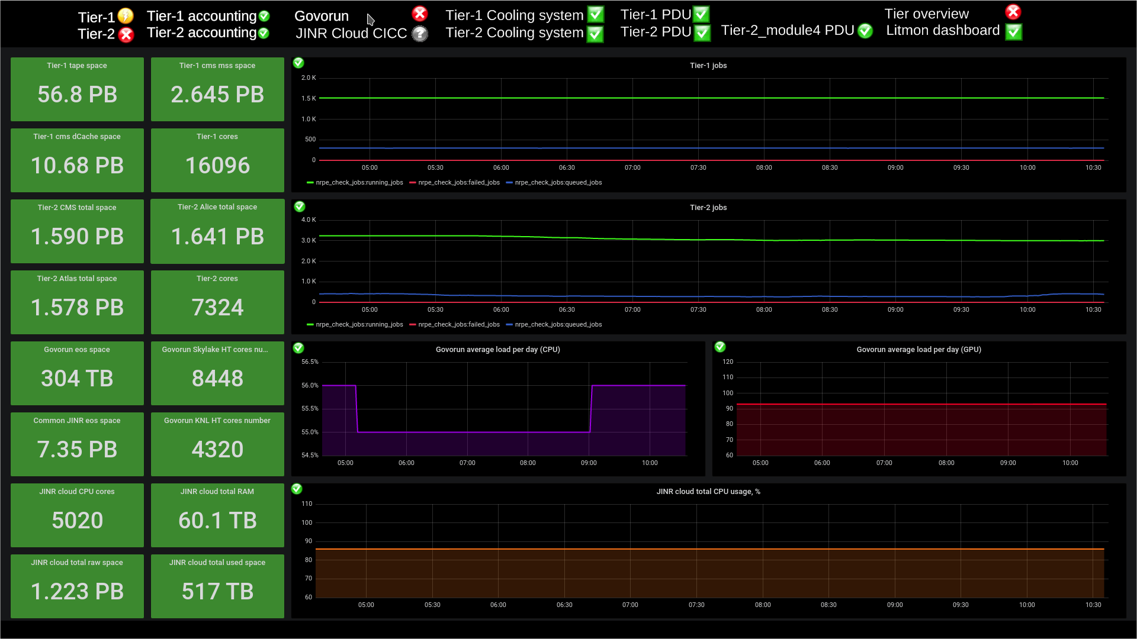
Integration into the monitoring system
https://litmon.jinr.ru https://litmon-01.jinr.ru
http://litmon-display.jinr.ru
11

Slide 13
Conclusions
JINR Tier1 got a new monitoring tool
JINR Tier2/CICC got a new monitoring tool
Old and new statistics can be compared
The database as a backend can be used by other monitoring systems
The JINR Tier1 & Tier2/CICC
accounting system was put into operation.
12

Slide 14
Thank you for your attention!

