Slide 1
Diagnostics development for Particle Accelerators
To change the colours, add department name and add the relevant icon, use the master templates. RGB breakdowns of the colours can be found in the guidelines. The page background colours can also be changed there.
Pavel Karataev,
John Adams Institute for Accelerator Science

Slide 2




John Adams Institute for Accelerator Science
Imperial College London
Royal Holloway, University of London
University of Oxford

Slide 3
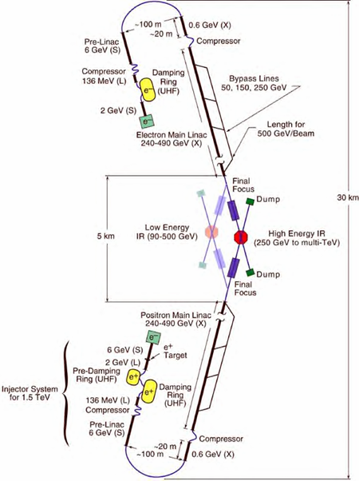
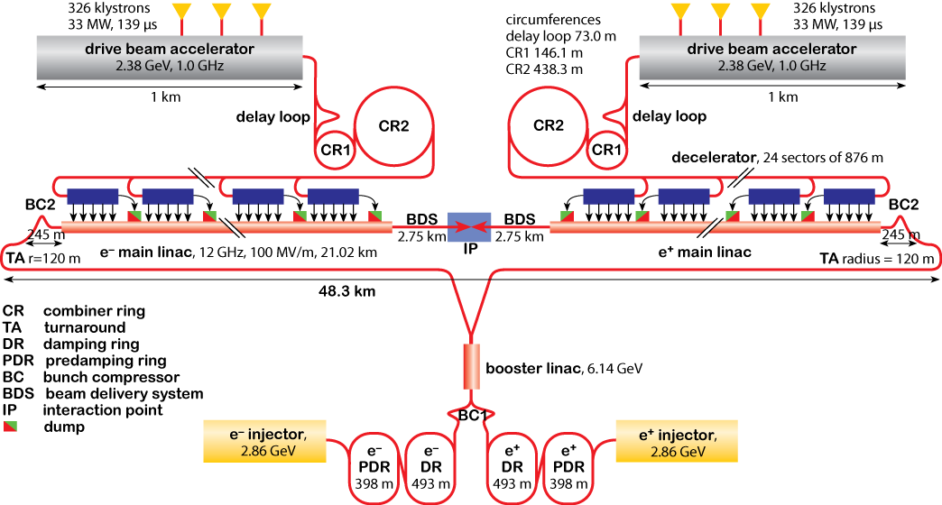
e-beam laser wire for linear colliders
Colliders e⁻/e⁺ high precision machines.
Two main current designs - International Linear
Collider (ILC) and Compact Linear Collider (CLIC).
Extreme focusing/charge/luminosity requirements.
Need high quality non-invasive measurements of beam size, emittance, position, charge, duration, etc.

Slide 4
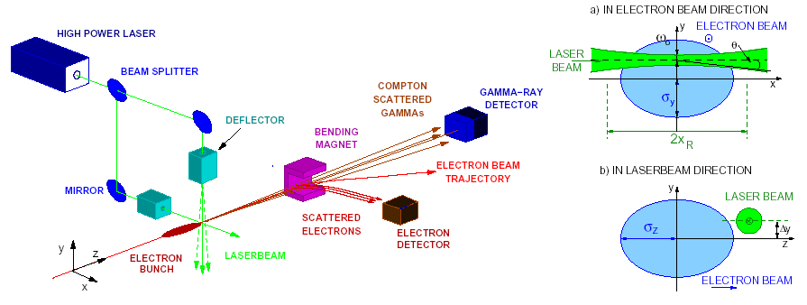
Laser-Wire for electrons

Slide 5
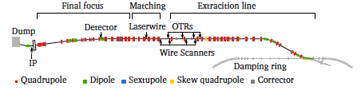
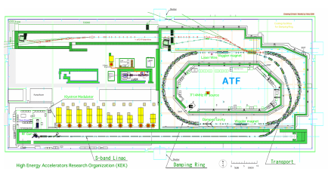
KEK:ATF2 – Accelerator Test Facility
Charge | 1 – 8 x 10⁹ e
Energy | 1.28 GeV
Beam size (LWIP) | 100 x 1 μm
Bunch | 30 ps (3.12Hz, single bunch)
Laser (532nm, Nd:YAG) | 100 mJ, 150 ps

Slide 6
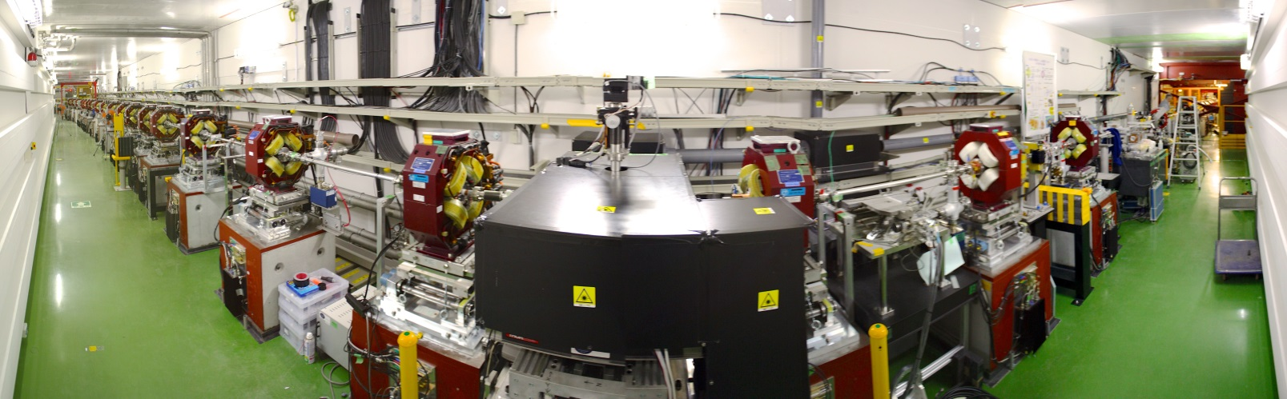
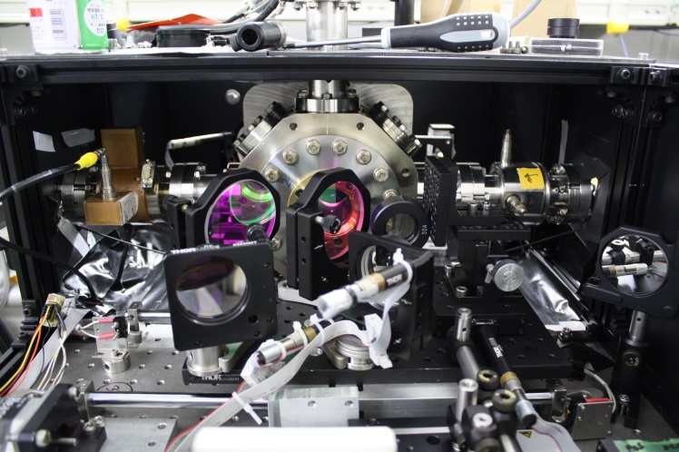
KEK:ATF2 – Accelerator Test Facility
Detector
Laserwire IP
Laser beam transport

Slide 7
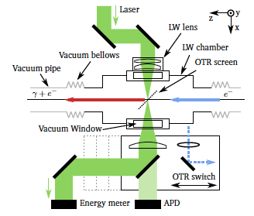
LW interaction region

Slide 8
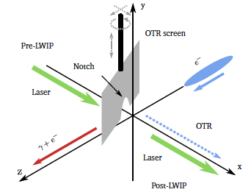
Laser – e-beam collision search

Slide 9
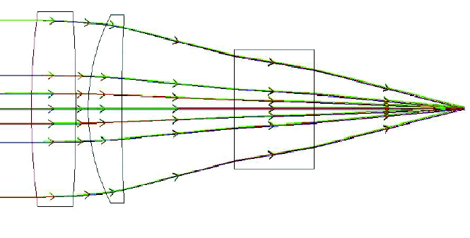
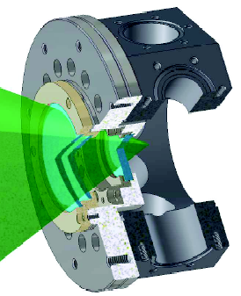
f2 lens design
f2 lens at 50 mm focal distance
Aberration free at 532 nm
Geometrical shadow avoided

Slide 10
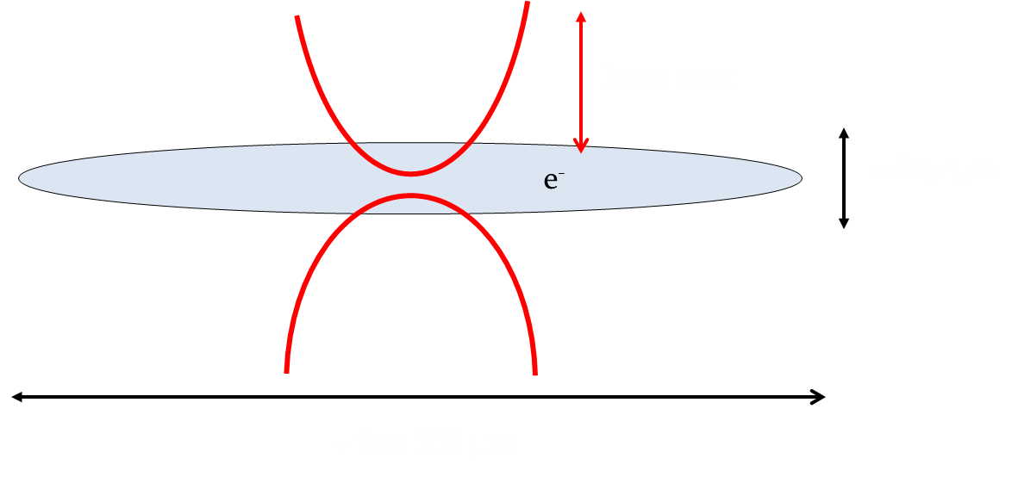
Laser-Wire Layout
2z_{R} ~ 30 – 40 μm.
Vertical direction
scan
Horizontal direction scan

Slide 11
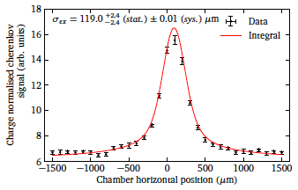
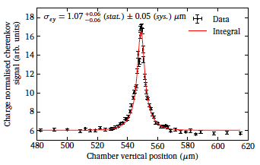
Horizontal and Vertical beam profiles
Horizontal
Vertical

Slide 12
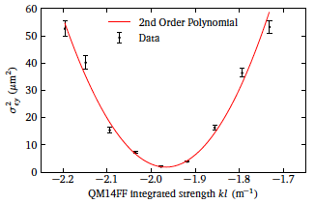
Emittance measurement
Physical beam emittance was 82.56 ± 3.04 pm rad

Slide 13
Performance characteristics
Dynamic range: Defined by the signal to noise ratio and can be adjusted by the laser power
Resolution - determined by the laser waist (Linear Collider requires 1μm, 3.4μm convoluted size achieved at ATF)
Accuracy
  Aberration of the lens system (need an aberration free lens)
  Laser waist and waist position should be stabilized
  Bunch-by-bunch instability
Non-Destructive method
  Major candidate for linear collider

Slide 14
H⁻ Laser-wire for proton machine injectors
Large Hadron Collider injection complex
  High Luminosity upgrade
Proton beam driven neutron sources
  High intensity beam is needed for generating high flux neutrons or neutrino

Slide 15
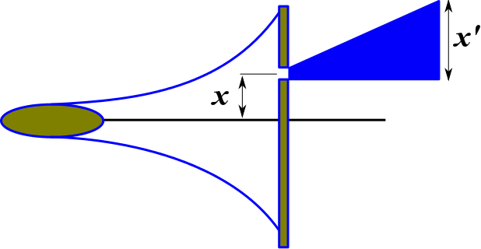
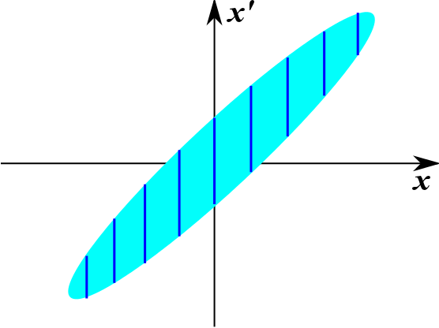
Direct Phase-space measurement principle

Slide 16
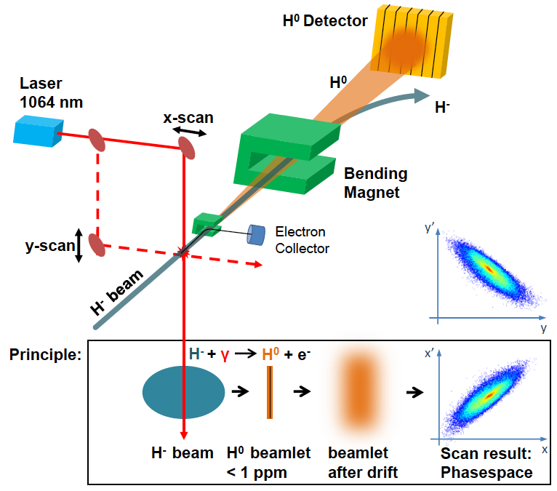
H⁻ Laser-wire principle
Courtesy to T. Hoffman

Slide 17
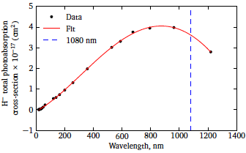
Photo-detachment cross-section
J.T. Broad and W.P. Reinhardt, One- and two-electron photoejection from H⁻: A multichannel
j-matrix calculation. Physical Review A, 14(6):2159–2173, 1976.

Slide 18
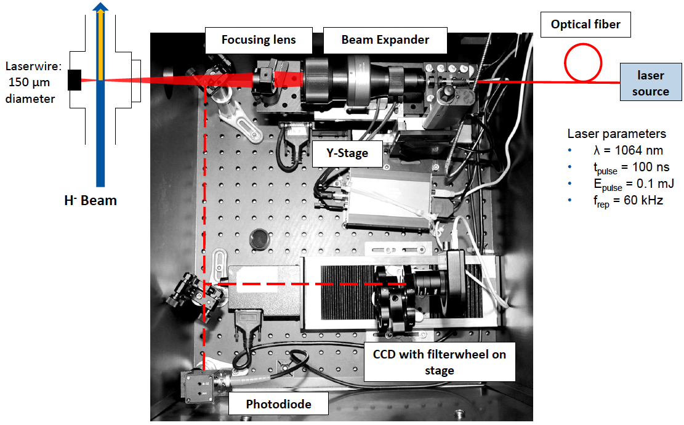
Laser delivery system
Courtesy to T. Hoffman

Slide 19
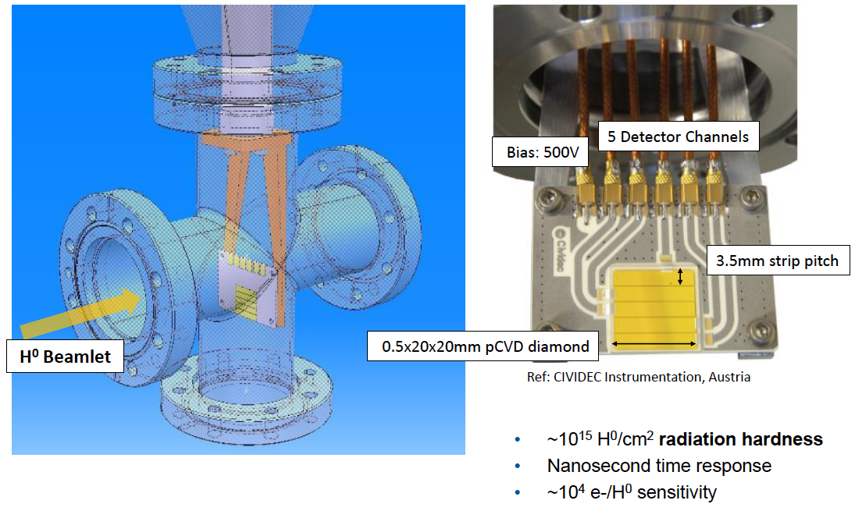
H⁰ Diamond Strip detector
Courtesy to T. Hoffman

Slide 20
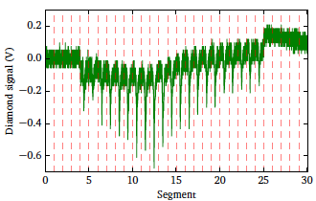
Diamond detector signal

Slide 21
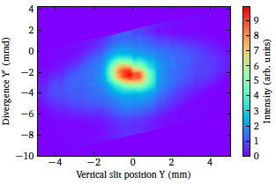
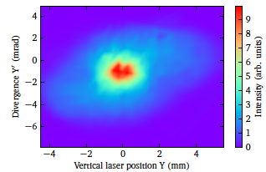
Phase-space measurements
Slit and grid technique
Laser-wire technique

Slide 22
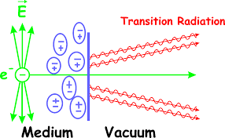
Transition radiation
Appearing when a charged particle crosses a vacuum-metal interface\
Characteristic opening angle is ~1/𝛾
Emitted along the particle trajectory (FTR) and along the direction of specular reflection

Slide 23
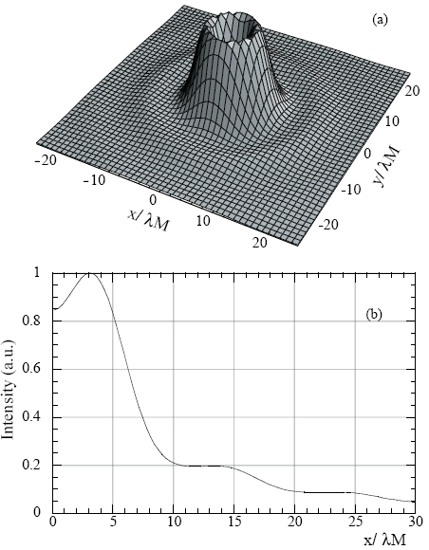
Resolution of OTR monitors
Resolution is defined by the width of the OTR Point Spread Function (PSF)
Castellano & Verzilov,
PRST-AB 1, 062801 (1998)

Slide 24
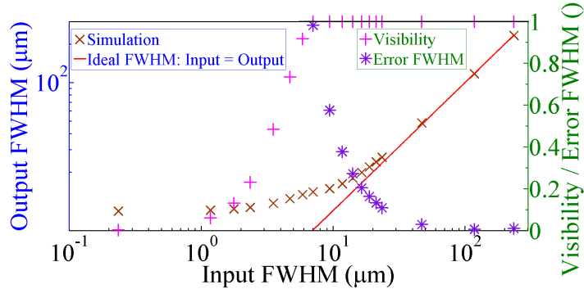
ZEMAX simulations of OTR PSF
Dark
area
T. Aumeyr, et al.,
PRST-AB 18,
042801 (2015)
B. Bolzon, et al.,
PRST-AB 18,
082803 (2015)
24

Slide 25
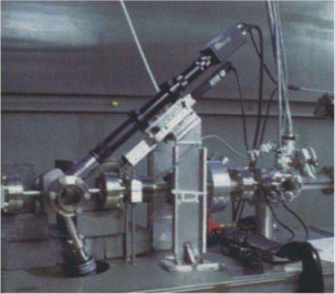
OTR monitor at ATF-Accelerator Test Facility built by SLAC team.
Very high resolution for an OTR monitor (~2μm) predicted by the theory but only ~5.5μm spot was actually measured.

Slide 26
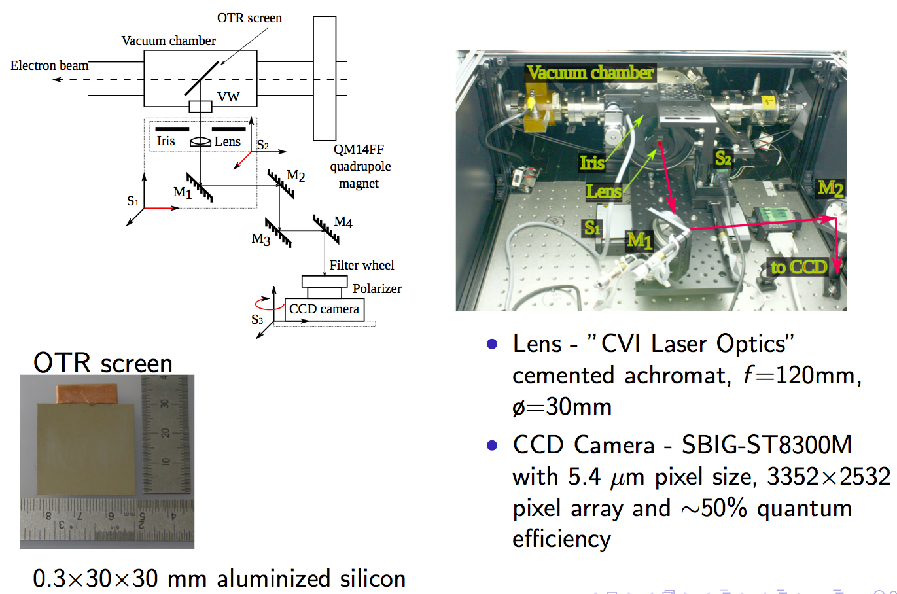
OTR PSF Diagnostics at ATF2

Slide 27
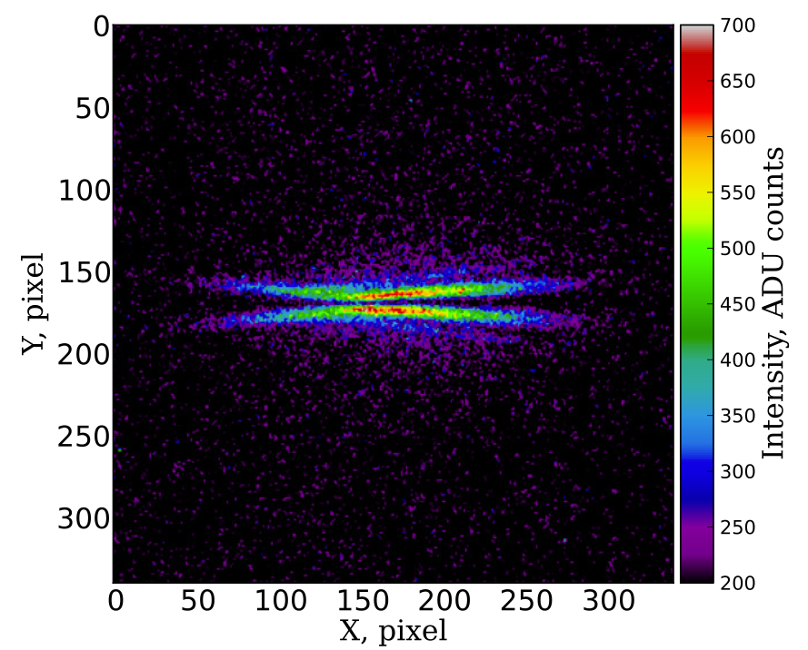
OTR PSF Diagnostics at ATF2
An example of the image measured with linear polarizer and 550±20 nm
First Observation: P. Karataev, et al., Physical Review Letters 107, 174801 (2011).

Slide 28
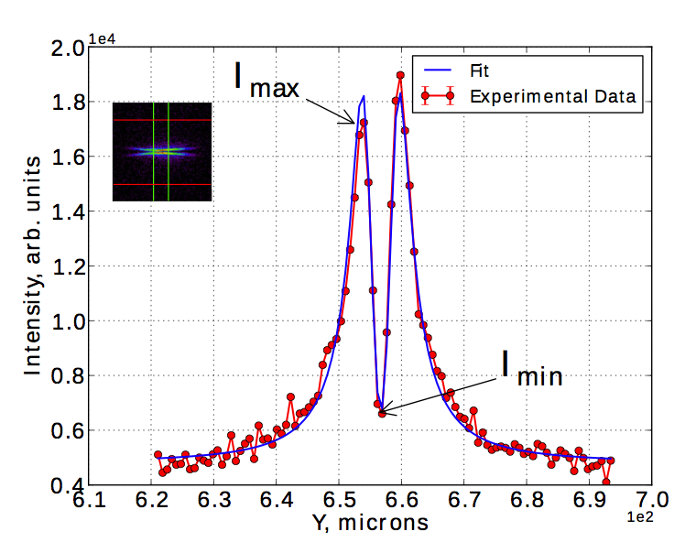
OTR PSF Diagnostics at ATF2
Vertical Projection
Horizontal Projection
The minimum vertical beam size measured was 0.754±0.034 μm

Slide 29
OTR PSF Diagnostics at ATF2
Emittance measurement

Slide 30
DIFFRACTION RADIATION
Diffraction radiation (DR) appears when a charged particle moves in the vicinity of a medium
Impact parameter, h, – the shortest distance between the target and the particle trajectory
- observation wavelength
γ = E/mc² – Lorentz - factor

Slide 31
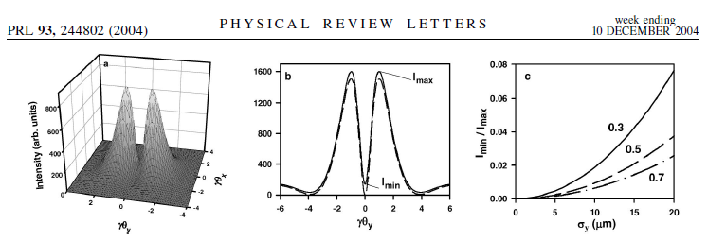
ODR Experiment at KEK-ATF
P. Karataev et al.

Slide 32
ODR Experiment at KEK-ATF

Slide 33
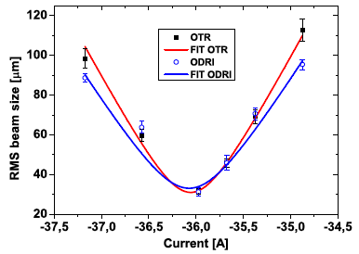
ODRI Emittance Measurement at FLASH facility
OTR emittance ε_{OTR} = 2.4 ± 0.4 mm mrad
ODRI emittance ε_{ODRI} = 2.3 ± 0.4 mm mrad
A. Cianchi, et al., New J. Phys. 16 (2014) 113029

Slide 34
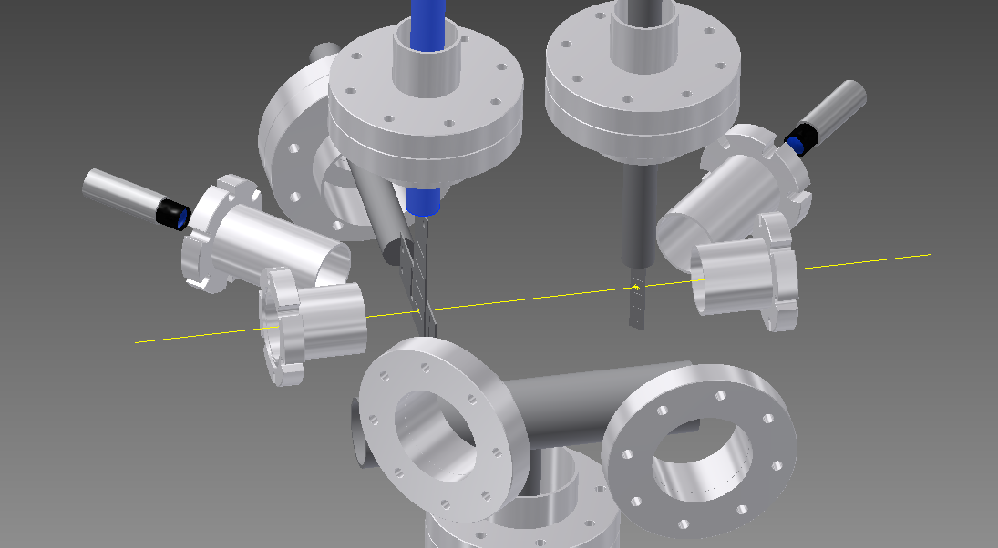
Design of a combined OTR/ODR diagnostics station for ATF2
Conceptual design
45deg View Port
Target laser alignment
Target
Actuator
45deg View Port
Mask Camera
Mask
Actuators
Camera
Beam
BPM Flange
(Beam)
BPM Flange
(Beam)
90 degrees
View Port on target (angular)
40 degrees
View Port on target (imaging)

Slide 35
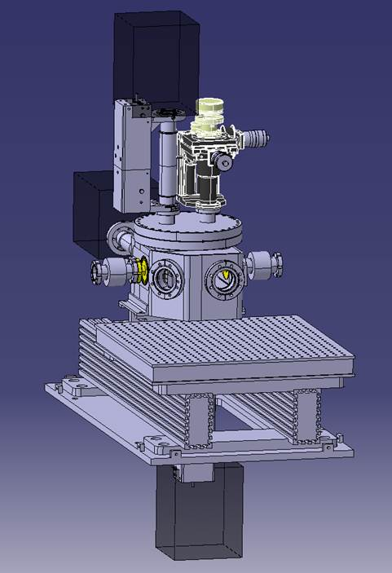
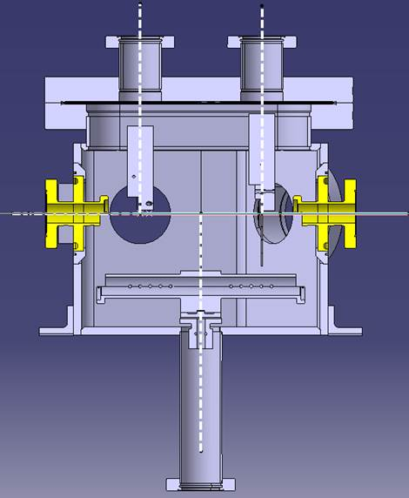
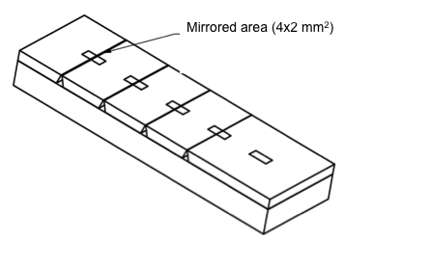
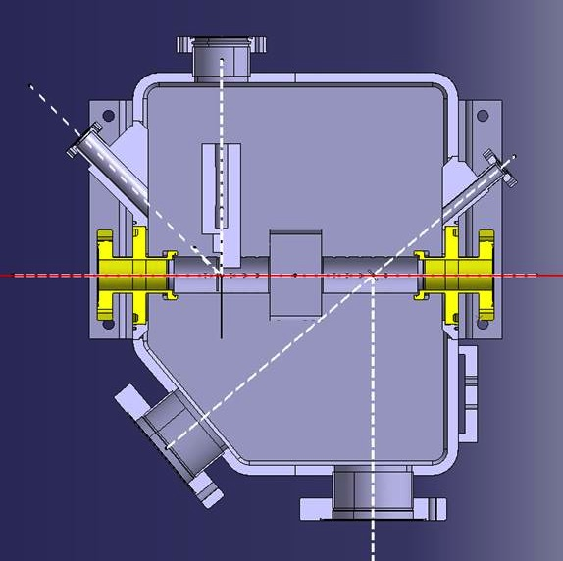
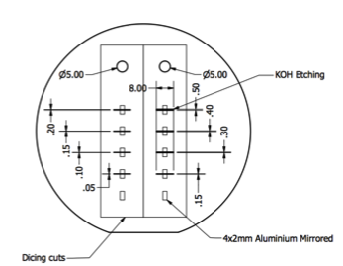
Design of a combined OTR/ODR diagnostics station for ATF2
Target I: molecular adhesion
30cm as Laser Wire
Target II: chemical itching
Optical table

Slide 36
UV DR measurements at ATF2

Slide 37
Beam size and emittance measurements
Emittance 32+-5 pm rad

Slide 38
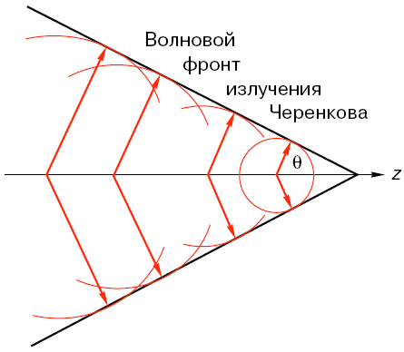
Cherenkov radiation
Cherenkov Radiation is generated whenever the charged particle velocity is larger than the phase velocity of light
R(t)
O
z(t)

Slide 39
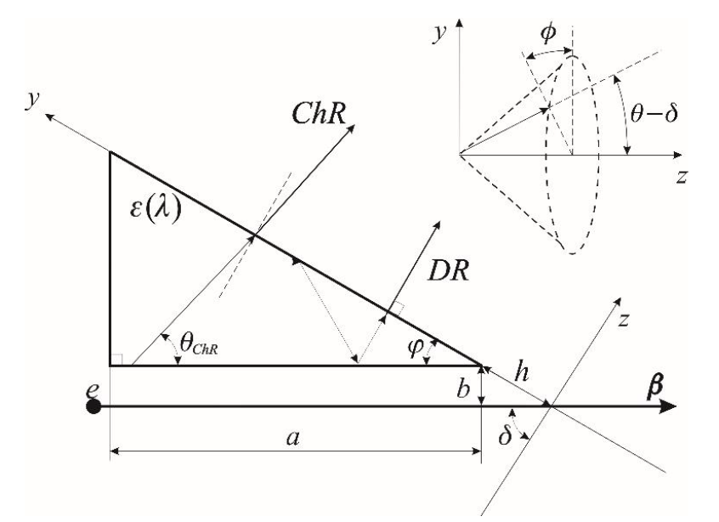
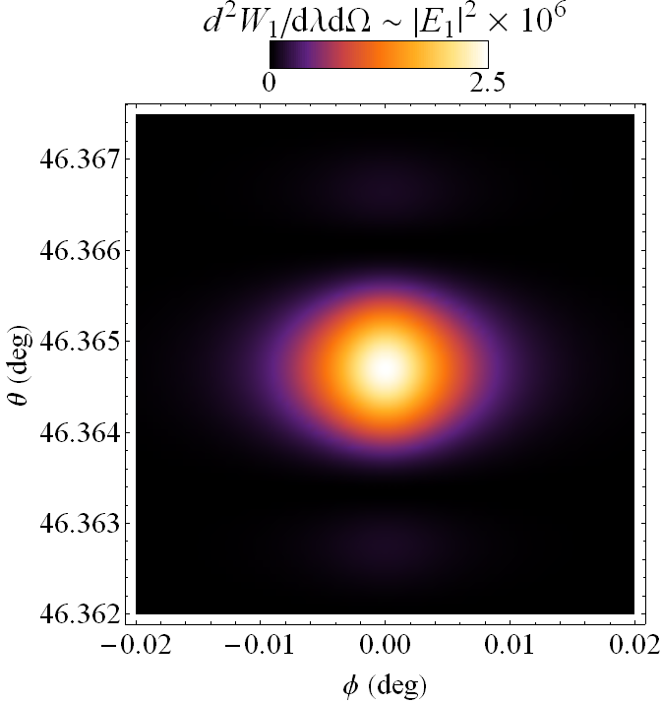
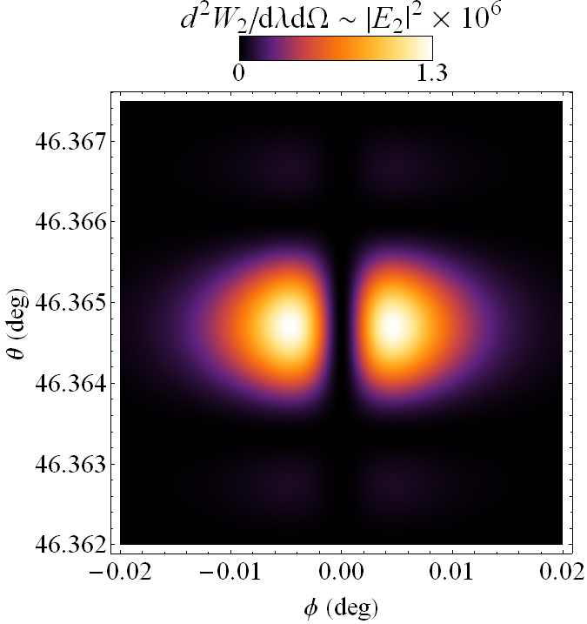
Cherenkov Diffraction Radiation
gamma = 10⁴, λ = 600 nm, b = 0.8 mm, a = 11.5 mm
Vertical polarization
Horizontal polarization

Slide 40
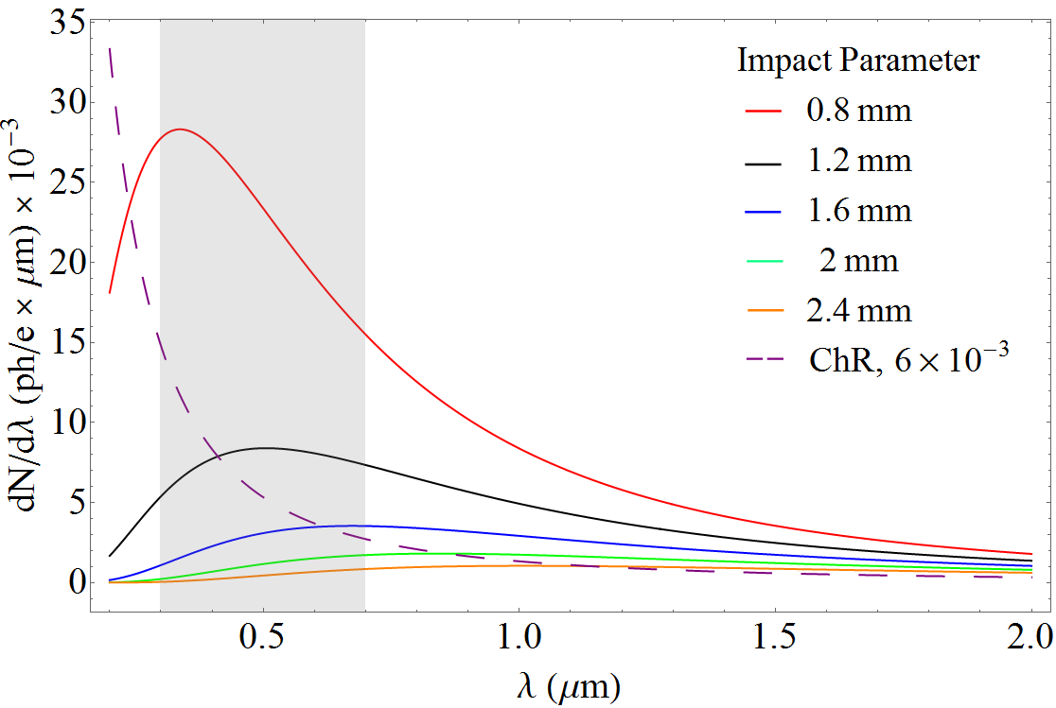
Cherenkov Diffraction Radiation
Exponential decay
of the particle field

Slide 41
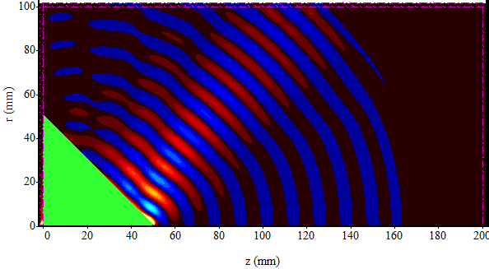
Cherenkov Diffraction Radiation
Simulations of Coherent ChDR using EM simulations codes
Using MAGIC and an electron beam current modulated at a 25GHz
propagating at the vicinity of a Teflon cone
d = 10 cm
ε = 2.1
ε = 5

Slide 42
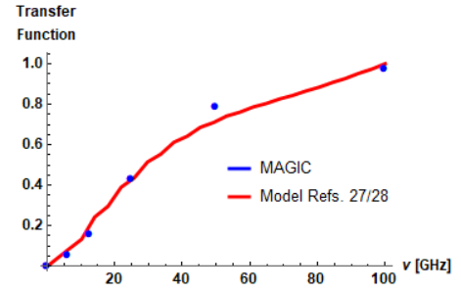
Cherenkov Diffraction Radiation
Depending on the physical size radiator, smaller frequencies cannot be produced (cut-off effect as in waveguide)
Measuring beam power spectrum in 3 frequency bands

Slide 43
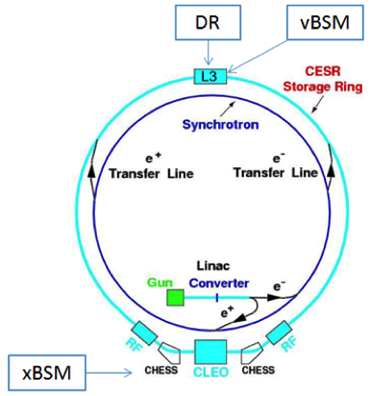
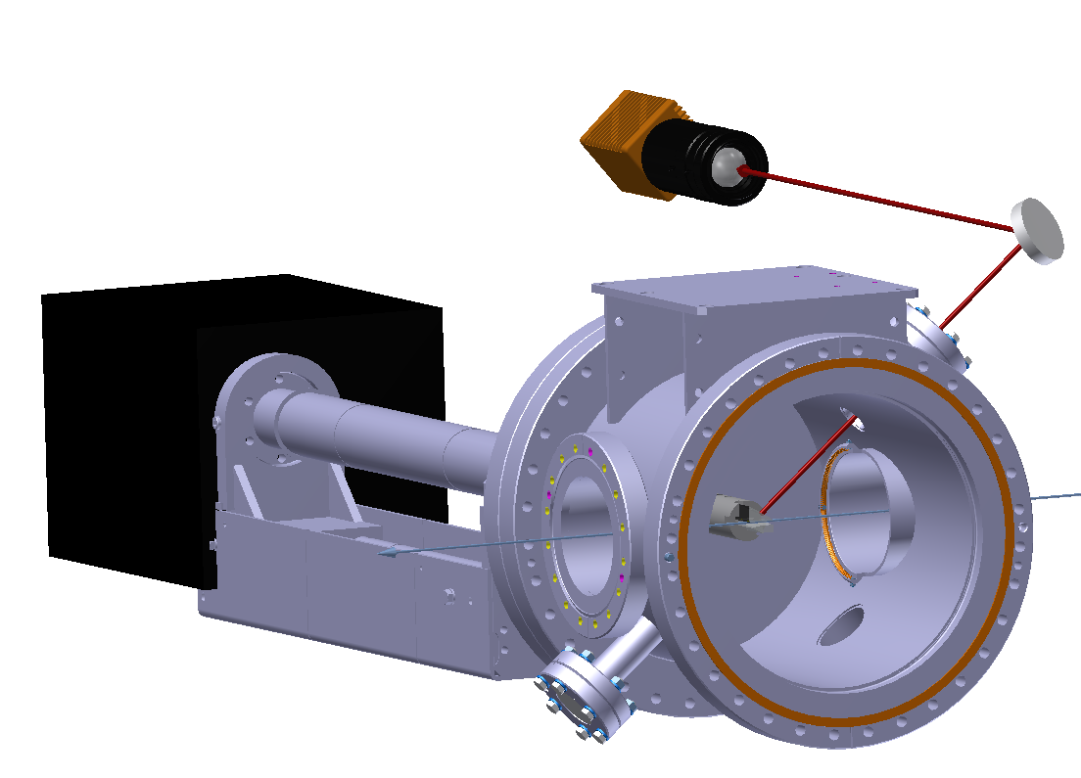
Optical/IR ChDR experiment at Cornell
First tests of incoherent ChDR on Cornell Electron Storage Ring
ChDR
Camera
ChDR
Target
L
CESR Ring Circumference | 768.4m
Revolution Time | 2.563 μs
Beam Energy | 2.1 and 5.3GeV
Beam Species | e⁻ and e⁺
Particles per bunch | 1.6 10¹⁰
R. Kieffer et al., “Direct Observation of Incoherent Cherenkov Diffraction Radiation in the Visible Range”, PRL 121 (2018) 054802

Slide 44
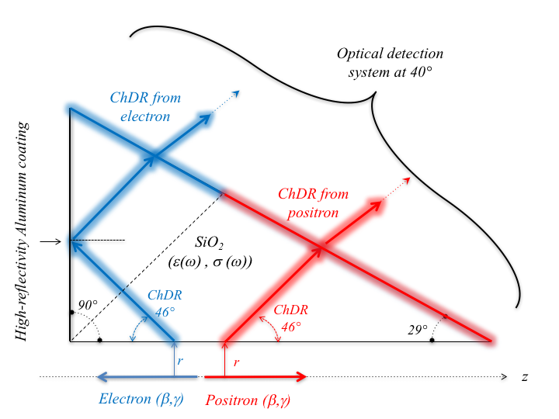
Optical/IR ChDR experiment at Cornell
Using a 2cm long SiO₂ (n=1.46) ChDR target

Slide 45
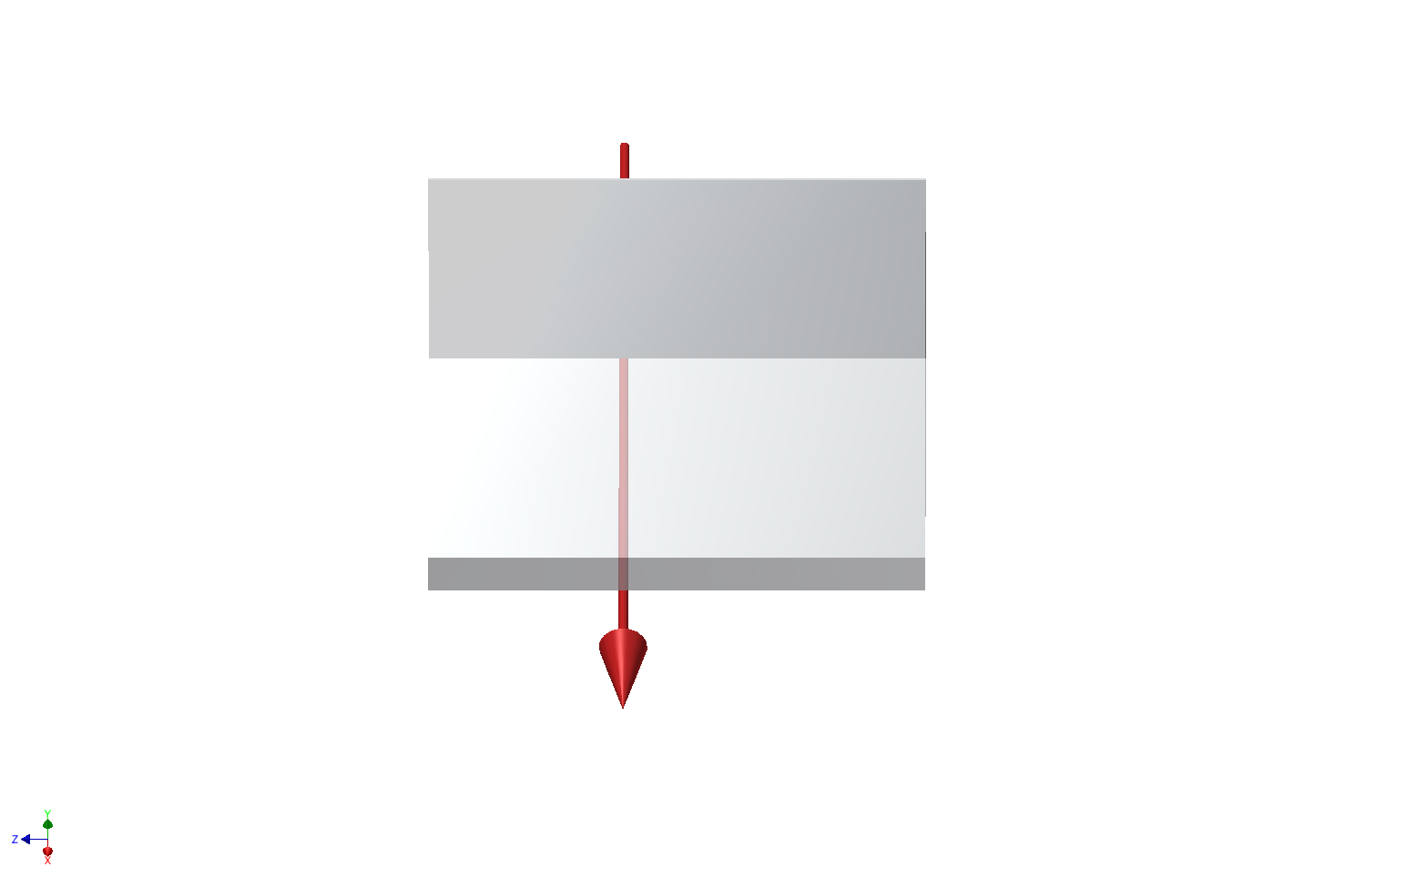


Optical/IR ChDR experiment at Cornell
Imaging Positrons
Cherenkov Diffraction Radiation
Positron
Beam
Positron
Beam

Slide 46



Optical/IR ChDR experiment at Cornell
Imaging Electrons
Cherenkov Diffraction Radiation
Electron
Beam
Electron
Beam
Images from e⁻ is truncated due to the limited aperture of the current detection system

Slide 47
Optical/IR ChDR experiment at Cornell
Electron Beam
The photons produced by electrons and positrons appear on a different zone of the image and give the possibility to high directivity beam measurements
Positron Beam

Slide 48

Optical/IR ChDR experiment at Cornell
  Imaging conditions and Radiation power vs Impact parameter
‘Cherenkov photons yield increasing strongly for smaller impact parameter’

Slide 49

Optical/IR ChDR experiment at Cornell
  Imaging conditions and Radiation power vs Impact parameter

Slide 50


Optical/IR ChDR experiment at Cornell
  Beam imaging - Polarization studies
5.3 GeV positrons - 600nm+/-10nm
Horizontal polarization
Vertical polarization
Cherenkov
Diffraction
Radiation
Positron Beam
‘Vertically polarized photons give the best spatial resolution (here for σ_{y}=2mm)

Slide 51
Optical/IR ChDR experiment at Cornell
  Beam imaging as function of impact parameter
  5.3 GeV positrons 600nm+/-10nm filter – Vertical polarizer
Measured beam size increasing for larger impact parameter
Theoretical model is being developed to investigate Line Spread Function as function of impact parameter

Slide 52

Optical/IR ChDR experiment at Cornell
Angular distributions
Horizontal polarization
Vertical polarization
Measurements with Positrons
Ang. divergence: ±200urad
Simulations from PCA

Slide 53

Optical/IR ChDR experiment at Cornell
Angular distributions as function of impact parameter
  5.3 GeV positrons - 600nm+/-10nm filter – Vertical polarizer
Impact parameter (mm) | 1.04 | 1.33 | 1.68 | 2.02 | 2.46
FWHM_{exp} (mrad) | 0.54 | 0.49 | 0.47 | 0.45 | 0.43
FWHM_{est} (mrad) | 0.56 | 0.49 | 0.46 | 0.44 | 0.40
Excellent agreement with simulations

Slide 54


Optical ChDR experiment at KEK-ATF2
Studying the spatial resolution of ChDR at ATF2/KEK - 2018
ATF2 extraction line
Beam Energy | 1.25 GeV
Particles per bunch | 1.6 10¹⁰
Achievable beam size H/V (microns) | 100 / 1
Re-using and modifying the hardware used for Diffraction radiation studies
Optical system in the visible
OTR for cross calibration

Slide 55




Optical ChDR experiment at KEK-ATF2
OTR Vertical beam profile
ChDR Vertical beam profile
Vertical rms is: 67.2 um
Vertical rms: 63.5 um

Slide 56
Optical ChDR experiment at CLEAR in CERN
CLEAR facility at CERN
Beam Energy | 200 MeV
Particles per bunch | 1.6 10¹⁰
Typical beam size H/V (mm) | > 0.1 / > 0.1
20cm long stripline in Fused Silica

Slide 57
Optical ChDR experiment at CLEAR in CERN
Images taken using visible light at 600 ± 10 nm and few bunches of 500pC with a beam size of 130um sigma.
Beam at 3mm from
surface of the dielectric
Beam size is important as transverse beam tail would generate Cherenkov radiation (as background light )

Slide 58


Coherent ChDR experiment at CLEAR in CERN
CChDR radiator installed in the in-air test-stand
A. Curcio et al, Beam-based sub-THz source at the CERN Linac Electron Accelerator for Research facility, PRAB 22, 020402 (2019)
Measuring in 3 bands (60-90-110GHz)
Scintillating screen on the radiator’s input face for beam tuning
Typical beam size (H/V) < 500microns
All set-up mounted on remotely controlled table to allow hor/ver centering
Pyramid in Teflon
5x5cm base
45∘ output angle
∅ 1cm hole

Slide 59
Coherent ChDR experiment at CLEAR in CERN
Comparison between CChDR and RF deflector
Larger noise for longer bunches as we measured at (too) high frequencies

Slide 60



Coherent ChDR experiment at CLARA in Daresbury
f = 10Hz
E = 35 MeV
Longitudinal beam size was about 0.2-0.3 ps with charge ranging within 70 - 100 pC
200 microns RMS transversal bunch size

Slide 61


Coherent ChDR experiment at CLARA in Daresbury
1 — Horizontal positioning stage
2 — Teflon (VCR) target
3 — Tip-Tilt stage
4 — Vertical positioning stage
5 — Concave mirror
6 — Mirror for TR
7 — Foil (TR) target
Both TR and ChDR scans were conducted during same accelerator run

Slide 62


Coherent ChDR experiment at CLARA in Daresbury

Slide 63


Coherent ChDR experiment at CLARA in Daresbury

Slide 64

Coherent ChDR experiment at CLARA in Daresbury

Slide 65

Coherent ChDR experiment at CLARA in Daresbury

Slide 66

Coherent ChDR experiment at CLARA in Daresbury

Slide 67


X-Ray Cherenkov Radiation
WEPF36
http://ibic2013.org/prepress/html/sessi0n.htm

Slide 68

Carbon Dielectric Permittivity
η
K-edge
−δ

Slide 69

Experimental Plan in Diamond LS
Very short bunches emitting Coherent radiation in the visible / NIR would benefit from ChDR with very compact BPM (for centering beams in dielectric capillaries)
1GeV electron in a 2mm aperture SiO2 capillary
Dielectric wakefield acceleration
Laser wakefield acceleration
Plasma acceleration
BPM response (a.u.)
Beam offset (mm)

Slide 70

Can we measure low fluxes of particle using long radiators (optical fiber)
Study plasmonic resonance induced in thin metallic layer coated on the dielectric surface
Beam
Dielectric substrate
Surface
plasmon
Metallic coating
Towards a ‘monochromatic’ emission of ChDR
S. Liu et al., “Surface Polariton Cherenkov Light Radiation Source”, PRL 109 (2012) 153902

Slide 71







International Network on Development of Advanced Instrumentation for Particle Accelerators
D. Alves ¹, A. Aryshev⁶, M. Bergamaschi¹, V.V. Bleko³, M. Billing⁵, L. Bobb⁷, J. Conway⁵, A, Curcio¹, K. Fedorov². J. Gardelle⁴, S.Y. Gogolev³, D. Harryman², R.O. Jones¹, R. Kieffer¹, I. Kishchin⁸, A.S. Konkov³, P. Karataev², A. Kubankin⁸, K. Lasocha¹, T. Lefevre¹, K. Lekomtsev², J.S. Markova³, S. Mazzoni¹, N. Mounet¹, R. Nazhmudinov⁸, Y. Padilla Fuentes⁵, A.P. Potylitsyn³, J. Shanks⁵, D.A. Shkitov³, S. Stuchebrov³, N. Terunuma⁶
CERN, Geneva, Switzerland
John Adams Institute at Royal Holloway, University of London, Egham, UK
Tomsk Polytechnic University, Tomsk, Russia
CEA, France
Cornell University, Ithaca, USA
KEK, High energy Accelerator Organization, Japan
Diamond Light Source, Oxfordshire, UK
Belgorod National Research University, Belgorod, Russia

