Slide 1
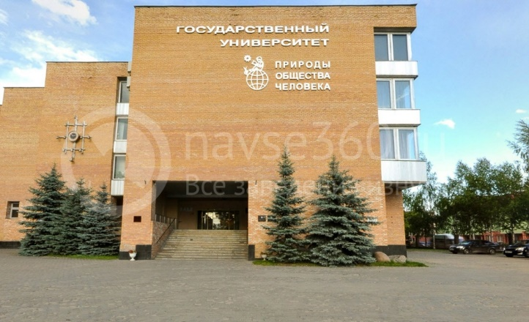
The XXIV International Scientific Conference of Young Scientists and Specialists (AYSS-2020)
Designing an agent
information-analytical system
in the thematic area “Cloud Computing”
Diana Koshlan²
PhD student E. S. Tretyakov¹, prof. V. V. Korenkov²,
prof. B. N. Onykij¹, PhD A. A. Artamonov¹
¹National Research Nuclear University MEPhI (NRNU “MEPhI”), Moscow, Russia
²Joint Institute for Nuclear Research (JINR), Dubna, Russia

Slide 2
Problem Statement
The increase in the number of sources of scientific and technical information on the Internet.
Increased time to search for information by laboratory staff.
Development agent system in the thematic area “Cloud Technologies”.

Slide 3
Agent Information and Analytical System
performs the following functions in automated mode:
• Automatic scanning of thematic clusters of Internet;
• Collection and delivery of news full-text information;
• Automatic output of resulting documents with extracted information.

Slide 4
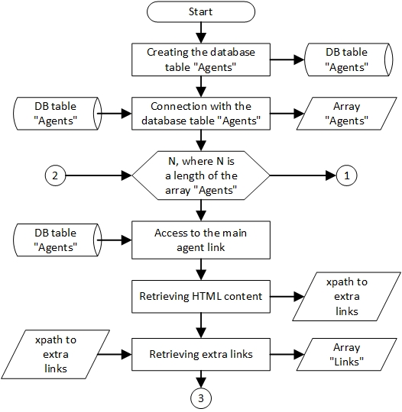
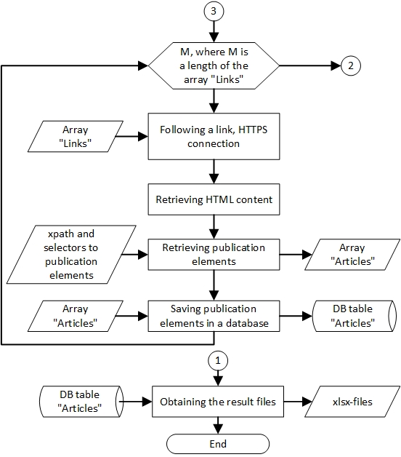
Algorithm for Constructing
of an Agent Information and Analytical System

Slide 5
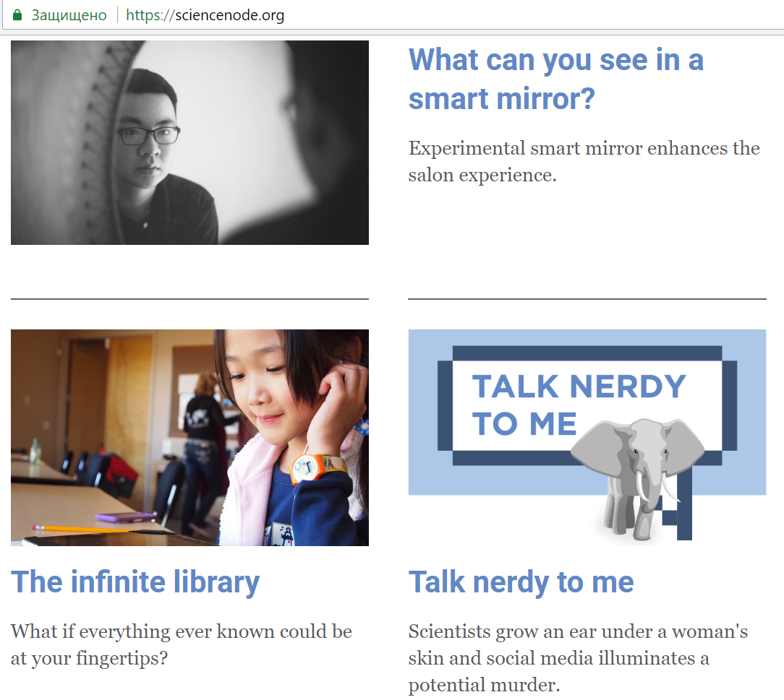
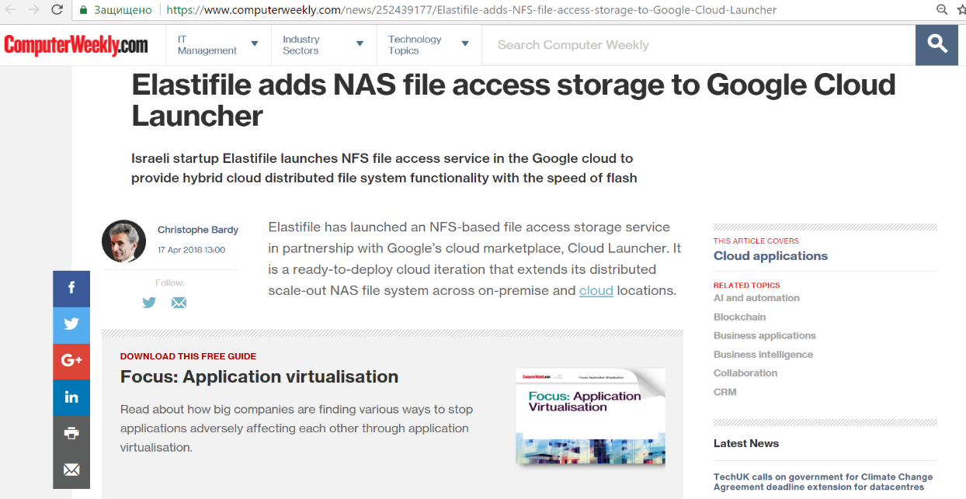
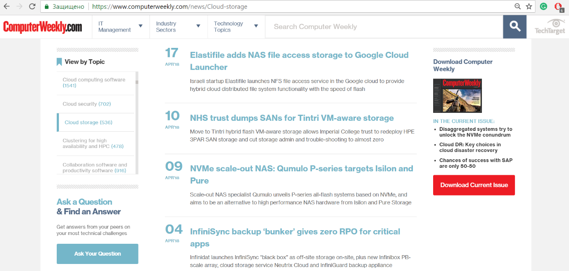
Constructing of an Agent
Information and Analytical System

Slide 6
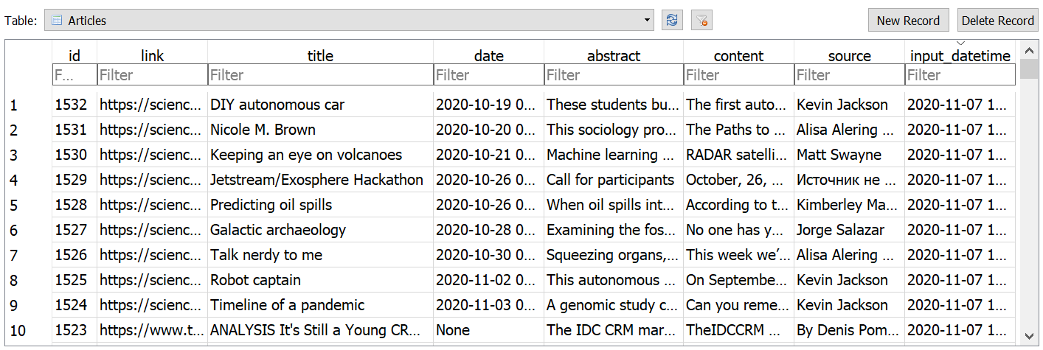
Constructing of an Agent
Information and Analytical System
Fragment of the table “Agents”
Fragment of the table “Articles”

Slide 7
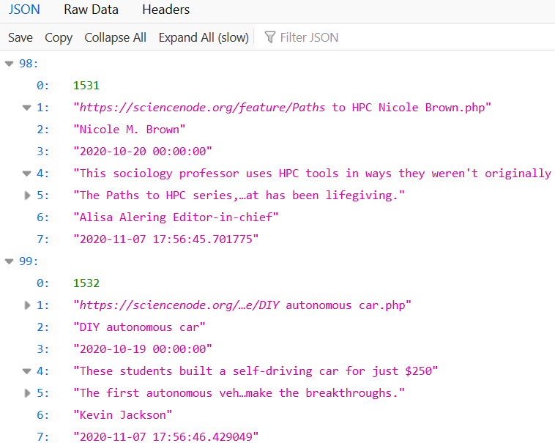
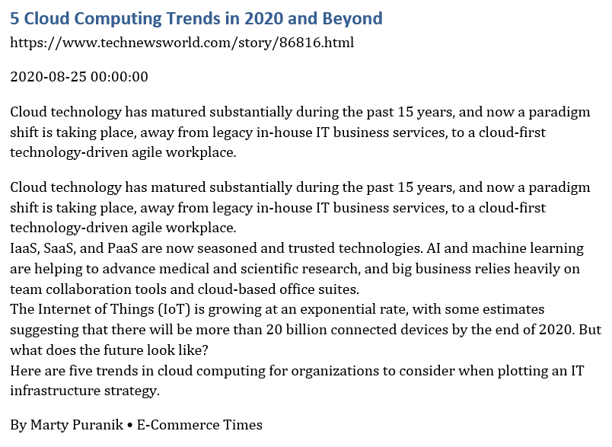
Results
Structure of json-file
Structure of docx-file

Slide 8
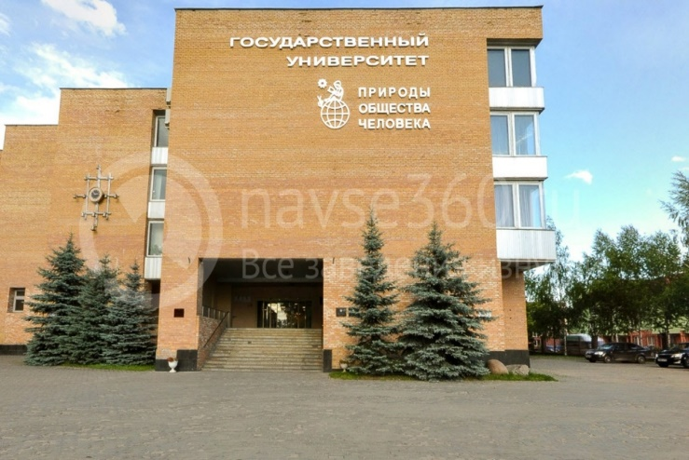
Thank you
for your attention!
Diana Koshlan
dkoshlan@jinr.ru

