Slide 1



The XXIV International Scientific Conference of
Young Scientists and Specialists (AYSS-2020)
November 9-13, 2020, Dubna
Using single-celled eucaryotes as a model organism in space radiation biology
V.S. Elizarova (Northern State Medical University, Arkhangelsk)
Scientific directors: N.A. Bebyakova (NSMU), N.А. Koltovaya (JINR)

Slide 2
Introduction
microgravity
space radiation
hypodynamy
isolation
microbiome dysfunction
↓ reactivity of the immune system
reactivation of certain viruses
dermatoses and allergic reactions
gastrointestinal disorders
bacterial infections
respiratory diseases

Slide 3
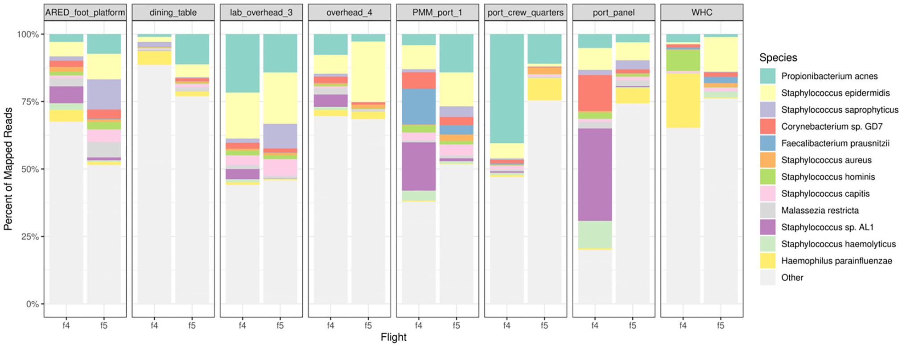

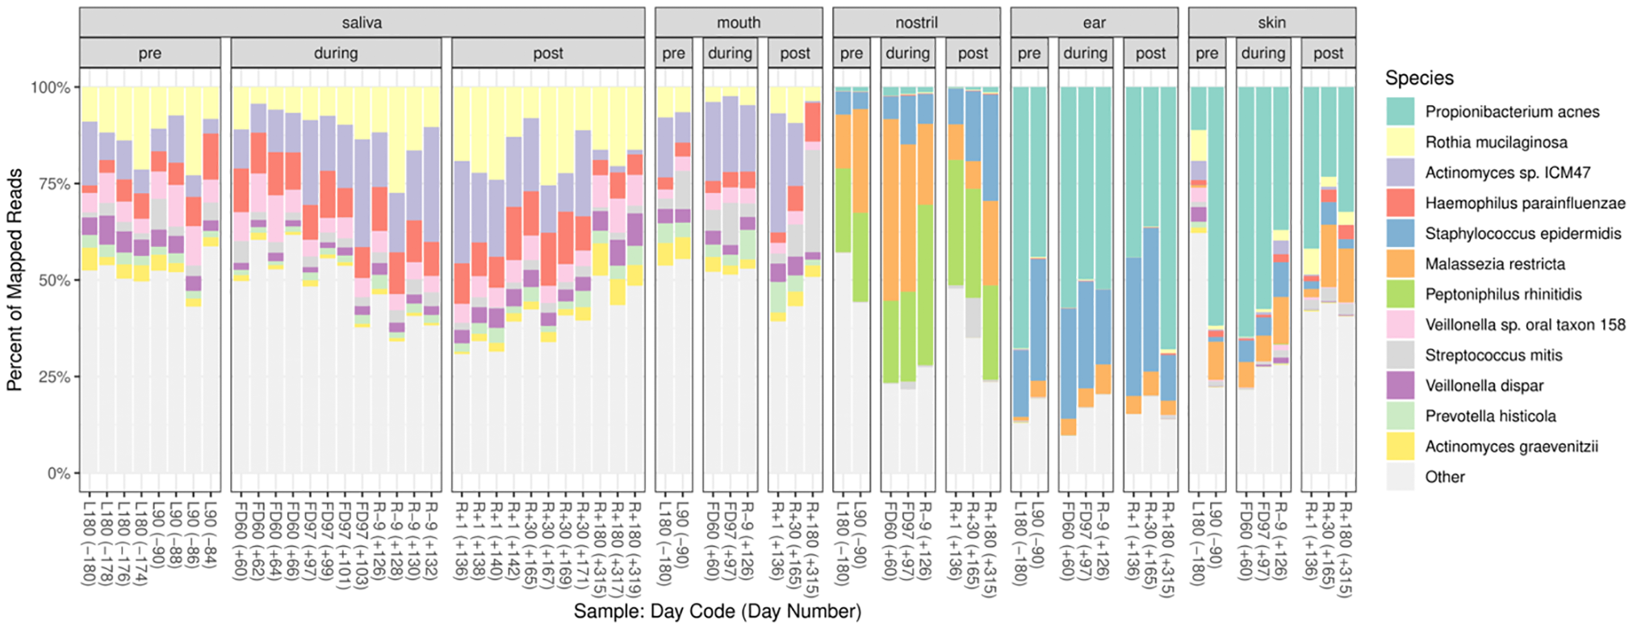
Introduction
Relative abundances of top 12 species in environmental samples in Flights 4 and 5
Top 12 most abundant species from crewmember samples pre-, during- and post-flight

Slide 4
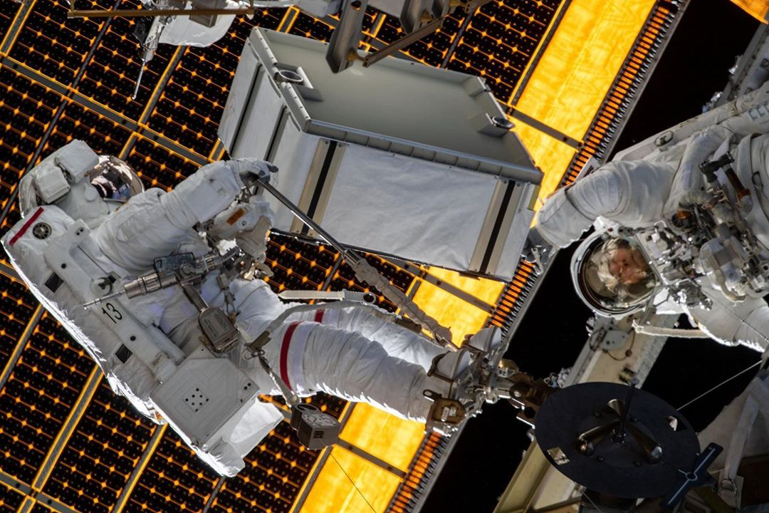

Investigation goal
The purpose of the study is to explore the influence of stressful conditions and the space ionizing radiation on the viability and the genetic stability of the yeast Saccharomyces cerevisiae, which is a unicell eukaryote and a part of the spacecraft microbiota

Slide 5
Materials and methods
Model organism: yeasts of the genus Saccharomyces cerevisiae RDKY 3023 (MATα his3–𝛥200 ura3–52 leu2–𝛥1 trp1–𝛥63 ade2–𝛥1 ade8 hom3–10 lys2–𝛥Bgl)
hom3-10 ACA GGG TTT TTT TGG TTT AGT
[646-651]
reversion ΔT
revertant ACA GGG TTT TTT GGT TTA GTT
lys2–𝛥Bgl ...AAAAAA….AAGATCgatcTGGAAA….CCCC
[388-391]
reversion ΔA ΔC

Slide 6
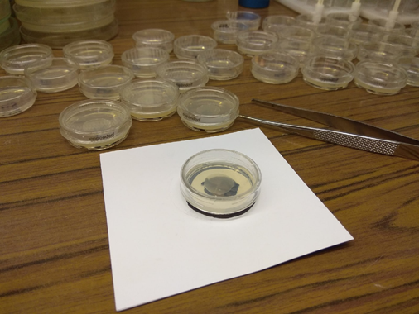
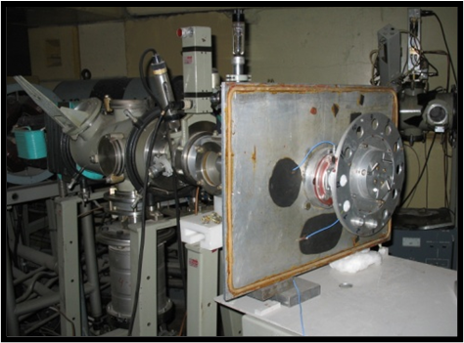
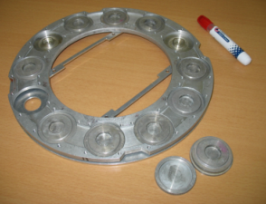
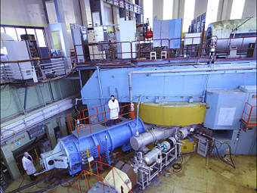
Experimental scheme
Getting mutants
Cultivation on YPD and MM
Cells were applied monolayer to filters
Containers with filters were placed in the drum
Irradiation with accelerated nitrogen ions ¹⁵N (U-400M)
Cultivation the culture on dishes with a nutrient medium
Cassette disk and equipment for irradiation by accelerated heavy particles
Determination of survival and frequency of mutants
Heavy-Ion Accelerator U-400M (Dubna, JINR)

Slide 7
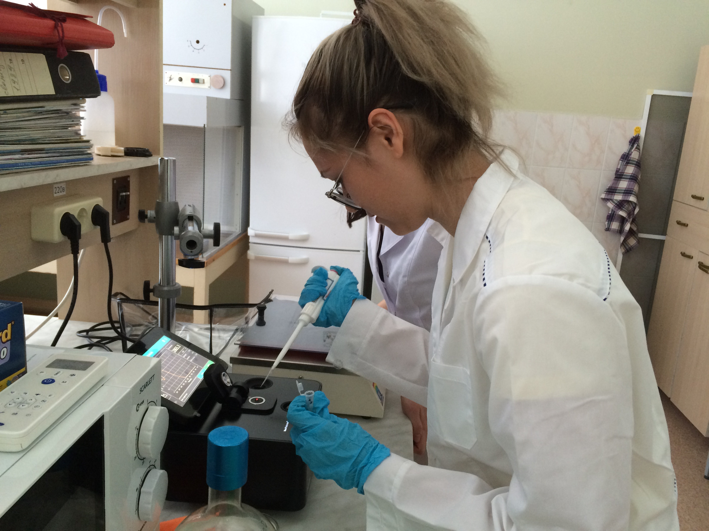
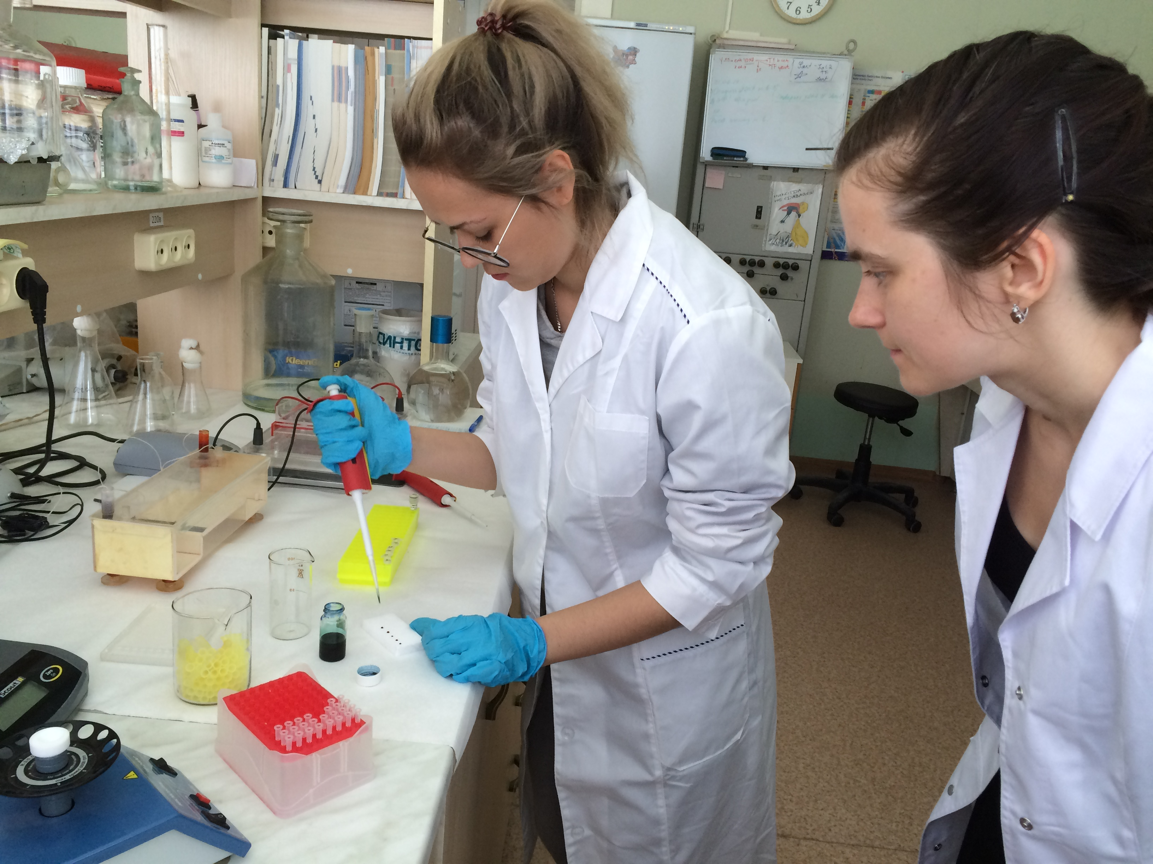
Experimental scheme
Growth a night culture
Sequences of primers used in the study
Gene | Primer | Oligonucleotide sequence
LYS2 | forward | 5'-GCTTTGAGTGTATGGGCTGC-3'
 | downstream | 5'-ATACACCCCACGAAATCGCA-3'
HOM3 | forward | 5'-GTGCCAGCGCTTTGGATAAC-3'
 | downstream | 5'-CGGTATAGCCACGACCAACA-3'
Isolation of DNA by the glass bead method
Determination of the amount of isolated DNA (NanoPhotometer NT80)
PCR amplification
TP4-PCR-01- «Tercyk»
Electrophoresis (TAE, 140 V, 150 mA, 35 min)
Sequencing (Syntol)
Sequence analysis (Codone Code Aligner, BLAST, programs for the conversion of DNA into protein)

Slide 8
Results
Survival of yeast cells irradiated with accelerated nitrogen ions ¹⁵N and gamma rays
Frequency of mutants induced by accelerated nitrogen ions ¹⁵N and gamma irradiation
RBE of lethal action was 3,5±0,7
RBE of mutagenic action was 4,4±0,6

Slide 9
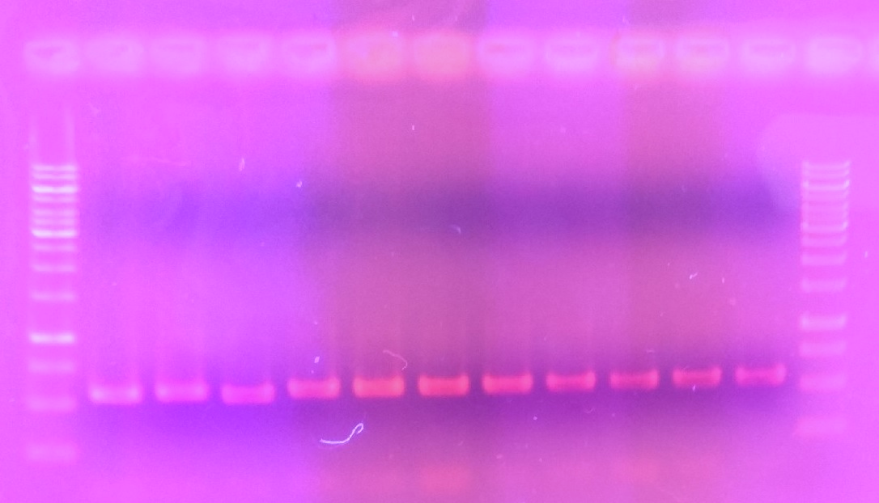
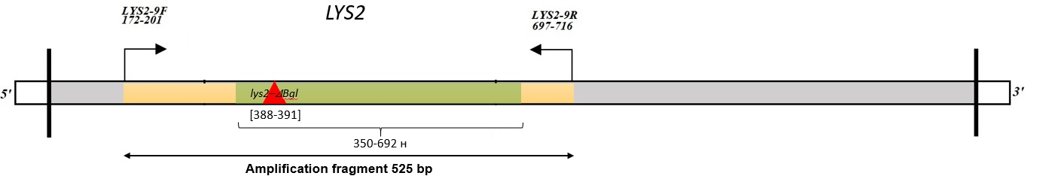
Results
bp
10000
Electropherogram of PCR DNA Lys+ fragments in 0.7% agarose gel (TAE, 140 V, 150 mA, 35 min)
8000
6000
5000
4000
3500
3000
2500
2000
1500
1000
750
500
250

Slide 10
Spectrum of mutations in the LYS2 gene (Part 1)
Type |  | K |  | 20 Gy |  | 80 Gy
 |  | event | frequency | event | frequency | event | frequency
Frameshift | Deletion (-1) | 6A→5A 3A→2A 2A→1A 1A→0A 6T→5T 1T→0T 4G→3G 2G→1G 1G→0G | 5/24 3/24 1/24 1/24 1/24 1/24 1/24 1/24 2/24 | 5A→4A 3A→2A 2A→1A 1T→0T 6T→5T 3T→2T 2C→1C 1C→0C 4G→3G 2G→1G 1G→0G | 1/20 1/20 2/20 1/20 1/20 1/20 1/20 1/20 3/20 3/20 2/20 | 6A→5A 1A→0A 5T→4T 2T→1T 4C→3C 2C→1C 1G→0G | 1/17 1/17 2/17 3/17 2/17 1/17 2/17
 |  | 16 (66,7%) | 21 (87,5%) | 17 (85%) |  | 12 (70,6%)
 | Insertion (+2) | 3A→5A | 1/24
 |  | 1 (4,2%)

Slide 11
Spectrum of mutations in the LYS2 gene (Part 2)
Type | K |  | 20 Gy |  | 80 Gy
 | event | frequency | event | frequency | event | frequency
Deletion |  |  | 𝛥25 bp | 1/20 | 𝛥75 bp 𝛥22 bp 𝛥7 bp 𝛥4 bp | 1/17 1/17 1/17 1/17
 |  |  | 1 (5%) |  | 4 (23,5%)
Complex | T3→T2+G→C T2→T1+A→C C→T+A6→A5 | 1/24 2/24 1/24 | T→A+G1→G0 T→C+G2→G1 | 1/20 1/20 | C→A+T3→T2 | 1/17
 | 4 (16,7%) |  | 2 (10%) |  | 1 (5,8%)
Multiple mutations | T3→T5+G3→G2 A2→A0+Δ74 bp | 1/24 2/24
 | 3 (12,5%)

Slide 12
Spectrum of mutations in the HOM3 gene
Type | K |  | 20 Gy
 | event | frequency | event | frequency
Frameshift | 7T→6T | 5/5 | 7T→6T | 3/3

Slide 13

Conclusions
It is shown that accelerated nitrogen ions have a higher lethal effect compared to rarely ionizing gamma rays. RBE of lethal action was 3,5±0,7
Accelerated nitrogen ions have a higher mutagenic effect (frameshift mutations) compared to rarely ionizing gamma rays. RBE of mutagenic action was 4,4±0,6
A determining of the sequence of nucleotides showed that that the overwhelming proportion of mutations are single nucleotide deletions
However, irradiation increases the proportion of extended deletions
Next steps were to study the behavior of another yeast strain of Saccharomyces boulardii, which has probiotic properties

Slide 14
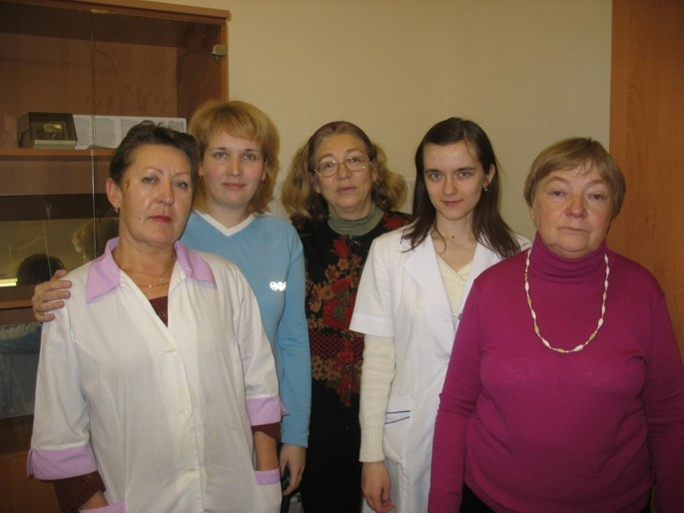
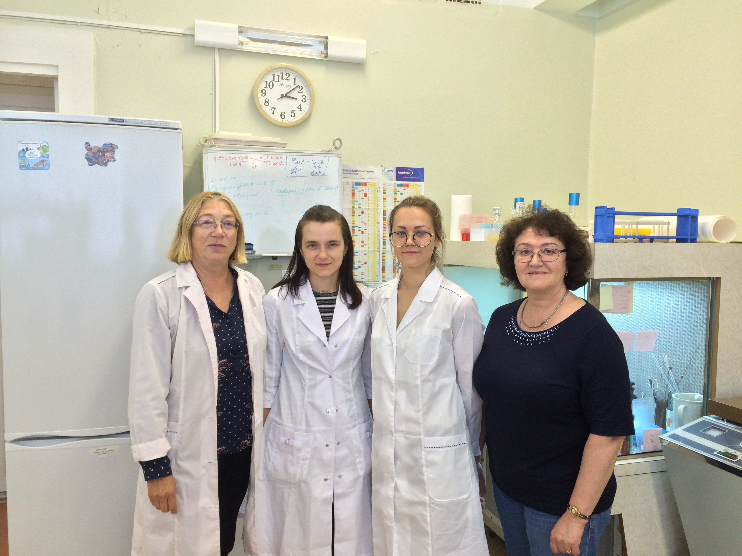
Gratitude for the provided data
T. Bazlova, A. Kokoreva, N. Koltovaya, N. Zhuchkina,
N. Shvaneva
N. Koltovaya, N. Zhuchkina (JINR)
V. Elizarova, N.Bebyakova (NSMU)
to the group of Yeast Radiation Genetics (JINR, Dubna)

Slide 15
Thank you for your attention!

