Slide 1
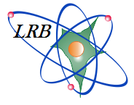
DNA double strand breaks repair kinetics in neurons and astrocytes of primary hippocampal cell culture after irradiation with ⁶⁰Co γ-rays and proton
The XXIV International Scientific Conference
of Young Scientists and Specialists
(AYSS-2020)
Filatova A.S. ^{1,2}, Boreyko A.V. ^{1,2}, Vasilyev L. A. ^{1,2}, Krupnova M. E.^{1,2}, Smirnova E. V. ¹, Hramco T.S. ^{1, 2}
¹ Joint Institute for Nuclear Research Laboratory of Radiation Biology, Dubna
² Dubna State University, Dubna, Russia
Dubna, 2020

Slide 2
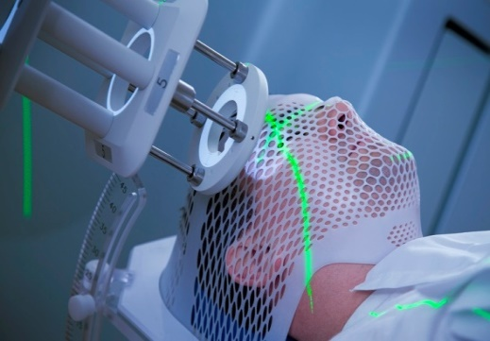
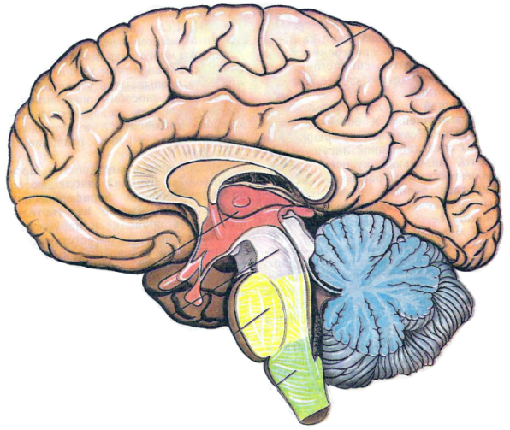
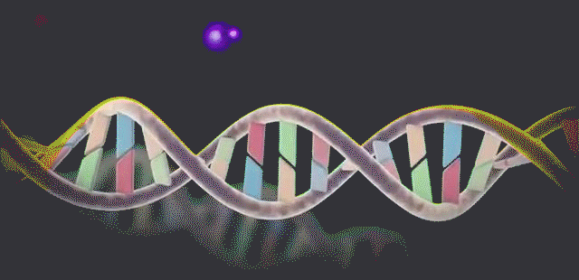
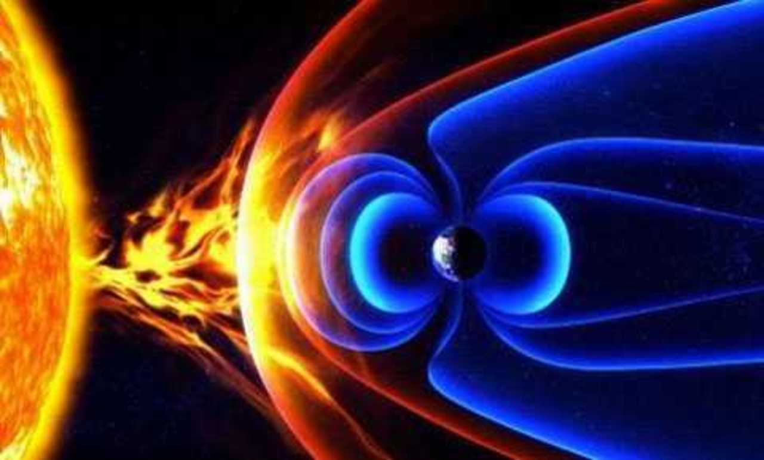
Introduction
DNA damage
Cognitive impairment
Cause unavoidable
brain damage
methods of radiation therapy
cosmic radiation
DNA double-strand breaks are one of the most severe DNA damage to the genetic structures of cells
Repair of this type of DNA damage in neurons remains poorly understood

Slide 3
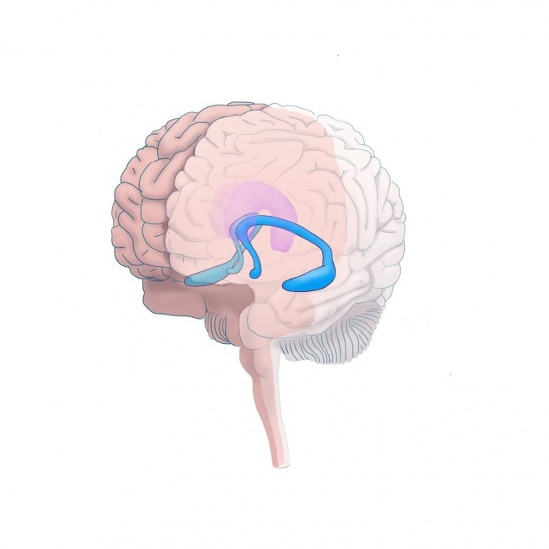
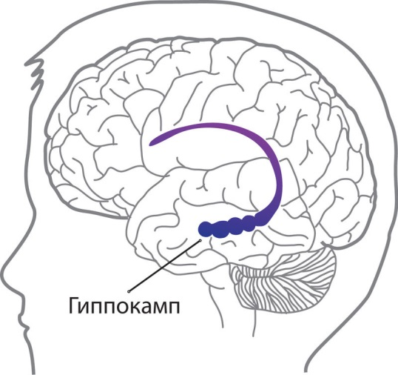
Hippocampus
Hippocampal
functions
Damage to the hippocampus
Hippocampus
Learning and memory
Decrease in hippocampal neurogenesis
Emotional behavior
Impairment
of cognitive functions
Spatial orientation
Impairment spatial memory in animals

Slide 4
Aim and goals
Aim:
To study the formation and repair of DNA DSBs in neurons of the rat primary hippocampal cell culture under the action of ⁶⁰Co γ-ray and protons
Goals:
To investigate the formation and elimination of γH2AX/53BP1 foci under the action of ⁶⁰Co γ-ray and protons in the rat primary hippocampal cell culture
To compare the formation and elimination of γH2AX/53BP1 foci in neurons and astrocytes of primary hippocampal cells culture

Slide 5
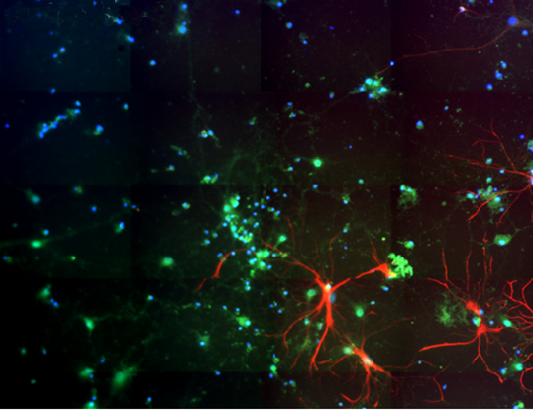
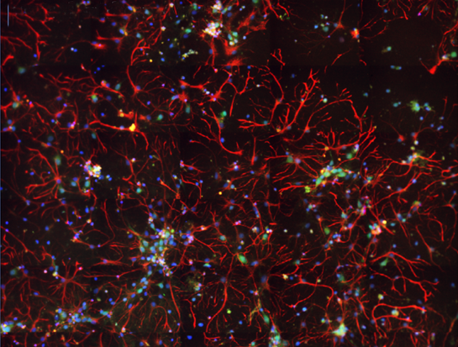
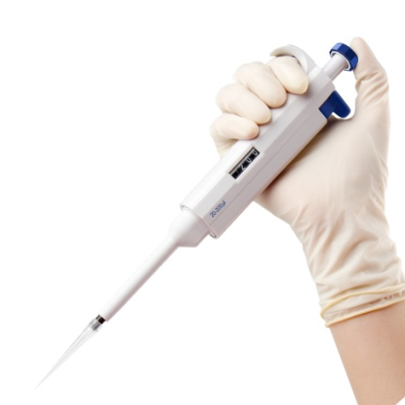
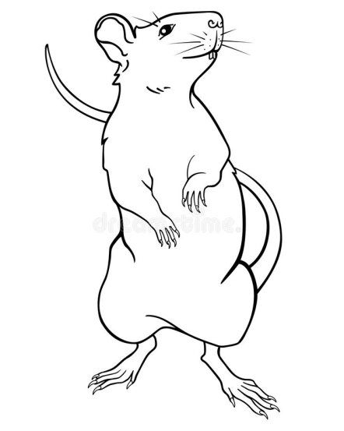
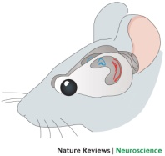
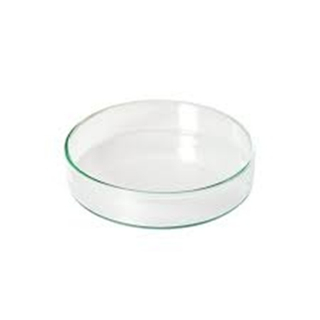
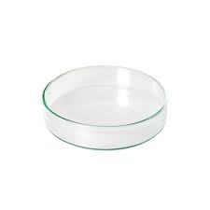
Hippocampal cell culture
Primary hippocampal cell culture
includes: neurons, astrocytes
and other cell types
Neuronal cell culture
includes only neurons
Tissue isolation
Cell dissociation
and plating
AraC-treatment
on DIV 4-7
(Days in vitro)
Irradiation with
γ-ray, protons
on DIV 16-18
Б

Slide 6
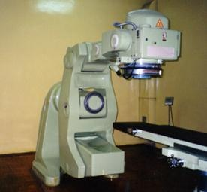
Materials and methods
Sample
preparation
Irradiation
Fixation
Immunostaining and analysis
“Rokus-M”
Phasotron

Slide 7
The kinetics of γH2AX/53BP1 foci formation and elimination in neurons after ⁶⁰Co γ-ray and protons irradiation
γH2AX/53BP1 foci complexity
AraC-treated cells
Mann-Whitney Test: ** P=0,001; * P=0,05

Slide 8
The kinetics of γH2AX foci formation and elimination in astrocytes after ⁶⁰Co γ-ray and protons irradiation
γH2AX foci complexity
Mann-Whitney Test: ** P=0,001; * P=0,05

Slide 9
Conclusions
1. The action of accelerated protons induces a higher level of RIF with a more complicated structure in comparison with γ-ray in both neuron and primary hippocampal cell culture during the post-irradiation period.
2. In neuronal cell culture the maximum yield of RIF was observed 1 h after γ-ray and proton irradiation. In case of primary hippocampal cell culture the highest level of foci was achieved 4 h after the proton irradiation and 1h after γ-ray.
3. At 24 h after γ-ray and proton irradiation, the yields and complexity of RIF in neurons remain higher compared with astrocytes, which probably indicates more effective DNA DSBs repair in astrocytes.

Slide 10
Thank you for your attention!
Notes:
ДР Образуются либо в результате прямого разрыва двух двух нитей ДНК- прямые ДР в результате передачи энергии локальному участку ДНК и приводящему к нарушению ее целостности
Либо могут формироваться из других повреждений в процессе клеточного восстановления в качестве издержек репарации в процессе работы различных ферментов.

