Slide 1
SYSTEM FOR CHECKING OF ELECTRICAL PARAMETERS OF SUPERCONDUCTING MAGNETS FOR NICA AND FAIR PROJECTS
B. Kondratiev, A.G. Antonov, V.V. Borisov, S.A. Dolgij, H.G. Khodzhibagiyan, S.A. Kostromin
Joint Institute for Nuclear Research
Laboratory for High Energy Physics
Superconducting Magnets Department

Slide 2
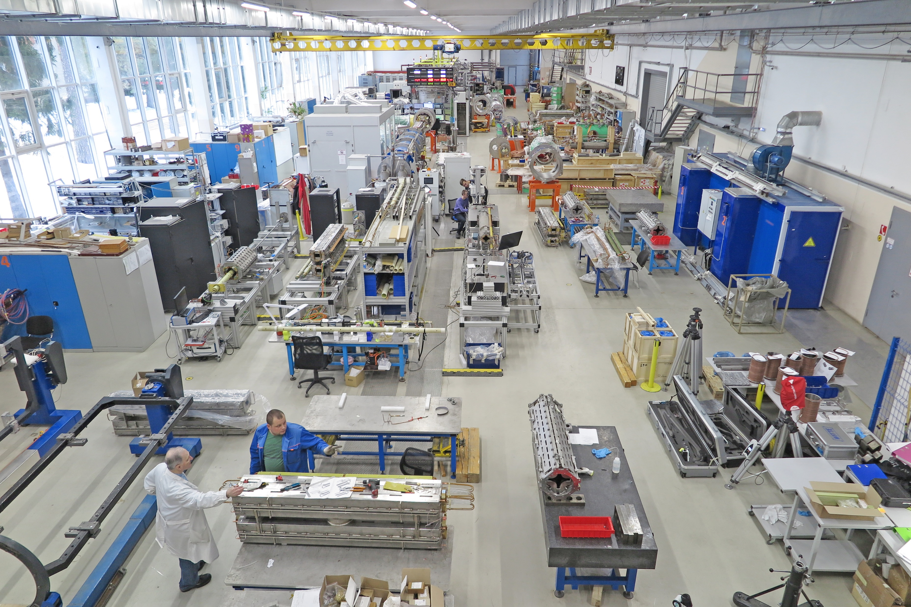
Introduction
Serial production of superconducting (SC) magnets for the NICA and FAIR projects is currently underway at Superconducting magnets department.
Electrical parameters of superconducting coil should be checked before each stage of assembling and cryogenic testing to avoid faults.
A system for checking of SC-magnets electrical parameters was developed.

Slide 3
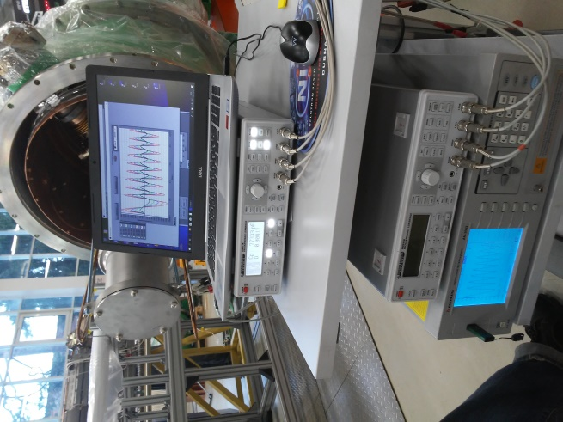
System for checking of electrical parameters
Modules of the system:
Coil tester Software;
Surge test;
RLQ measurements in required frequency range;
Tests of insulation.

Slide 4
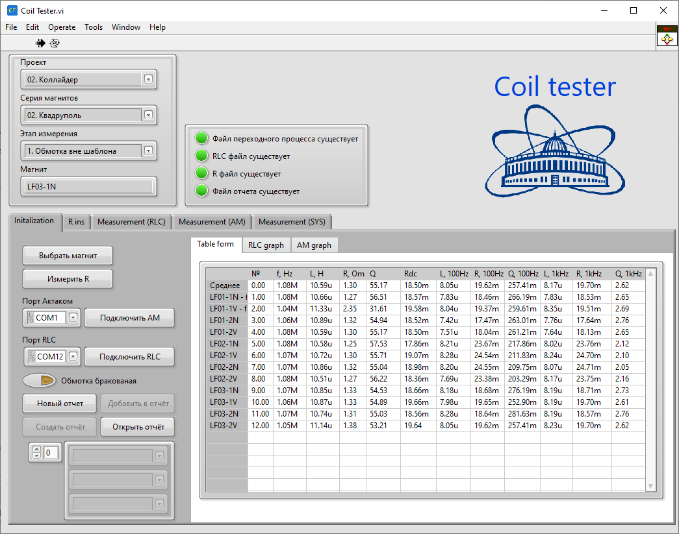
Coil tester software
Coil tester software was developed by LabVIEW.
Software needs to acquire, store and compare test data and also manage and calibrate devices.
It allows to generate measurement reports.

Slide 5
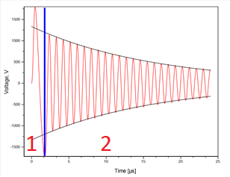
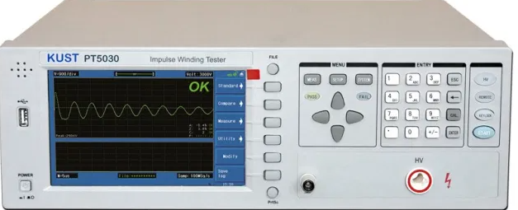
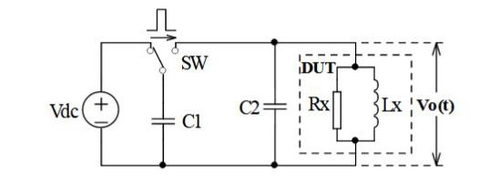
Surge test
Surge tester allows to find turn-to-turn insulation weakness of SC coil.
High-voltage impulse applies to a coil, which produces a voltage difference between adjacent loops of wire. If arc between turns happens – pulse waveform will change.
Device | Max voltage, V | Max energy, mJ
Aktakom AM-3083 | 3000 | 90
Kust PT5030 | 5000 | 250
Epowersys CDG7000 | 7000 | 49000
High voltage discharge test zone
Energy loss test zone

Slide 6
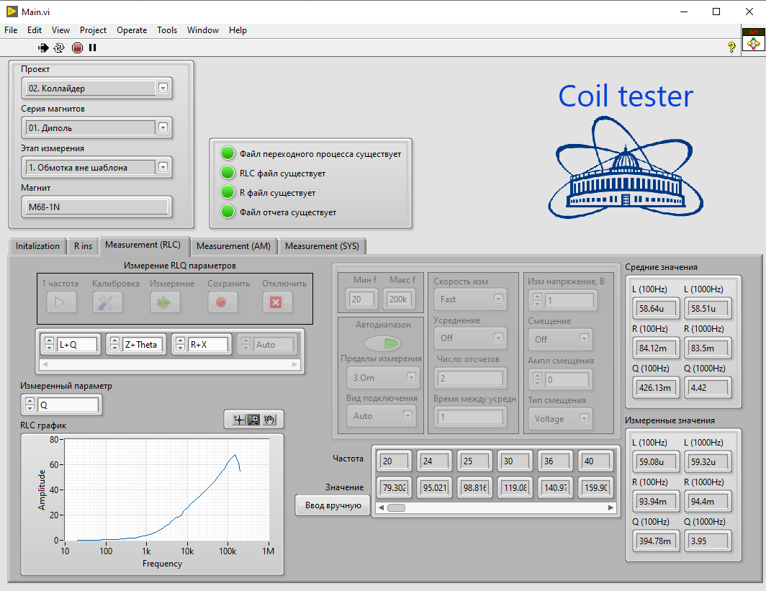
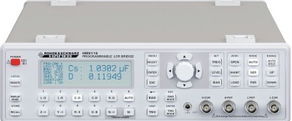
RLQ measurements
RLC meter Hameg HM8118 measures values in wide range of frequencies.
Measured values of inductance, resistivity, and quality factor compare with calculated values and series values.
Hameg HM8118 characteristics
Measurement functions | L, R, |Z|, Q, D and others
Test frequencies | 20 Hz…200kHz (69 steps)
Basic accuracy | 0.05%

Slide 7
Comparison between surge tester and RLC-meter
In case of measured oscillation frequency of surge tester waveform lies in range of HM8118 frequencies it is possible to compare surge tester waveform parameters with Hameg HM-8118 measured parameters.
-> Surge tester waveform params:
f = 20.3 kHz
R = 94.7 Ω
L = 29.95 mH
Q = 40.3
HM-8118 measurements (20kHz):
R = 90.5 Ω
L = 29.96mH
Q = 41.6

Slide 8
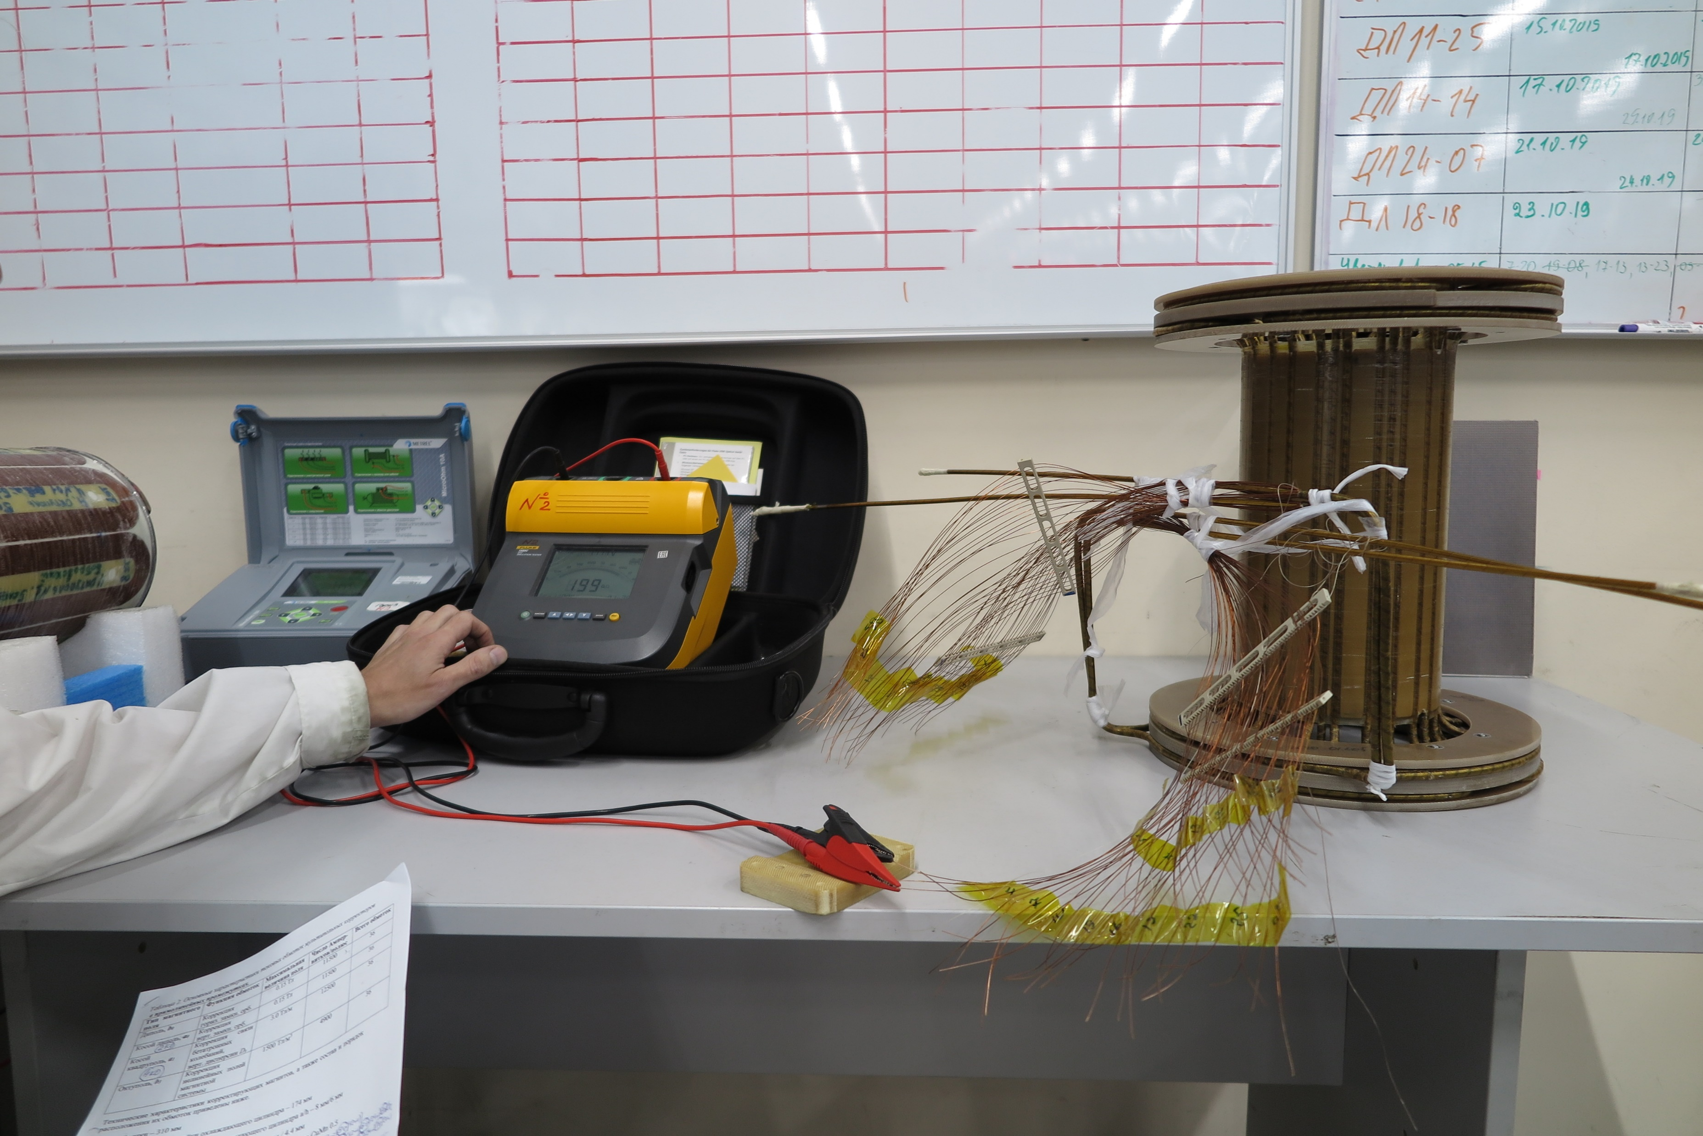
Insulation test
It is unacceptable to have insulation failure between coil and yoke, coil tube, terminal box or between adjacent wires.
Insulation parameters are measuring by Insulation tester Fluke 1550C under high voltage during 2 minutes.
Fluke 1550C characteristics
Test voltage | Up to 10kV
Accuracy | 5-20%
Test time | 0-99 minutes
Resistance measurement | Up to 2TΩ
Leakage current | 1 nA … 2 mA

Slide 9
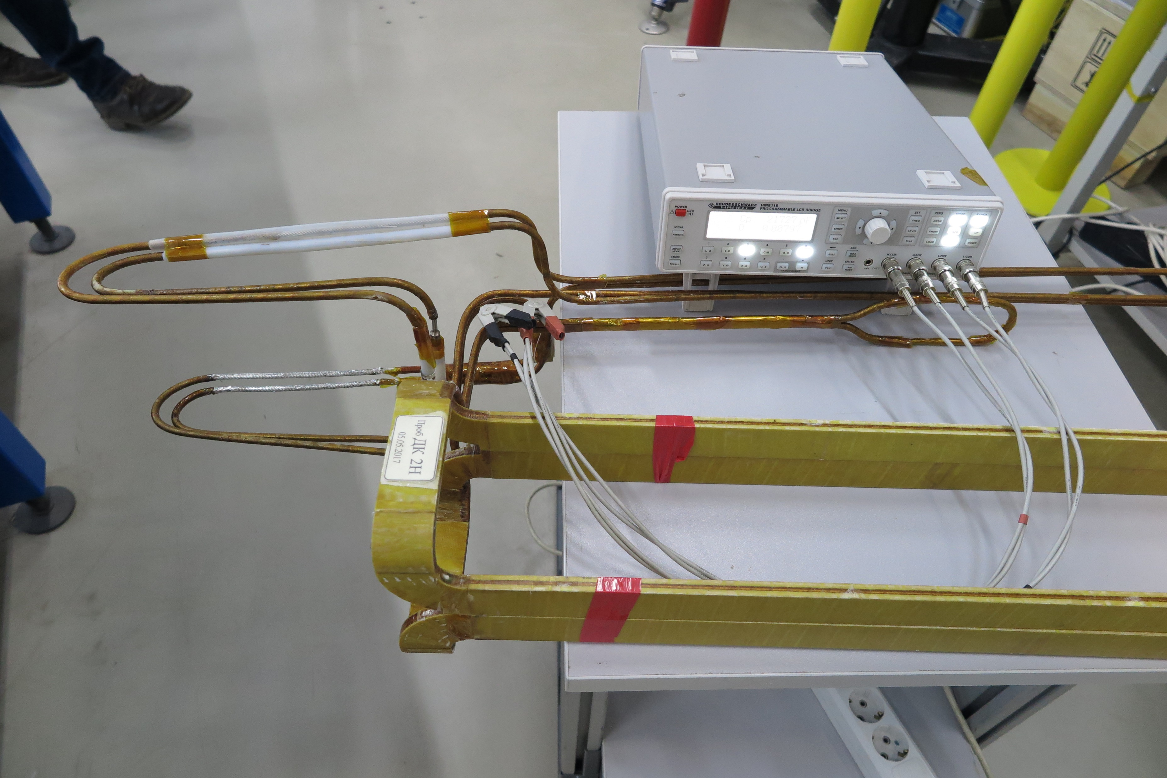
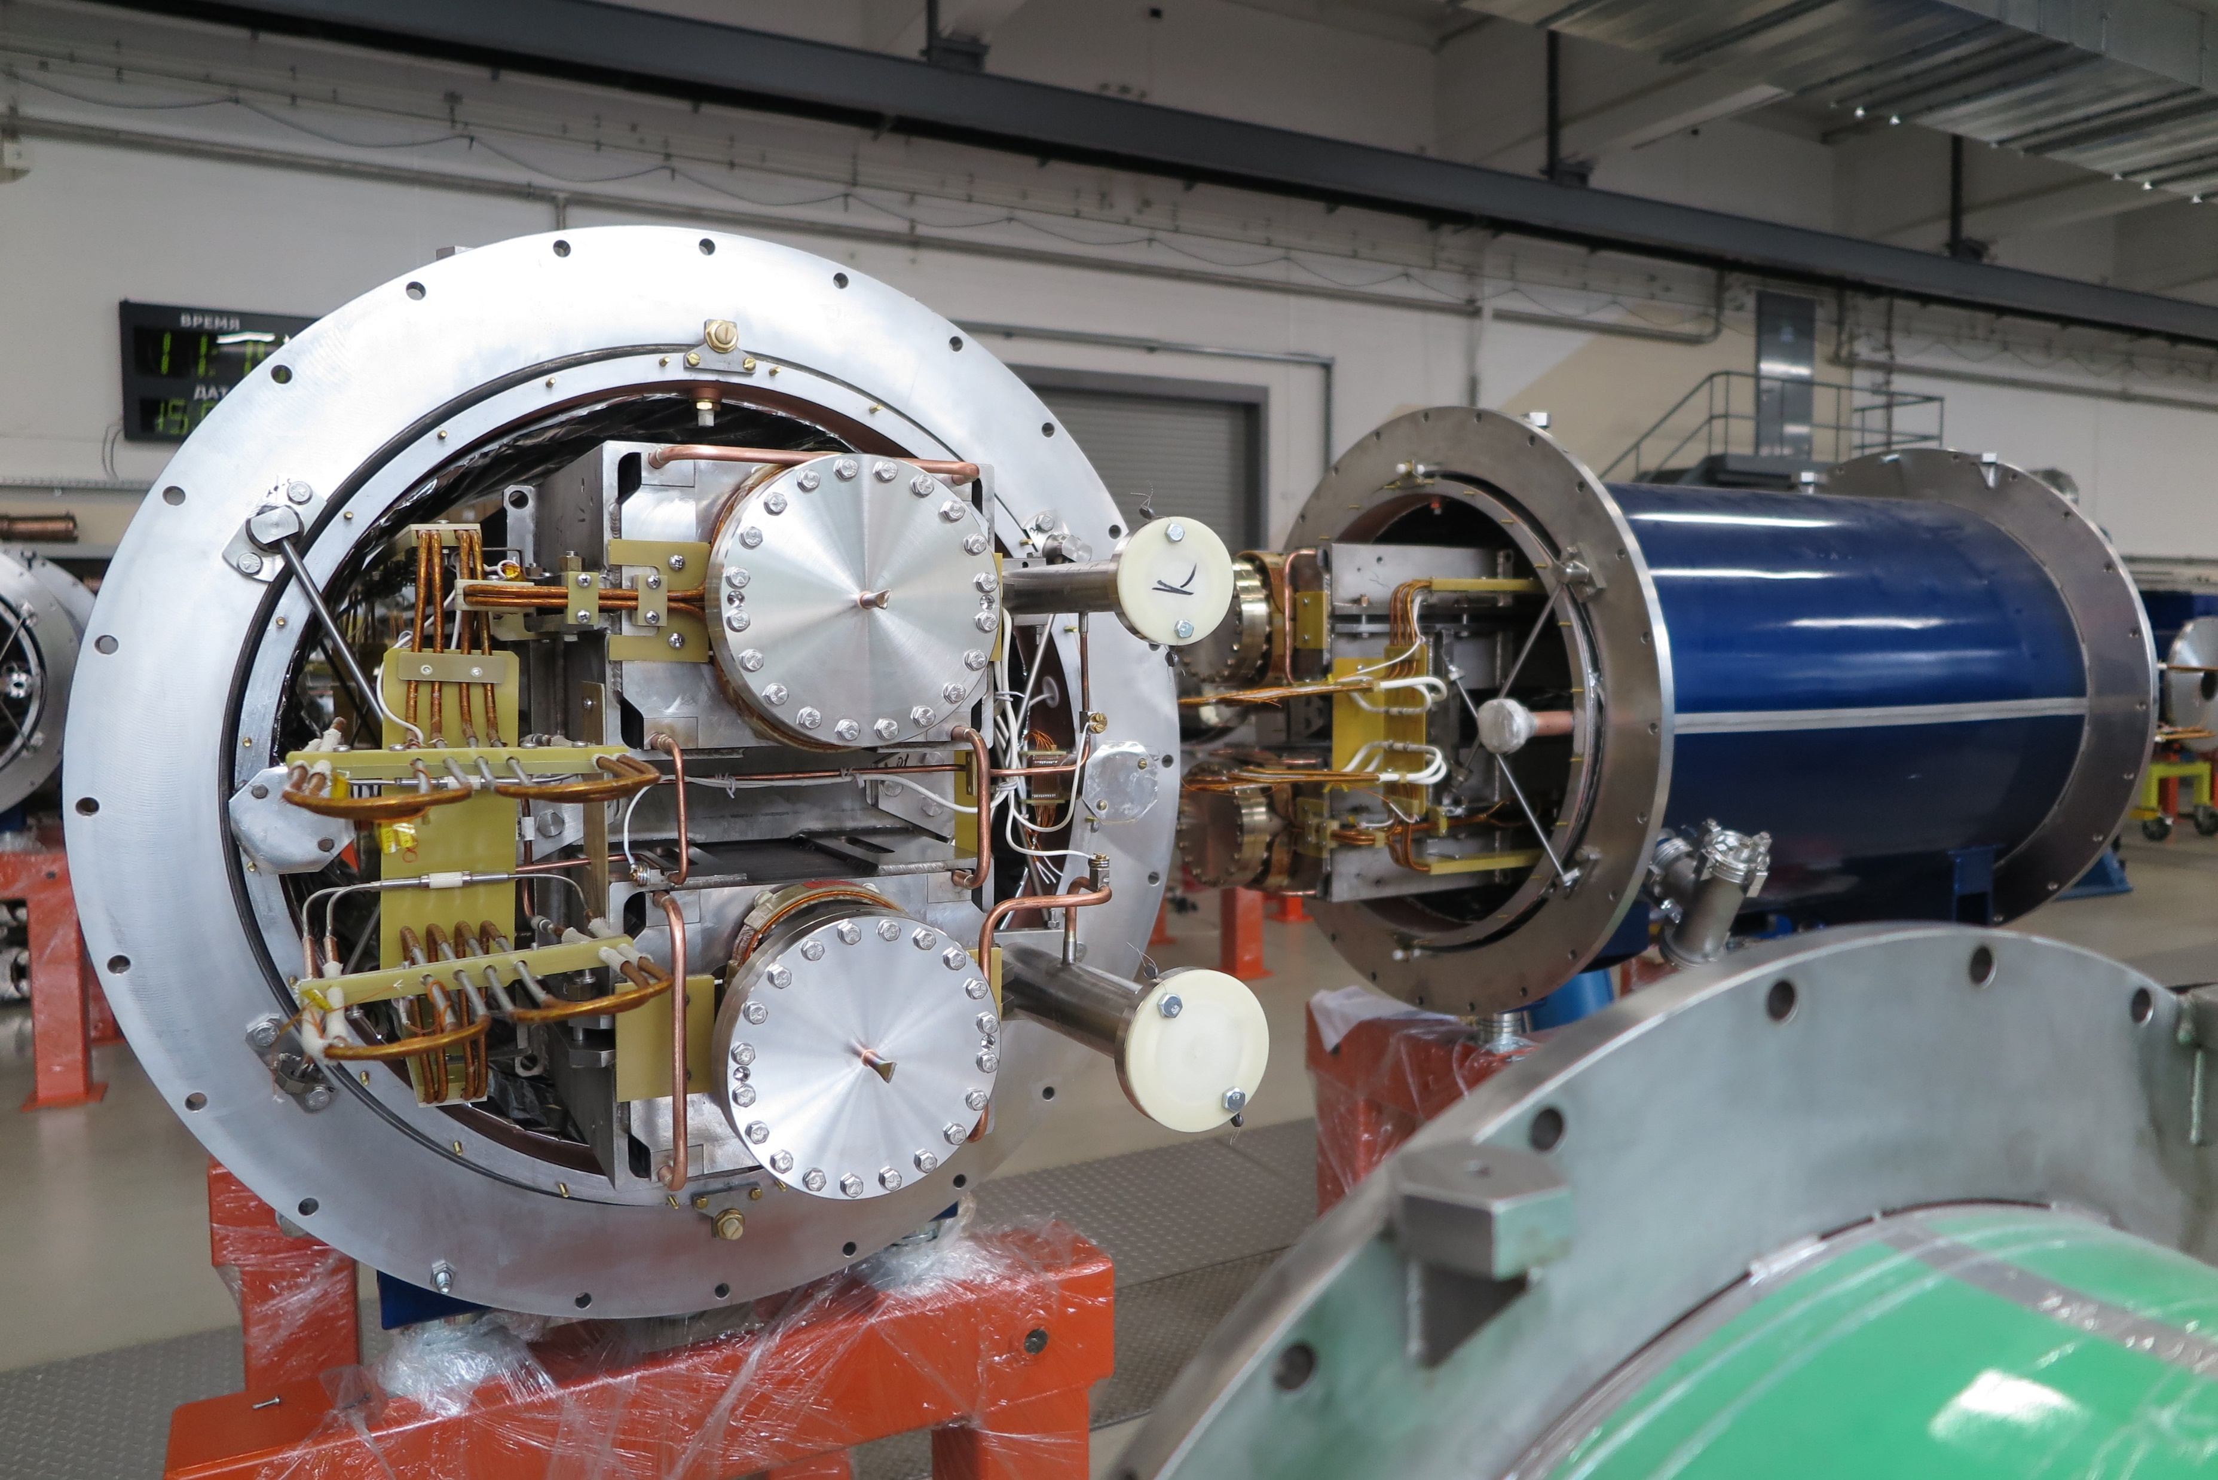
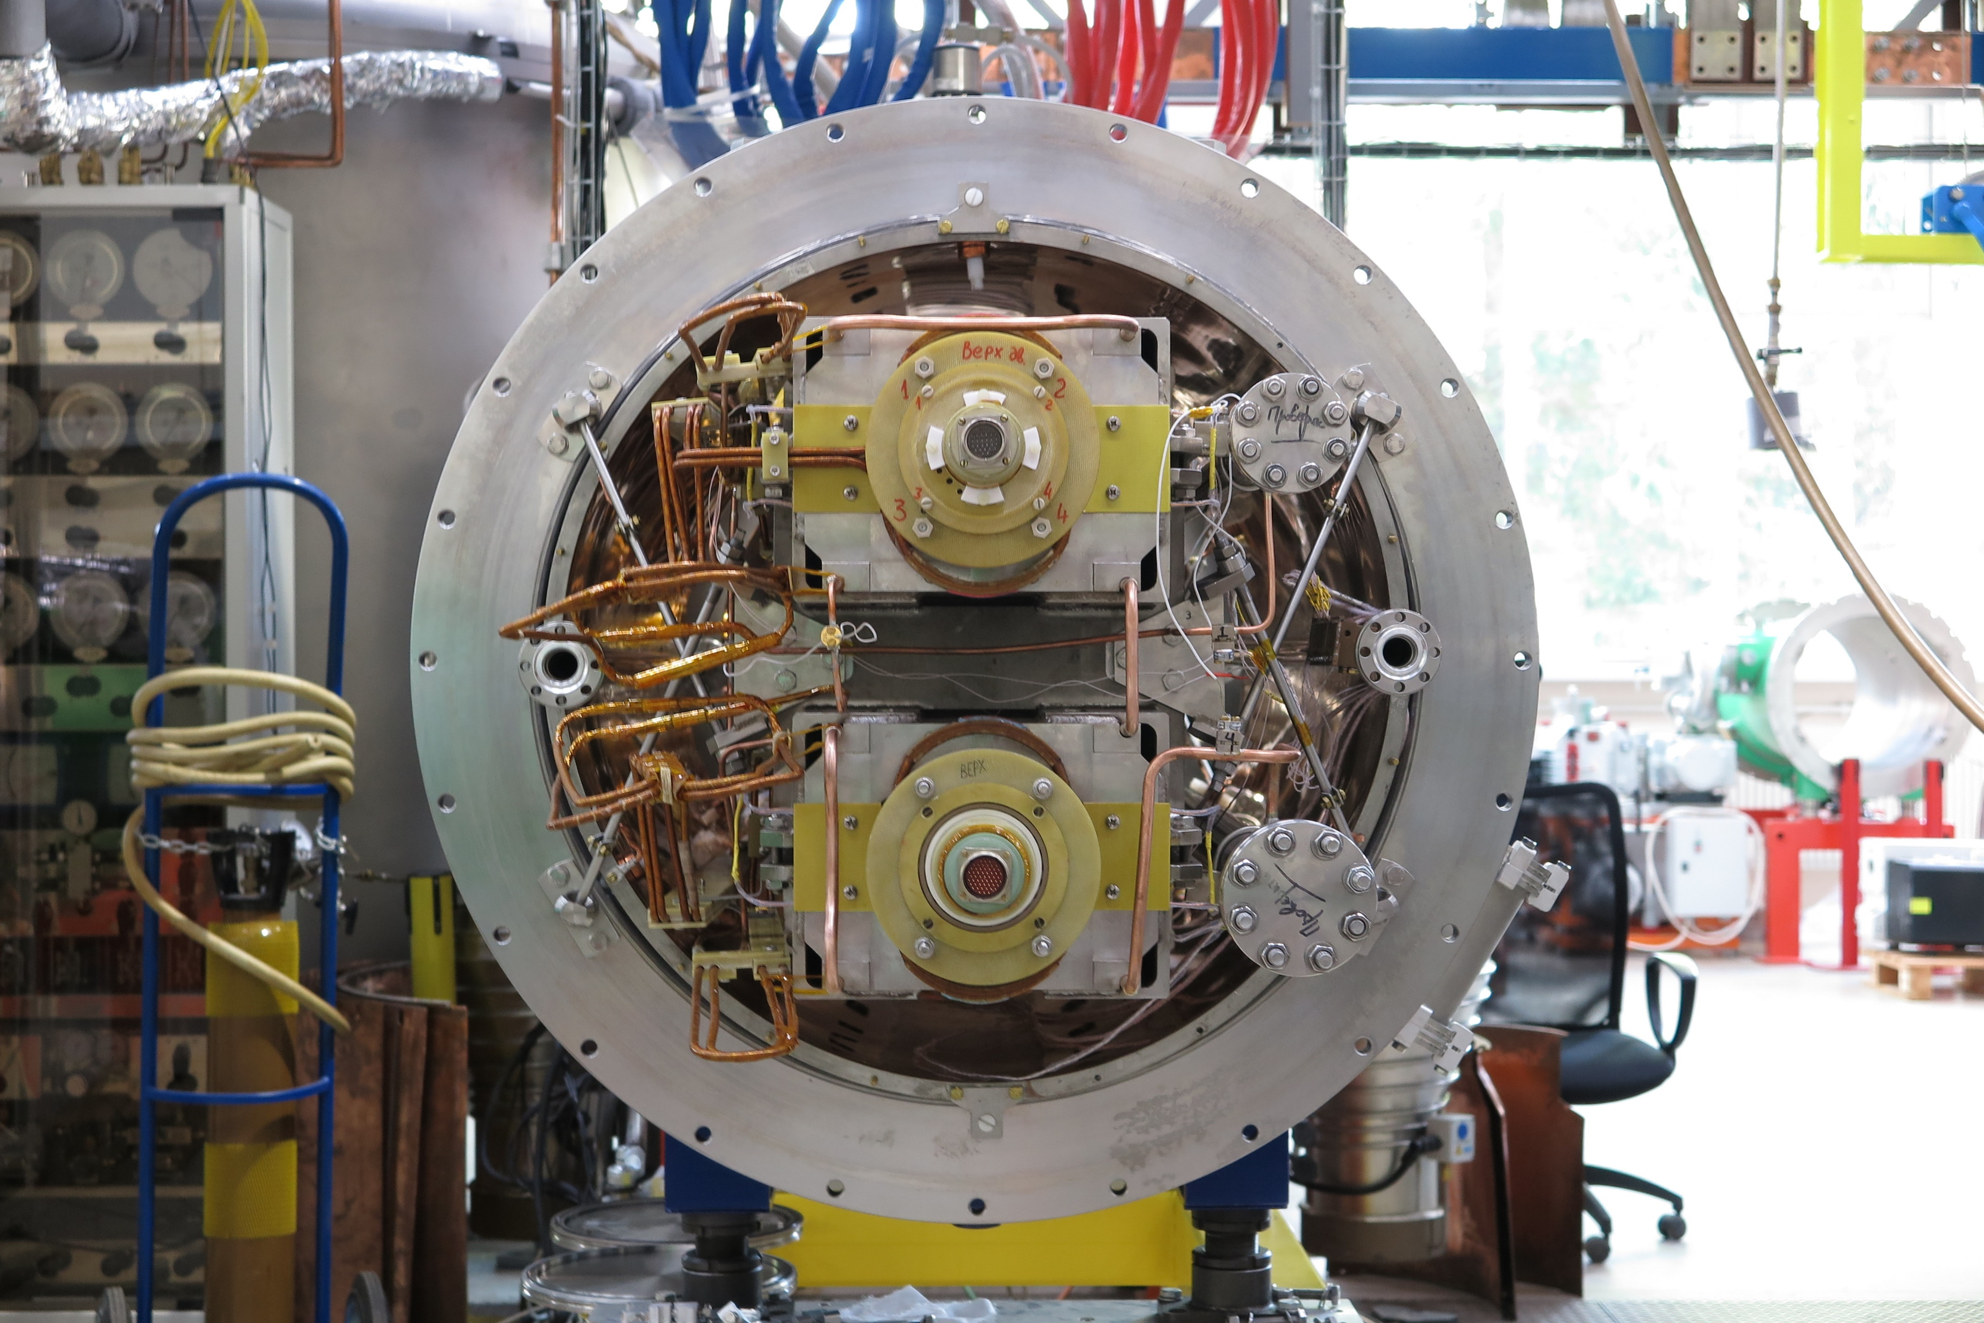
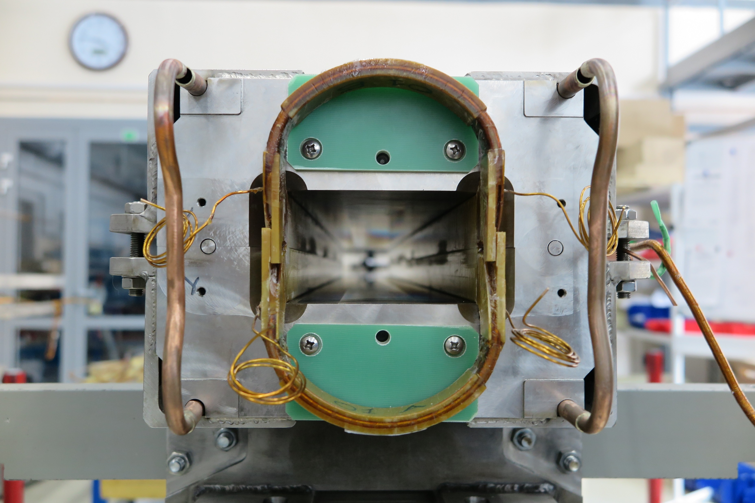
Stages of testing NICA main dipole/quadrupole electrical parameters
Coil without yoke test
Coil in yoke
Coil with yoke in cryostat
Coil with yoke in cryostat with vacuum chamber

Slide 10
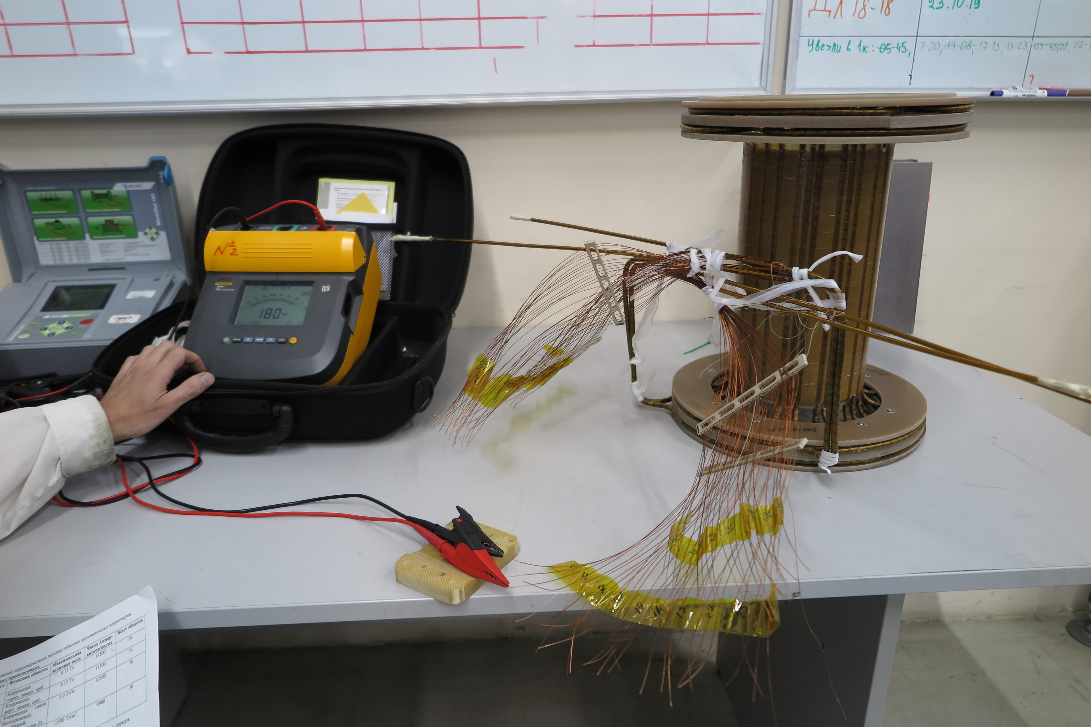
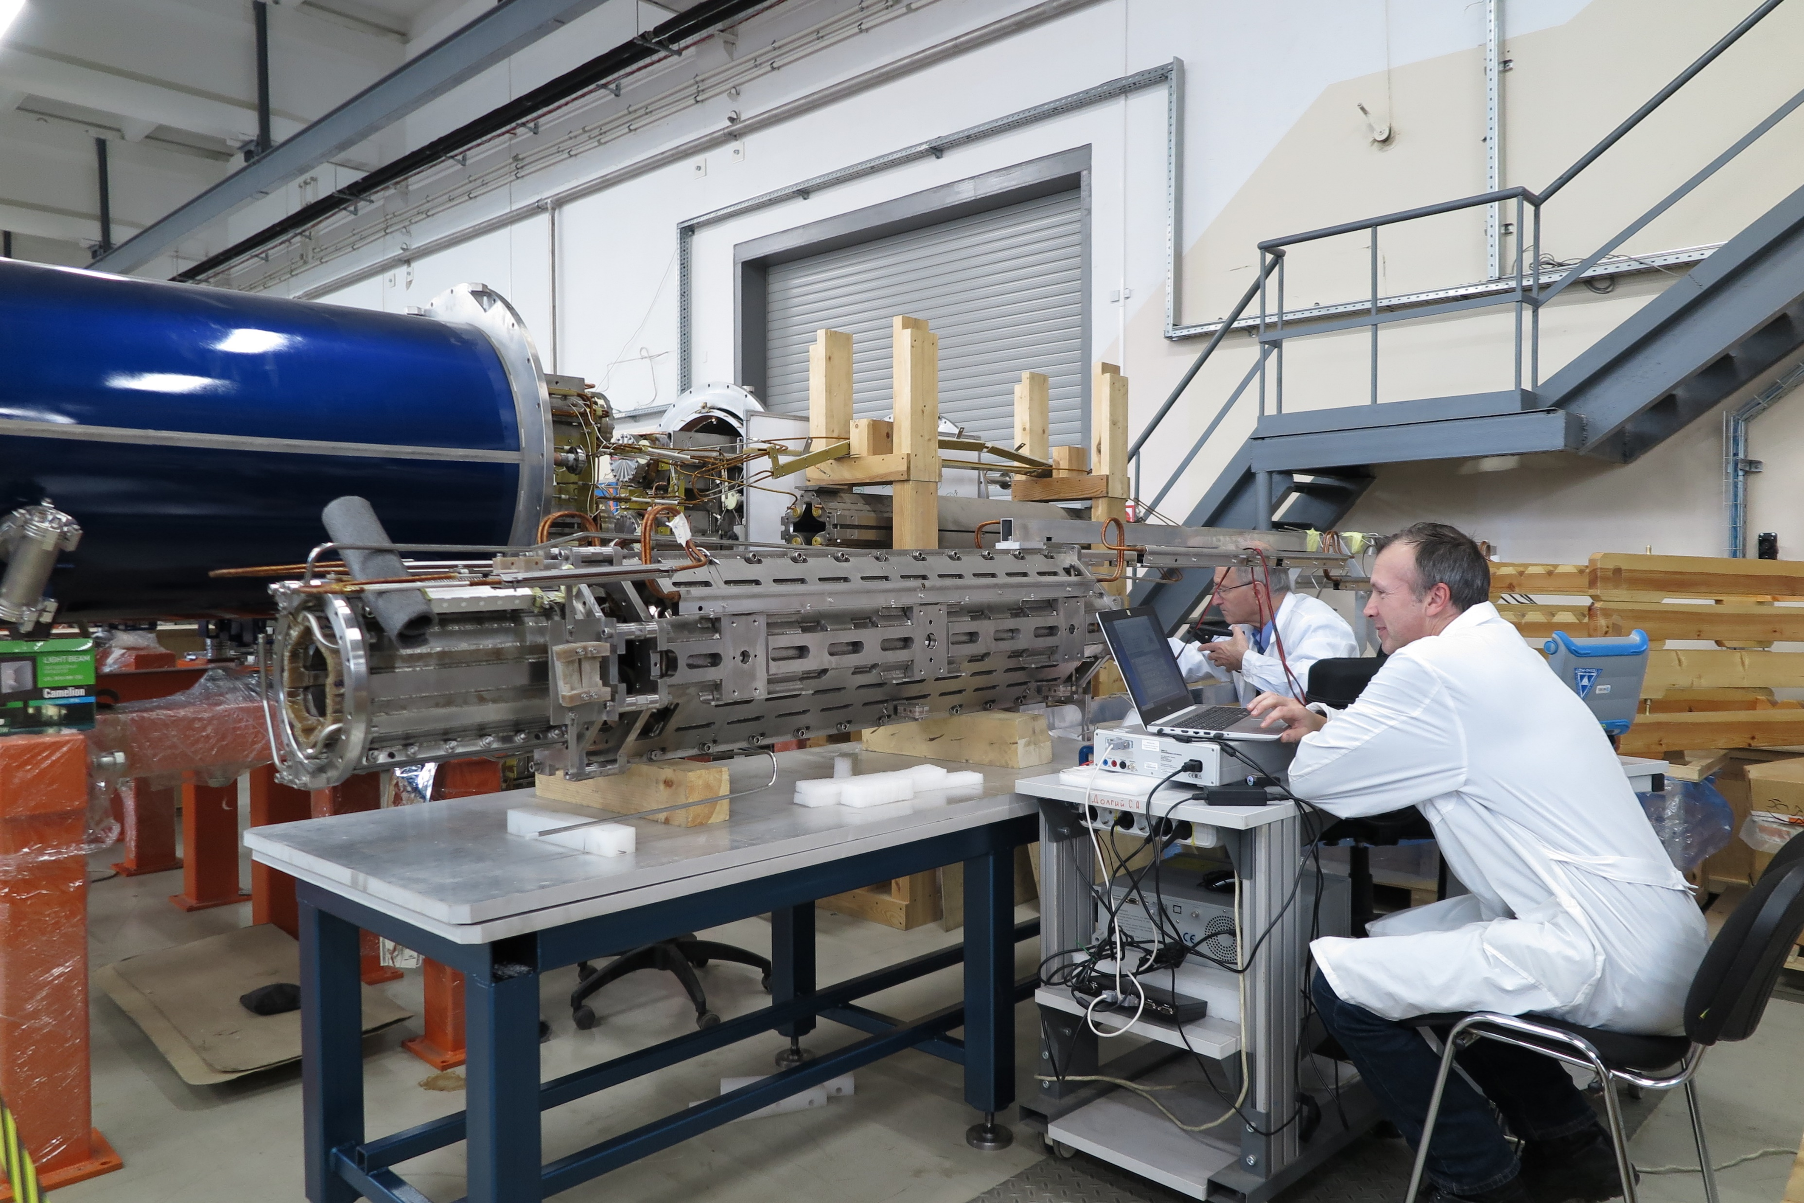
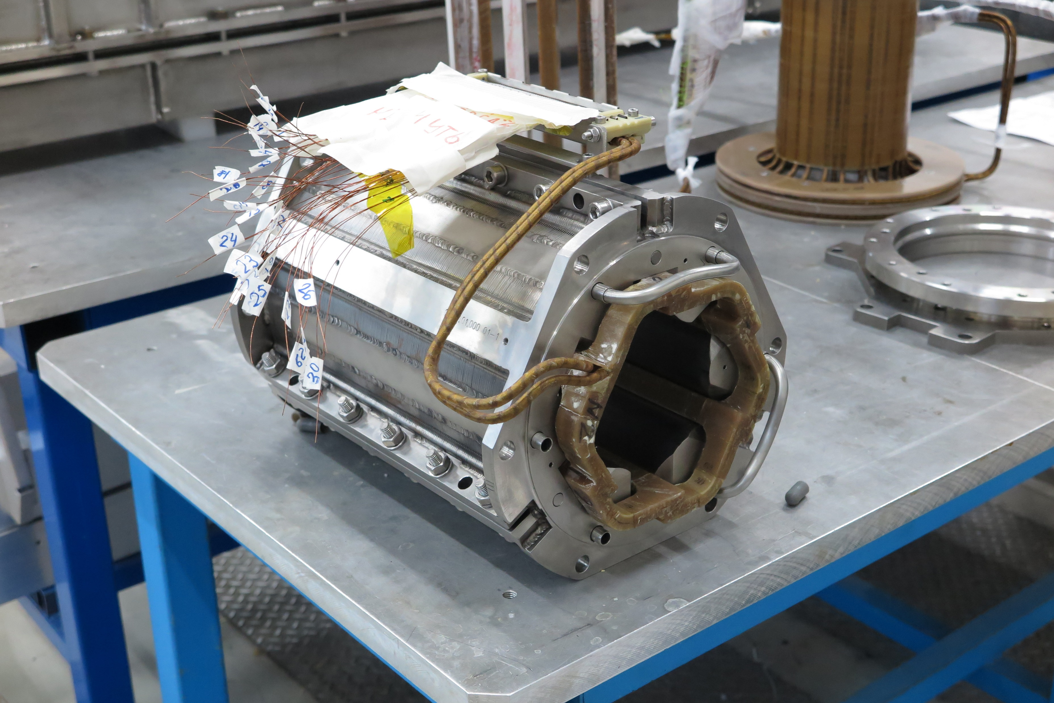
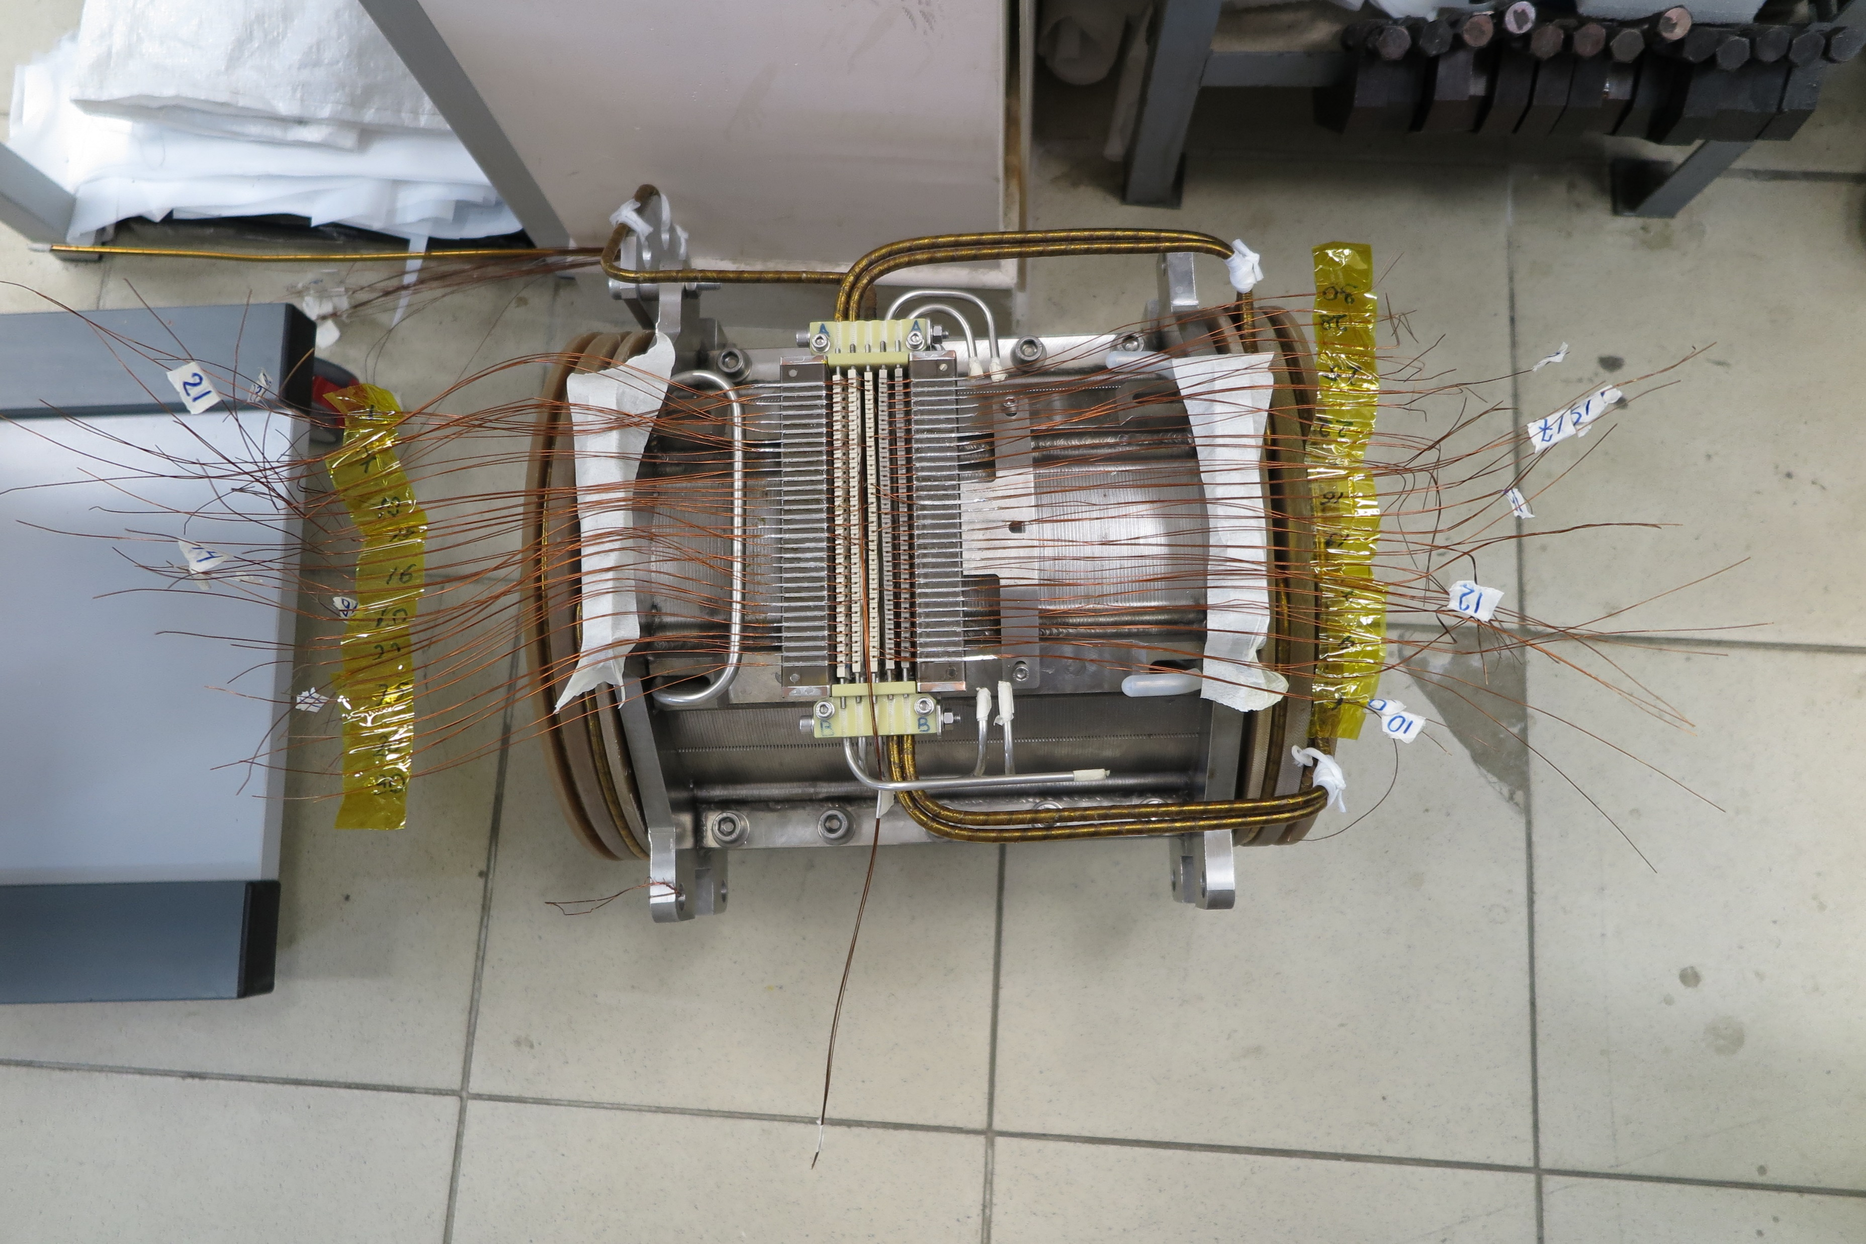
Stages of testing GSI corrector magnet electrical parameters
Cured coil in baking mold without Terminal box
Assembly of corrector magnet with unimpregnated Terminal Box
Assembly of corrector magnet with impregnated Terminal Box
Unit test (assembly of corrector magnet with main quadrupole)

Slide 11
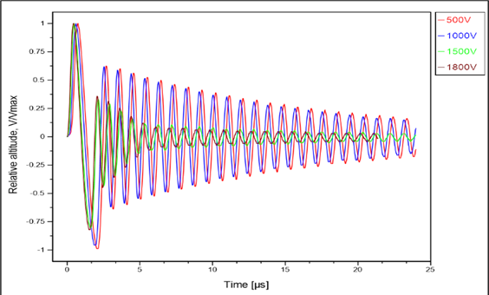
Examples of failures
Superconducting coil was tested under different voltages.
Damping factor increases by voltage. It is signaling about coil failure.
 | 500V | 1800V
Q | 46.6 | 6.9
R, Ω | 1.56 | 10.4

Slide 12
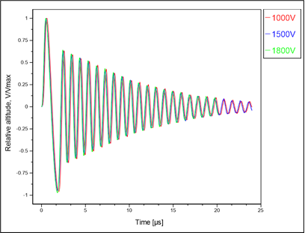
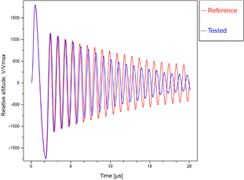
Examples of failures
Frequency and damping factor are not depending on voltage.
But comparison of this coil with other coils of series show damping factor deviation.
 | Average value of series | Tested coil
Q | 31.6 | 55.1
R, Ω | 2.35 | 1.31

Slide 13
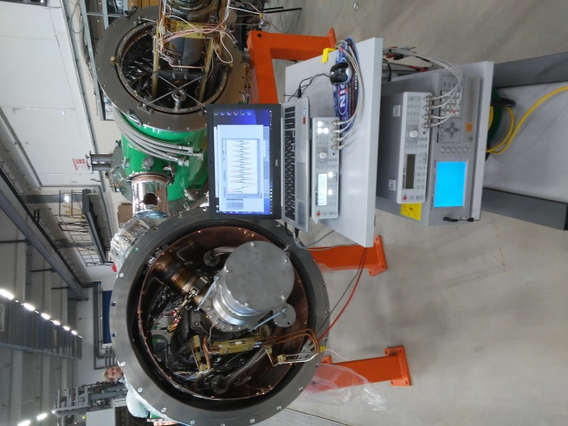
Summary
The system for checking of electrical parameters was successfully commissioned to the superconducting magnets test process.
There were performed more than 1400 tests at different stages.
There were detected a series of damaged coils, which were then repaired.
The system was awarded by a collective LHEP prize in 2019.

Slide 14
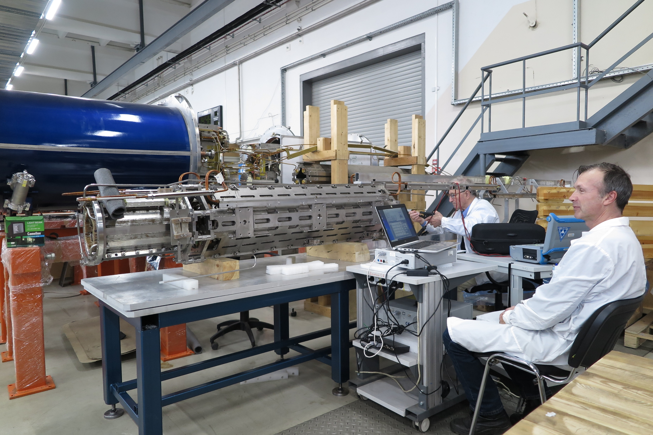
Thank you for attention!

