Slide 1
Web App Authentication

Slide 2
Service FreeIPA
1
BM@N Wiki
2
BM@N Database
3
BM@N Forum
4
BM@N Logbook
5
………………………

Slide 3
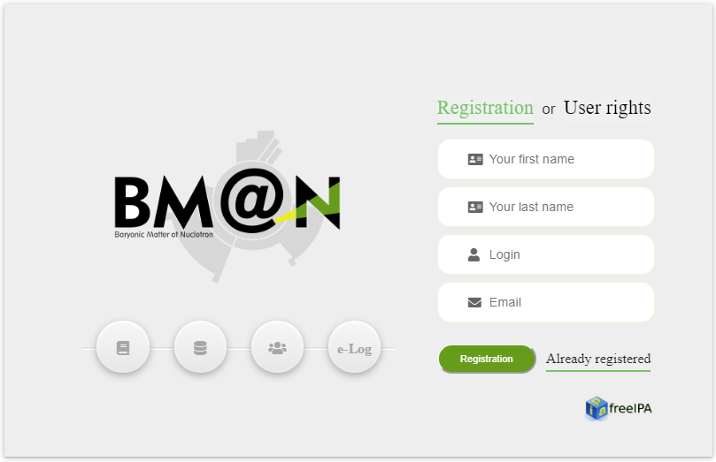

Slide 4
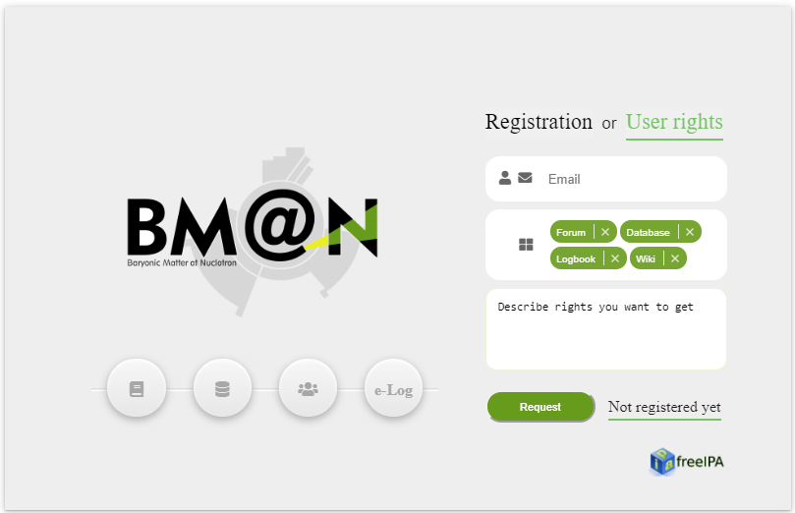

Slide 5
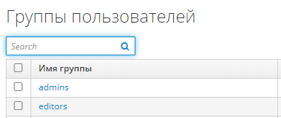

Slide 6
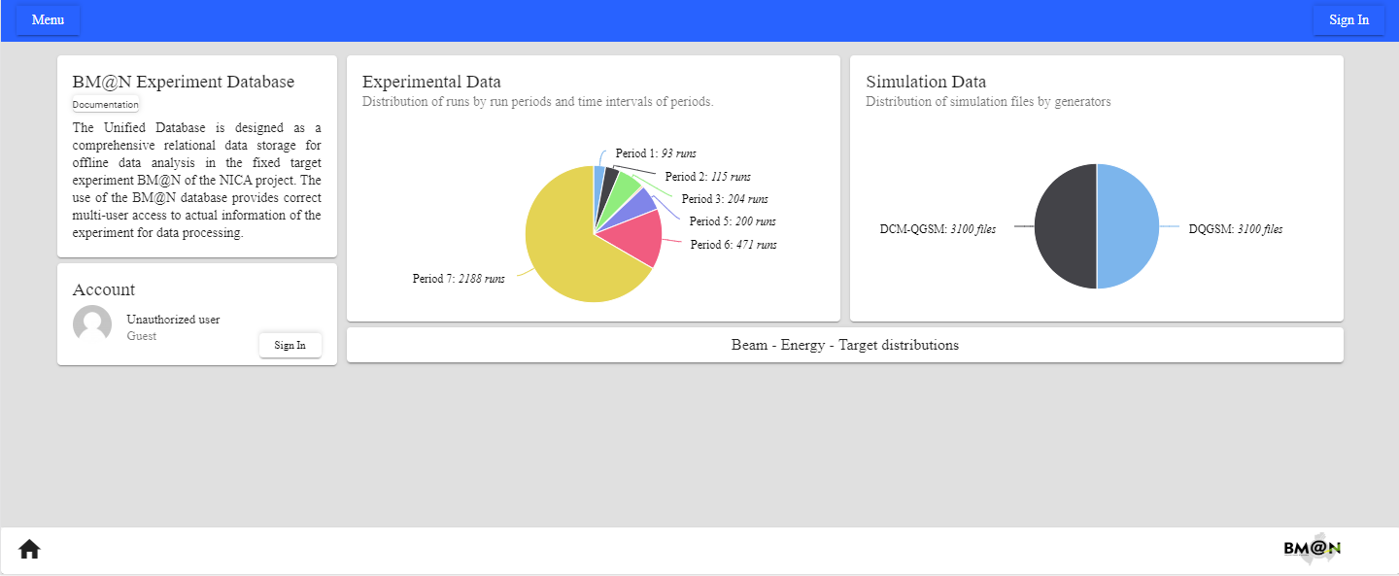
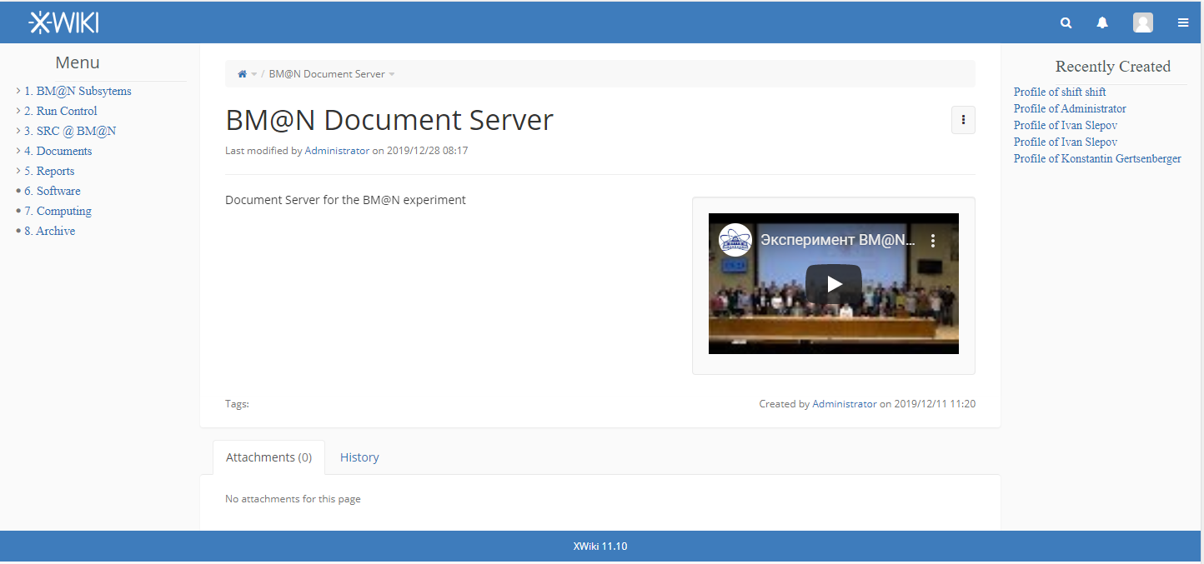

Slide 8
System requirements
Document Server should contain all reports, meetings, posters, proceedings materials, articles, theses, grants, video materials, TDR, technical documentation for all experiment systems, etc. It allows cataloging hierarchically all the data for quick access to the desired BM@N section Document Server provides a quick search by the desired criteria and sections (keywords, authors, themes…) Personalization is highly desirable: subscriptions, favourites for sections and docs

Slide 9
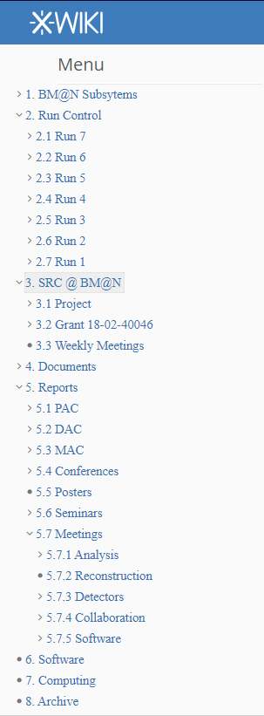

Slide 10
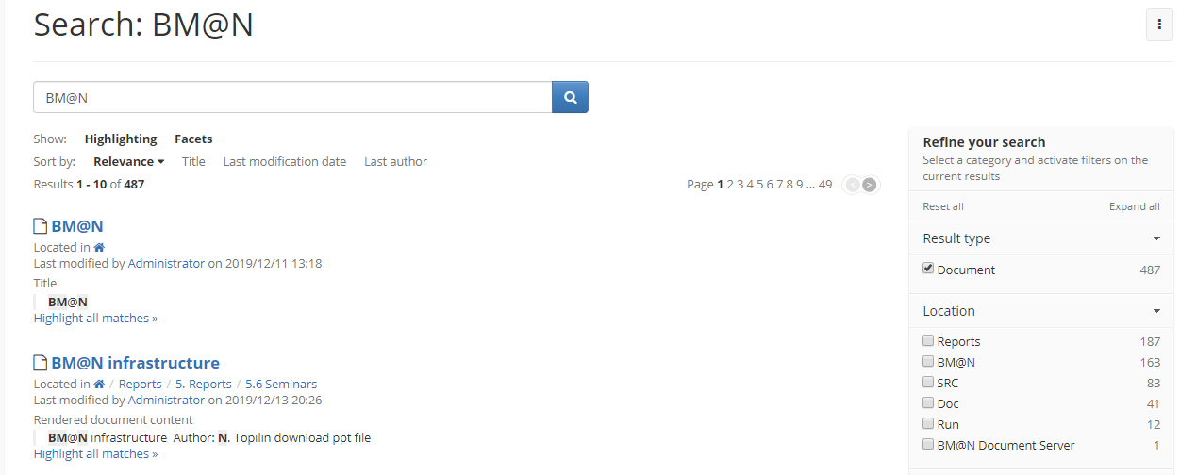

Slide 11
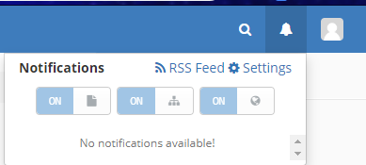

Slide 13
