Slide 1



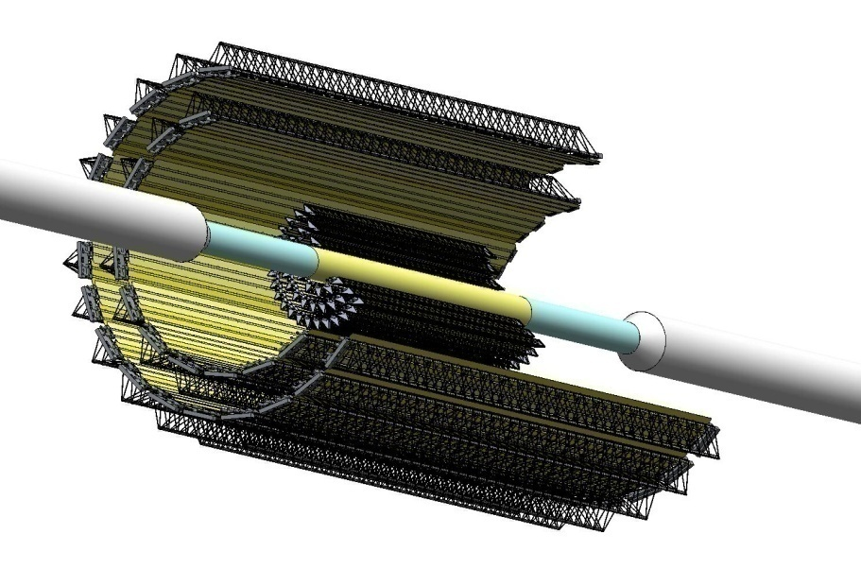
Identification power of the vertex tracking detector of the NICA-MPD setup for decays reconstruction of strange and charmed particles.
Идентификационная способность вершинного трекового детектора установки NICA-MPD при реконструкции распадов странных и очарованных частиц.
Igolkin S.N., Kondratev V.P,
Murin Yu.A., Zinchenko A.I.
MDP-ITS Coordination Meeting, Dubna, 6 February 2020

Slide 2
Contents
Introduction
Physical motivation of using vertex detectors
Modeling of the Inner Tracker (IT) of the MPD setup
Geometric layout
Pointing resolution
Strange particle reconstruction
Charmed particle reconstruction
Conclusion

Slide 3
Physical motivation of using IT
                MPD is being constructed to study the properties of extremely dense nuclear matter formed in relativistic nucleus-nucleus collisions at NICA energies. The yields and spectra of strange and charmed particles are the important observables sensitive to critical phenomena in phase transitions of the QCD-matter. So, vertex detector (IT) is required for highly efficient registration of such short-lived products of nuclear interactions.
Modern vertex detectors consist of a few layers of silicon position-sensitive sensors.
This kind of detectors are already used in ALICE , ATLAS, CMS and STAR experiments.

Slide 4
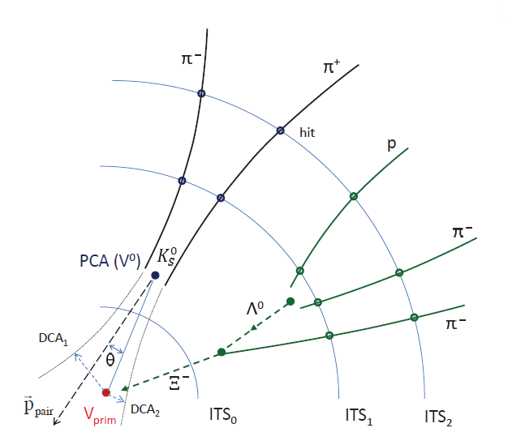
Registration of strange and charmed particles by the vertex detector
Λ⁰ → p + π –
Ξ¯ → Λ + π –
└→ p + π –
Ω¯ → Λ + K¯
└→ p + π –
Λ_{c}→ p + K‒ + π –
τc = 68 μm
D⁰ → K¯ + π ⁺
τc = 123 μm
Reliable identification of short-lived particles (multistrange hyperons and charmed mesons) is performed by determining the invariant mass of their decay products. So, for high-efficient reconstruction of decay vertices near the interaction point detectors with high pointing resolution are needed.

Slide 5
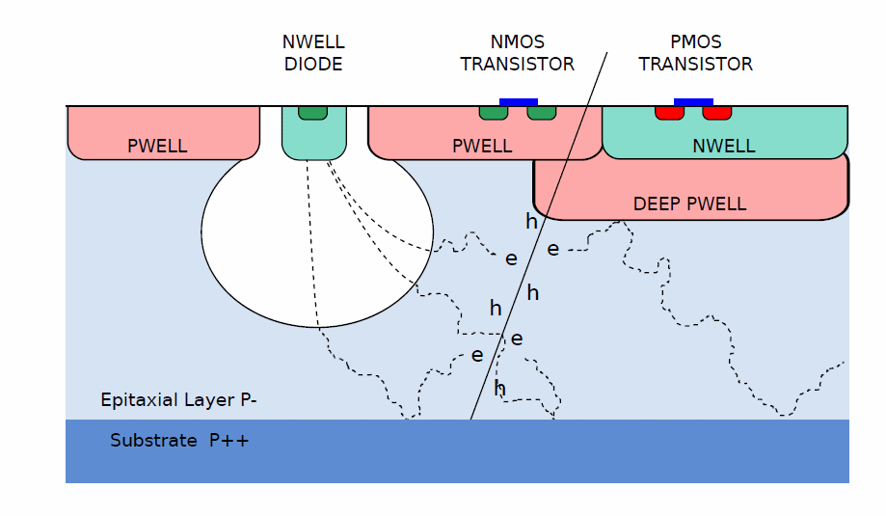
Monolithic Active Pixel Sensor (MAPS)
Pixel sensors of the new generation - MAPS - have the best spatial resolution at a high counting rate and their high level of segmentation per pixel allows to install detectors of this type at distances of several centimeters from the interaction point without a threat of frequency overload. Combination of the TPC and the MAPS based vertex detector IT will allow to register short-lived products of A-A interactions with maximum efficiency.
Sensitive area: 15×30 mm²
Thickness: 50 μm
Number of pixels: 512×1024
Pixel size: 28×28 μm².
Space resolution:
σ_{rφ} = 5 μm , σ_{z} = 5 μm

Slide 6
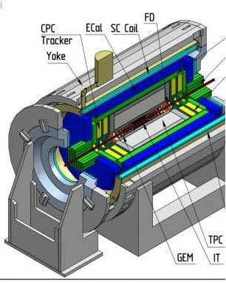
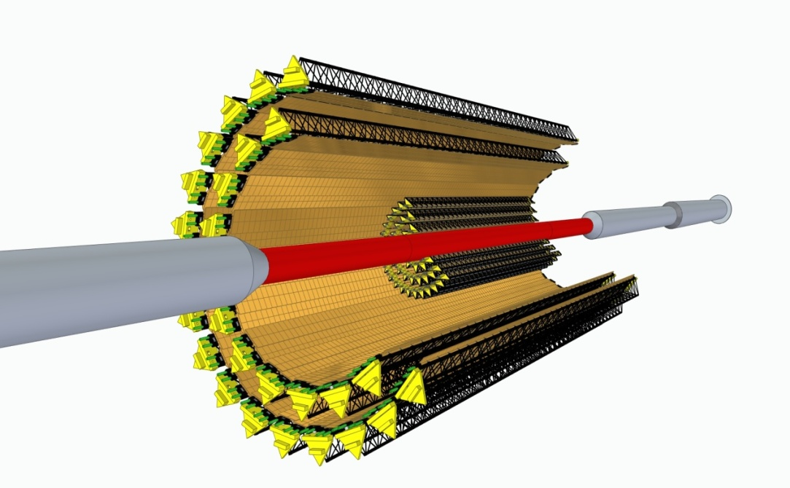
IT design on the base of MAPS
Geometric limitations:
by the size of the beam pipe, the diameter of which can vary from 40 to 65 mm;
by the dimensions of the TPC, the inner diameter of which is 500 mm
Constructive limitations:
by the dimensions of the carbon composite support structures;
by the transverse dimensions of MAPS.
These limitations lead to a 5-layer construction of IT with 12 ladders in the innermost layer.

Slide 7
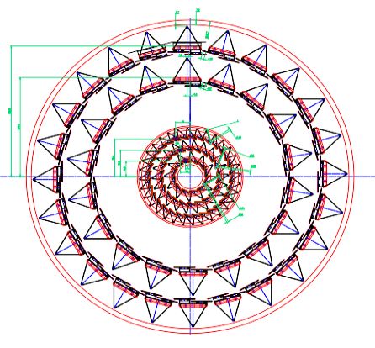
IT geometric model using for simulation
TPC bore
Model IT5-40 (basic project configuration):
5-layer IT for a beam pipe with the smallest possible diameter of 40 mm with a staggered arrangement of ladders in Outer Barrel (OB) and a fan-like arrangement of ladders in Inner Barrel (IB)
OB
IB
OB: ladders similar to ALICE ITS2
IB: ladders similar to ALICE ITS3
Beam pipe
Layer | Number of ladders | Number of MAPS | R_{min}, mm | R_{max}, mm | Ladder length, mm | Effective thickness, μm
1 | 12 | 288 | 22.4 | 26.7 | 750 | 100
2 | 22 | 528 | 40.7 | 45.9 | 750 | 100
3 | 32 | 768 | 59.8 | 65.1 | 750 | 100
4 | 36 | 3528 | 144.5 | 147.9 | 1526 | 700
5 | 48 | 4704 | 194.4 | 197.6 | 1526 | 700

Slide 8
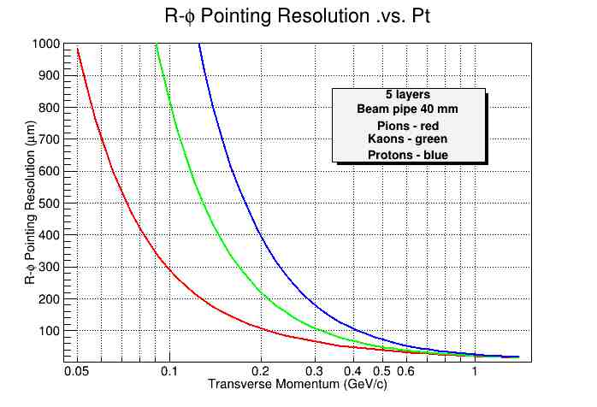
IT pointing resolution for π, K and p
The spatial resolution of the IT5-40 model was evaluated in the framework of the simplified code developed by ALICE collaboration, which performs tracking of charged particles through cylindrical silicon layers with a given radiation thickness.
Layer | Mean r, мм | σ(ρφ), um | X/X₀, %
Beam pipe | 20.0 | - | 0.22
1 | 24.6 | 5.0 | 0.30
2 | 43.3 | 5.0 | 0.30
3 | 62.5 | 5.0 | 0.30
4 | 146.2 | 5.0 | 0.30
5 | 196.0 | 5.0 | 0.30
Evaluated resolution of IT5-40 provides, for example, the possibility of D⁰ decay vertex reconstruction in the channel
D⁰ → K⁻ + π⁺ ( λ = 123 μm) with small p_{T} up to 300 MeV/c.

Slide 9
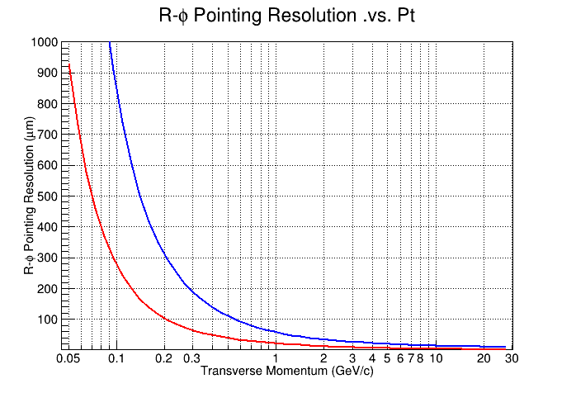
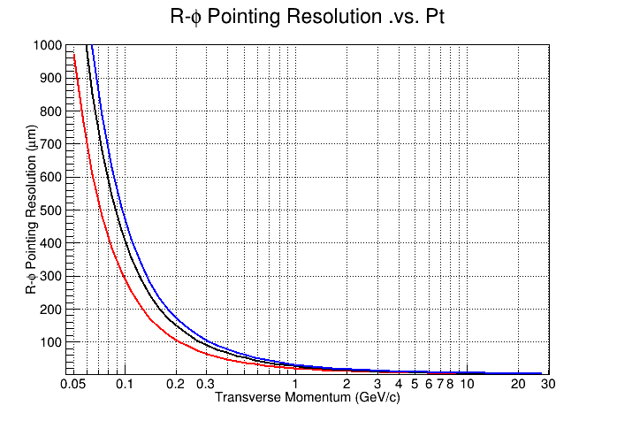
MPD IT pointing resolution compared to ALICE ITS
ALICE ITS2
MPD IT
Pions
Pions
New ITS2
Beam pipe Ø = 40 mm
Old ITS1
Beam pipe Ø = 50 mm
Beam pipe Ø = 60 mm
MPD IT pointing resolution with a beam pipe Ø = 40 mm is comparable with ALICE ITS2.

Slide 10
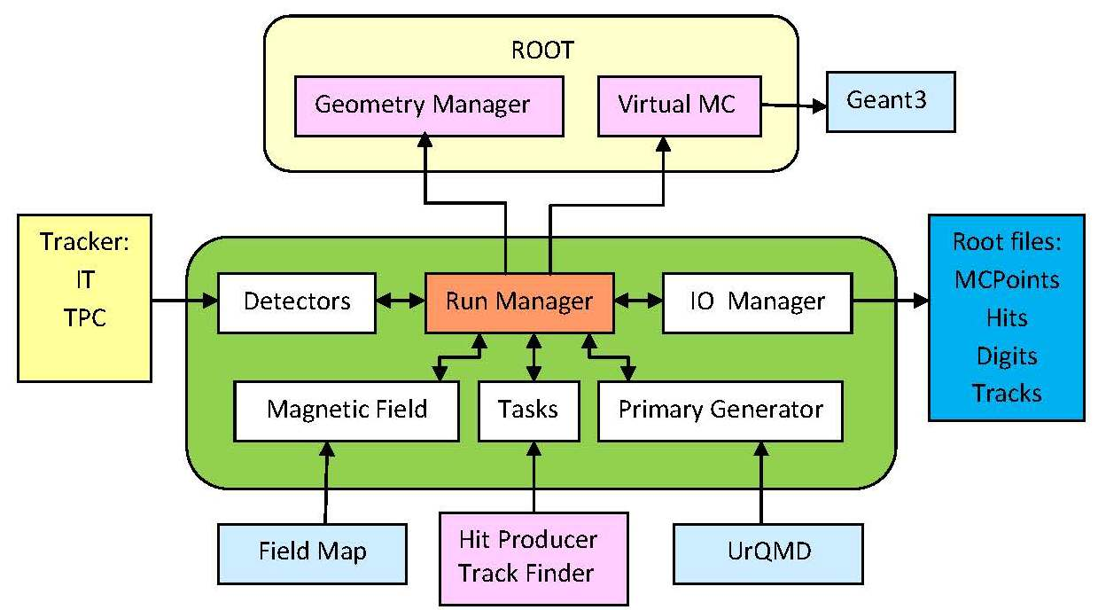
IT Monte-Carlo simulation scheme within MpdRoot
Event MC generator:
QGSM, Thermal generator
Particle MC transport
through IT: GEANT3
Hit generation
Track finding: KF
MC generator
Vertices reconstruction
The main simulation tasks include:
generation of detector responses (Hit Producer);
reconstruction of particle tracks using generated hits (Track Finder + Track Fitter) ;
reconstruction of the primary and secondary interaction vertices (Track Analysis).

Slide 11
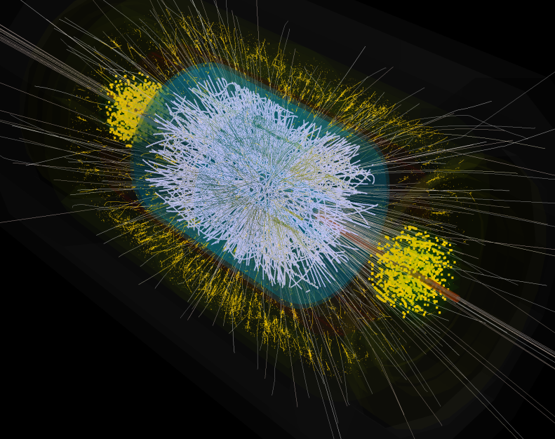
Strange particle reconstruction in central Au+Au collisions at = 9 GeV
Particle | Mass [MeV/c²] | Mean path сτ [сm] | Decay channel | BR
Λ | 1115.68±0.01 | 7.89 | π⁻ + р | 63.9%
Ξ⁻ | 1321.71±0.07 | 4.91 | π⁻ + Λ | 99.9%
Ώ– | 1672.45±0.29 | 2.46 | K⁻ + Λ | 67.8%
To suppress a large combinatorial background in Au+Au collisions it is necessary to use strict criteria for signal selection corresponding to real particle decays.

Slide 12
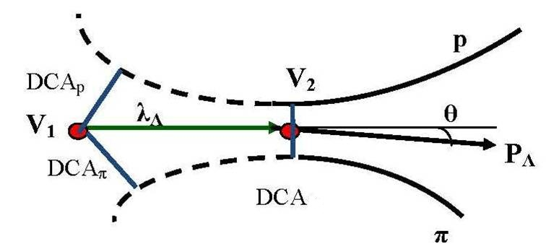
Selection criteria for two particle decay
Λ selection parameters are dictated by the decay topology:
distances of closest approach to the collision vertex DCA_{π, p} ,
two-track separation DCA_{πp} ,
decay path λ_{Λ},
pointing angle θ_{Λ}.
Λ → p + π⁻
Λ
πp
Selection criteria:
DCA_{π} > С₁ & DCA_{p} > С₂ & DCA_{πp} < С₃ & λ_{Λ} > С₄ & θ_{Λ} < С₅
The parameters C_{i} (cuts) of the corresponding selection are optimized by maximizing
the signal significance :
where S and B are the estimated numbers of the signal and background events.

Slide 13
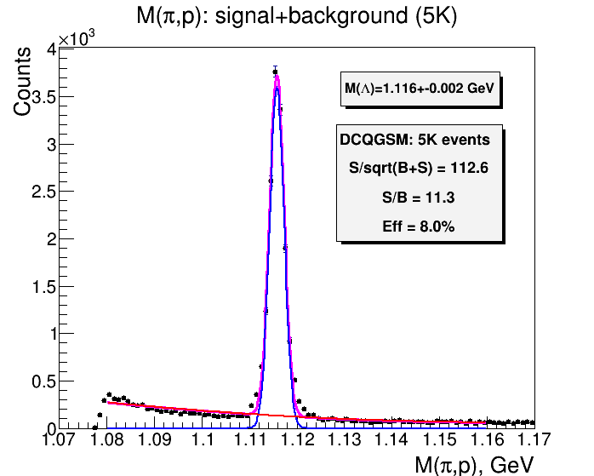
Λ reconstruction (5∙10³ events):
Λ → p + π⁻
dca(p)>0.3 сm & dca(π )>0.3 сm &
dca(πр)<0.05 сm & λ(Λ)>3.0 сm & θ(Λ) < 0.09 rad
Obtained values of significance level 112.6 and signal-to-noise ratio 11.3 indicate a high quality of charged particle tracking in the MPD tracking system.

Slide 14
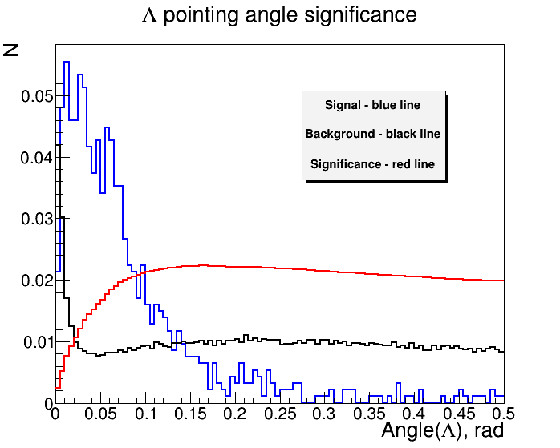
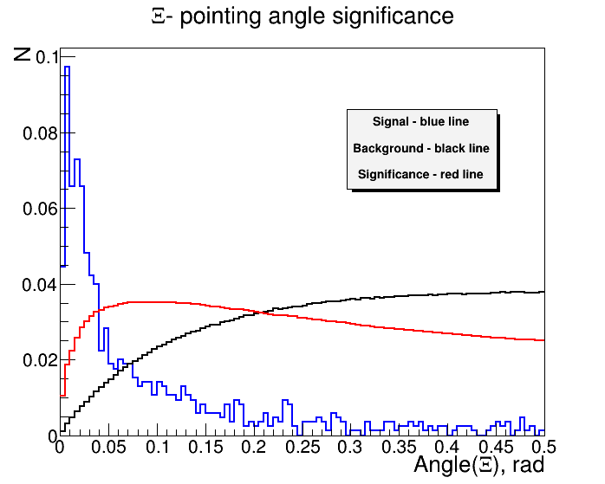
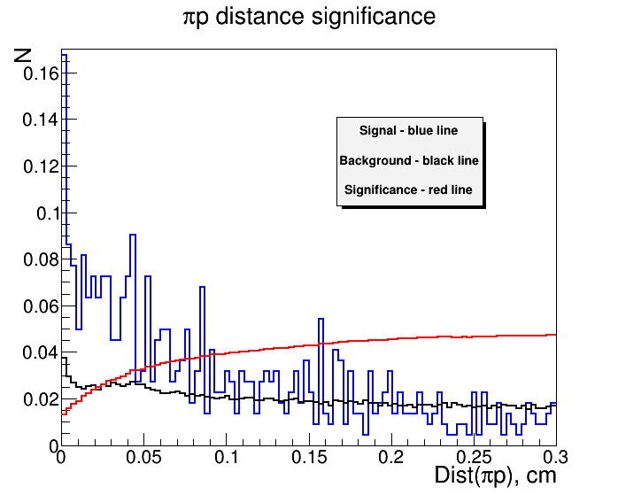
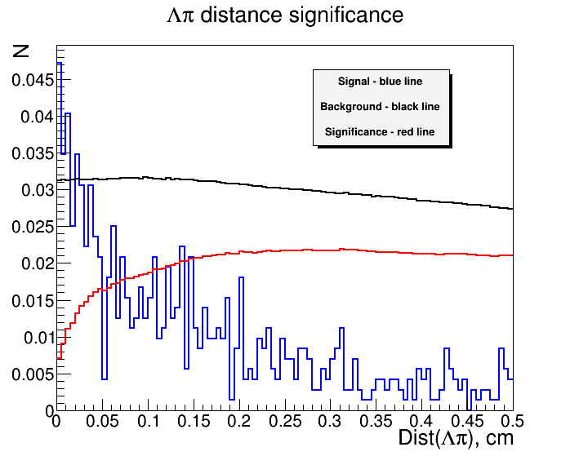
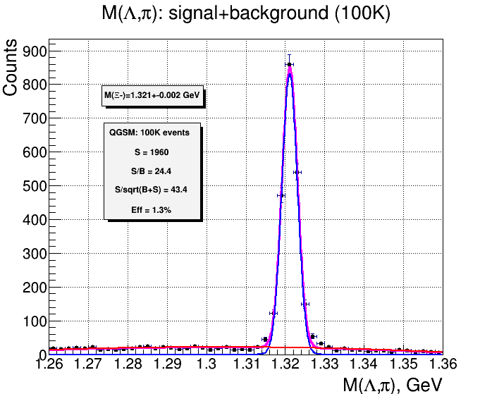
Ξ⁻ reconstruction (10⁵ events):
Ξ⁻ → Λ + π⁻
└→ p + π⁻
dca(p)>0.3 сm & dca(π )>0.3 сm & dca(Λ)>0.1 сm &
dca(πp)<0.05сm & dca(Λπ)<0.2 сm &
θ(Λ)>0.02 rad & θ(Ξ)<0.05 rad
The use of optimized selection criteria allows to reconstruct Ξ⁻ with an efficiency of 1.3% at sufficiently high level of significance of 43.4

Slide 15
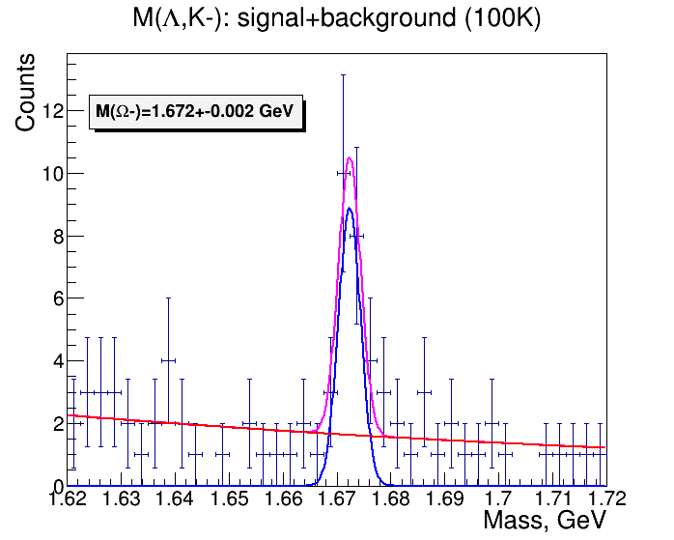
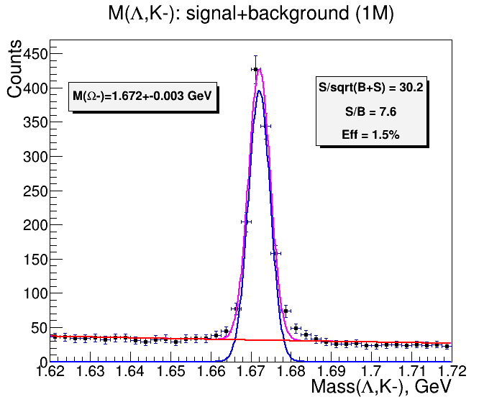
Ω⁻ reconstruction (10⁶ events):
Ω⁻ → Λ + K⁻
└→ p + π⁻
dca(π)>0.05 cm & dca(p)>0.05 cm & dca(K)>0.1 сm & dca(Λ ) >0.1 сm & dca(πp)<0.3 сm & dca(ΛK)<0.1 сm & θ(Λ)>0.01 rad & θ(Ω)<0.015 rad & λ(Λ)>5 сm & λ(Ω)<8 сm
Signal – QGSM generator
Background – QGSM generator
Signal – thermal generator
Background – QGSM generator
Increasing the statistics to 1M events allows to reconstruct Ω⁻ with an efficiency of 1.5% at a significance level of 30.2

Slide 16
Charmed particle reconstruction in central Au+Au collisions at = 9 GeV
Particle | Mass [MeV/c²] | Mean path сτ [mm] | Decay channel | BR
D⁺ | 1869.62±0.20 | 0.312 | π⁺ + π⁺ + K⁻ | 9.13%
D⁰ | 1864.84±0.17 | 0.123 | π⁺ + K⁻ | 3.89%
Background simulation - using QGSM generator (100K events)
Signal simulation – using thermal generator (1M events)
Two methods are used for signal selection:
Method of topological cuts (TC)
Method of multivariate data analysis (MVA)

Slide 17
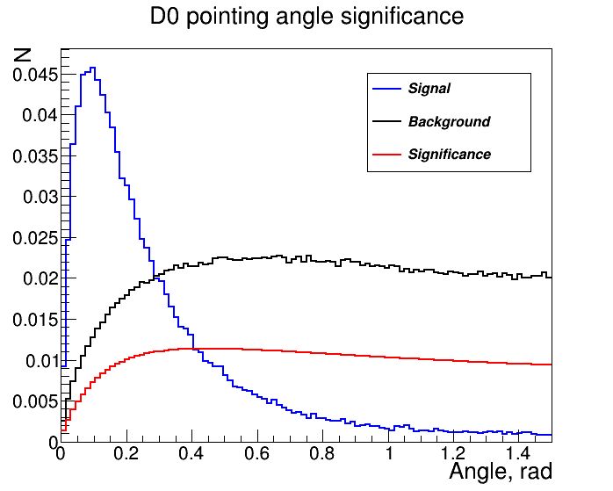
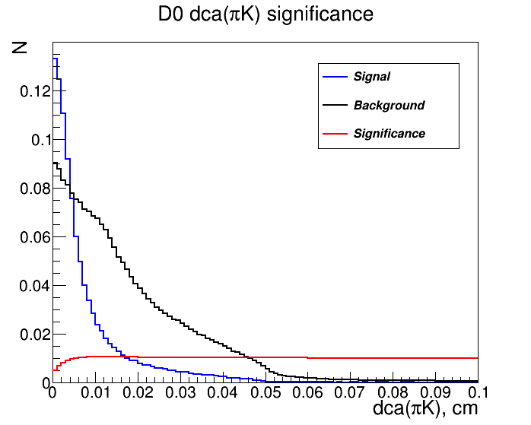
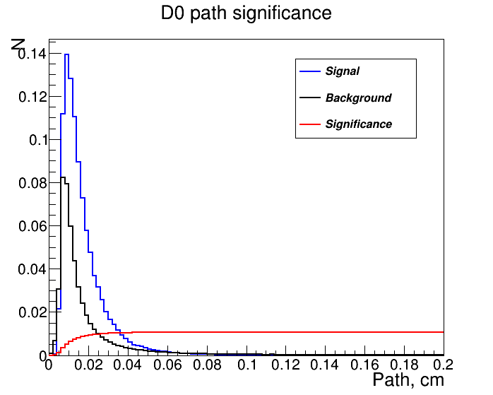
D⁰ reconstruction by TC method: cut selection
All topological cuts are selected according to the maximum of significance functions
dca(K)>0.012 сm & dca(π)>0.012 сm & dca(πK) < 0.019 cm & λ(D⁰) > 0.044 сm & θ(D⁰) < 0.15 rad

Slide 18
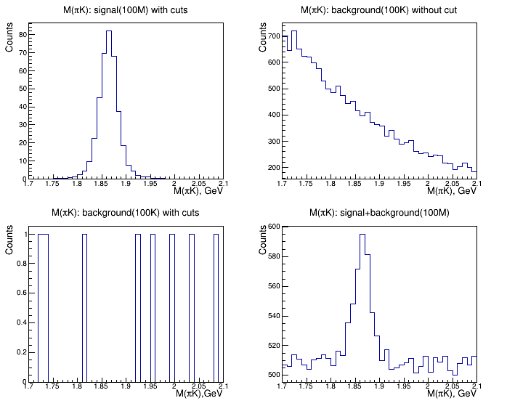
D⁰ reconstruction (10⁸ events): invariant mass spectra
Signal after applying
cuts in 10⁸ events
Background before applying
cuts in 10⁵ events
a
b
c
d
Background after applying cuts in 10⁵ events
Signal + background after applying cuts in 10⁸ events

Slide 19
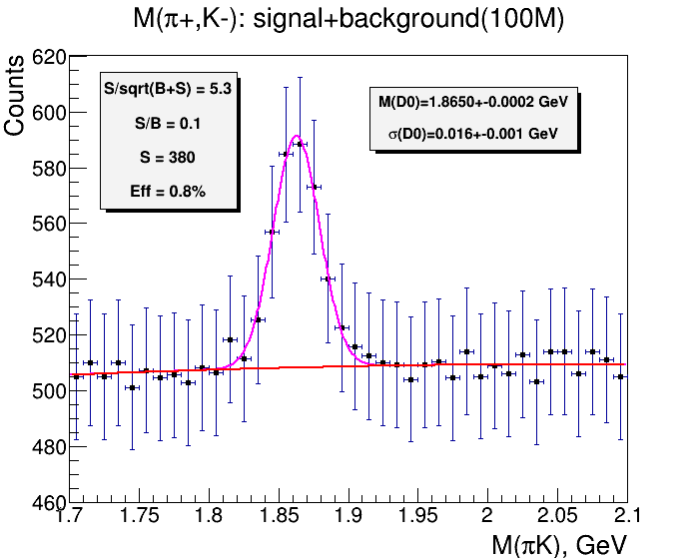
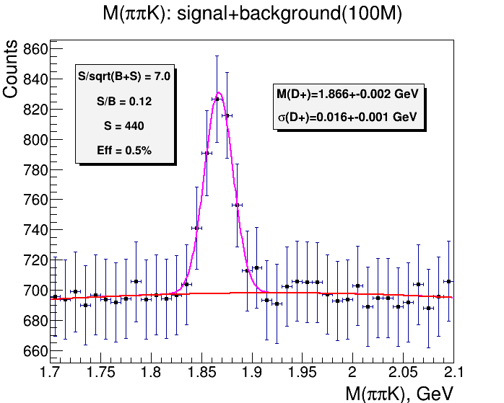
D mesons reconstruction by TC method: invariant mass spectra
D⁰ → K‒ + π ⁺
D⁺ → K‒ + π ⁺ + π ⁺
Using the method of topological cuts allows to reconstruct D⁰ and D⁺
with an efficiency of 0.8% and 0.5% respectively.

Slide 20
Toolkit for MultiVariate Analysis
TMVA is a ROOT package for training, testing and performances evaluation of multivariate classification techniques.
Analysis is generally organized in 2 steps :
Training phase
At this stage the variables from the signal and background samples are trained according the classifier chosen by the user. The results of the classification is written into weight files, traducing the initial N input
variables V to one dimensional variable R (response) :
V^{N} → R
Application phase
At this stage the data classification, reading from the weight files, is applied to the data to be analyzed.
The classifier BDT (Boosted Decision Trees) has been chosen for the analysis phase when reconstructing D mesons

Slide 21
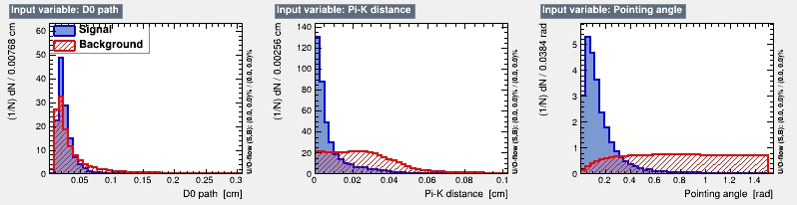
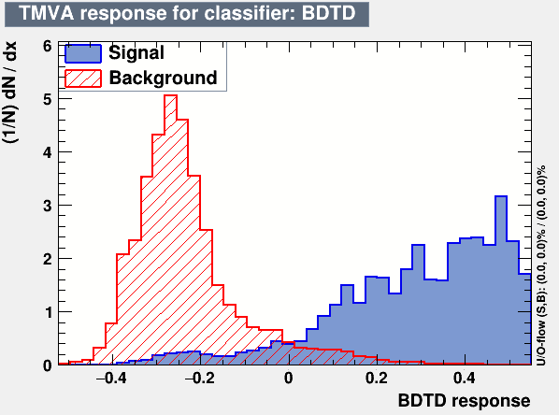
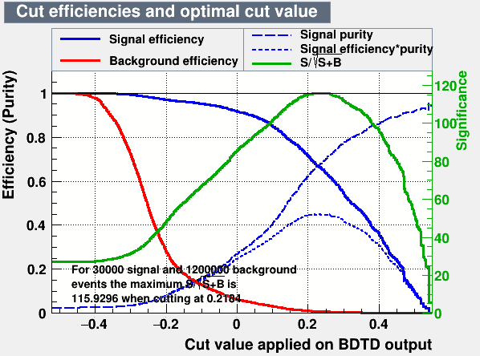
D⁰ reconstruction by MVA method: cut selection
dca(π), dca(K), dca(πK), λ(D⁰), θ(D⁰)
BDT cut
To separate the signal and background the optimal value of the resulting cut of the classifier BDTD_response>0.3 was selected and applied to 1M signal and 100K background events generated using the thermal and QGSM generator

Slide 22
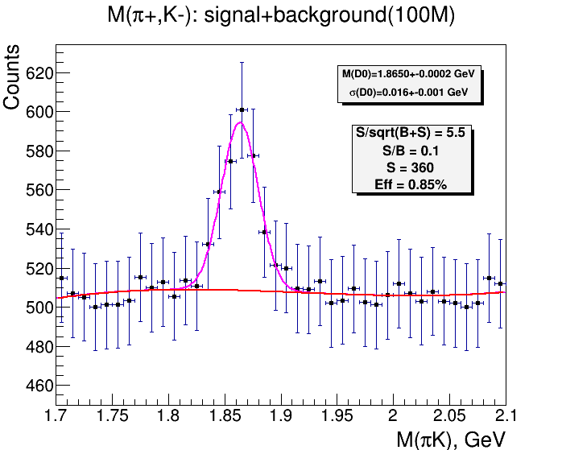
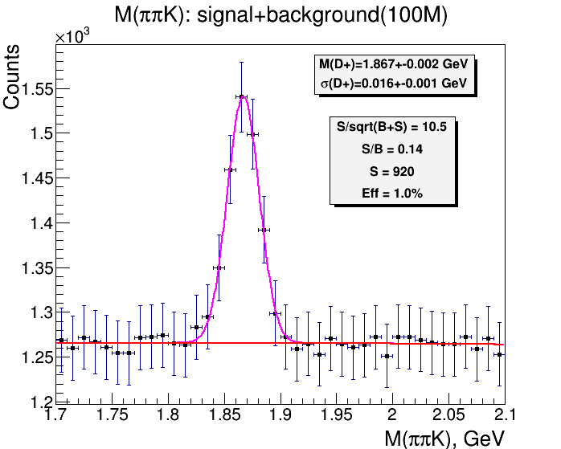
D mesons reconstruction by MVA method: invariant mass spectra
D⁰ → K‒ + π ⁺
D⁺→ K‒ + π ⁺ + π ⁺
Using the optimal BDT cut allows to reconstruct D⁰ and D⁺
with an efficiency of 0.85% and 1.0% respectively.

Slide 23
Reconstruction parameters of strange and charmed particles
in central Au+Au collisions at = 9 ГэВ
Particle | Λ | Ξ⁻ | Ω– | D⁰ |  | D⁺
Method | TC | TC | TC | TC | MVA | TC | MVA
Multiplicity | 20 | 1.2 | 10⁻¹ | 10⁻² | 10⁻² | 10⁻² | 10⁻²
Number of events | 5∙10³ | 10⁵ | 10⁶ | 10⁸ | 10⁸ | 10⁸ | 10⁸
Efficiency, % | 8.0 | 1.3 | 1.5 | 0.80 | 0.85 | 0.50 | 1.0
Significance | 112.6 | 43.4 | 30.2 | 5.3 | 5.5 | 7.0 | 10.5
S/B(2σ) ratio | 11.3 | 24.4 | 7.6 | 0.10 | 0.10 | 0.12 | 0.14
Yield per month | 2∙10⁹ | 3∙10⁷ | 2∙10⁶ | 6∙10³ | 7∙10³ | 1∙10⁴ | 2∙10⁴
If D⁰ reconstruction efficiencies by MVA and TC are similar, then the use of MVA in the case of D⁺ allows doubling the efficiency with a higher level of significance.

Slide 24
Conclusion
Quality assessment of the MPD tracking system, which includes TPC and MAPS based IT has been studied when reconstructing strange and charmed particles formed in AA collisions at NICA energies.
Simulation shows:
reliable reconstruction of hyperons Λ, Ξ⁻, Ω⁻
possibility of D-mesons reconstruction in central Au + Au collisions at = 9 GeV, which opens up prospects for studying the heavy flavors physics at the NICA-MPD facility.

Slide 25

Thank you for your attention!

Slide 26
Back up slides

Slide 27
Effective thickness of ITS2 layers
Outer barrel
Effective Si thickness t=760 μm
Inner barrel
Effective Si thickness t=260 μm

Slide 28
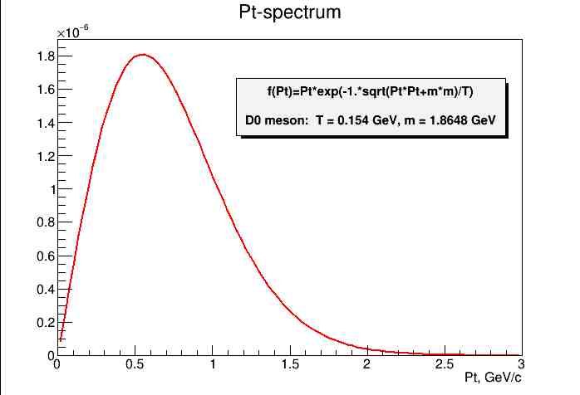
Thermal generator: p_{t} – spectrum of D⁰ in Au+Au collisions at NICA energies
Abdel Nasser TAWFIK† and Ehab ABBAS
Thermal Description of Particle Production in Au-Au Collisions at STAR Energies
Physics of Particles and Nuclei Letters. November 2013

Slide 29
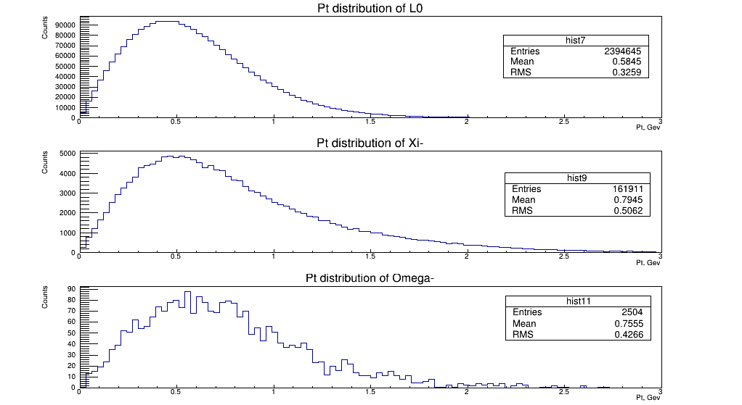
QGSM generator: p_{t} – spectra of strange particles in 100K central Au+Au collisions at = 9 GeV

Slide 30
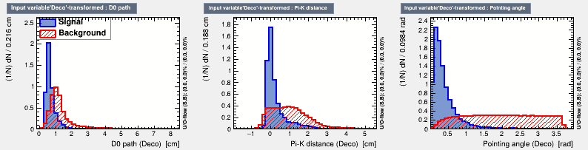
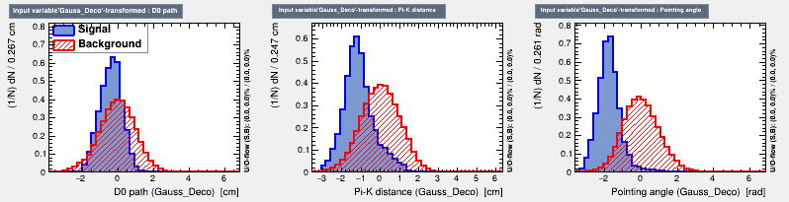
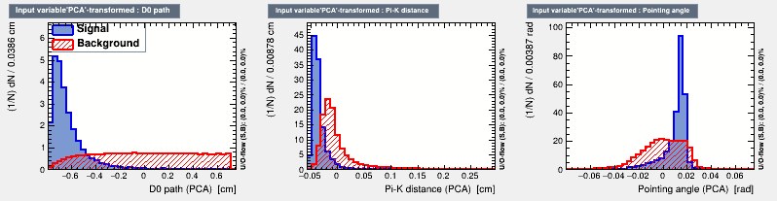
lnput variables distributions for signal and background events after the decorrelation , gaussianisation and principal component decomposition

Slide 31
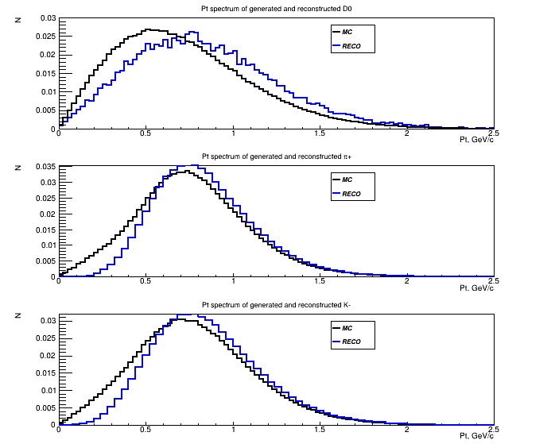
MC and reconstructed p_{t}-spectra of D⁰-mesons and they decay products
D⁰ mesons
Pions
Kaons

Slide 32
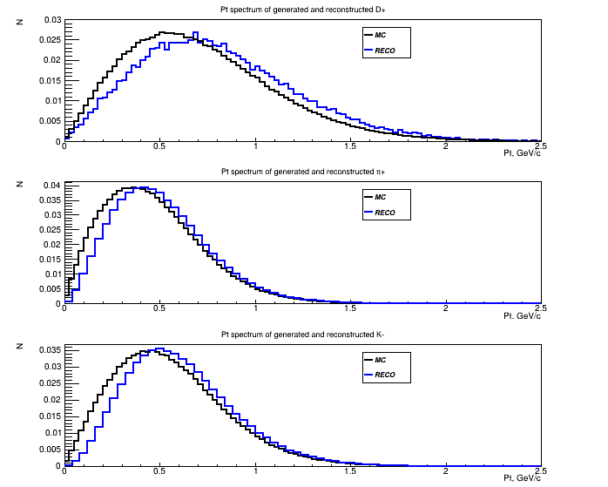
MC and reconstructed p_{t}-spectra of D⁺-mesons and they decay products
D⁺ mesons
Pions
Kaons

