Slide 1
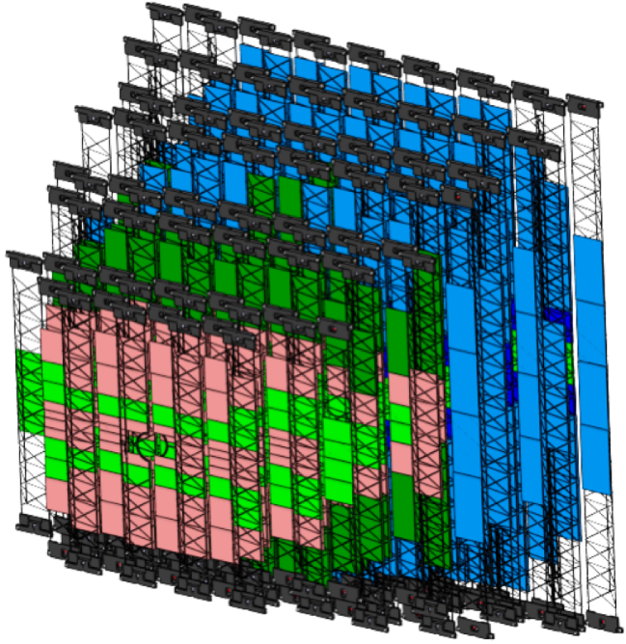
Tree Pillars of the STS Department
J. Steinheimer, A. Botvina, M. Bleicher arXiv:1605.03439v1
BM@N-2 / CBM
MPD/ITS
„Innovative“ projects

Slide 2
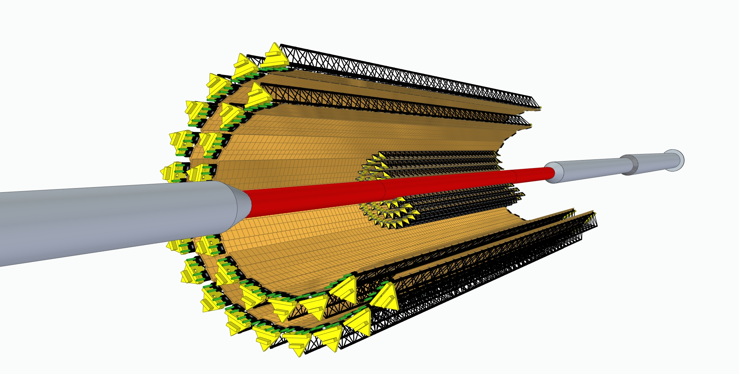
The MPD ITS Project

Slide 3
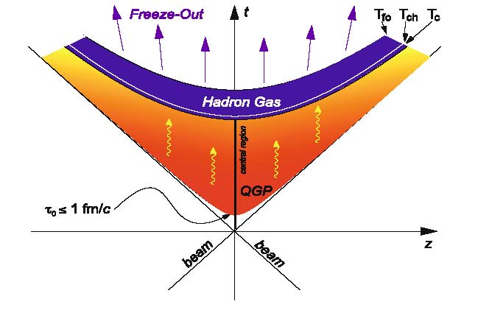
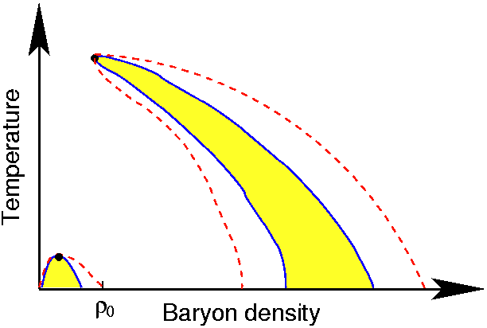
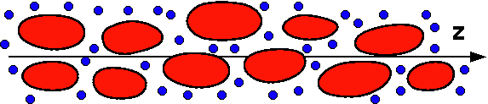
High energy HI physics major objective – deconfined matter in the lab
ALICE@CERN
MPD@NICA-JINR
“Compressing”
RHIC@BNL
“Heating”
CBM@FAIR
Deconfined matter
BM_N@JINR
Confined matter
Spinodial decay ?

Slide 4
Acelerator-driven QGP link to Astrophysics
Big Bang
“No direct Observables”
“Direct Observables!”
Neutron Star Merger
Deconfined matter
Neutron Star Core
“No direct Observables”
Confined matter
Spinodial decay ?

Slide 5

Russian Universities major role

Slide 6
Goals of the workshop
meeting of the JINR and SPbU and MSU teams’ leaders
revisit the MPD ITS project status and plans
planning of work for SPbU and MSU role in the project for the next three years
concrete steps towards new contracts
identify needed resources for the Universities
  hardware, personnel, work share, funding
agree on timeline and tasks
establish efficient project follow-up structure

