Slide 1
Status of new FHCAL with Forward Hodoscope
A. Ivashkin
on behalf of INR team, Moscow
5th BM@N Collaboration meeting, April 20-21, 2020

Slide 2
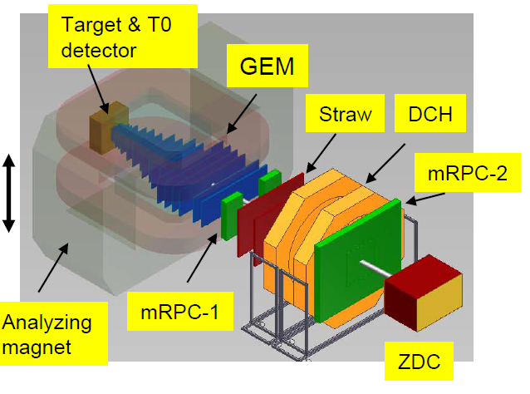
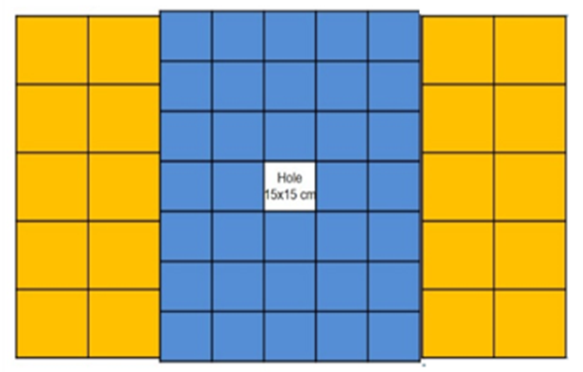
FHCal at BM@N
Previous ZDC is replaced by new FHCal .
Features:
Beam hole;
Longitudinal segmentation;
Higher dynamic range;
Reliable cosmic muon calibration.
Central hole for high intensity ion beam.
Central part – 34 MPD-like modules with 15x15 cm² transverse sizes. Longitudinal segmentation - 7 sections.
Outer part – 20 CBM modules with 20x20 cm² transverse sizes. Longitudinal segmentation – 10 sections.

Slide 3
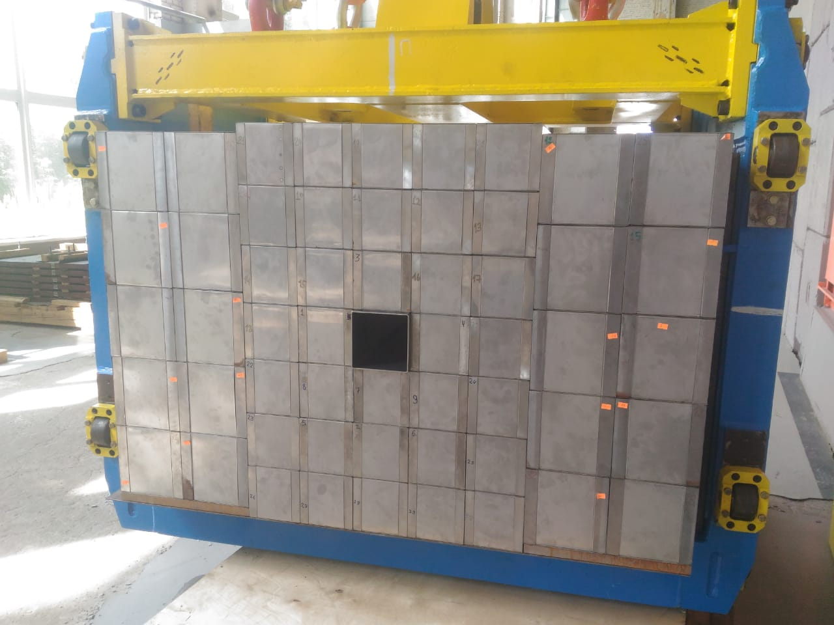
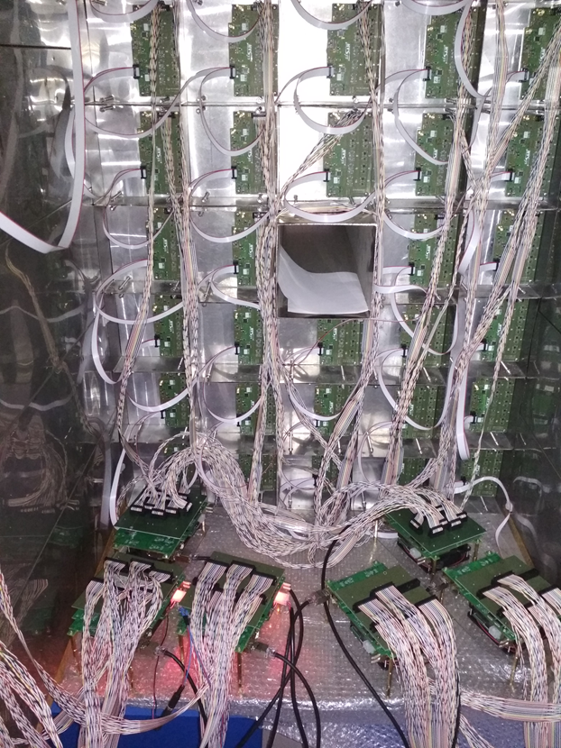
Installation of FHCal at BM@N
Assembly of the FHCAL (Sep. 2019)
Number of readout channels – 438;
Photodetectors – Hamamatsu MPPC;
FEE – 54 boards;
Readout – 8 ADC boards.
Front view.
FHCal was mounted at BM@N in June 2019.
Front-End-Electronics was installed at the end of 2019.
Back view (with FEE).

Slide 4
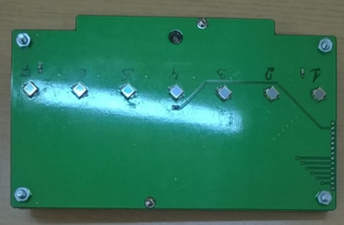
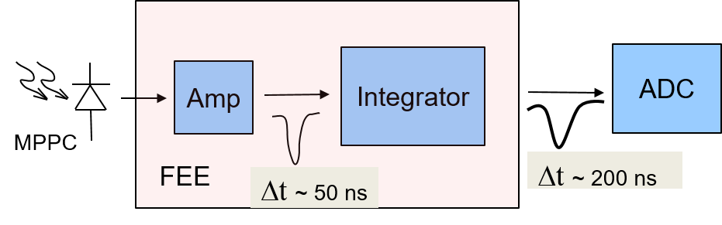
Status of Front-End-Electronics
Assembly of the FHCAL (Sep. 2019)
Two PCBs in each module with:
inner module - 7 channels;
Outer module – 10 channels;
Photodetectors – MPPCs;
two-stage amplifiers;
HV channels;
LED calibration source.
Hamamatsu MPPC:
S12572-010P
size – 3x3 mm²;
pixel -10x10 µm²;
PDE~12%.

Slide 5
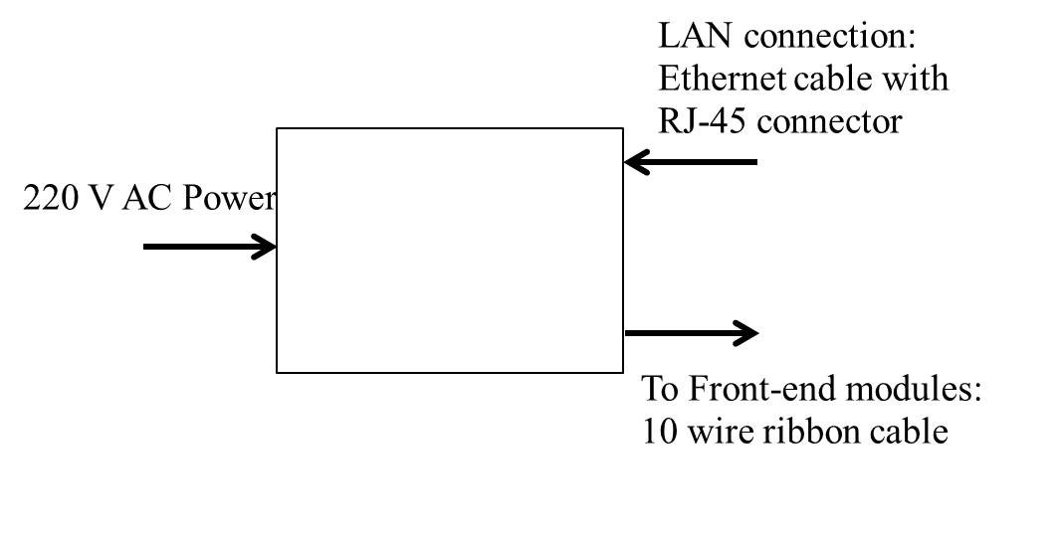
Slow Control of FHCal
Control of HV at photodetectors (MPPC);
Temperature control of photodetectors;
Compensation of temperature drift of MPPC gain;
Monitoring of MPPC gain with stabilized light source.
Hardware: SC System Module
Software:
Test version (full functionality) is ready.
New (advanced) python version in development (ETA: June 2020)
  Proxy mode: let other software read FHCal transparently
  Provide TANGO bindings
  Faster operation with multiple System Modules
LAN
RS485
General
Slow Control
FHCal New Slow
Control (proxy)
System Module
FEE
FEE
FEE
System Module
FEE
Database
FEE
FEE

Slide 6
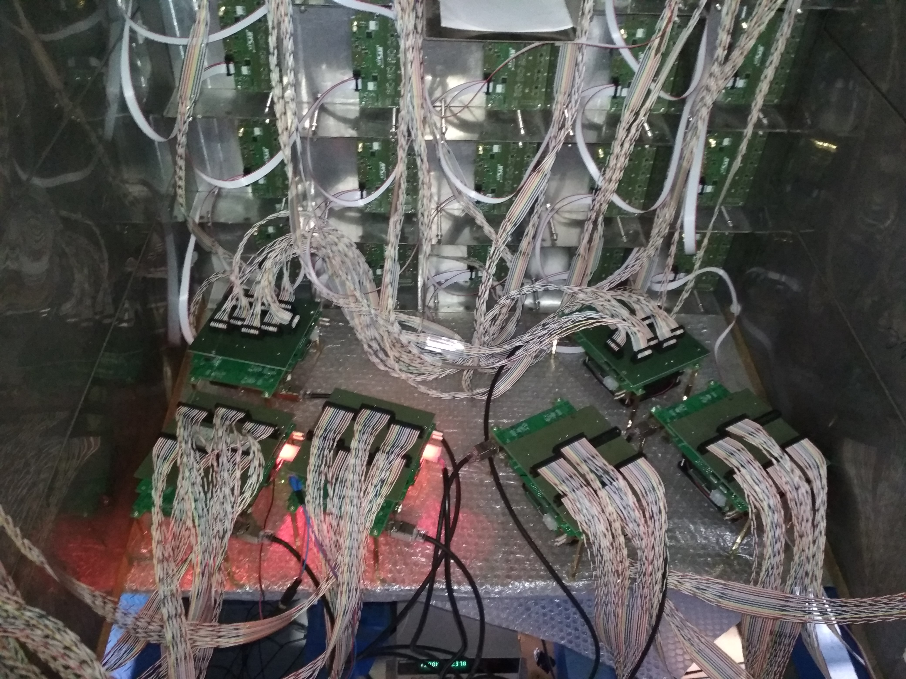
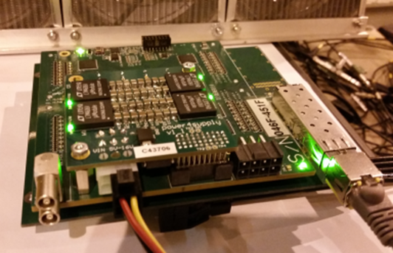
Readout of FHCal
Installed:
8 ADC boards;
Cooling of ADC boards;
Temporary power supply for 8 ADC boards;
To be done:
Power supplies for 8 ADC boards;
Remote control on power supplies;
Synchronization of readout system.
General Data Acquisition.
Cooperation with JINR electronics group is established.
The readout electronics: FPGA based 64 channel ADC64 board, 62.5MS/s (AFI Electronics, JINR, Dubna).

Slide 7
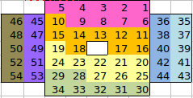
Tests with cosmic muons
Each group of modules is readout by its own ADC.
Since the ADC’s are not synchronized, each group is tested separately.
Cosmic muon spectrum in one section.
Raw spectrum.
µ
After correction for pass length in scintillators.
Fit of corrected spectrum.
Common trigger is needed for full test and energy calibration with cosmic muons.
This muon trigger is under preparation.
It includes a few analog adders of signals from top/bottom rows of modules.
The analog adders were already produced.

Slide 8
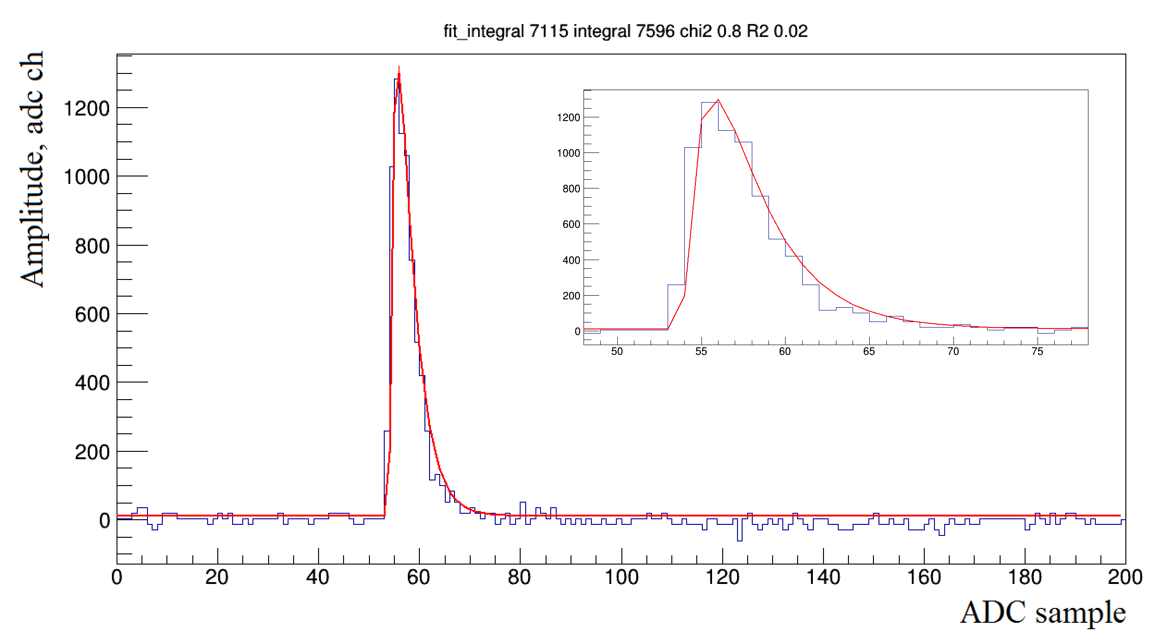
FHCal data flow estimation
Number of ADC readout channels – 440;
Number of samples per one ADC channel – 100;
Size of one ADC sample – 2 Bytes;
Size of one event: ~100 kB;
Trigger rate ~ 10⁵.
FHCal Data Flow - 10 GB/sec.
Minimum 20 ADC samples are needed to digitize the signal.
About 100 ADC samples are needed to reject the pile-up.
Occupancy ~100% for heavy ion beam.

Slide 9
Forward Hodoscope in FHCal beam hole
PCB with SiPMs
FH will be used for:
Correction of E_{dep} in FHCAL
Alignment of the FHCAL
MB trigger
Two version with scintillator and quartz strips (for light and heavy ion beams).
Light readout for scintillator hodoscope:
Each strip with one MPPC from each end.
Two readout channels for each strip.
32 readout channels.
Light readout for quartz hodoscope:
Each strip with two MPPC pairs from each end.
Two readout channels for each strip.
32 readout channels.
PCB with SiPMs
16 quartz or scintillator strips;
strip size: 10x160x4 mm³;
it covers beam hole 15x15 cm².
MPPC: S14160-3010PS
size – 3x3 mm²;
pixel -10x10 µm²;
PDE~18%.
MPPC: S14160-3015PS
size – 3x3 mm²;
pixel -15x15 µm²;
PDE~32%.

Slide 10
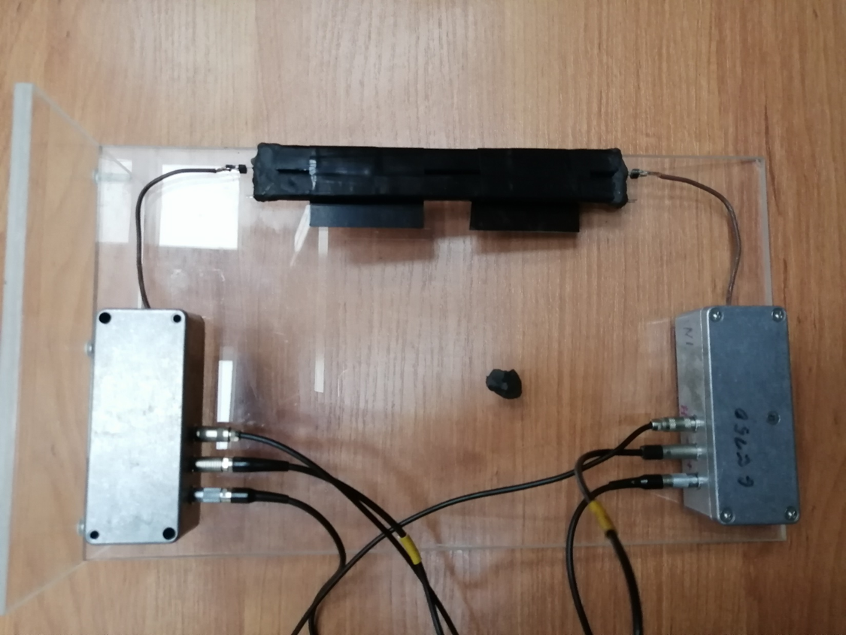
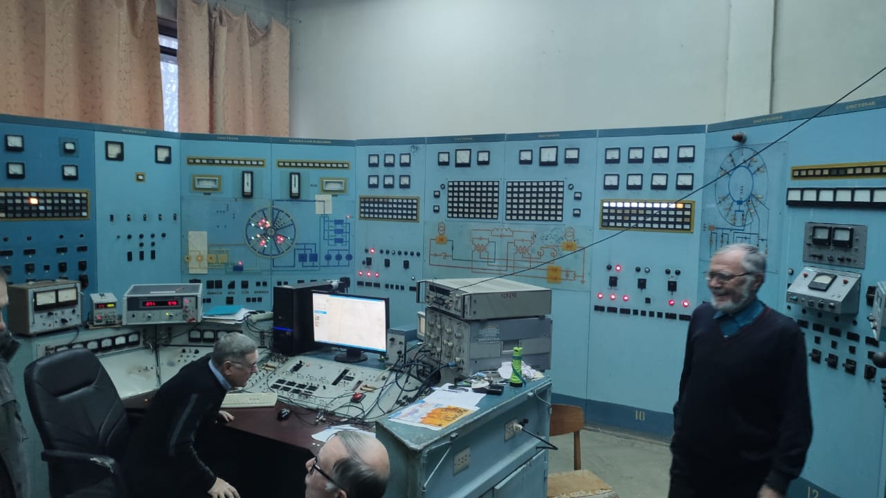
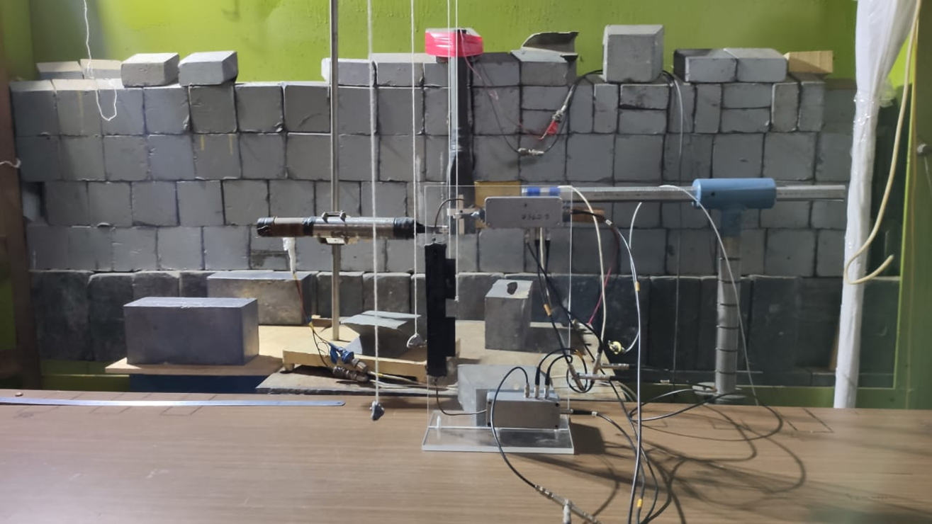
Beam test of single quartz strip at electron beam
Synchrotron “PAKHRA”, LPI RAS, Troitsk, Moscow.
Energy E_{e}=700 MeV;
Count rate ~ 50 Hz.
Quartz strip
amplifiers
Beam test was done in January 2020.
Beam counters

Slide 11
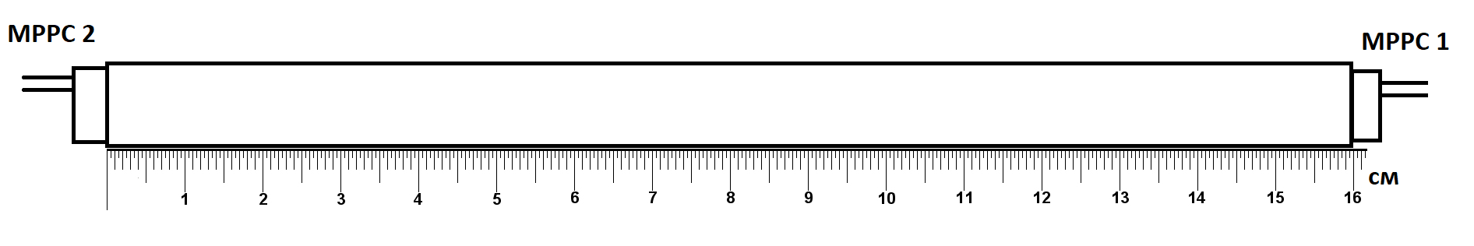
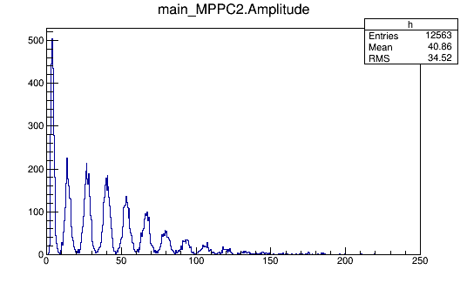
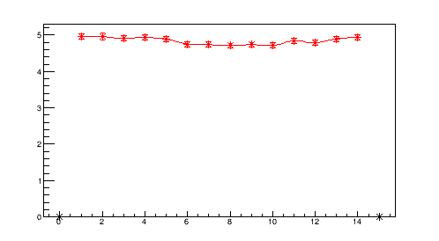
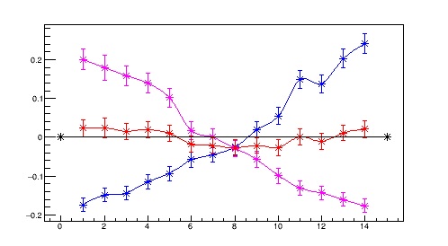
Results of beam tests
Amplitude spectrum from one MPPC.
Sum of light yields from both MPPCs .
Light yield ~ 2.5ph.e. from one end.
Light yield [ph.e.]
Light yield ~ 5ph.e. from both ends.
ADC [ch]
Non-uniformity of light yield along the strip.
Beam position at strip [cm]
2-nd SiPM
1-st SiPM
two SiPMs
Non-uniformity +-3% for double readout.
Non-uniformity
Beam position at strip [cm]

Slide 12
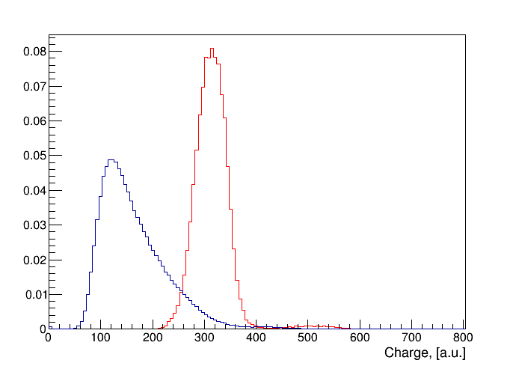
Beam tests of single quartz strip at GSI (Lead beam).
Q-strip position
2
Pb-beam
1 AGeV Pb-beam;
Beam rate: ~10⁸ ions/sec
Quartz strip position:
(1) ~1.5cm from beam axis,
(2) - on the beam axis.
1
Target
Quartz strip charge spectra at HV= 66V (reduced voltage).
In-beam position.
off -beam position.

Slide 13
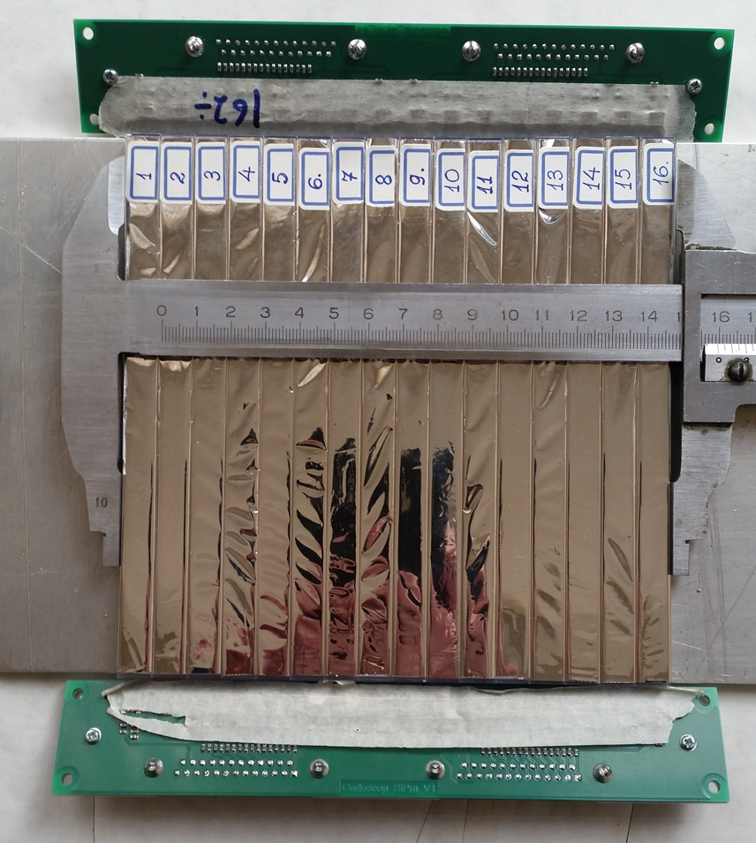
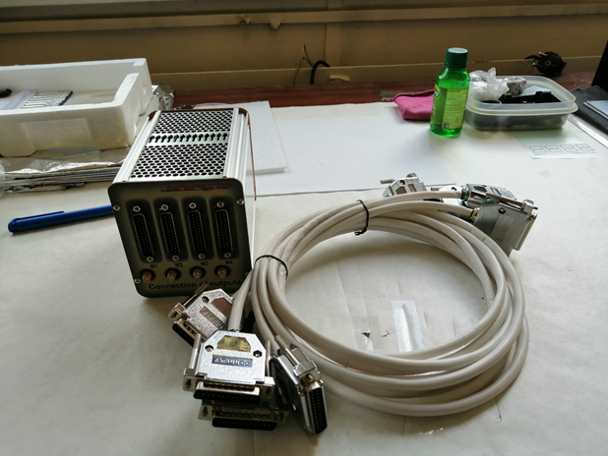
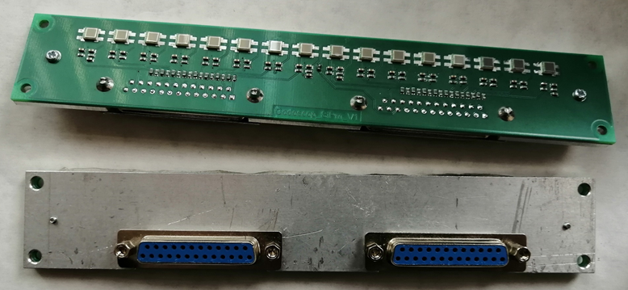
Preparation for FH assembling.
Cables and box with amplifiers.
FH parts
Assembling of hodoscope is planned after lockdown.
Boards with MPPC’s.
(scintillator version).

Slide 14
Summary. Open issues.
FHCal is fully equipped by FEE and readout electronics.
Tests with cosmic muons were done for separate groups of FHCal modules.
The overall cosmic muon calibration of FHCal requires a common trigger.
The cosmic muon trigger is in preparation.
All the detector’s and electronics parts of Forward Hodoscope are produced.
The beam tests of hodoscope elements were done.
The full assembling of hodoscope is expected after lockdown.
Synchronization of readout system.
implementation of FHCal readout in general DAQ.
Power supplies for 8 ADC boards;
Remote control of power supplies;
Trigger for cosmic muon calibration.
Full scale tests with cosmic muons.
Energy calibration with cosmic muons.
Assembling of hodoscope.

Slide 15
Thank you!

