Slide 1
jira & CONFLUENCE
M. Milewicz-Zalewska, Engineering Support Sector, DEPARTMENT NO 3, NEOMD, V&BLHEP

Slide 2
OUTLINE
How to get access?
What should you do after you log in?
How do we work?
Tips for proper planning
Where can you get help?

Slide 3
How to get acces?
Get JINR email
Ask Head of the Sector to send you an invitation
Log in via link

Slide 4
How to get JINR email?
Prepare your data: name, position, sector etc.
Send all these data to sbg@jinr.ru
Log at webmail.jinr.ru

Slide 5
HOW TO LOG IN to JIRA & CONFLUENCe?
For JIRA go to https://nicampd.atlassian.net/
For Confluence

Slide 6
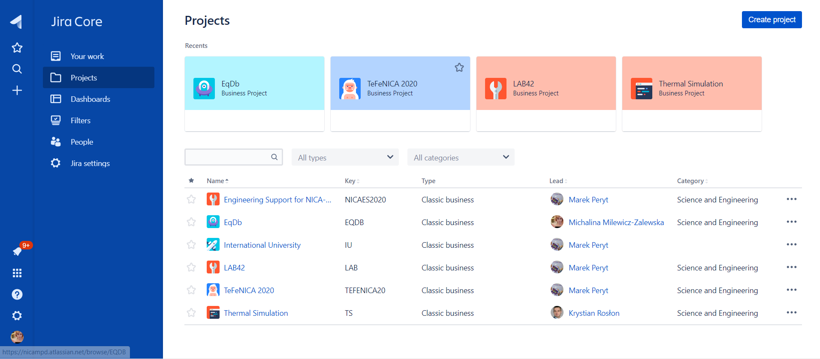
HOW TO LOG IN to JIRA&CONFLUENCe?
For JIRA go to https://nicampd.atlassian.net/
For Confluence

Slide 7
HOW TO LOG IN to JIRA&CONFLUENCe?
For JIRA go to https://nicampd.atlassian.net/
For Confluence
CLICK HERE AND
SWITCH to CONFLUENCE

Slide 8
What should you do after you log in?

Slide 9
DO NOT MAKE A MESS
Work only in the projects you know, do not create any projects without Head of sector consent

Slide 10
SET UP YOUR PROFILE
Accept invitation to the team
Fill all your data
Look around
Assign yourself to the tasks if there is anything available for you

Slide 11
How do we work?
EVERYTHING you put in both Jira and Confluence should be in ENGLISH
If you can not write in English, use Google Translate
If you need to put something in Russian (for example name of the document), make sure it is ABSOLUTELY necessary
You assign yourself to the tasks
We work in 2 weeks-long „sprints”

Slide 12
Tips for proper planning
Be realistic
Ask for help
Set small goals
Divide
Keep track

Slide 13
Where can you get help?
Directly at Jira/Confluence
On YouTube
Your colleagues’ heads – ask them!

Slide 14
Time to start is now

