Slide 1
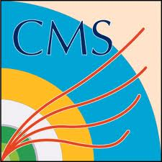
Hit reconstruction in Cathode-Strip Chambers Nikolay Voytishin LIT JINR
Alushta-2020
September 28, 2020

Slide 2
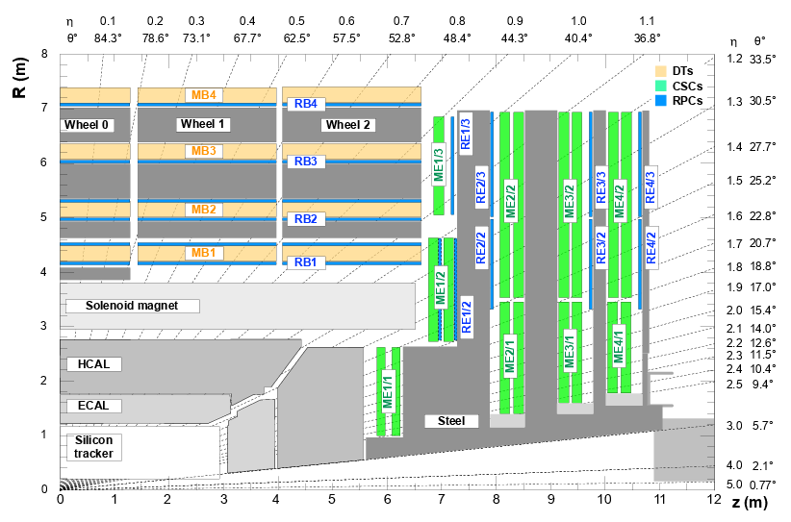
Cathode-Strip Chambers @ CMS
Cathode-Strip Chambers in the experimental setup
Reconstruction in CSC

Slide 3
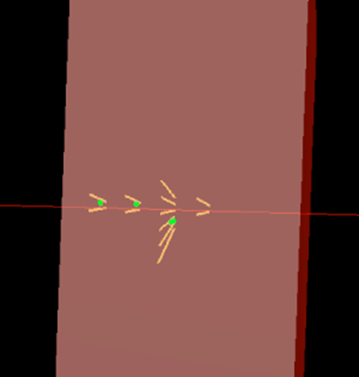
Simple two overlapped signals recognition
Make two maxima and share the charge of common strip proportionally
Regular strip charge distribution
Regular wide cluster strip charge distribution
Abnormal strip charge distributions
CMS Simulation
16
16
15
17
13
14
15
17
18
13
14
15
18
Strip ADC’s
10
106
119
374
178
12

Slide 4
Abnormal strip charge distributions under consideration
16
16
15
17
13
14
15
17
18
13
14
15
18
1
2
(mirror of 1)
3
4
(mirror of 3)

Slide 5
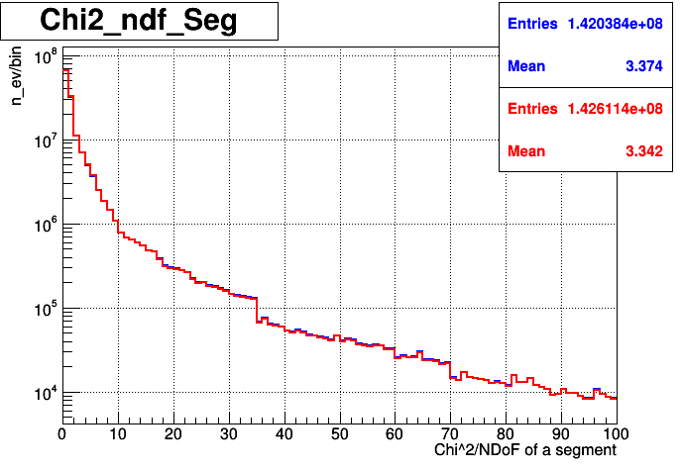
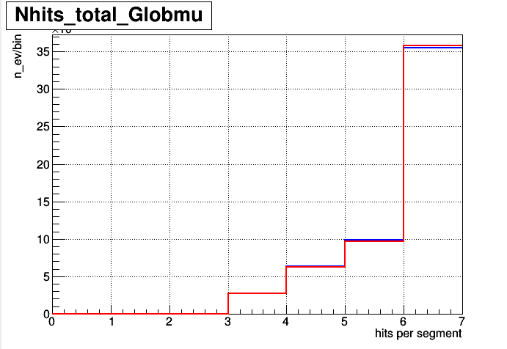
Number of hits per segment
Improvement analysis
L1 L2 L3
Abnormal charge distribution handling
L1 L2 L3
14.37 14.32 16.20
14.37 14.32 14.16
16.23
CMS Preliminary Simulation
CMS Preliminary Simulation
+0.7%
All segments
χ²/NDoF segment
BLUE – standard RH Builder; RED – abnormal strip distribution division
5

Slide 6
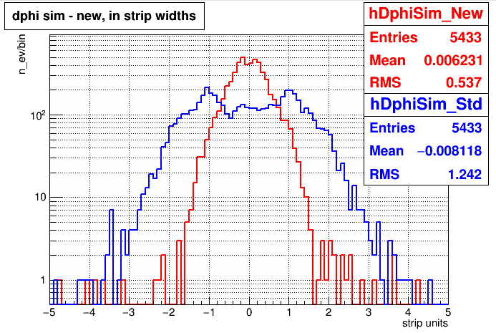
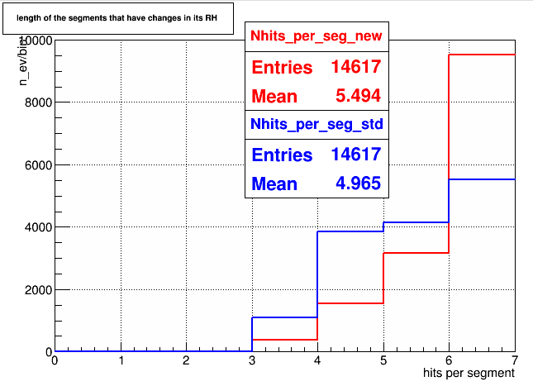
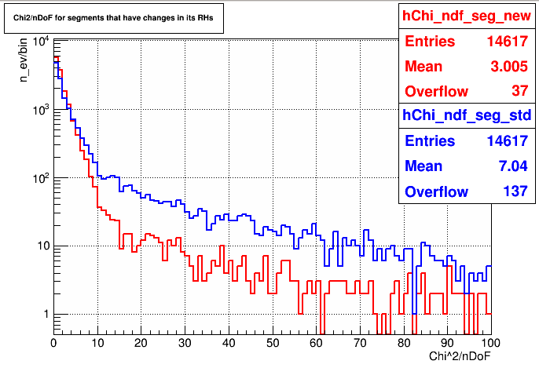
Only Segments that changed
dPhi(Sim-RH)
Compare hits and segments in events where std and new reconstruction differs
BLUE – standard RH Builder; RED – abnormal strip distribution division
6

Slide 7
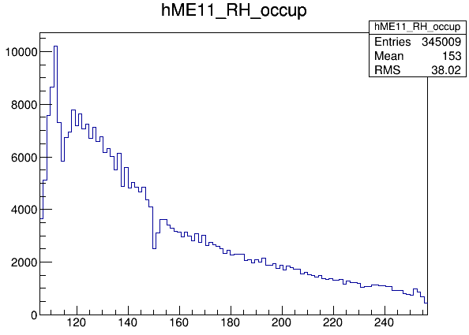
ME1/1 specific geometry
wg 48
wg 1
ME1/1

Slide 8
ME 1/1 special geometry
last wire
Not reconstructed
WG 48
central wire
first wire
last wire
WG 1
central wire
first wire
Not reconstructed

Slide 9
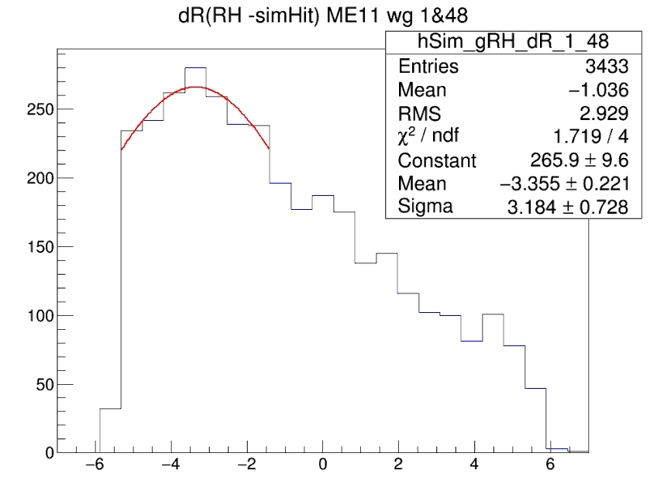
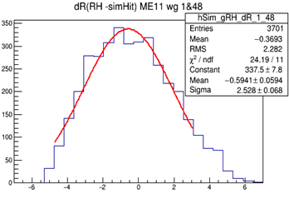
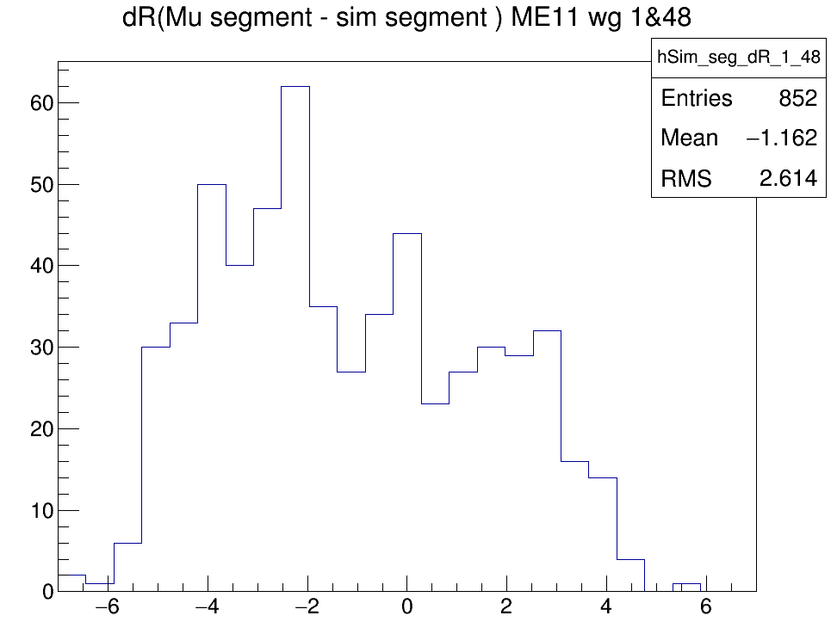
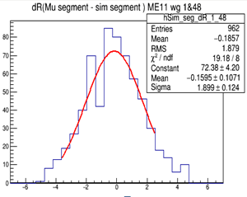
WG 1 & 48 difference in global coordinates
RecHit-SimHit
+ 7.8% MuRHs in wg1|48
R(cm)
R(cm)
STD
NEW
Segments(Reco-Sim)
+ 12% Mu segs with RHs in wg1|48
R(cm)
R(cm)

Slide 10
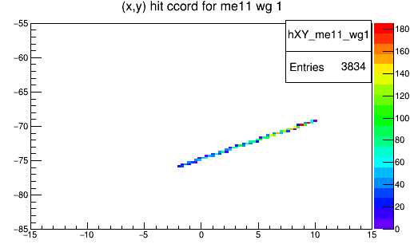
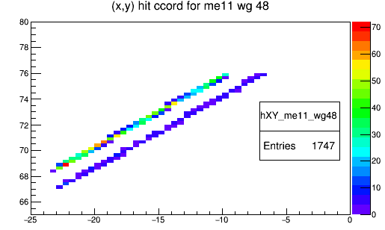
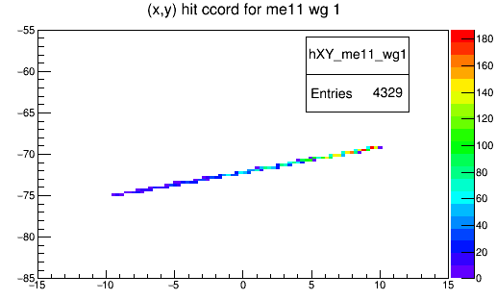
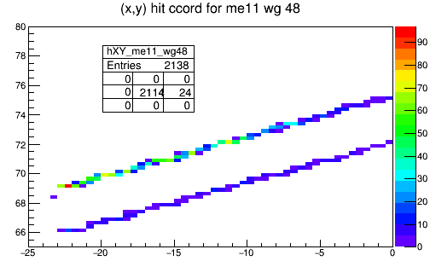
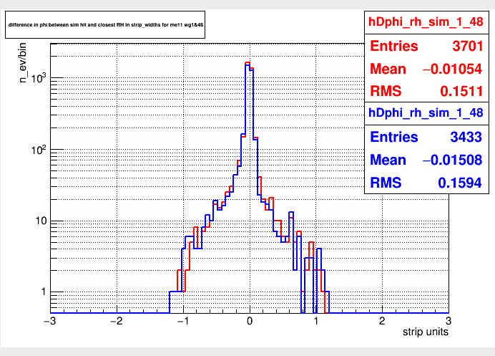
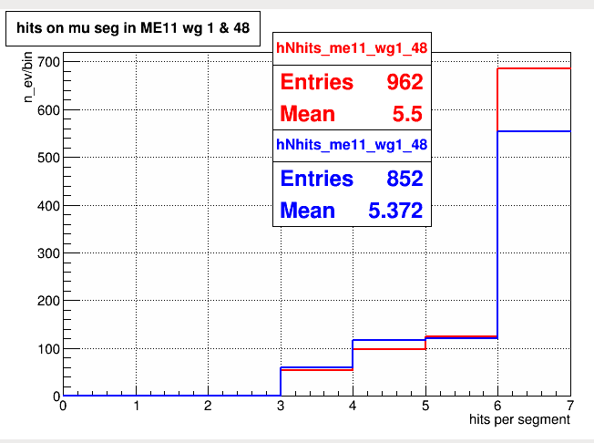
WG 1 & 48 coordinates and MU segment length
Lost hits!
WG 1
STD
29˚
29˚
WG 48
Lost hits!
WG 48
WG 1
NEW
29˚/2
29˚/2
NEW
dPhi (RH-sim)
STD
Mu Segment length
12 % more Mu segs
10

Slide 11
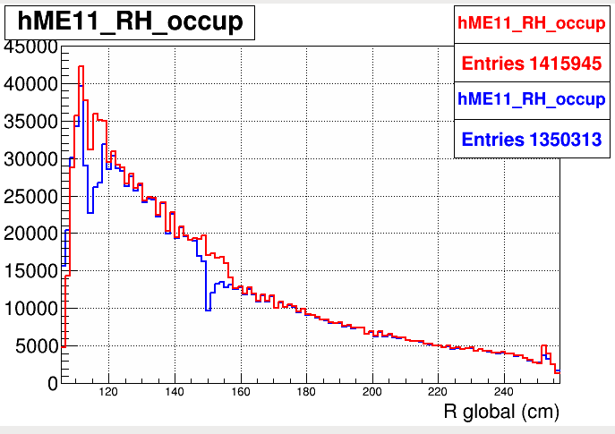
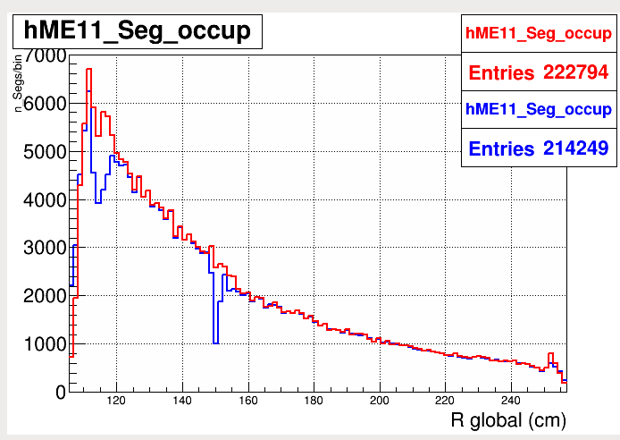
Overall improvement
ME11 wg1&48 + strip cut region
RecHits
Segments
The distributions became more regular.
BLUE – standard RH Builder
RED – New
11

Slide 12
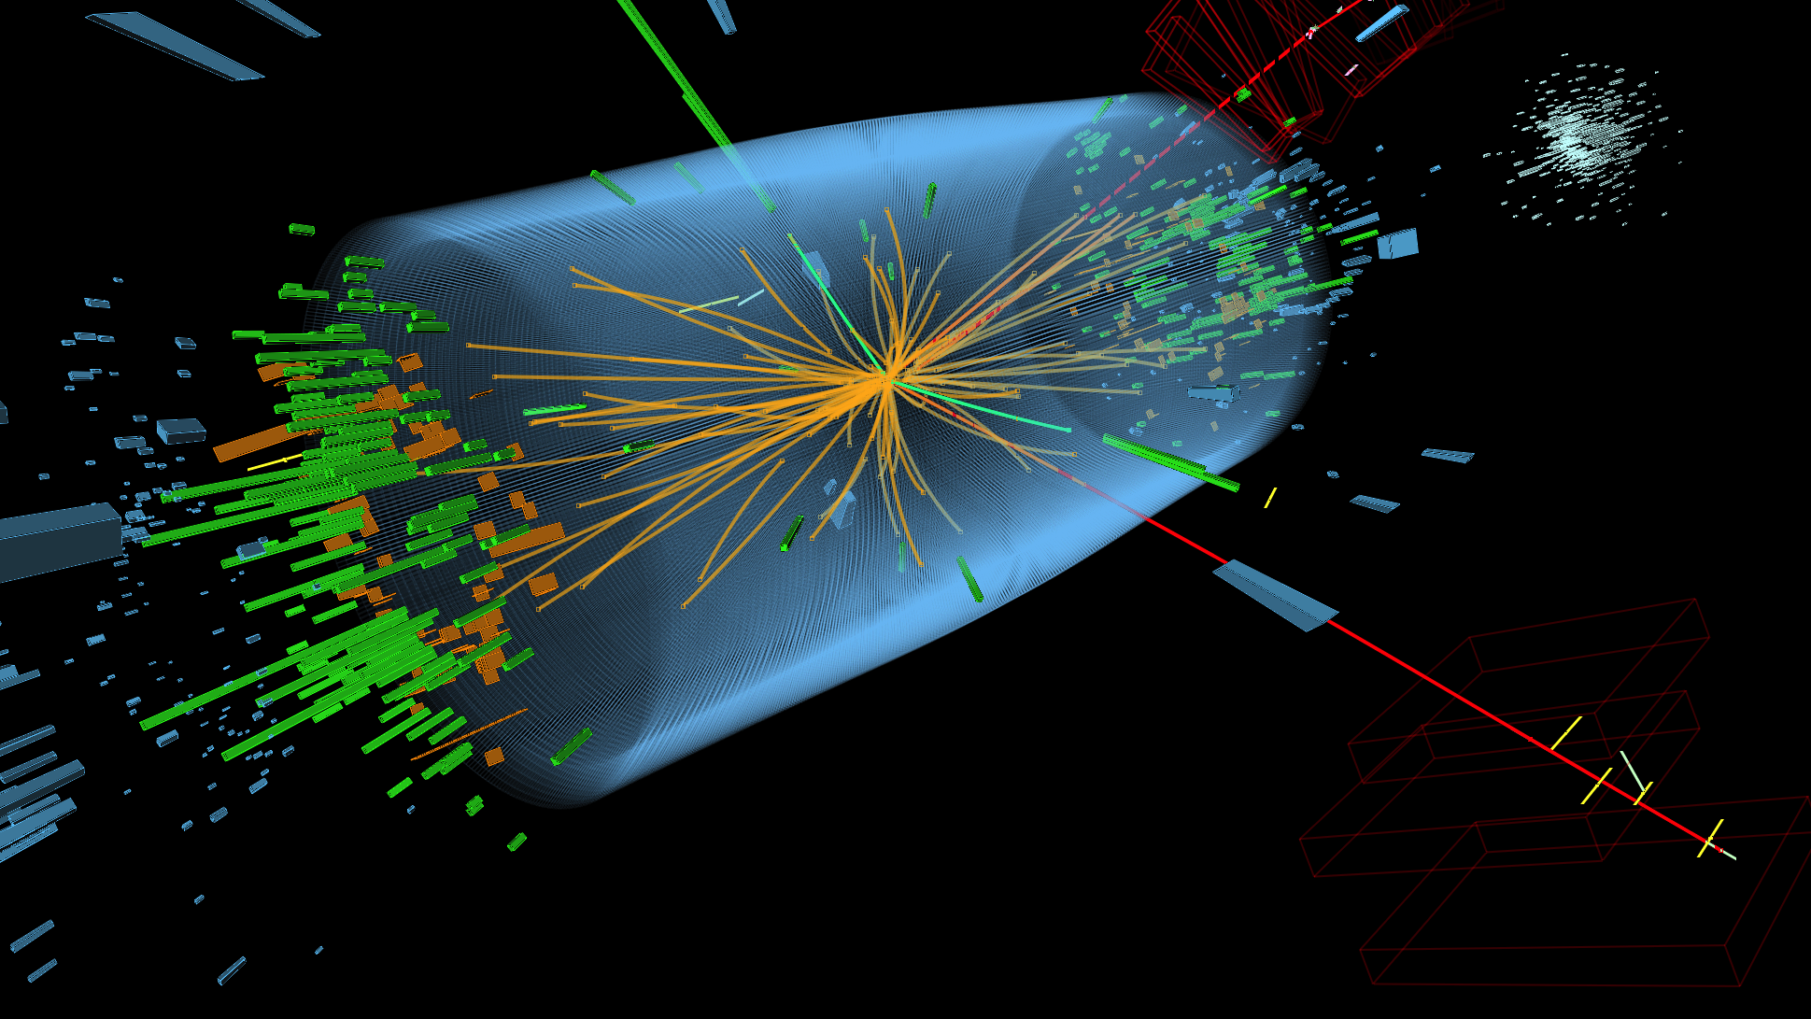
Thank you for your attention!!!

