Slide 1
Investigation of shape coexistence in ⁹⁶Zr and ⁹⁶Mo within the framework of one-dimensional geometric collective model
Mardyban М.А., Kolganova E.A., Jolos R.V.,
Sazonov D.A., Shneidman T.M.
^{BLTP JINR, Alushta 2020}

Slide 2
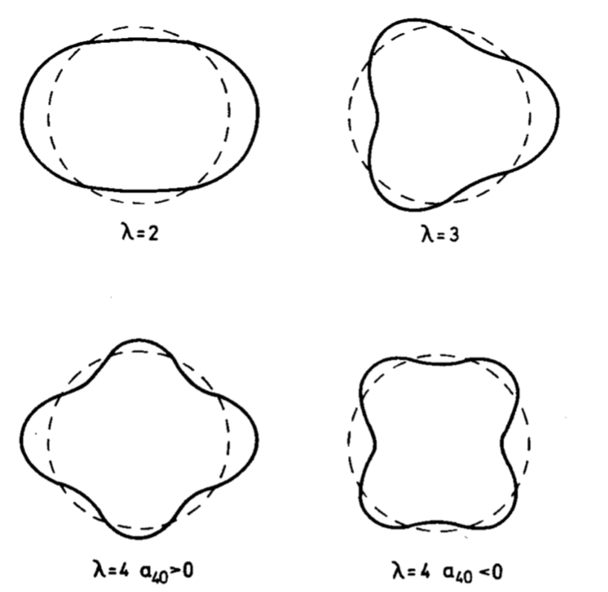

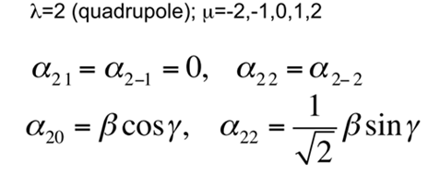
Problem model

Slide 3
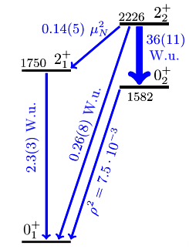
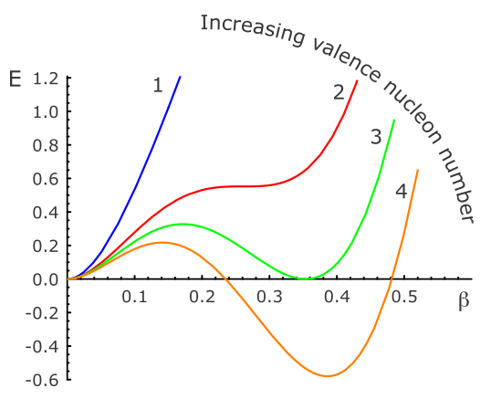

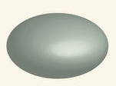
Nucleus shapes
Potential energy curves illustration.
Ellipsoidal shape
Spherical shape
New experimental data: C. Kremer et al. "First Measurement of Collectivity of Coexisting Shapes Based on Type II Shell Evolution: The Case of ⁹⁶Zr" Phys. Rev. Lett. 117, 172503 (2016)
Structural Features: Form сoexistence in ⁹⁶Zr

Slide 4
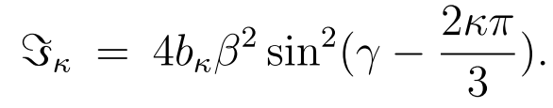


Bohr Hamiltonian
The collective quadrupole Bohr Hamiltonian can take the form:
The parameter B₀ is the overall dimensional scaling factor for the components of the tensor of inertia. Coefficients b_{ββ} b_{ɣɣ} and b_{βɣ} are dimensionless coefficients of inertia for β- and ɣ-oscillations.

Slide 5
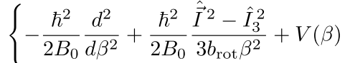

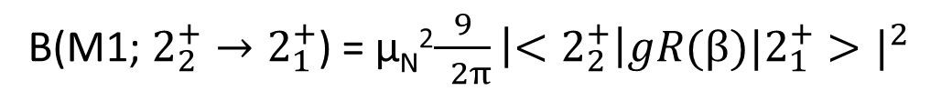
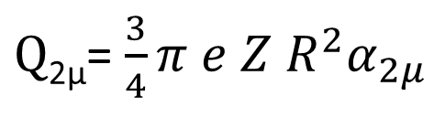
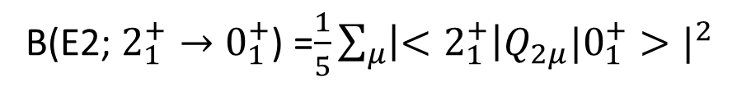
Schrödinger equation that will be used to analyze the phenomenon of coexistence of forms:
Е2 transition
М1 transition
B(E2; $2_{1}^{+}→0_{1}^{+}$) =$\frac{1}{5}\sum_{μ}{\left|<2_{1}^{+}\right|Q_{2μ}|0_{1}^{+}>|^{2}}$
B(М1; $2_{2}^{+}→2_{1}^{+}$) = μ_{N}²$\frac{9}{ 2π}\left|<2_{2}^{+}\right|gR(β)|2_{1}^{+}>|^{2}$
$\text{Q}\text{2}\text{μ}$= $\frac{3}{4}π e Z R^{2}α_{2μ}$

Slide 6
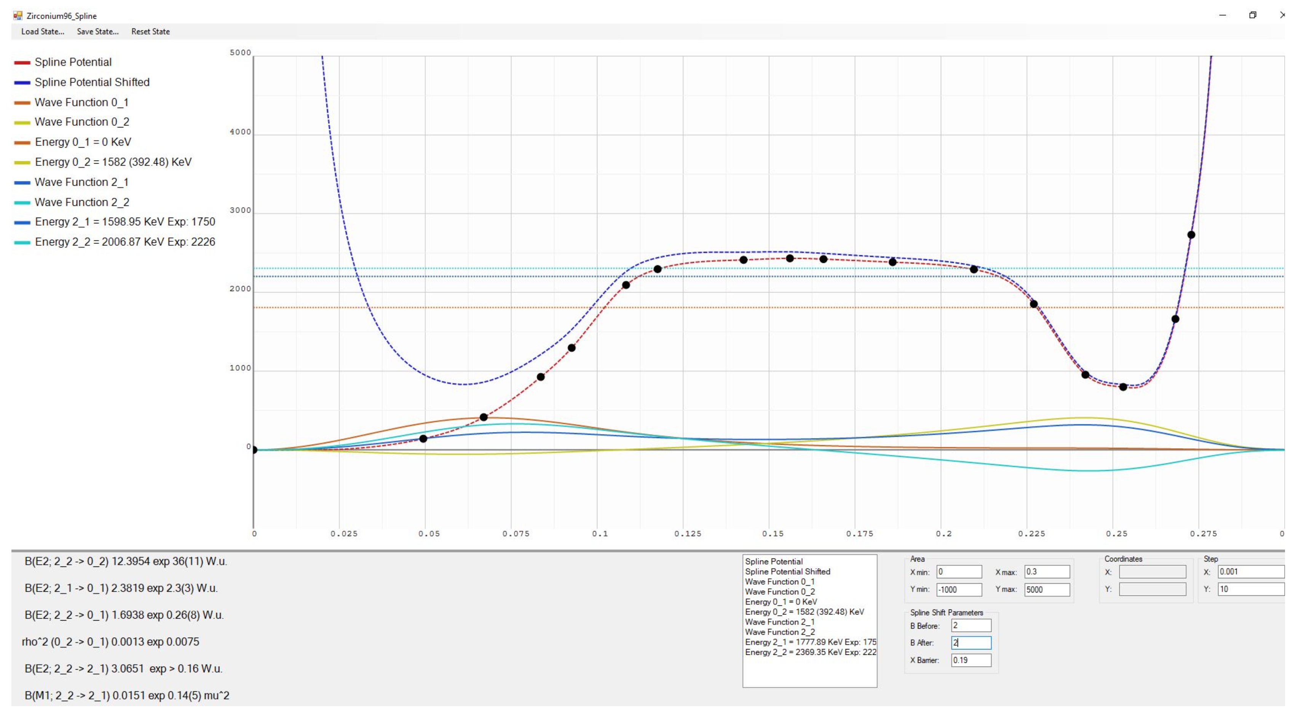
Potential energy V (β) and calculated energy levels for ⁹⁶Zr

Slide 7
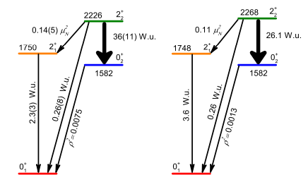
Calculation results for ⁹⁶Zr
experiment
calculation

Slide 8
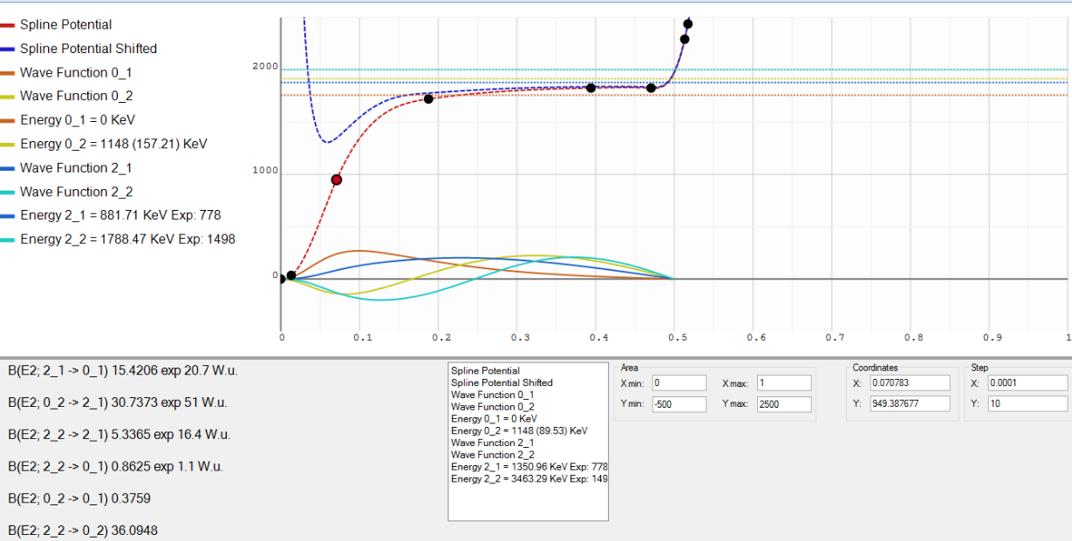
Potential energy V (β) and calculated energy levels for ⁹⁶Mo

Slide 9
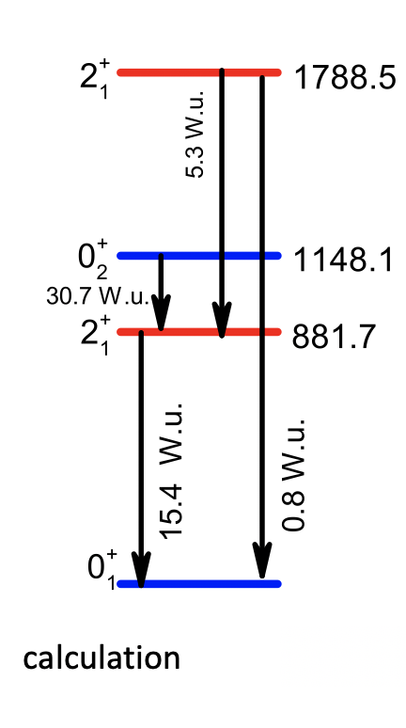
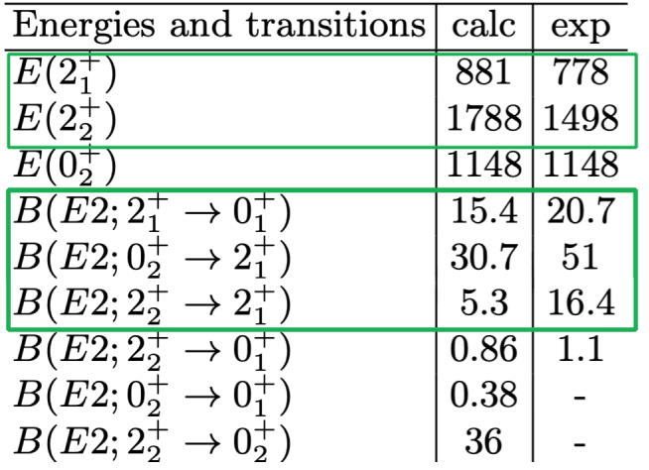
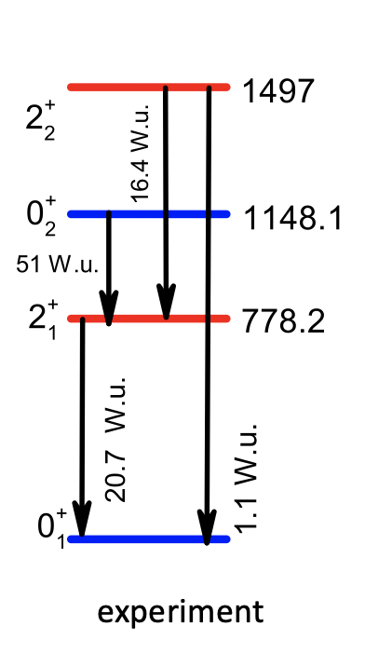
Calculation results for ⁹⁶Mo
experiment
calculation

Slide 10
Conclusion
The obtained energy and the probabilities of transitions of low-lying collective states are in good agreement with experiment.
The used model makes it possible to predict the probabilities of E2 and M1 transitions
In the next talk by E.Mardyban you will see the results with the ɣ-degree of freedom
The main results of the work on ⁹⁶Zr and ⁹⁶Mo are included in the articles:
D. A. Sazonov et al. Phys. Rev. C 99, 031304 (R) - (2019)
M.A. Mardyban et al. SNFP №6, 1960203 (2019)
THANKS FOR YOUR ATTENTION!

