Slide 1
MPD cooling system proposal
V. Benda

Slide 2
MPD shield cooling by GHe/LHe or by GN₂/LN₂? - at nominal
Magnet
Thermal loads of MPD magnet P=82W @ 4.5K reference: 3НМ1002.00.000ТО , table 2.4.3.3.1, page 28
Current leads P_{CL}=10W reference: 3НМ1002.00.000ТО , table 2.4.3.3.1, page 28
Cooling power of Satellite P_{S}=100W @ 4.5K reference: ILK-B-1-16-319a_v
Whole cooling power of the Satellite is required by MPD magnet
Shield
Thermal load of MPD thermal shield Q=2200W @ 80K reference: 3НМ1002.00.000ТО , table 2.4.3.3.1, page 28
If T₁=300K and T₂=80K
Thermal load of MPD thermal shield Q=3000W @ 30K estimation
If T₁=300K and T₂=43K, T₂= Tin(5K)+Tout(80K)/2=42.5K, dT=75K
Required flow of LHe
m=Q/(Cp x dT)=3000/(5200 x 75)=0.008kg/s=8g/s ~ 160W
In case of using LHe for MPD thermal shield cooling extra 160W from the Satellite is required. This extra power is not available.
This analysis is done for the normal operation @ 4.5K
For cool down of the system, higher cooling power is required
Conclusion
Original proposal of using GN2/LN2 for cool down/warm up and normal operation is better adopted solution
From thermodynamic point of view better and more economic solution (in long term)
No new questions which could delay the project will be raised. The “LHe” solution would have to be discussed and approved by ASG

Slide 3
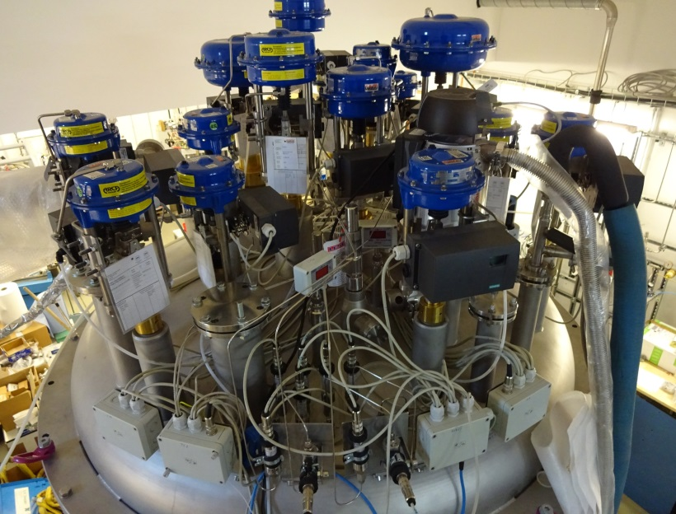
MPD satellite, no space on the top plate Modification is difficult, warranty would be lost

Slide 4
Схема предварительной подачи LN₂
Cold GN₂
To be used for shielding of LHe line #1
Экран
MPD control cryostat
Satellite
GN₂
MPD magnet
Стена
Heater 5kW
LN₂ tanks
MFS
From CERN
By-pass for LN₂ to be added
Испаритель 5kW
LN₂ filling
LN₂
Гибкая криогенная линия

Slide 5
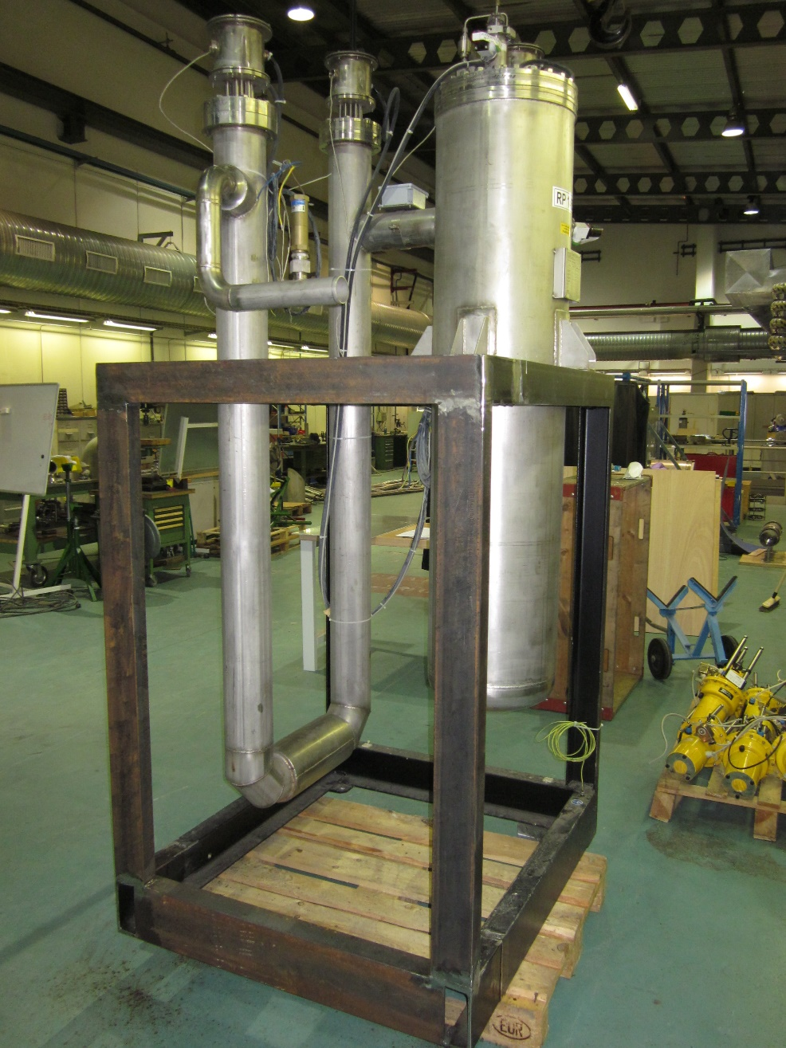
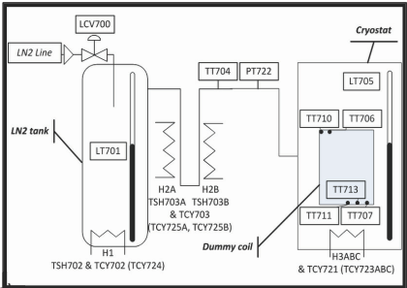
MFS - magnet flushing station, with Unicos control system For time being not in use at CERN

Slide 6
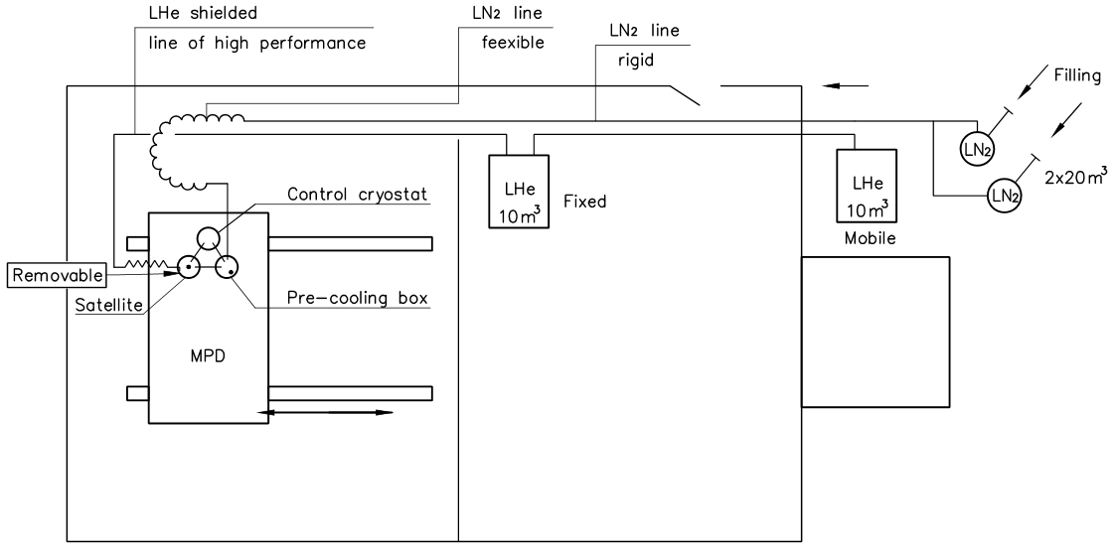
Provisional solution
LHe line #1

Slide 7
Location for LN2 and LHe tanks – waiting for approval

Slide 8
Схема предварительной и окончательной подачи LN₂
MPD distribution box
Экран
Satellite
MPD magnet
Стена
Нагреватель (Смесительная камера)
(HP GN₂ warm)
LN₂ tanks
Испаритель
LN2 filling
Ожижитель
GN₂ cold
GN₂ warm
LN₂
Гибкая криогенная линия

Slide 9
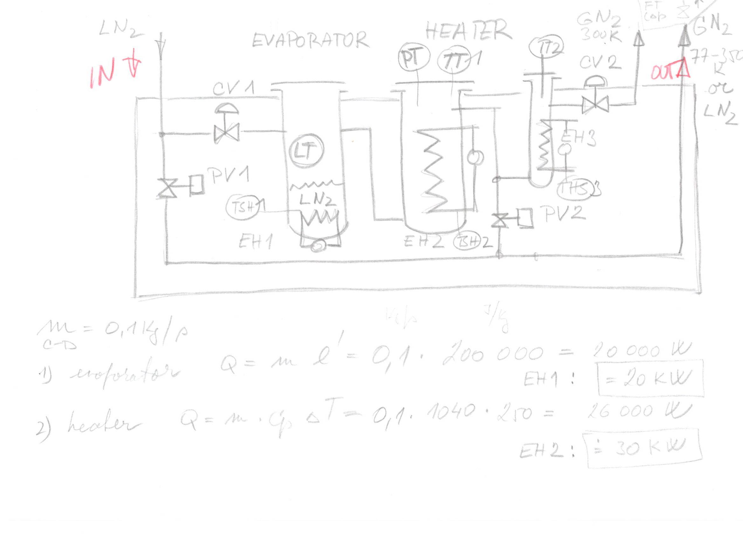
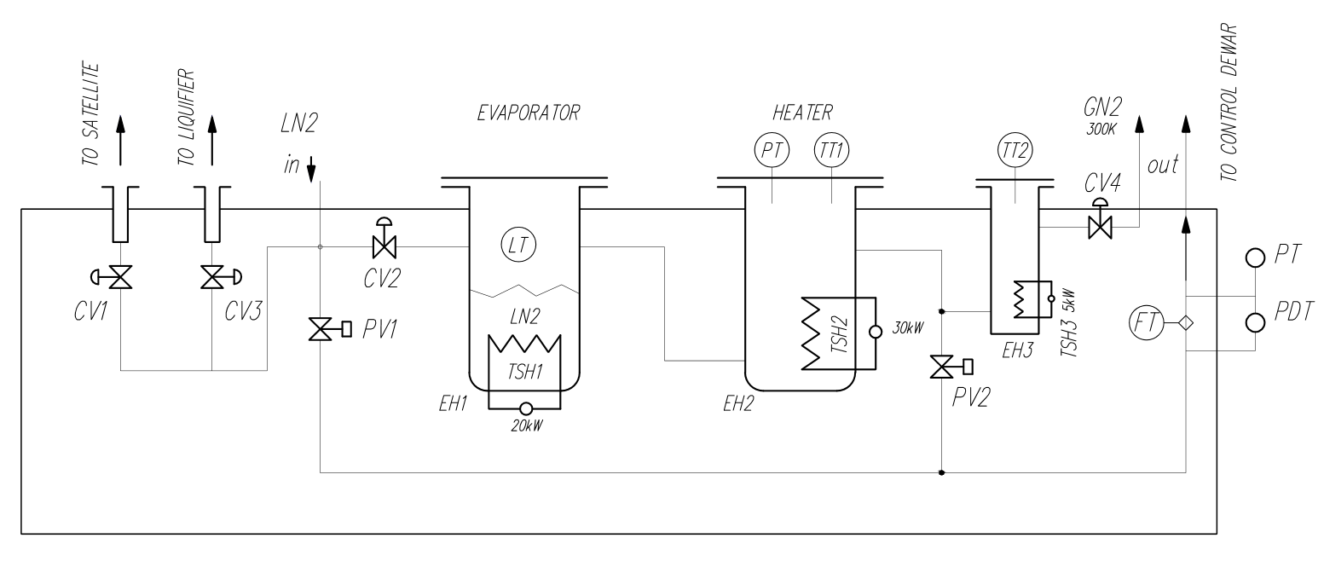
Final LN2 pre-cooling box
To be analyzed if this part is necessary

Slide 10
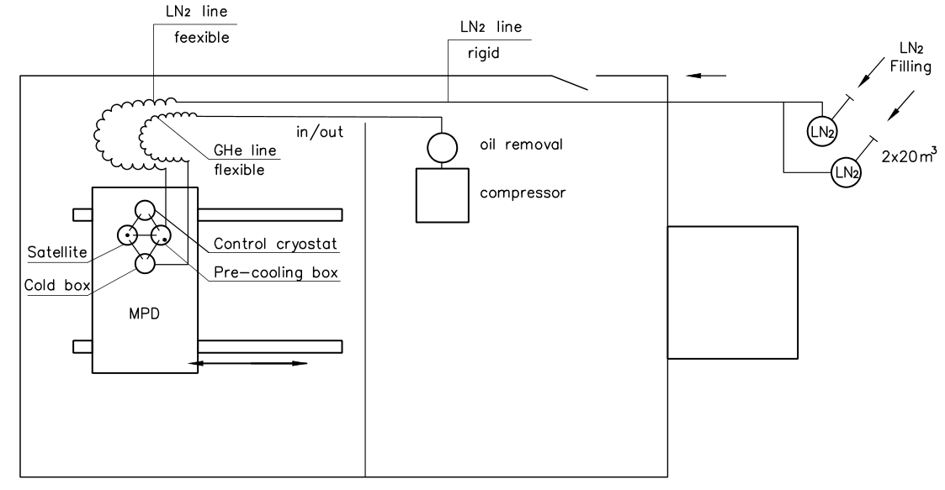
Окончательное решение, if required the provisional LHe solution can stay in place

Slide 11
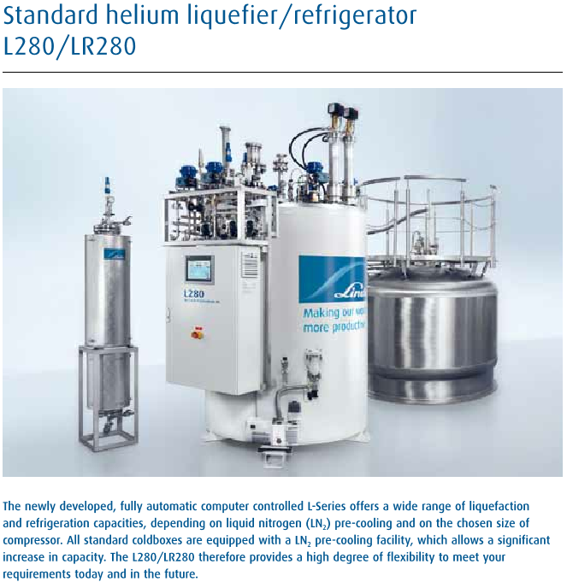
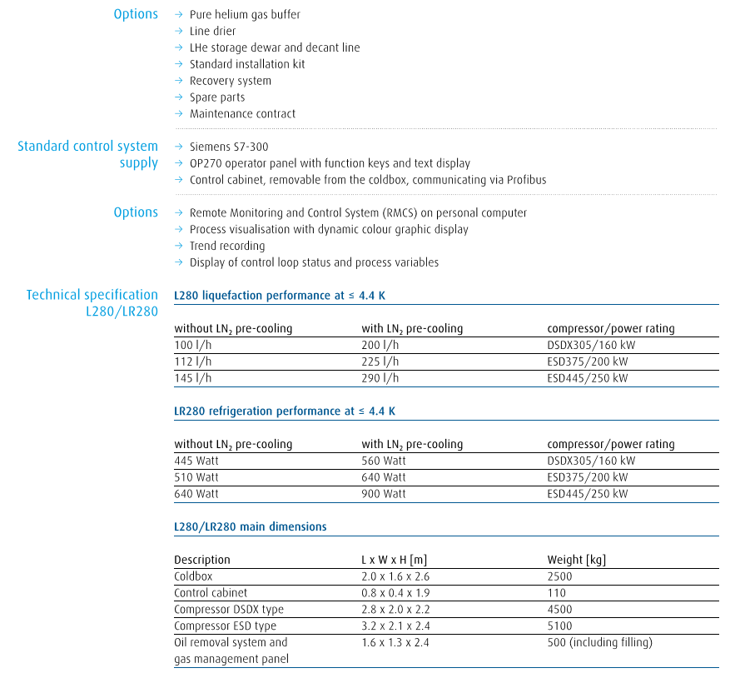
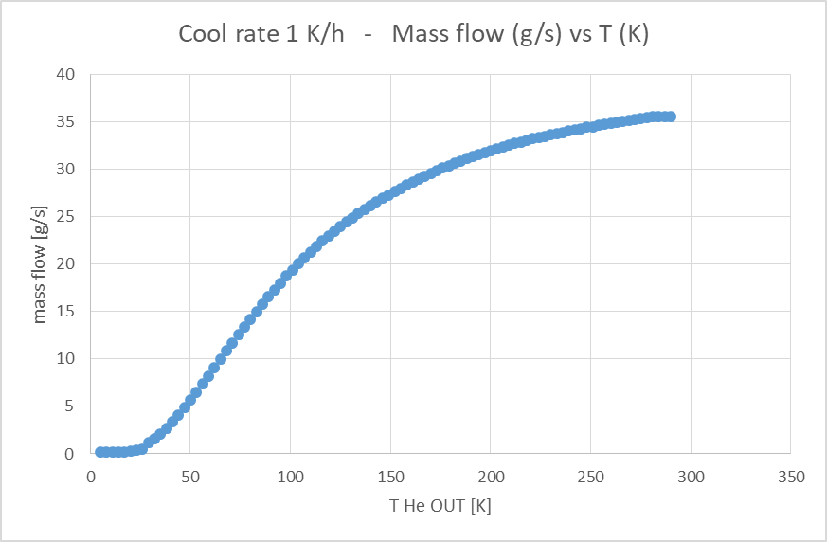
Small liquefier
MPD requirement
Nominal: 4.34g/s = 129l/h @ 4.5 K
Cool down/Warm up: 16.2 g/s of GHe T=80K – 5K
From this point LHe is required, but how much?

Slide 12
Simplified estimation of required liquefier cooling power for magnet cool down
Cool down by satellite
From 300K down to 80K indirectly by LN2
From 80K down to 5K by LHe considering that all helium enthalpy is used by means of satellite heat exchanger
In this case for cool down of Aluminum from 80K down to 5K is required 0.2l(LHe)/kg(Al)
For 14t of magnet 336 kg of LHe is required
If we consider cooling speed 1K/h, the required flow of LHe is m=1.2g/s
It can be expected that cooling speed below 80K can be much higher (no shrinkage)
In this case with Linde liquefier L280 of cooling power 10g/s of LHe, the cooling speed of the magnet would be nearly 10K/h which is fully satisfactory

