Slide 1
MPD provisional cryogenic component and tasks definition
V. Benda

Slide 2
Main points and agreements
On our last meeting 19 February it was proposed and approved the provisional solution of MPD shield cooling by LN₂ with a speed of 1K/h
Final solution will be clarified later on, but
The general strategy shall be approved in reasonable time in order to go from provisional to the final solution quickly and with minimum extra budget
Official MPD Cryogenic working group was established
Агапов Н.Н. гл.инженер ЛФВЭ
Бенда Вл. ответственный за криогенную систему MPD
Емельянов Н.Э. ответственный за включение и эксплуатацию Соленоида
Кошурников Е.К. сопровождение проекта Соленоид
Топилин Н.Д. ответственный за сборку магнита и монтаж криогенной платформы
Ткачев Г.П. электрическое подключение систем Соленоида
Головатюк В.М. координатор работ по MPD
Слепов И. ответственный за криогенный сайт и депозитарий документов
Regular meeting every second Wednesday at 15h in b.202 (at Slava)

Slide 3
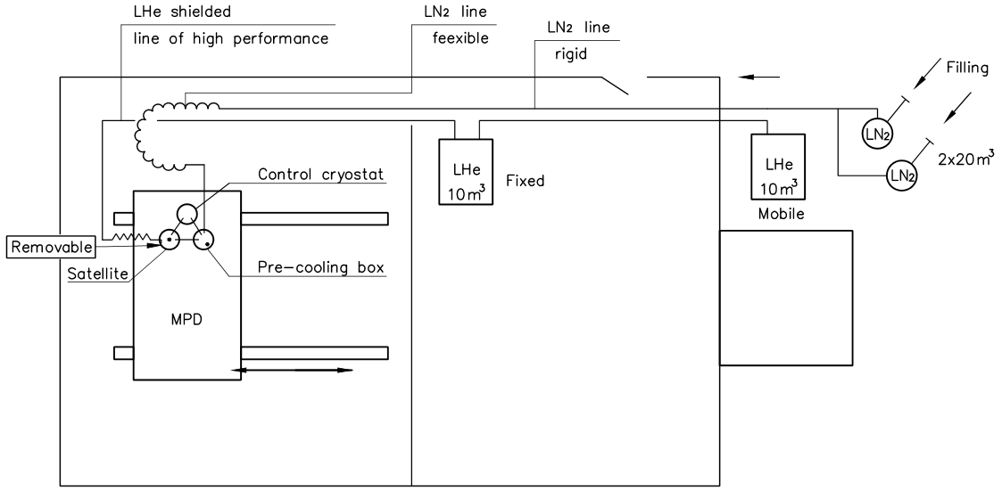
Provisional solution Components numbering
LHe line #1
5
3
4
1
2
For the final solution one LN₂ tank can be removed while the second one can by filled by fixed LN₂ line from our LN₂ factory.
EH
MFS
6

Slide 4
Provisional simplified scheme of LN₂ Components numbering
Cold GN₂
To be used for shielding of LHe line #1
Экран
MPD control cryostat
2
Satellite
GN₂
MPD magnet
EH
Стена
Heater 5kW
LN₂ tanks
MFS
From CERN
By-pass for LN₂ to be added
Испаритель 5kW
5
5a
LN₂ filling
LN₂
5
Гибкая криогенная линия

Slide 5
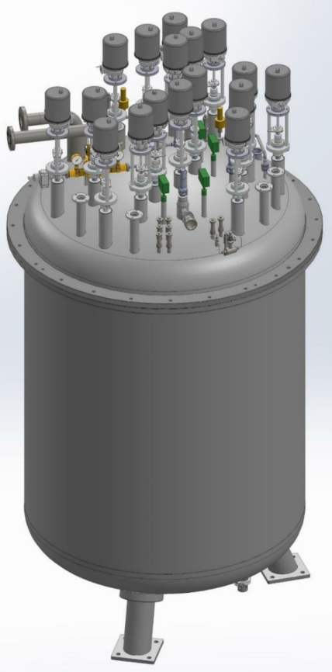
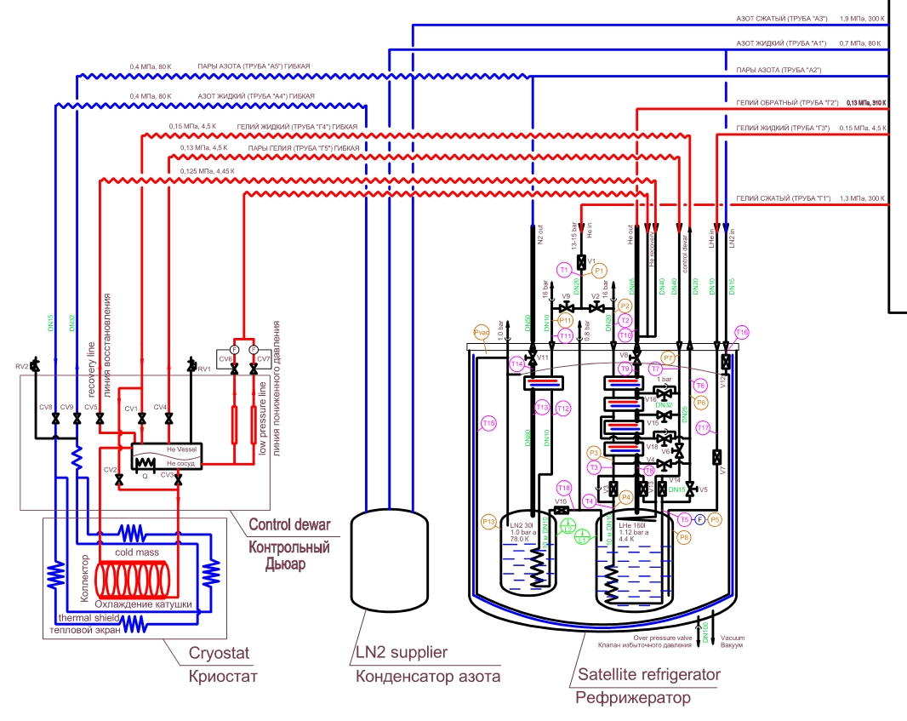
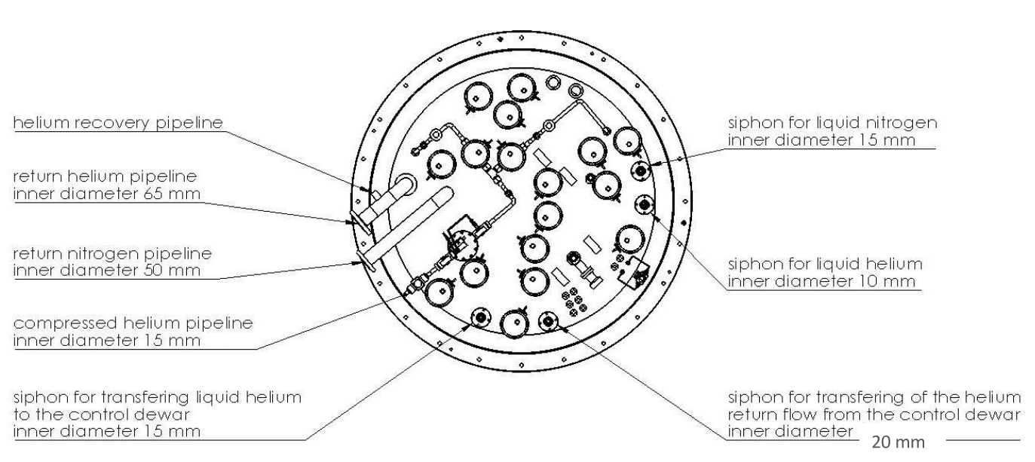
Satellite/Control cryostat lines
2
9
6
5
1a
1b
7
3
8
11
10

Slide 6
List of components and task description
MPD provisional solution – Procurement of components
Writing technical specifications including planning!
Description
Table of basic parameters (L, P, dP, m, Qr)
Calculation of main features (d)
Safety analysis and SV/RD calculation
Material and technology definition
Tender
Find/propose companies
Follow up the production (design – testing)
Transport to JINR
Procurement of the documentation and putting them on JINR server
Transport to JINR
Installation
Testing in situ

Slide 7
Preliminary risks estimations
Insufficient resources
Cryogenics
Control system
Paper work
Technicians
To be organize
Planning including resources, responsible?
MPD cryo-server to be established
Documents to be organized (structure to be done)

Slide 8
Satellit under cold test, photo
Line 1a
Line 1b
Satellite
Control cryostat

