Slide 1
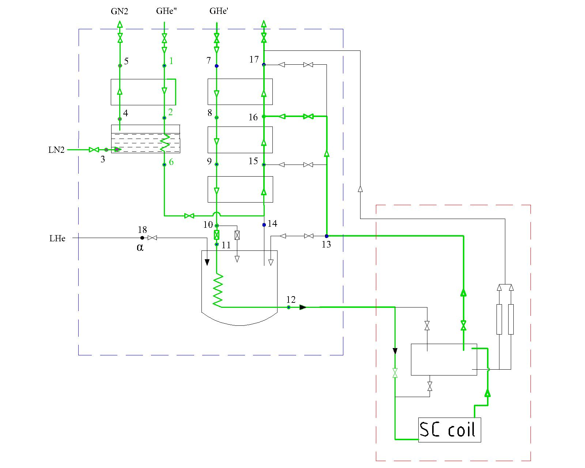
Nitrogen pre-cooling
From 300 K to 100 K
Total amount of LN2
~8000 liters
1 K/hour constant
20 K between inlet and outlet
constant

Slide 2
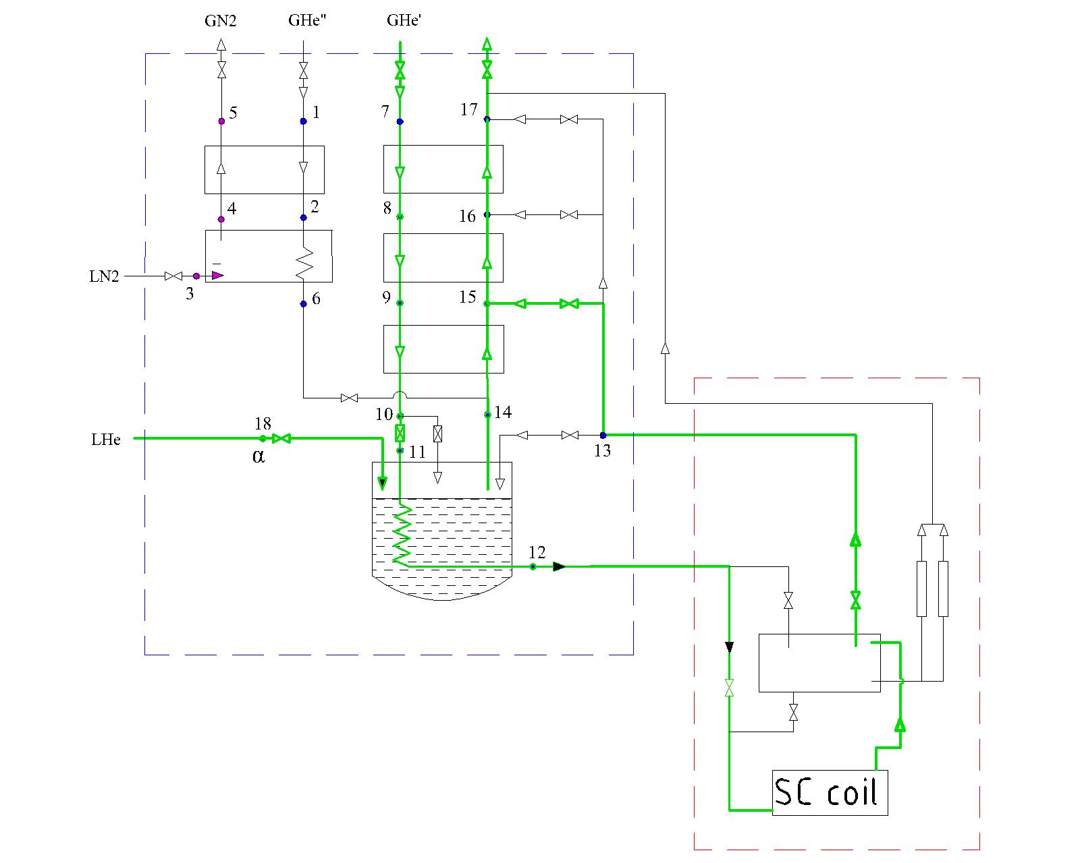
Helium pre-cooling
From 100 K to 4.5 K
1 K/hour constant
20 K between inlet and outlet
constant

Slide 5
Total amount of Lhe
~7000 liters

