Slide 1
Семинар ЛЯП
20 марта 2020
Проект: Развитие техники эксперимента и прикладные исследования на монохроматических пучках позитронов
Продление на 2021-2023 гг.
Руководители проекта: А. Г. Кобец, К. Семек,
Научный руководитель: И. Н. Мешков
Исполнители:
ЛЯП: Е. В. Ахманова, О. С. Орлов, А. Ю. Рудаков, К.Семек, А. А. Сидорин,
Л. В. Соболева, В. И. Хилинов, С. Л. Яковенко

Slide 2
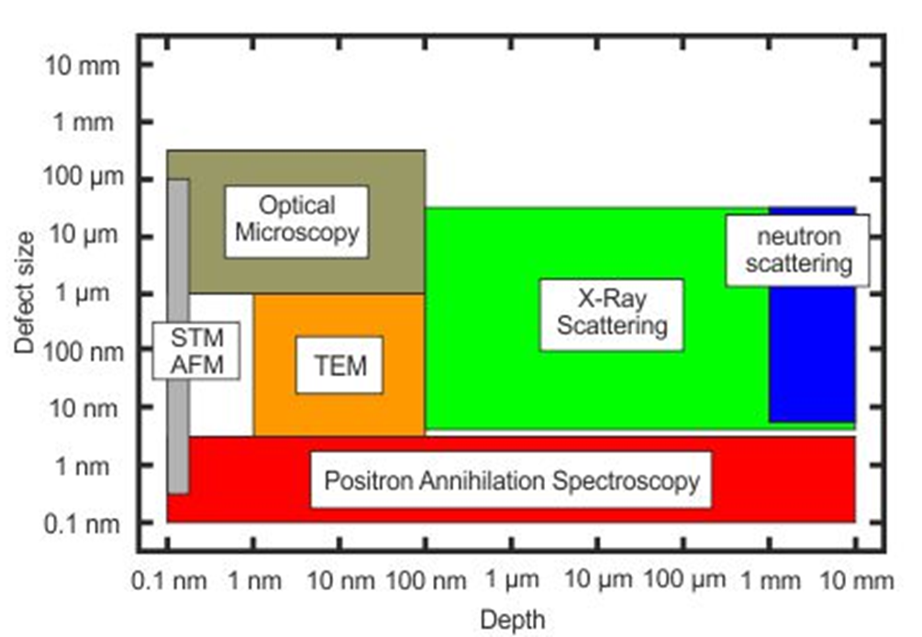
Positron annihilation spectroscopy
PAS techniques allow us to find defects with the size ranging from 0.1 to 3 nm with the concentration up to 10⁷ ppb
PAS makes possible the detection of defects in the wide range of depths from single nanometers up to milimeters
^{*)} https://www.hzdr.de/db/Cms?pNid=3581
Notes:
The many methods can be used during investigations of defects concentrations and defects type such as atomic force microsopce transmission microsope optical microsopy, X ray diffraction ane neutron scattering. Among this method exist a positron annihilation spectrocopy which allows to study the defects in wide range depths from single nanometers up to milimieters. This methot is one of the most sensitivity especcially for low defect concencentration and allow to observe defect up to 10 milion ppm.

Slide 3
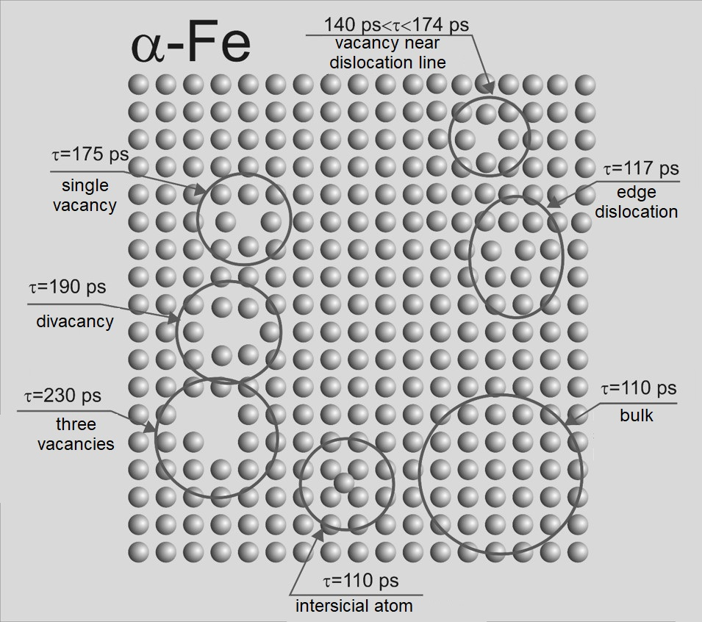
Positron annihilation spectroscopy
PAS techniques:
Doppler spectroscopy (DB)
positron lifetime spectroscopy (LT, PALS)
Possibilities:
determination of defect concentration
evaluation of defect concentration profile
detection of the kind/size of defects
Applications:
solid body physics
material and surface engineering
metals, semiconductors, thin layers
* http://www.ifj.edu.pl/~mdryzek/
Notes:
We can distinguish three positron spectrosopies method: angular correlations of gamma quantum doppler spectroscopy and positron lifetime spectrosopy. In these method we use positron as a probe. After implanation positron firstly lose its Energy interacting with the matter. When it reach the termal Energy of lattice positron can diffuse in randomly between the atoms. If it find a defect such as vacancy the positron will be trapped by this defect and after very short period of time called positron liftime the positron will annihilate with one of the electron. The positron lifetime allow to distinguish different positron traps. When the size of voids increase the positron lifetime also increase. It means that positron spectroscopies gives information about the defect concentrations its distributions and also allow detect different kind of defects.

Slide 4
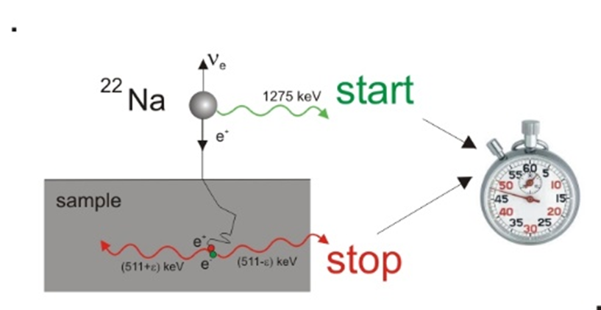
PALS Spectroscopy
The annihilation rate λ - the reciprocal value of mean positron lifetime
r₀ – electron radius, c – velocity of light
Bi
electron density inside the defect is lower in comparison to bulk area what finds a reflect in the mean positron lifetime
e.g. for pure Fe τ = 110 ps in nondefected structure while positron trapped inside vacancy lives τ = 174 ps
Notes:
Generally the annihilation rate which is the reciprocal value of mean positron lifetime and is proportional to the electron density. electron density inside the defect is lower in comparison to bulk area what finds a reflect in the mean positron lifetime. Bigger voids decrese the electon density and increase positron lifetime, which we could observe for examplary calculations performer for Bizmuth. In case of bismuth the vacancy clusters up to 5 vacancies can be well recognized. Over this value is hardly to distnigush excacly numer of defects in samples due to small difference between its positron lifetimes. The experimntal positron lifetime is mesured as the difference between time when positron born and when it annihilate

Slide 5
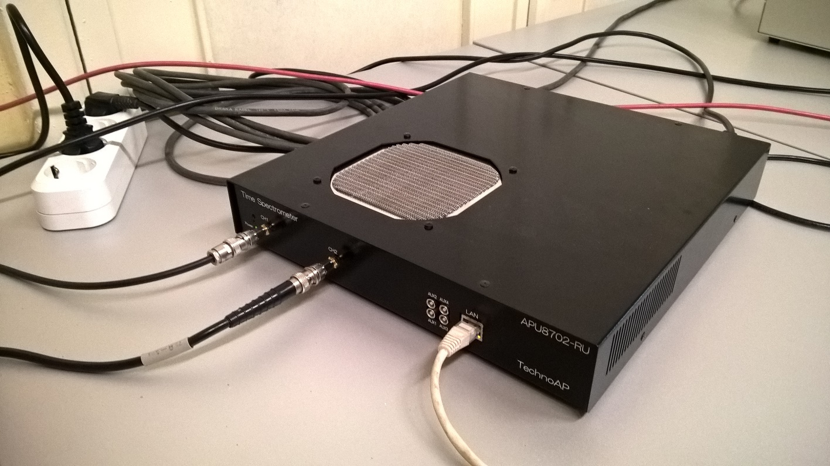
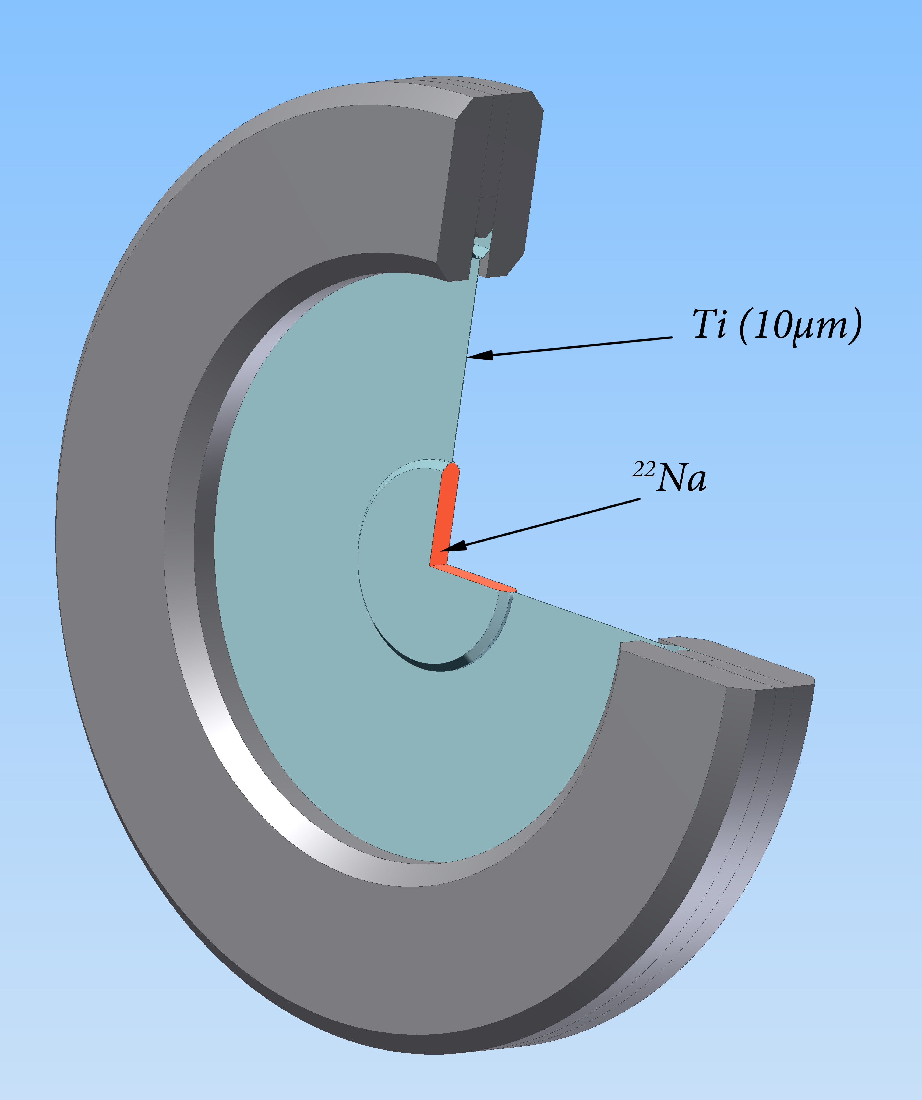
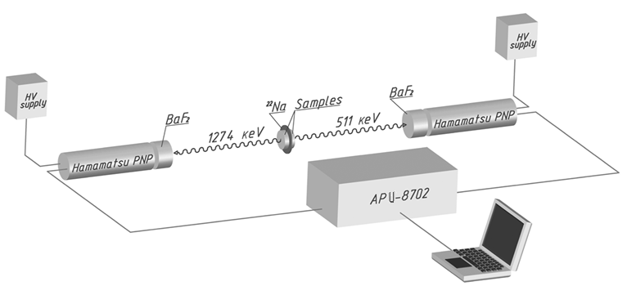
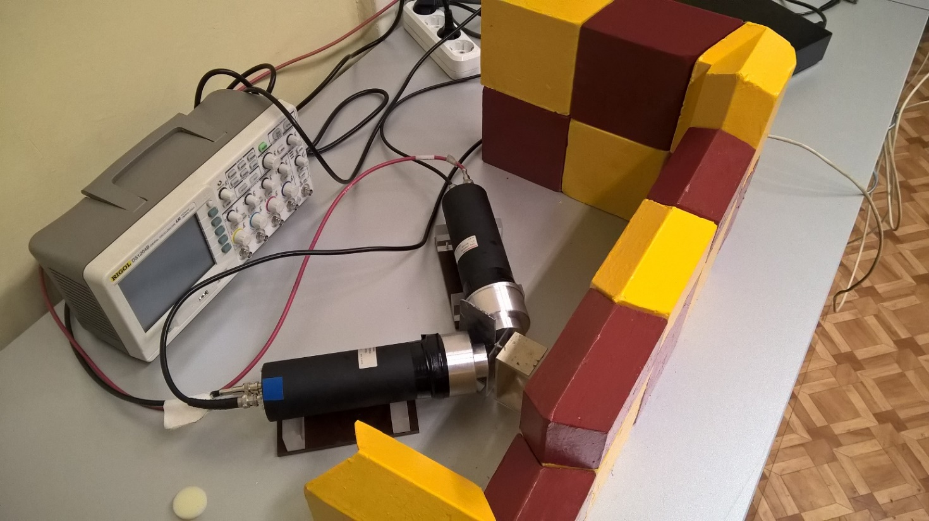
Positron annihilation spectroscopy
digital spectrometer: BaF₂- based detectors and APU8702 unit
spectra including 10⁶ counts were deconvoluted by LT code [*], substracting the background and the source components
^{*)} J. Kansy, Nucl. Instrum. Method. Phys. Res. A 374 (2) (1996) 235
Notes:
In our equipment we observe the signal of born end annihilation of positron using a fluorium barium scintilators connectd to hammamatsu multiplires. Signal from multipliresc goes to digital lifetime spectrocop and then we coan analyse obtained lifetime spectrum. Deconvolution of the spectra can be done using commarcialy free available programs like LT program.

Slide 6
Experimental techniques: LT spectroscopy
The positron lifetime spectroscopy
positron lifetime spectra consists of the exponential decay components
positron trapping in the open-volume defects leads to long lived components
longer life time due to lower electron density
analysis by non-linear fitting: lifetimes τ_{i} and intensities I_{i}
The example of positron lifetime spectrum.
Notes:
During the deconvolution we have to substract the background and source components. The source component represent the positron which annihilate in the inner of the source and are not implanted to the samples. On this plot the typical positron lifetime spectrum is present. positron lifetime spectra consists of the exponential decay components which in logaritmic scale can be plotted as straight lines. In current case the undefected and plasticly defeormed silicon spectrum is shown. Its clear thad deformation produce the defects in the samples which in this case are divacancies and bigger vacancy clusters. From analsis we gain information about the positron lifetime and its intensity. Intensity is proportional to defects concentraction in the samples.

Slide 7
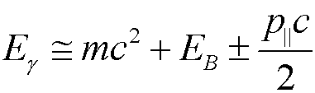
DB Spectroscopy
The change of photon energy by relativistic Doppler effect in the laboratory system
S parameter
ratio of area under the central part of 511 keV line to whole area below this line
defines the participation of e⁺e⁻ pairs with low momentum
higher value means bigger concentration of such defects as vacancies
Notes:
This is the typical spectrum for annihilation line registered by high purity german detector. Two spectra for iron withouth defect and after plastic deformation are shown. Its clear that non-defected samles are much brodened than undefected one. This is caused by hihger propability of annihilation with low energies electron after positron trapping in defects. In this method we use two parameters called S parameter and dabliu parameter. S parameter is define as a numer of below central part of annihilation devided by total number of positron below the annihilation line. It represant positrons which annihilate with low energies positrons and decreace when concentraction of defects being smaller.

Slide 8
Positron Annihilation Spectroscopy
The change of photon energy by relativistic Doppler effect in the laboratory system
W parameter
ratio of area under the wing part of 511 keV line to whole area below this line
defines the participation of e⁺e⁻ pairs with high momentum
together with S parameter gives limited information about kind of defects
Notes:
The second one dabliu parameter is define as the number of positron below the wing part of the spectrum divided by the number of count below the annihilation line. This parametr represent the number of positron which annihilate with high momentum energies and increse with defect concentraction. Together with S parameters its allow to to get informaion about kind of defects and atoms which sorround the anihilation place.

Slide 9
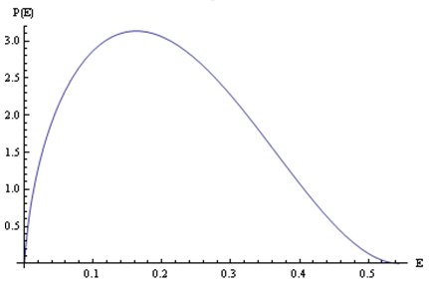
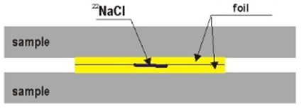
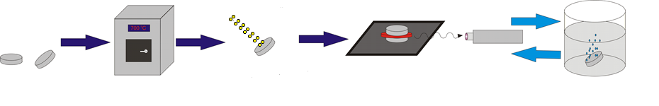
Etching experiment
Notes:
In before experiment we have’t mesure positron lifetime. We don’t dispose the pulsed positron beam which allow to study the positron lifetime in function of positron Energy. However the conventionl positron lifetime spectrosopy also can be used in this case. I remind that in this case the positron energies looks like this one. The positron reach all damaged area and also undefected one. We cannot change here positron Energy, so to look on other region of samples we have to remove a outside layer. We can to it using acids. In our mesurements we have to prepare two samples. All samples are firstly anneald to remove all defect present in samples then all samples was irradiated. Then we mesure positron lifetime, etched samples in acid and mesure it again. In this way we can obtain information about defects in all irradiated areas.

Slide 10
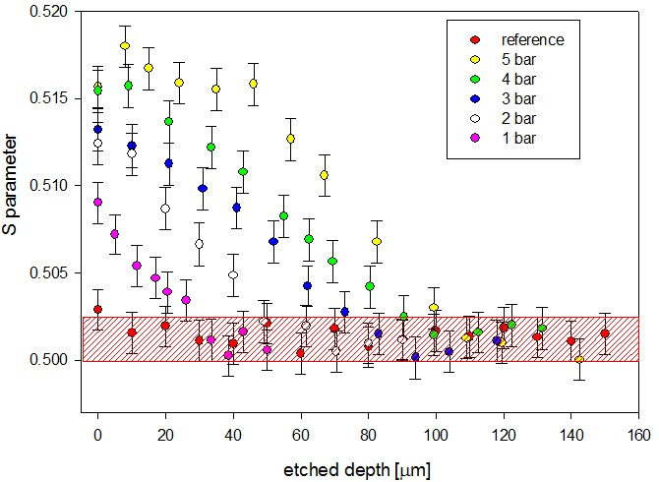
Etching experiment

Slide 11

The conventional pas experiment
HERE EXPERIMENTS WITH SLOW POSITRONS ARE REQUIRED !!
There are some areas i.e. thin layers, ion implantation, semiconductors where the application of conventional PAS experiments is strongly limited
Notes:
Like i said before positron emittes directly from the samples cannot reach precisevly depth becouse such positrons posses different energies. Its not a problem for samples with deformations ranging in dozens of um however when we like observe irradiation defects or the film films we shoul use positron with moderated energies. If we know the positron energies we know how deeply positrons is implanted in the samples.

Slide 12
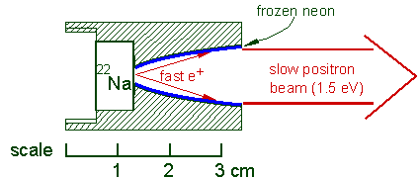
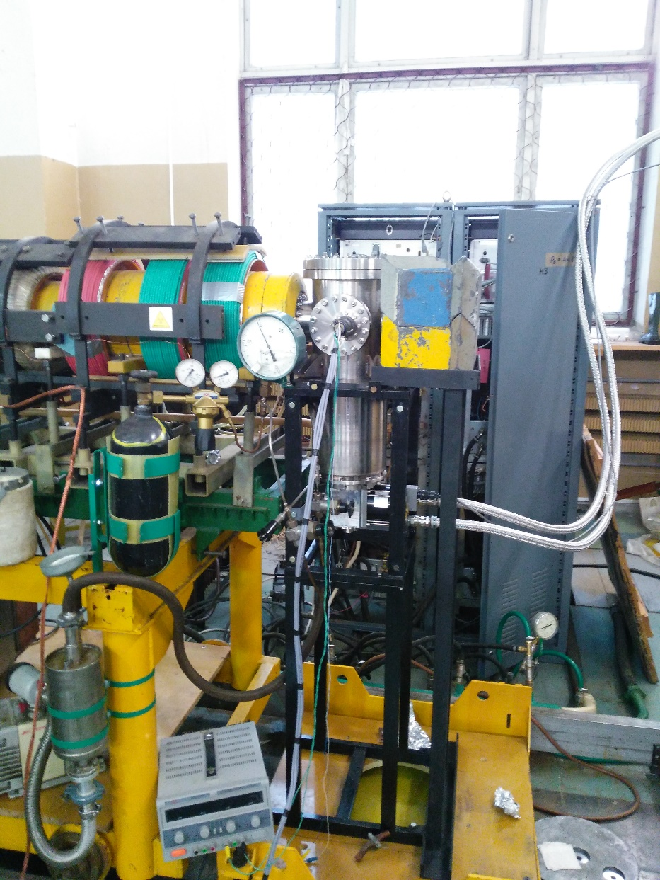
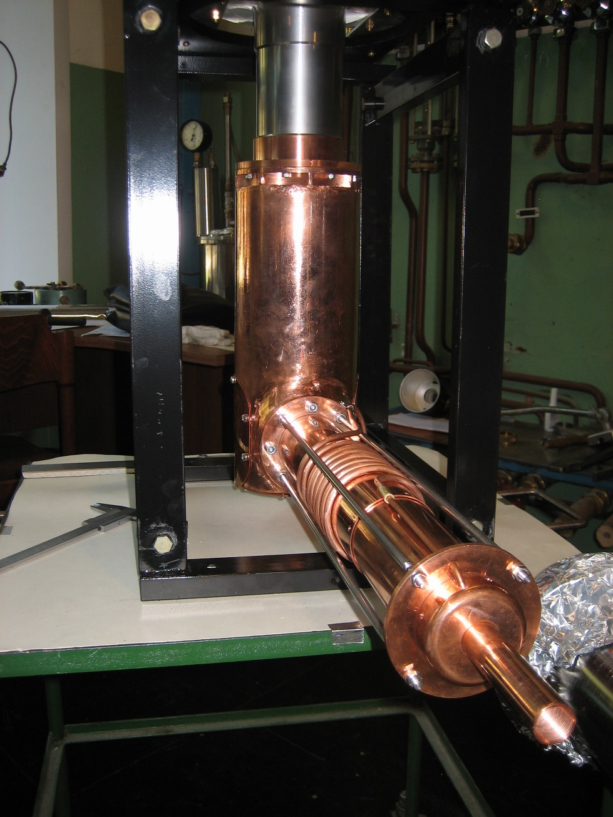
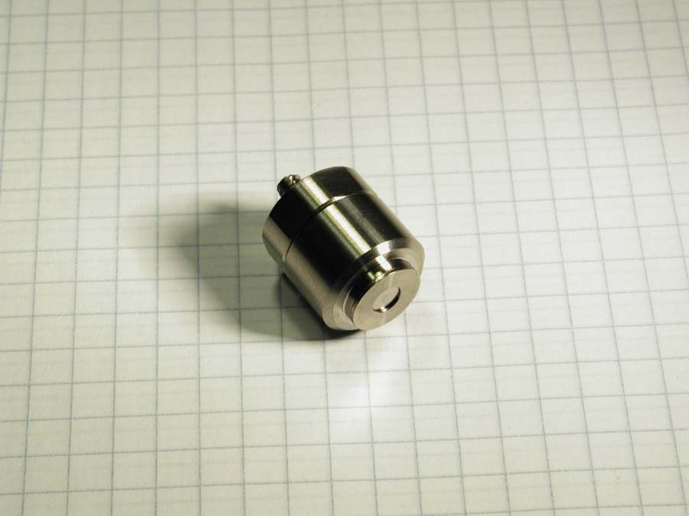
The Variable energy positron beam
from iThemba LABS (RSA)
Notes:
How to produce low Energy positrons? Few ways exist. In our laboratory we moderate poitrons energies emitted from sodium-22 isotope. A Few moderators of positrons exist. in most cases positron beam are obtained using tungstun foils which have negative work out of positrons. Some of positrons can annihilate in such moderators, the other one don’t change energies, but few of them about promil reach ev energies. The last one will be used to construct slow positron beam. In our laboratory we use the most efficient moderetor which is frozen neon. In comparison with tungten it has 10 Times higher moderation efficiency. Our source have high activity about 50 mCi and it was bought from ithemba labs in south africa. It has shape of small capsules. Postrons are emittet through small windowns in the top of this capsules and comes them into chamber on which walls a frozen neon is located. This source is build in high vacuum and finnaly looks like this one.

Slide 13
The Variable energy positron beam
Feature | Value
activity of ²²Na isotope | ~30 mCi
moderator | frozen Ne (7K)
magnetic field | 100 Gs
vacuum conditions | 10⁻⁹ Torr
intensity | ~10⁶ e⁺/s
energy range | 50 eV ÷ 40 keV
diameter of the flux | 5 mm
Notes:
This is a energetic spectrum of positrons after moderation and separation. The positrons have energies around 50 eV which allow move the positrons into ion guide. Here the basic information about positron beam are presented. Currently activity of our source is abuot 30 mCi. Its 1000 higher in comparison with traditional source used in positron lifetime mesurements. In our beam we get aruont 1 mln positron per second which is formed then in flux with diameter around 5 mm. In our experiment we can change the positron energies from 50 ev up to 40 keV

Slide 14
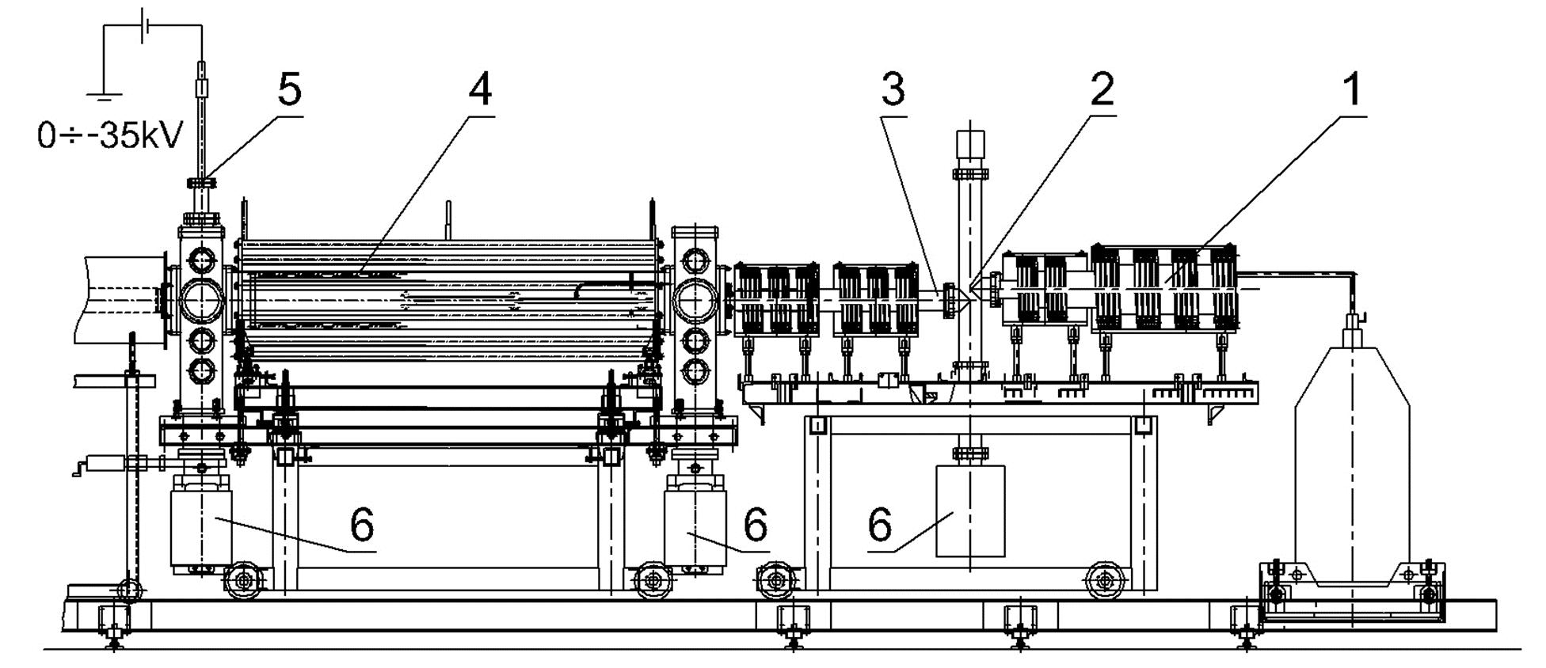
The Variable energy positron beam
Notes:
This is the schemat of positron beam in jinr. The source of positrons are located here. All beam works in high vacuum regime. Like I said before after moderation we have fast and slow positrons in our beam. We have to firstly saparete the slow one. We do this using electromagnetic field and small curve in ion guide. Here the separations occurs. Its hard to change the track of the fast positron so they collide and annihilate in ion guide on courve. Only slow positron remains which are then accelereted using electric field apllied to samples locacaded here.

Slide 15
The Variable energy positron beam
Notes:
In our equpment we can produce the positrons with Energy up to 36 keV. Here we could observe how the positron implanation range change when we change the positron energies. The dependency its not linear and depend on sample material. Maximal energies which could be obtained by us is arond 36 keV. On this plot the we can observe the maximal depth which could be studied by us using slow positron beam. For low density materials like polymers we could study a region of several micrometers, however for steel and typical transistions metlas its only about 1 um.

Slide 16
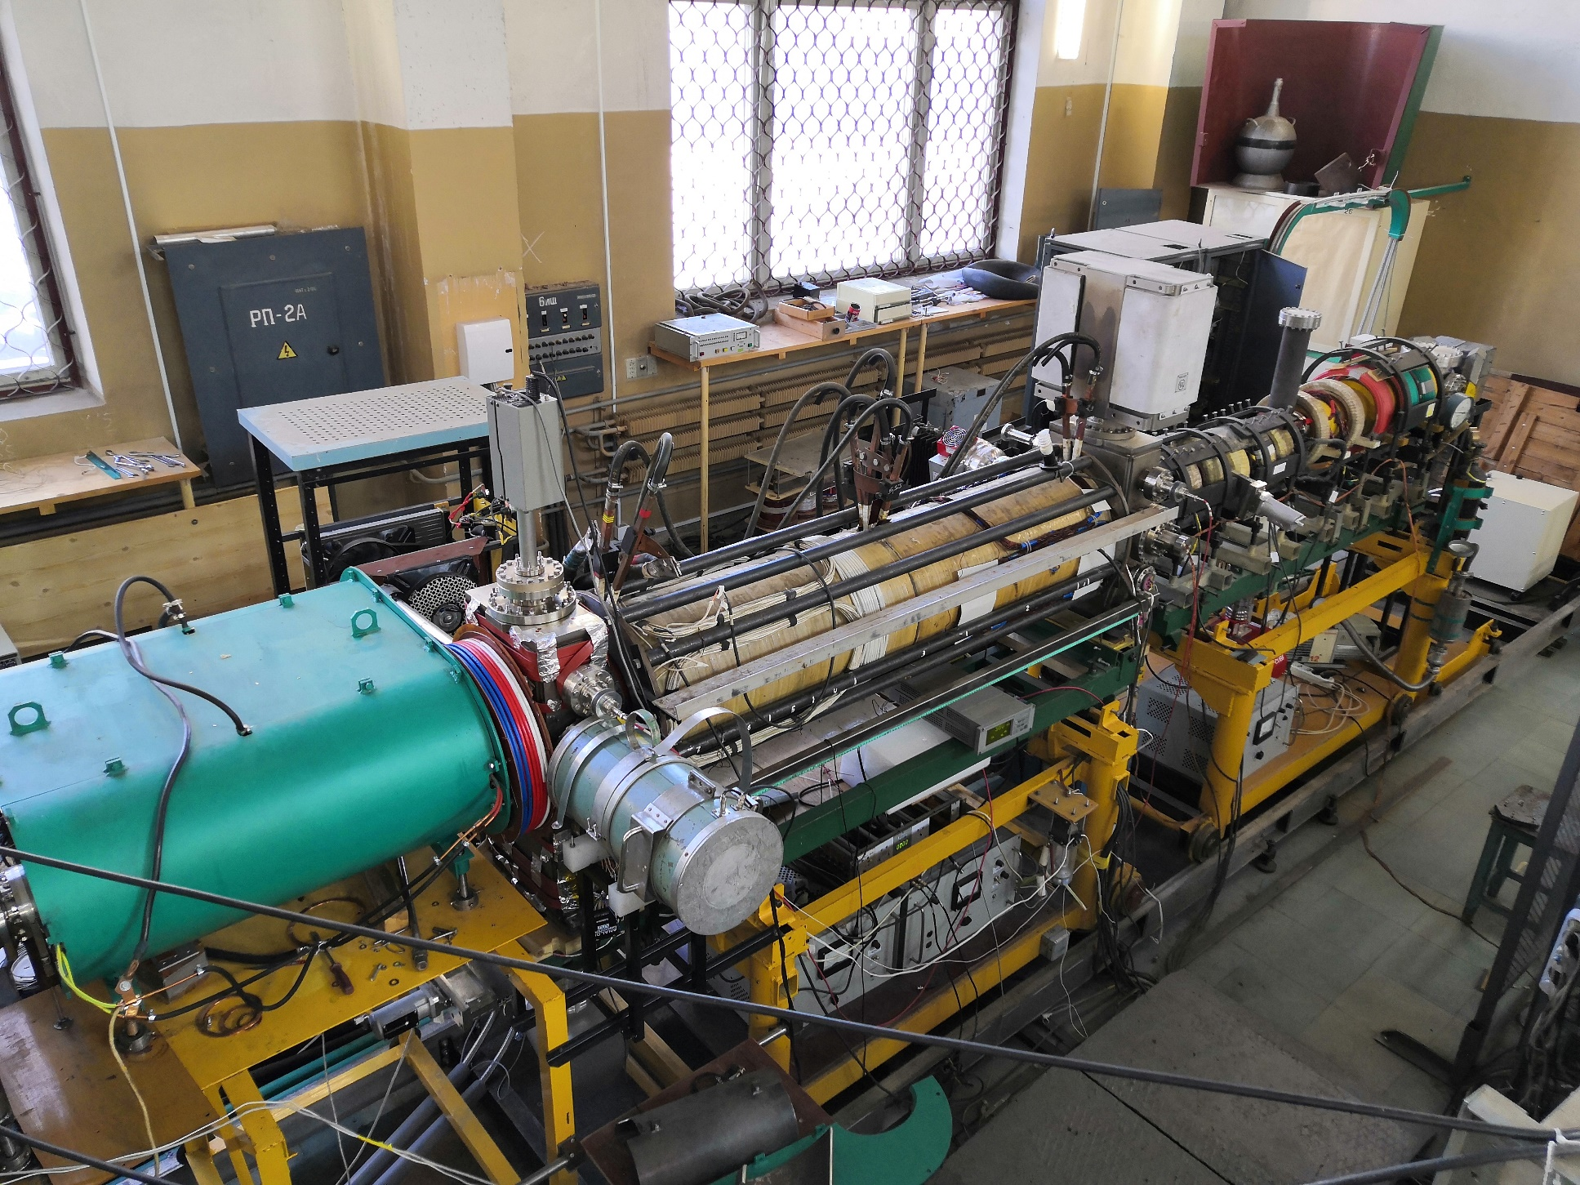
The Variable energy positron beam
Notes:
Our positron beam is used not only for materials studies so we have two channels. This one is predicted for positron material studies. The samples are located inside in this chamber. Mostly we put several samples up to 8 samples in special holder mounted with carbon tape. We change the samples moving holder up or down. The acceleration electric field is put to the holder and allow precisly control positron energy and its implanation depth.

Slide 17
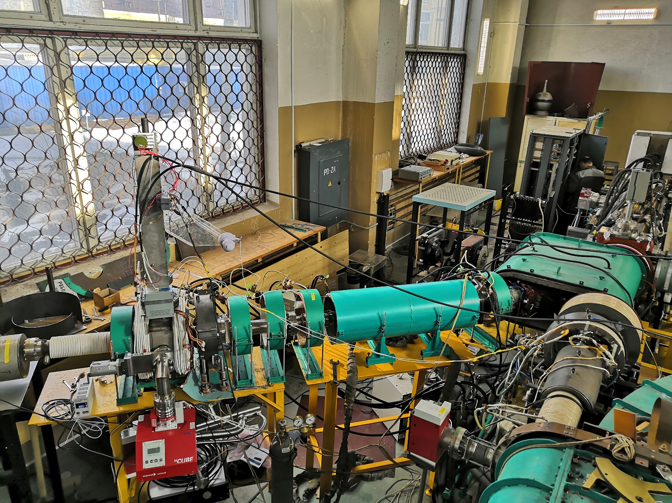
The Variable energy positron beam

Slide 18
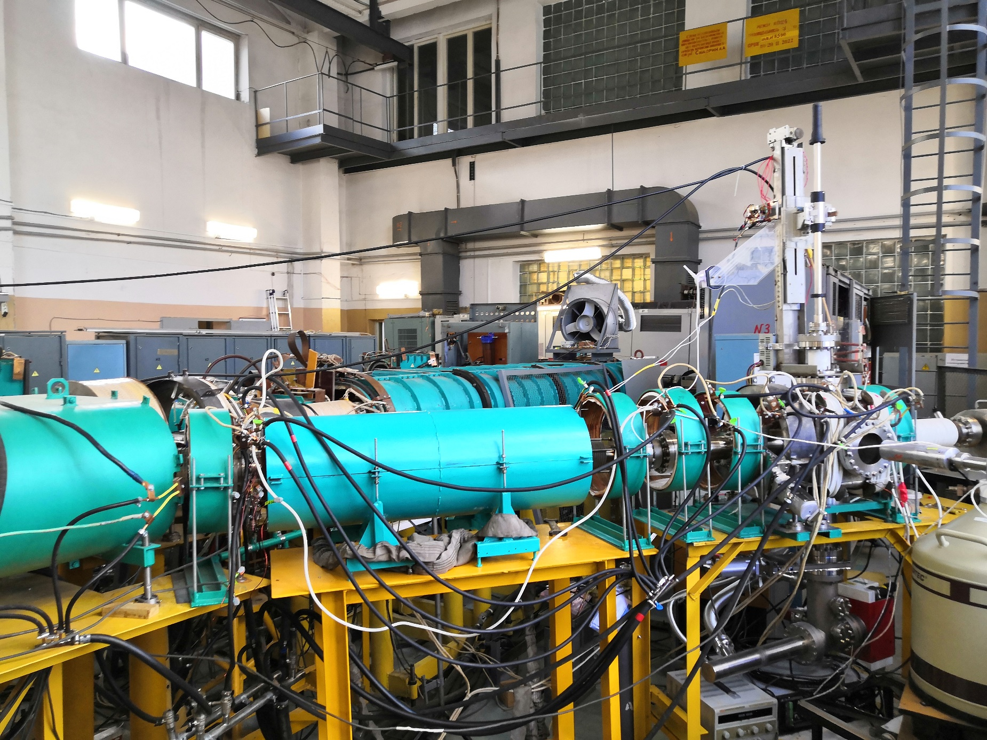
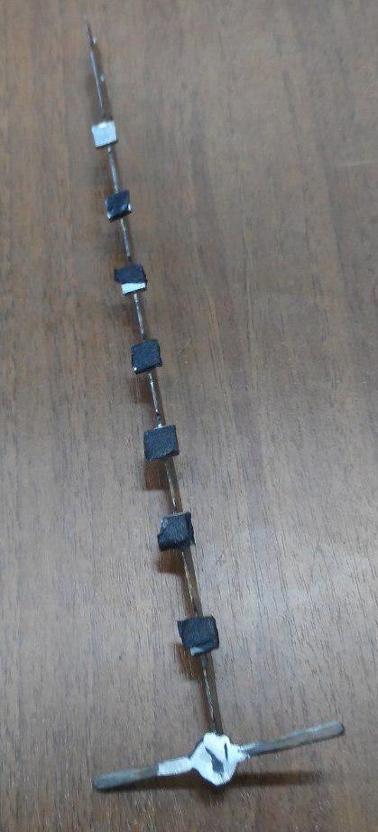
The Variable energy positron beam

Slide 19
Results: Cu
*) P. Horodek et al., Vacuum 138 (2017) 15–21.
Notes:
that S-parameter decrease with positron energies end saturate for high positron energies. But in comparison with previous studies we observe two dissimilarity. The first one is the S- interior value which is not depend on the ion dose. But this value is higher than undefected samples. The major dissimilarity is observed in first region up to 300 nm. We could observe that the Surface value differ for all samples and decrease with ion dose this dissimilarity can be caused by changes in chemical composition of Surface caused by irratiation. It is well known that during the irradiation the defects are produced however in some cases this defect cause fast oxidation of Surface. In current mesurements we observe that higher on dose induce oxidation of copper surfase. The S-W plot can be assumed as straight line which means that similar type of defects are produced in whole studied region.

Slide 20
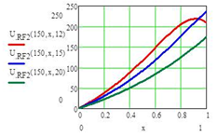
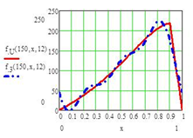
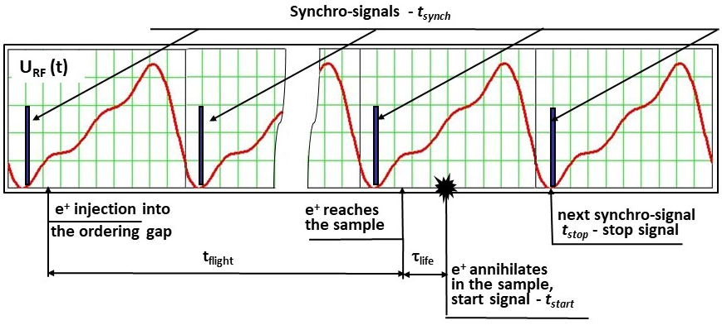
PALS Spectroscopy with beam
Function U_{RF}(t), T₀ = 10 ns (100 MHz), the positron energy E₀ = 150 eV and L_{A} = 20, 15, 12 cm (curves from the top to the bottom); x = t/T₀
The voltage pulse (V) in the accelerating gap of the RF system for the original form (solid curve) and composed with to the first three harmonics (dashed curve).

Slide 21
PALS Spectroscopy with beam

Slide 22
PALS Spectroscopy with beam

Slide 23
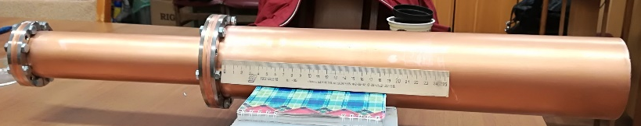
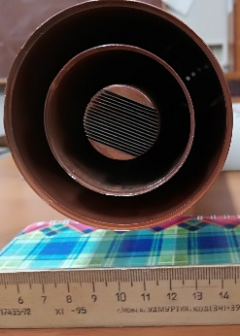
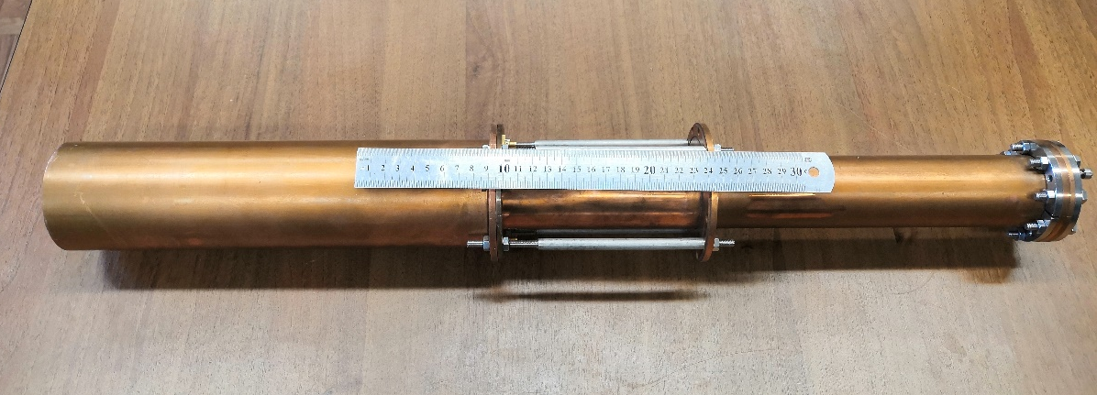
PALS Spectroscopy with beam

Slide 24
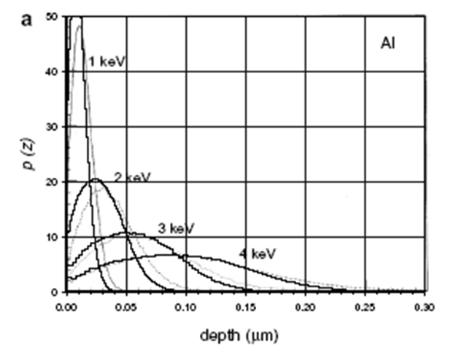
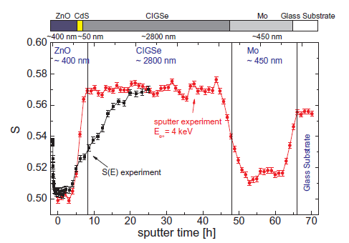
ION ETCHING SYSTEM
Makhov profile

Slide 25
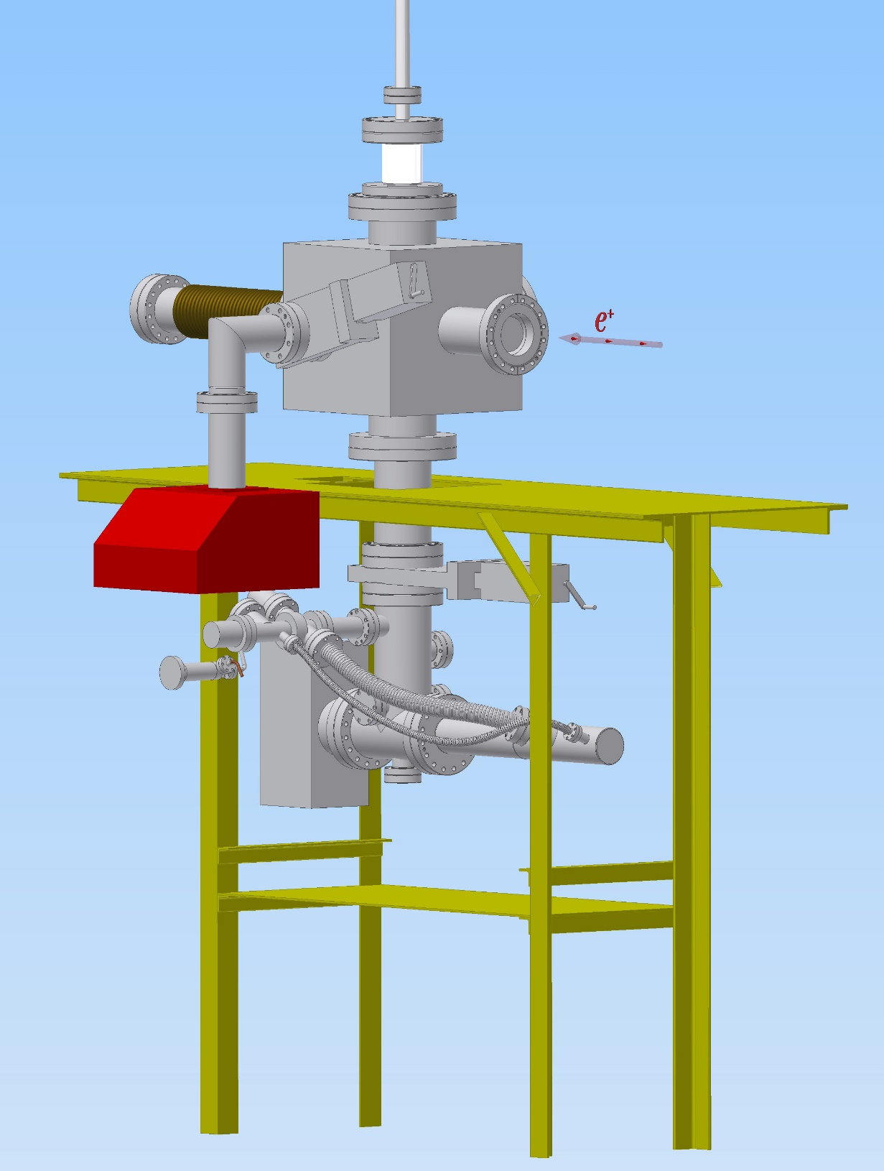
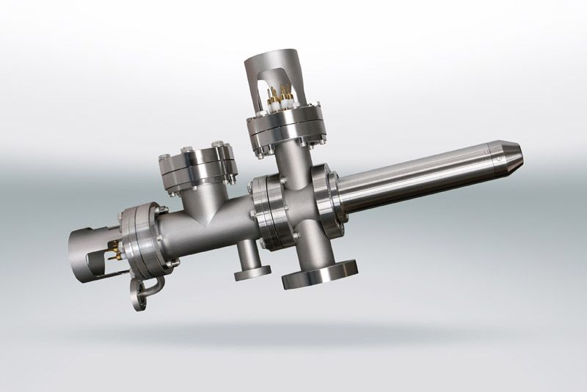
ION ETCHING SYSTEM
Technical data
Energy range | 0.15 keV - 5 keV
Gases | Ar and reactive gases (O₂, H₂ hydrocarbons with reduced lifetime)
Scan area | 10 mm x 10 mm
Current density | up to 4 mA / cm²
Beam current | > 1 μA
Working pressure | 10⁻⁸ mbar (with max beam current)

Slide 26
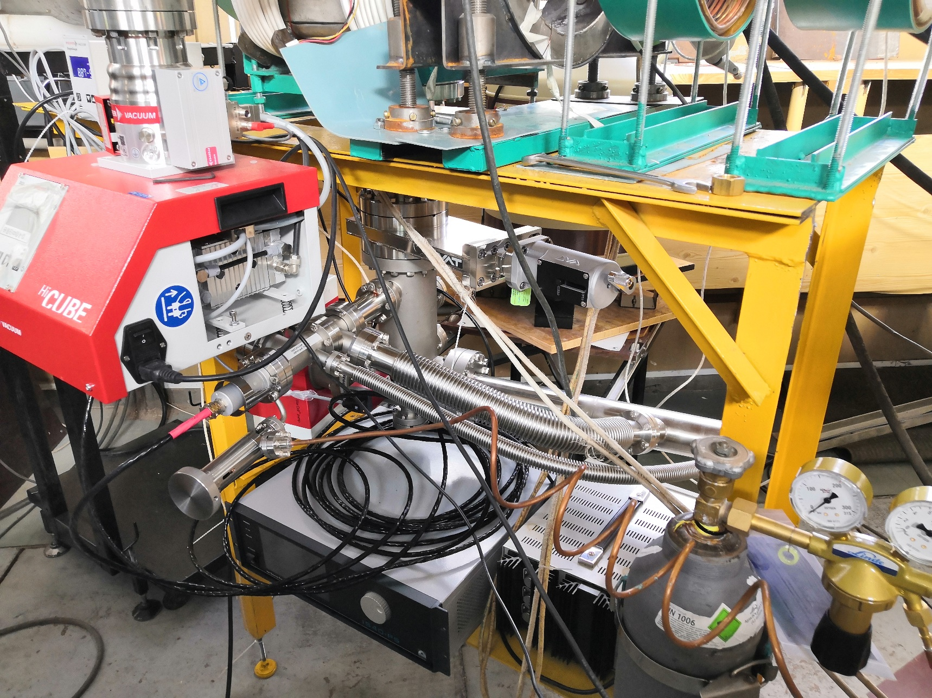
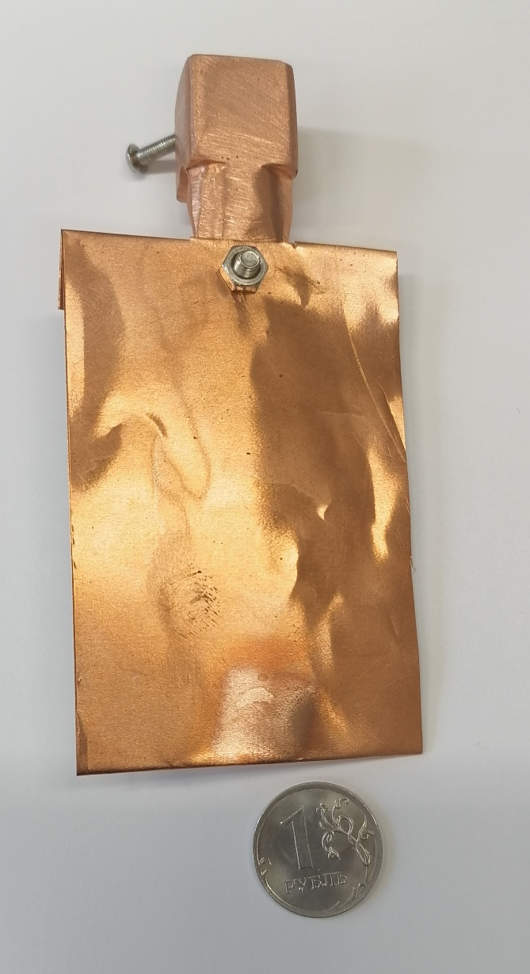
ION ETCHING SYSTEM

Slide 27
Cooperations:
Studies of materials for usage in IV type nuclear reactors
Institute of Nuclear Physics PAS, Kracow, Poland
Institute of Radiation Problems NAS, Baku, Azerbaijan
Institute for Nuclear Research and Nuclear Energy, Sofia, Bulgaria
University of Szczecin, Poland
JINR, FLNR
Belarusian State University, Belarus
Sumy State University, Ukraine
Studies on high irradiation resistivity materials, surface nanostructurization – thin layers of Zr/Nb
PTU Tomsk, Russia
Surface modification by ion implanatation in semiconductors and MOS structures
UMCS Lublin, Poland
CNT Hochiminh, Vietnam
Institute of Physics, VAST, Hanoi, Vietnam

Slide 28
Cooperations:
Surface modification of zeolite ZSM-5 by irradiation
CNT Hochiminh, Vietnam
Study of defects in optical materials - LiGaSe_{2 ,} bromides and chlorides APb₂C₅ type, where A=K or Rb, and C=Cl or Br
IGM SB RAS and NSU, Novosibirsk, Russia
JINR, FLNP
Study of destruction proces – cavitation, wear, corrosion
Institute of Nuclear Physics PAS, Kracow, Poland
Northern Arctic Federal University, Arkhangelsk, Russia
The role of defects in magnetic properties in nanopwoders -BaTiO₃ – VSU, Voronezh, Russia
Mechanical modification of materials – sandblasting, hydrostatic extrusion, surface modification attrition techniques
Institute of Nuclear Physics PAS, Kracow, Poland
UE, Kracow, Poland
AGH University, Kracow, Poland
Rzeszów University of Technology, Poland

Slide 29
Nearest plans
Doppler Coincidence Spectroscopy
- coincident detection of
second annihilation γ reduces background
- use of a second Ge detector improves energy resolution of system

Slide 30
Nearest plans
Исследования методами ПАС
Отработка методики ионного травления
Завершение создания спектрометра PALS

Slide 31
Спасибо за внимание!

