Slide 1
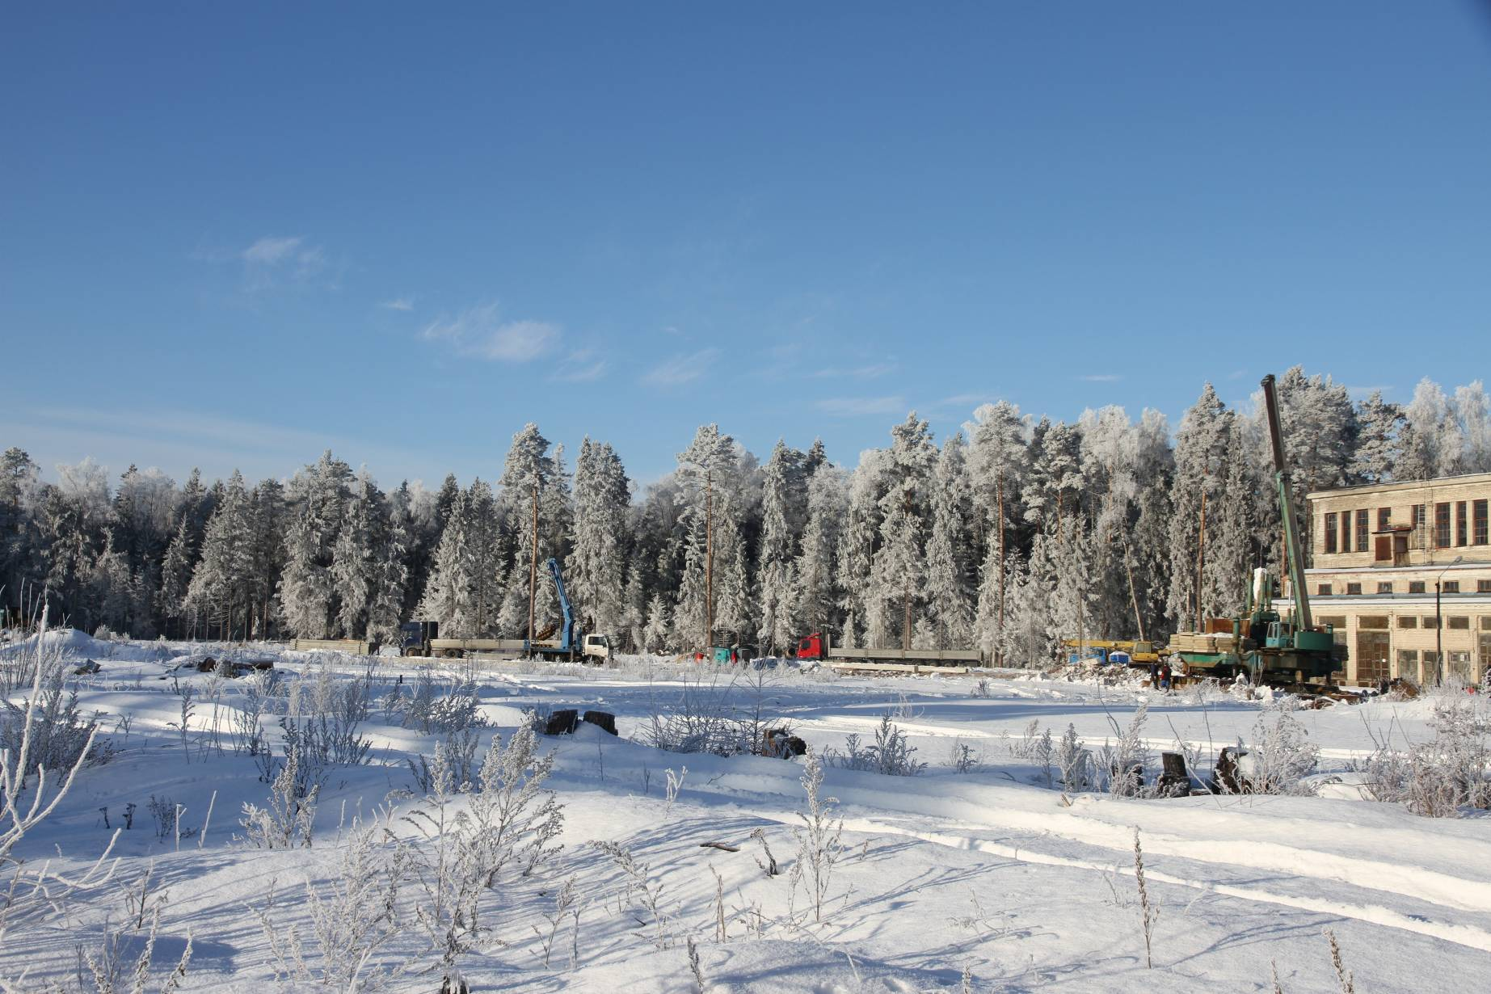
NICA project at JINR, Dubna:
Perspectives for applied research
G.Trubnikov
for the NICA team

Slide 2
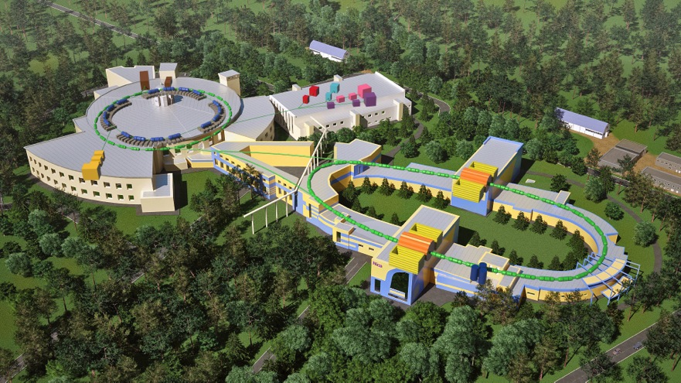
NICA is aimed at generation of intense heavy ion and polarized nuclear beams for searching the baryonic matter of a high density at high (comparatively) temperature and investigation of polarization phenomena.
NICA Collider parameters:
√s_{NN} = 4-11 GeV heavy ion beams @ luminosity L~10²⁷ cm⁻² c⁻¹ (Au), and polarized p↑ (d↑) of √s_{NN} up to 26 (13) GeV at L ~ 10³² cm⁻² c⁻¹

Slide 3

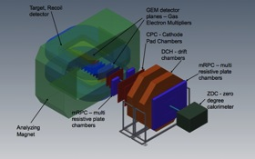
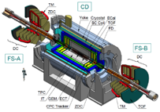
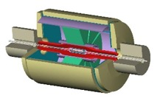
NICA facility
In operation Under construction
Fixed target experiments
Nuclotron 0.6-4.5 GeV/u
Linac LU-20 (5 MeV/u)
BM@N
MPD
SPD

Slide 4
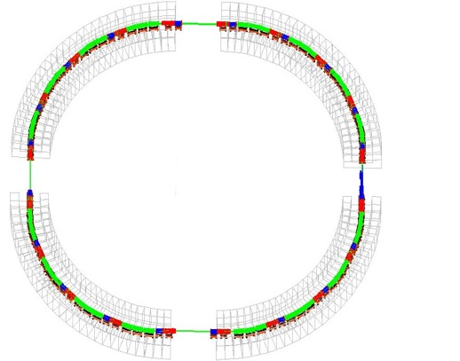
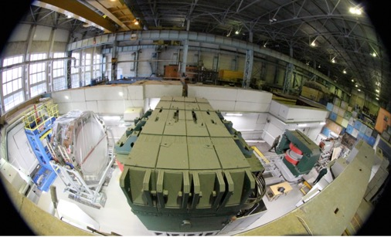
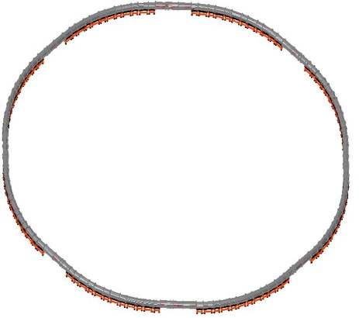
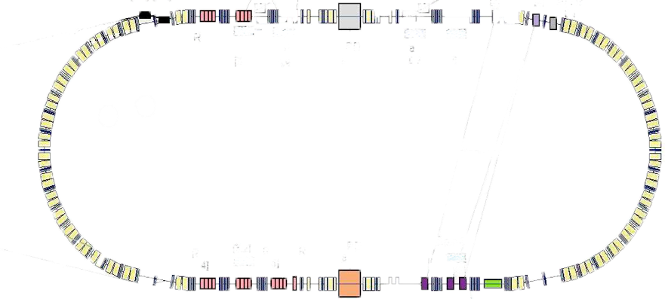
NICA @ Heavy Ion mode
Linac HILac (3.2MeV/u)
ESIS KRION
Booster (25 Tm)
1(2-3) single-turn injection,
storage of (2 ÷ 4)×10⁹ ions,
acceleration up to 100 MeV/u,
electron cooling, acceleration
up to 600 MeV/u
Linac LU-20 (5MeV/u)
Ion sources
Fixed Target Area
Stripping (80%) ¹⁹⁷Au³¹⁺ => ¹⁹⁷Au⁷⁹⁺
Nuclotron (45 Tm)
injection of one bunch
of ≤ 2×10⁹ ions,
acceleration up to
1 - 4.5 GeV/u max.
Two SC rings of the collider
L ≥ 10²⁷ см⁻²с⁻¹
~ 2 x 22 injection cycles
22 bunches per ring

Slide 5
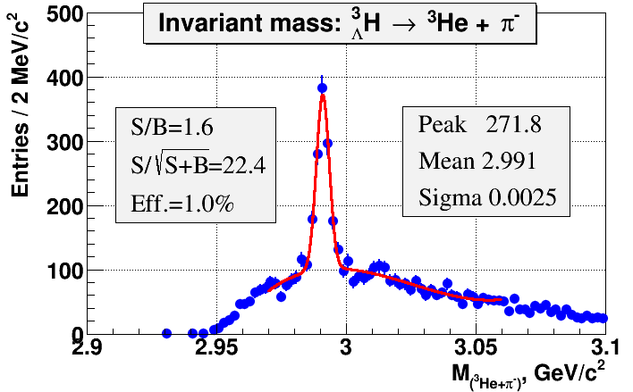
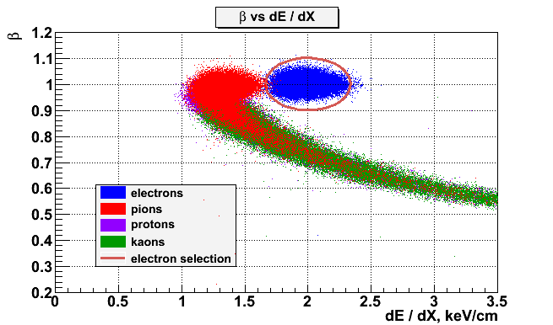
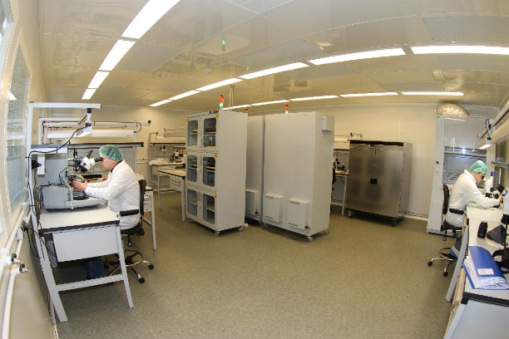
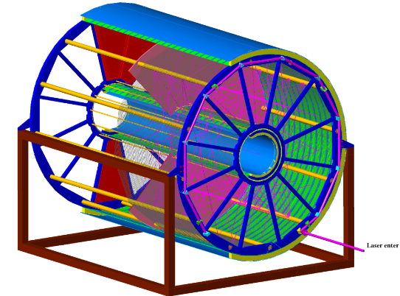
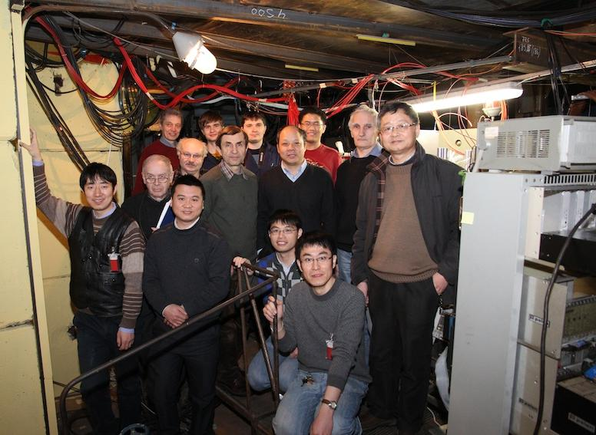
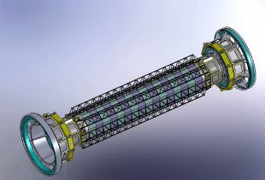
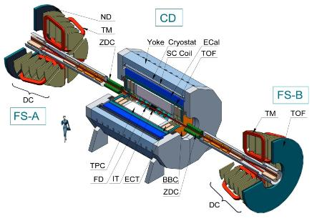
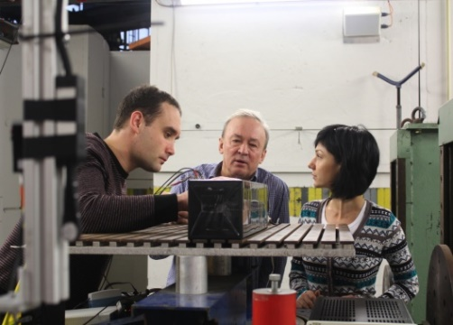
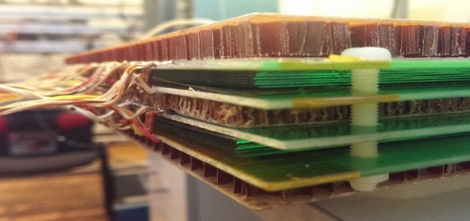
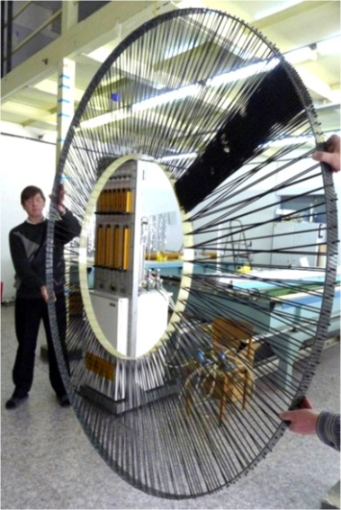
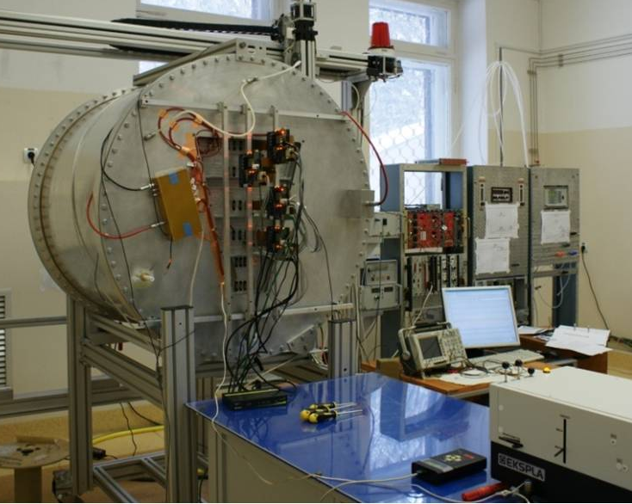
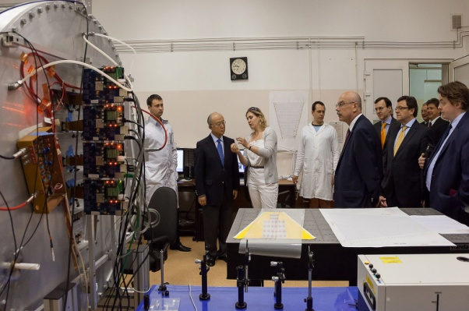
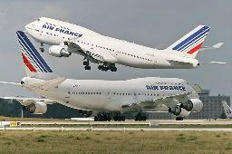
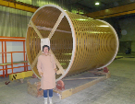
NICA MPD: status of construction
Microstrip detectors (SiT)
Time of Flight system (TOF)
FF: 38 ps, mPRC: 63 ps
EM calorimeter: Energy resolution = 2.5% / √E
MPD: Multipurpose Detector
Time Projection Chamber
Straw Detector
TPC Detector

Slide 6
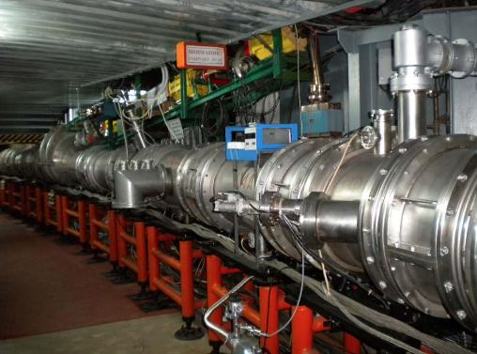
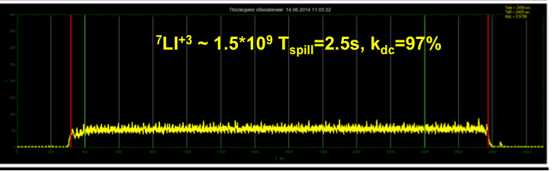
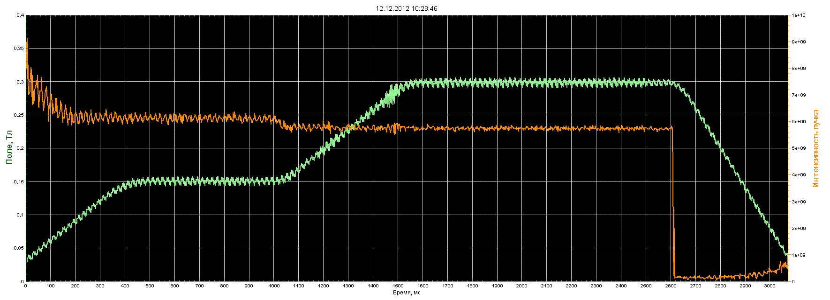
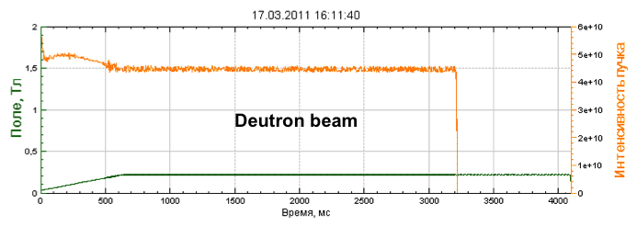
Nuclotron for the Nuclotron based Ion Collider fAcility
Ion beams for fixed target: p, d, Li, C, Ar, Fe, … Xe
Nuclotron – 4.5 AGeV, 251 m.
superconducting synchrotron.
Commissioned in 1993,
Upgraded in 2011.
Adiabatic debunching and recapture at efficiency of about 95% was demonstrated

Slide 7
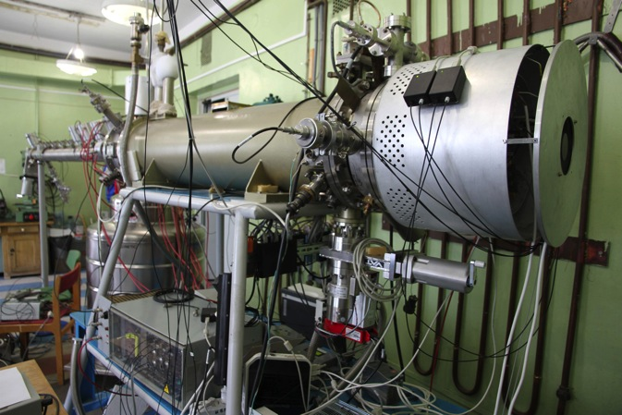
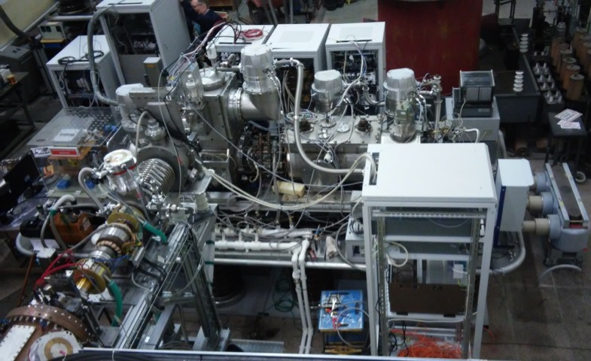
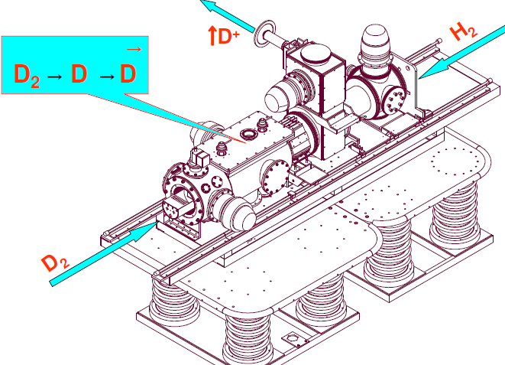
Ion sources
JINR Krion-6T (ESIS) for NICA
B = 6 (5.4) T
Ee = 25 (15) keV
J_el (design) = 1000 A/cm²
Au³⁰⁺³²⁺ achieved 6*10⁸ ppp, (1*10⁹)
Peak currect = 10 mA/pulse
t_{ion} = 20 ms @ 50 (100) Hz.
Ion of Au⁵¹⁺÷ Au⁵⁴⁺ generated
Polarized particle (p, d, He³) source
up to 10¹⁰ p/pulse, 80% polarization

Slide 8
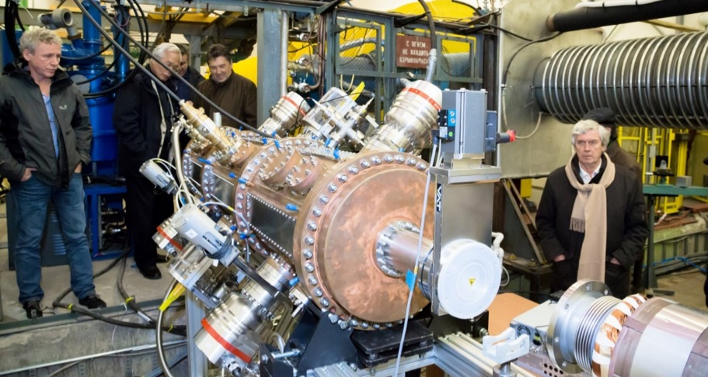
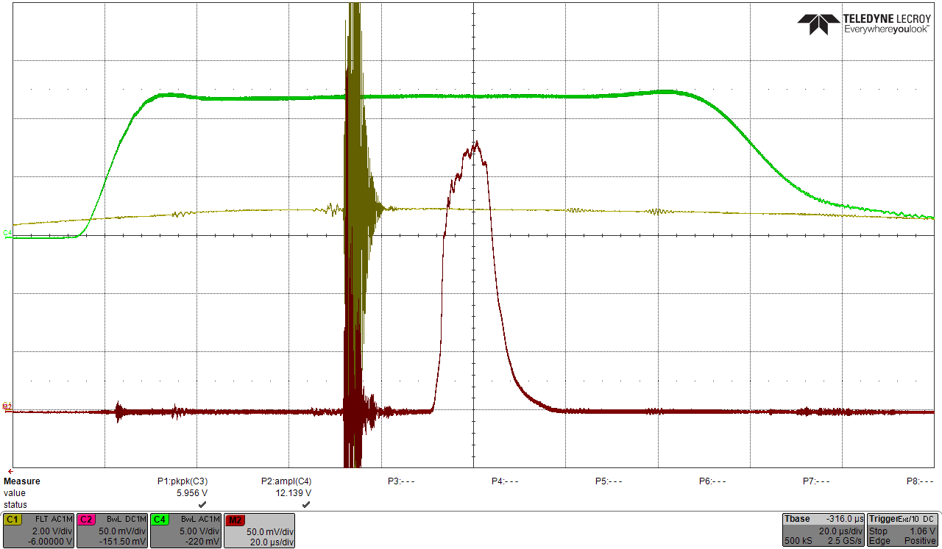
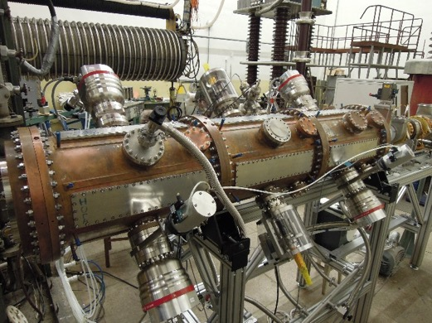
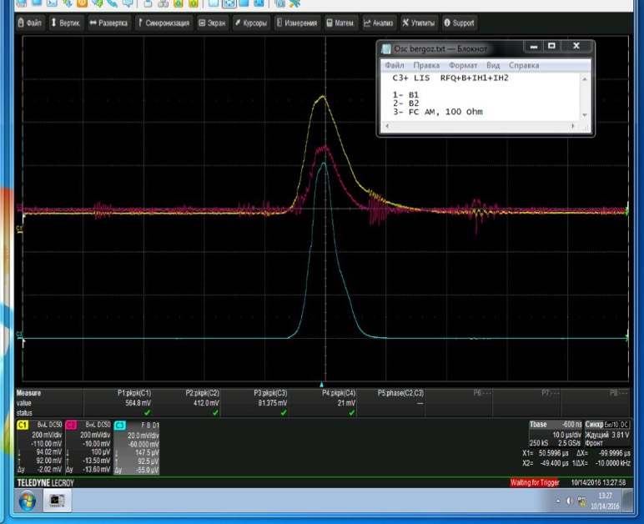
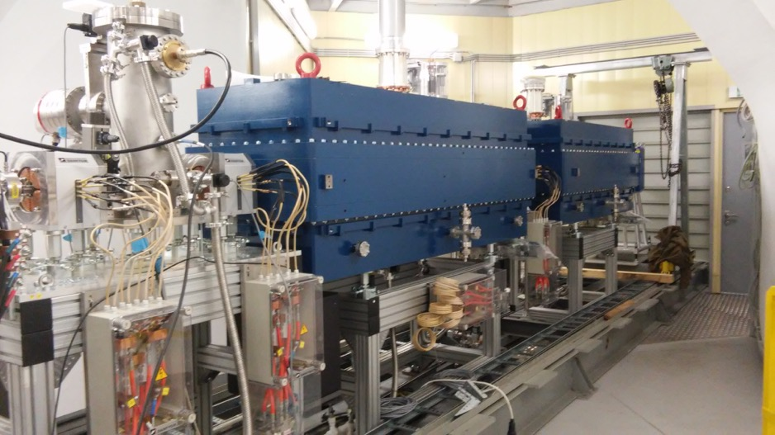
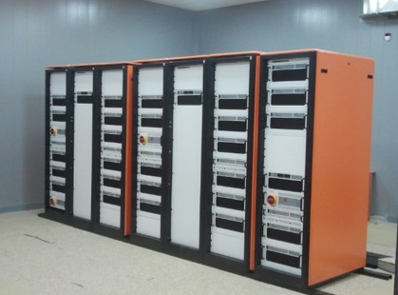
Injection complex: FI RFQ linac (160 keV)
RFQ resonator. Production started in 2013 (ITEP, MEPHI, VNIITP Snezhinsk)
JINR-ITEP-MEPhI-Snezhinsk
d ~10 mA, C⁴⁺ ~5 mA
NICA Heavy ion injector
(HILac) 3.2AMeV (p..U)
RFQ + 2 RFQ DTL sections
IAP, BEVATECH, JINR, ITEP

Slide 9
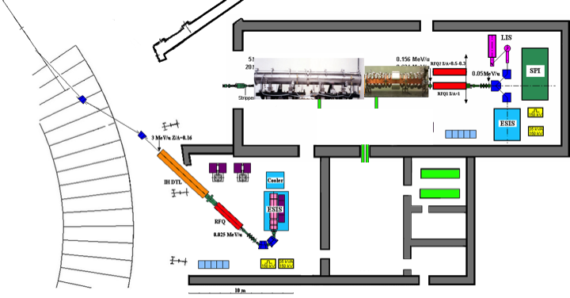
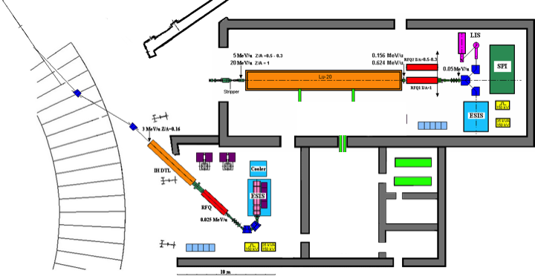
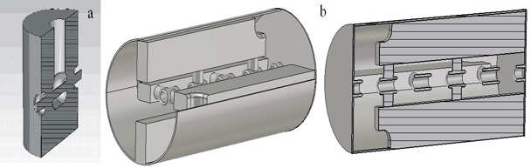
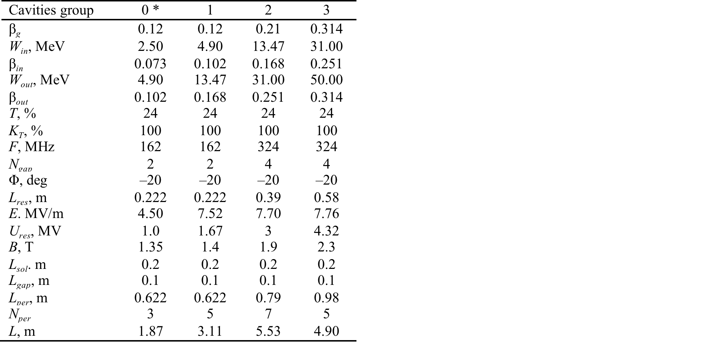
Development of new injector @ VBLHEP JINR
162.5 MHz
325 MHz
←1-1.5 m →
← 1.5-2 m →
←3 m →
←1.8 m →
←3.1 m →
←5.5 + 4.9 m →
Source
LEBT
RFQ (FI)
RFQ
QWR
QWR
CH/HWR: 2 gr.
~60 keV
160 keV
2.5 MeV
4.9 MeV
13.5 MeV
31/50) MeV
The ion beam motion stability analysis show that with the slipping factor about 17.5% the new SC linac will consists of four groups of cavities having geometrical velocities of β_{g}=0.07, 0.141, 0.225 and 0.314. First two groups of cavities should be two-gap QWR’s and the other – four-gap CH-cavities or Spoke-cavities. The total length of the linac was reduced from 17.8 to 15.5 m and the number of cavities was also reduced from 32 to 28.

Slide 10
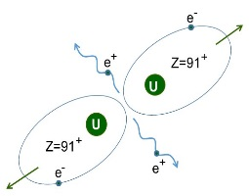
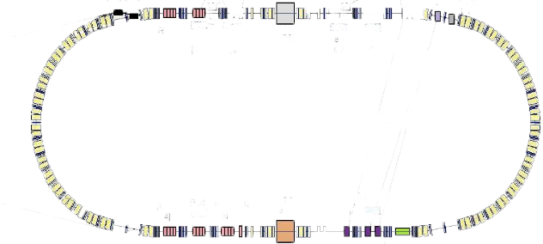
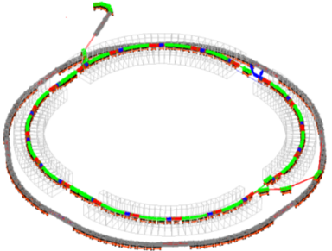
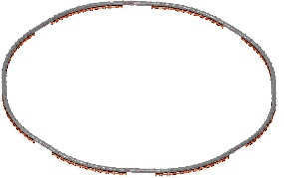
“Collector ring”,
C~150-200m
SC proton-linac (~10MV/m)
Radioactive
ions
e- beam
SC linac,
1 GeV, ~ 30m
Target
Fragment-
Separator
(~30m)
Merging ⁹²⁺U²³⁵ beams
E~ 0,6 GeV/u
~ 11 Tm ring

Slide 11
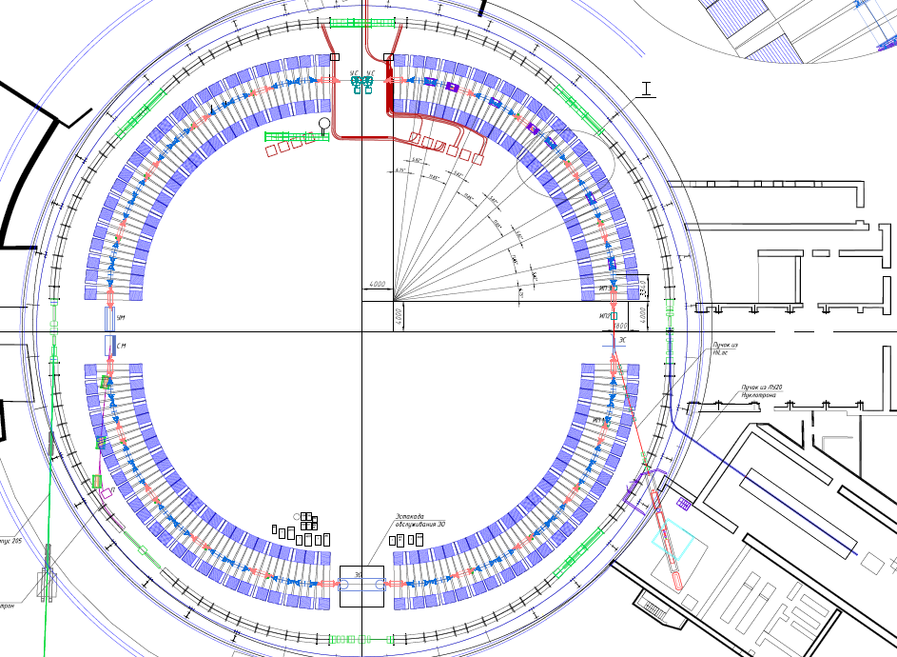
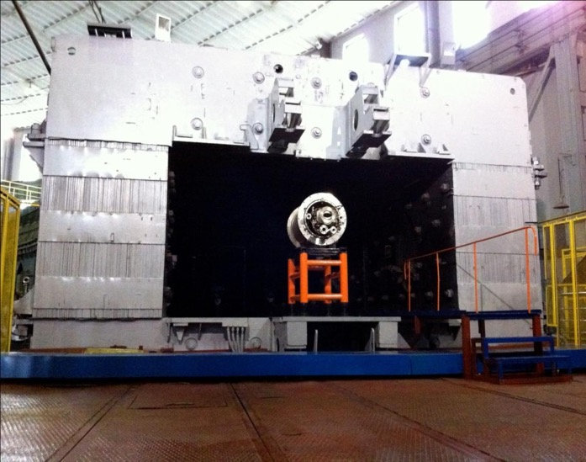
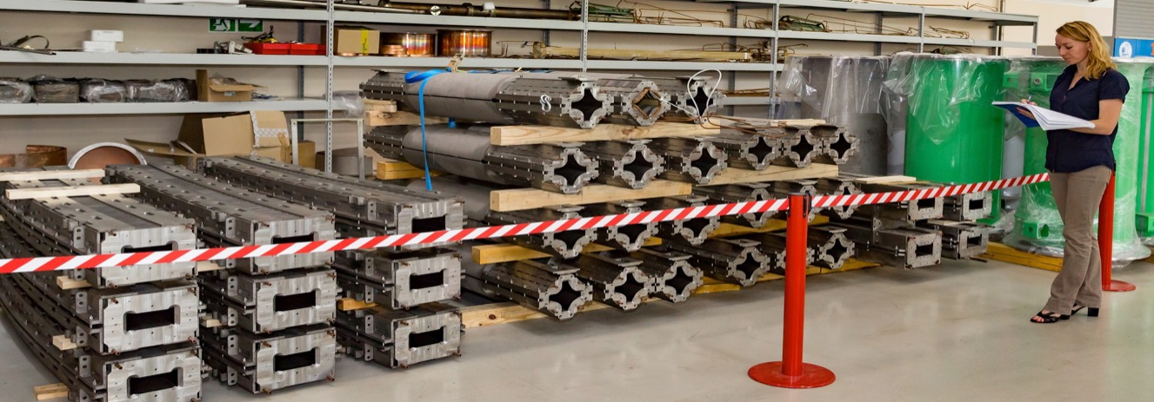
NICA Booster synchrotron
Prototype of the Booster dipole
2.3 m
4.0 m

Slide 12
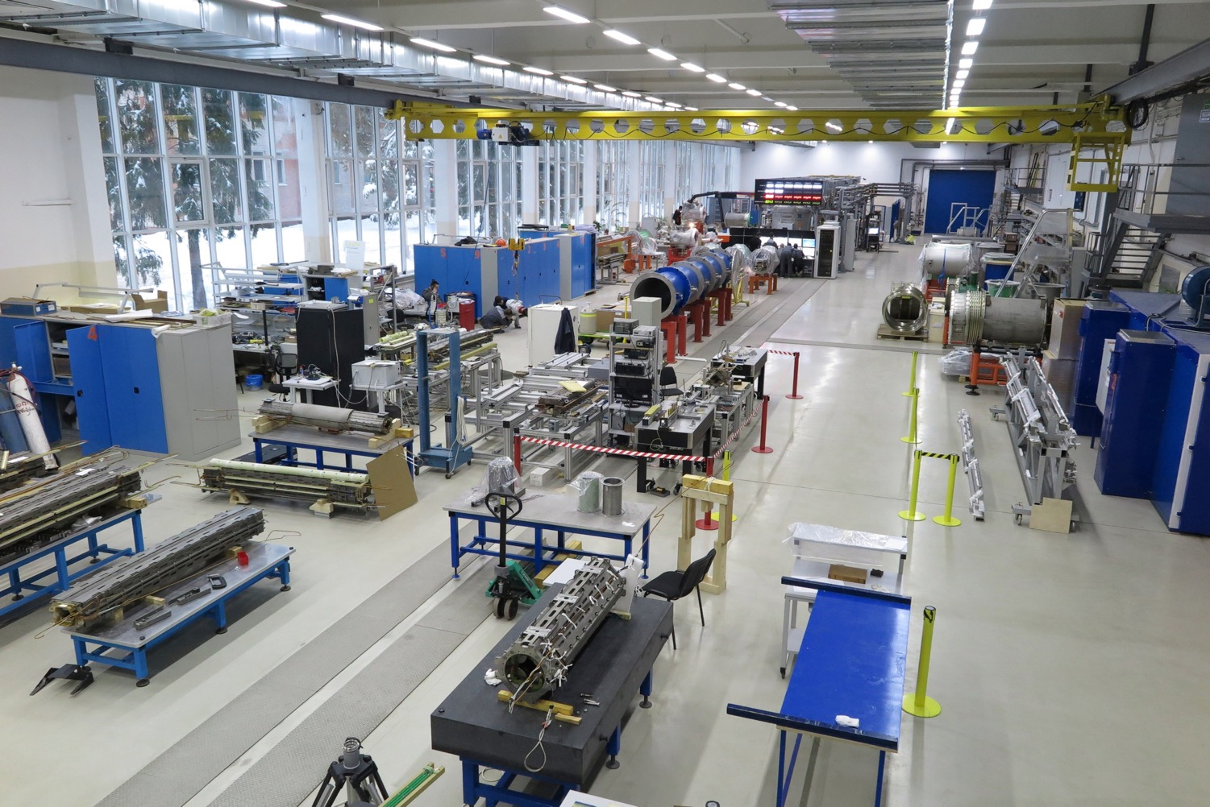
Test Facility for SC magnets : excellent collaboration of NICA and GSI/FAIR.
Start of operation – December’14. Full scale (6 arms) – since 28 Nov. 2016

Slide 13
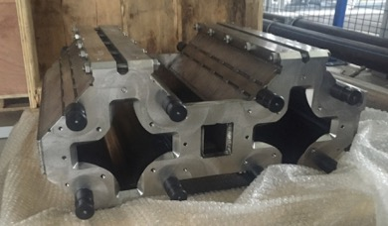
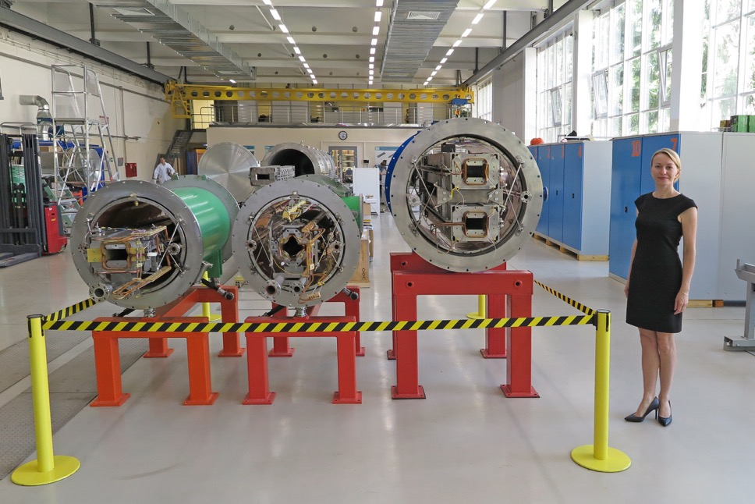

NICA collider magnets
Double-aperture SC Magnets for the NICA collider:
80 + 8 Dipole Magnets
86 + 12 Quadrupole Lenses
88 Corrector Magnets
Start of serial production and cryogenic tests of the magnets is scheduled for 2017.

Slide 14

The NICA Collider: two of 503 m superconducting rings in the common cryostat system,
separated vertically by 32 cm
Collider lattice:
FODO,
12 cells x 90⁰
each arc
Number of bunches | 22
rms bunch length, m | 0.6
β-function in IP, m | 0.35
Kin. energy of Au⁷⁹⁺, GeV/u | 1.0 | 3.0 | 4.5
Number of ions per bunch | 2.0·10⁸ | 2.4·10⁹ | 2.3·10⁹
Δp/p_{rms}, 10⁻³ | 0.55 | 1.15 | 1.5
ε_{rms}, (h/v) π mm·mrad | 1.1/0.95 | 1.1/0.85 | 1.1/0.75
Luminosity, cm⁻² s⁻¹ | 0.6·10²⁵ | 1·10²⁷ | 1·10²⁷
IBS growth time, s | 160 | 460 | 1800
Electron cooling & stochastic cooling

Slide 15


Slide 16
















International mega-project NICA
~ 70 Russian Institutions and Universities + 26 Organizations abroad RF
МИФИ, МЭИ, МФТИ, КГТУ, СПбГУ,...
NRC KI IHEP, Protvino: RFQ,beam dynamics, Feed-back systems
Budker INP SB RAS, Novosibirsk
NRC KI ITEP: Beam dynamics
RFQ linac
FZ Juelich (IKP)
HV Electron cooler
Stoch. cooling
INR RAS, Troitsk polarised source,
Linacs, beam diagnostics
South Africa Republic:
DST, iThemba, NECSA,
Universities: Capetown, Stallenbosch, etc
others (Theory, cryostats, ion source, cryogenics
CERN
SC technologies, Rad.safety, energetics, beam cooling and dynamics
FNAL:
HV Electron cooler
Beam dynamics,Stoch.cooling
GSI/FAIR
SC dipoles for Booster/SIS-100
beam cooling, diagnostics
BNL (RHIC)
Beam dynamics,
Stoch. Cooling
Rosatom: Sarov, Snezhinsk, Lesnoy
Rostex: Savelovo, etc

Slide 17

Status of the NICA mega-science @ JINR
On 27th April 2016 the RG Prime-minister issued the Governmental Decree about establishment of the NICA mega-science on Russian territory at JINR.
Russia and JINR co-invest to the“NICA Complex.
Agreement between RF Government and JINR (signed on 2nd June 2016) in the frame of Decree formulates basic principles of the setting and development of the International collaboration “Complex NICA.
We assume that in coming years similar Agreements will be prepared, agreed and signed with other countries and International Scientific centers, expressed their interest to participate and contribute to NICA.
We invite new countries to join NICA (Germany, China, India, SAR, …) and leading International centers (CERN, FAIR, … ), also Universities.

Slide 18
Applied research program at NICA
Area - 1 Low energy beams Injector (< 5 MeV/u) | Area - 2 Medium energy beams Booster (< 600 MeV/u) | Area - 3 High energy beams Nuclotron (< 4.5 GeV/u)
Research in field of nanotechnologies | Possibility to have cooled ion beam study of radiation damages in microelectronics; radiobiology for space new materials; R&D for elements and prototypes of the carbon beam therapy center | Possibility to have cooled ion beam study of radiation damages in microelectronics; radiobiology for space Relativistic nuclear energetics. Utilization of radioactive waste; Remote control and monitoring of the fission substances
Notes:
Новые экспериментальные зоны и установки для проведения инновационных исследований.
Решение этой задачи обеспечивает возможность выполнения прикладных программ в основных направлениях инновационного развития России, а именно:
энергоэффективность и энергосбережение; ядерные технологии; космические технологии; биологические и медицинские технологии; стратегические информационные технологии.

Slide 19





Nanotechnologies and material irradiation study at NICA. Energy range 10 keV/u – 5 Mev/u
Superconducting heavy ion source KRION-6T
Construction of periodical nanostructures (holes 5×5 nm), nanodiodes, etc using methodics of the Coulomb “explosion” when bombarding the surface with heavy ions (i.e. Xe44+) of 10 kEv energy.
«Delivery» of multicharged ions to the cell regions with accuracy up to 100 nm.
New heavy ion LINAC (<3.2 MeV/u) at assembly

Slide 20






Cooperation in NICA mega-projects
High temperature superconducting current leads obtained for the NICA project from China ASIPP and from NRC KI (Moscow).
Unique hollow superconducting cable (Nuclotron type: JINR know-how) technology is implemented now for Chineese megaproject EAST and ASIPP contribution to ITER.
2m
Nuclotron-type SC cable
(jointly patented with Germany)
New generation of HTSC ceramics,
assembly technologies, devices (<300A)
6 kA HTSC (77K)
current leads for
accelerator Nuclotron
12 kA HTS current leads at mounting on JINR’s test facility
17 kA HTS current leads made by NRC KI

Slide 21




Superconducting technologies (Т=4.5 К, Т=77К)
R&D and construction of high-temperature superconducting current leads (HTSC @ 77К), conductors and elements. (20кА х 200 V = 4 МW).
Power saving factor of ~ 20-30
R&D, serial production of compact fast-cycling superconducting (5 Hz, 4-8 T/s) magnets (dipoles, quadrupoles, multipoles). Compactification with factor
of ~2-3 in geometrical sizes in comparison to “warm” magnets.

Slide 22
SC magnets
Energy-saving, for proton and carbon ions
(Еnergy from 200 to 600 МeV/u) – synchrotrons for beam therapy
Systems of carbon-beam GANTRY and beam transportation channels
Weight of HIT GANTRY - 600 tons,
size: 19 х 12 meters
Weight of the GANTRY (JINR design): 40 tons, size: 8,5х7 m

Slide 23





R&D in physics of low temperatures (down to 4К)
Liquid Helium tank (40m³)
NICA cryogenics complex: 8 кW @ 4К.
The most powerful in Europe
Screw compressors 110/30 (1.2 МW)
Turbodetanders (180 000 turns/min)
Notes:
Очевидны перспективы исследований в области низких температур. Потребителями жидкого гелия являются медицина, ракетная техника,
полупроводниковая и оптическая промышленность, наука, атомная энергетика и другие. В ОИЯИ для комплекса НИКА создан и развивается самый мощный
по производительности гелиевый ожижитель в Европе. Который используется в качестве тестового полигона отечественной промышленностью например
для разработки парожидкостных турбин, испытания контейнеров для транспортировки сжиженных газов (природного и благородных).
Последнее необычайно востребовано и уже используется – на Сахалине создан завод по ожижению природного газа для транспортировки сырья морским
Транспортом.

Slide 24










Beam channel at Nuclotron for research in radiobiology. Well-controlled ion beam (from protons and deutrons to Carbon, Fe, Xe) with energy from 300 to 1000 MeV/u allows cell scanning and to define the degree of radiation damage.
Damages of the higher nervous activity centers
Tracks of iron ions are well visualized with markers of double-strands of RNA (γH2AX)
Experiments with monkeys (JINR – IMBP RAS).
Protons 170 MeV, C6+ nuclei 500 MeV/u
0 sGr
50 sGr
100 sGr
200 sGr
hyppocampus
Action of B¹¹ ions
Cataractogenic and damage of the retina

Slide 25
PHYSICAL SUPPORT OF RADIOBIOLOGICAL EXPERIMENTS AT NUCLOTRON
The spatial distribu-tions of X and Y wires currents measured by the multiwire propor-tional chamber (● − X; ▲−Y) and TLD readings distribution (○ −X; Δ − Y) in the formed field of 1 GeV protons. The dashed lines are the borders of the irradia-tion area
The quasiuniform particle field is formed in biological patterns area
Data of MPC and TLD (orb. units)
X, Y position data, mm
Multiwire
prorortional
chamber
Activation detectors
Blood pattern
The dosimetric ionization chamber calibration at the Nuclotron beams by the activation detectors
Magnetic lenses
F3′
Nuclei | p | He | C | C | Mg | Ar | Fe
Energy GeV/n | 1 | 0.5 | 1 | 0.5 | 0.5 | 1 | 1.25
LET in blood keV/μm | 0.233 | 1.157 | 8.40 | 10.65 | 39.62 | 75.5 | 151.4
Vacuum pipe
Dosimetric
chamber
TLD matrix
The experimental arrangement at radiobiological exposures at the Nuclotron
List of radiobiological experiments at the Nuclotron

Slide 26



Radiation damage of electronics. Research at Nuclotron.
Relativistic heavy ion beams at Nuclotron are unique instrument for test of microelectronics for space program

Slide 27

Study of irradiation of sub-critical uranium assembly + lead target. International collaboration “Energy+Transmutation” at Nuclotron
Getting new basic nuclear-physics data with relativistic proton, deutron and light ion beams (1 - 4.5 GeV/u)
for modeling and design of the active core of the prototype for close-to-industrial setup of the radioactive waste processing

Slide 28
Nuclotron Beams
Parameter | Achieved |  | Project (2018 - 2020)
Magnetic field, T | 2.0 |  | 2.0 (Bρ = 42.8 T⋅m)
Field ramp, T/s | 0.8 |  | 1.0
Repetition period, s | 8.0 |  | 5.0
 | E, GeV/u | Ions/cycle | Energy, GeV/u | Ions/ cycle
Light ions ⇒ d | 5.8 | 2⋅10¹⁰ | 6.0 | 5⋅10¹⁰
Heavy ions | With KRION-2 |  | With KRION-6T & Booster
⁴⁰Ar¹⁸⁺ | 3.5 | 5⋅10⁶ | 4.9 | 1⋅10⁸ 2⋅10¹⁰
⁵⁶Fe²⁶⁺ | 2.5 | 2⋅10⁶ | 5.4 | 1⋅10⁸ 1⋅10¹⁰
¹²⁴Xe^{48/42+} | 1.5 | 1⋅10³ | 4.0 | 1⋅10⁷ 2⋅10⁹
¹⁹⁷Au⁷⁹⁺ | --- | --- | 4.5 | 1⋅10⁷ 2⋅10⁹
Polarized beams | With Polaris |  | With SPI
p↑ | --- | --- | 11.9 | 1⋅10¹⁰ **)
d↑ | 2.0 | 5⋅10⁸ | 5.6 | 1⋅10¹⁰
NICA Stage II
With KRION-6T & Booster
**)
**) With the Siberian snake and upgraded RF systems

Slide 29

Extracted beams of the VBLHEP Accelerator complex
Корп. 1
Корп. 205
Нуклотрон
Измерительный
павильон
Корп. 1Б
BM@N
≅ 160 м

Slide 30


Beam transportation channel to BM@N
Beam channel from Nuclotron to "IP/MP” (channel “н”)
4СП-12А
BM@N
3
4
ГКМ
ВКМ
1
2
3.7м
T
6в
к.205
ВП-1
ИП
Channel length – 150 м
Number of magnet elements – 23+2+1:
dipoles: 5+2+1
quadrupoles: – 18
к.1
канал “н”

Slide 31

Nearest perspectives: beam channels dedicated for applied research at energy 250-800 MeV/u for ions of different spices (with A~1-100 and Z/A = 0,3 – 1)

Slide 32
Протокол международного рабочего совещания BIOMAT-2016
Участники совещания выражают заинтересованность в установлении сотрудничества с ОИЯИ, участии в формировании программы и реализации прикладных исследований на комплексе NICA.
Участниками совещания BIOMAT сформулированы направления программы прикладных исследований на комплексе NICA, которые являются актуальными и востребованными для международных групп пользователей:
- Разработка и сооружение каналов транспортировки пучков и экспериментальных установок, предназначенных для прикладных исследований.
- Радиобиологические исследования с ионами при энергиях 250-800 MэВ/н.
- Моделирование воздействия космического излучения на персонал космических аппаратов во время длительных полетов.
- Облучение микроэлектронных компонент и моделирование воздействия косм. облучения на них.
- Радиационное воздействие ионных пучков на различные материалы.
- Разработка диагностической техники и измерительного оборудования для прикладных исследований с облучаемыми материалами и биологическими объектами.
В ходе реализации исследовательской программы на комплексе NICA, ОИЯИ готов обеспечить научные группы других институтов и организаций временем на пучках ионов, а также будет готов представить инфраструктуру комплекса NICA для выполнения совместных работ в соответствии с правилами и нормами ОИЯИ.
Сотрудничество по использованию инфраструктуры Комплекса NICA для прикладных исследований может осуществляться на основе двухсторонних/многосторонних индивидуальных соглашений между ОИЯИ и организациями, которые направляют группы пользователей.

Slide 33
MINUTES of the BIOMAT WORKSHOP
Considering that JINR is preparing to establish and operate the NICA complex that will serve as the basis for fundamental and applied research carried out by an international user community.
The Workshop participants expressed a intents to set up scientific collaboration with JINR for the purpose of formation of program and realization of applied researches at the NICA complex.
Within the framework of BIOMAT Workshop the following program of applied researches at NICA complex was recommended:
Development and construction of the beamlines and experimental setups for applied researches at NICA.
Radiobiological investigations with ions at the particle energy range of 250-800 MeV/u.
Modeling of cosmic ray irradiation of space shuttle personal at long term flights at NICA acceleration complex.
Irradiation of electronics hardware with NICA ion beams and modeling of cosmic ray irradiation of electronic components.
Radiation hardness of materials at the interaction with NICA ion beams
Development of diagnostic technique and instrumentation that is applied for irradiated materials and biological objects.
During the realization of research program JINR provides scientific teams of other institutes and organizations by beam time and offers infrastructure of the NICA complex for collaboration works in accordance with the JINR regulations.
Collaboration at use of NICA complex infrastructure will be regulated by two sides/many sides individual Agreements between JINR and Organizations which direct user teams for realization of applied researches.
Within the framework of Workshop Round table, a meeting between representatives of business community and scientists was organized. Innovation aspects of realization of applied researches at the NICA complex were discussed.

Slide 34

Thank you very much!

