Slide 1
Experience in hardness control of electronic components for space application to high energy particles
V.S. Anashin, P.A. Chubunov, A.E.Koziukov, G.A. Protopopov, S.A. Iakovlev - Branch of JSC URSC - ISDE
S.N. Dmitriev, G.G. Gulbekyan, V.A. Skuratov, S.V. Mitrofanov – FLNR JINR

Slide 2
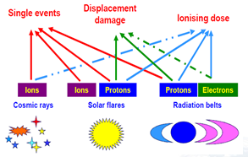
Space radiation environment and effects
According to the GSFC Space Science Mission Operation Team, 59% of all space missions experience the impact of space weather disturbance
During 2015 not less than 15 upsets and failures due to space radiation were registered at Russian satellites
Ecoffet R, RADECS – CNES CCT Workshop on Radiation Design Margins, 2015

Slide 3
Single event effects (SEE) classification
№ | Type/subtype | Characteristic | Failure mode | Manifestation
1 | SEU (Single Event Upset) / MBU (Multiple-Bit upset) | Inversion of logical state of memory unit or trigger circuit / SEU in neighboring unit | Reversible failure | Bistable elements Logical devices
 | SEDU (Single Event Destructive Upset) | Destructive Inversion of logical state of memory unit or trigger circuit | Catastrophic failure | Bistable elements Logical devices
2 | SEL (Single Event Lаtchup) | Inclusion of the parasitic four- layer p-n-p-n structure leading to harsh increase circuit current | Catastrophic (reversible) failure | All CMOS elements
 | SEB (Single event burnout) | Burnout of MOS structure, analog of SEL | Catastrophic failure | Power MOS devices
 | SESB (Single Event Snapback) | Snapback in SOI CMOS structure, analog of SEL | Catastrophic failure | SOI devices
3 | SEHЕ (Single Event Hard Error) | Microdose effect | Catastrophic failure | All types of devices
4 | SEFI (Single Event Functional Interrupt) | Inversion of logical state of memory unit or trigger circuit operation leading to violation of program progress (for example, program hangup) | Reversible failure | Controllers
5 | SEDR (Single Event Dielectric Rupture) | Breakdown of dielectric along nuclear track | Catastrophic failure | MOS-structure Linear devices
6 | SET (Single Event Transient) | Short- time pulse in output element of analog or digital IC | Reversible failure | Input and output signal processing devices

Slide 4
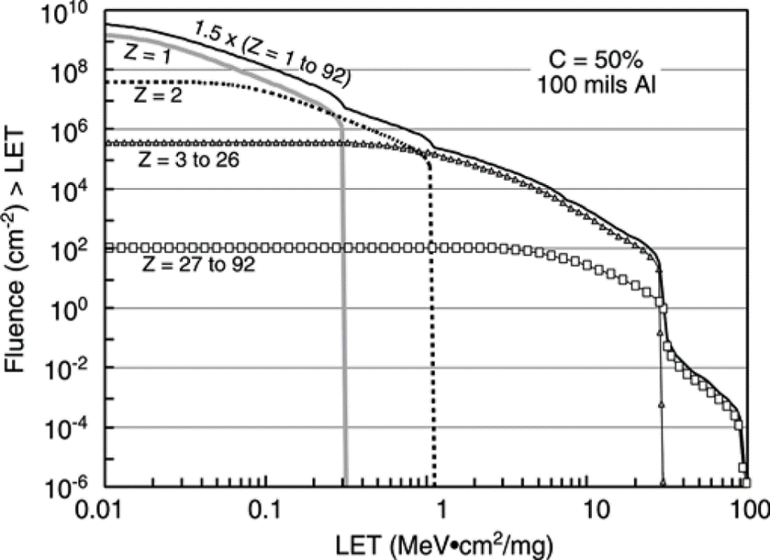
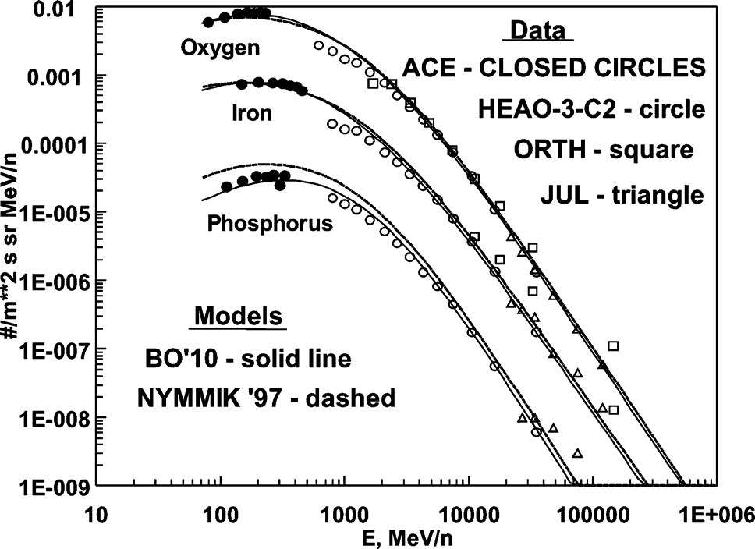
Composition of space radiation environment (heavy ions) induced single event effect
1. Solar energetic particles: protons and ions Z=2 to 92, E up to 10 GeV/n [1]
2. Galactic Cosmic Rays: protons and ions Z=2 to 92, E up to 10¹¹ GeV [1]
Linear energy transfer fluence spectrum of an example 2 year mission, 50% confidence interval behind 100 mils Al shielding [1]
GCR spectra for several ions [1]
[1] M.A. Xapsos, P.M. O'Neill, and T.P. O'Brien, “Near-Earth space radiation models,” , IEEE Trans. Nucl. Sci., vol. 60, no. 3, pp. 1681-1705, 2013

Slide 5
SEE testing foundations
The principle of equivalence thresholds LET for space heavy charged particles and monoenergetic ions, in which the electronic components having SEE :
equality thresholds LET under the influence of space heavy charged particles, containing ions of different chemical elements with different spectral and energetic characteristics and any monoenergetic ion having a given value of LET, under the influence of which in electronic components appears SEE
Main SEE hardness characteristics:
Threshold LET
Effect cross-section (saturation)
Dependence of effect cross-section from ions LET
Russian-made SRAM

Slide 6
Requirements to electronic components for space application
In spacecraft equipment we can apply only electronic components which were tested, and the hardness of which was validated to all types of radiation effects and which also exceeded the specified requirement.
General requirements for electronic components to SEE hardness:
LET threshold for SEE (upsets) ≥ 15 MeV·cm²/mg
LET threshold for SEE (failures) ≥ 60 MeV·cm²/mg
Cross-section effects of LET dependence
Requirements for concrete mission depends on orbit, active lifetime and probability of non-failure operation

Slide 7
Admissible procedures for SEE testing
SEE testing is carried out with:
Ion accelerator (dominating)
Proton accelerator
Laser simulator (result calibration on the ion or proton accelerators is necessary!)
Pavel Chubunov npk1@niikp.org

Slide 8
General structure of the SEE Test Facilities based on Ion Sources
Diagnostic and modification system for beam characteristics
Cyclotron installation console
In the vacuum tract
On the test item
Cyclotron
Test chamber
Operator
WKS
Bending magnet
Vacuum tract
Test item
Test item control equipment
Operator
WKS
Vacuum system
Equipment for test item characteristic control
Equipment for test item operation conditions
Pavel Chubunov npk1@niikp.org

Slide 9
Technical Features of the SEE Test Facilities based on ion sources
Technical features | Low energy facilities | High energy facilities
Ion source | Cyclotrons U-400/U-400М FLNR JINR (Dubna) | Cyclotron U-400М FLNR JINR (Dubna)
Initial energy, MeV/nucleon | 3 .. 6 | 15 .. 40 (60 for light ions) Tunable with using degraders
Flux density, particle/(cm² × s) | 10 .. 10⁵ | 10 .. 10⁵ (10⁴ for Bi)
Nonuniformity, % | ± 10 | ± 15
Suit of ions | C, O, Ne, Ar, Fe, Kr, Xe, Bi | Ne, Ar, Kr, Xe (C, O, Fe, Bi)
LET (material), MeV × cm²/mg | 1…99(Depends on material of electronic component, type of ion and energy)
Range in material, μm | ≥30 (Depends on material of electronic component, type of ion and energy)
Irradiation area, mm | 150 х 200/200 х 200 | Ø 60 (Ø 40 for Bi)
Operational pressure | Vacuum | Forvacuum/atmosphere
Chargeover time for gaseous ion, hour | 6 | 6
Chargeover time for metal ion, hour | 18 | 18
Vacuum pumping time, min | 8/ 6 | 5
Temperature range, °С | +25 .. +125 | +25 .. +125
Pavel Chubunov npk1@niikp.org

Slide 10
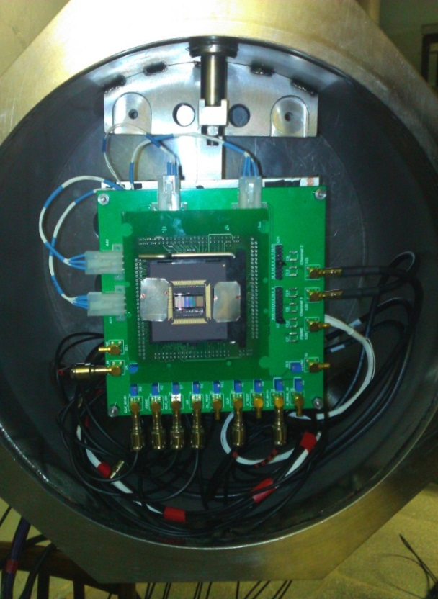
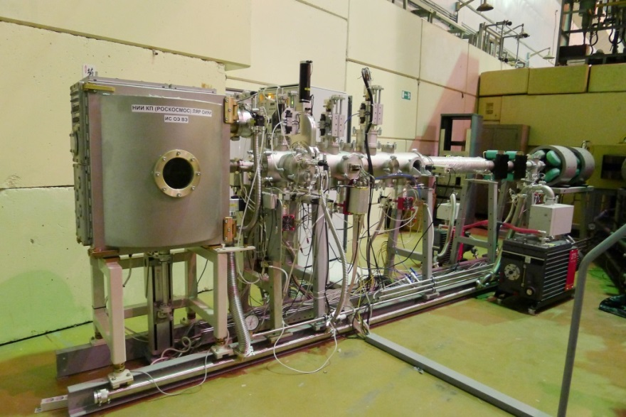
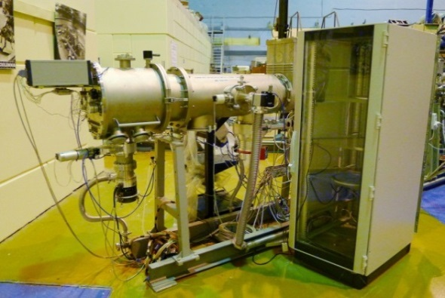
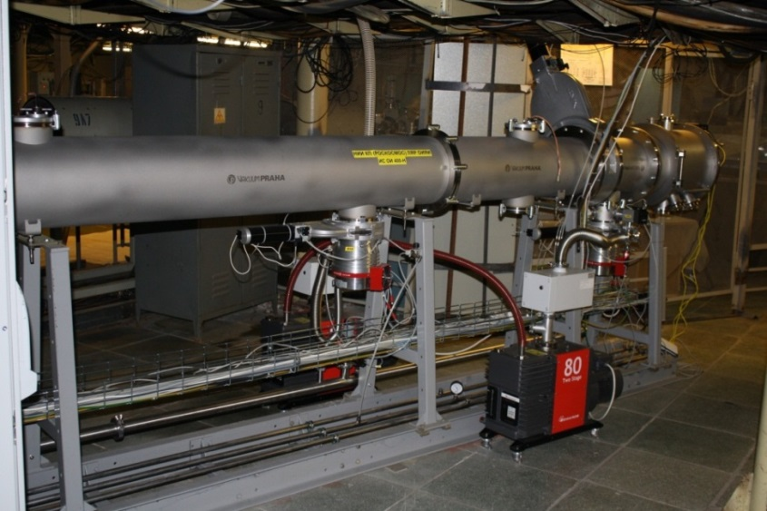
Heavy Ions SEE Test Facilities
Pavel Chubunov npk1@niikp.org

Slide 11
Estimation of beam characteristic - techniques
The main energetic parameters of the ion beam:
Energy of ion in vacuum tract
Energy of ion in test chamber
LET in material of electronic component
Range of ion in material of electronic component
The Applied techniques:
Characteristic | Low energy facility | High energy facility
Initial energy of ion | Measurements (TOF technique) | Measurements (TOF technique)
Energy of ion on DUT |  | Calculation (SRIM )
LET | Calculation (SRIM ) | Calculation (SRIM )
Range of ion | Calculation (SRIM ) | Calculation (SRIM )
Pavel Chubunov npk1@niikp.org

Slide 12
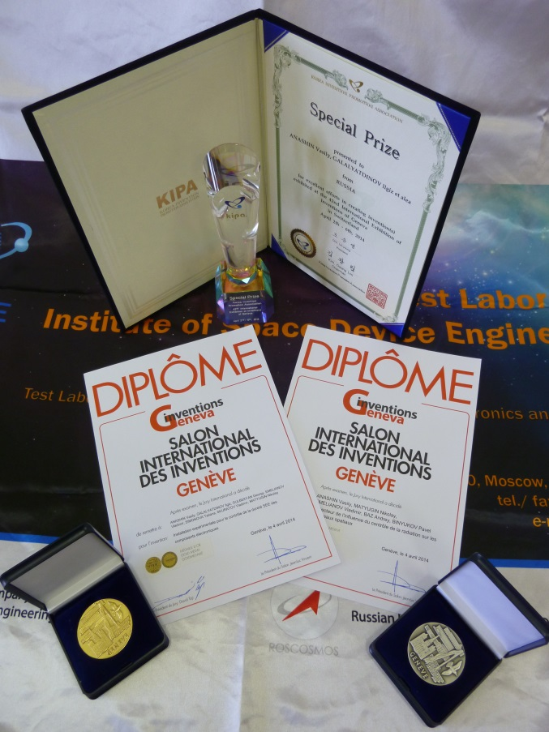
Recognition of High Scientific and Technical Level
Pavel Chubunov npk1@niikp.org

Slide 13
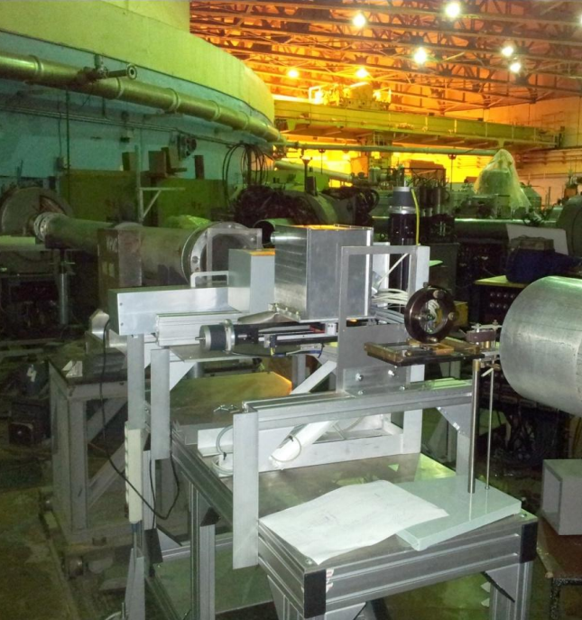
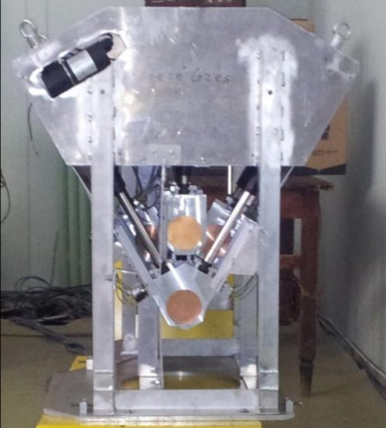
Proton SEE Test Facility
Based on synchrocyclotron accelerator SC-1000 PNPI
Technical features
Energy, MeV | 200 .. 1000
Energy nonuniformity, % | 1 .. 3
Flux density, particle/(cm² × s) | 10⁵ .. 10⁸
Nonuniformity, % | 10
Pavel Chubunov npk1@niikp.org

Slide 14
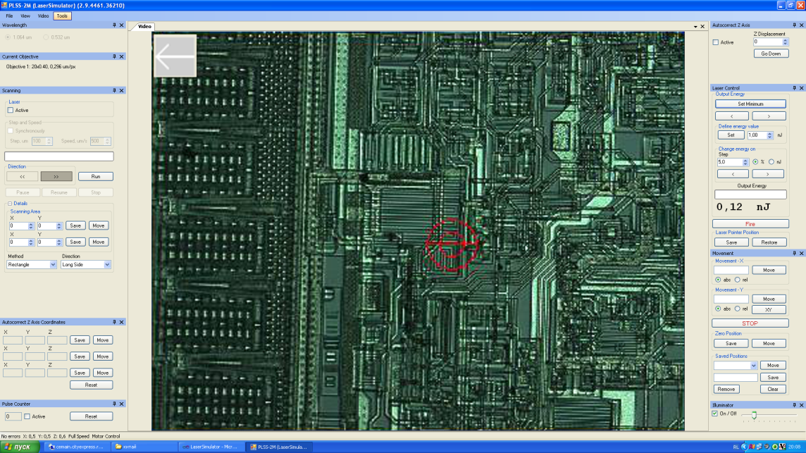
Laser SEE Test Facility
Technical features
Laser type | Picosecond DPSS Nd³⁺:YAG
Wavelength, nm | 1064/532
Pulse duration, ps | 20
Max pulse energy on chip, nJ | 8000/3000
Pavel Chubunov npk1@niikp.org

Slide 15
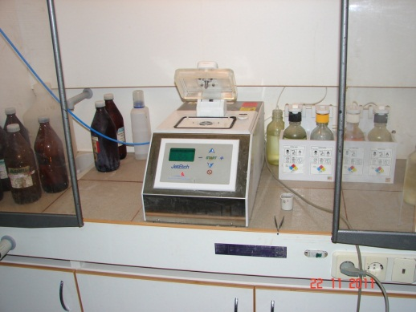
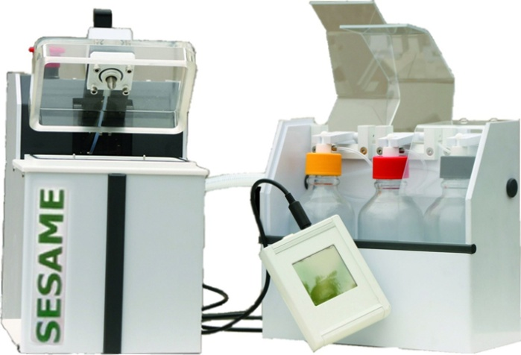
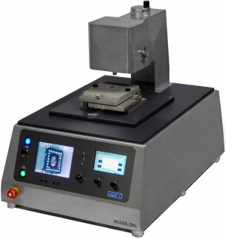
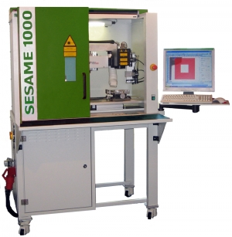
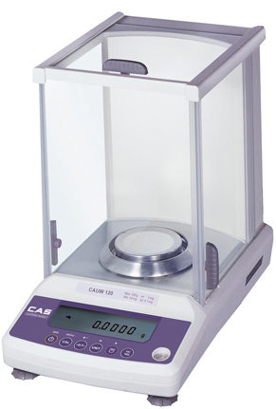
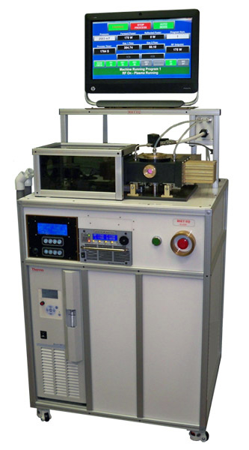
The Facility for Preparing Components – Decapsulation and Analysis
Pavel Chubunov npk1@niikp.org

Slide 16
Some practical aspects for heavy ion testing at existing facility
Number of samples – not less than 3 (SEL, SEU, SEFI, SET); 12 (SEB, SEGR)
LET from 1 (5) to 60 (100) MeV ×cm²/mg (4 (5) type of ions is needed – Ne,Ar, Kr, Xe (Bi))
Range of ions in Si – more than 30 µm
Decapsulation is needed
Tilted irradiation for investigation only
Test norms – Fluence not less than10⁷ (taking into account possible errors) or 100 SEE
Safety operation area for SEB, SEGR
Maximum supply voltage and temperature for SEL
Minimum supply voltage for SEU
Worst case biasing conditions
UI-curve for SEL, SET
Survivability test for SEL (holding in SEL for 5 min)
Pavel Chubunov npk1@niikp.org

Slide 17
Roscosmos Testing Aids Directions for the Development
Main future trends:
Performance upgrade of existing test facilities (efficiency, accuracy, reliability, availability) with testing cost reductions
The creation of reference ion beam and the system of metrological support
The creation of test facilities with milli- and micro- beams for fundamental investigations
The creation of technological bench for insuring decapsulation of electronic components
The creation of new test facilities based on existing and construction accelerators in JINR (including extra – high energy)
Pavel Chubunov npk1@niikp.org

Slide 18
LET’s and ranges in Si for most common ions with different energies
 | Low energy |  | High energy
 | E=3 MeV/nucleon | E=6 MeV/nucleon | E=20 MeV/nucleon | E=40 MeV/nucleon | E=60 MeV/nucleon
ion | LET, (MeV × cm²/mg) / Range in Si, mkm
C | 2,98 / 39,03 | 1,91 / 103,43 | 0,69 / 873,82 | 0,40 / 2990 | 0,31 / 5450
O | 4,66 / 37,65 | 3,10 / 95,23 | 1,30 / 629,95 | 0,74 / 2120 | 0,53 / 4550
Ne | 6,98 / 32,75 | 4,88 / 77,60 | 1,99 / 504,52 | 1,17 / 1680 | 0,851 / 3430
Ar | 16,40 / 31,45 | 14,4 / 70,95 | 6,26 / 356,49 | 3,80 / 1080 | 2,77 / 2280
Fe | 27,94 / 29,77 | 22,42 / 60,75 | 12,04 / 268,57 | 7,42 / 809,49 | 5,71 / 1480
Kr | 40,66 / 33,18 | 37,03 / 60,75 | 22,26 / 229,41 | 14,21 / 641,89 | 9,90 / 1480
Xe | 68,85 / 35,31 | 66,39 / 60,49 | 45,23 / 195,74 | 28,83 / 564,07 | 22,64 / 989,11
Bi | 98,40 / 41,91 | 98,28 / 65,73 | 76,68 / 205,72 | 58,57 / 464,63 | 44,37 / 770,00
Pavel Chubunov npk1@niikp.org

Slide 19
Ions parameters needed to provide different LET with given penetrating ability
Device package thickness = 10 mm
Ion’s energy E₀
LET
Semiconductor chip
E₀, MeV/n | Ion | LET, MeV*cm²/mg
125 | Ne | 1
113 | Ne | 5
162 | Ar | 15
284 | Xe | 40
184 | Bi | 60
179 | Bi | 80
Pavel Chubunov npk1@niikp.org

Slide 20
Specification of New Test Facility
20
Technical features
Energy | Tunable, up to 300 MeV/nucleon
LET (Si) | 1 – 80 (100) MeV × сm²/mg
Range in Si | Depends on test object, up to 10 mm
Temperature range | –40 (-60)... 125 °С
Operational pressure | atmosphere, forvacuum
Irradiation area | ≥ 200 х 200 mm
Flux density | 10 – 10⁶ particle/(cm² × s)
Nonuniformity | ≤ 10 %
Ion cocktails modes | low, medium and high energy ions
Beams mode | micro-, milli- beams
Chargeover time from ion to ion
Within one ion cocktail mode | ≤ 10 min
From one cocktail to another | ≤ 4 hours
From one ions energy to another | ≤ 4 hours
Pavel Chubunov npk1@niikp.org

Slide 21
Conclusions
The number of SEE Test Facilities were created by Roscosmos order and are currently in operation
Existing SEE Test Facilities based on ion sources provides SEE testing in required interval of LETs and ions ranges in different materials of electronic components (but with some restrictions)
Before testing detailed calculations should be done to estimate LETs and ions range taking into account structure of electronic component
More than 3000 components were tested to SEE in 2010-2016
Directions for the development of SEE Test facilities were defined
We invite you to joint research – common application of existing heavy ions test facilities for electronic components radiation testing and investigations and also creation of new ones
Pavel Chubunov npk1@niikp.org

Slide 22
Thank you for your attention!
Pavel Chubunov npk1@niikp.org

