Slide 1
Proposals for the content of the remote Report from the PWG1 at the MPD collaboration meeting in April
PWG1-MPD
G.Feofilov (SPbSU)
09/04/2020, PWG1/MPD/, 17:30 (Moscow time)
JINR portal for the meeting: http://mpd.jinr.ru/portal/ PWG1 MPD INDICO page: https://indico.jinr.ru/event/1244

Slide 2
To be discussed today
17:30 -17.50 (Moscow time)- G.Feofilov, Proposals for the content of the Report from the PWG1 at the coming MPD collaboration meeting
17:50-18:30 …other reports today and discussion

Slide 3
To be discussed today
It is also possible to present a separate report from one of the groups involved in the PWG1.
Options:
“On centrality determination in the 1st day of physics measurements”
…MexNICA report?
…other?
….MC production, experience with NICA cluster -- is an important issue

Slide 4
Proposals for the content of 30 min Report from the PWG1 at the coming MPD collaboration meeting
PWG1-MPD – tasks, status of the group, institutes, people involved, where to see us…
PWG1 physics: reports, papers, documents – prepared so far and discussed at the PWG1 and at some other meetings
MC production, experience with NICA cluster (?)
Near plans

Slide 5
1) PWG1-MPD – tasks, status of the group, institutes, people involved, where to see us…
.

Slide 6
PWG1: Global Observables Some topics of interest and the main tasks
Rapiidity distribution of charged particles
---- particle ratios
Total event multiplicity
Total event energy
— event transverse energy
— event mean transverse pT
— charged particles density at midrapiidty
--- particle ratios
Centrality determination and different estimators
— spectator nucleons (N_s) and number of nucleon-participants (N_{part})
— multiplicity classes: pros and cons
— different estimators and impact parameter b
----event-by-event spectator measurement
Total cross-section measurement
Event primary vertex determination
Event plane measurement at all rapidities

Slide 7
PWG1-MPD – tasks in view of existing panorama of data
Our general task is to make the analysis of the existing experimental landscape (BES-1 and BES-II programmes , NA61/SHINE results) and to developed a detailed experimental program for the MPD
Physics tasks and MC simulations – what types of the MC Event generators should be considered ?

Slide 8
PWG1-MPD – status
Institutes: SPbSU (St.Petersburg), INR (Troitsk), MEPhI (Moscow), Mexican team …other?
People: - …what is the list that we should put here ?
Where to see us:
You may visit our WEB page: https://indico.jinr.ru/category/343/

Slide 9
Physics: reports, papers, documents – prepared so far and discussed at PWG1 and other meetings
PWG1 meetings in 2019
23.07.2019, G.Feofilov (SPbSU,Russia), ”The 1st PWG1 meeting: Global observables - topics of interest”
03.09.2019 Vladislav Sandul (SPbSU,Russia),"Impact-parameter and multiplicity in nuclear collisions at NICA energies: SMASH modeling”
24.09.2019 Pedro Nieto (Mexican group), “Magnetic Fields in Heavy Ion Collisions at NICA energies”
17.10.2019 Denis Uzhva(SPbSU,Russia): Convolutional neural network for centrality in xed target experiments
07.11.2019 Petr Parfenov (MEPhi), "Centrality Determination in Heavy-ion Collisions with MPD (NICA) using MC Glauber".

Slide 10
Physics: reports, papers, documents – prepared so far and discussed at PWG1 and other meetings
PWG1 meetings in 2020:
16.01.2020, Prepartion for First Physics with MPD:
--G.Feofilov, Proposals for the physics analysis plans for the "First Day" MPD/NICA data
--Ivonne Maldonado, Proposals from Mexican group
--Alexander Ivashkin(INR), Petr Parfenov(MEPhI, Moscow), Classes of centrality for the 1st MPD data analysis data
30.01.2020, G.Feofilov, “Brief news from the PWG Convenors meeting: status of the preparation of the "First Physics" document”.
01.04.2020, Discussion on existing productions: QA, issues/questions.
Speakers: Alexander Mudrokh (JINR), Alexey Aparin (Joint Institute for Nuclear Research), Andrey Seryakov (St.Petersburg State University), Daria Prokhorova (St Petersburg State University), Evgeny Andronov (Saint Petersburg State University), Igor Altsybeev (Saint-Petersburg State University), Pavel Batyuk (Joint Institute for Nuclear Research), Peter Parfenov (MEPhI, Moscow), Vladimir Kovalenko (Saint Petersburg State University)

Slide 11
Physics: reports, papers, documents – prepared so far and discussed at PWG1 and other meetings
….other meetings….?

Slide 12
PWG1: possible topics of interest for the 1st Day Analysis of Au+Au collisions at √s=10 GeV
Centrality classes determination
Mean event total multiplicity of Nch vs. centrality
Rapidity distributions of charged particles in several centrality classes
---- particle ratios for h-/h+
PID and event transverse energy determination at midrapidity for several centrality classes
— mean event transverse energy and ratios for h-/h+
— event mean transverse pT and ratios for h-/h+
— charged particles density at midrapiidty and ratios for h-/h+
yields of lyambda measurements in several centrality classes (?)

Slide 13
SUMMARY TIMELINE FOR FIRST-DAY PHYSICS RESULTS PUBLICATIONS
KEY FIRST-DAY OBSERVABLES, DRAFT 00-002
Contributions from the PWG1 groups: MexNICA team, SPbSU team, INR team, MePHI team, (Dated: January 20, 2020).
The following papers could be proposed from the PWG1 for “the 1st Day observables”:
1. Measurement of the charged particle pseudorapidity density in Au+Au collisions at 10 GeV at NICA/MPD.
2. Measurements of mean transverse energy per identified charged hadron as a function of Npart in Au+Au collisions at 10 GeV at NICA/MPD
3. Measurements of particle ratios at midrapidity in Au+Au

Slide 14
Centrality determination issues
Different centrality estimators…different approaches etc…?
MC simulations…………………………………?
…???

Slide 15
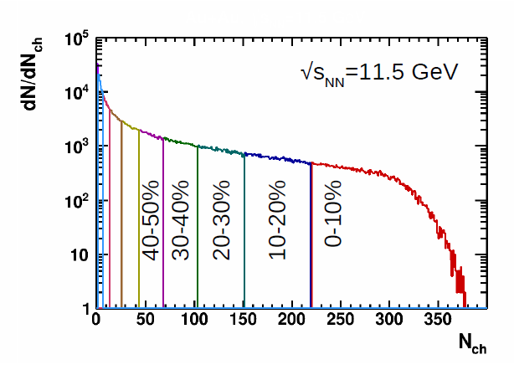
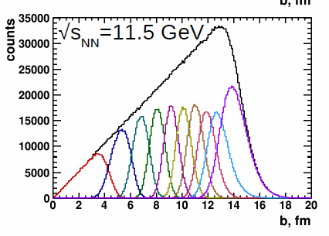
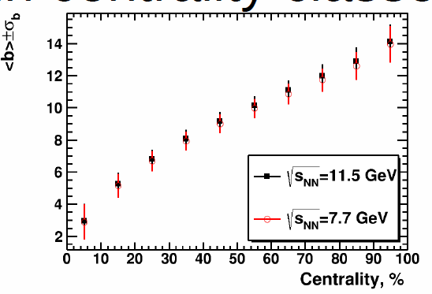
Example: Centrality determination with multicity in TPC.
Report by Alexander Ivashkin, Petr Parfenov, Classes of centrality for the 1st MPD data analysisdata, PWG1 meeting, 16.01.2020

Slide 16
…this all so far…
--Shall we put here into this PWG1 report some our results in simulations on centrality?
Some summary on the simulations with the UrQMD, PHSD, SMASH and MCGlauber MC even generators?
--Shall we discuss problems in centrality classes selection in diffenet approacjes?
-- …..
Your comments are appreciated!

