Slide 1


PWG1-MPD
PWG1: Global observables and Centrality of nuclear collisions at NICA
Grigory Feofilov, (Saint-Petersburg State University, St. Petersburg, Russia)
(for PWG1-MPD@NICA team)
G.Feofilov (SPbSU) Proposals for the content of the remote 30 min Report from the PWG1 at the MPD collaboration meeting in April
Draft -01 for discussion 14/04/2020, PWG1/MPD/, 17:30 (Moscow time)
JINR portal for the meeting: http://mpd.jinr.ru/portal/
PWG1 MPD INDICO page: https://indico.jinr.ru/event/1244

Slide 2
Proposals for the content of 30 min Report from the PWG1 at the coming MPD collaboration meeting
COMMENTS to this Draft -01 ARE WELCOME!
Title of the report: “PWG1: Global observables and centrality of nuclear collisions at NICA”
Content:
1) Introduction: PWG1-MPD – tasks, status of the group, institutes, people involved, where to see us…
2) PWG1 – global observables and physics: reports, papers, documents – prepared so far and discussed at the PWG1 meetings
3) Brief overview of experimental landscape of some global observables in A+A collisions (multiplicity, transverse energy, particle yields …from AGS to SPS and RHIC)
4) Centrality of nuclear collisions at NICA, nuclear stopping, critical issues
3) MC production, experience with NICA cluster (?) – to be added briefly (?)
4) Near plans (?)….

Slide 3
1) Introduction.
PWG1-MPD – tasks, status of the group, institutes, people involved, where to see us…
Disclaimer: this report covers only some of the tasks discussed at the PWG1
.

Slide 4
Introduction:
PWG1 -- Global Observables at MPD to start with
1) Event-by-event measurements, in pA and A+A collisions at √s_{NN}.=10 GeV:
Event charge particle multiplicity and particle identification
Event mean transverse momentum (p_{T})and event transverse energy (E_{T})
Particle ratios
Net charge (for baryons…)
Number of nucleon-participants (N_{part})
2) These event-by-event studies will allow at the next step of analysis for well defined initial conditions (for classes of events) to get :
Mean charged particles density at midrapidity (<dN_{ch}/dη _{|η=0}>),
Pseudorapidity distribution (dN_{ch}/dη),
Charged particles multiplicity distribution and total (N_{ch})
Mean transverse momentum (<p_{T}>) and mean event transverse energy (<E_{T}>)
Mean values of particle ratios
PWG1: Global Observables
-

Slide 5
Introduction:
PWG1 -- Global Observables at MPD to start with
…”well defined initial conditions (for classes of events)”:
It is important to define for each event the initial collision geometry in terms of the relevant impact parameter b.
As a proxy for b different estimators could be considered.
Centrality of A+A collision and classes of events:
Different estimators of centrality
— spectator nucleons (N_{s})
— multiplicity classes: pros and cons
— different estimators, classes of events and the impact parameter b
Selection of classes of events is very important for further studies of fluctuations and various correlations of observables

Slide 6
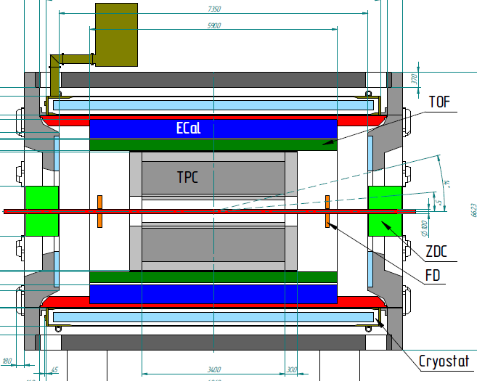
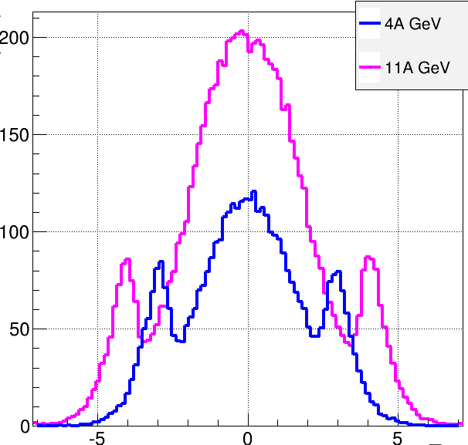
Multi-Purpose Detector (MPD)
stage I: TPC, TOF, ECAL, FHCal, FFD
stage II ( 2023): + ITS + EndCap (CPC, Straw, TOF, ECAL)
stage II
acceptance
URQMD
charged
b<11 fm
11 A GeV
4 A GeV
dN/dη
TPC
CPC
TOF
ECal
FFD
FHCal
FHCal
FFD
η
stage I: put in operation in 2022
Notes:
The MPD will be put in operation at two stages. At the first one the barrel part will be equipped with major tracking detector TPC, TOF end ECAL. FHC and FD will be operational as well.
At the second stage the detector will be supplemented with IT and end cap subdetectors.

Slide 7
PWG1-MPD – status
Institutes: SPbSU (St.Petersburg), INR (Troitsk), MEPhI (Moscow), MexNICA …other?
People: - …what is the list that we should put here ? Should we?
Convenors: Alexandre Ivashkin and Grigory Feofilov
Where to see the PWG1 meetings:
You may visit our WEB page:
https://indico.jinr.ru/category/343/

Slide 8
2) Physics: reports, papers, documents
– prepared so far and discussed at the PWG1 meetings
.

Slide 9
Physics: reports, papers, documents – prepared so far and discussed at PWG1 and other meetings
PWG1 meetings in 2019
23.07.2019, G.Feofilov (SPbSU,Russia), ”The 1st PWG1 meeting: Global observables - topics of interest”
03.09.2019 Vladislav Sandul (SPbSU,Russia),"Impact-parameter and multiplicity in nuclear collisions at NICA energies: SMASH modeling”
24.09.2019 Pedro Nieto (Mexican group), “Magnetic Fields in Heavy Ion Collisions at NICA energies”
17.10.2019 Denis Uzhva(SPbSU,Russia): Convolutional neural network for centrality in fixed target experiments
07.11.2019 Petr Parfenov (MEPhi), "Centrality Determination in Heavy-ion Collisions with MPD (NICA) using MC Glauber".

Slide 10
Physics: reports, papers, documents – prepared so far and discussed at PWG1 and other meetings
PWG1 meetings in 2020:
16.01.2020, Prepartion for First Physics with MPD:
--G.Feofilov, Proposals for the physics analysis plans for the "First Day" MPD/NICA data
--Ivonne Maldonado, Proposals from Mexican group
--Alexander Ivashkin(INR), Petr Parfenov(MEPhI, Moscow), Classes of centrality for the 1st MPD data analysis data
30.01.2020, G.Feofilov, “Brief news from the PWG Convenors meeting: status of the preparation of the "First Physics" document”.
01.04.2020, Discussion on existing productions: QA, issues/questions.
Speakers: Alexander Mudrokh (JINR), Alexey Aparin (Joint Institute for Nuclear Research), Andrey Seryakov (St.Petersburg State University), Daria Prokhorova (St Petersburg State University), Evgeny Andronov (Saint Petersburg State University), Igor Altsybeev (Saint-Petersburg State University), Pavel Batyuk (Joint Institute for Nuclear Research), Peter Parfenov (MEPhI, Moscow), Vladimir Kovalenko (Saint Petersburg State University)

Slide 11
(3) PWG1-MPD – tasks in view of existing panorama of data
Our general task is to developed a detailed experimental program for Global observables at the MPD with the account of the existing experimental landscape (BES-1 and BES-II programmes and NA49 and NA61/SHINE results)

Slide 12
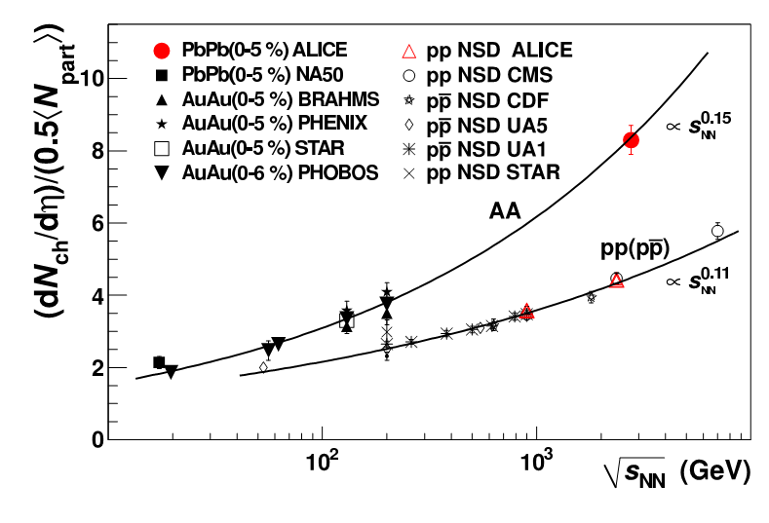
Charged particle pseudo-rapidity density per participant
pair for central nucleus-nucleus and non-single diffractive pp (pp) collisions , as a function of √s_{NN}
an increase of about
a factor 1.9 relative to pp collisions at similar collision energies,
an increase of about
a factor 2.2 to central Au-Au collisions at √s_{NN} = 0. 2 TeV !
Faster growth with √s_{NN} in AA than in pp!
Logarythmic extrapolation is rulled out
Important constraint for the models!
arXiv:1011.3916 [nucl-ex]. Phys. Rev. Lett. 105 (2010) 252301
12

Slide 13
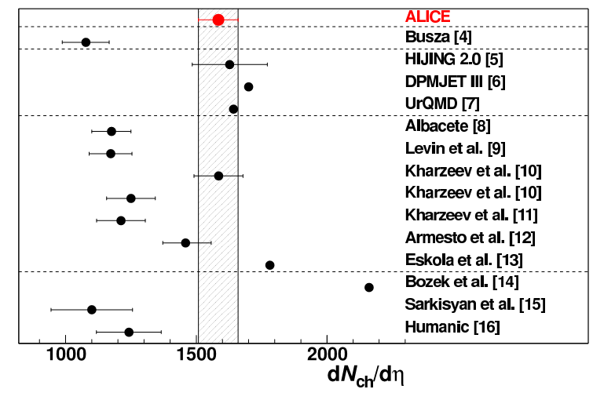
Charged-particle multiplicity density at mid-rapidity
in central Pb-Pb collisions at √s_{NN} = 2.76 TeV: :
Multiplicity:
is essential to estimate
the initial energy density and it is the 1st important constraint for the models!
Comparison of ALICE measurement
with model predictions.
Bjorken energy density in ALICE: 2.8 x RHIC for 5% of most central collisions
arXiv:1011.3916 [nucl-ex]. Phys. Rev. Lett. 105 (2010) 252301
Notes:
We measure a density of primary charged particles at mid-rapidity dNch/dETA = 1584+ 4 (stat. )+ 76(sys. ).
J.Harris, ALICE
Transverse energy density per participant pair: 2.5 x RHIC Consistent with 20% increase in <pt>.
Bjorken energy density: 2.8 x RHIC for 5% of most central collisions
Empirical extrapolationfrom lower energy data [4] signicantly underpredicts the measurement. Perturbative QCD-inspired Monte Carloevent generators, based on the HIJING model tuned to 7 TeV pp data without jet quenching [5], on the DualParton Model [6], or on the Ultrarelativistic QuantumMolecular Dynamics model [7] are consistent with the
measurement. Models based on initial-state gluon density saturation have a range of predictions depending on
the specific implementation [8{12], and exhibit a varying level of agreement with the measurement. The prediction
of a hybrid model based on hydrodynamics and saturation of final-state phase space of scattered partons [13]
is close to the measurement. A hydrodynamic model in which multiplicity is scaled from p+p collisions overpredicts the measurement [14], while a model incorporating scaling based on Landau hydrodynamics underpredicts
the measurement [15]. Finally, a calculation based on modified PYTHIA and hadronic rescattering [16] under-predicts the measurement

Slide 14
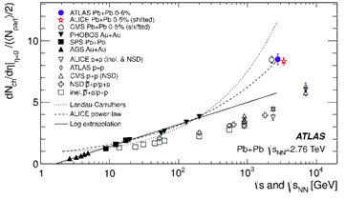
Charge particle density at midrapidity
Our region of interest lies below √sNN = 11 GeV

Slide 15
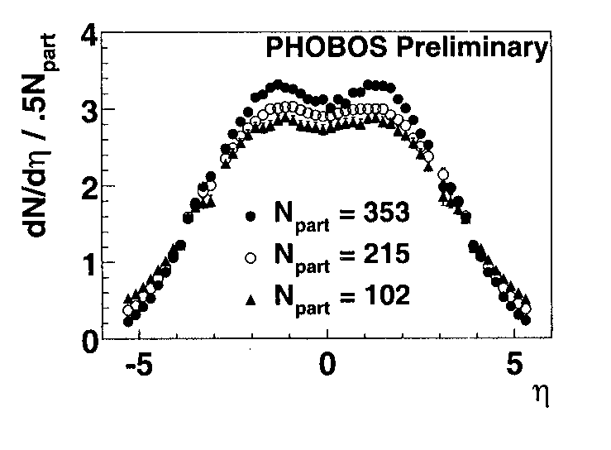
Pseudorapidity distributions at various N_{part} (example of PHENIX at RHIC)
Pseudorapidity distribution, PHENICS. Au+Au collisions , 130 GeV. P.A.Steinberg, Nuclear Physics A698 (2002)314c-322c).

Slide 16
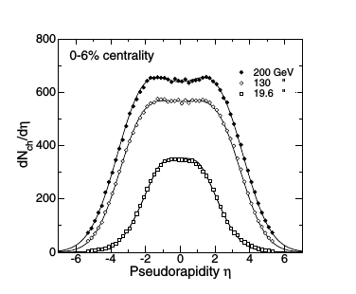

Pseudorapidity distributions at various √s_{NN}

Slide 17
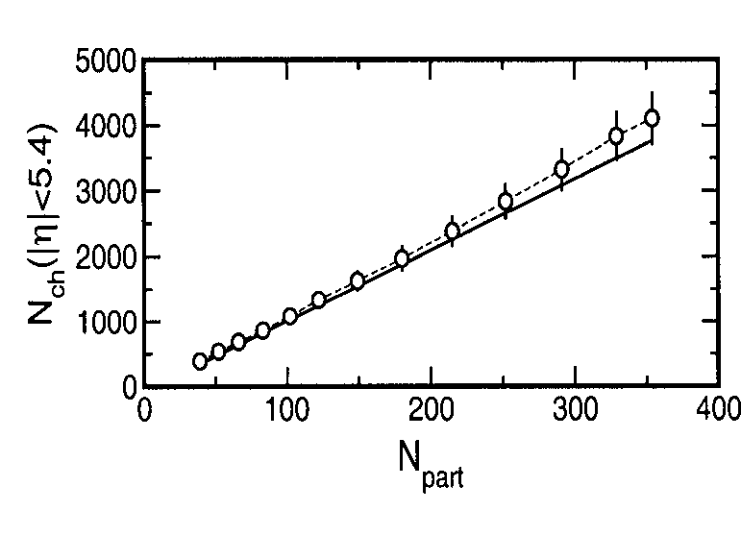
By integration of dN_{ch}/dη we can get the total N_{ch} vs. N_{part}
PHOBOS data on total Nch vs. Npart. P.A/Steinberg, Nuclear Physics A698(2002)314c0322c). Au_Au, 130 GeV

Slide 18
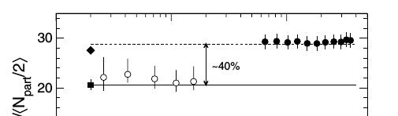
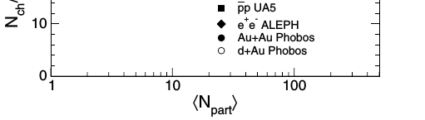

B.B.Back. Studies of multiplicity in relativistic heavy-ion collisions Journ.of.Phys.Conf/Ser/5(2005)1-16
DOI: 10.1088/1742-6596/5/1/001

Slide 19
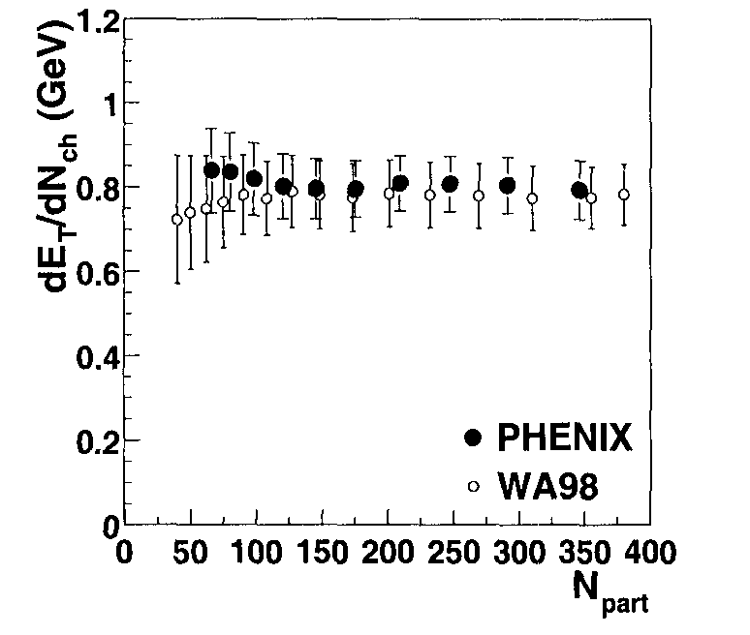
Average transverse energy per charged particle (dE_{T}/d_{Nch})vs. N_{part}
Swatantra Kumar Tiwari and Raghunath, “Transverse energy per charged particle in heavy-ion collisions: Role of collective flow”
Eur. Phys. J. A (2018)54:39 DOI 10.1140/epja/i2018-12475-8
Sahooa
PHENIX and WA98 data on dE_T/dNch(GeV)
vs. Npart. P.A/Steinberg, Nuclear Physics A698
(2002)314c0322c).
PHENIX, Au+Au, 130 GeV.
WA98 at SPS, Pb+Pb sqrt(s)=17 GeV
Notes:
There is a need to study the global observ- ables like ET /Nch in more details including the collectivity in the system to understand its energy and centrality de- pendence and to put some light on possible effects from other sources like the gluon saturation.

Slide 20
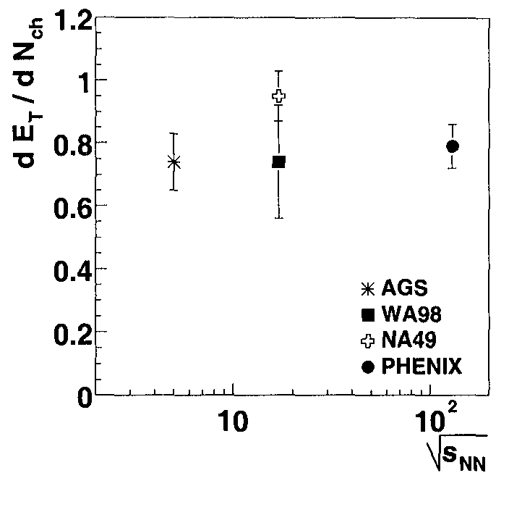
Transverse energy E_T/Nch vs. sqrt(s_NN)
PHENIX, AGS and SPS results on dE_T/dNch as a function of sqrt(s_NN). See Fig.8 in: P.A/Steinberg, Nuclear Physics A698(2002)314c0322c). Au_Au, 130 GeV

Slide 21
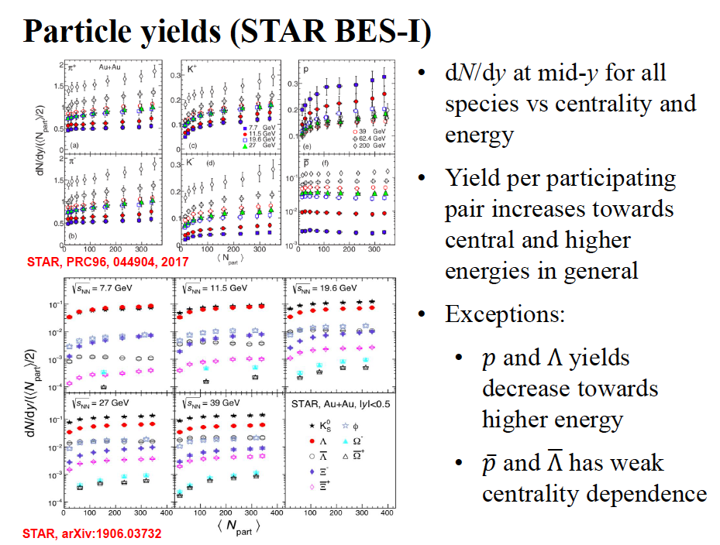
.
by Xianglei Zhu

Slide 22
What could be new with MPD data on Bi+Bi collisions , √s=10 GeV, for the "First Day» physics analysis?
In case of the PID with the TPC of the MPD installation it could be possible to measure with better statistics, for √s=10 GeV in Bi+Bi collisions, the yields and ratios of charged particles π, K, p, anti-p ( in particular, p and anti-p) and to check scaling of yields with <N_{part} >
– Is it relevant to baryon stopping mechanism?

Slide 23
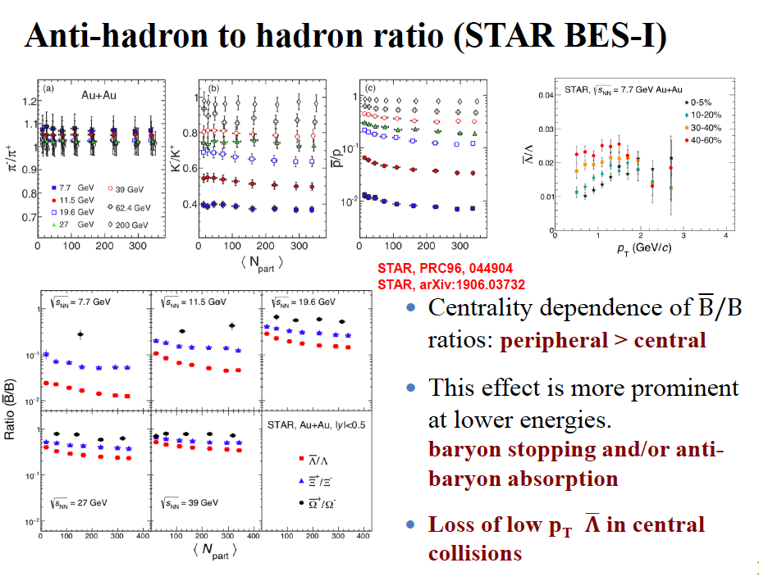
by Xianglei Zhu

Slide 24
What could be new with MPD data on Bi+Bi collisions at √s=10 GeV, for the "First Day» analysis?
To measure with better statistics the yields and ratios of anti-Λ/Λ vs. pT
and for several centrality classes
To measure with better statistics the yields and ratios of anti-p/p vs. pT
and for several centrality classes
To check scaling of yields of charged particles observed with <N_{part} >
– Is it relevant to baryon stopping or anti-baryon absorption?
To measure with better statistics the ratios of particles: π-/π+, K-/K+,
anti-p/p vs. <Npart>
-- To clarify the role of resonances in charge-transfer mechanism of particle production

Slide 25
“FIRST-DAY”
PHYSICS RESULTS FUTURE PUBLICATIONS proposed by the PWG1
1. Measurement of the charged particle pseudorapidity density in Au+Au collisions at 10 GeV at NICA/MPD.
2. Measurements of mean transverse energy per identified charged hadron as a function of Npart in Au+Au collisions at 10 GeV at NICA/MPD
3. Measurements of particle ratios at midrapidity in Au+Au collisions at 10 GeV as a function of centrality.

Slide 26
Centrality determination at the MPD
In order to compare the results with a majority of existing data, theMPD experiment centrality classes are supposed to be defined based on two signals:
(i) the charged particle multiplicity in the TPC (Time Projection Chamber or
(ii) the energy deposition in the FHCal (Forward Hadron Calorimeters) .
Current method uses the multiplicity of the produced particles within pseudorapidity cut|η| < 0.5, pT > 0.15 GeV/c and full azimuth without simulation of the fragments formation.
Notes:
References
[1] M. Golubeva et al., J. Phys. Conf. Ser. 798, no. 1, 012074 (2017). doi:10.1088/1742- 6596/798/1/012074
[2] M.Golubeva et al., http://mpd.jinr.ru/
wp-content/uploads/2018/05/MPD_TDR_ FHCal_28_05_2018.pdf
[3] C. Loizides, J. Nagle and P. Stein- berg, SoftwareX 1-2, 13 (2015) doi:10.1016/j.softx.2015.05.001 [arXiv:1408.2549 [nucl-ex]].
[4] E. Zherebtsova, V. Klochkov, I. Se- lyuzhenkov, A. Taranenko and E. Kashirin, EPJ Web Conf. 182,

Slide 27
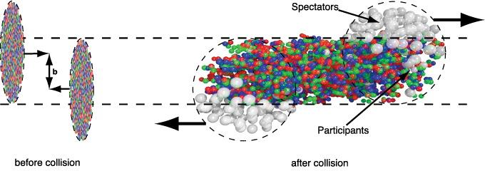
Terminology
^{• Nucleon-participants (𝑁}_{𝑝𝑎𝑟𝑡}) – nucleons collided at least once
^{• Nucleon-spectators (𝑁}_{𝑠𝑝𝑒𝑐} ^{= 2𝐴 − 𝑁}_{𝑝𝑎𝑟𝑡}^{=216 − 𝑁}_{𝑝𝑎𝑟𝑡}^{) – nucleons}
^{which didn’t interact}
• Number of nucleon-nucleon collisions (𝑁_{𝑐𝑜𝑙𝑙}⁾
• Multiplicity of charged particles (𝑁_{𝑐h}⁾

Slide 28
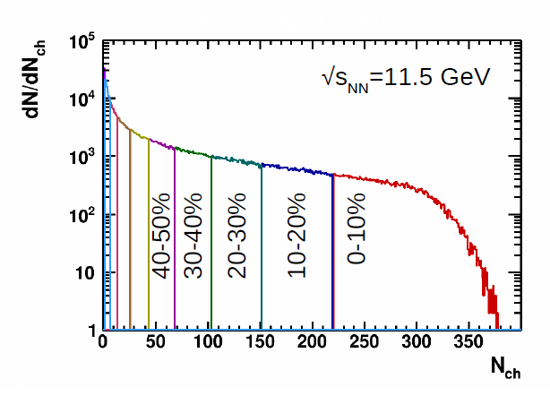
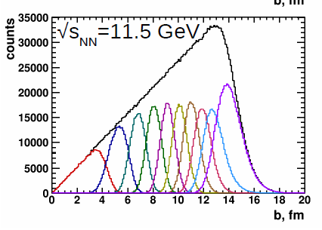
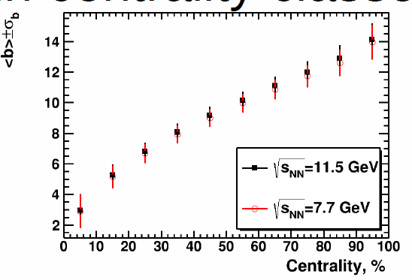
Example: Centrality determination with multicity in TPC.
Report by Alexander Ivashkin, Petr Parfenov, Classes of centrality for the 1st MPD data analysisdata, PWG1 meeting, 16.01.2020

Slide 29
Centrality determination with FHCal
Only information from FHCal is used.
see in the report by Alexander Ivashkin at PWG1

Slide 30
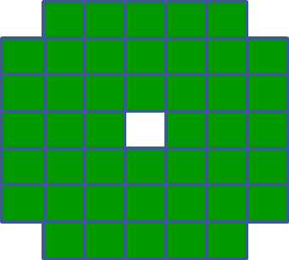
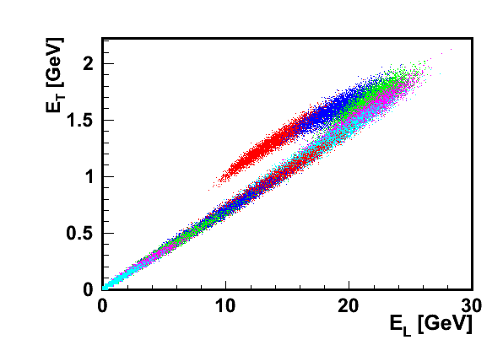

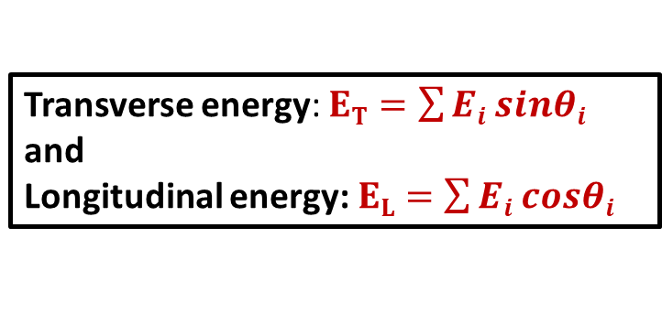


Construction of two energy (E_{T}, E_{L}) components.
$$Ei$$
Transverse energy: $ET=\sum{Ei sinθi}$
and
Longitudinal energy: $EL=\sum{Ei cosθi}$
$$θ$$
Cone of spectators
$$Ei$$
Two branches in (E_{T}, E_{L}) correlations.
Central events
Peripheral events
Each color bin is 10% of b-centrality.

Slide 31
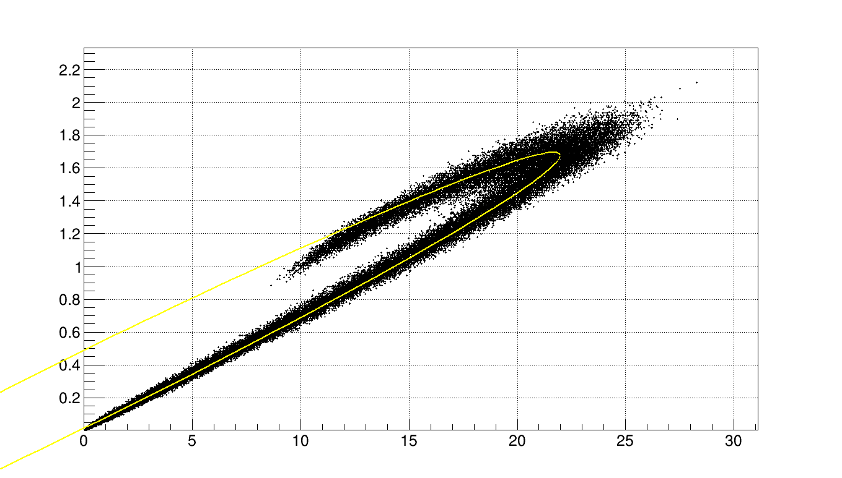
Fit of (E_{T}, E_{L}) correlations by ellipse.
Procedure of event selection for the centrality classes:
E_{T}(GeV)
fit the histogram by ellipse;
divide the histogram by 10% of events as:
move along the ellipse in small increments and build perpendiculars at each point;
count the events for each bin on the perpendicular;
as soon as 10% of all events are collected, move on to the next color (sub histogram);
E_{L}(GeV)

Slide 32
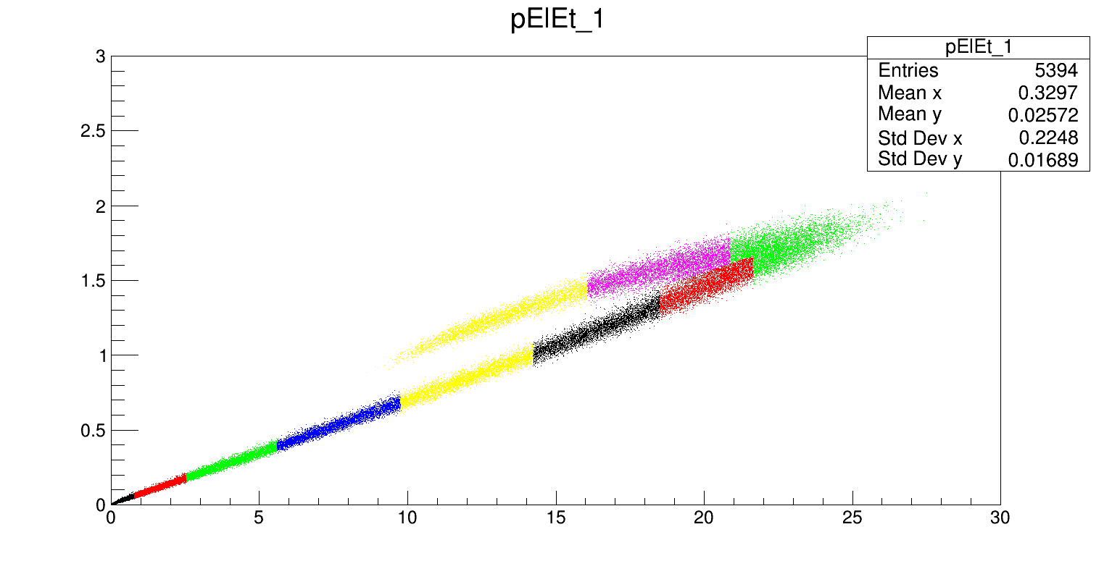
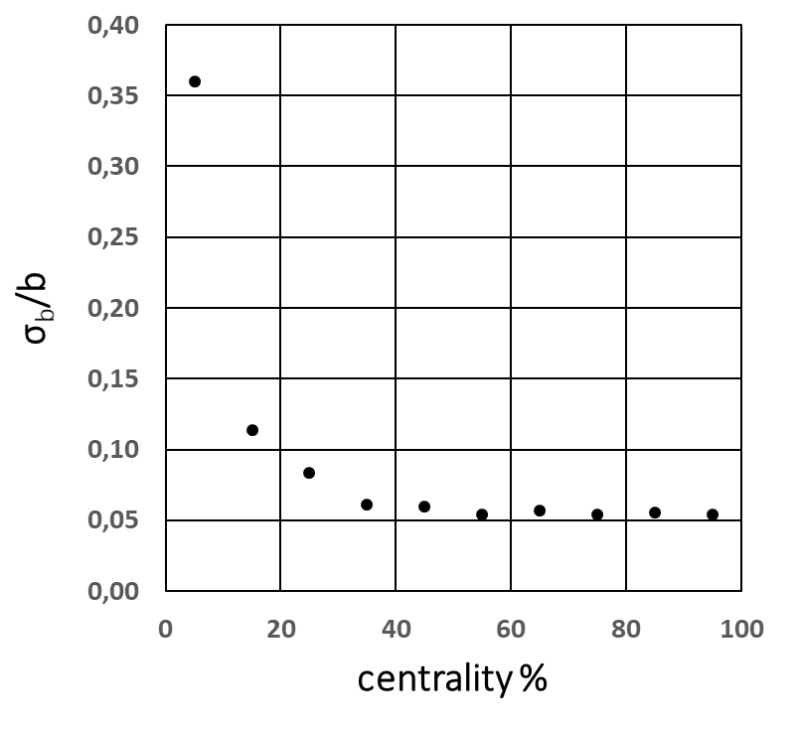
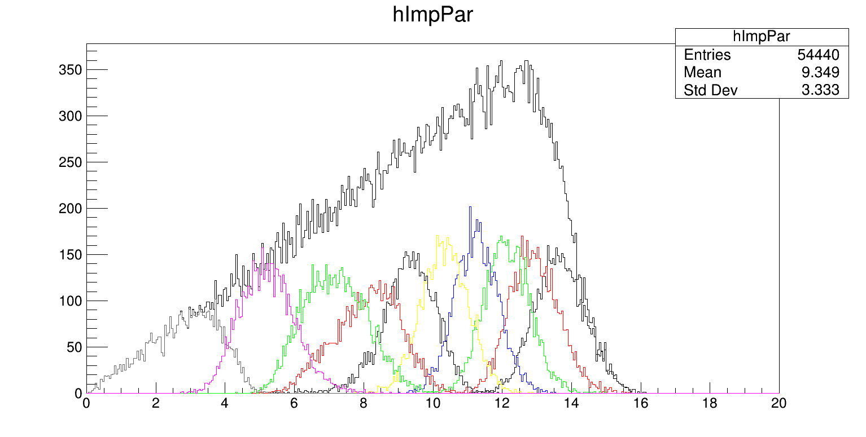
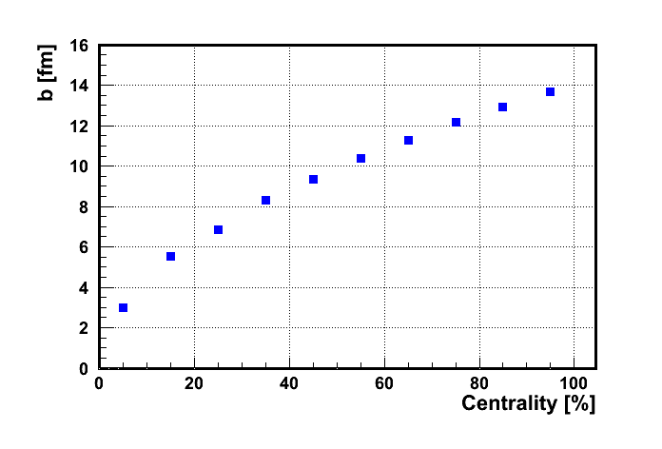
Centrality for (E_{T}, E_{L}) correlations.
Dependence of resolution of impact parameter on centrality
Each color bin is 10% fractions of the total number of events.
E_{T}(GeV)
E_{L}(GeV)
Impact parameter [fm]

Slide 33
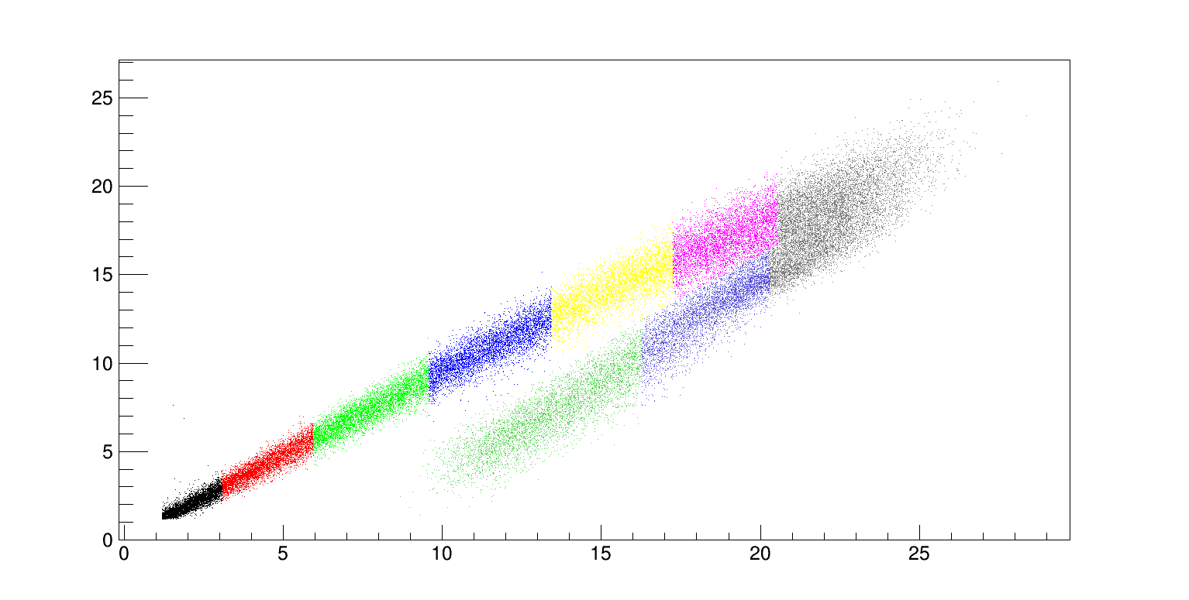
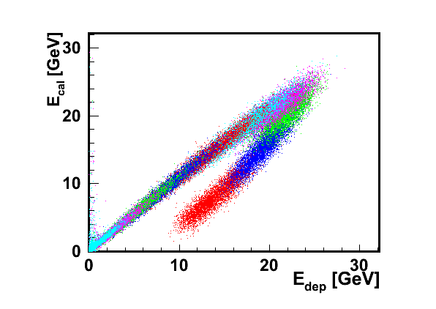
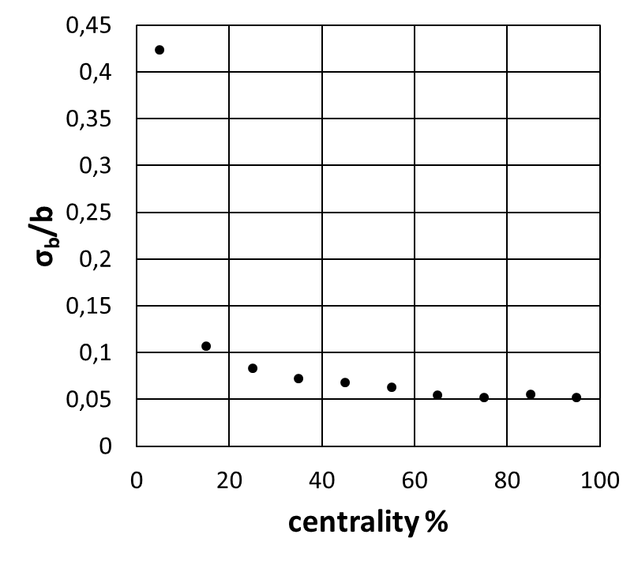
Another approach is correlation between deposited energy and corrected on pion contribution energy in FHCal.
Each color bin is 10% of b-centrality.
Each color bin is 10% fractions of the total number of events.
Corrected energy
Corrected energy, E_{cor} [GeV]
Deposited energy, Edep [GeV]

Slide 34
Problems:
Centrality and widths of centrality class
in relativistic heavy ion collisions
Figure 3. Geometry of a non-central heavy ion collision (left panel). Density fluctuations in the transverse plane in a sample collision event (right panel).
^{Berndt Mu ̈ller,} ^{Arxiv 1309.7612v2 12 Oct2013}

Slide 35
Why centrality is important?
What is the width of centrality class?
--- global observables and event mean values
--- fluctuations
--- correlations
--- flow
--- event shape engineering
--- …..
We have to minimize “the trivial Volume Fluctuations” if we wish to study any fluctuations or correlations

Slide 36
The centrality percentile c of an A-A collision with an impact parameter b is defined as :
_{db}

Slide 37
Centrality of relativistic heavy ion collisions
^{In various experiments:}
^{ALICE as an example}
PHYSICAL REVIEW C 88, 044909 (2013)
FIG. 10. (Color online) Distribution of the sum of amplitudes in the VZERO scintillators. The distribution is fitted with the NBD- Glauber fit (explained in the text), shown as a line. The centrality classes used in the analysis are indicated in the figure. The inset shows a zoom of the most peripheral region.

Slide 38
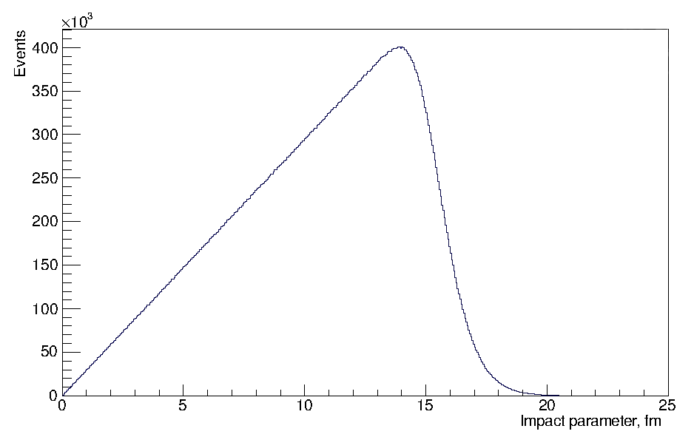
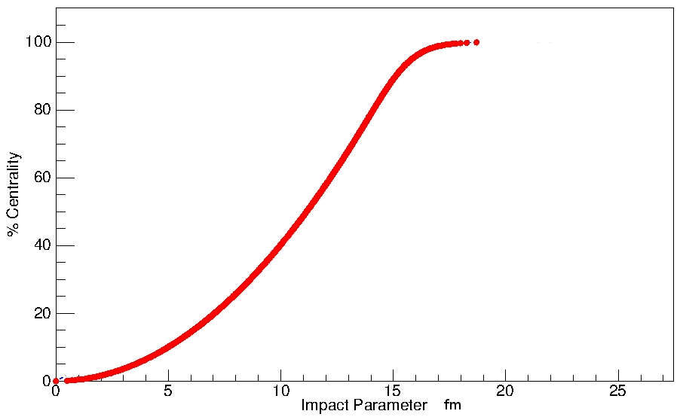
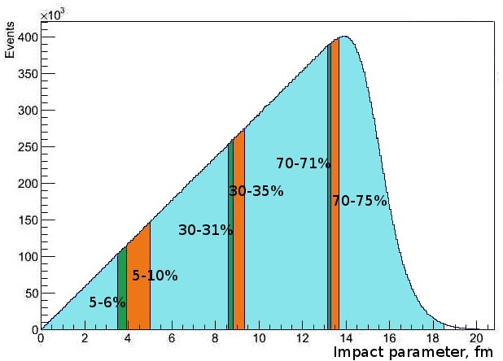
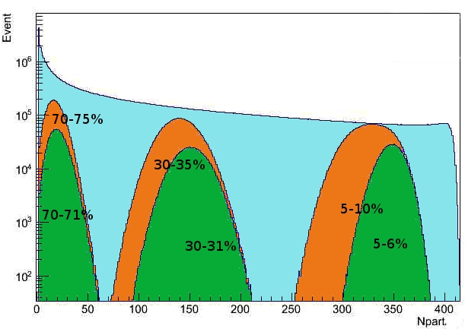
Impact parameter b and N_{part} in MC Glauber model
Impact parameter
Percentile
MC Glauber, PbPb 2.76TeV
b
b
Some impact parameter centrality classes
Npart distribution in the different centrality classes

Slide 39
Conclusions from MC Glauber calculations:
Two centrality determination procedures (by multiplicity distribution and by impact parameter) were tested
Results indicate that selection of a narrow centrality class in multiplicity does not assume real selection of very central events in terms of the impact parameter
At the same time RMS of distributions in N_{part} could be very large unless the narrow centrality class in multiplicity is selected
-- this is important for any study of fluctuations
In case of p-Pb collisions centrality classes from Multiplicity selection should not be used - the results could be ambiguous

Slide 40
Modified Glauber Model[1]
Each nucleon in collisions loses in the inelastic collision
the fixed portion (1-k) of momentum in the center of mass system[1]
This loss of momentum goes to the production of charged and neutral particles
One can define parameter k by fitting the available experimental data on charged-particle multiplicity yields in AA collisions
[1] G. Feofilov, A. Ivanov, Journal of Physics G CS, 5, (2005) 230-237.

Slide 41
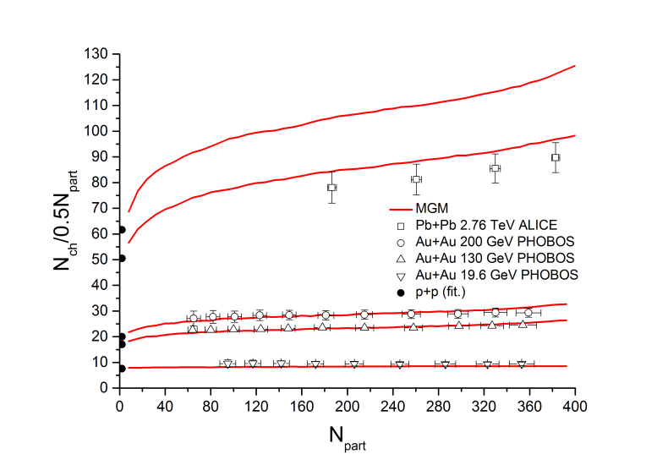
MGM for Pb-Pb collisions https://arxiv.org/abs/1603.08825

Slide 42
MGM for Pb-Pb collisions https://arxiv.org/abs/1603.08825

Slide 43
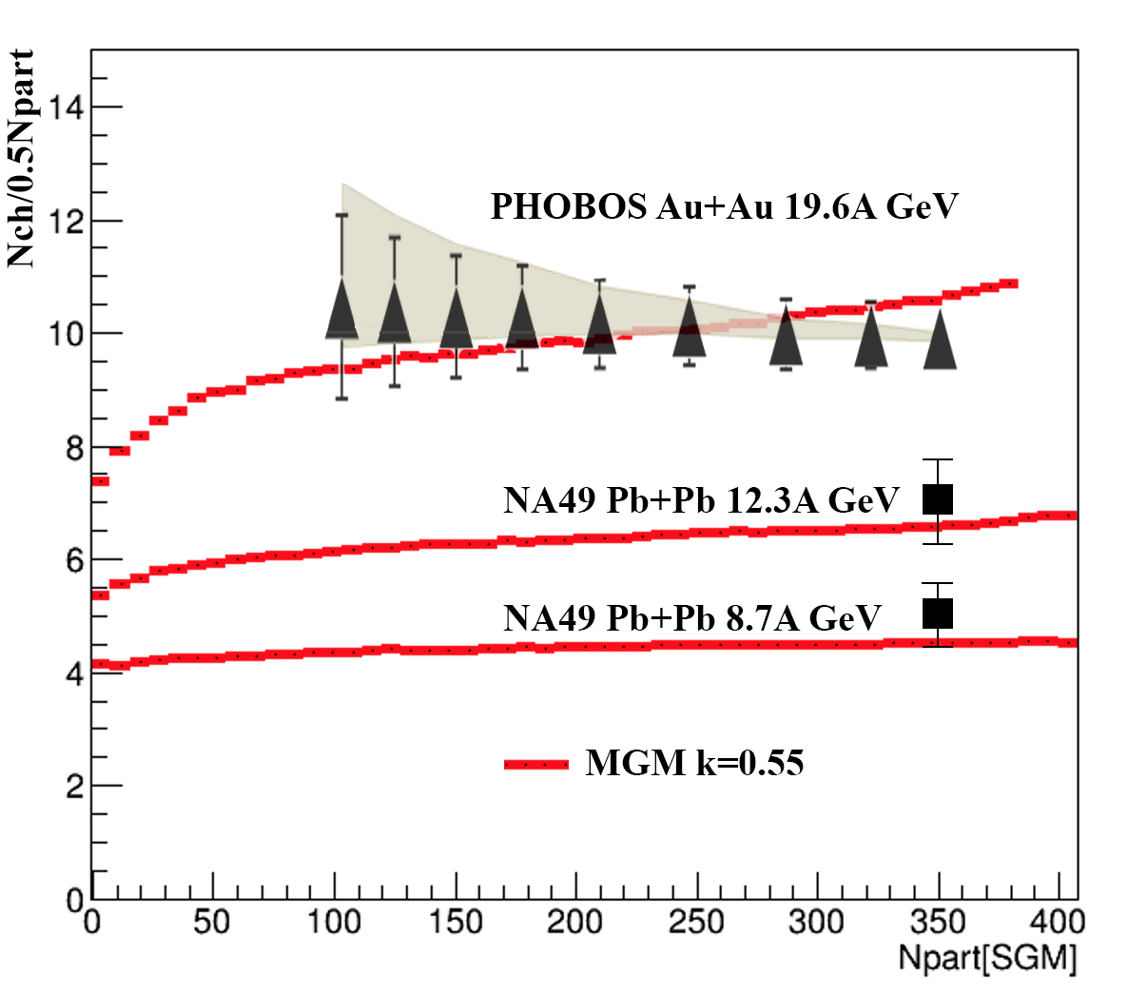
Modified Glauber Model (MGM) calculations for Au+Au collisions at NICA energies

Slide 44
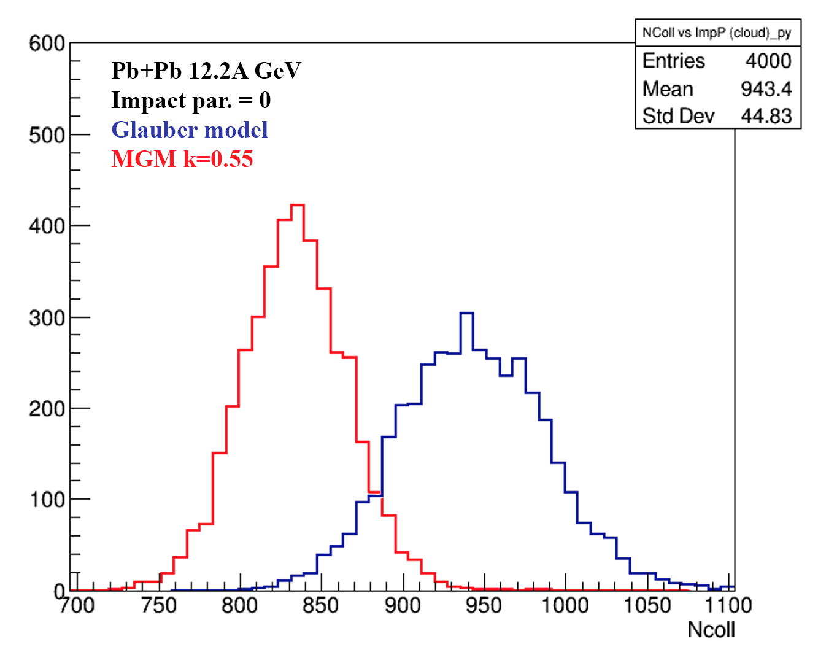
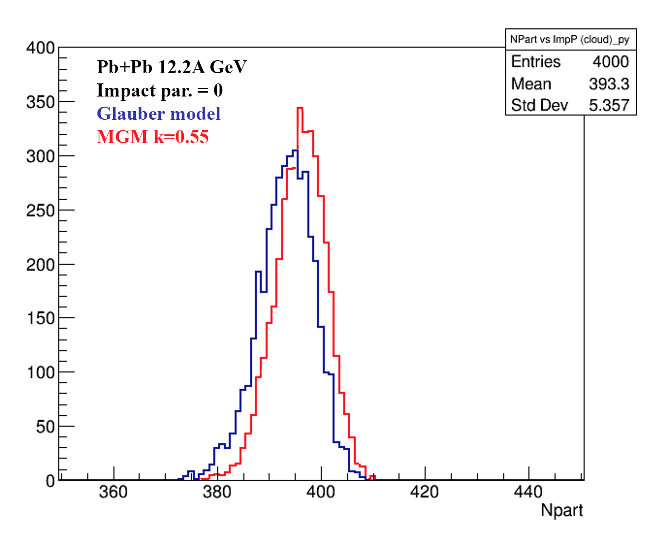
Sandard Glauber and MGM calculations for Au+Au collisions at NICA energies: fluctuation in Ncoll and Npart

Slide 45
Summary and outlook -1
The initial conditions of nucleus-nucleus and proton-nucleus collisions at high energies are important for any analysis and haracterization of the expected quark-gluon plasma formation
The impact parameter b, and its relevant values N_{part} and so-called binary collisions N_{coll}, are widely used to normalize the measured fractional cross sections both of soft and hard processes of particle production in collisions of heavy ions
We show that the correct inclusion of energy-momentum consevation in multiprticle production process decreases considerably values of N_{coll}, (the result is especially striking for p-Pb collisions)
Binary collisions N_{coll} should be treated differently for soft and hard processes in order to exclude in the analysis any possible biases to initial conditions

Slide 46
PWG1 strategy for 2020:
To define the main lines for the PWG1 aimed at the “FIRST-DAY” data analysis
To define the people interested for the 1st day physics
To define and discuss and proceed with the long-term plans to be included into the MPD Physics Performance Report
To proceed with MC simulations
To proceed with regular report at the PWG1 seminars
Keep in touch!

Slide 47
BACK-UP SLIDES

