Slide 1
A brief overview of the PWG1 near tasks after the last MPD collaboration meeting
17:30 → 17:50 G.A.Feofilov, (SPbSU),
Thursday, the 30th of April 2020, 17:30-18:30 PWG1 regular meetung

Slide 2
Layout
It is proposed to discuss:
Centrality (multiplicity classes) codes in the MPDRoot -- how to implement
and
MC simulations with event generators
-- what is interesting to do

Slide 3
Reports at the MPD April meeting (slides and audio) are available
https://indico.jinr.ru/event/1138/timetable/#20200424.detailedhttps://indico.jinr.ru/event/1138/timetable/#20200424.detailed

Slide 4
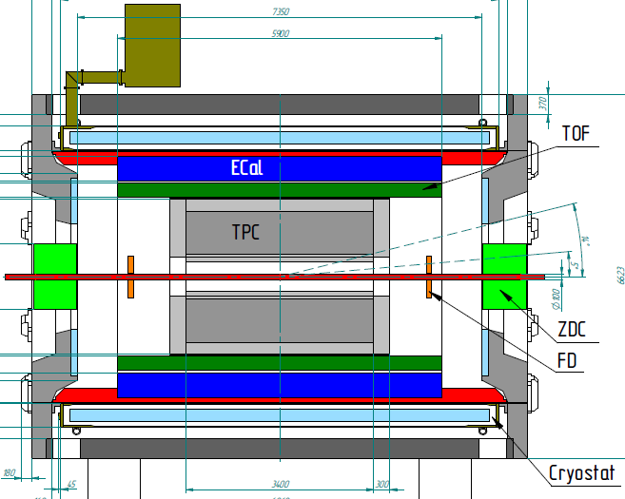
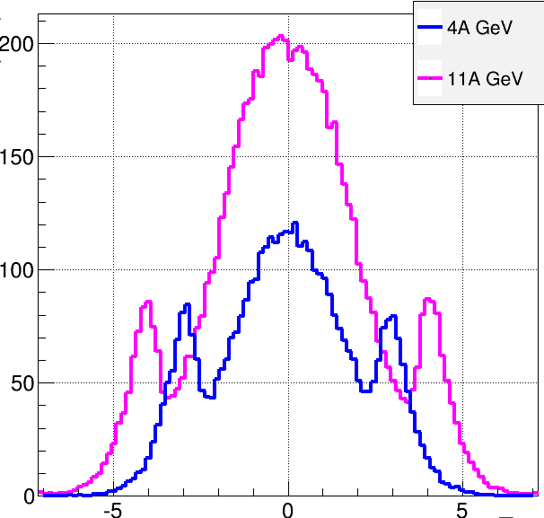
Multi-Purpose Detector (MPD)
stage I: TPC, TOF, ECAL, FHCal, FFD
stage II ( 2023): + ITS + EndCap (CPC, Straw, TOF, ECAL)
stage II
acceptance
URQMD
charged
b<11 fm
11 A GeV
4 A GeV
dN/dη
TPC
CPC
TOF
ECal
FFD
FHCal
FHCal
FFD
η
stage I: put in operation in 2022
Notes:
The MPD will be put in operation at two stages. At the first one the barrel part will be equipped with major tracking detector TPC, TOF end ECAL. FHC and FD will be operational as well.
At the second stage the detector will be supplemented with IT and end cap subdetectors.

Slide 5
Beams and detectors at NICA at Stage-1
NICA beams: Bi+Bi, Pb+Pb or Au+Au
discussion
The 1st day physics
For PWG-1 – Global observables could come from:
TPC, TOF, ECAL, FHCal, FFD

Slide 6
Физика
-
The 1st day physics
NICA beams: Bi+Bi, Pb+Pb or Au+Au ?
discussion

Slide 7
Some interesting results reported
Topics:
Direct flow and centrality (Arkadiy Taranenko)
Centrality and event plane resolution (Eleazar Cuautle Flores)
Software Developments for Femtoscopic
Analysis and Data Storage (Grigory Nigmatkulov1, Pavel Batyuk2)

Slide 8
Физика/PWG-3/Flows (Arkadiy Taranenko)

Slide 9
Физика/PWG-3/Flows (Arkadiy Taranenko)

Slide 10
Физика/PWG-3/Flows (Arkadiy Taranenko)

Slide 12
G,].Ni

Slide 14
Software Developments for Femtoscopic Analysis and Data Storage (Grigory Nigmatkulov1, Pavel Batyuk2)

Slide 15
All approaches mentions above
Are using multiplicity classes as s proxy to centrality

Slide 16
A package to perform centrality classes definition/selection for the MPDRoot framework
Multiplicity classes (standard HEP approach based on MC Galuber application)
Classes in nucleons-participants (N_{part})
Non-Glauber approach to binary collisions estimates and centrality classes definition

Slide 17
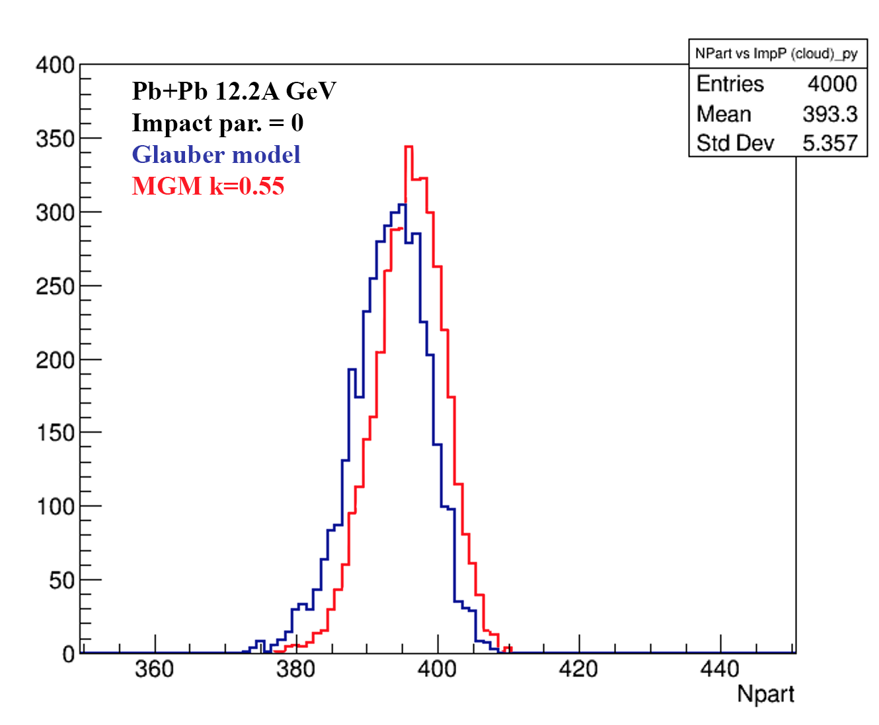
Sandard Glauber and MGM calculations for Au+Au collisions at NICA energies: fluctuation in N_{coll} and N_{part}
Modified Glauber Model (MGM) calculations for Pb+Pb collisions at NICA energies (red lines – new results [A.Seryakov,G.Feofilov])
Account of energy-momentum conservation in multiprticle production process decreases considerably values of N_{coll}

Slide 18
From Grigory Nigmatkulov report:
Should we do something similar?

Slide 19
It is interesting to check with different MC event-generators and with the focus on the number of N_{coll}:
Slide 17
Slide 10
Slide 12
…

Slide 20
BACK-UP SLIDES

Slide 21
Charge particle density at midrapidity
NICA region of interest lies below √sNN = 11 GeV
Rather monotonous behavior

